Slide 1




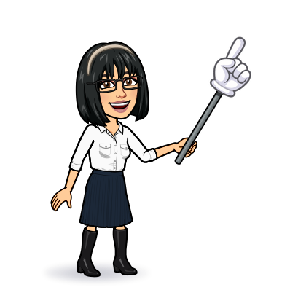

8 reading
9 writing
10 project
Today:
Date:
- -
Page 93 - 94
By: Dalal Al-Juaid

Slide 2


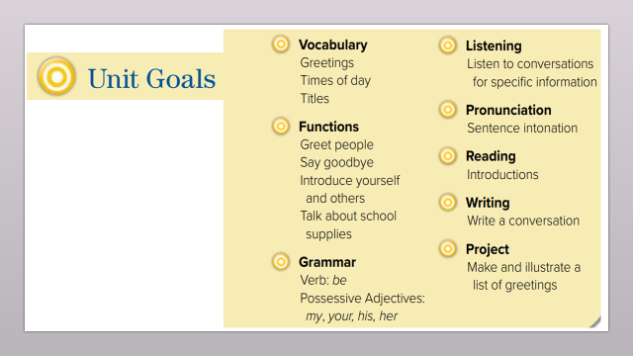
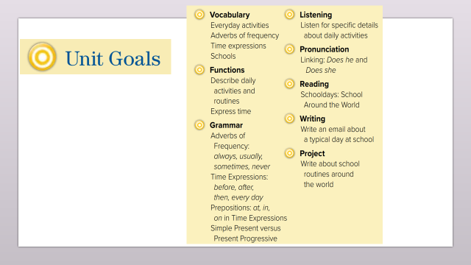
Find similarities / differences between schools
Scan the reading text for specific information
Warm up
Write about a day in school
Use ( by – to – in ) in sentences

Slide 3
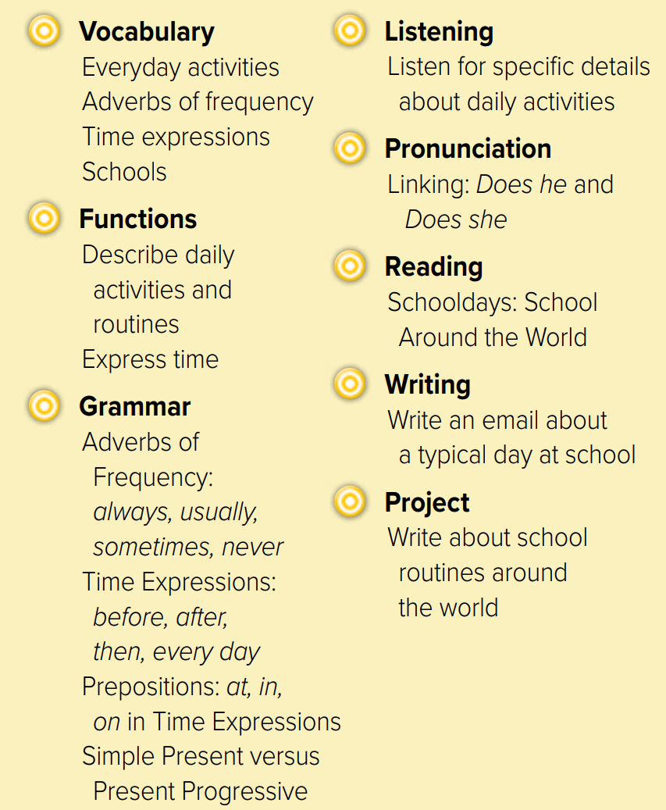
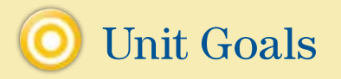

Slide 4




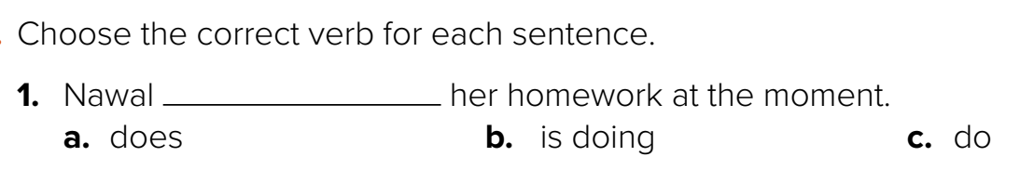
Revision
…..
…..
…..
….
100%
80%
50%
I go to school …………
The bank usually opens ….. nine.
….
#
late

Slide 5










Answer with emoji
Warm up
O’clock
night
early
Monday
sometimes

Slide 6
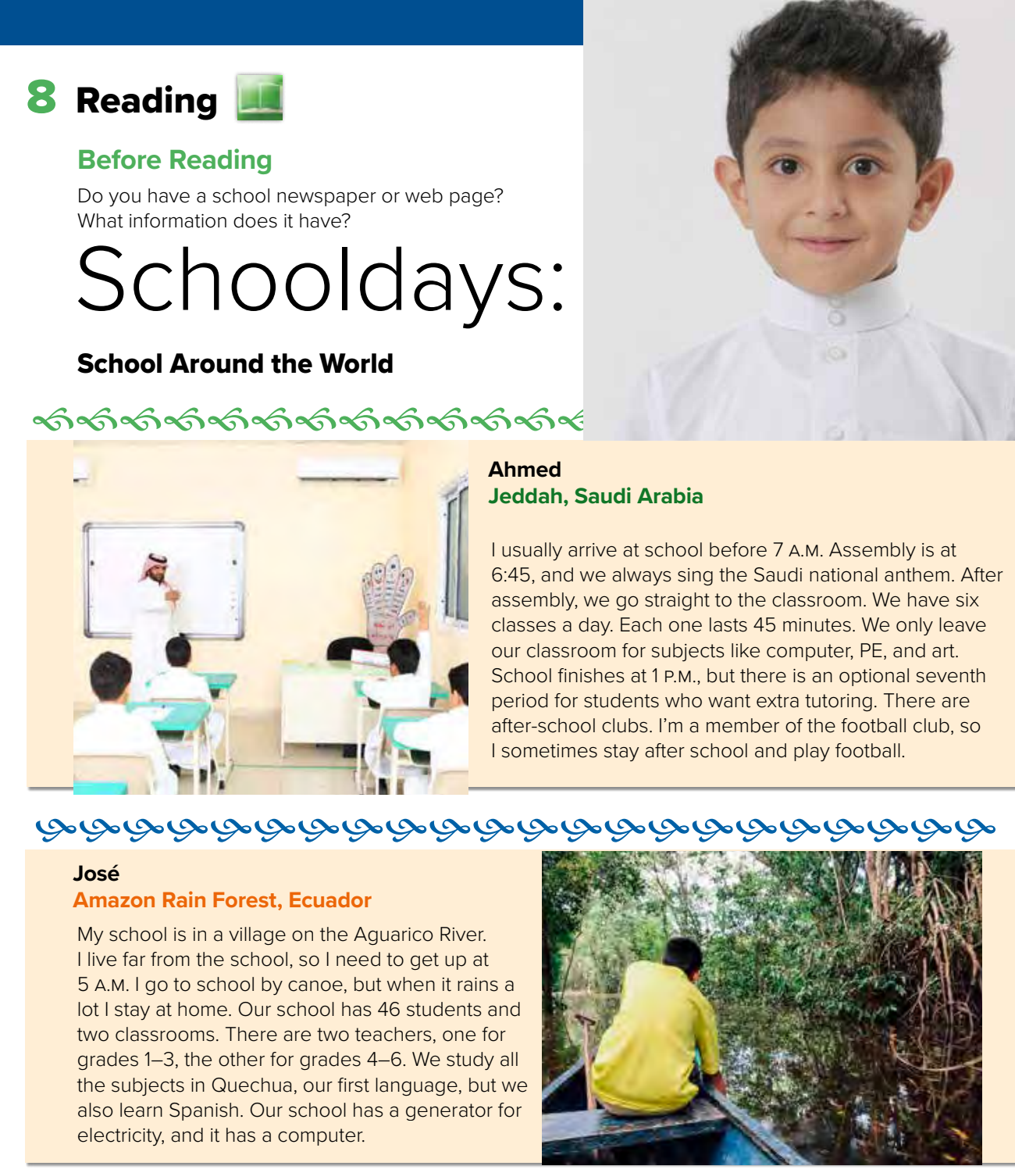



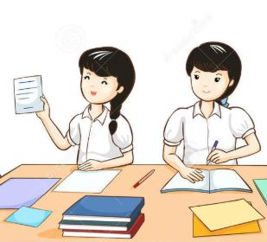
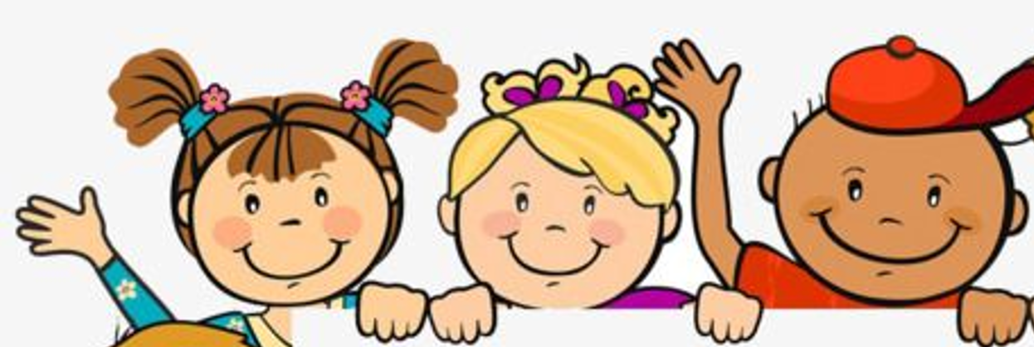
Page 93
What countries are you going to read about?
Warm up
Think pair share

Slide 7
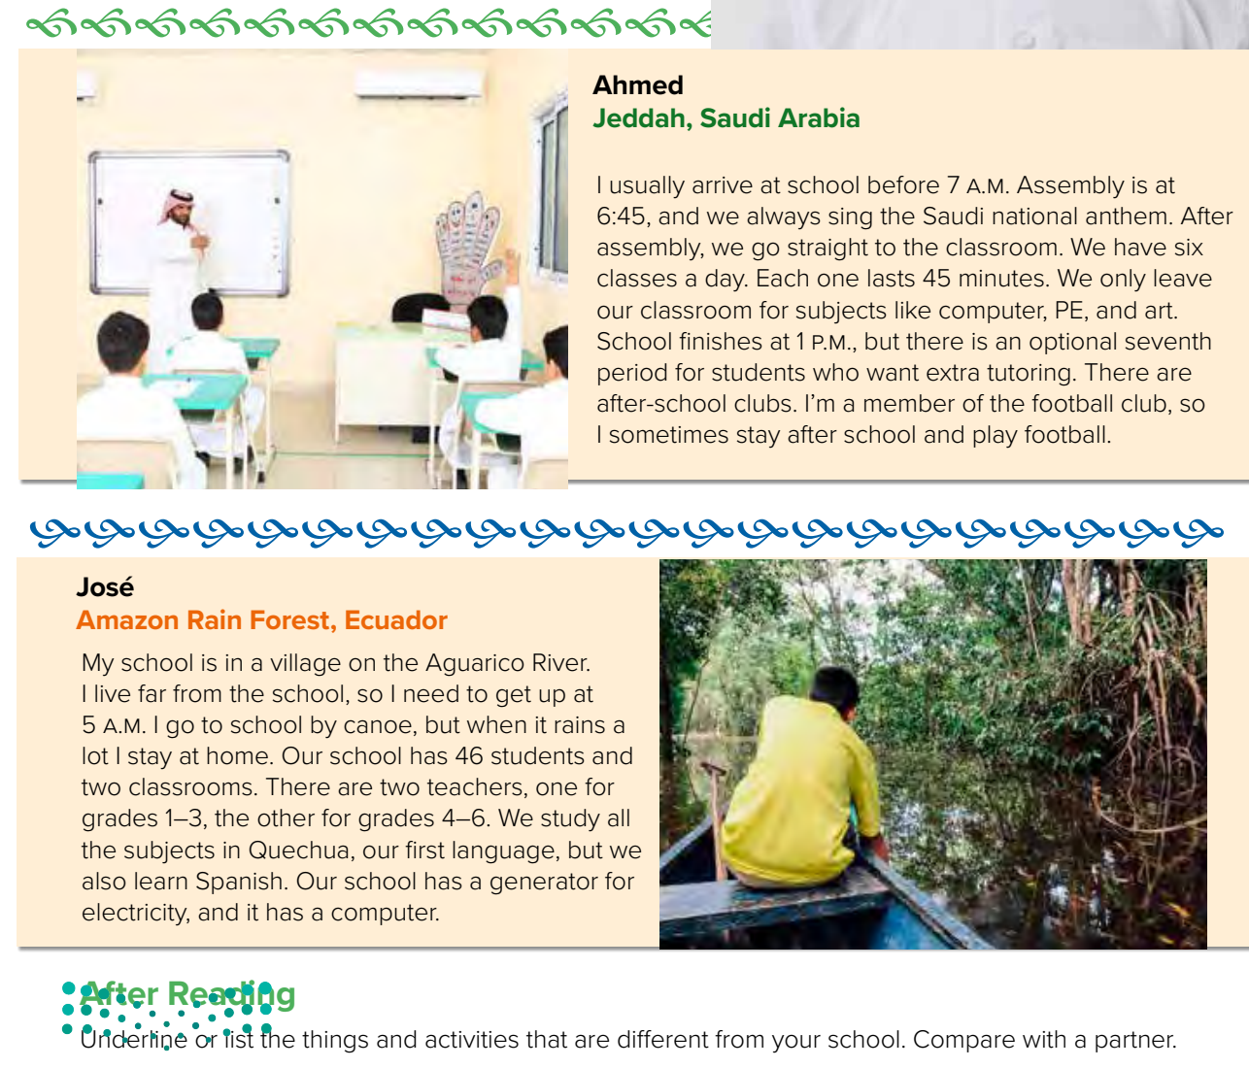

Page 93
Warm up

Slide 8
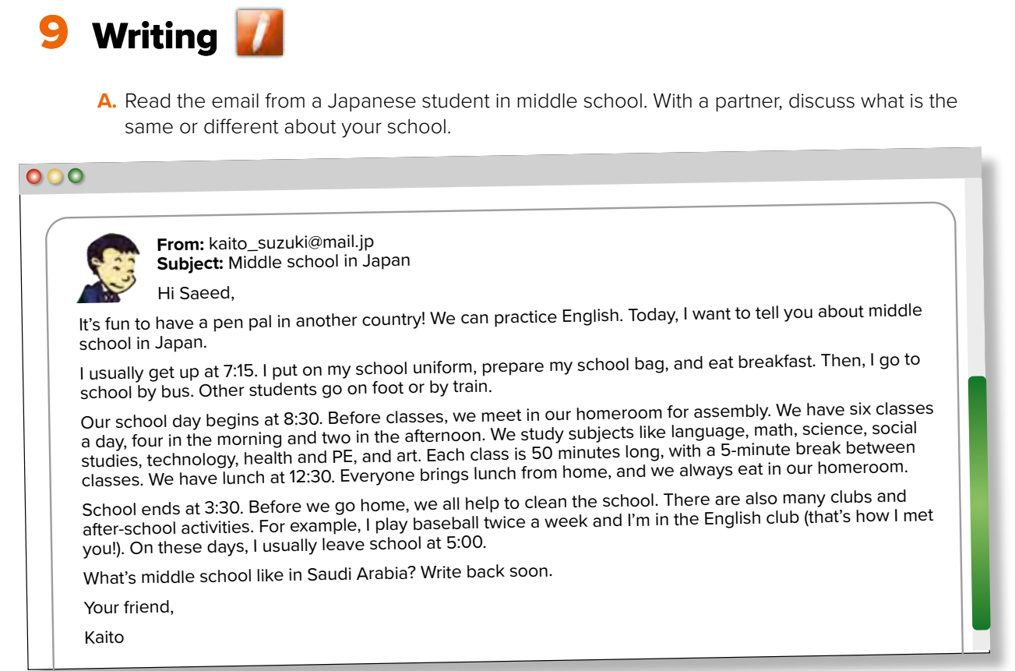
Page 94
Same # different
Warm up

Slide 9
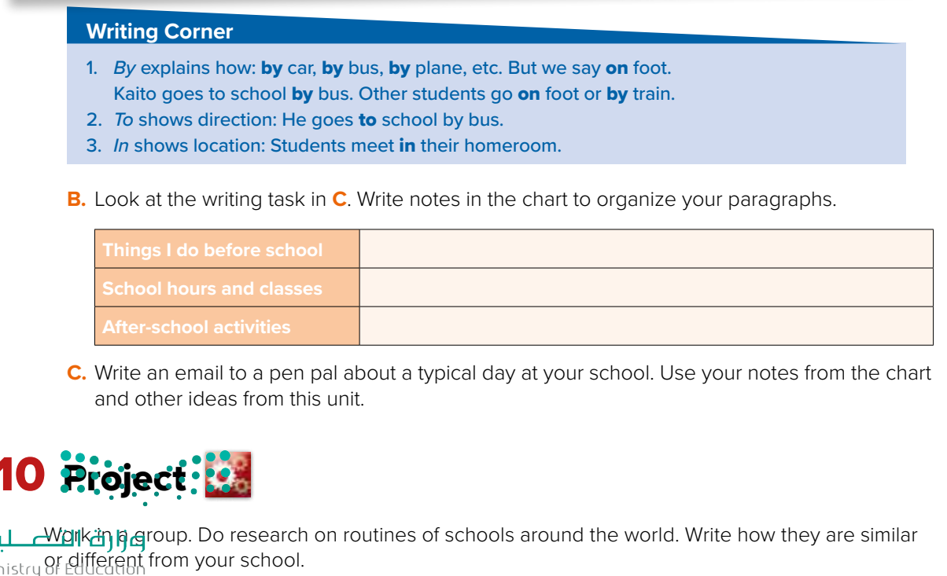

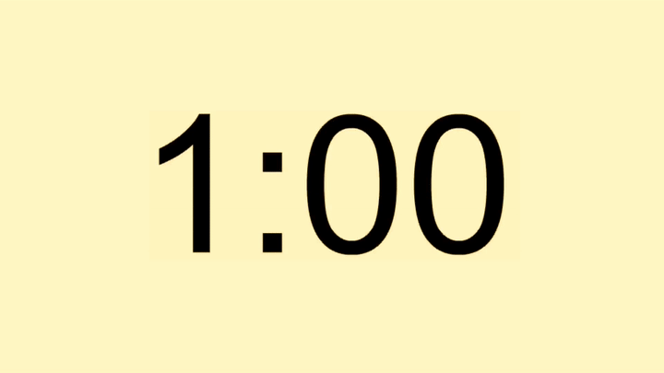










Page 94
Warm up

Slide 10

Warm up
Talk in groups

Slide 11


Lets play

Slide 12





page 232 Ex(F-G)
for practice reading - writing
Warm up

Slide 13
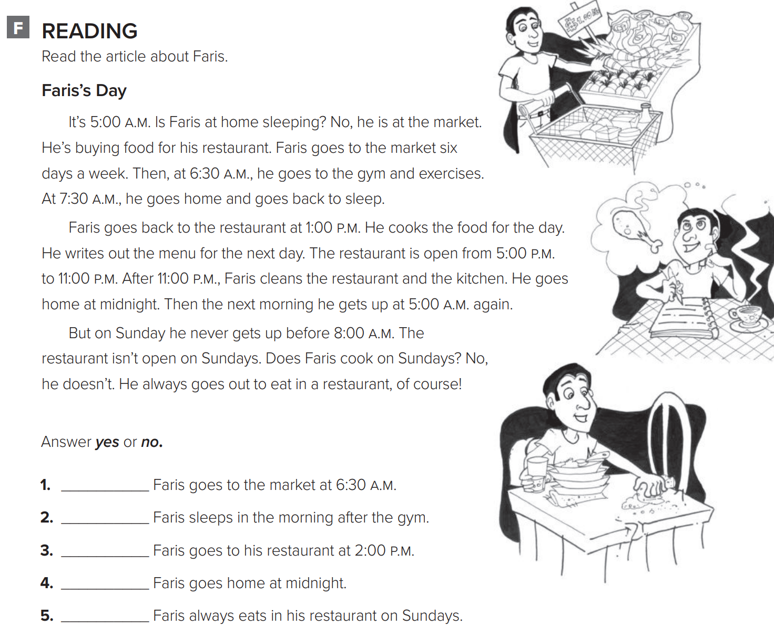
p.232
Warm up
no
yes
no
yes
no

Slide 14
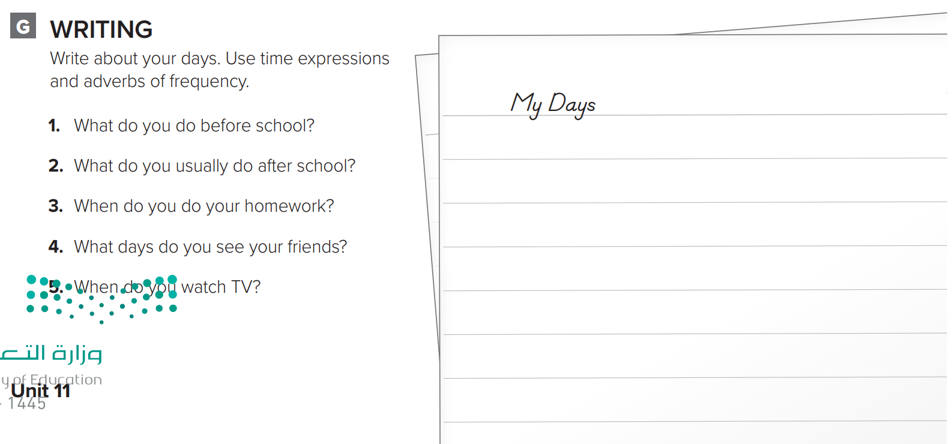
p.232
Before I go to school, I get up. I always get up at 7:00 a.m. Then I take a shower and brush my teeth. I always eat breakfast at home. I eat breakfast at 7:30 a.m. Then I go to school. After school, I usually go to the park. Sometimes I play video games with my friend. I usually do my homework in the evening. Then I go to bed. I see my friends every day. I watch TV every day, too.
Warm up

