Slide 1
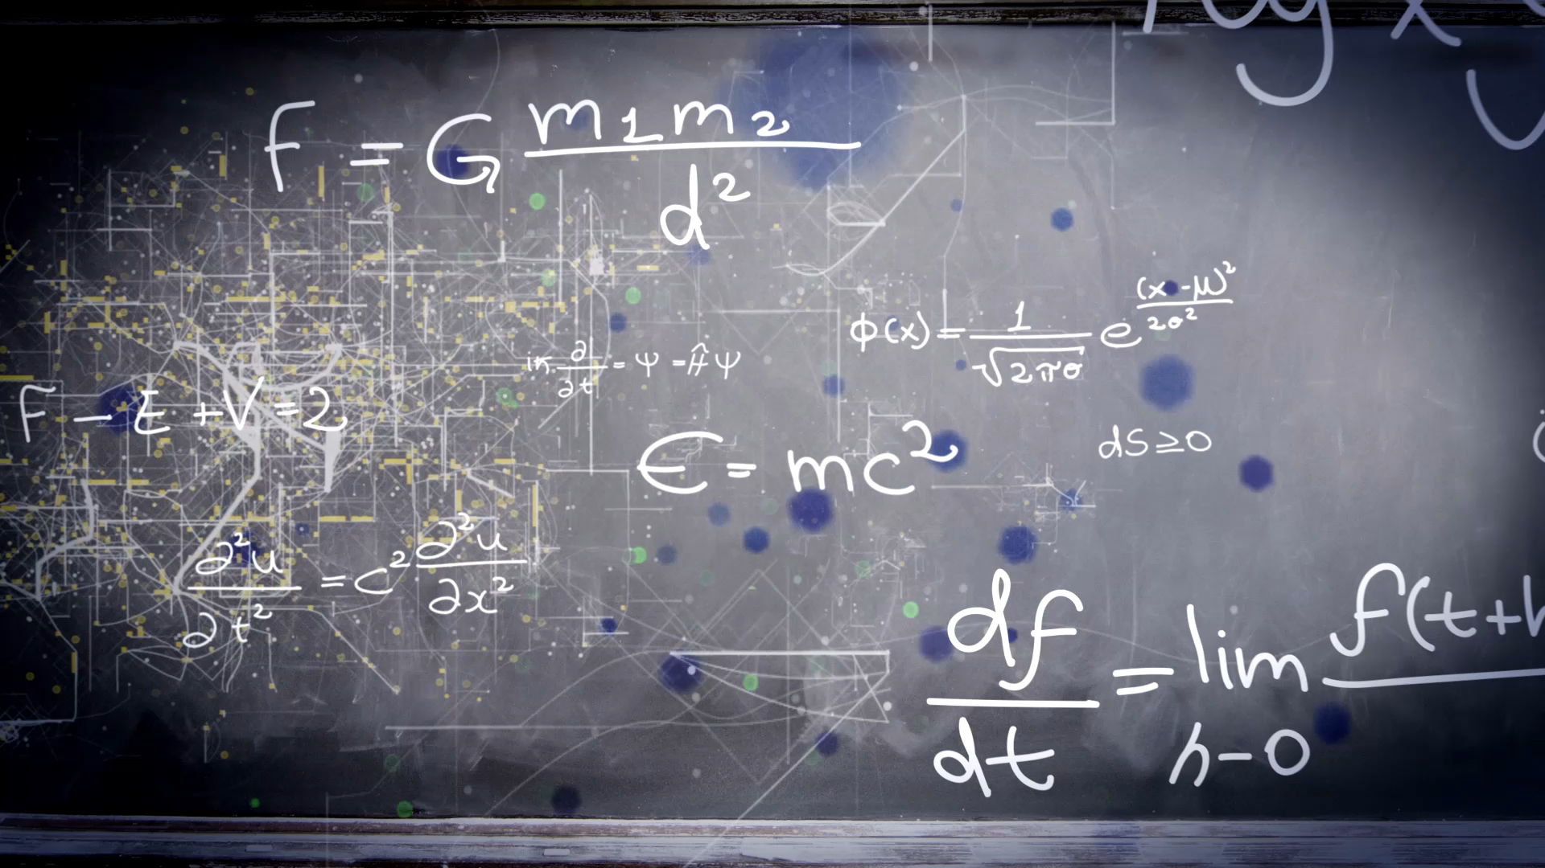
Unit 11
What time do you get up?
Workbook pages (229 – 232)

Slide 2
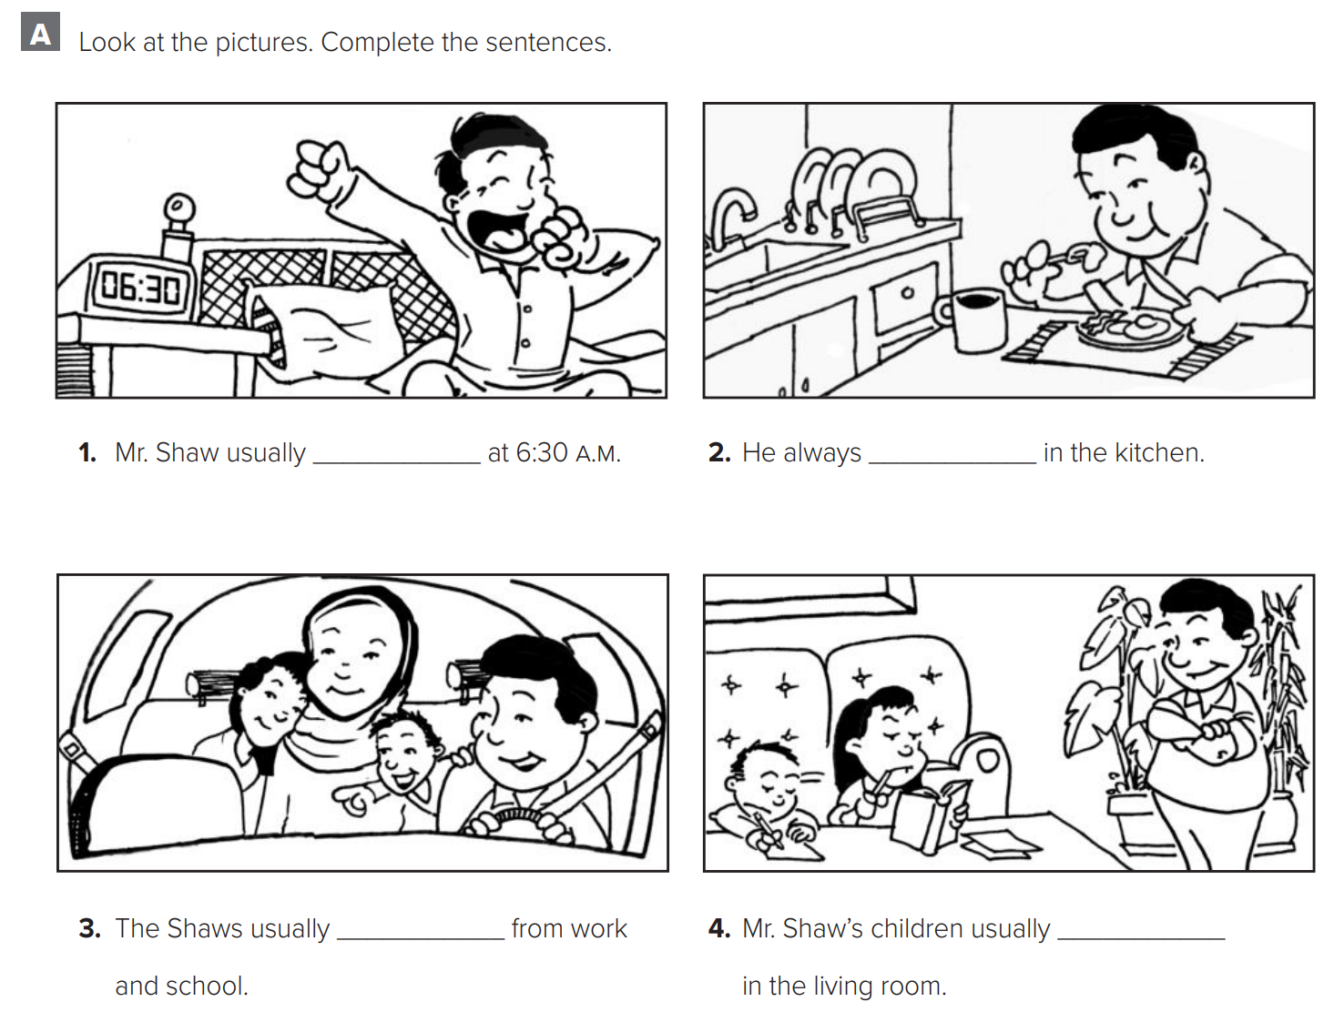
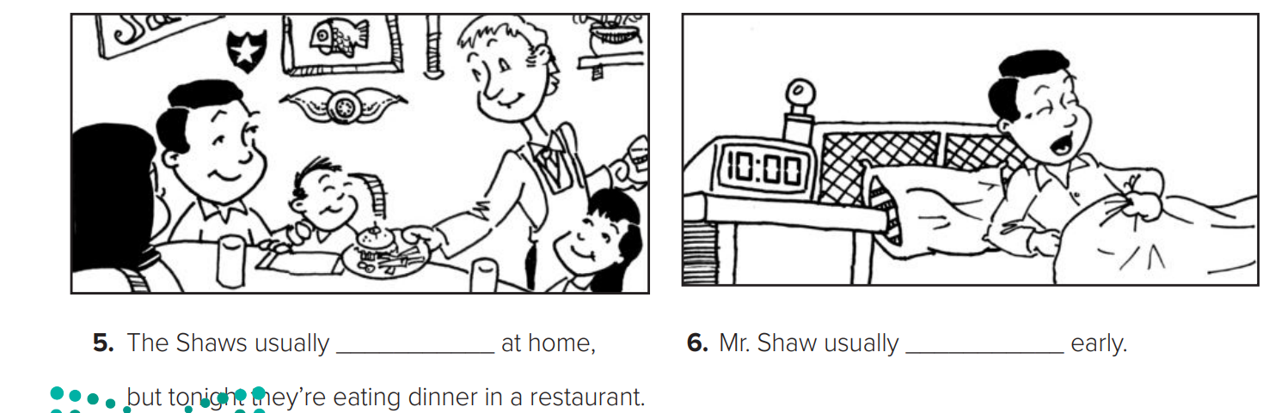

p.229
gets up
eats
drives
study
eat
sleeps

Slide 3
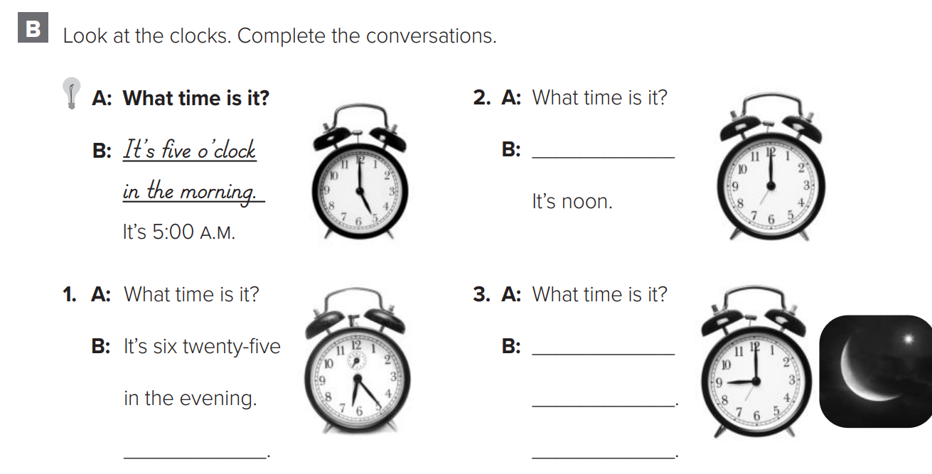

p.230
It’s twelve o’clock
It’s nine o’clock at night.
It’s 9:00 P.M.
It’s 6:25 P.M.

Slide 4
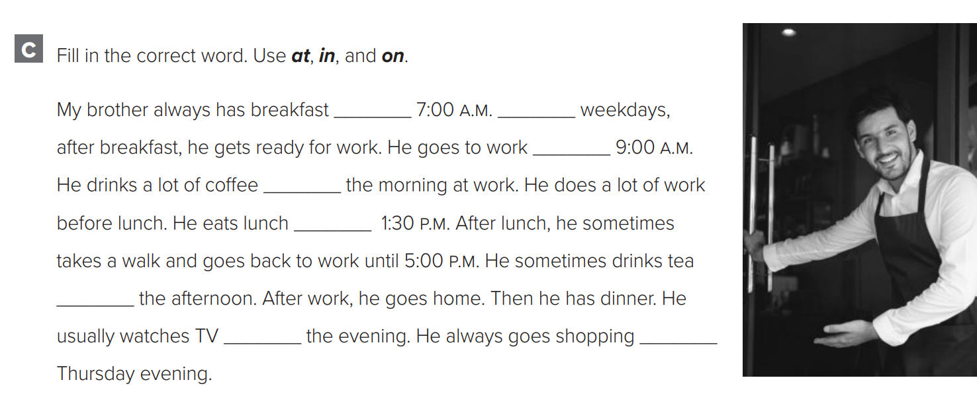

p.230
at
on
at
in
at
in
in
on

Slide 5
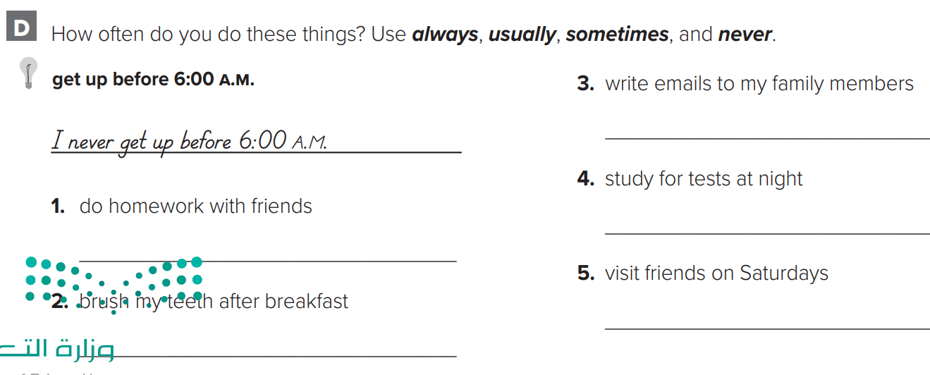

p.230
I sometimes write emails.
I always study for test at night
I never do homework with friends
I usually visit friends on Saturdays
I always brush my teeth after breakfast

Slide 6
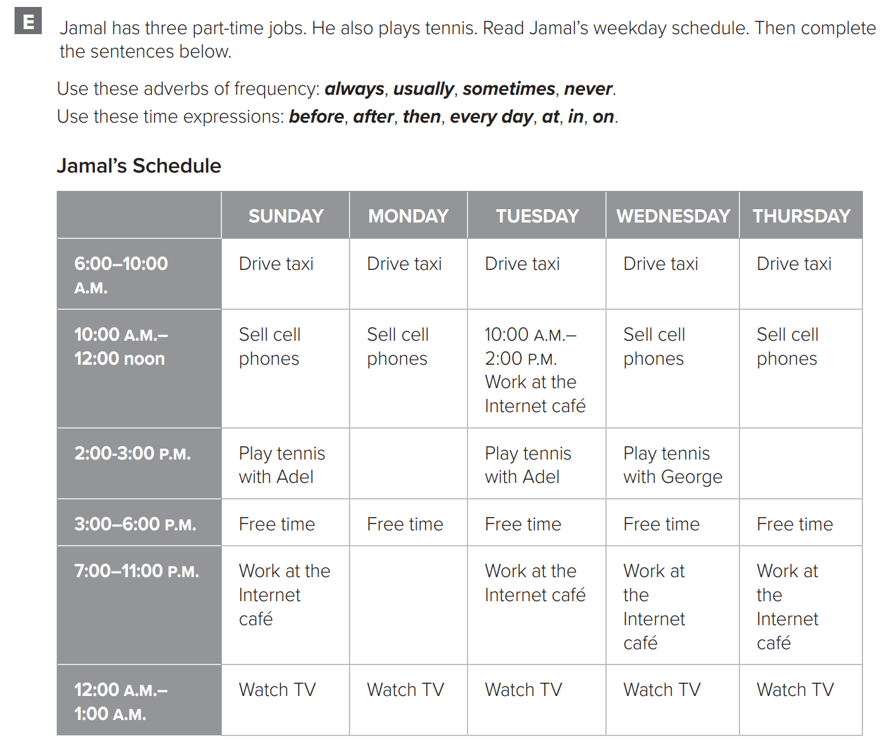
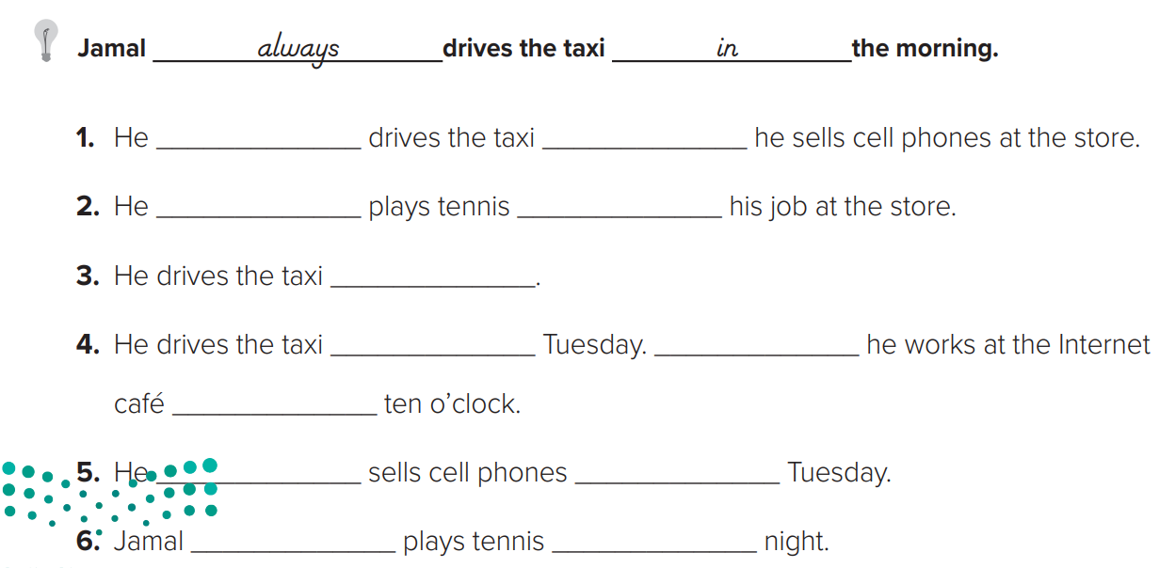

p.231
always
before
usually
after
everyday
on
Then
at
never
on
never
at

Slide 7
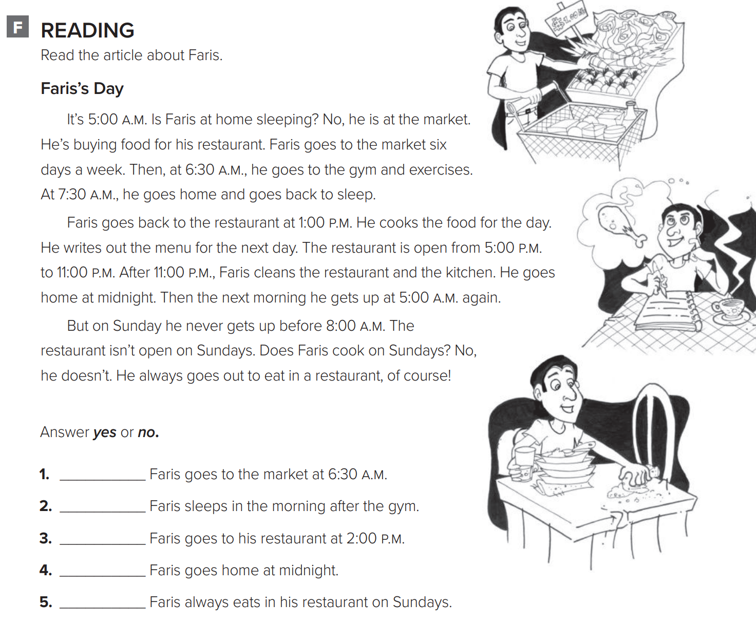
p.232
no
yes
no
yes
no

Slide 8
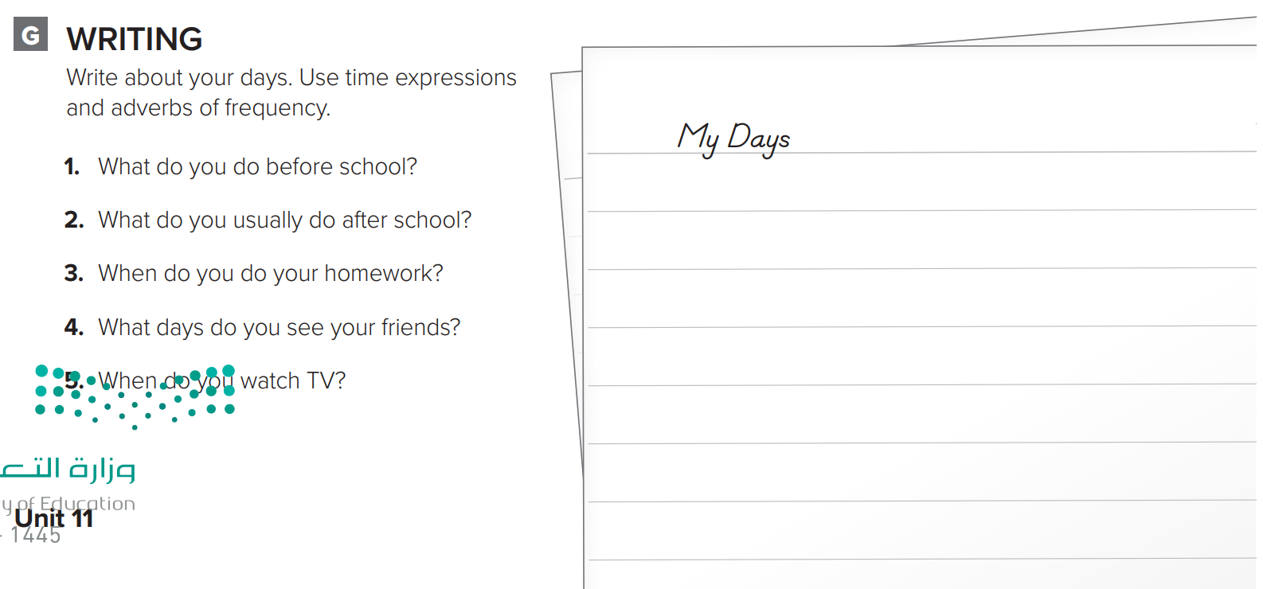

p.232
Before I go to school, I get up. I always get up at 7:00 a.m. Then I take a shower and brush my teeth. I always eat breakfast at home. I eat breakfast at 7:30 a.m. Then I go to school. After school, I usually go to the park. Sometimes I play video games with my friend. I usually do my homework in the evening. Then I go to bed. I see my friends every day. I watch TV every day, too.

