Slide 1


There is no comparison
Form meaning and function
By : Asma AlMjlad

Slide 2
objectives
1
Use So...That
2
Use such...That
3
Answer question in the book

Slide 3
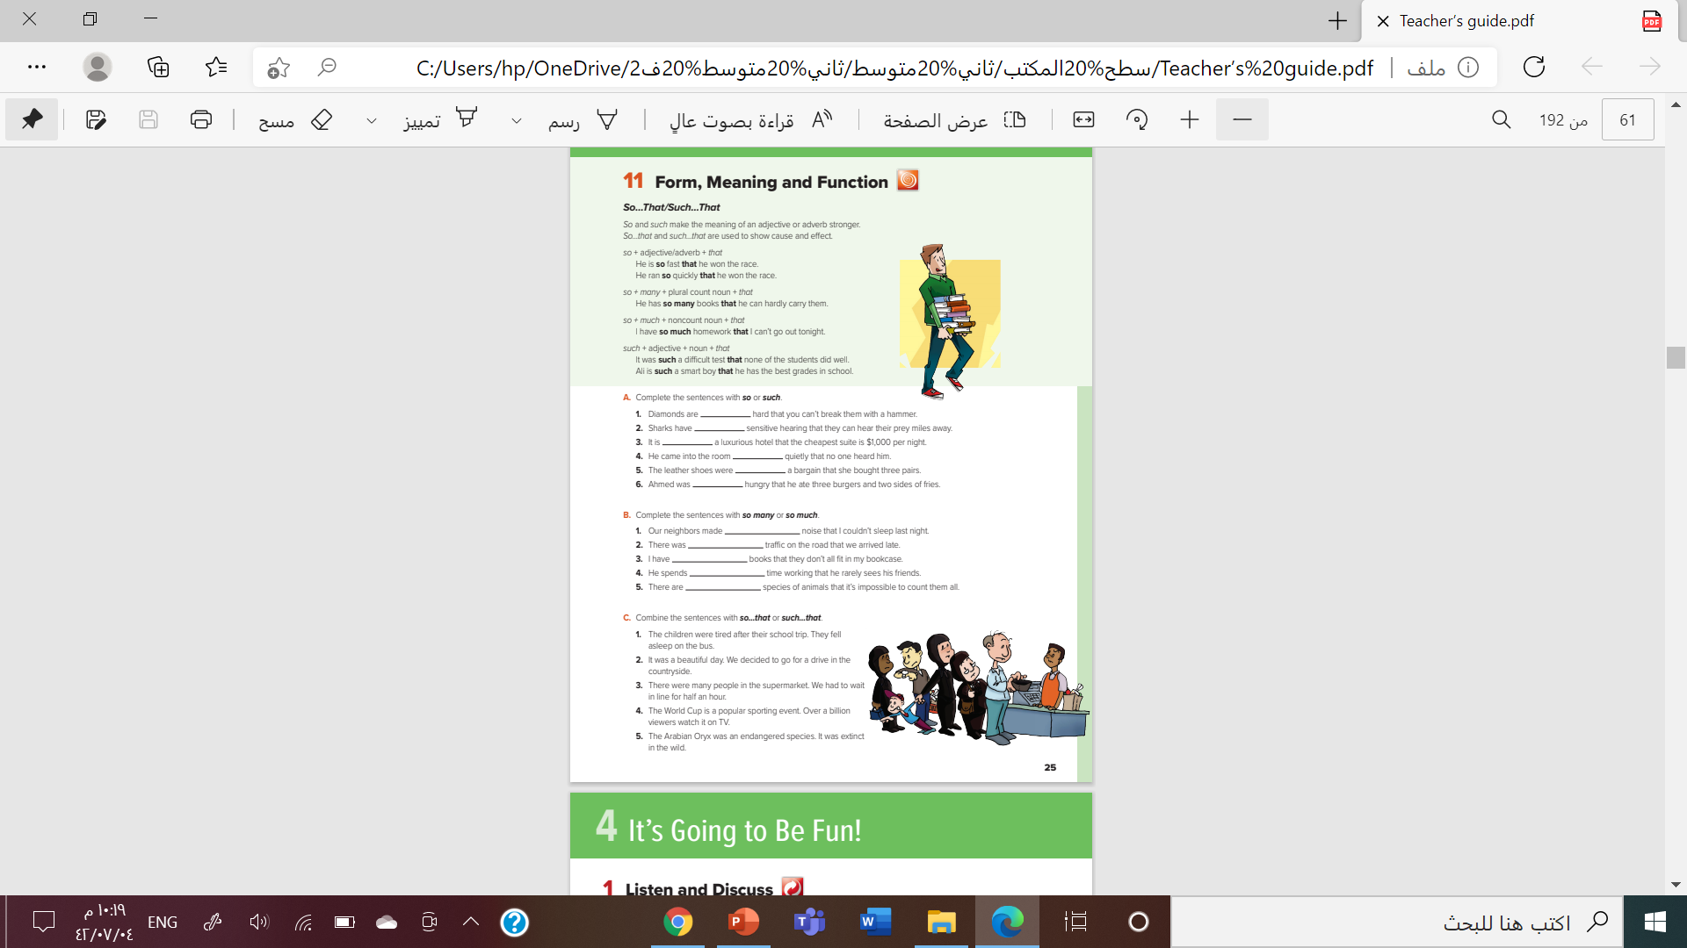

@ page 25

Slide 4

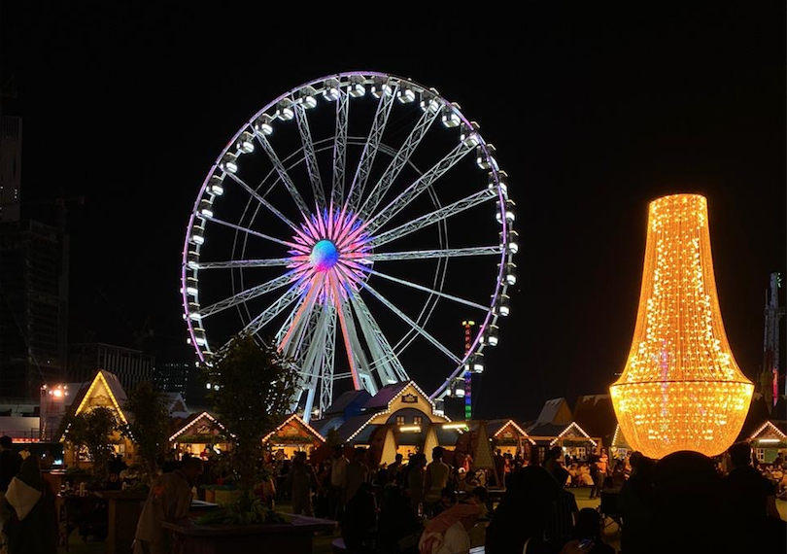
Worm up
Jeddah is such a beautiful city that
we visit it every month,
According to 2030 vision There is so many events that you can see it in Saudi Arabia.

Slide 5
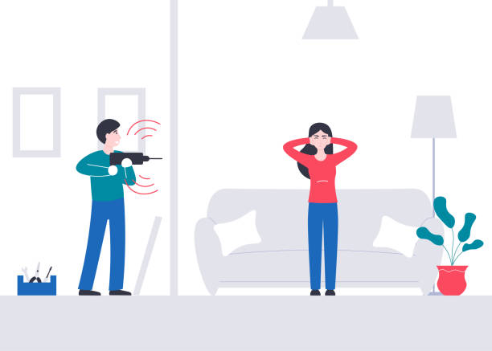
This machine works loudly
This machine works so loudly that I have a headache
I have a headache

Slide 6

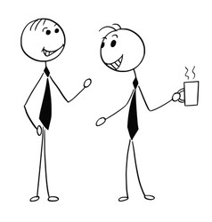

He is so fast
He is so fast that he won the race.
He won the race

Slide 7

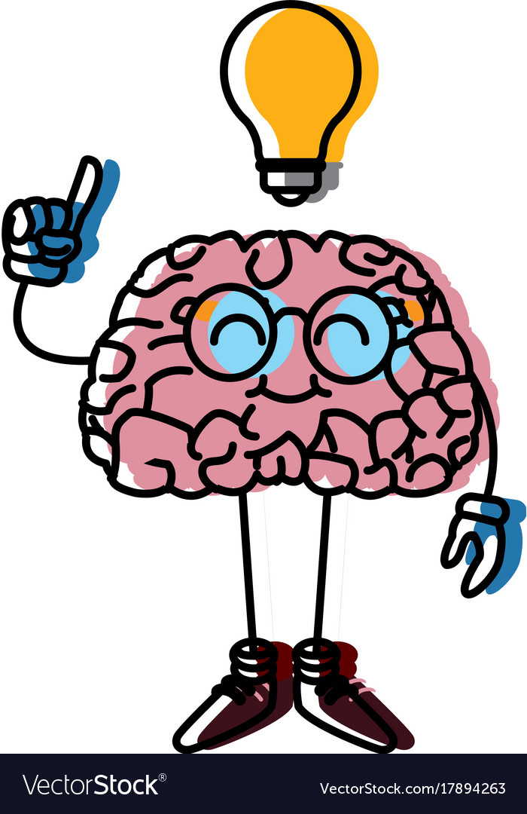

He is so fast that he won the race.
This machine works so loudly that I have a headache
Make a mind map

Slide 8


So much ……that
So many ……that
It uses with plural count nouns
Apples - books -
It uses with Noncount nouns
- Time - noise -
she has so much Homework that she can’t go to the park.
He has so many books that he can’t hardly carry them
Complete:
I drink so …………..coffee so I couldn’t sleep well
Complete:
There are so ……..…cars that we couldn’t park,
Much
MANY

Slide 9




It was such a good movie that many people watches it.
Adj + noun

Slide 10
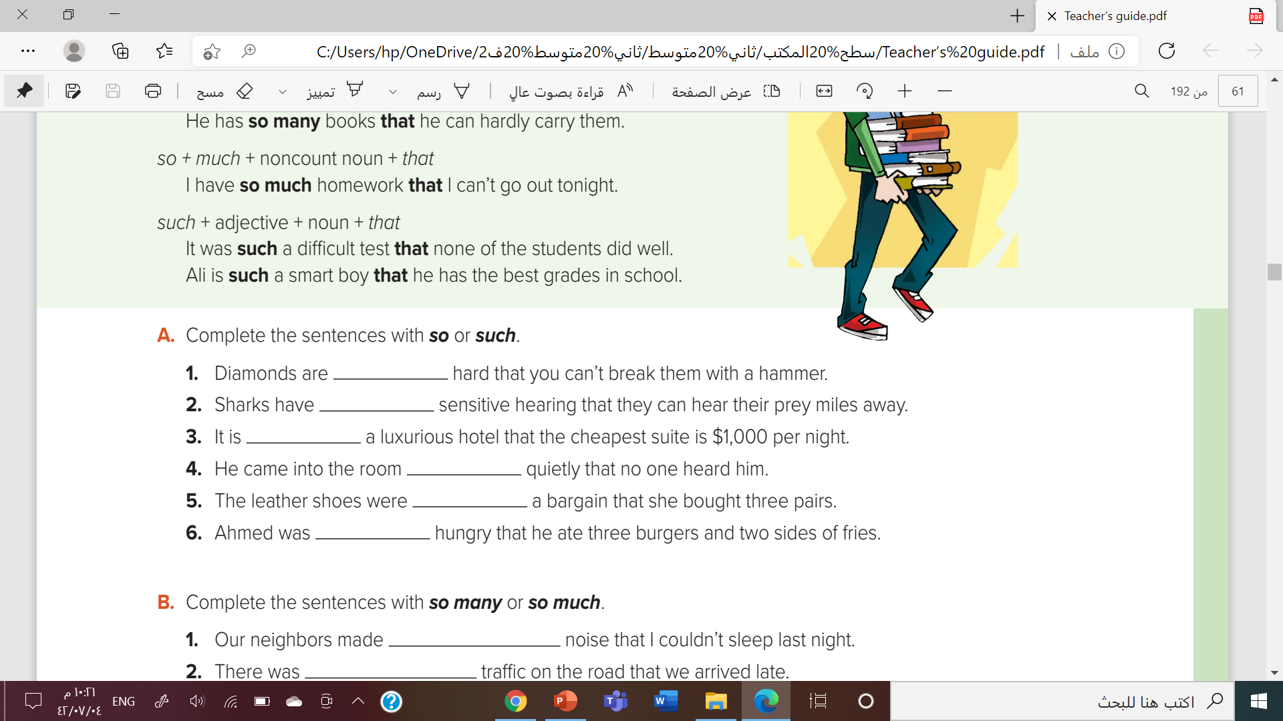


Slide 11


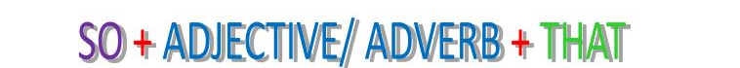
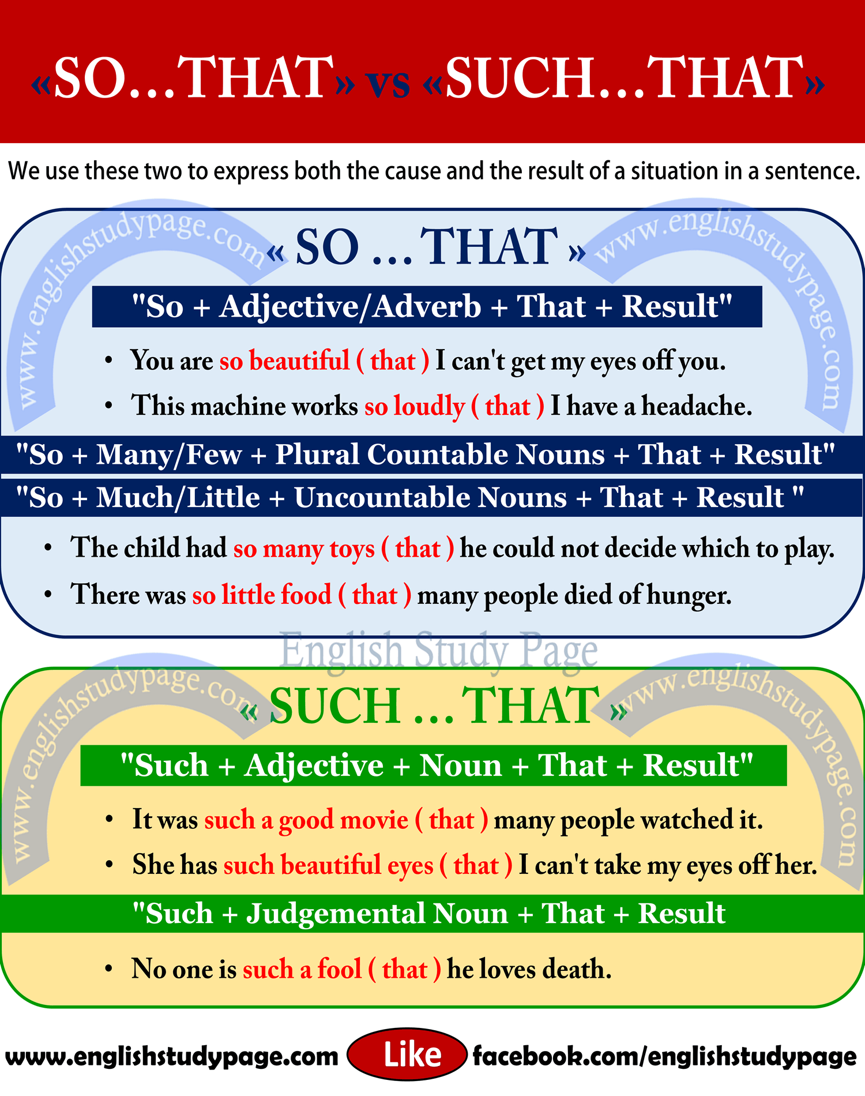
So.…..that
So …..such
So many +count noun + that
So much + Noncount noun + that
Make the meaning of an adj or adv stronger
Summarize
Used to show cause or effect

Slide 12

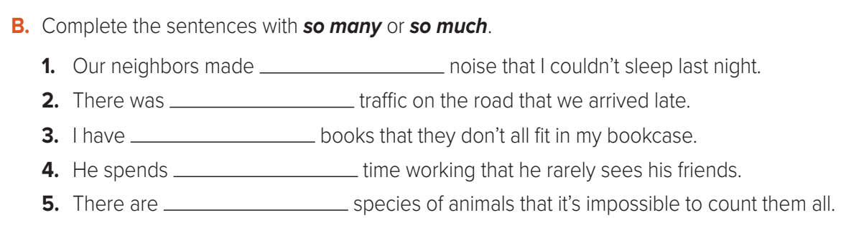

Slide 13


I was
(so- such)
Tired that I fell asleep in the sofa.
It was
( such – so)
nice weather that we spend the whole day outside
1
2
He eats so
( many – much )
sugar that he may be a diabetic
It was
( such – so)
Easy question that every body can answer it
4
3

Slide 14



Slide 15



Slide 16



Slide 17

By : ET Asma Almjlad

