Slide 1
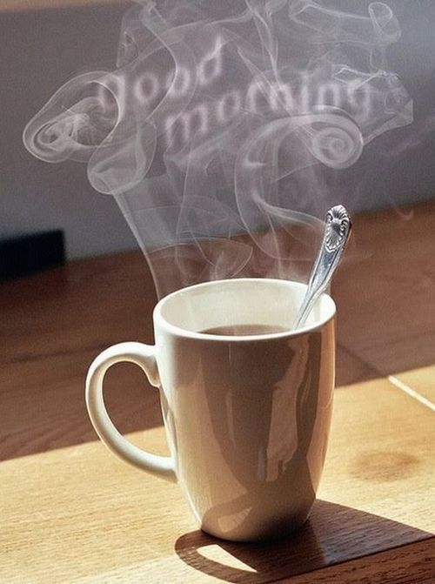
Good
Morning
اللَّهُمَّ انْفَعْنِي بما علمتني، وعلمني ما ينفعني، وَارْزُقْنِي علماً ينفعني

Slide 2
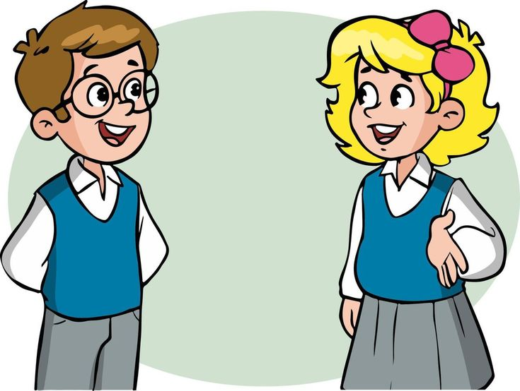
How are you today ?

Slide 3
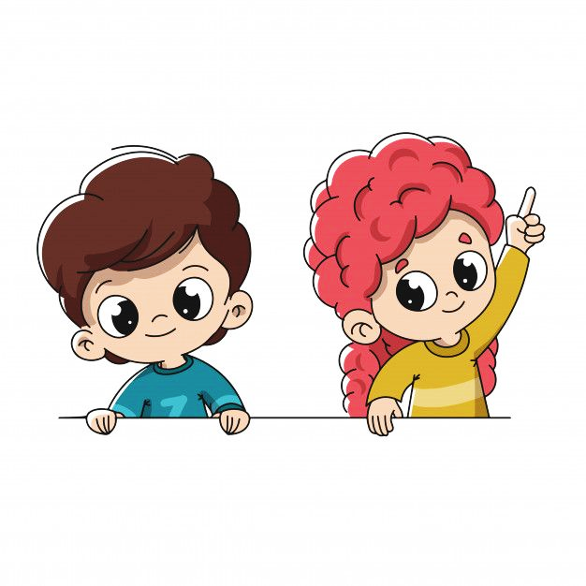
Revision
Use adverbs of frequency and time expressions.
Use prepositions.

Slide 4
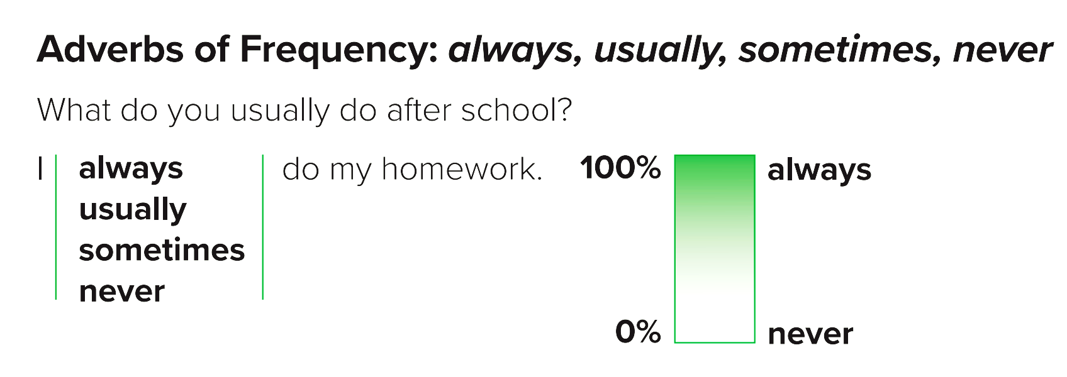

Slide 5
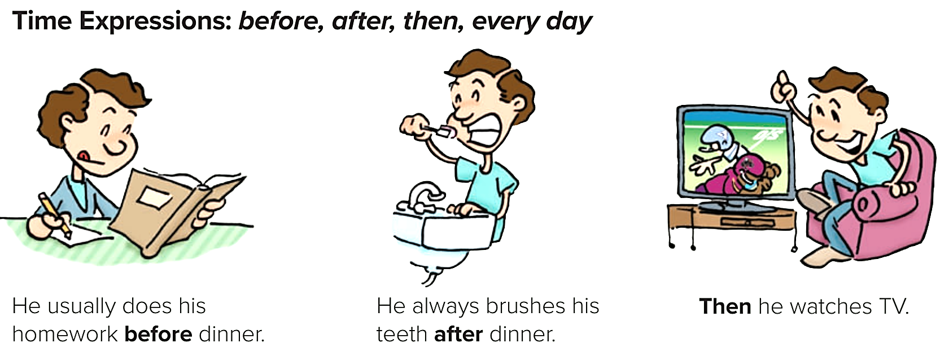

Slide 9
Objectives
Today you will learn about..
Listening : Listen for specific details about daily activities
Pronunciation: Linking—Does he and Does she.
Conversation: Practice & answer questions from a conversation.

Slide 11
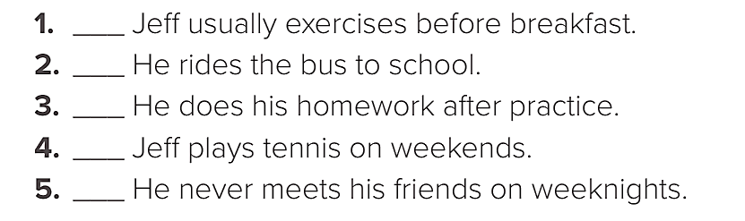
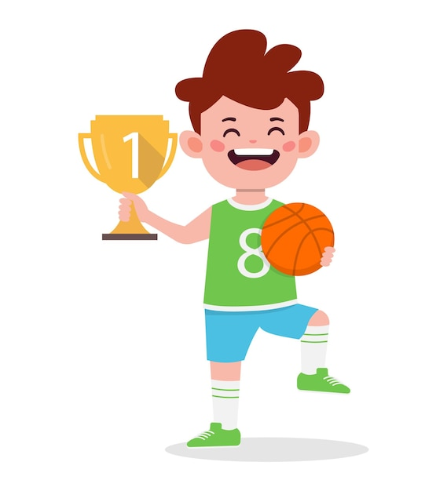
Listen to Jeff’s typical day. Tick ( ) the things he does.
Nice
Let’s listen again.

Slide 12
Listen to the pronunciation of Does he and Does she.
Notice how the words are pronounced together. Then practice.
Does she get up early?
Does he exercise every day?

Slide 13
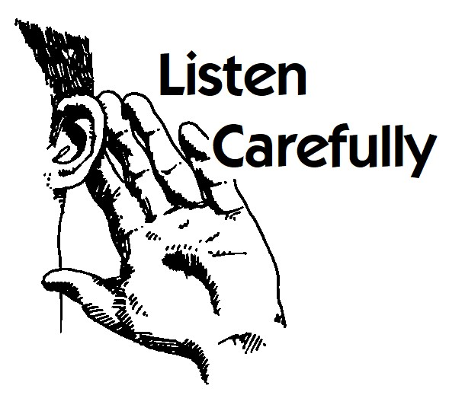

Slide 14
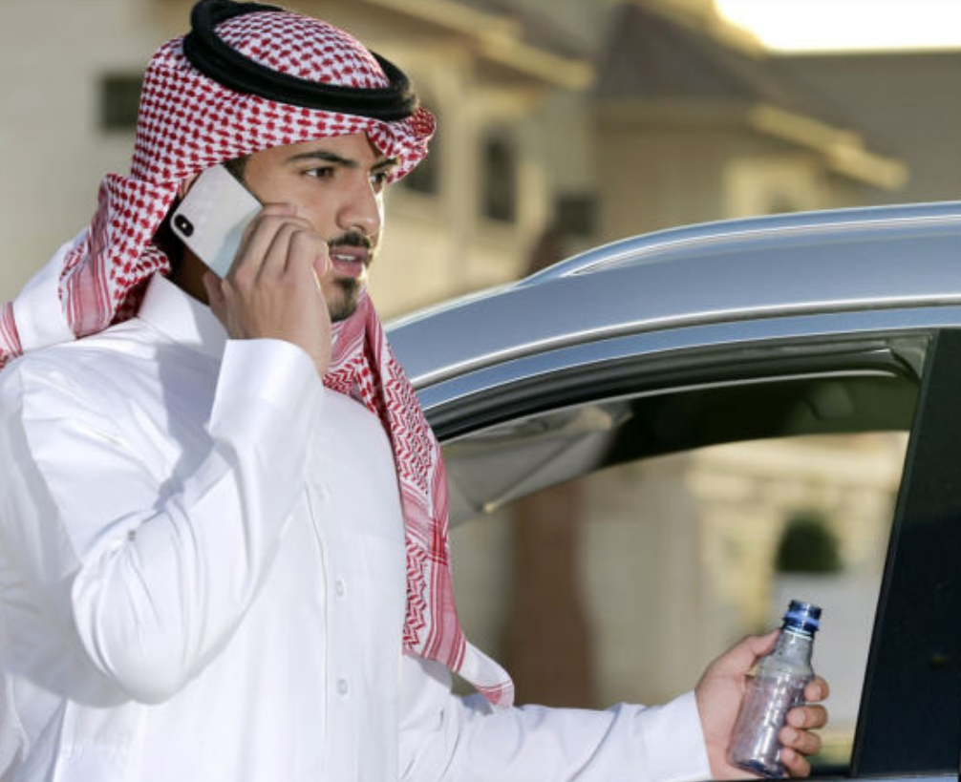
92
Fahd: Hi, Ryan. Where are you going?
Ryan: To the gym. I usually work out for about an hour in the afternoon. Where are you off to?
Fahd: To martial arts class.
Ryan: That’s awesome! What are you learning?
Fahd: Well, right now, I’m learning some difficult karate moves. But sometimes we do special exercises to learn how to concentrate. Come along some time.

Slide 15
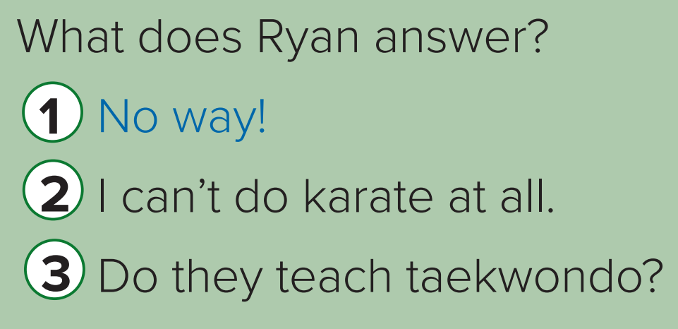
Nice

Slide 16
92
About the conversation
1. What does Ryan usually do in the afternoons?
2. What kind of lesson does Fahd have?
3. What is he learning now?
He usually works out for about an hour.
Nice
He has a karate lesson. \ He has a martial arts class.
He is learning some difficult karate moves.

Slide 17
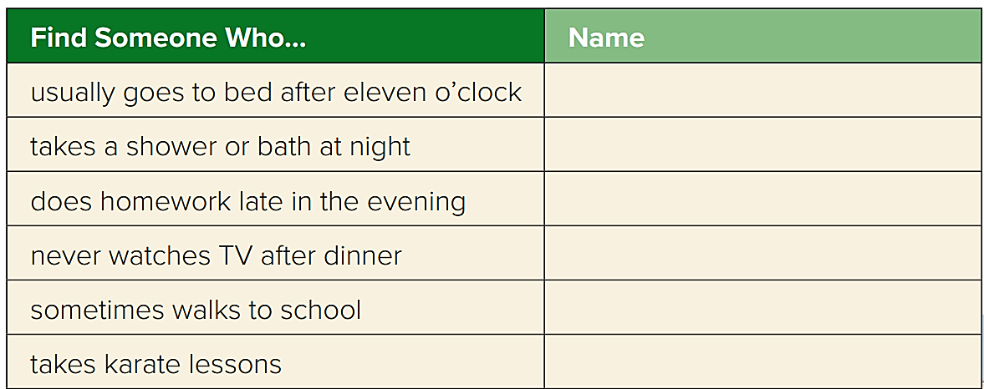
Your Turn
Find someone in your class who does each of the activities.
Nice

Slide 18
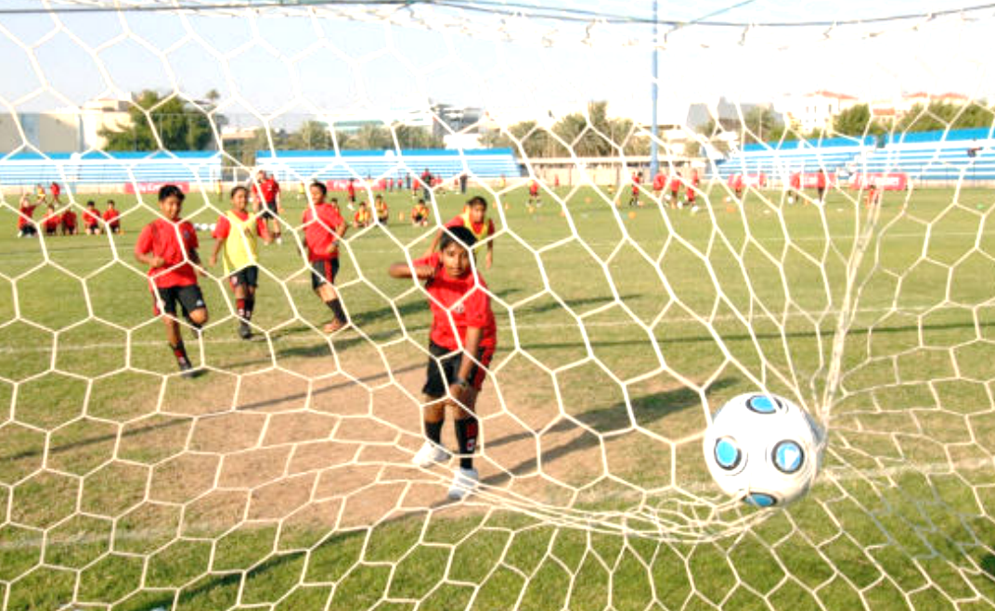
Nice
Find someone in your class who does each of the activities.
1. Do you take any lessons? What kind?
2. What do you usually do on Saturdays?
3. What do you never do on Saturdays?

Slide 19
Book Time
Open page 91 - 92
Let’s fill out the listening
chart &
‘about the conversation’
answers together

Slide 20
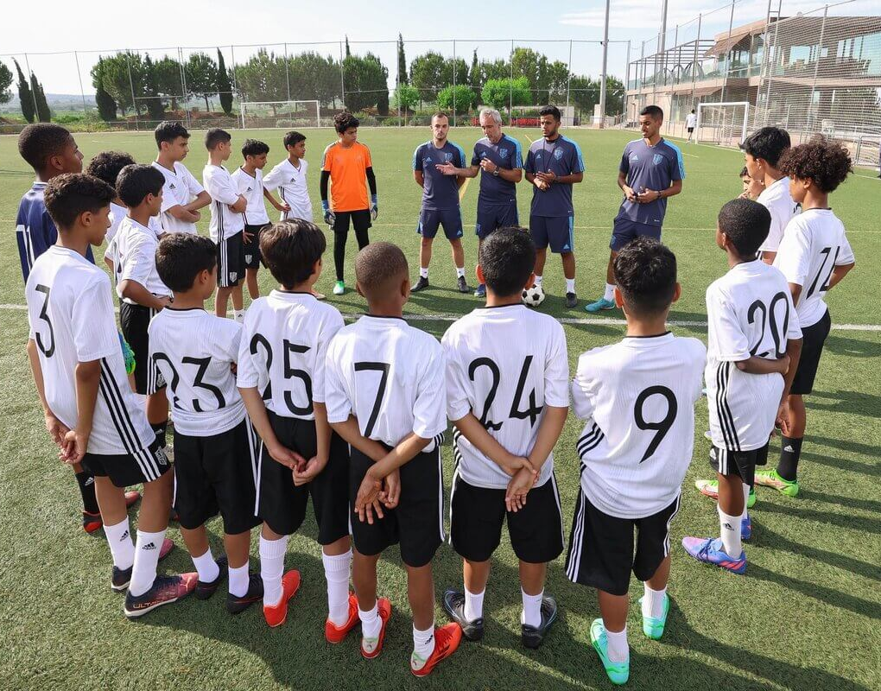
Linking this lesson to my Country
Alhamdulillah our country,
the kingdom of Saudi Arabia.
Have launched a lot of sport’s training centers at every areas at every park, that you can visit everyday.
And you can add it as a healthy, habit and a lifestyle.
To make leisure time beneficial and gain healthy and physical skills.

Slide 22
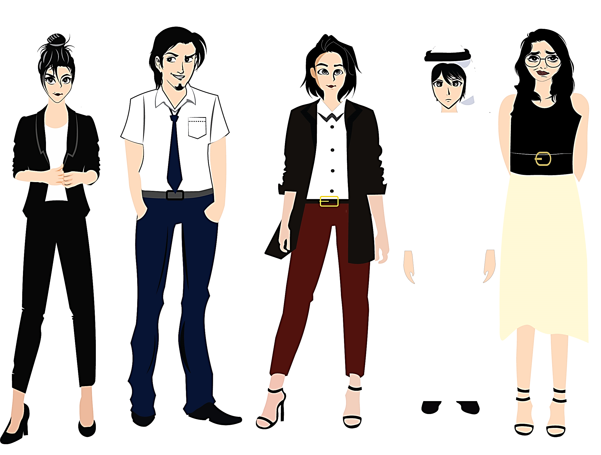
تم تصميم هذا العرض من قبل: فريق عمل البوابة الإنجليزية ، وهو مجاني لكي يستفيد منه معلمي اللغة الإنجليزية.
هذه الشريحة تعتبر كـ"حفظ حقوق" نتمنى عدم حذفها حال مشاركة العرض مع معلمين آخرين.
نسمح بحذف الحقوق في حالة واحدة فقط: اذا أراد معلم الإنجليزي إضافة هذا العرض كـ انتاج معرفي خاص فيه.

