Slide 1

Good
Morning
اللَّهُمَّ انْفَعْنِي بما علمتني، وعلمني ما ينفعني، وَارْزُقْنِي علماً ينفعني

Slide 2
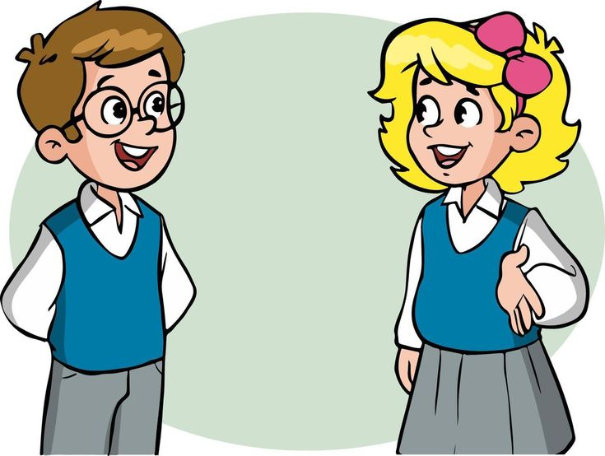
How are you today ?

Slide 3

Revision
Reading:
Read about schools around the world.
Activity

Slide 4


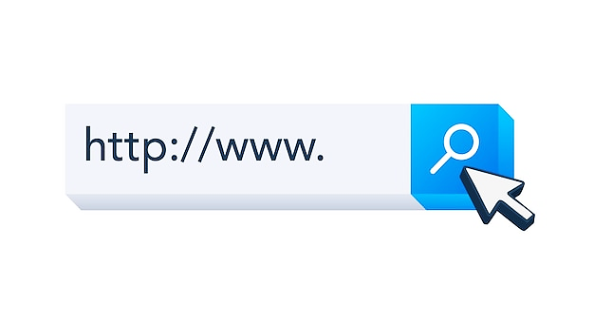
Before Reading
Do you have a school newspaper or web page?
What information does it have?

Slide 5
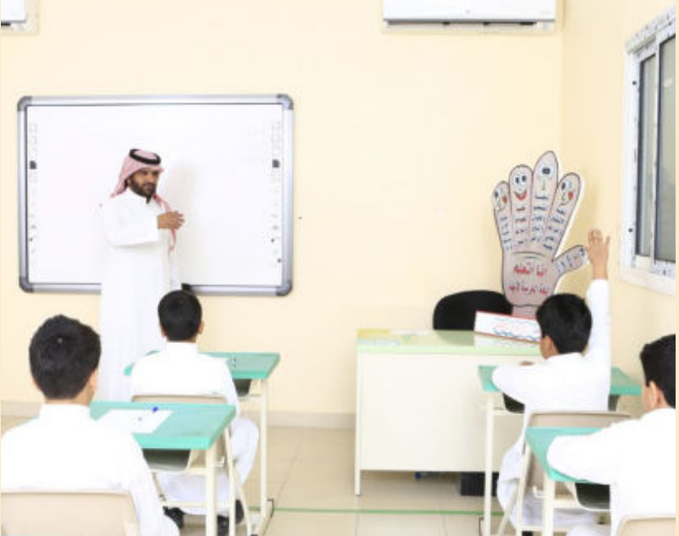
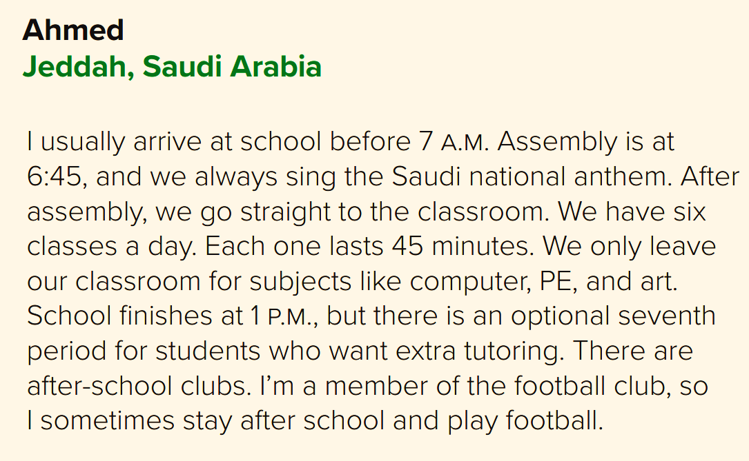
Schooldays:
School Around the World

Slide 6
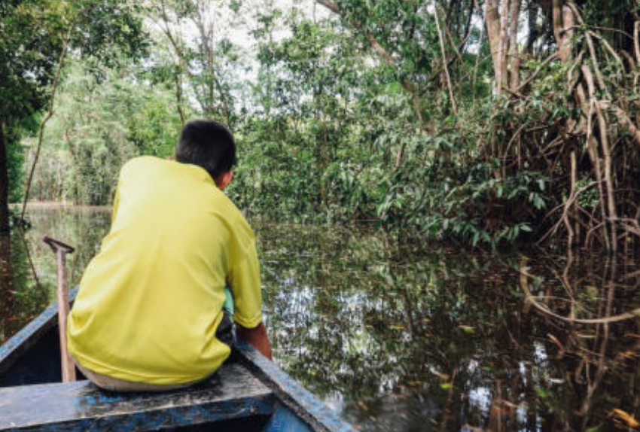
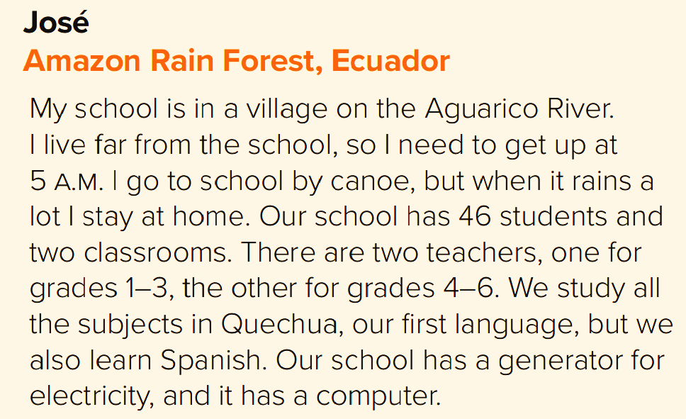
Schooldays:
School Around the World

Slide 7

After Reading
Underline or list the things and activities that are different from your school.
Compare with a partner.

Slide 8


Slide 9
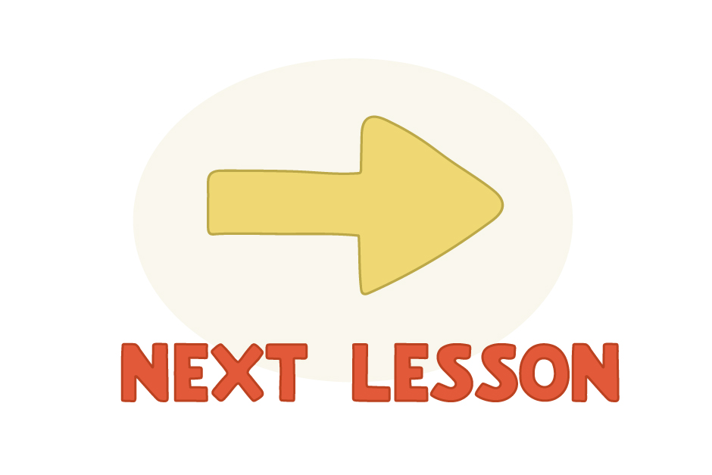

Slide 10


Slide 11


Objectives
Today you will learn about..
Writing: Write an email about a typical day at school.
Writing corner : Using ‘by’
Writing Project : Write about school routines around the world.
Form\Meaning & Function : Simple Present versus Present Progressive.

Slide 12


Slide 13
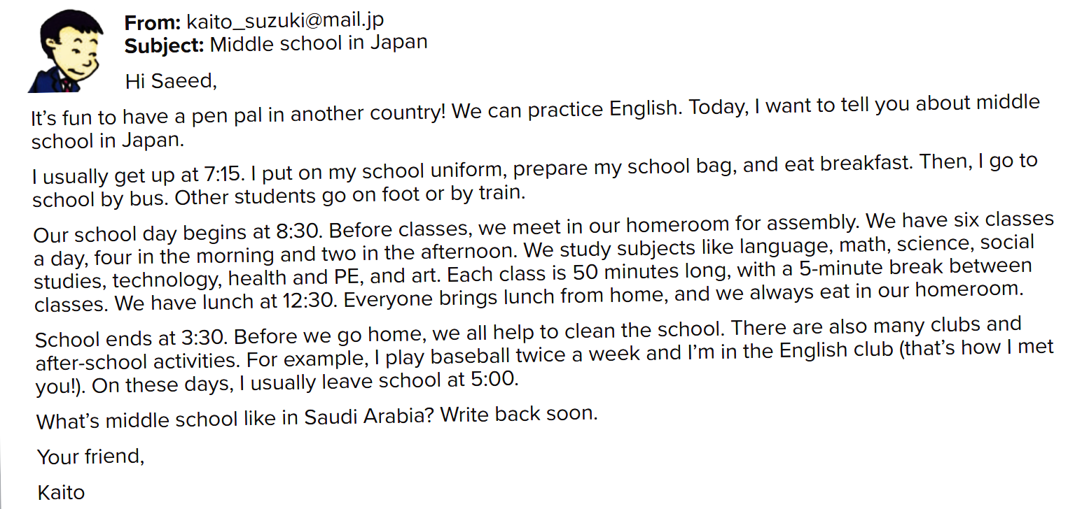
Page 94
A. Read the email from a Japanese student in middle school. With a partner, discuss what is the same or different about your school.

Slide 14
Writing Corner
By explains how: by car, by bus, by plane, etc. But we say on foot.
Kaito goes to school by bus. Other students go on foot or by train.

Slide 15
Writing Corner
2. To shows direction:
He goes to school by bus.

Slide 16
Writing Corner
3. In shows location:
Students meet in their homeroom.

Slide 17

PROJECT

Slide 18

PROJECT
Work in a group. Do research on routines of schools around the world. Write how they are similar or different from your school.

Slide 19

START

Slide 21
Vs.
Simple Present
Present Progressive
Permanent Actions
Temporary Actions
Habits \ Routines
Happening NOW
Saeed lives in Jeddah
He is studying in Riyadh this year.

Slide 22
Use the simple present to talk about permanent actions like habits or routines.
The students usually write tests every month.
Mohammed plays football everyday.
The film starts at 8pm.

Slide 23
Use the present progressive to talk about temporary actions that are happening now.
The students are writing a test at the moment.
Look! Rana is playing Tennis now.
Khalid is working in the office this week.

Slide 24

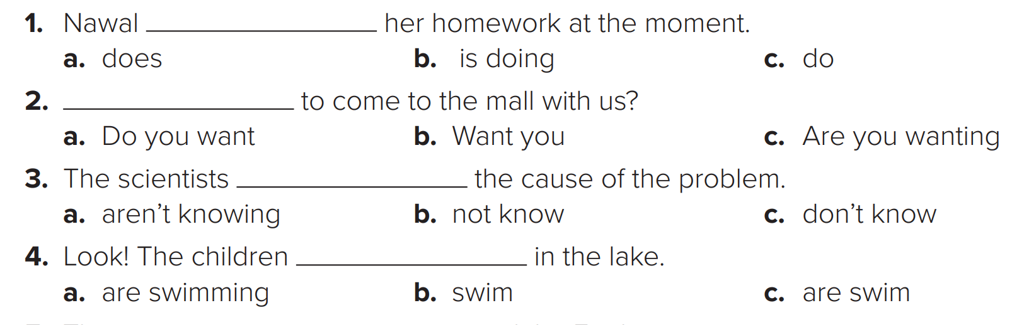
Page 95
Activity
A. Choose the correct verb for each sentence.

Slide 25
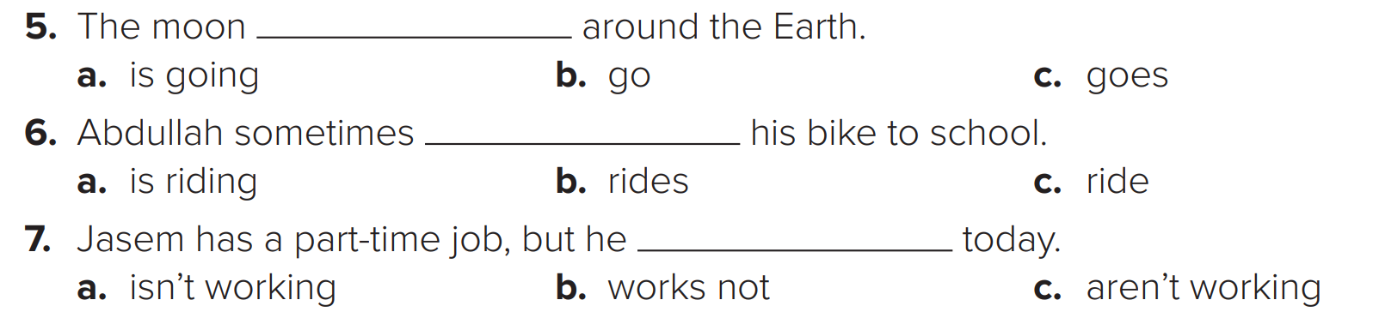
Page 95
A. Choose the correct verb for each sentence.

Slide 26
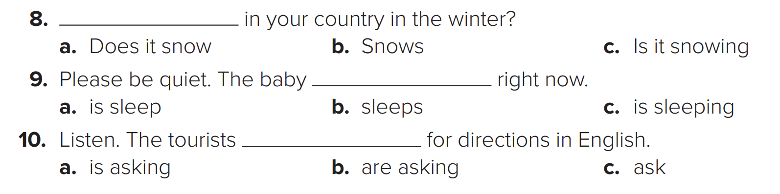
Page 95
A. Choose the correct verb for each sentence.

Slide 27


Slide 28
Page 95
Activity
B. Put the verbs in parentheses into the present progressive or simple present.
1. ___________ your email every day? (you/check)
2. Look at them! They ___________ horses on the beach. (ride)
3. I _____________ this exercise. Can you explain it again? (not/understand)
4. We______________to the park. Would you like to come with us? (go)
Do you check
are riding
don’t understand
are going

Slide 29
Page 95
Activity
B. Put the verbs in parentheses into the present progressive or simple present.
5. Majid usually_______________at the gym three times a week. (work out)
6. What time__________________in the morning? (you/usually/wake up)
7. ______________the newspaper? Can I have a look at it, please? (you/read)
works out
do you usually wake up
Are you reading

Slide 30
Page 95
Activity
B. Put the verbs in parentheses into the present progressive or simple present.
8. Fatimah always__________ her teeth after dinner. (brush)
9. Khalid has football after school, so he____________ home early. (not/come)
10. My father’s car is at the mechanic’s, so he_____________ the bus to work. (take)
brushes
Isn’t coming
Is taking

Slide 32

Book Time
Open page 94- 95
Let’s fill out
the previous exercises
that we have done in the book.

Slide 33
Linking this lesson to my Religion & Country.
Education is important, for you and your future goals.
Inshallah with your hard work on studying, you will reach the goal that you want to achieve.
Alhamdulillah the kingdom of Saudi Arabia have given us so many chances to extend our opportunities in education.
عن أبي الدرداء رضي الله عنه عن النبي صلى الله عليه وسلم قال:
«مَنْ سَلَكَ طَريقا يَبْتَغي فيه عِلْما سَهَّل الله له طريقا إلى الجنة».

Slide 34


Slide 35

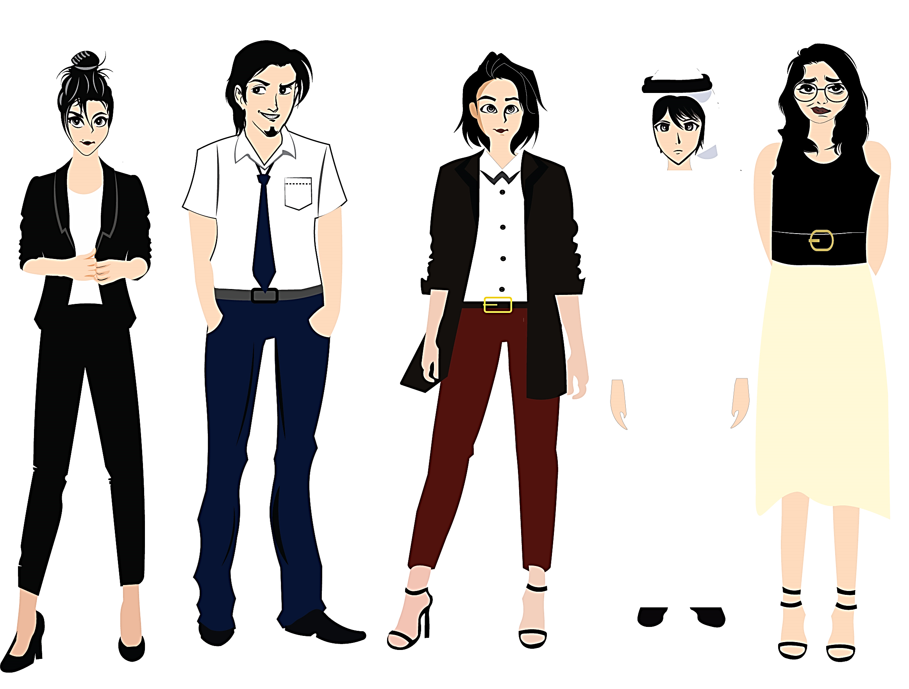


تم تصميم هذا العرض من قبل: فريق عمل البوابة الإنجليزية ، وهو مجاني لكي يستفيد منه معلمي اللغة الإنجليزية.
هذه الشريحة تعتبر كـ"حفظ حقوق" نتمنى عدم حذفها حال مشاركة العرض مع معلمين آخرين.
نسمح بحذف الحقوق في حالة واحدة فقط: اذا أراد معلم الإنجليزي إضافة هذا العرض كـ انتاج معرفي خاص فيه.

