Slide 1
Unit 2
Going Green
Conversation+ Listening
Mega Goal 2.2
Done by : Entisar Al-Obaidallah

Slide 2
Lesson Objectives
Listen for specific information
Use “ Real Talk” in correct sentences
Form a correct suggestion
Match the words with their meanings

Slide 3
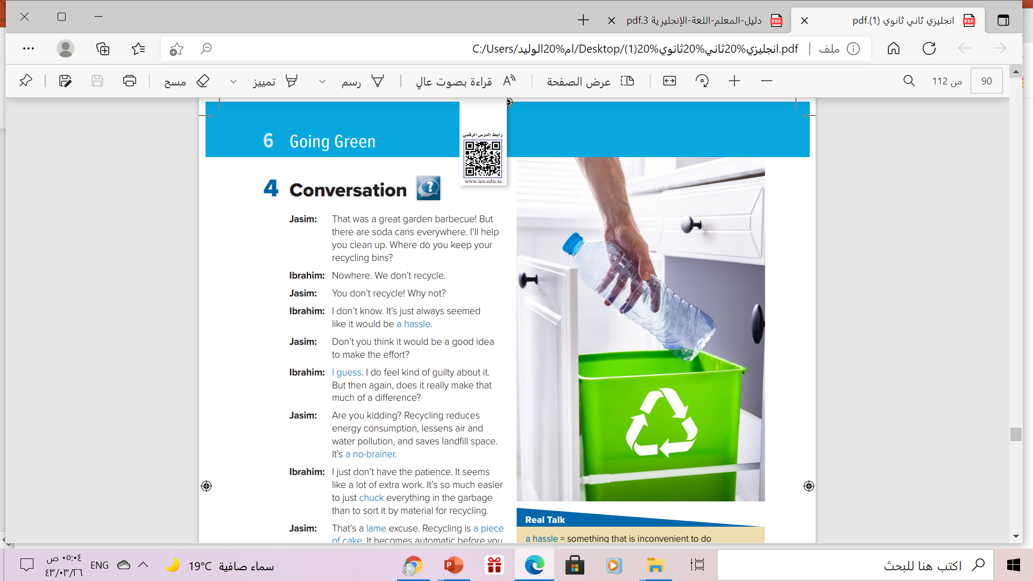


What do you think has been happening here?
Maybe people were having a barbecue or a picnic and threw all the cans and bottles in the trash

Slide 4
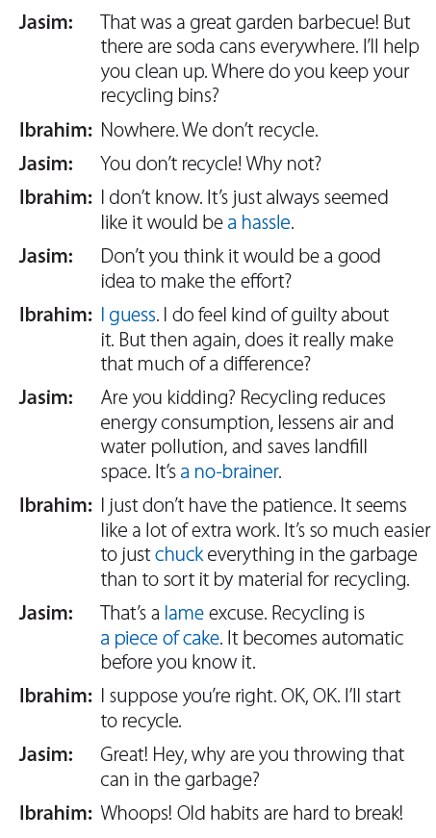


Open UR book p.(16)
Read along as u listen

Slide 5
How many persons are there?
Two
Who are they ?
Jasim and Ibrahim
What are they talking about?
About recycling

Slide 6
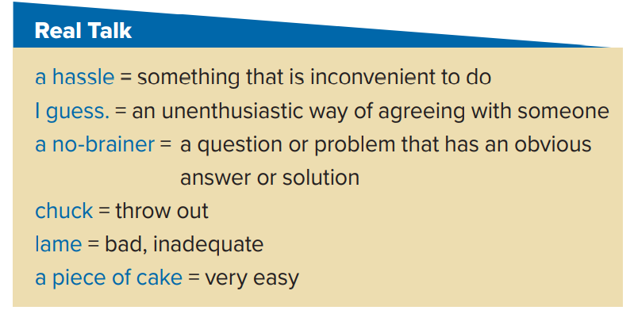
Who says each expression ?
Ibrahim
Ibrahim
Jasim
Ibrahim
Jasim
Jasim

Slide 7
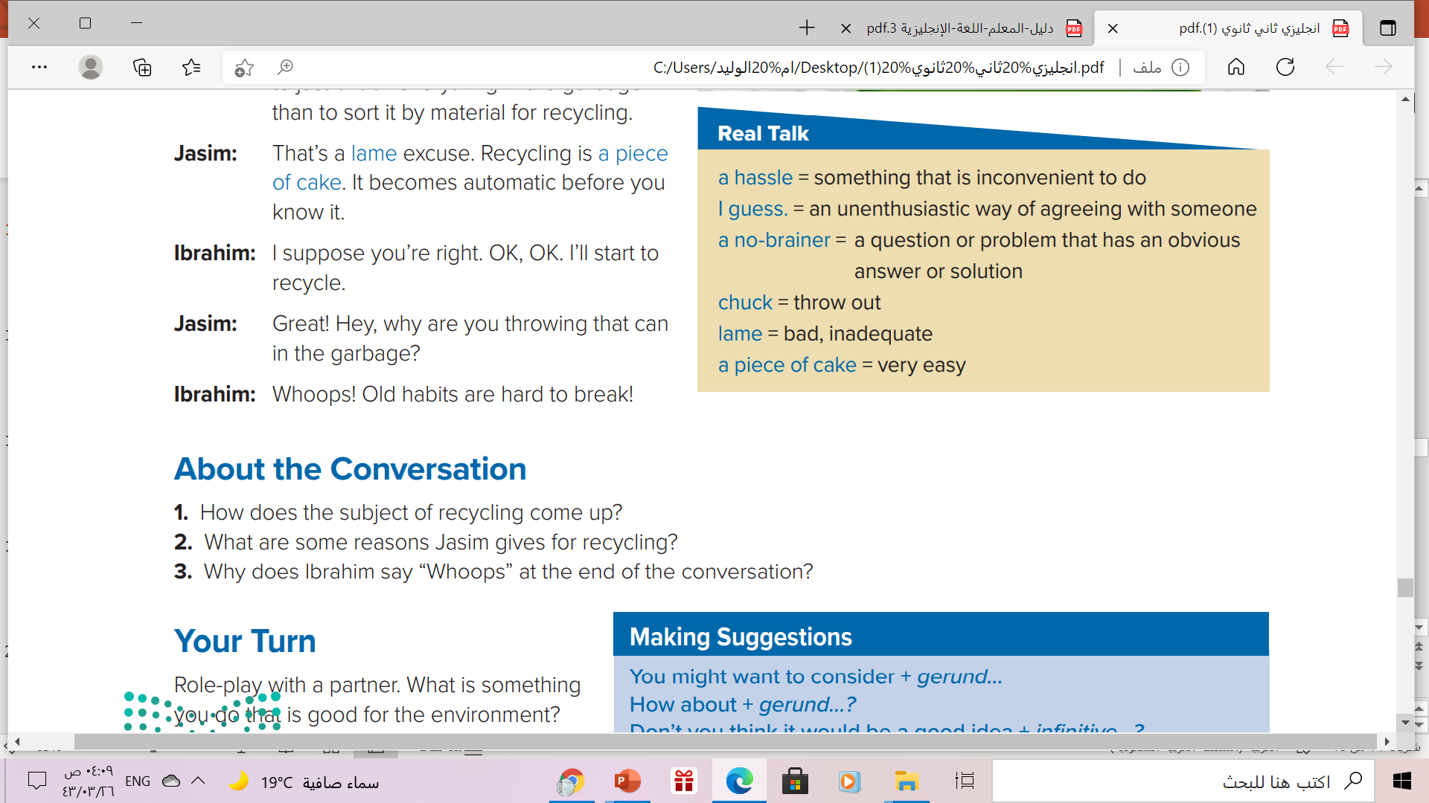
Jasim and Ibrahim are cleaning up after a party and there are soda cans everywhere.
Jasim says that recycling reduces energy consumption, lessens air and water pollution, and saves landfill space.
Because Ibrahim accidentally threw a can into the garbage rather than recycling it.

Slide 8

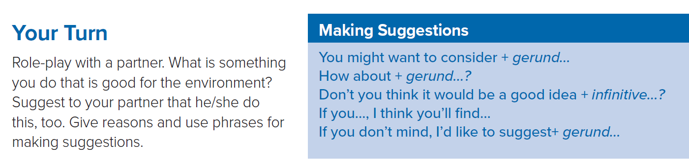
These phrases are often used as an
introduction to making a suggestion.
They assure the person you’re speaking to that you’re giving them a suggestion, not an order.

Slide 9
Which expression does Jasim use in the
conversation?

Slide 10
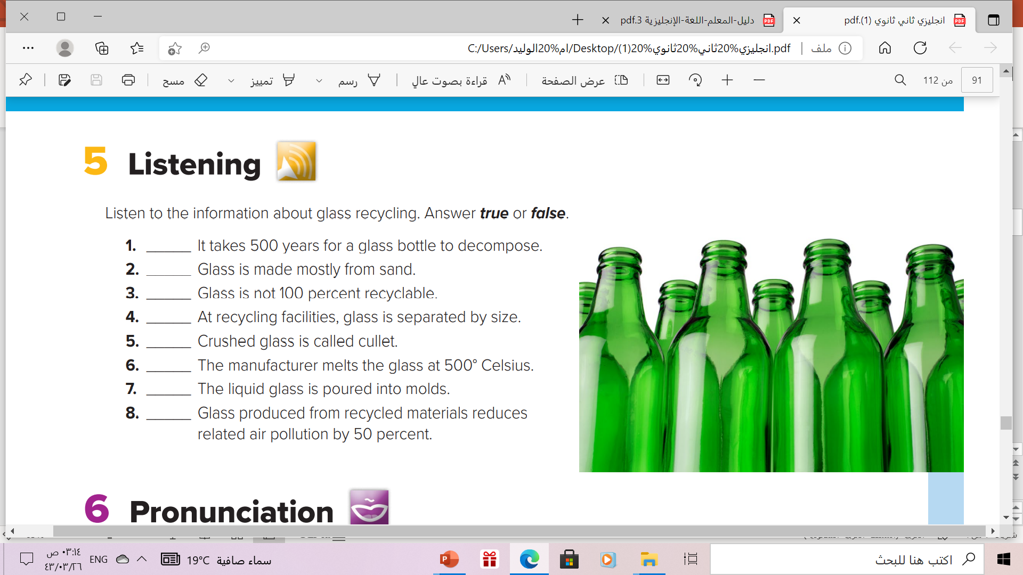
False
(It takes 1 million years.)
True
False
False
(It is separated by color.)
True
False
It is melted at 1,500 degrees Celsius.
True
False
It reduces related air pollution by 20 percent and water pollution by 50 percent

Slide 11
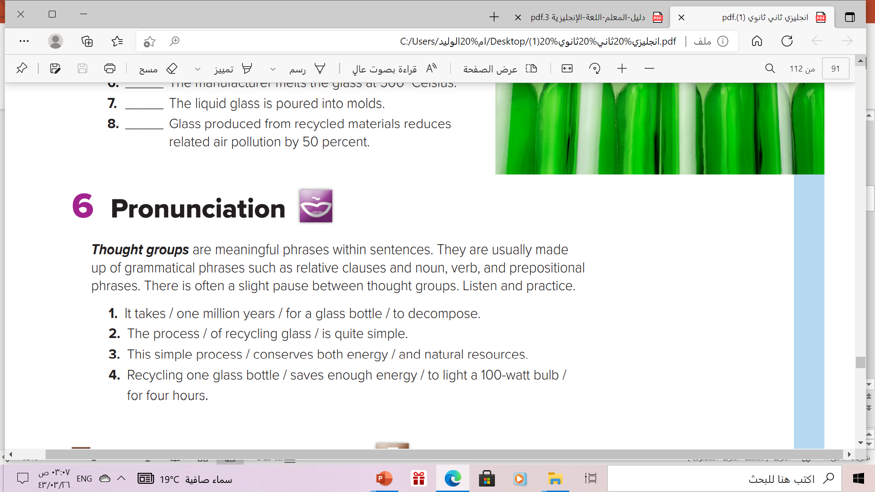

Slide 12
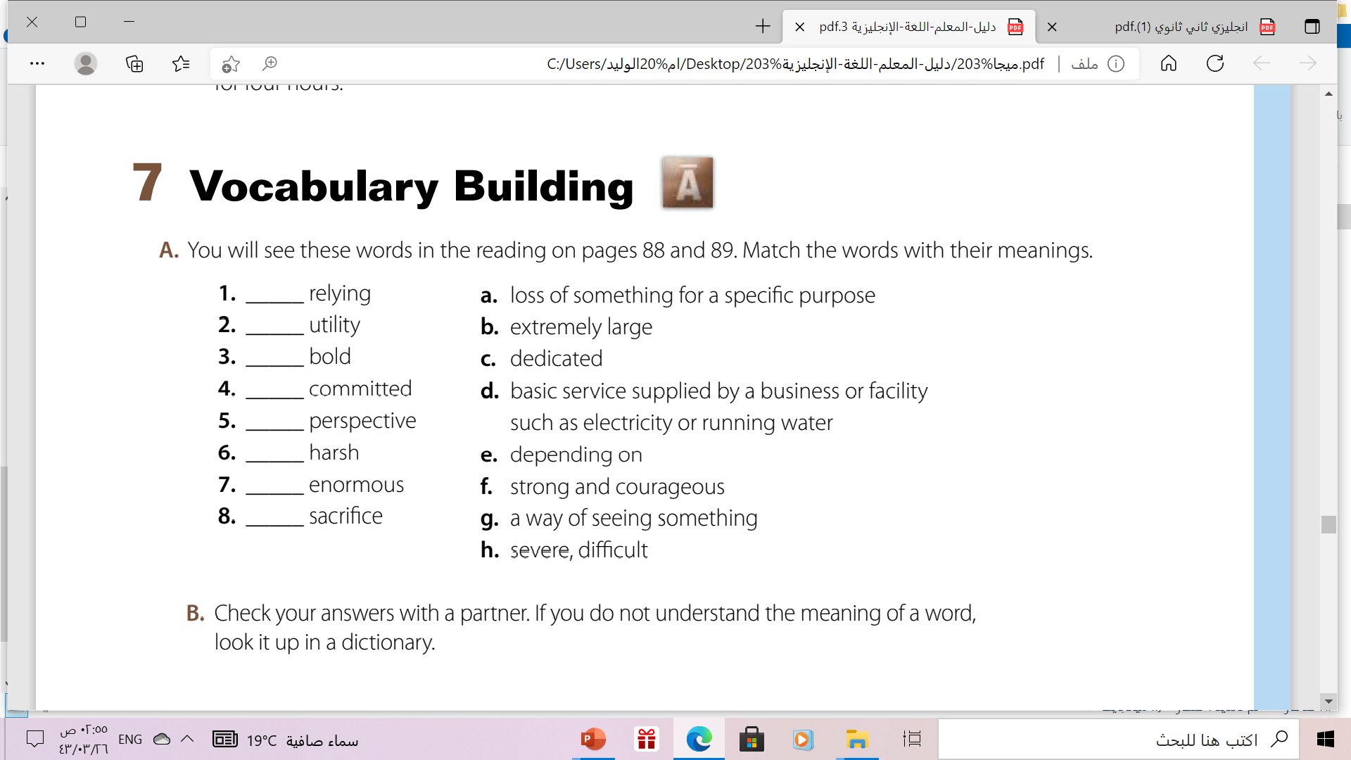
e
d
f
c
g
h
b
a

Slide 13
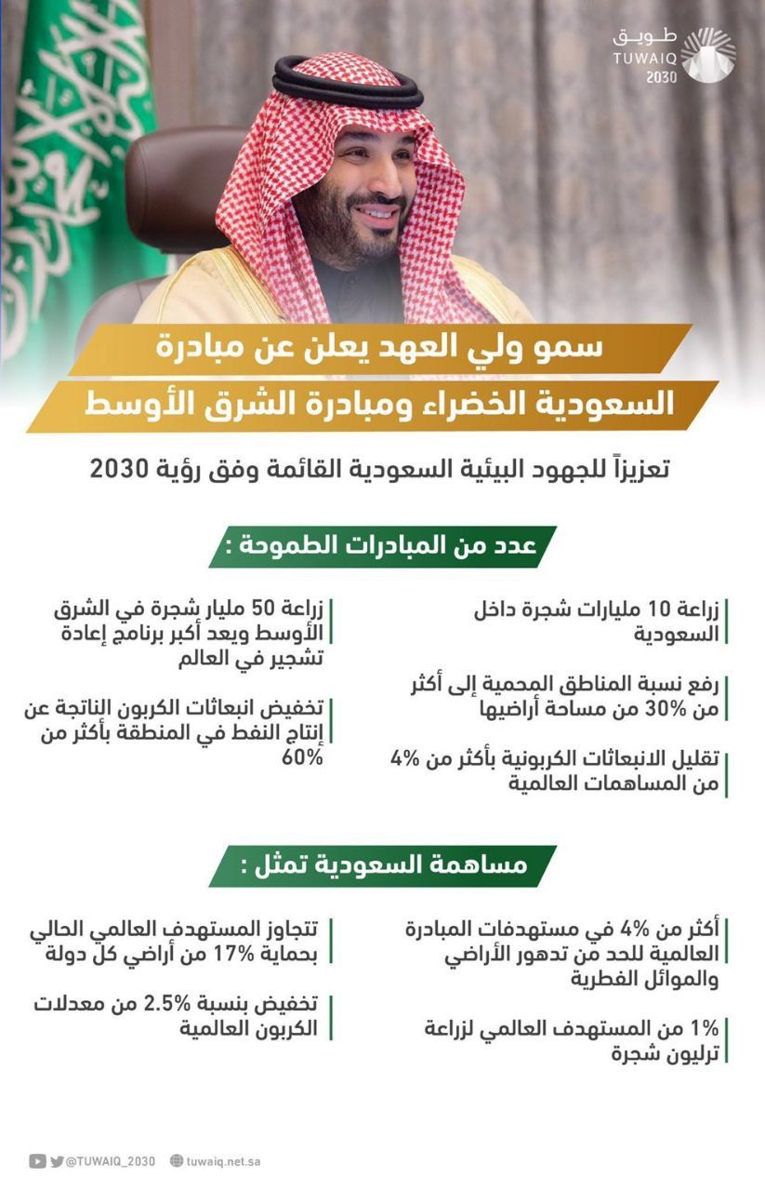


Slide 14

Remember

Slide 15
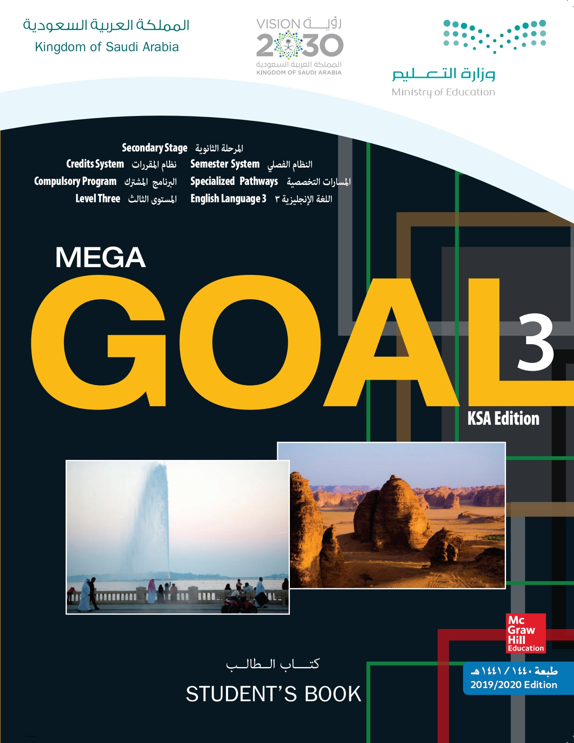
Homework!
Workbook page (90)
exercise ( H)

Slide 16

Thanks!

