Slide 1

Drive Slowly
Unit 8
Language in context

Slide 2
بسم الله الرحمن الرحيم
Day:
Date:

Slide 3


listen for specific information in a conversation
Talk about driving
Learning Objectives
answer questions about the conversation
pronounce vowel sound /ǝ/ in should & must

Slide 4
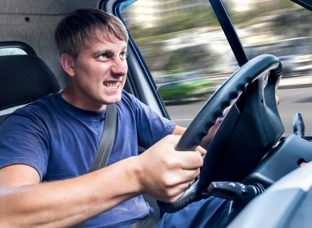
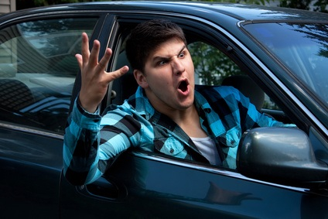
Vocabulary
Aggressive driver

Slide 5
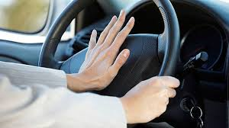
Vocabulary
Blow horn

Slide 6
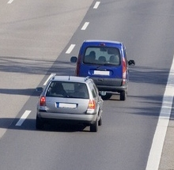
Vocabulary
tailgate

Slide 7
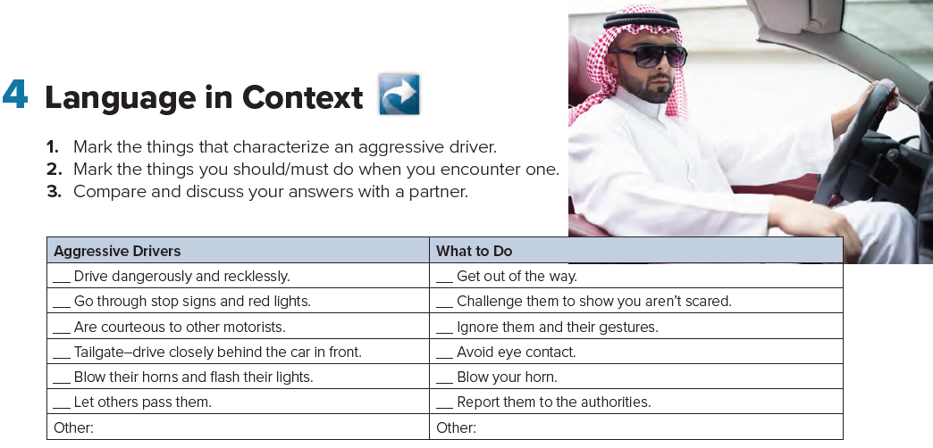

Page 82

Slide 8

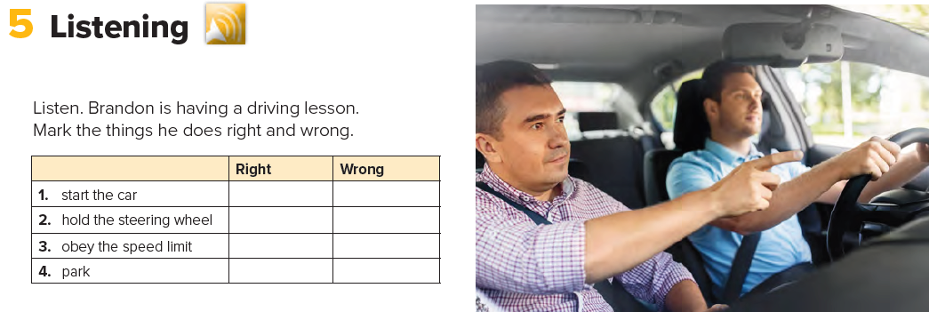
Page 82

Slide 9
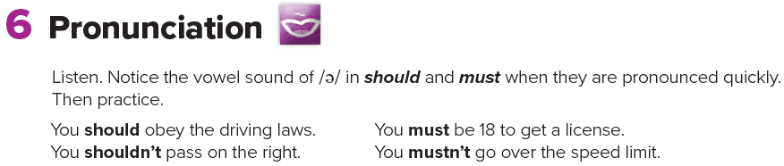
Page 82

Slide 10
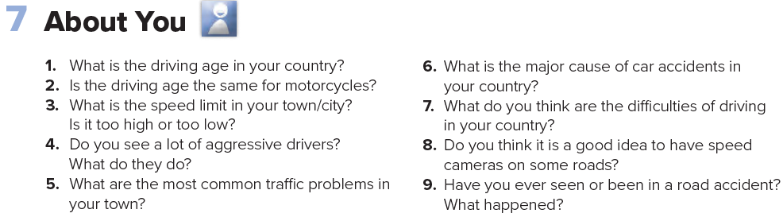
Page 82

Slide 11
Homework
Page 217

Slide 12
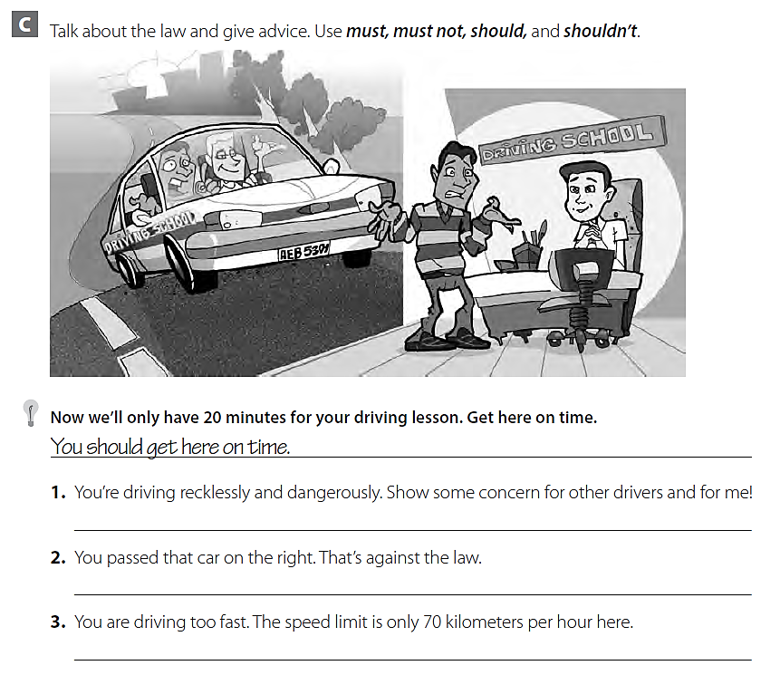
You shouldn’t drive recklessly and dangerously. You should show some concern for drivers and for me
You must pass cars on the left . That’s the law .
You shouldn’t drive too fast . You must obey the speed limit .

Slide 13
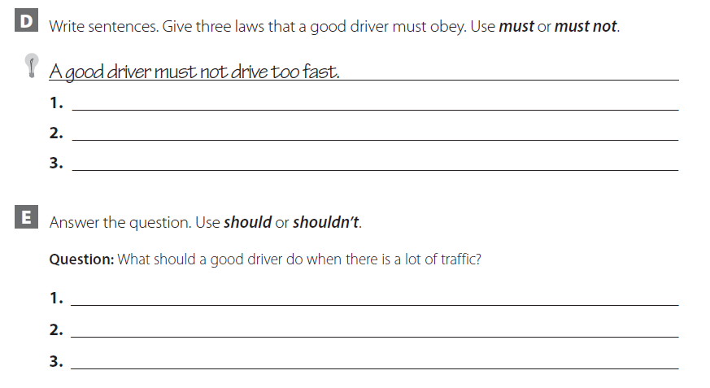
A good driver must stop at stop signs .
A good driver must obey the laws .
A good driver must not pass from the right .
A good driver should slow down .
A good driver shouldn’t talk on the cellphone .
A good driver should watch the other cars carefully .

Slide 14
THANK YOU

