Slide 1

Drive Slowly
Unit 8
Conversation

Slide 2
بسم الله الرحمن الرحيم
Day:
Date:

Slide 3


listen for specific information in a conversation
answer questions about the conversation
Learning Objectives
practice using real talk phrases
Act some situations

Slide 4
Page 83
Who is in the car?
What is their relationship?
What is happening?
Where are they going?

Slide 5
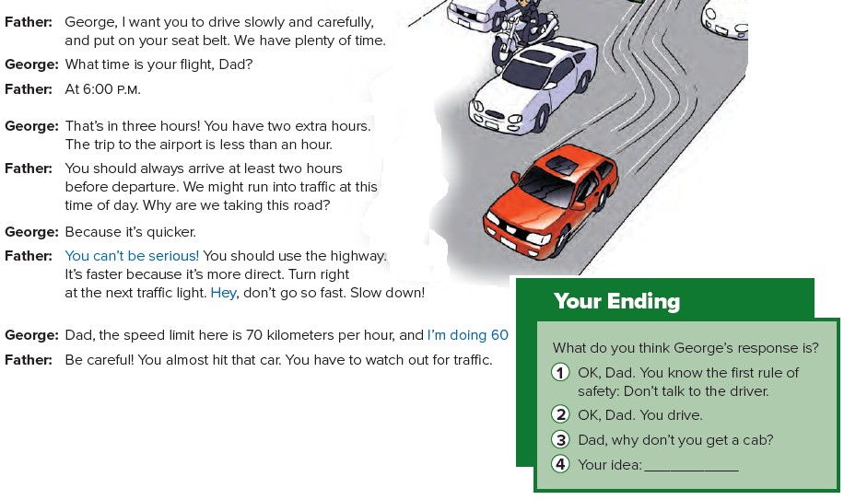

Page 83

Slide 6
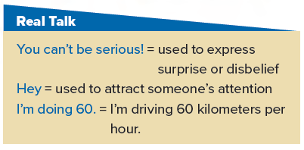
Page 83

Slide 7
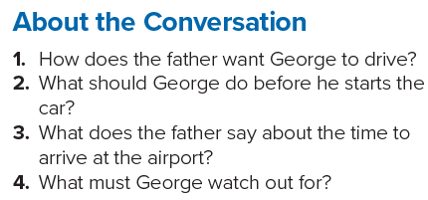
Page 83
1. He wants George to drive slowly and carefully.
2. George should put on his seat belt.
3. He says that you should always arrive at the airport two hours before the departure.
4. George must watch out for traffic.

Slide 8
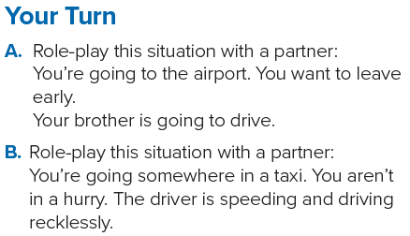
Page 83

Slide 9
Homework
Page 218

Slide 10
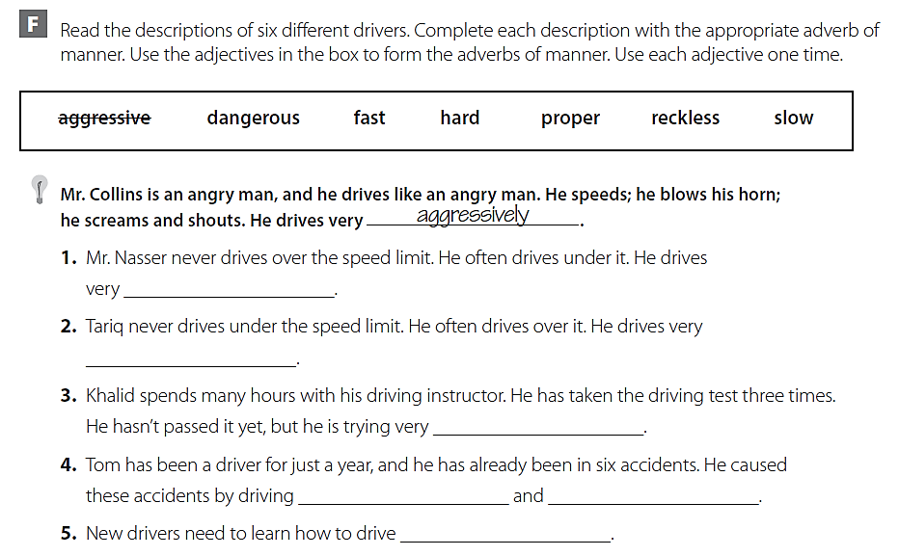
slowly
fast
hard
dangerously
recklessly
properly

Slide 11
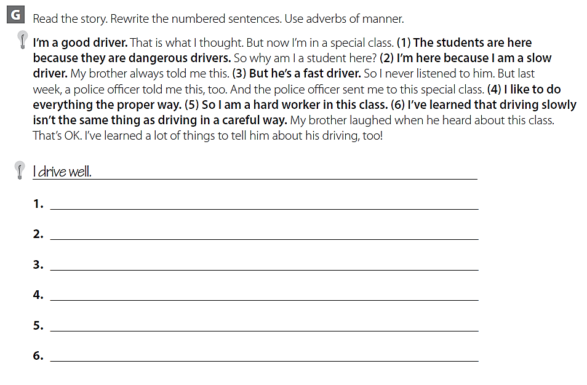
The students are here because they drive dangerously .
I’m here because I drive slowly .
He drives fast .
I like to do everything probably .
I work hard in this class .
Driving slowly isn’t the same as driving carefully .

Slide 12
THANK YOU

