Slide 1
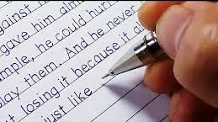

11. Writing
Objectives
Talk about their abilities.
Form simple short sentences
Reorder a paragraph.
Form a paragraph about things they’re learning.

Slide 2



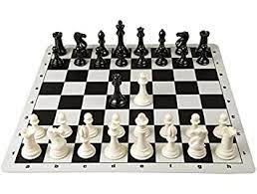
Think about several things you are learning to do.
I’m learning to speak English.
I’m learning to cook.
I’m learning to drive.
I’m learning to play chess.

Slide 3

What were you able to do 3 or 5 years ago?
I was able to start the car.
I was able to …………
What are you able to do now?
Now, I am able to drive a car very well.
Now, I am able to ………
What will you be able to do in the future?
Soon, I hope I can drive a manual car
Soon, I hope ………

Slide 4

Now read the following sentences and put them in the correct order.

Slide 5

6
* I know I won’t be able to drive trucks ever. And I have no intention to.
3
* Now I’m able to drive an automatic car very well and park it too.
1
* Five years ago I wasn’t able to drive a car at all.
4
*But, I’m still not able to drive trucks.
2
* I was only able to start the ignition.
* Hopefully soon I’ll be able to travel to Abha driving my own car and drive a manual one.
5

Slide 6
Five years ago I wasn’t able to drive a car at all. I was only able to start the ignition. Now I’m able to drive an automatic car very well and park it too. But I’m still not able to drive trucks.
Hopefully soon I’ll be able to travel to Abha driving my own car and drive a manual one. I know I won’t be able to drive trucks ever. And I have no intention to.

Slide 7
Now think of what you are learning and write a paragraph about it.
Before you start remember the rules of writing a good paragraph.

Slide 8

Topic sentence
What are you learning?
Supporting sentences
What were you able to do?
What are you able to do now?
What will you be able to do in the future?
Conclusion sentence
How good do you think you’ll be?

Slide 9
What were you able to do?
I was able to …………
What are you able to do now?
Now, I am able to ………
What will you be able to do in the future?
Soon, I hope ………

Slide 10
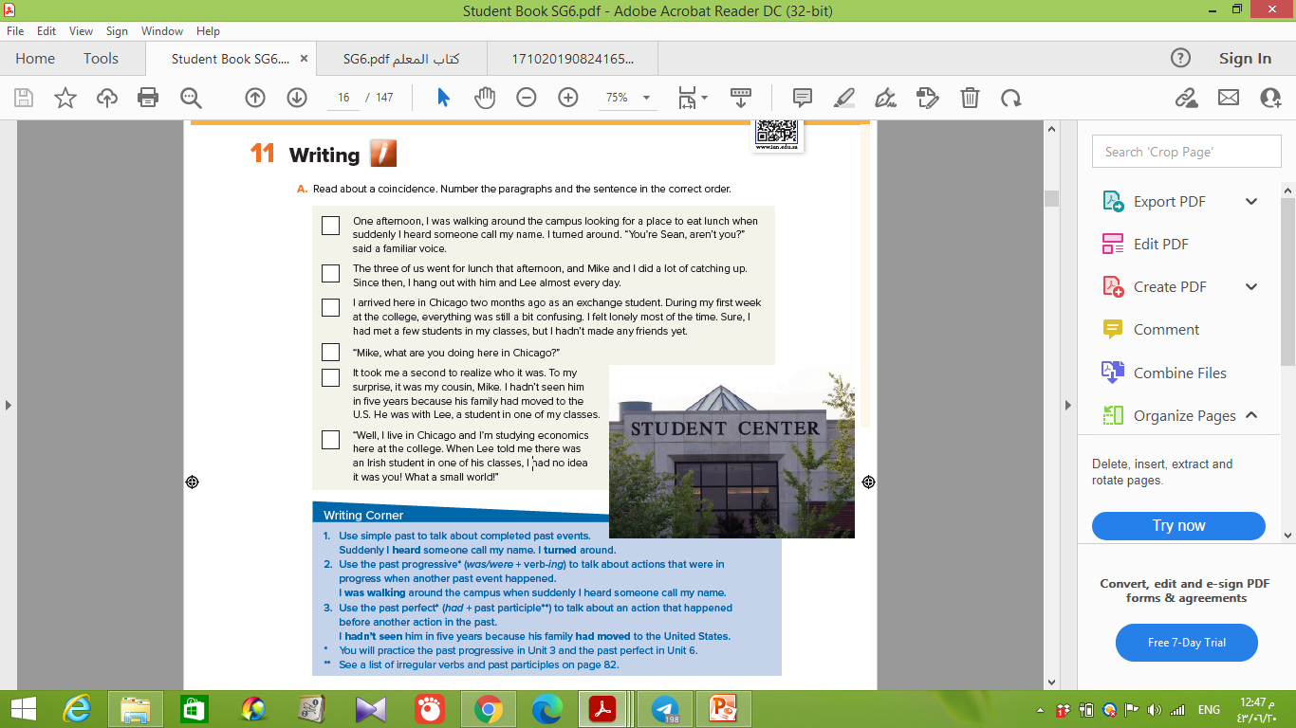
2
6
1
4
3
5

Slide 11
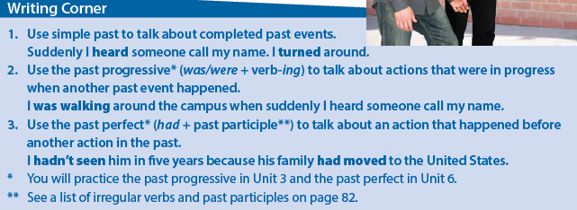

Slide 12
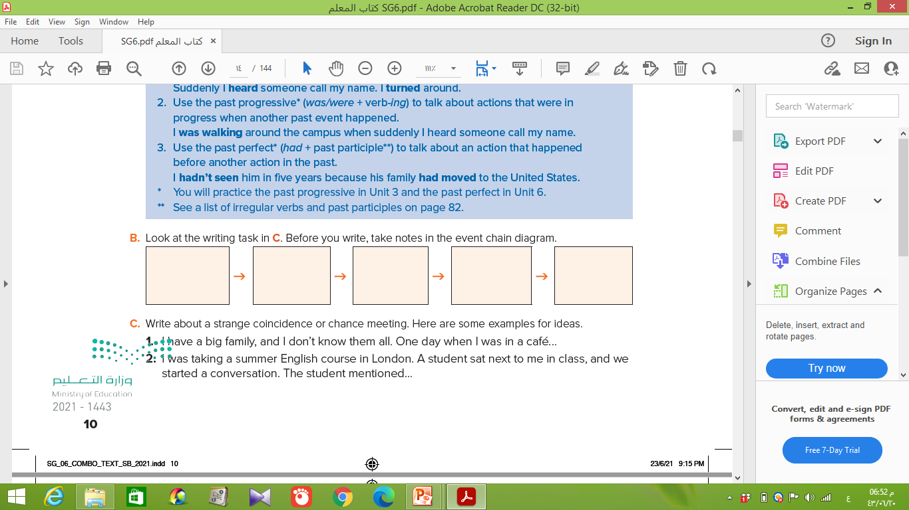
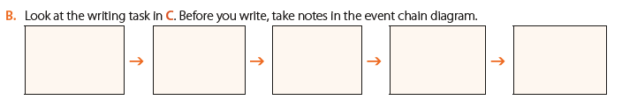
Person has the same full name
A few years ago
one of my cousins
in the university
bad degree

Slide 13
A few years ago I had a wonderful chance. I met a person in the university who has the same full name . He wasn’t good and got a bad degree. I went to the professor to complain and I found it was a degree of another person who has the same name. I told my father who came and discovered that he was his cousin’s son who lives in another city.

