Slide 1
Unit 1
Two is Better than One
Grammar
Done by: Entisar Al-Obaidallah

Slide 2
Lesson Goals
01
03
Recognize
Use
02
04
Distinguish
Apply
Do imphatic correctly
the meaning & using of another , other & others
Between other & others
the rules to do the exercises

Slide 3


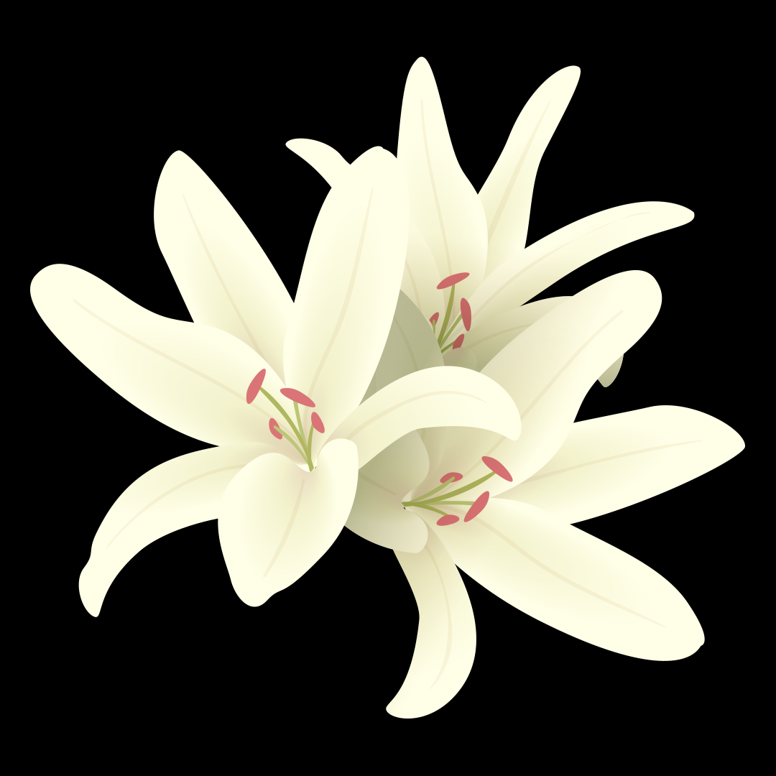

Book Open
Pages ( 8-9)

Slide 4
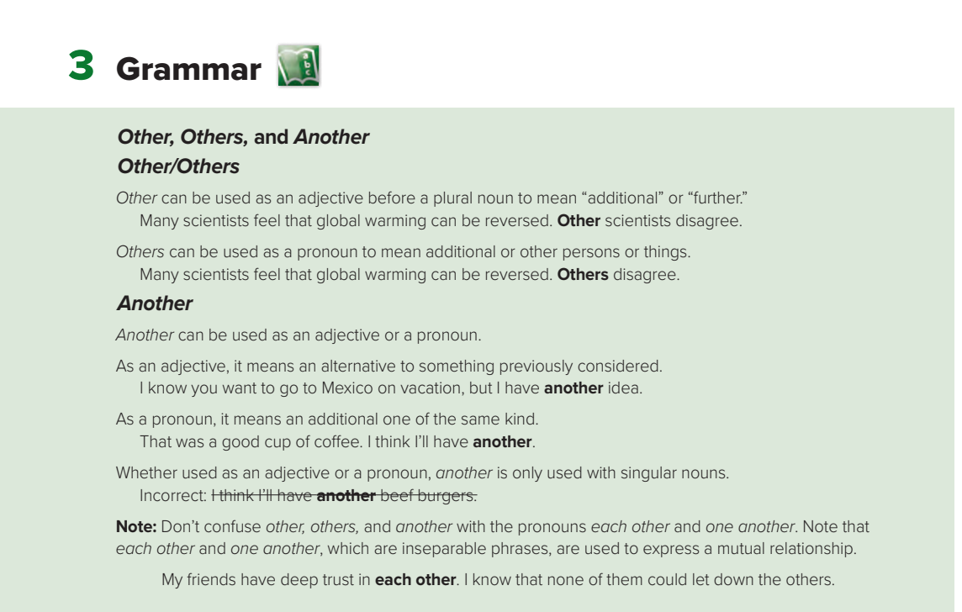

Slide 5
What is the difference between another ,other and others?
another + singular , countable noun
other + plural noun( countable & uncountable )
others (a pronoun to replace other + plural noun)
Examples
I need another cup. (cup is singular so we use another )
I need other cups. (cups is plural so we use other )
I need others. (refers to other cups)

Slide 6
Another
Note: Used only with singular nouns
can be used as an adjective
can be used as a pronoun
it means an alternative to something previously considered.
it means an additional one of the same kind.
I know you want to go to Dubai on vacation, but I have another idea.
That was a good cup of coffee. I think I’ll have another.

Slide 7
Other
Note: Used with plural nouns(countable & uncountable)
can be used as an adjective
can be used before Plural Noun
it means an “additional” or “further.”
Examples
I have invited some other people.
I’m sorry , but I have other plans.
He wants other books .

Slide 8
Others
Note: Used instead of ( other+ plural noun)
can be used as a pronoun
It means “additional”
“other persons or things.”
Examples
I don’t like these shoes. Let’s ask for others. (others = other shoes)
These cars are expensive . Others are cheap. ( others= other cars)

Slide 9

What is the difference between other and others?
Other is followed by a noun or a pronoun
Others is a pronoun and is NOT followed by a noun.
Examples
These shoes are too small. Do you have any other shoes?
These shoes are too small. Do you have any others? (No noun after others)

Slide 10


Slide 11

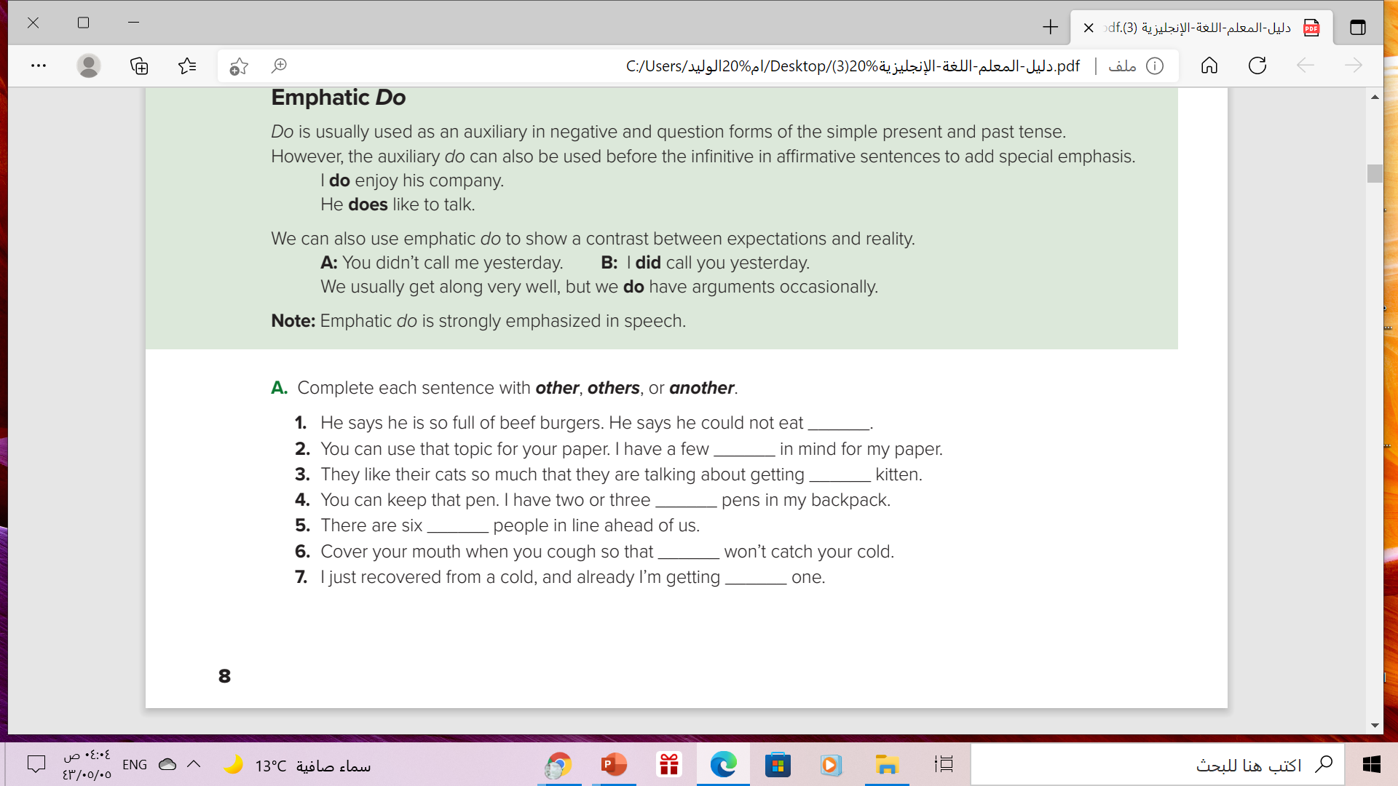


another
others
another
other
other
others
another

Slide 12
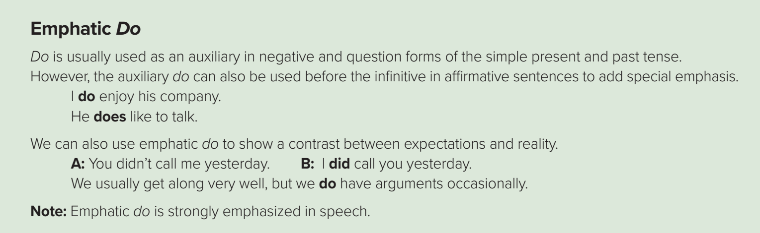

Slide 13
Emphatic Do
used as an auxiliary
Negative
Question
Present Simple & Past Simple
The auxiliary do can also be used before the infinitive in affirmative sentences to add special emphasis.

Slide 14



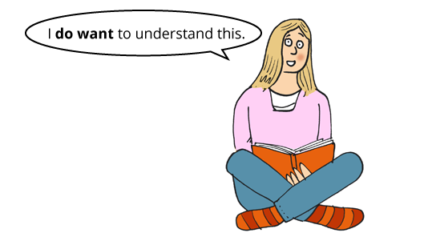
Examples
I do speak English!
I do like this book!
He does speak English well!
They did live here before!

Slide 15
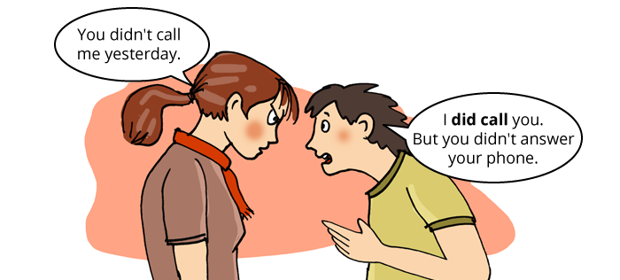
We can also use emphatic do to show a contrast between expectations and reality.
Examples
I did call you yesterday.

Slide 17
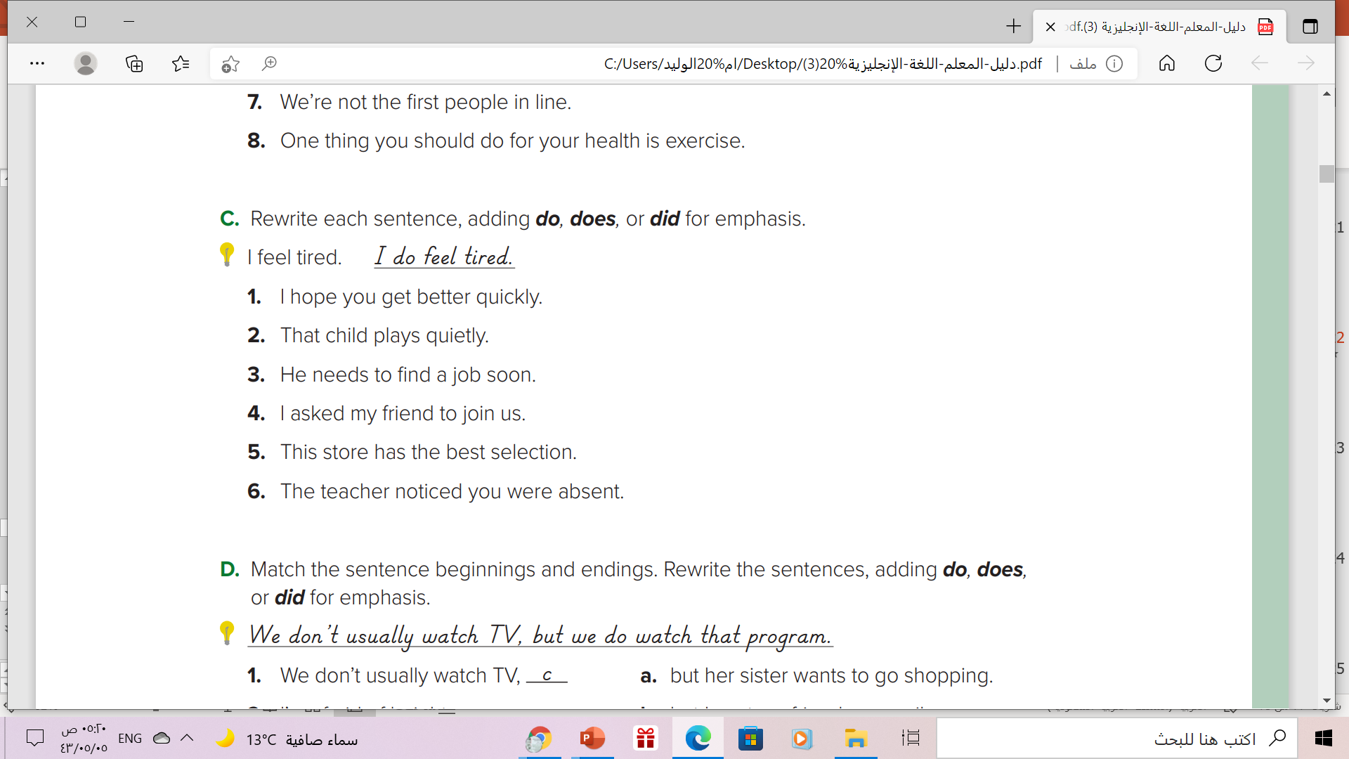

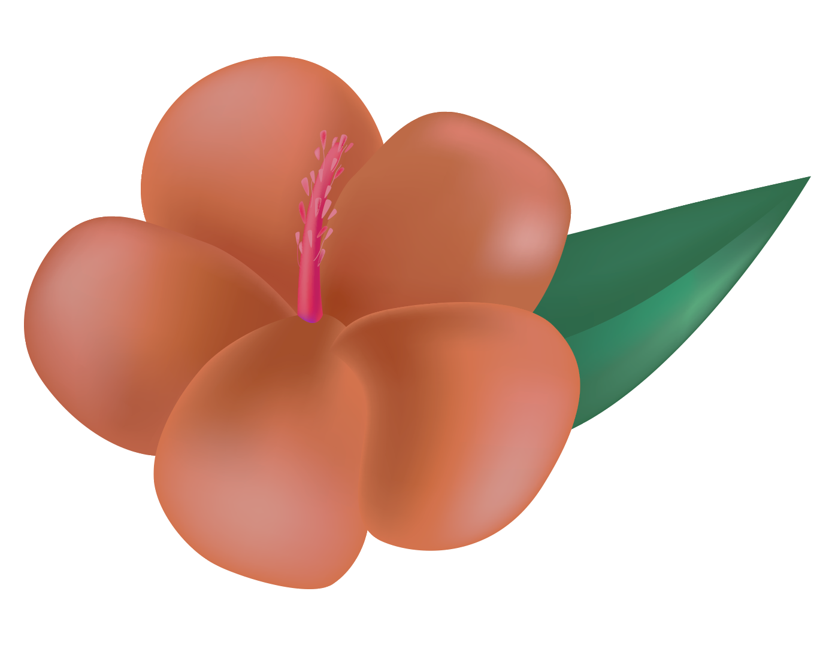
1.I do hope you get better quickly.
2. He does enjoy playing on his own.
3.He does need to find a job soon.
4. I did ask my friend to join us.
5. This store does have the best selection.
6. The teacher did notice you were absent

Slide 18
Great Ideas Can Change the World
Venus has a beautiful name and is the second planet from the Sun

Slide 19

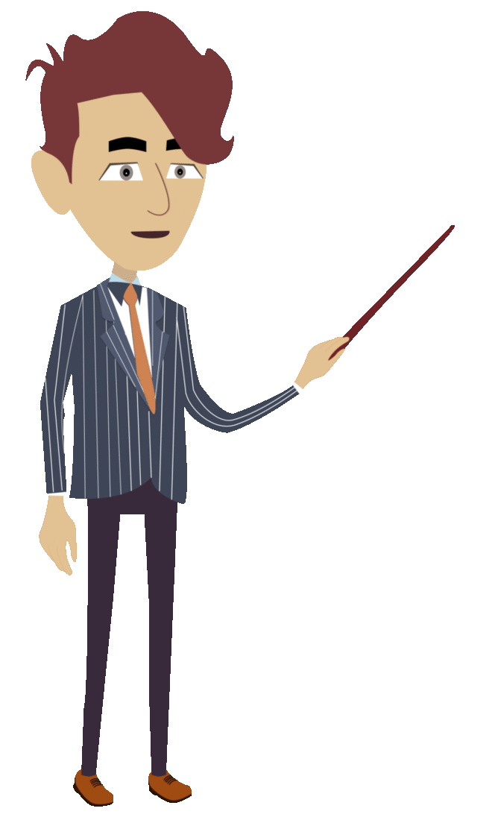
Remember

Slide 20
Homework
Workbook page ( F ) ,
Exercise ( 6 )

Slide 21

Thanks

