Slide 1
Unit 3
What Will Think of Next
Reading
Mega Goal 5
Done by: Entisar Al-Obaidallah

Slide 2
Lesson Objectives
01
03
02
Read
Give
For specific information
predictions based on information.
List
some future plan for space tourism.

Slide 3


Warm Up
What is space tourism ?
when ordinary people visit space for vacation
Do you think space tourism will become
common in your lifetime?

Slide 4
01
Pre-Reading

Slide 5
If you could go into space, would you? Why or why not?

Slide 6
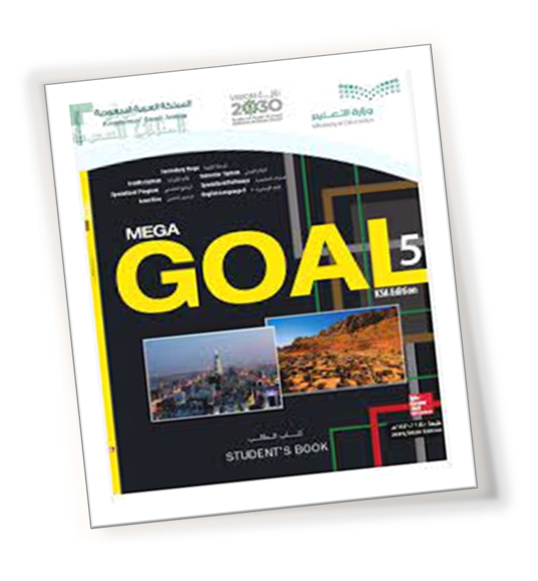
Open your student’s book p. 40

Slide 7

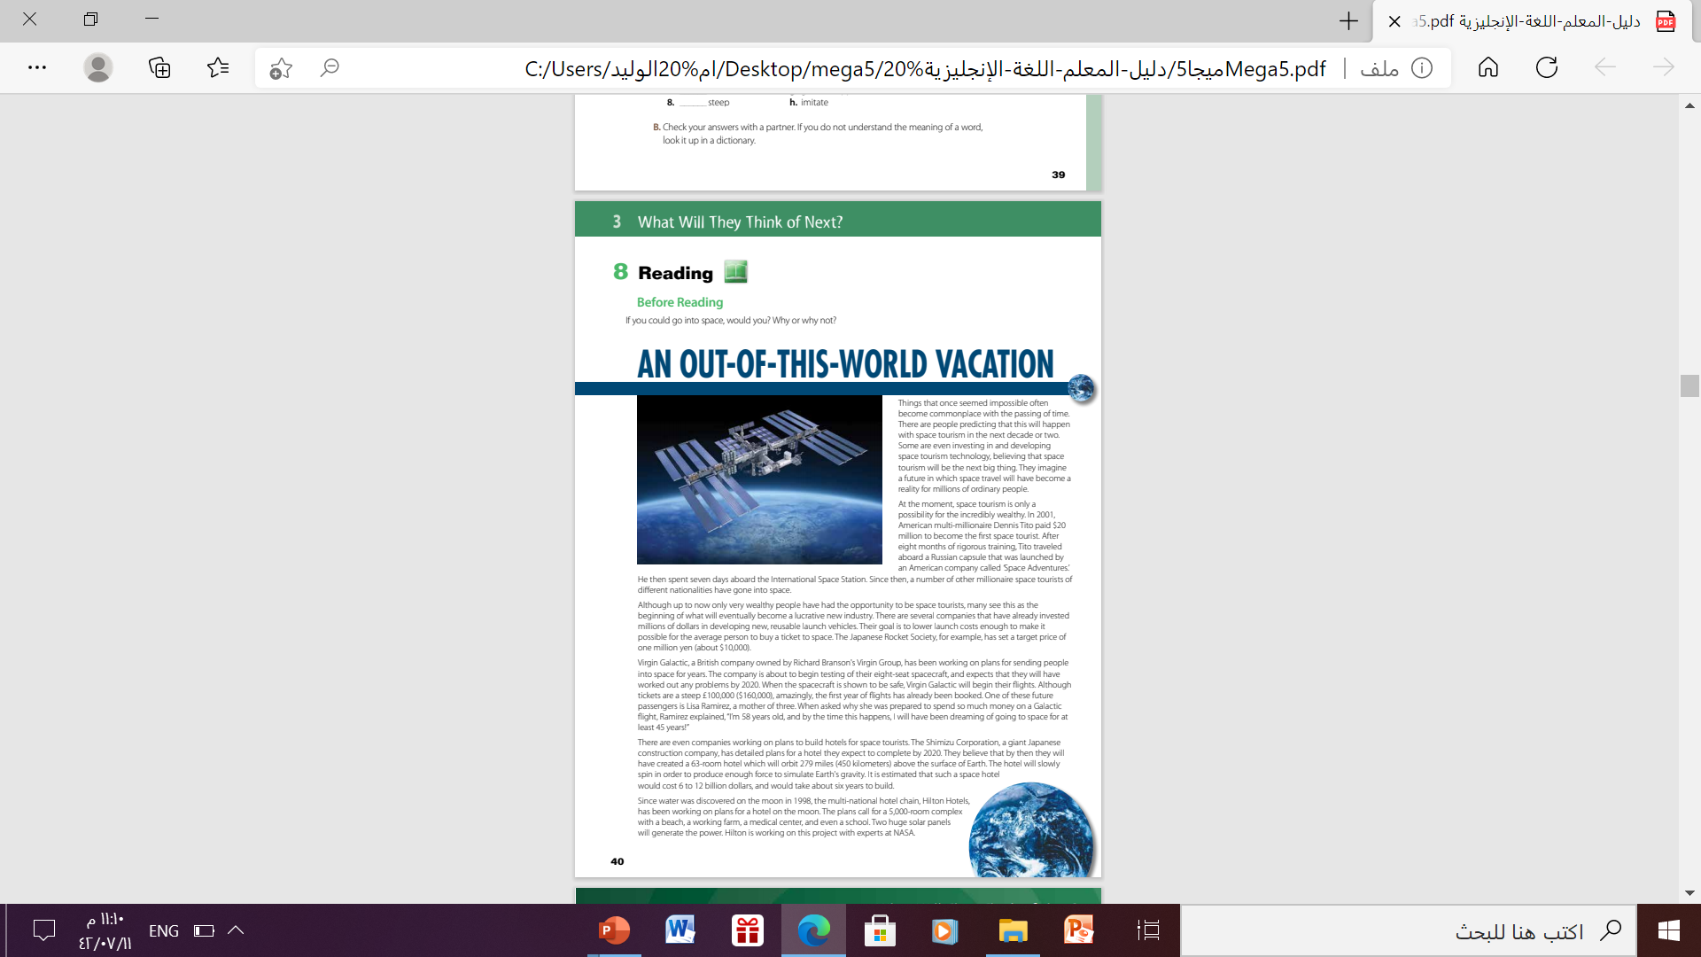
what is the title of the passage?
An Out-Of –This –World Vacation
What does out-of-this-world mean?
This phrase has two meanings in this context:
(1) It means literally outside of our world, in outer space;
(2) It means extraordinarily exciting and great.
What do you think this article will be about
space tourism

Slide 8
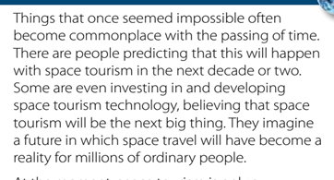
what is the title of the passage?
what is the title of the passage?

Slide 9
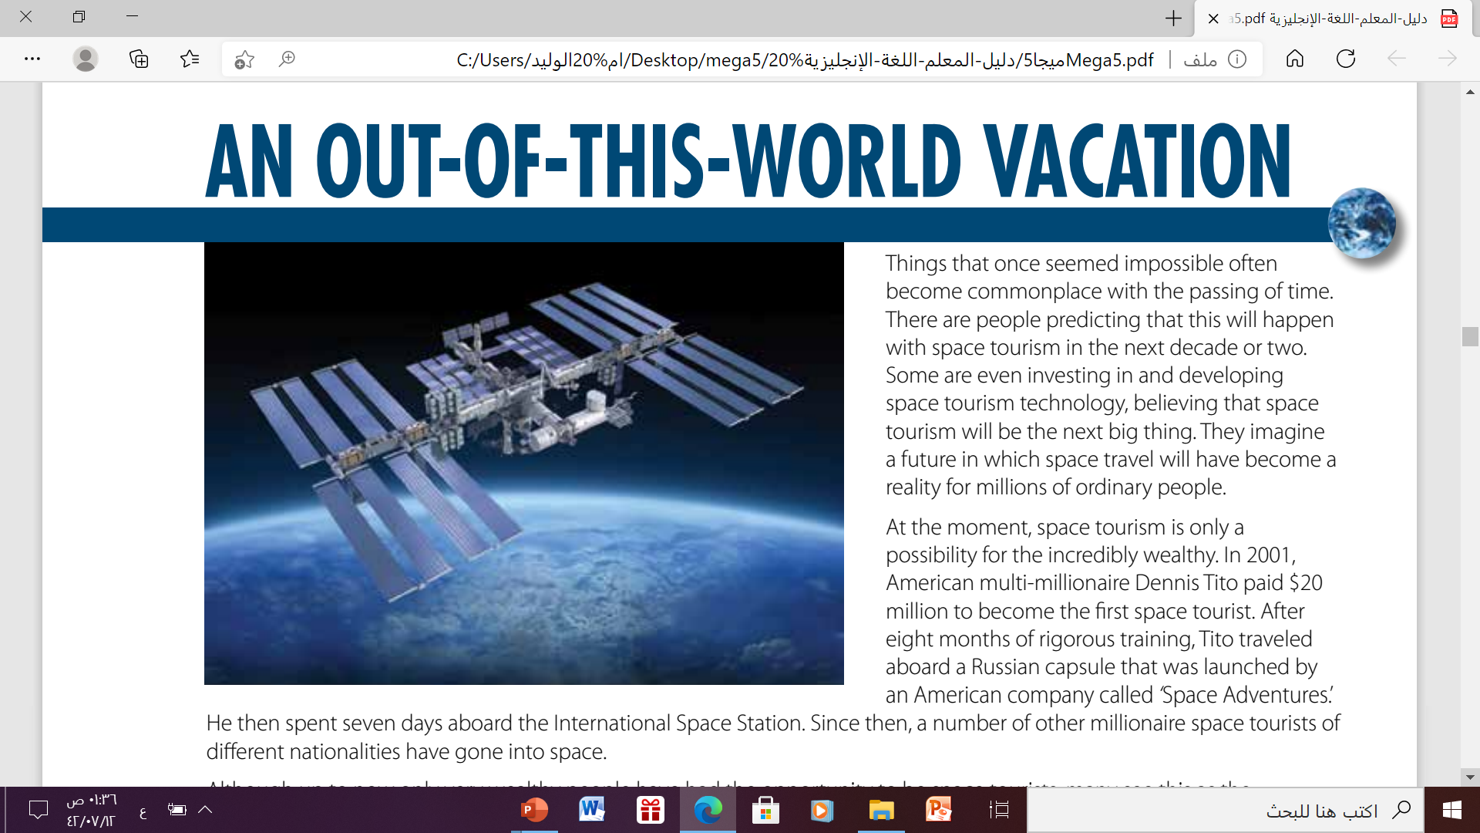

Who is space tourism possible for at the moment?
for the incredibly wealthy

Slide 10
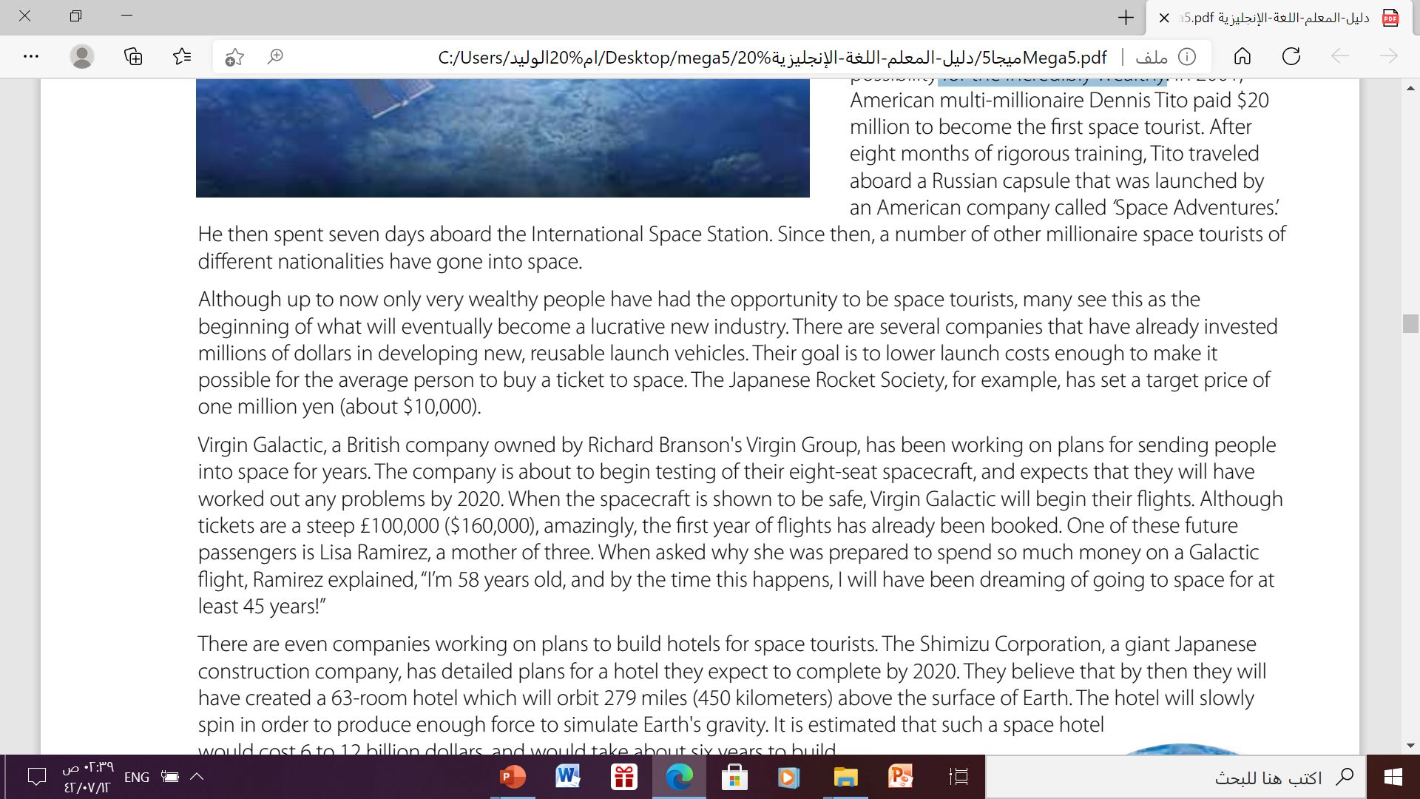
Why do companies want to lower launch costs?
to make it possible for the average person to buy a ticket to space

Slide 11
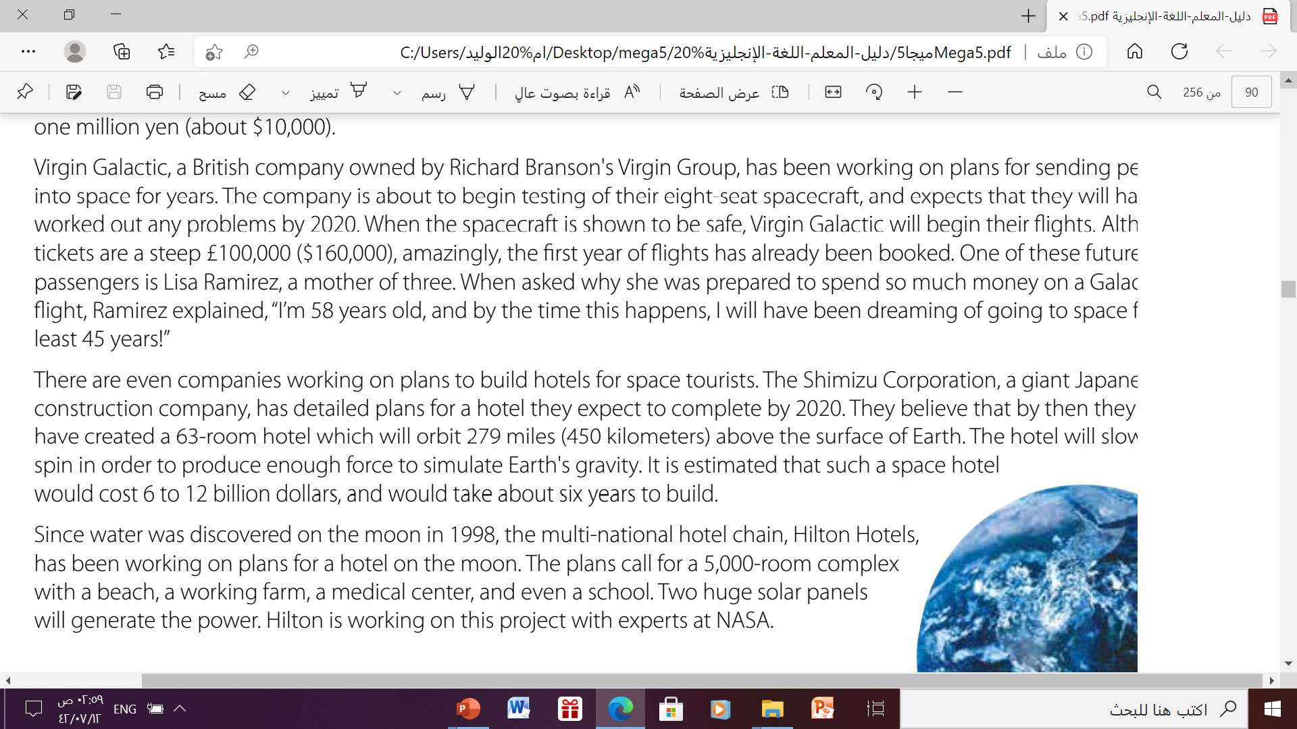

What has Virgin Galactic been working on ??
plans for sending people into space for years.

Slide 12
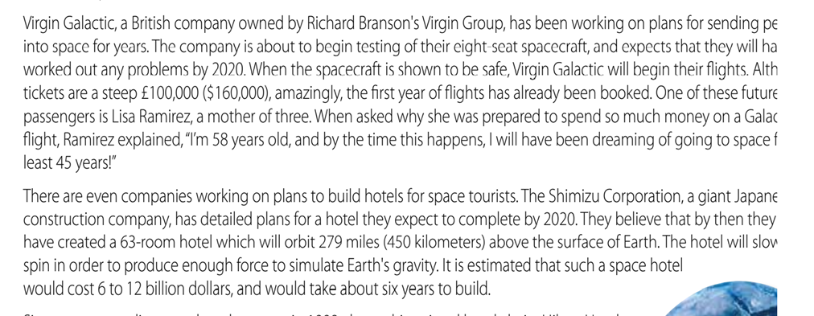
When will the Japanese construction company expect to complete building hotel in space?
by 2023

Slide 13
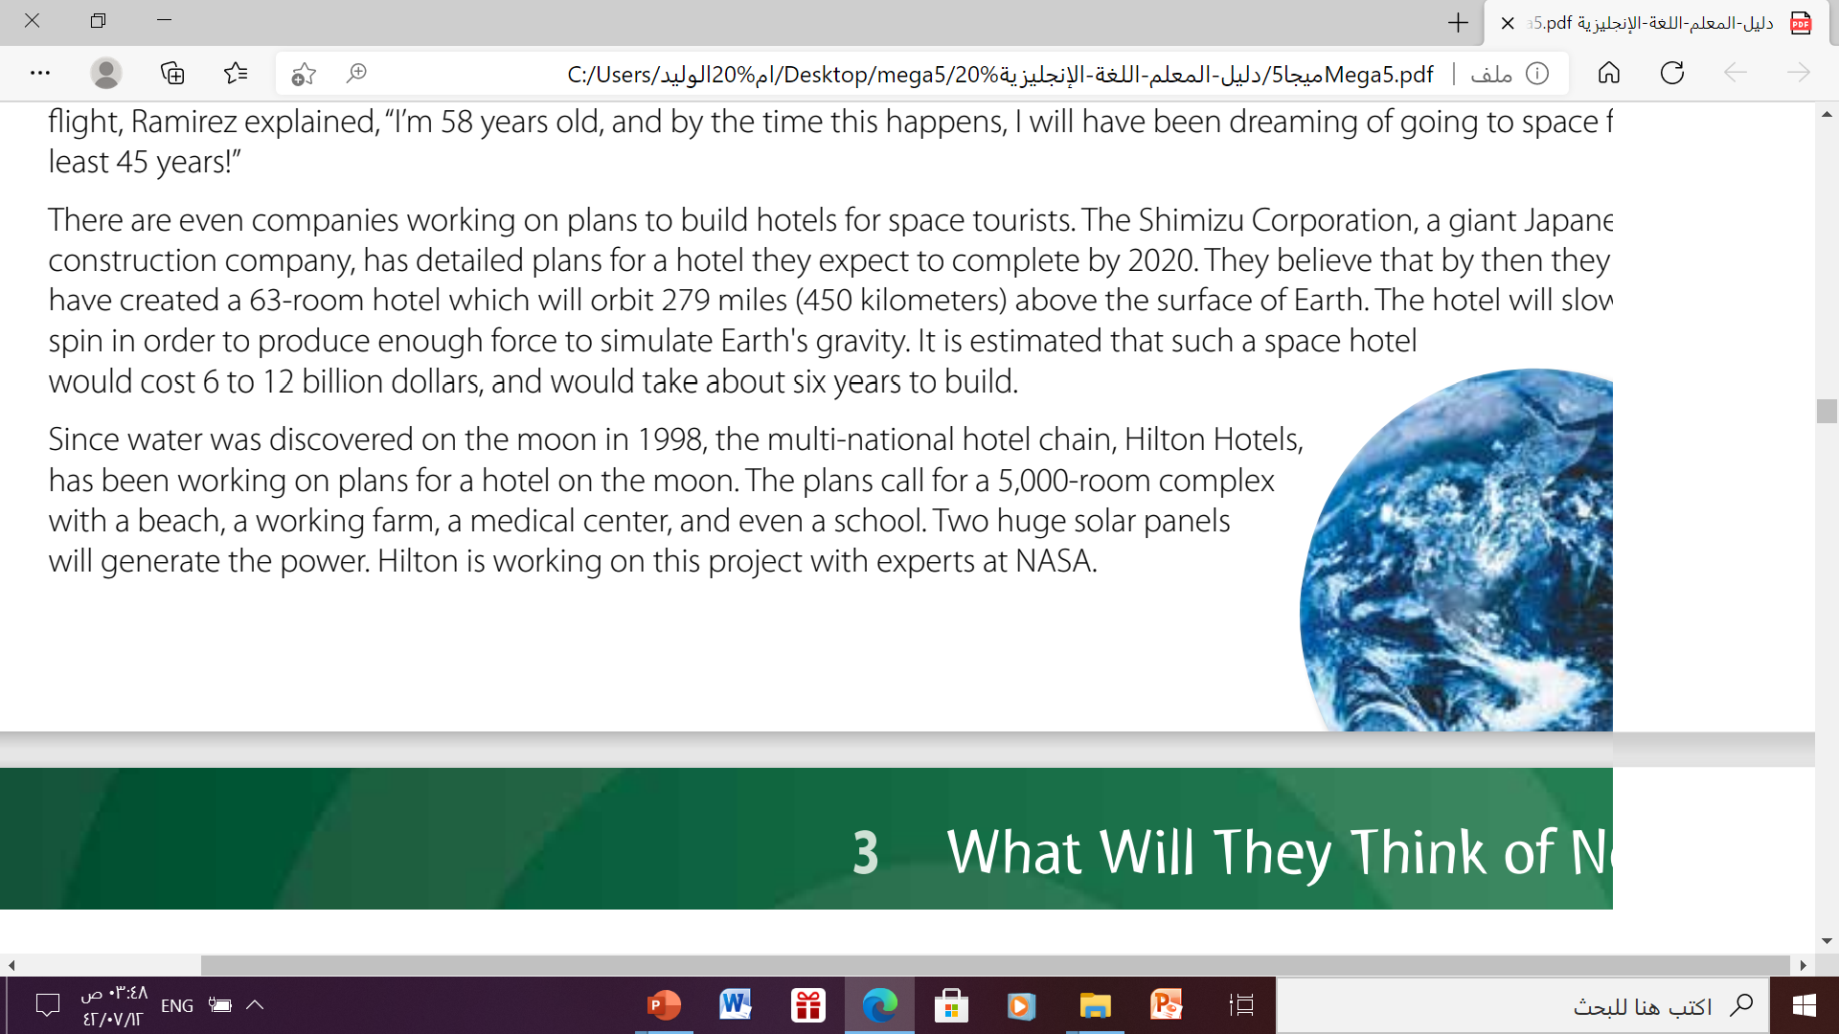

What is name of the multi-national hotel chain, that is working on plans for a hotel on the moon ??
Hilton Hotels

Slide 14
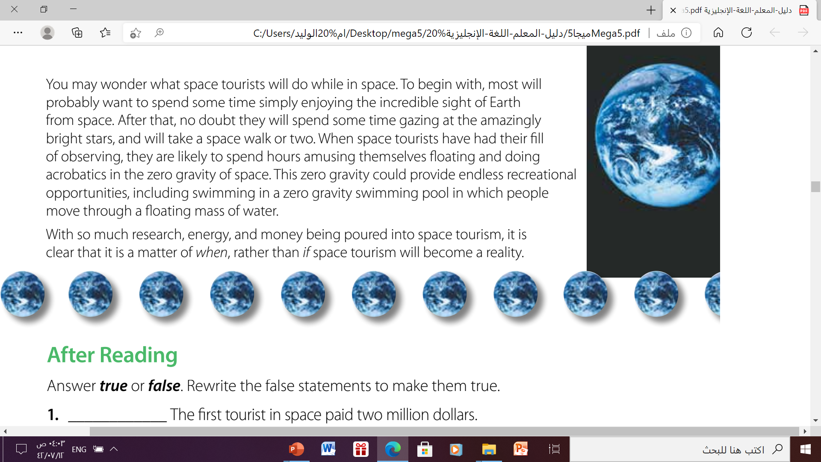
What will most people want to see from space ??
The incredible sight of Earth

Slide 15
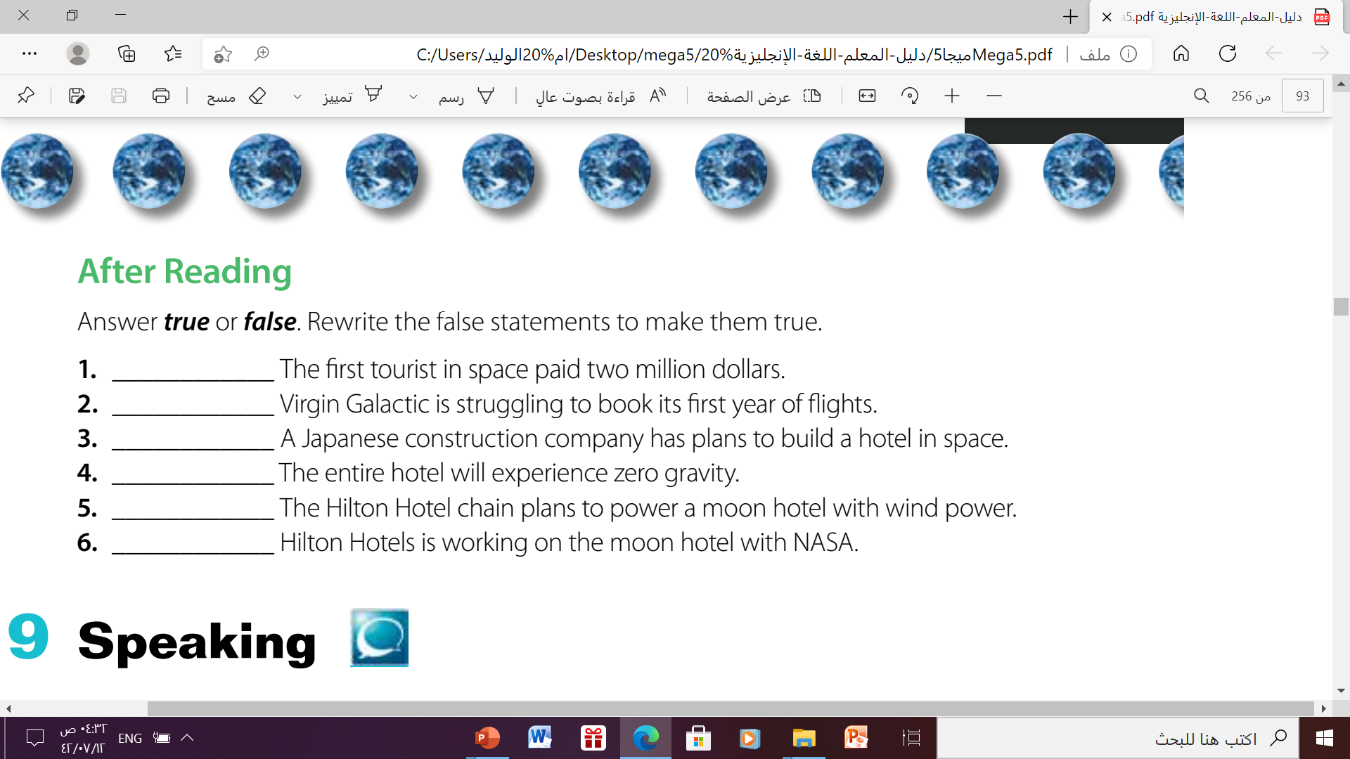
F
F
T
F
F
T

Slide 16
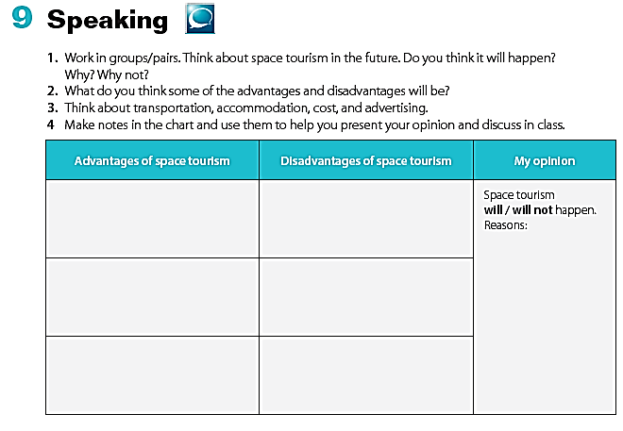
It will provide a new view of our planet
There are health risks to humans in space (radiation, risk of being hit by meteors, cosmic rays)
-Our current technology makes it dangerous to get into space in the first place.
-it has high cost
-it could be a one-way trip .
it encourages technological in novation and high investor interest
It isn't very eco-friendly rockets require around 100,000 gallons of
fuel most of which comes from
non-renewable resources.
It will inspire a new generation of engineers
*Making scientific discoveries
Space exploration creates a lot of trash around our planet.

Slide 17

Homework
https://wordwall.net/play/5596/957/447

Slide 18
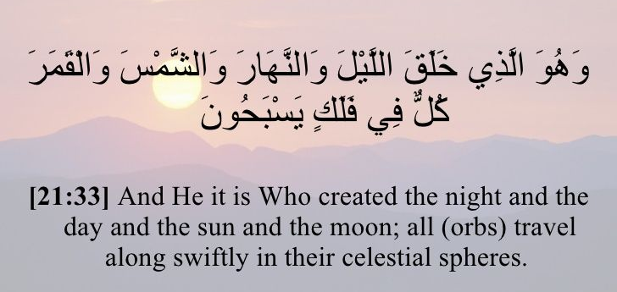

Slide 19

Thanks!

