Slide 1
Unit3
What Will They Think of Next
Listen & Discuss
Mega Goal 5
Done by : Entisar Al-Obaidallah

Slide 2
Lesson Objectives
Discuss
Make
Answer
Match
Technology invented over the last one hundred years
Predictions about life in the year 2100
Some questions about the topic correctly
the words with their meanings

Slide 3

Warm Up
What Will They Think of Next
What does these words indicate to ?
Predictions of Future

Slide 4
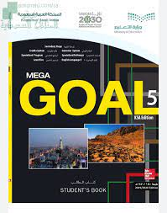
Open your
student’s book
p. 34

Slide 5
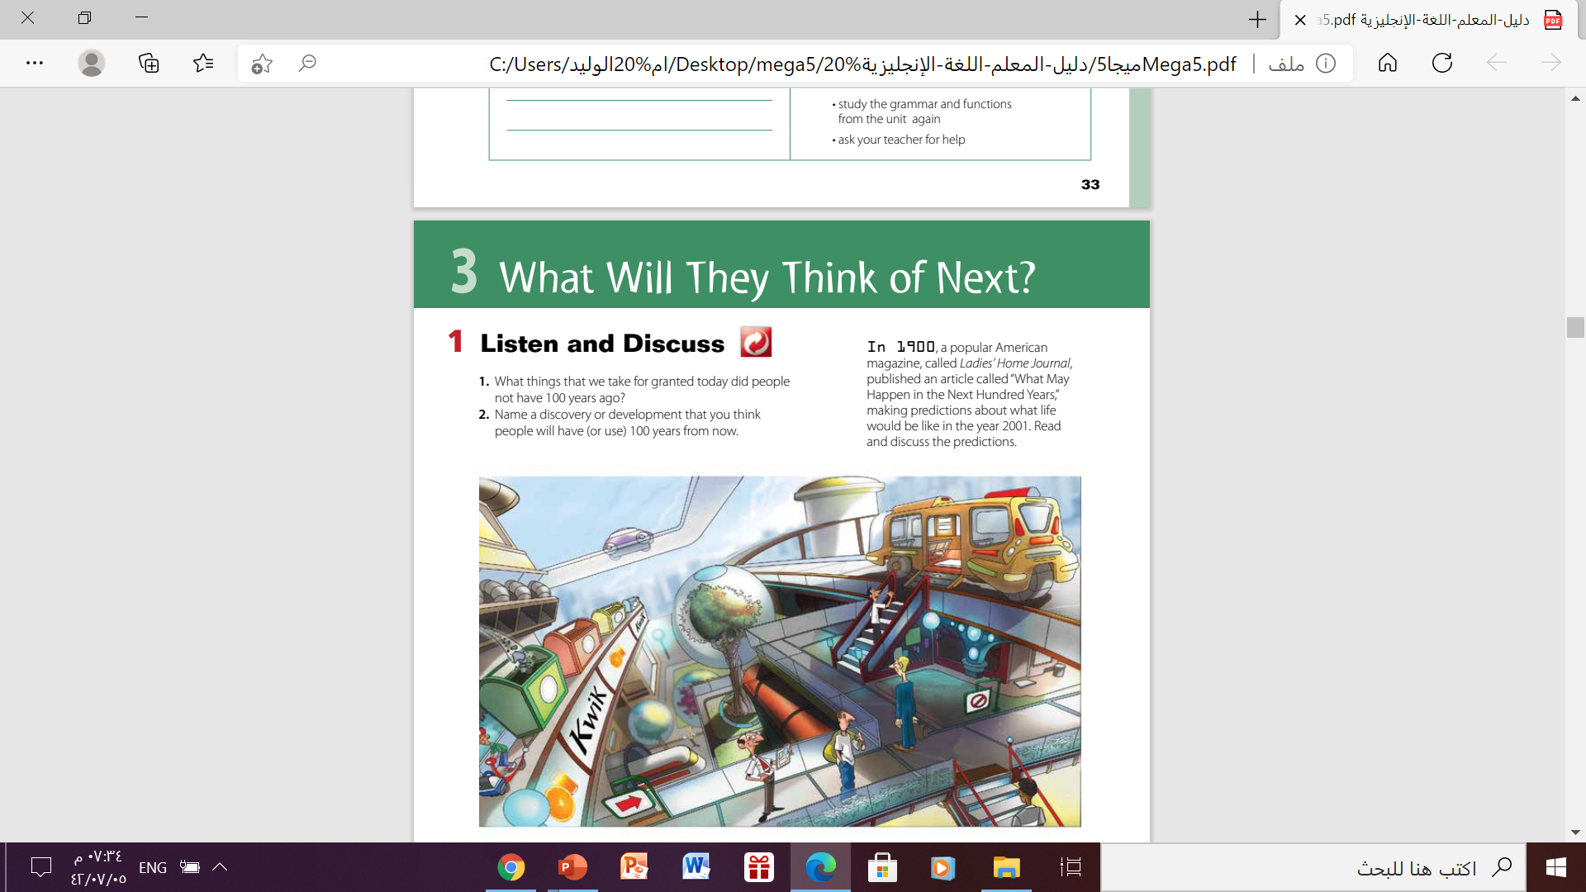
Listen and Discuss

Slide 6
Listen and Discuss
What things that we take for granted today did people not have 100 years ago?
computer
clothes
transportation
internet
life style
entertainment
Smart phone
Abundance food
Electricity

Slide 7
Listen and Discuss
Name a discovery or development that you think people will have (or use) 100 years from now.
01
02
03
04
05
Space Elevator
Digital cities
3D printing of houses and furniture
Flying cars
Robot Cop

Slide 8
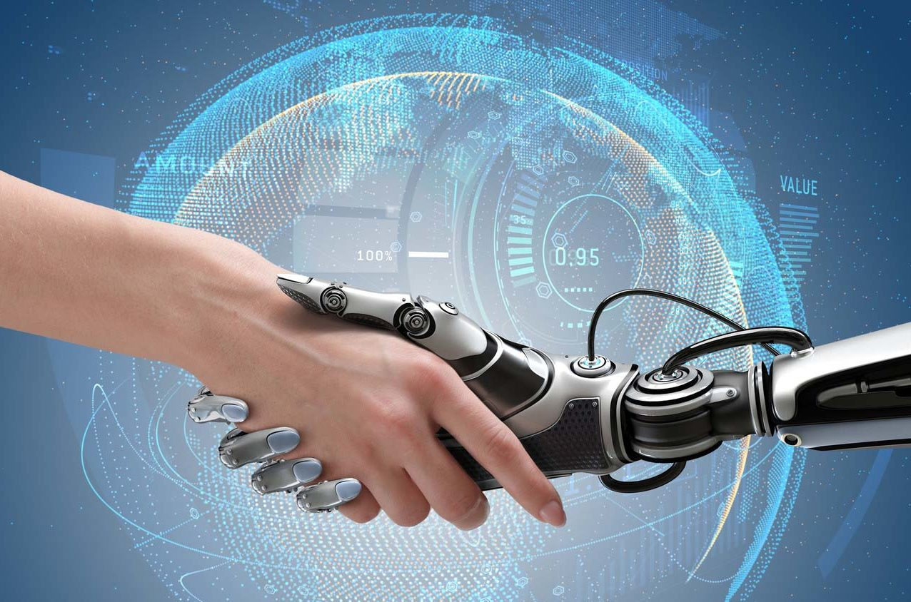
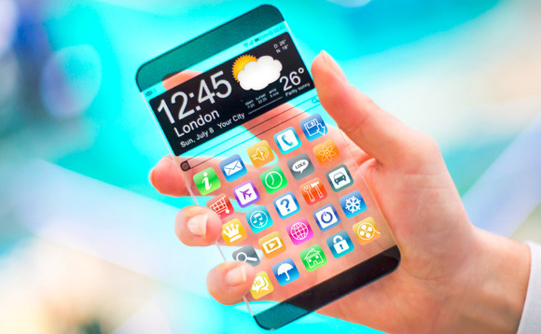
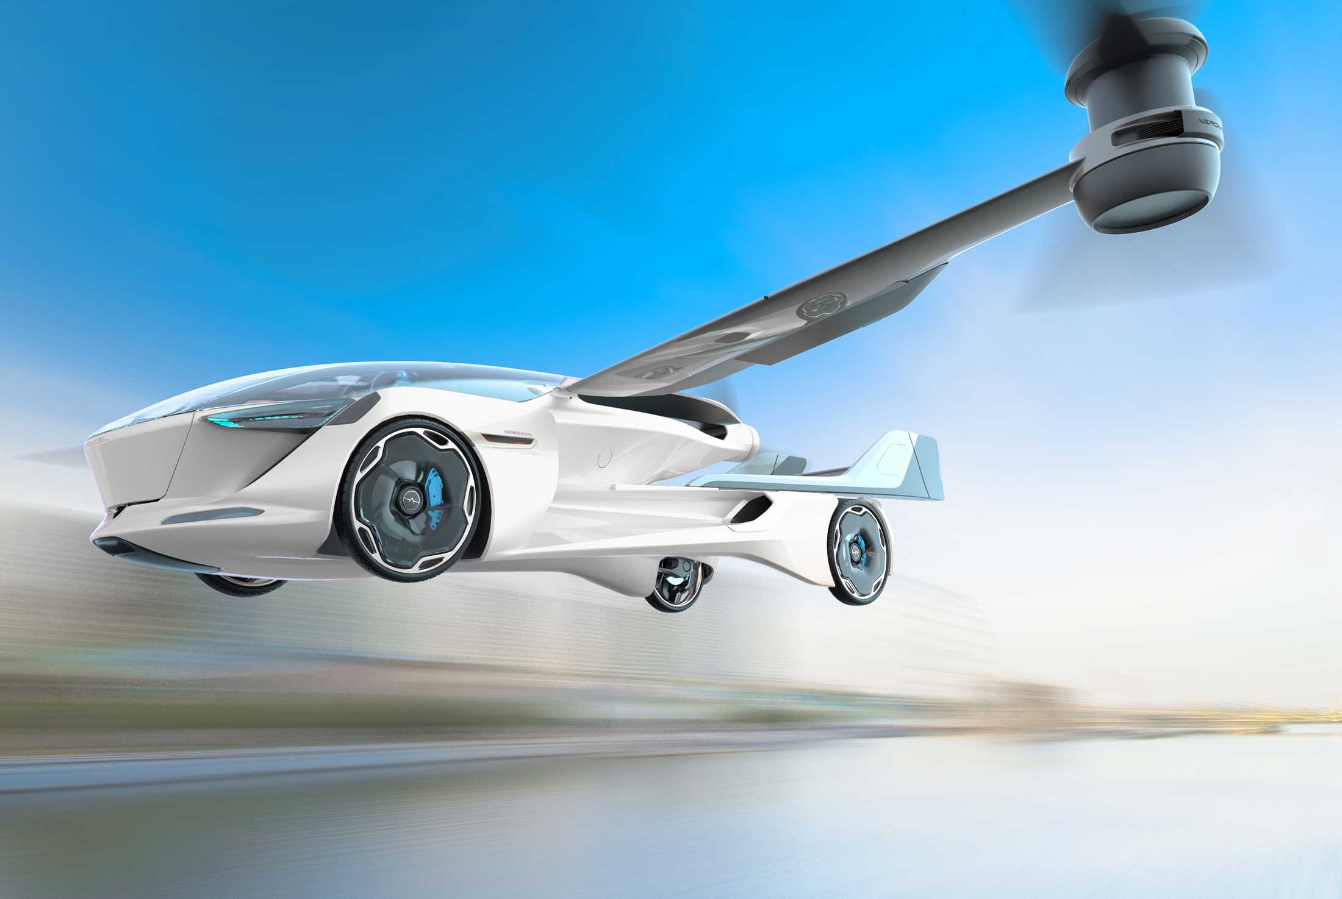
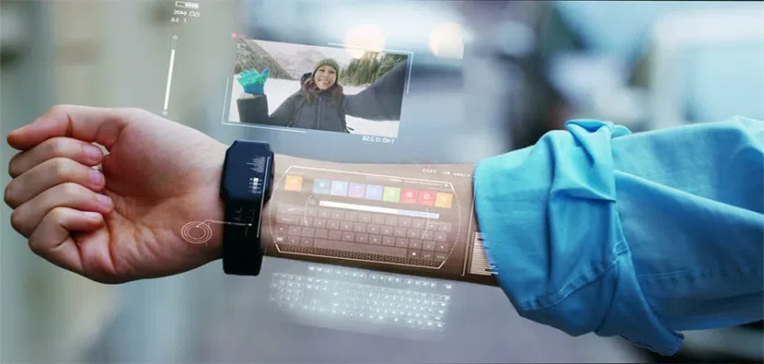
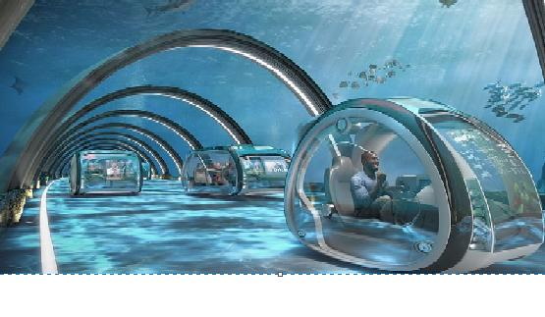
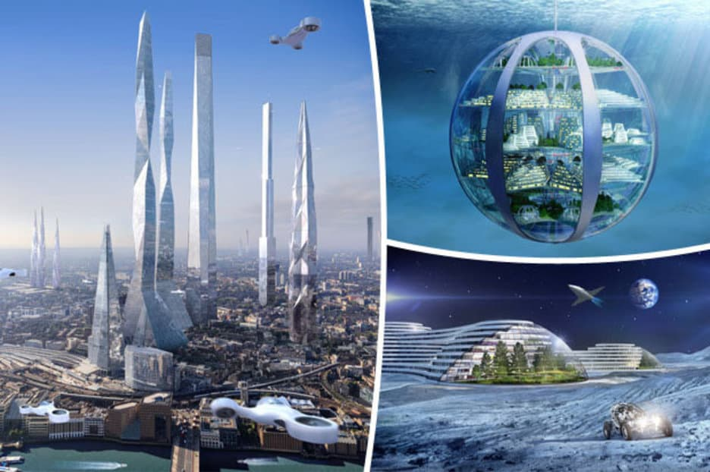
These are pictures of somethings may happen in the future
All these things related to technology

Slide 9

Most of people think of “technology” when they talk about future

Slide 10


List some things that may change in the future , and they are not related to “ Technology”
People
Communication
Language
Deliveries
Transportation
Traffic
Media

Slide 11
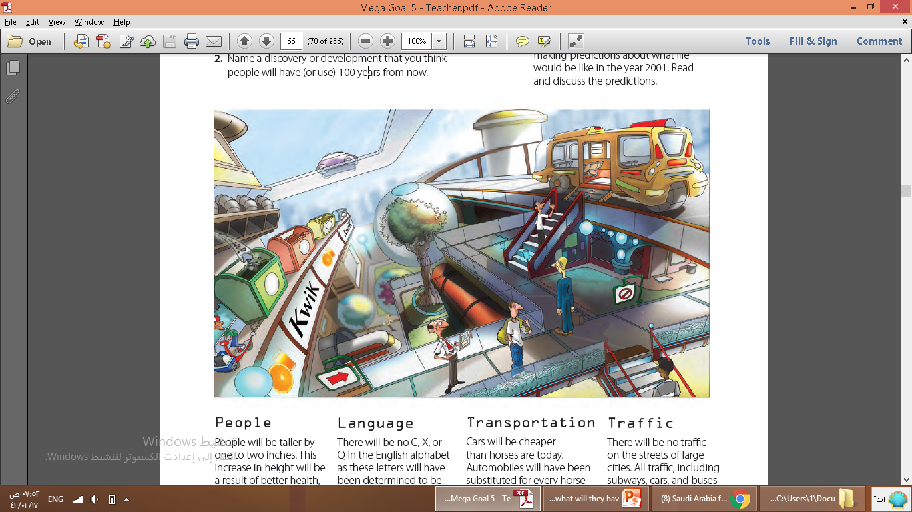
What predictions does this picture show?
The predictions related to transportation
and traffic
Does this city look like a modern city?
Yes , it looks like a digital city

Slide 12
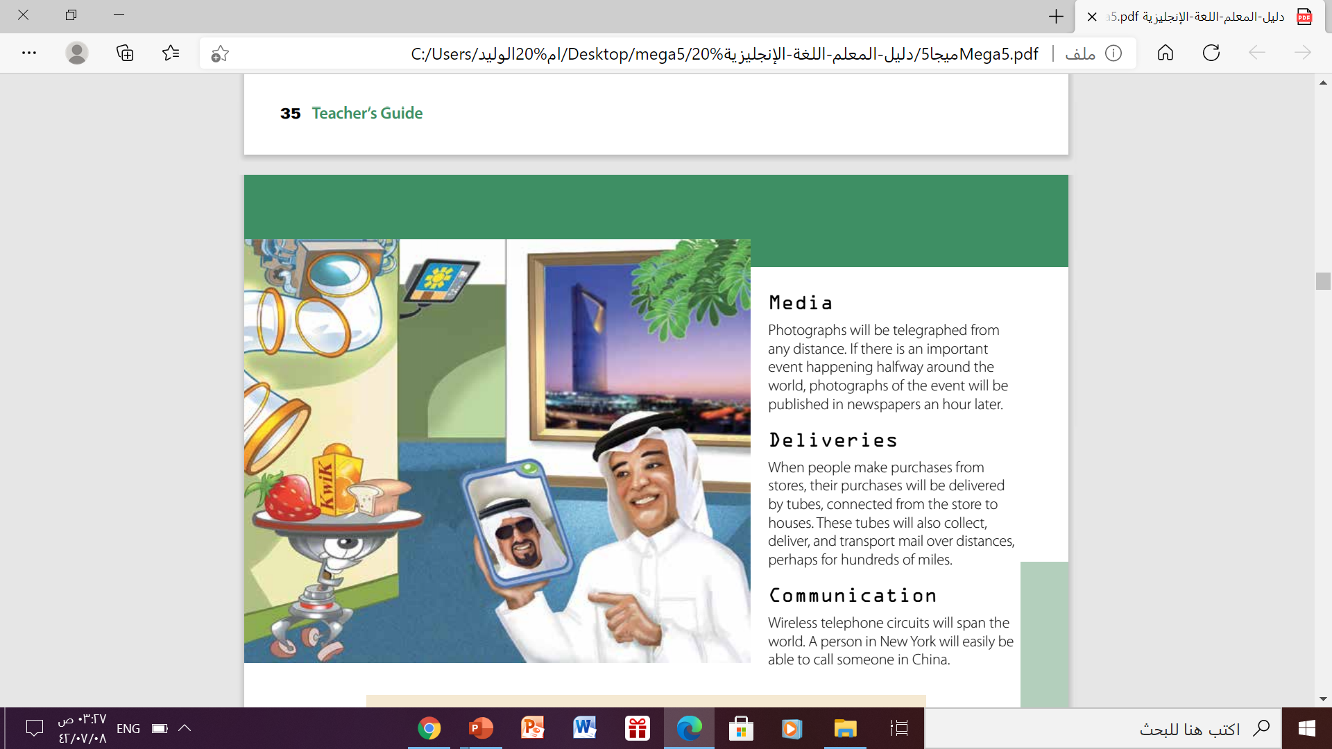
What predictions does this picture show?
Predictions related to communication
What predictions shown in the photo have not come true?
Tubes are not able to deliver goods to homes from stores

Slide 13

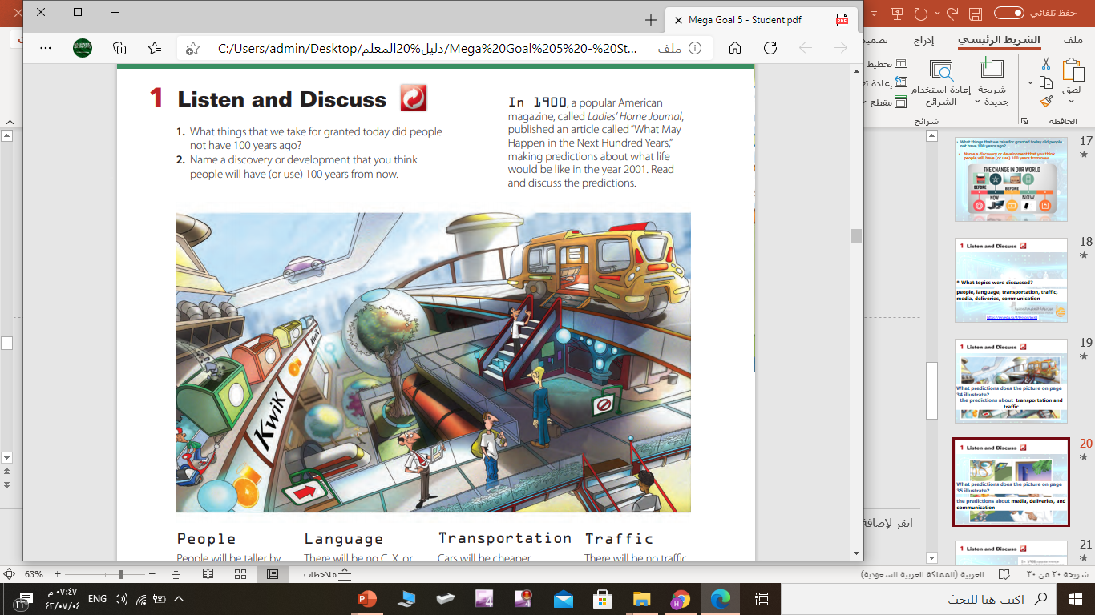
Listen and Discuss
When was this article written?
In 1900
What is the article about ?
about what life
would be like in the year 2001.

Slide 14
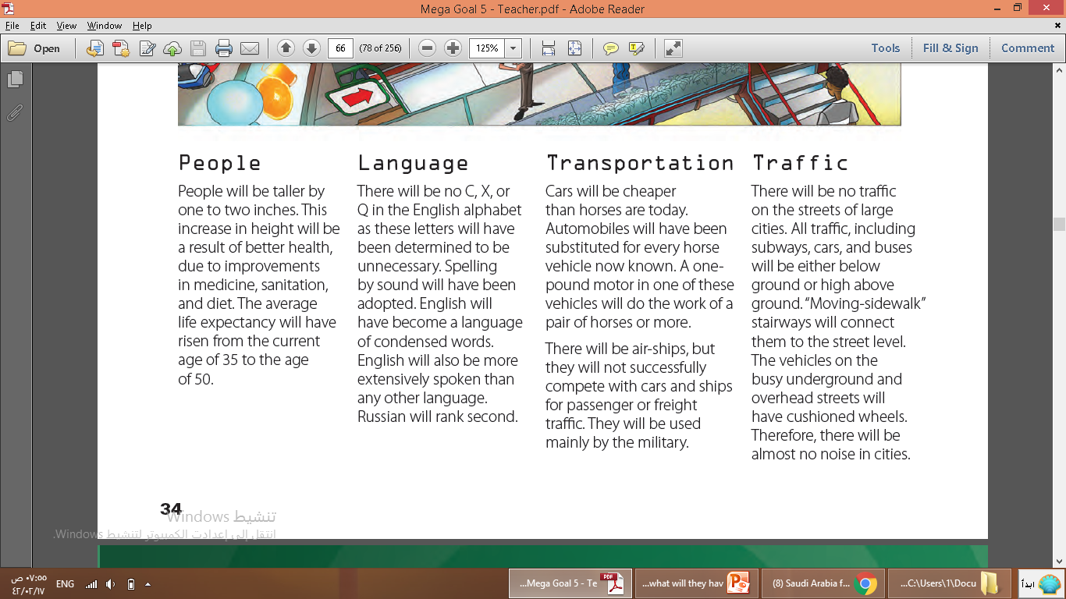


Listen and Discuss
What predictions are in this part?
1
Which have come true?
2
The average life expectancy will have risen
Which have not come true?
People will be taller by one to two inches

Slide 15
Listen and Discuss
What predictions are in this part?
Which have come true?
1
1-Spelling by sound will have been adopted.
2- English will be more extensively spoken than any other language
2
3
Which have not come true?
4
1-There will be no C, X, orQ in the English alphabet
2- English will have become a language
of condensed words.

Slide 16
Listen and Discuss
What predictions are in this part?
Which have come true?
1
Automobiles will have been substituted for every horse vehicle now known.
2
Which have not come true?
3
There will be air-ships, but they will not successfully compete with cars and ships

Slide 17
Listen and Discuss
What predictions are in this part?
1
Which have come true?
2
subways, cars, and buses will be either below ground or high above ground. “
3
Which have not come true?
1-There will be no traffic on the streets of large cities.
2-“Moving-sidewalk” stairways will connect them to the street level.
3-The vehicles on the busy will have cushioned wheels
4

Slide 18
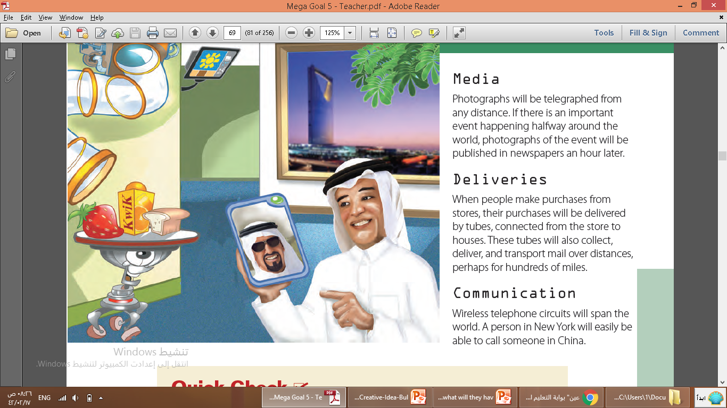
Listen and Discuss
What predictions are in this part?
Which have come true?
1
Photographs will be telegraphed from any distance
Which have not come true?
1
1- purchases will be delivered by tubes, connected from the store to houses.
2-tubes will also collect, deliver, and transport mail over distances
2

Slide 19
Listen and Discuss
What predictions are in this part?
Which have come true?
1
Wireless telephone circuits will span the world

Slide 20
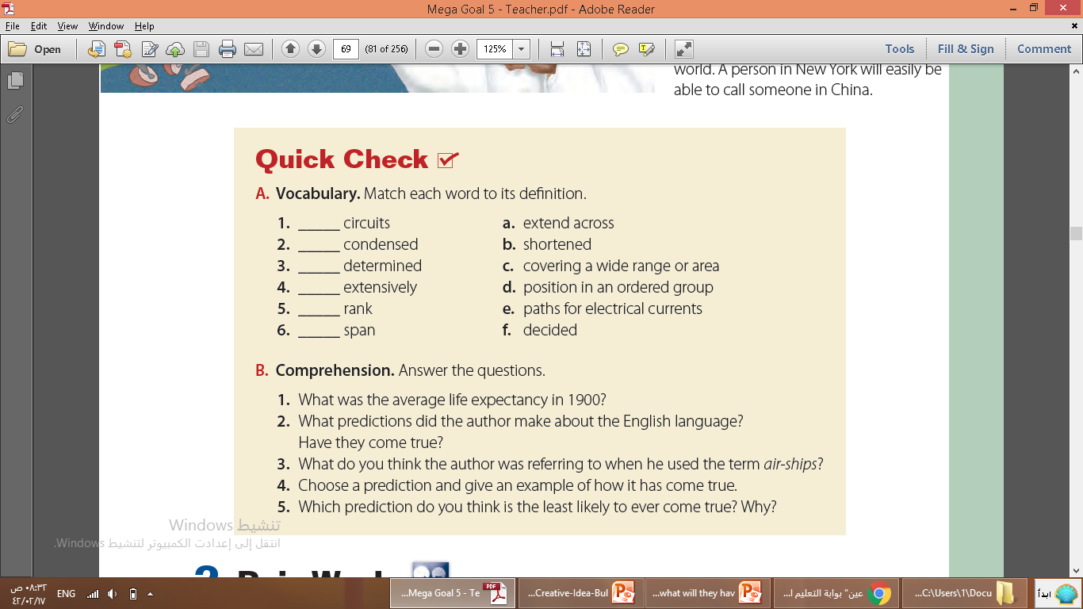
Vocabulary
e
b
f
c
d
a

Slide 21
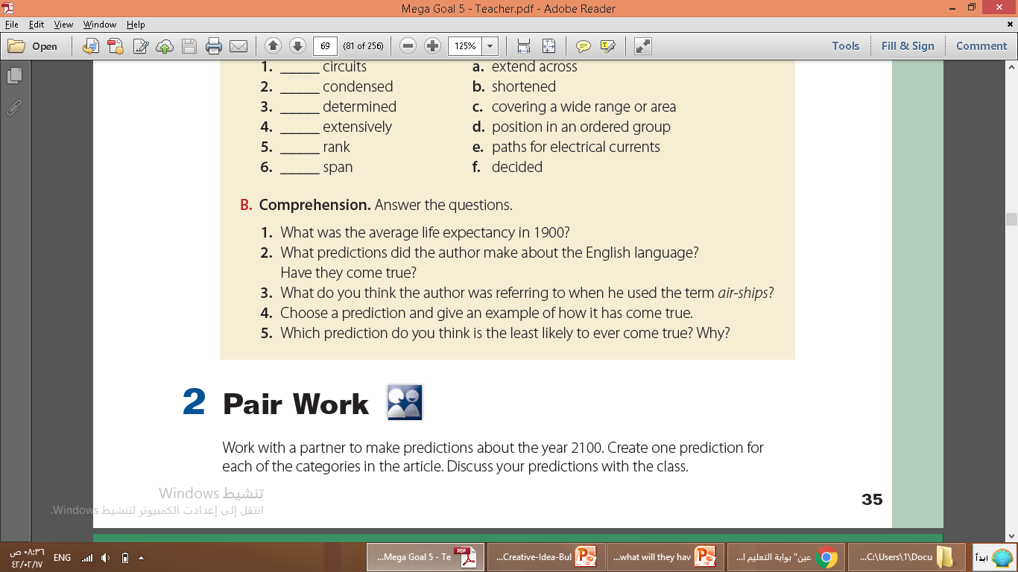
1
1- Mercury is the smallest planet in the Solar System
2
2- He thought there would be no C, X, or Q; spelling would be by sound; the language would be condensed; and English would
be the most widely spoken language. The prediction about English being the most widely spoken language came true.
3
4
3- He was probably thinking about airplanes.
4- Automobiles have replaced all horse-drawn vehicles.
5
5- There will never be tubes connecting houses to a store. This is impossible.

Slide 22
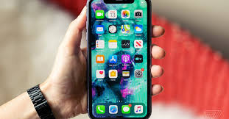
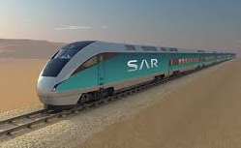


Slide 23
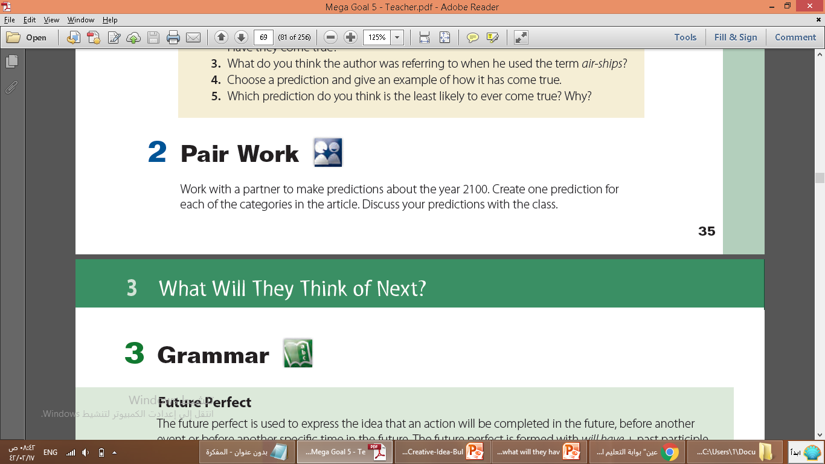
People
Media
Language
transportation
Deliveries
Communication
Traffic

Slide 24
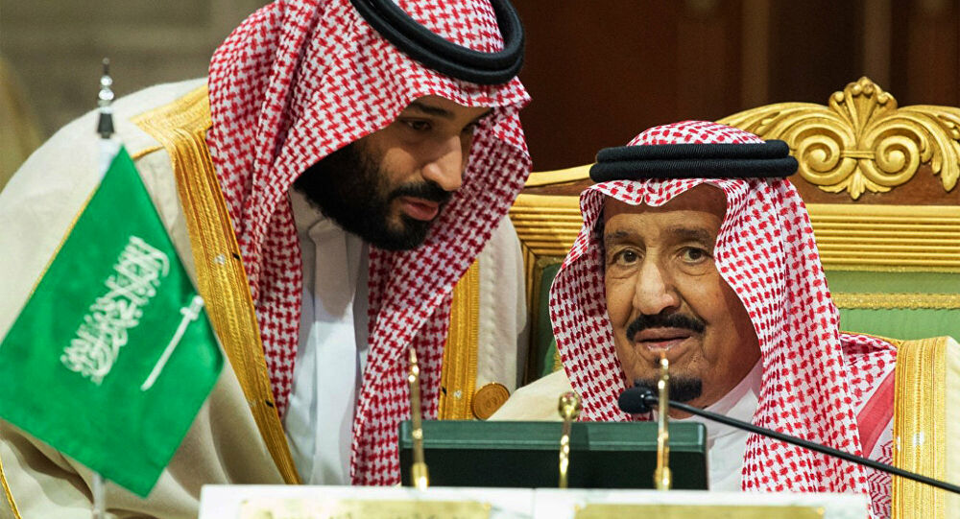

Your Turn
Write a list of predictions of changes that will have been made in Saudi Arabia by 2030?

Slide 25
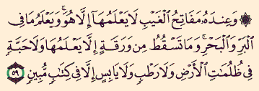
Remember…
These are just predictions
Not any more , because no one knows about future except
Allah

Slide 26
Home work
workbook
p. 21

Slide 27

Thanks

