Slide 1
Unit3
What Will They Think Of Next
Writing
Mega Goal 2
Done by: Entisar Al-Obaidallah
Notes:
© Copyright PresentationGO.com – The free PowerPoint template library

Slide 2
Lesson Objectives
1
2
3
4
Discuss the developments
will have been made by 2030 in Saudi Arabia
Read the text
for specific information
Write a descriptive essay about future developments in Saudi Arabia
Talk about how the world will have changed by 2050
Notes:
© Copyright PresentationGO.com – The free PowerPoint template library

Slide 3
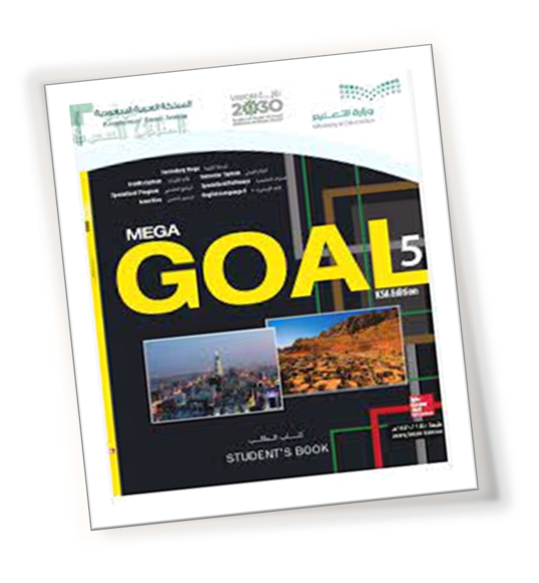
Open your student’s book p. 42

Slide 4
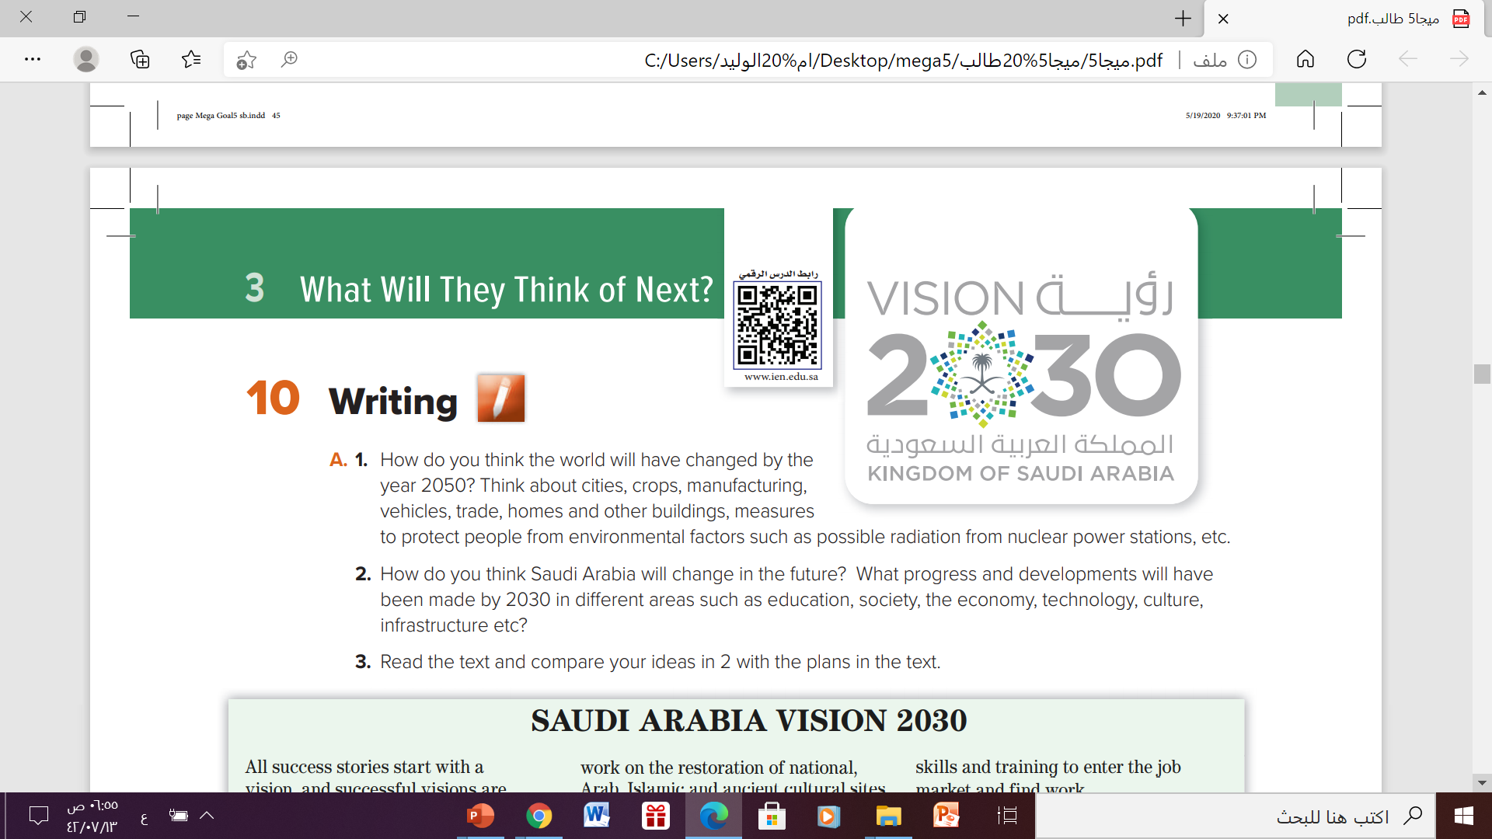

Slide 5
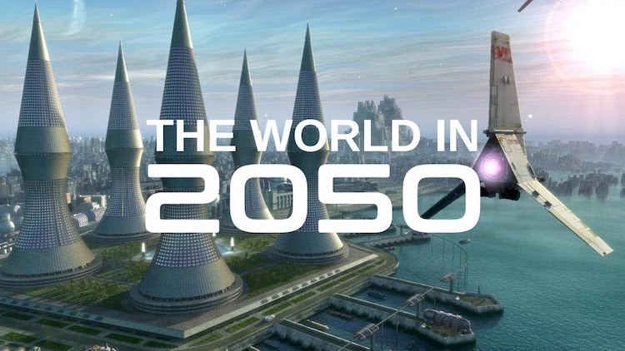
1. How do you think the world will have changed by the year 2050? Think about cities, crops, manufacturing, vehicles, trade, homes and other buildings, measures to protect people from environmental factors such as possible radiation from nuclear power stations, etc.

Slide 6




Cities: will have expanded and will become digital
Education: on line classes – learning at home using computer
Shopping : shopping will be carried out electronically
Hospitals: special, zero gravity hospitals will have been constructed
transportation: fluing cars and tele transportation will have been introduced.

Slide 7
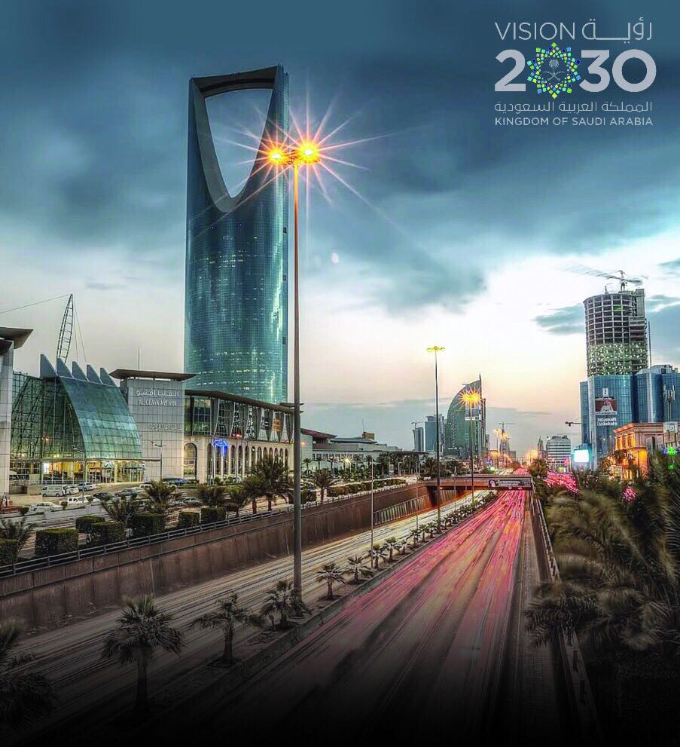
How do you think Saudi Arabia will change in the future? What progress and developments will have been made by 2030?

Slide 8
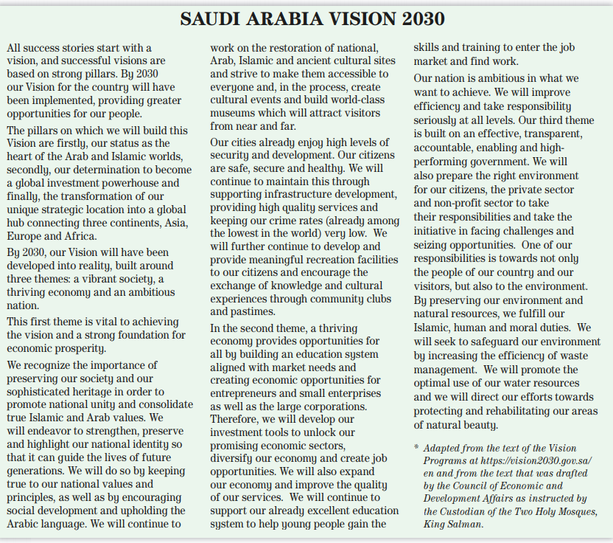
What is the title of the text?
Saudi Arabia Vision 2030
How many paragraphs are there?
8 paragraphs
What is the topic of this text?
The developments and changes will have been made by 2030 in Saudi Arabia .

Slide 9
Open your student’s book p. 43

Slide 10
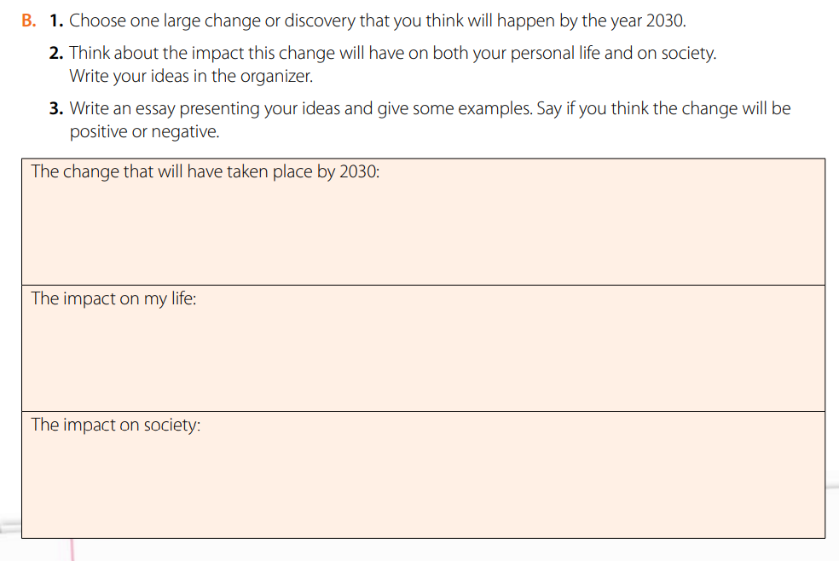
Self-driving cars ( driverless car)
I can go anywhere safely and fast
Decrease the level of road crashes , lower accidents injuries and save lives

Slide 11
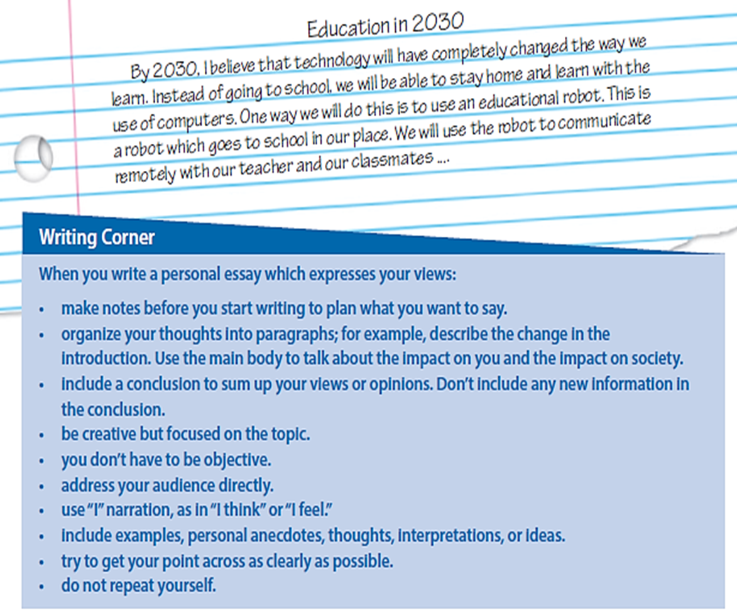
Your essay should presenting your ideas and give some examples
When you write your essay which express your views , follow the steps here

Slide 12

Notes:
© Copyright PresentationGO.com – The free PowerPoint template library

Slide 13
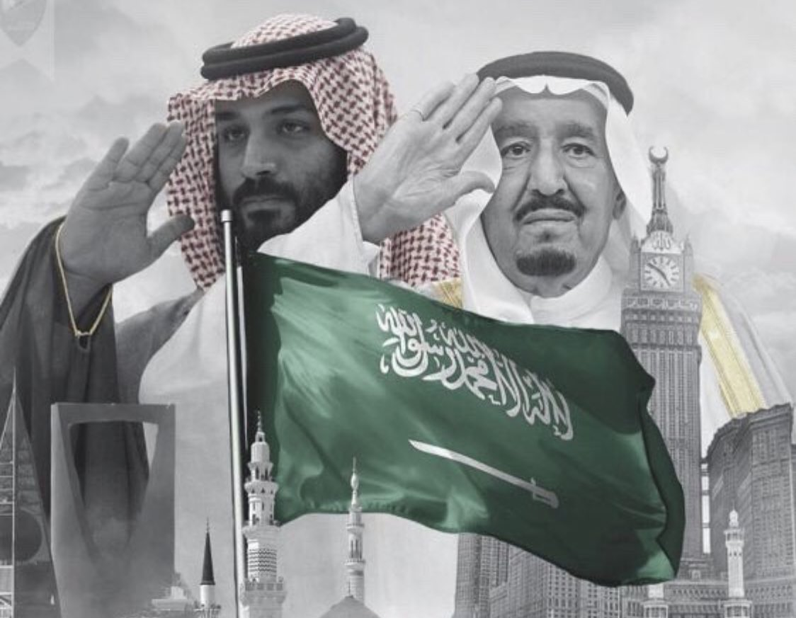
Thanks!
Notes:
© Copyright PresentationGO.com – The free PowerPoint template library

