Slide 1
Unit 5
Do You Really Need It?
Conversation & Listening
Mega Goal 5
Done by: Entisar Al-Obaidallah

Slide 2
Lesson Goals
Read the conversation for specific information
Answer some questions about the conversation
Match the new vocabulary with its meaning
Use the “Real Talk”in a sentence.
Pronounce the word “to "differently Before consonants and before vowels

Slide 3



Warm Up
Where do you go shopping?
Do you like to go sopping?
Do you really buy what you need?
What are all these bags for?

Slide 4
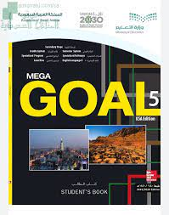
Book Open
page (72)

Slide 5

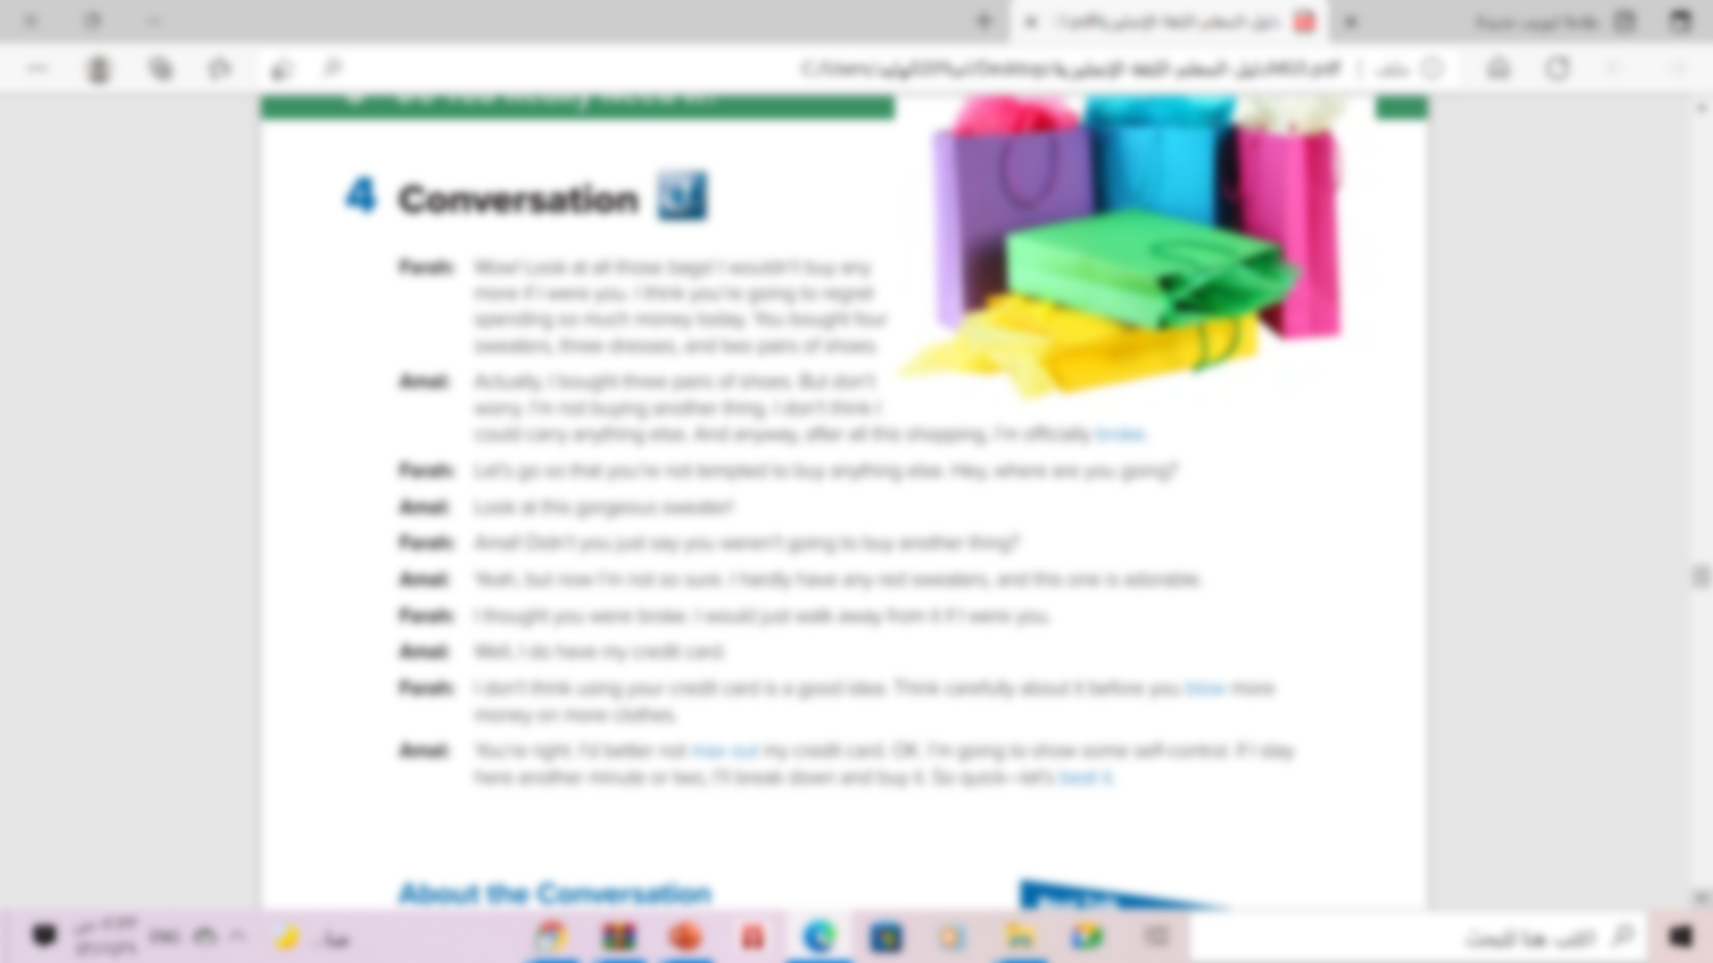


Read along as you listen

Slide 6
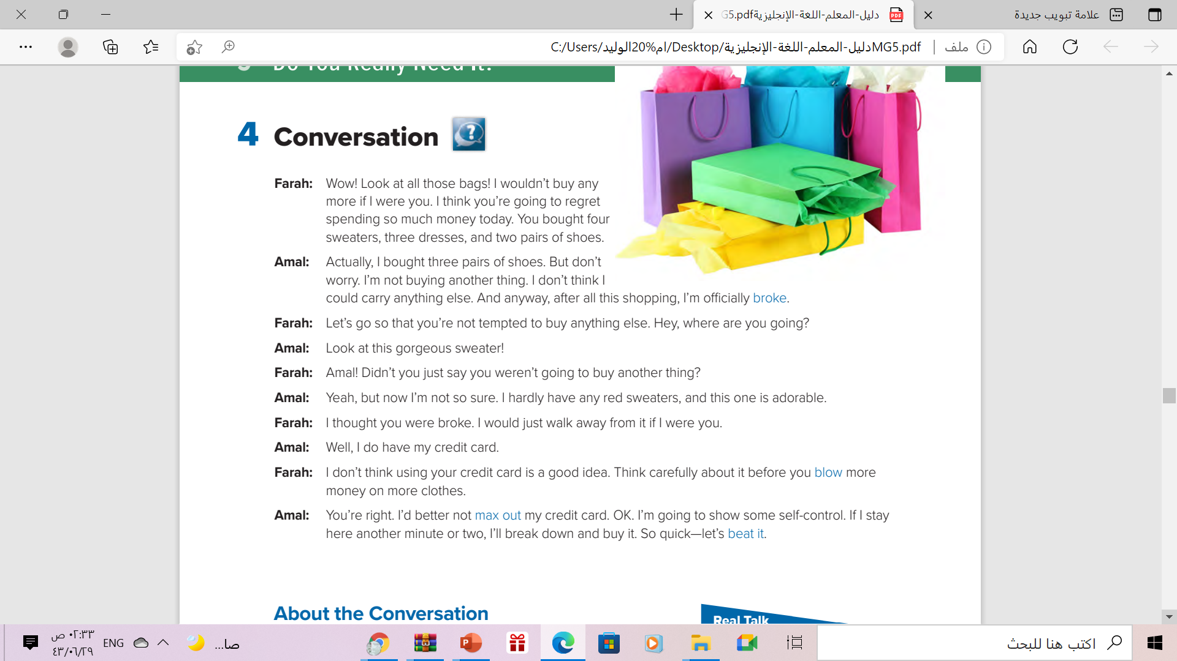
What are all these bags?
Shopping
How many persons are there?
Two persons
Who are they ?
Amal and Farah
Where are they?
They are shopping, probably at a mall or department store

Slide 7
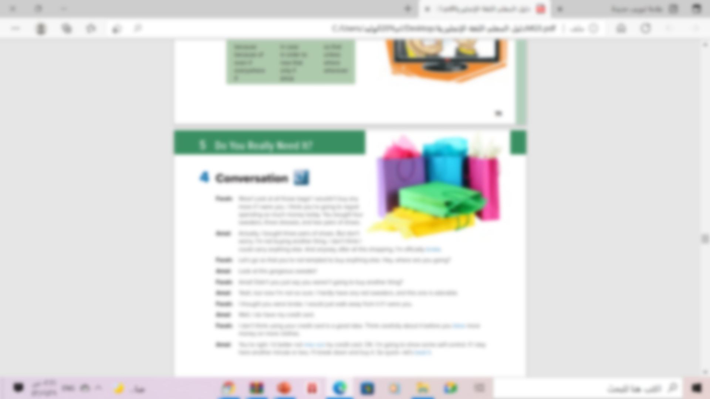
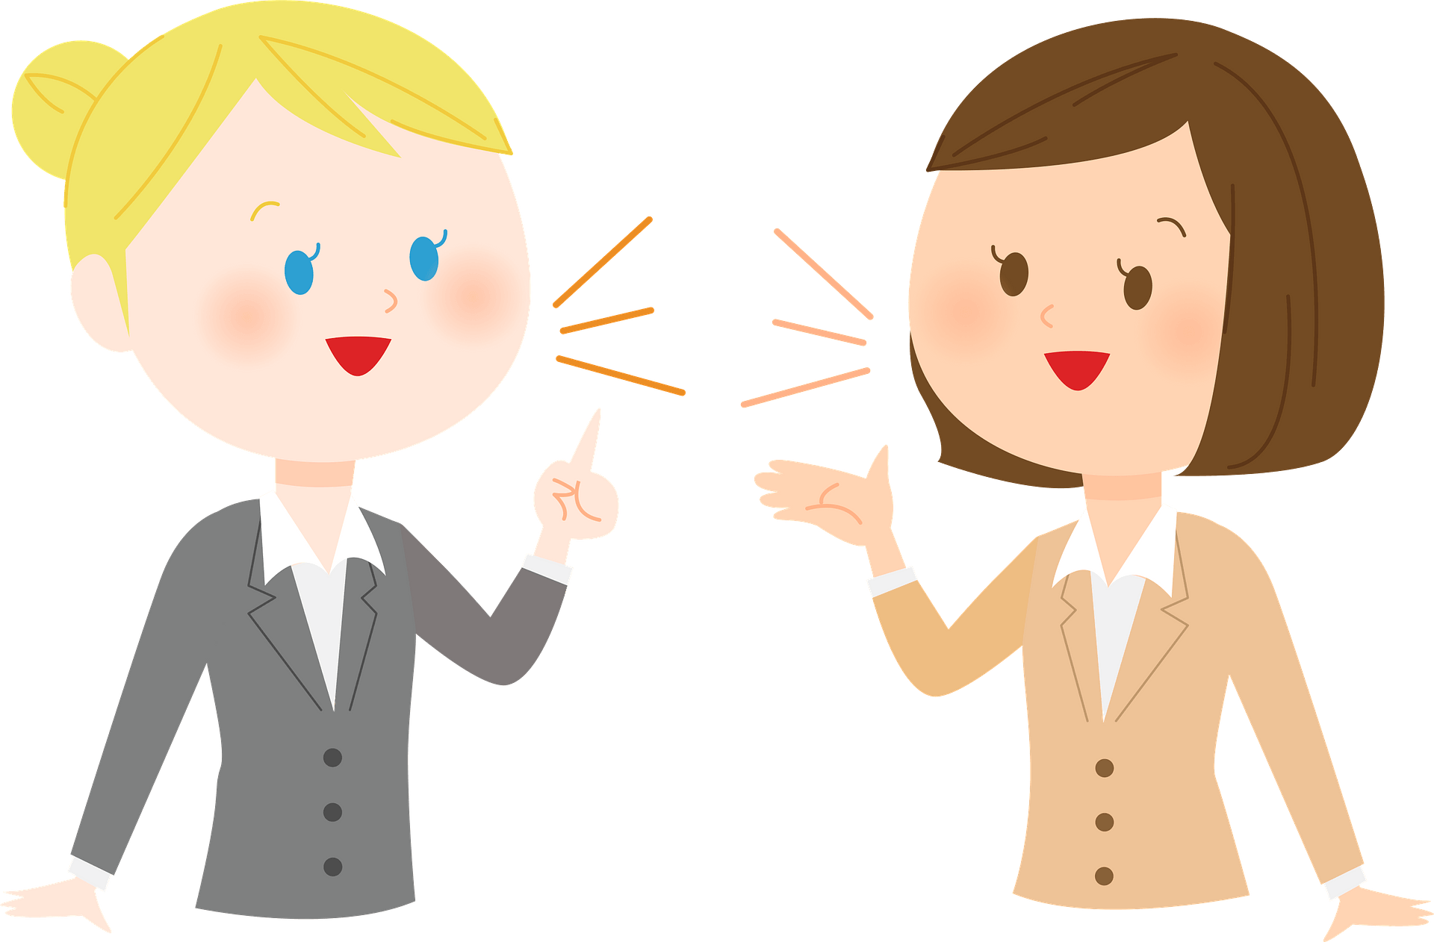
Who says ………
broke
Amal

Slide 8
Who says ………
blow
Farah

Slide 9
Who says ………
max out
Amal

Slide 10
Who says ………
beat it
Amal

Slide 11
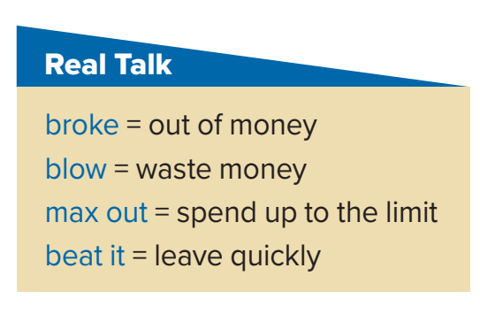
Read the words and their meaning:

Slide 12
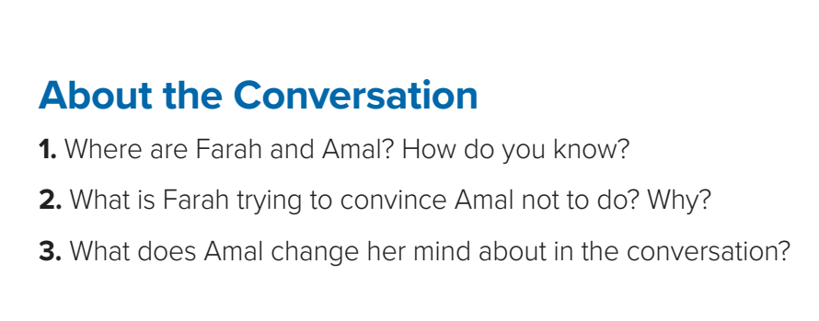


1. They are at the mall or in a department store.
Amal has bought a lot of different things.
2. Farah tells Amal not to buy anything else because
she has already bought a lot of clothes.
3. Amal decides not to buy the red sweater since
she doesn’t want to max out her credit card

Slide 13

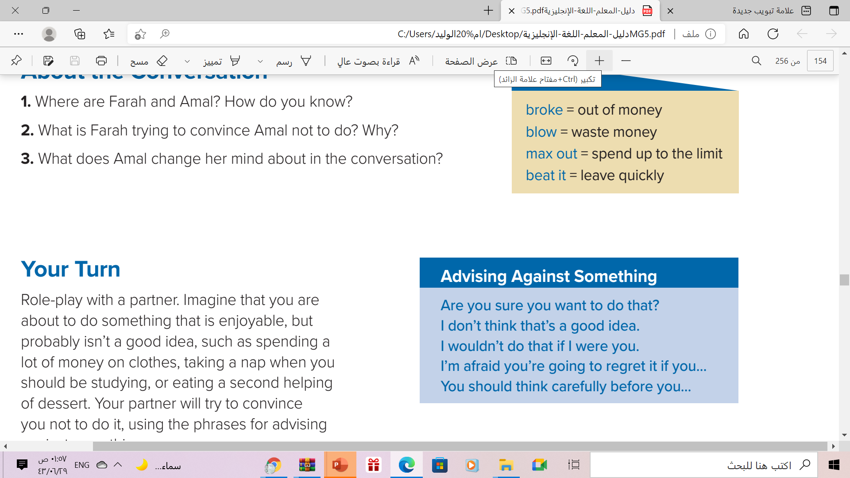

These are phrases that people often use when they are politely trying to
stop someone from
doing something.

Slide 14
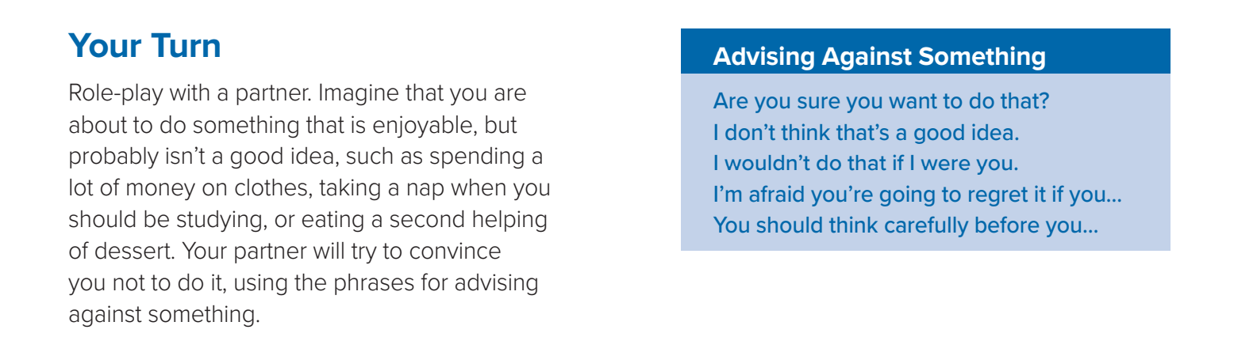
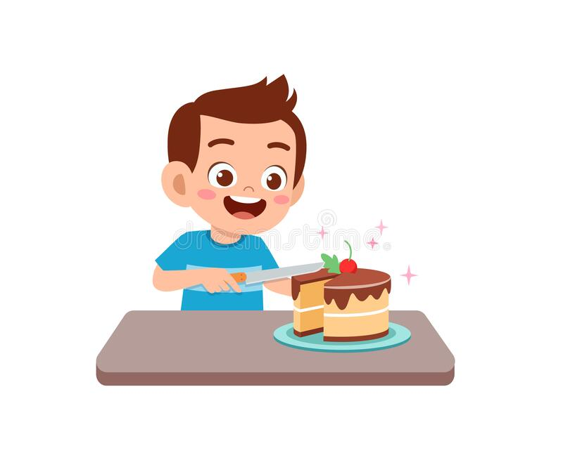
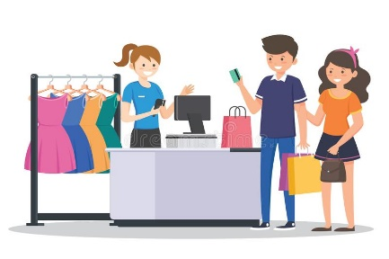


Slide 15
Book Open
page (73)

Slide 16
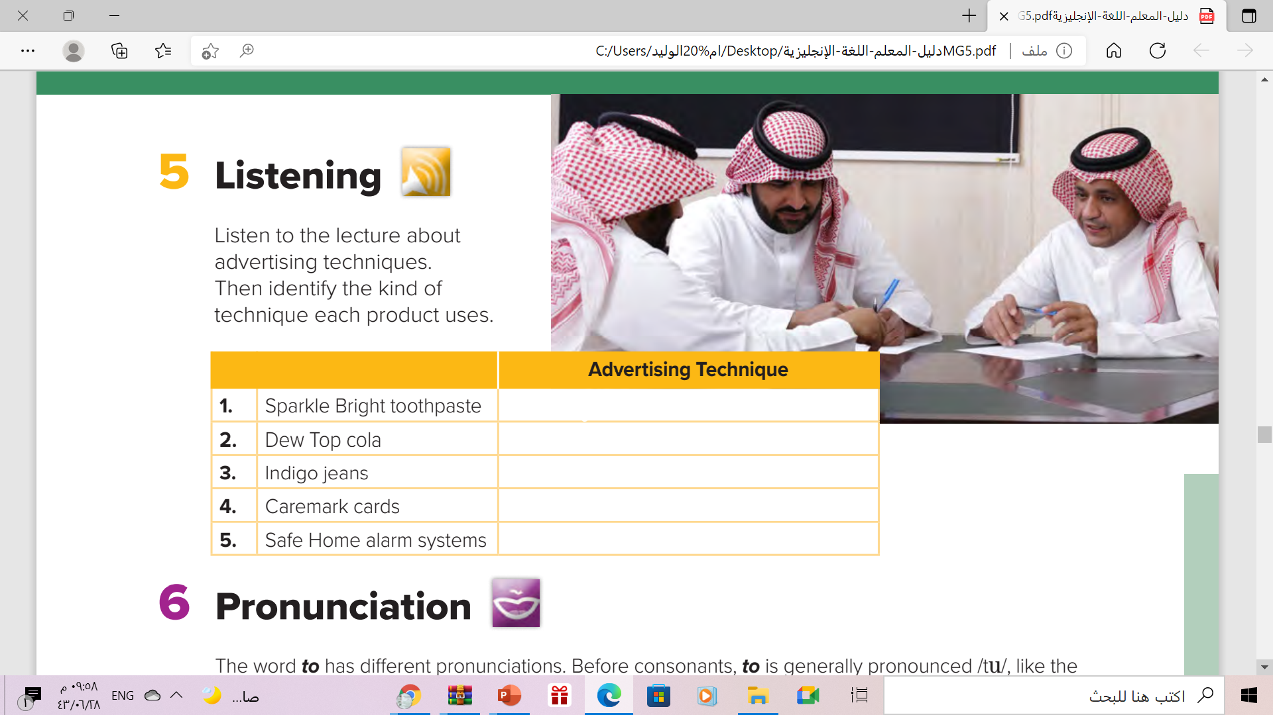
Endorsement
Bandwagon Technique
Anti-Bandwagon Technique
Emotional Appeal
Emotional Appeal

Slide 17
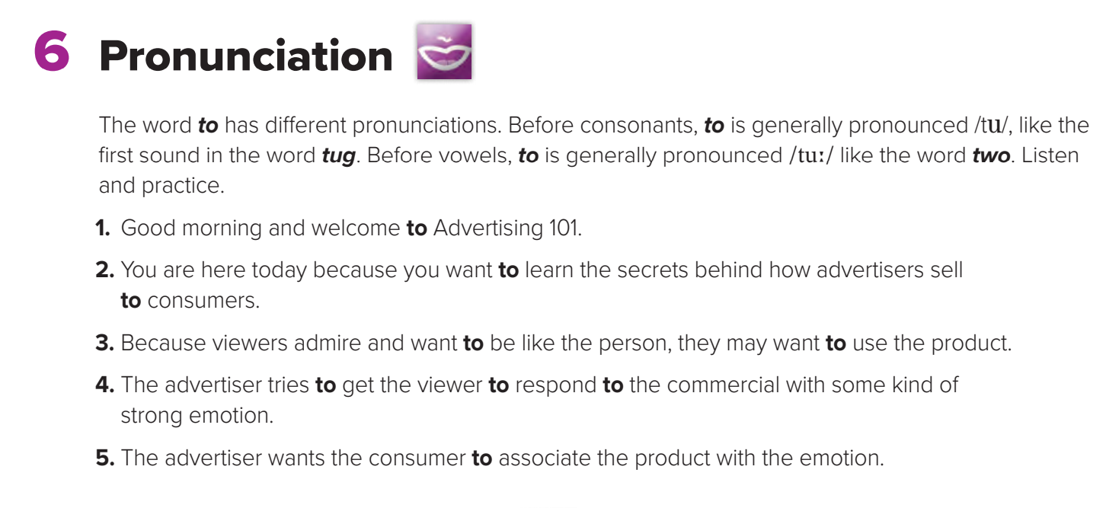

Slide 18

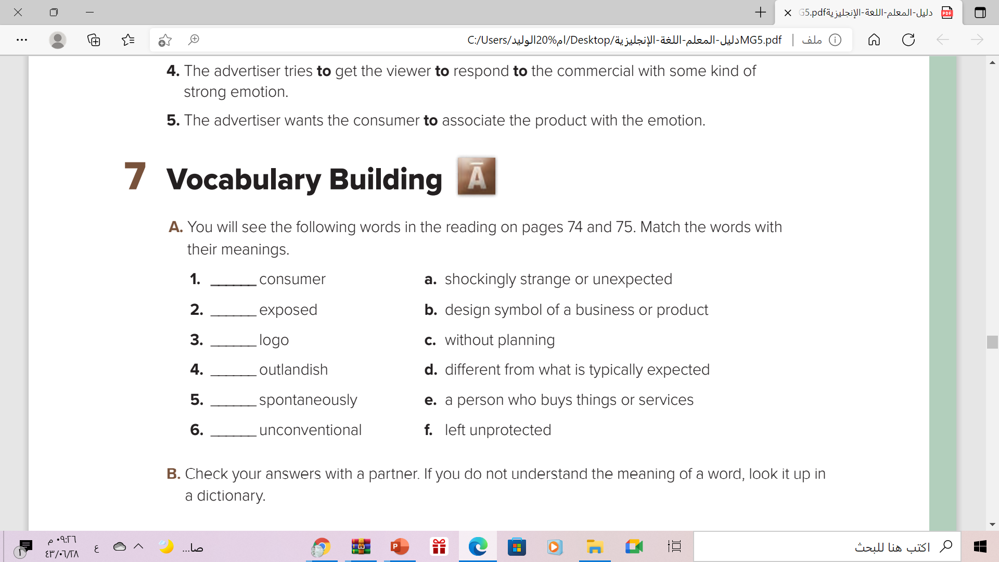
e
f
b
a
c
d

Slide 19
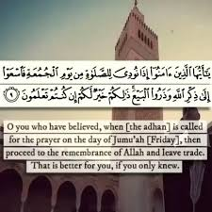
Remember!!

Slide 20
Homework!!
workbook
p. (4) , exercise (i)

Slide 21

Thanks!!

