Slide 1
Unit 5
Do You Really Need It?
Writing
Done by : Entisar Al-Obaidallah

Slide 2
Lesson Objective
01
Talk
03
Identify
02
Read
04
Write
about the topic of “handwriting”
the thesis statements and supporting statements
The text about “ handwriting” for specific information
a letter to your local newspaper

Slide 3

Open student’s book p. 76

Slide 4
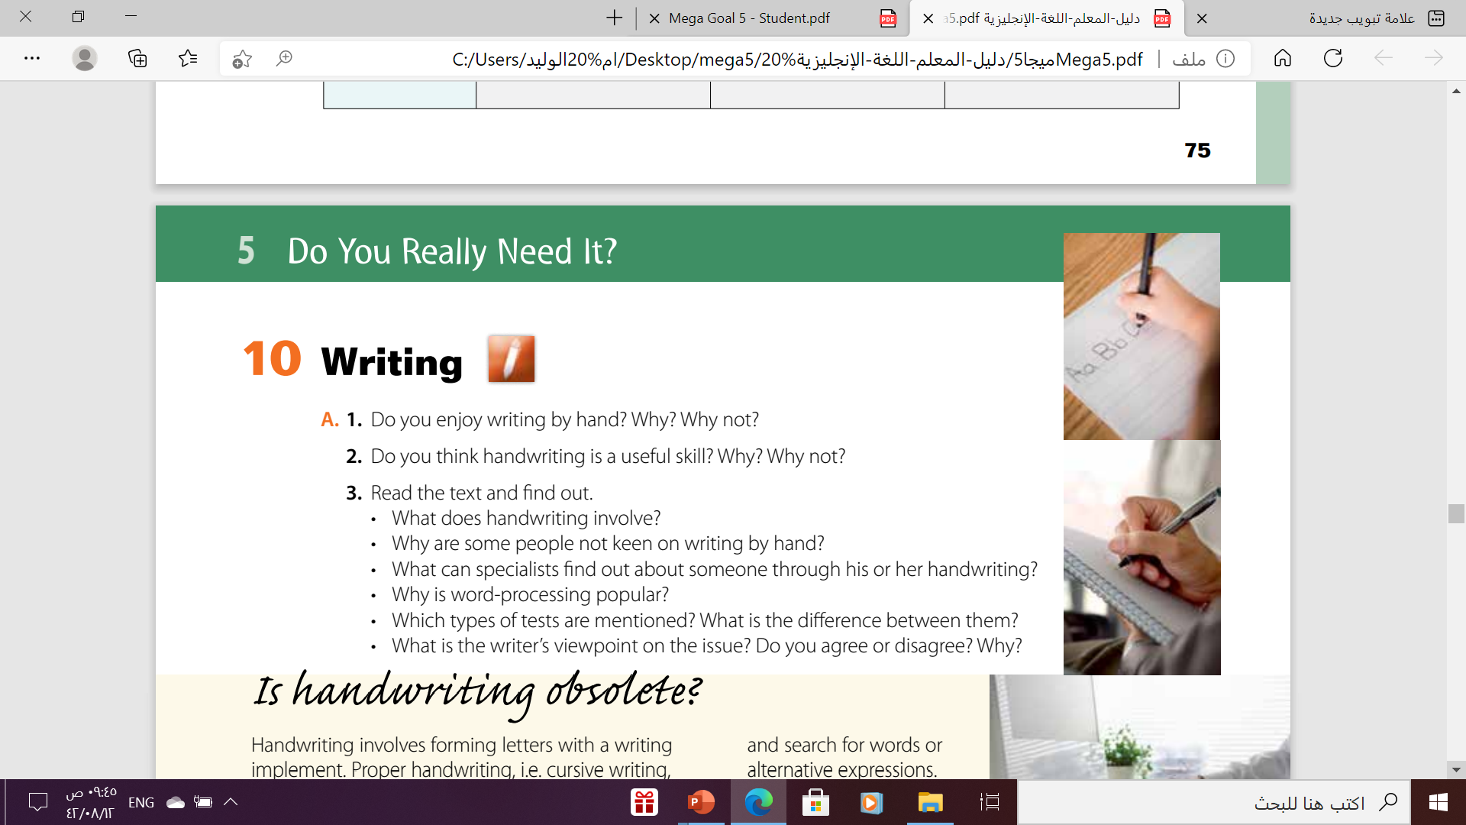
Let’s Discuss

Slide 5
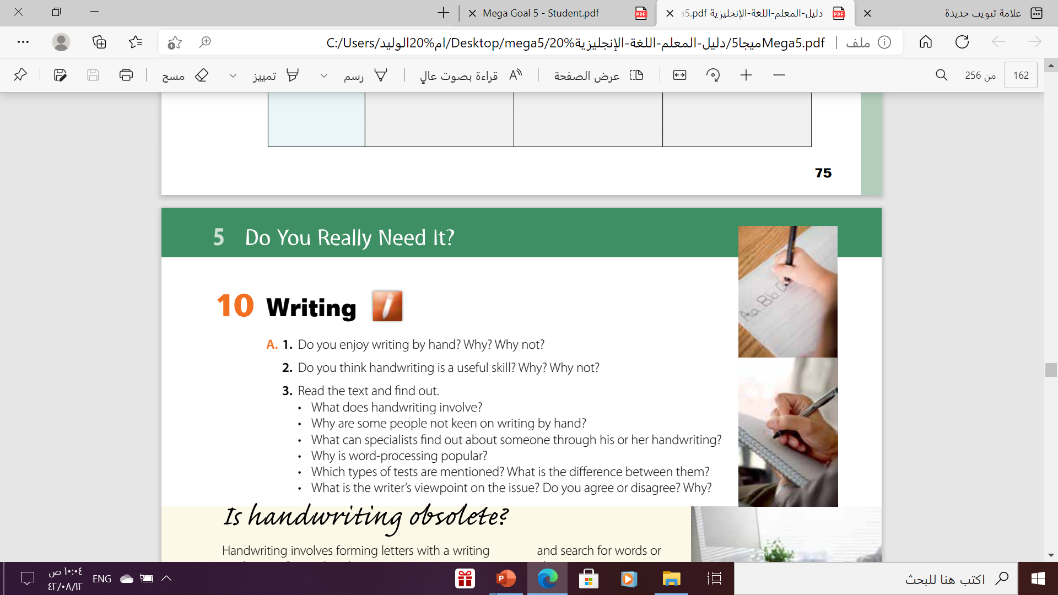
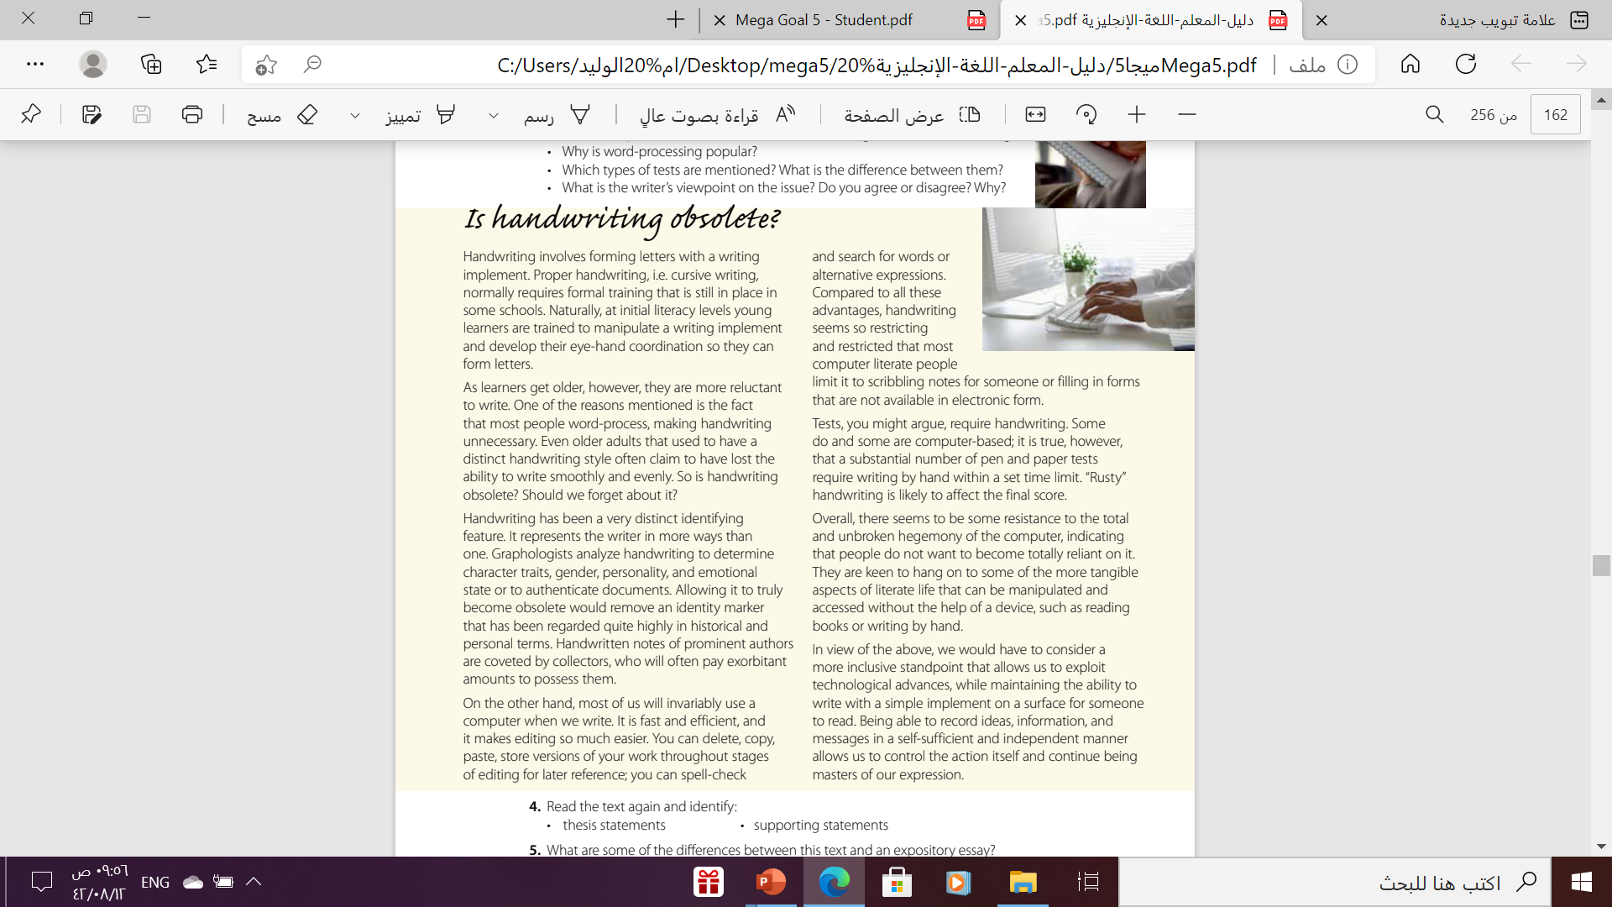
Handwriting involves forming letters with a writing implement. Cursive writing requires formal training and initial literacy stages require children to learn how to manipulate a writing implement and develop their eye hand coordination.
Some people are not keen on handwriting because they prefer word-processing.
Specialists can analyze a person’s handwriting to determine
character traits, gender, personality, emotional state or to
authenticate documents.
It’s popular because it is fast and efficient and facilitates
editing as people can make changes, add or correct parts of
a text without having to write the whole thing. In addition, a
computer can be used to check spelling through spell-check.

Slide 6
There are computer based tests and pen and paper tests.
Computer based tests do not require writing by hand within a set time limit, whereas pen and paper tests do.
The writer is in favor of technological advances that allow us to do things efficiently but he is also keen to preserve the skill of writing by hand without the help of a device; as a means of self-sufficiency and independence which is not reliant on machines.

Slide 7
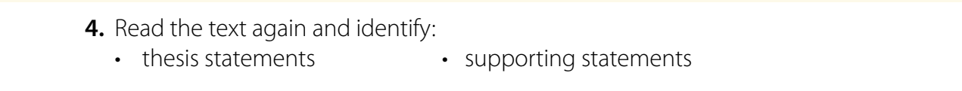
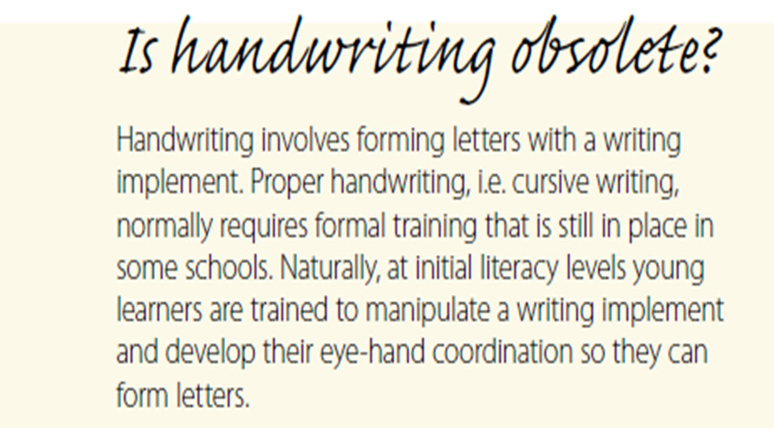
Thesis Statement
Supporting statements:
Subsequent information

Slide 8
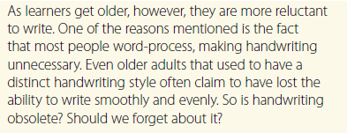
Thesis Statement
Supporting statements:
Subsequent information

Slide 9
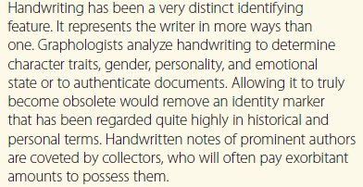
Thesis Statement
Supporting statements:
Subsequent information

Slide 10

Open
student’s book p. 77

Slide 11
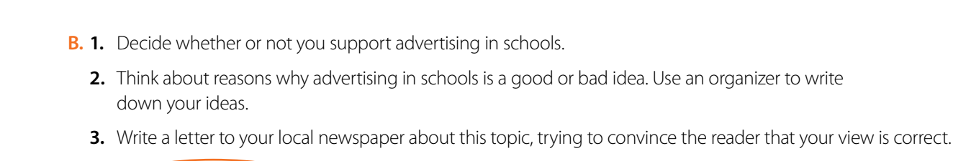
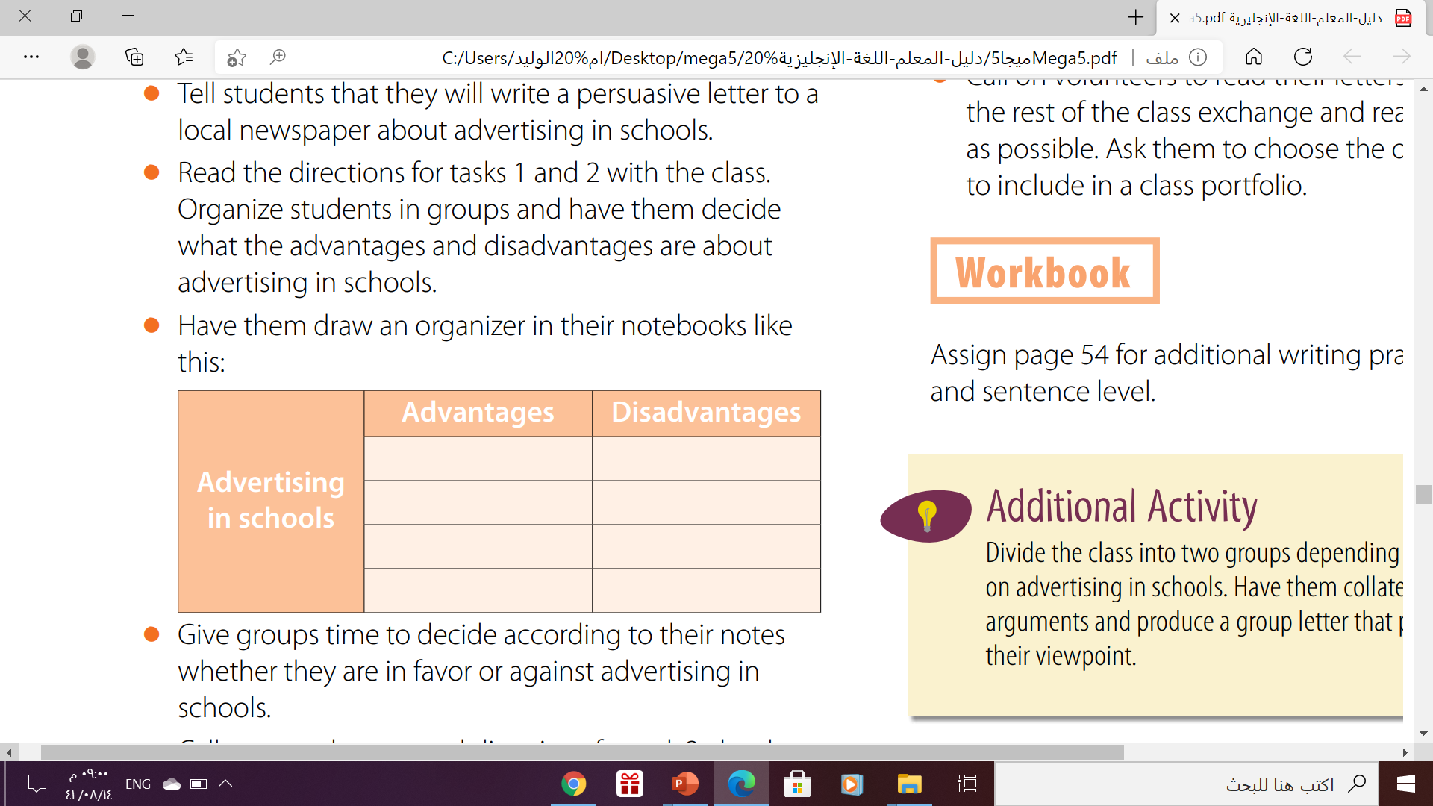

Slide 12
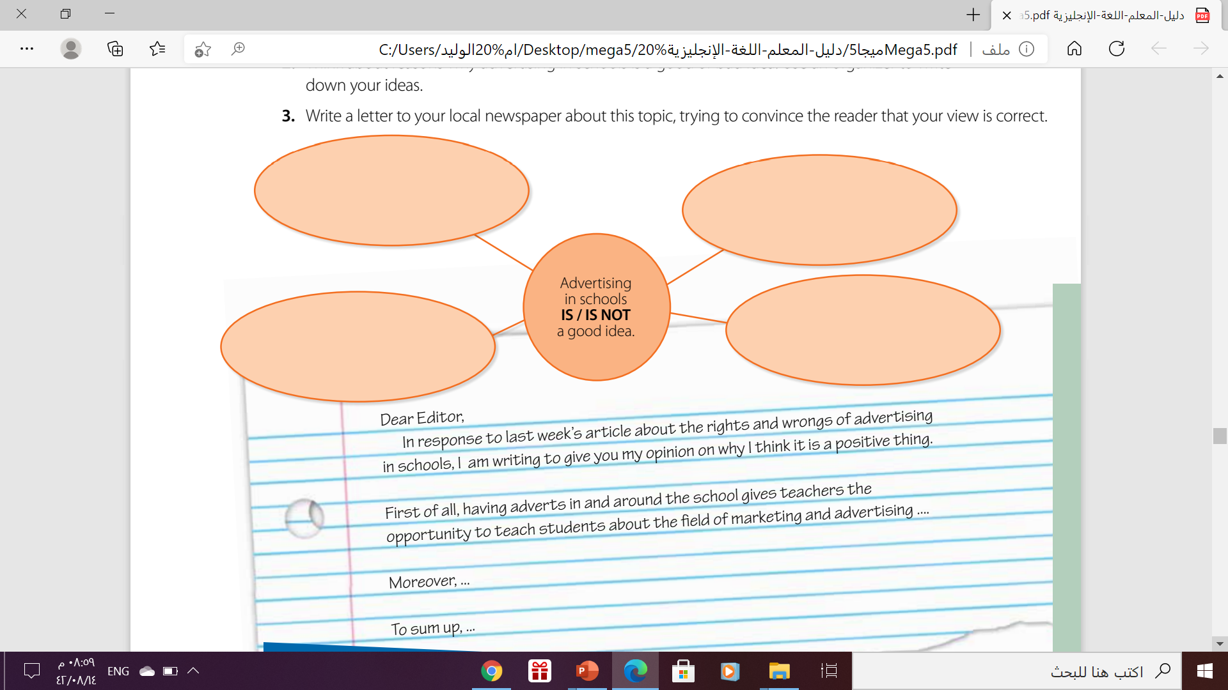

Slide 13
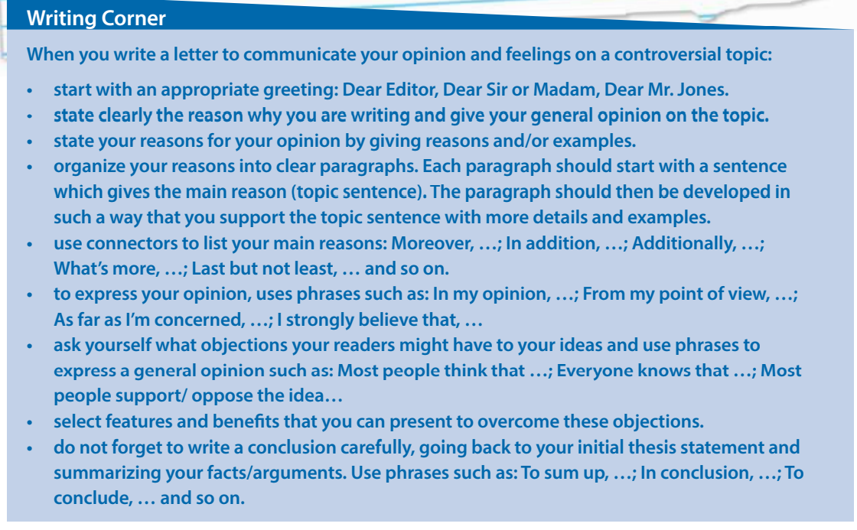
Follow these steps to write a letter to communicate your opinion and feelings on a controversial topic:

Slide 14

THANKS!

