Slide 1

Unit 5
Do You Really Need It?
Grammar
Mega Goal 5
Done by : Entisar Al-Obaidallah

Slide 2

Lesson Objectives
01
04
02
05
03
06
Identify
Practice
Adverb clauses correctly
Using :Where, wherever, and everywhere correctly
Use
Complete
Because, because of, since, and now that (In order) to and so that
The sentences with their own words
Combine
Apply
Sentences using Conditional sentences with when, if, even if, in case, only if, and unless
The rules to do the exercises

Slide 3
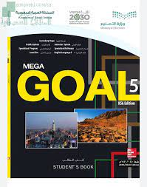
Open
Your student’s book
p. 70

Slide 4

01.
Adverb Clauses

Slide 5
What is an adverb clause ?
➔An adverb Clause is a dependent clause. It begins with an adverb and is always linked to an independent clause.
Example:
Which is dependent clause and which is independent clause?
Because the shoes were on sale , I bought two pairs.
adverb
dependent clause
independent clause
(It is not a complete sentence.)
(It is a complete sentence.)
This dependent clause is an adverb clause. How do you know this?
➔ It begins with the adverb” because”.

Slide 6
Another Example
Which is dependent clause, and which is independent clause?
Don’t buy that dress unless you really need it.
independent clause
adverb
dependent clause
(It is a complete sentence.)
(It is not a complete sentence.)
This dependent clause is an adverb clause. How do you know this?
➔ It begins with the adverb” unless”.

Slide 7

➔When an adverb clause begins the sentence, use a comma to separate it from the independent clause.
➔When the adverb clause is at the end, DO NOT use a comma.

Slide 8
Adverbs of …
Reason
Purpose
Condition
Place
Because
In order to
if
where
Because of
So that
Even if
wherever
since
In case
anywhere
Now that
Only if
unless

Slide 9
Adverbs of …Reason
because
since
Because of
Now that
Because of : it must be followed by a noun or (noun phrase).
Example : They went to the mall because of the sale.

Slide 10
Adverbs of …Purpose
In order to
So that
( In order to ) must be followed with the base form of the verb.
Clauses with (so that) usually include a modal.
I go to Makkah in order to do Umrah
I wore warm clothes so that I wouldn't be cold.

Slide 11
Adverbs of …Condition
if
Even if
Use if to show that the condition affects the result. Use the present tense with an if-clause, even if it refers to a future time.
Example:
We won’t go to the picnic if it rains.
Use even if to show that the condition DOESN’T affect the result.
Example:
We’re going to the picnic, even if it rains.
In case
Only if
unless

Slide 12
Adverbs of …Place
Where
Wherever
Everywhere

Slide 13
Open
Your student’s book
p. 71

Slide 14
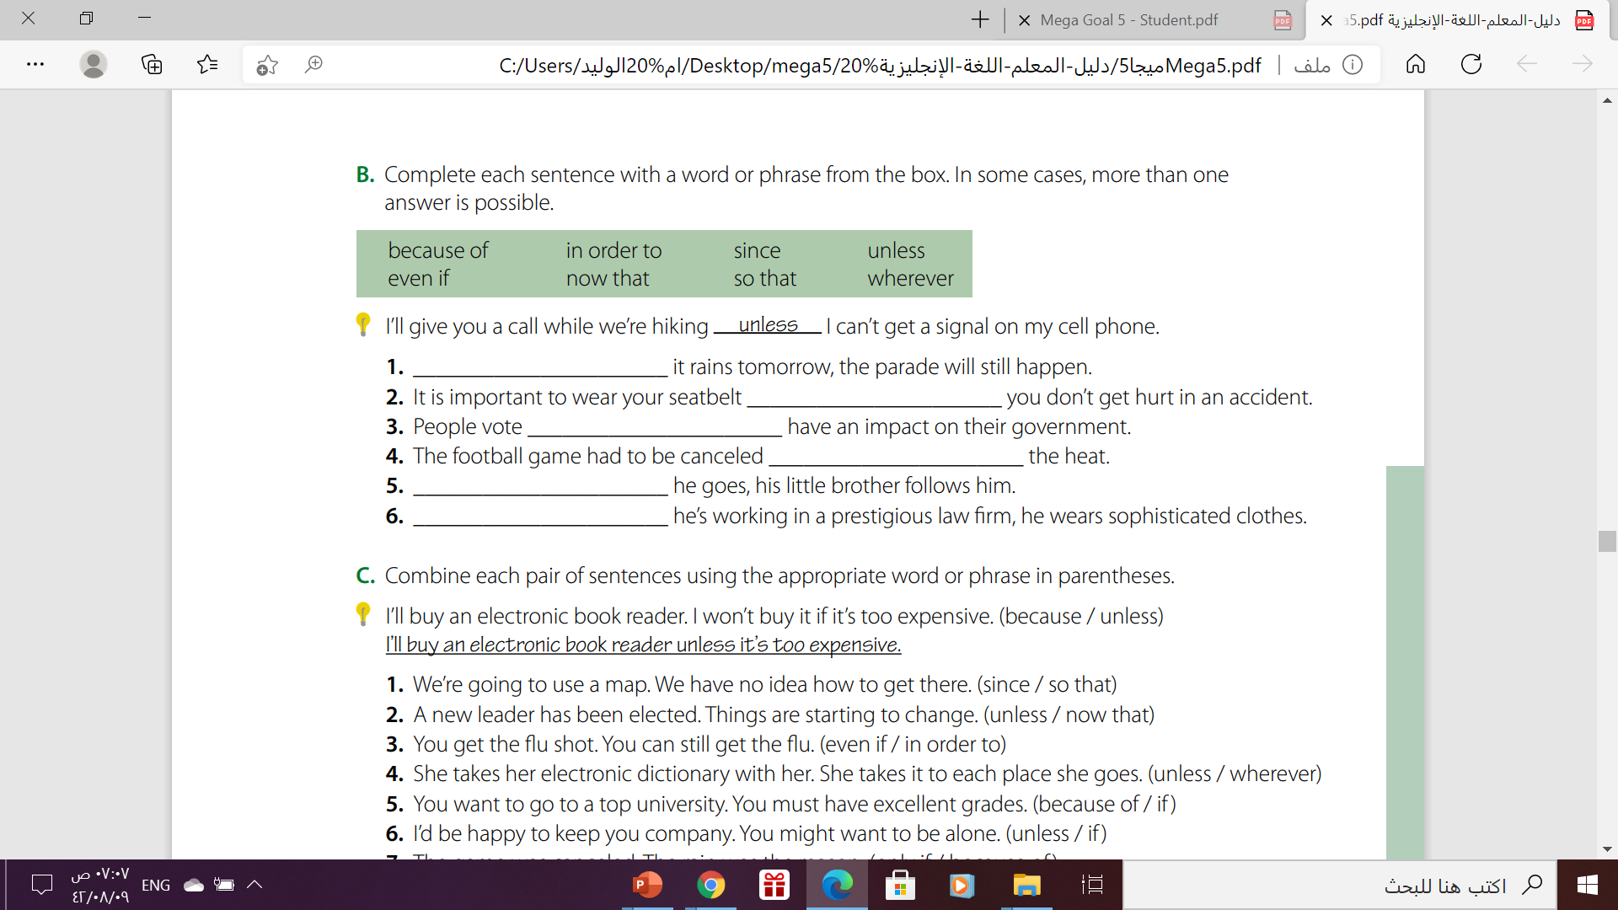
Even if / Unless
so that
in order to
Because of
Wherever
Because / Since / Now that

Slide 15
Homework.
Workbook , exercise (D) . P. 48

Slide 16

THANKS

