Slide 1
Unit 5
Do You Really Need It?
Listen & Discuss
Done by: Entisar Al-Obaidallah

Slide 2
Lesson Objectives
01
04
02
05
03
Discuss
Answer
the influence of advertising
Some questions about the advertisment
Listen
Create
For soecific information
an advertisement for a product
Match
The words with their correct definition

Slide 3
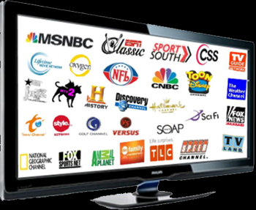
What Can You See on TV?
Films
Shows
Programs
Sports
NEWS
Documentaries
Commercial

Slide 4


What is commercials ?
Commercials are a type of advertisement broadcast on
radio or television
They are a familiar part on everyday television

Slide 5
What is the difference between commercials & advertisement ?
All commercials are advertisements, but NOT all advertisements are commercials.
➔An advertisement is a message paid for by a company and delivered through a mass medium to a target audience.
➔Commercials are examples of ads that run specifically on broadcast media like television and radio.

Slide 6

What is the purpose of advertisement?
Advertising has three primary objectives:
To inform
To persuade
To remind
Advertisement announces new products and can educate people about the benefits of new products

Slide 7
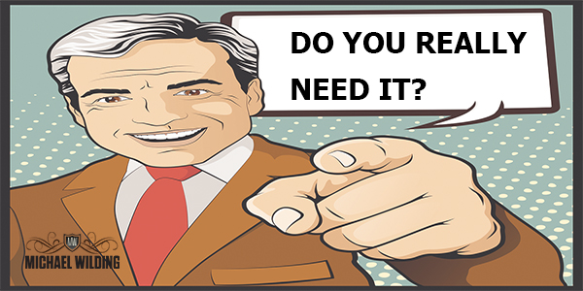
When you want to buy something , do you ever ask yourself:

Slide 8

Open your student’s book p. 68

Slide 9
01
Before Reading

Slide 10



Where can we find and see the ads?
ADS is the abbreviation of “ advertisement”

Slide 11

What is the best method of advertising ?
TV: because it is the only medium that offers the power of sight, sound, color and movement.

Slide 12
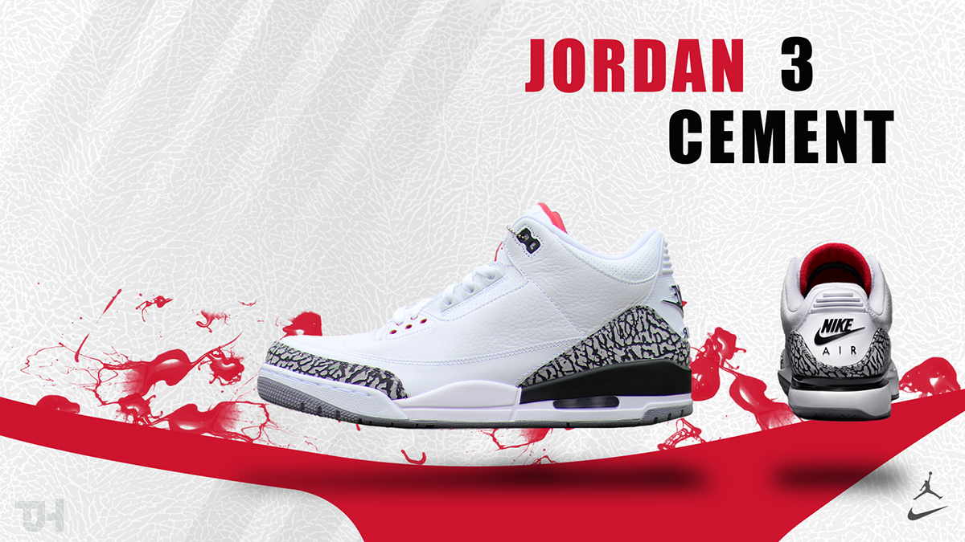
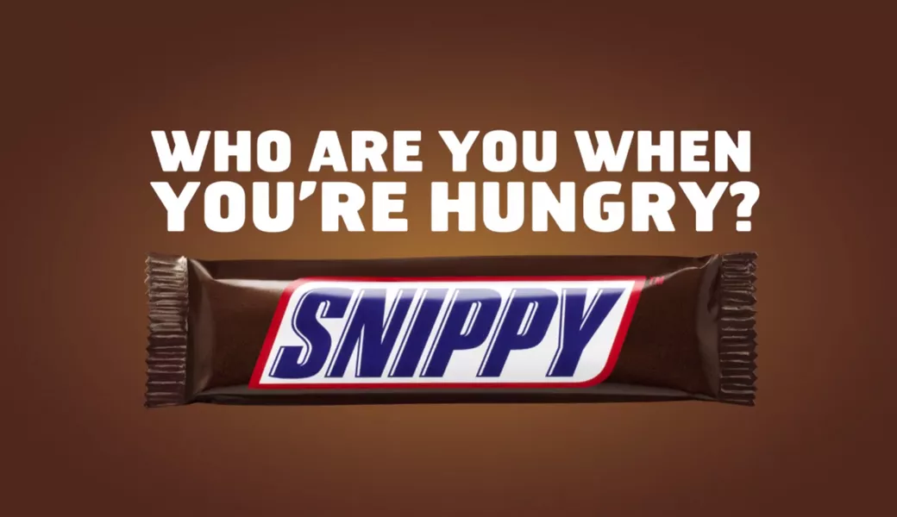

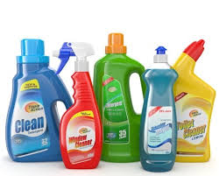
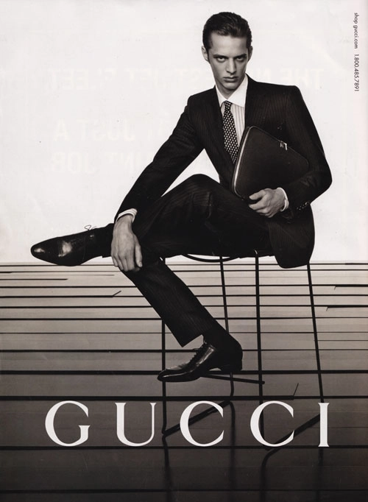
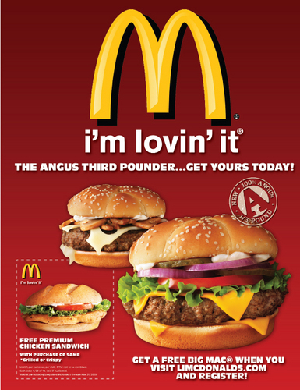
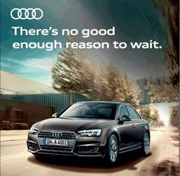

There are advertisements for everything.
Give Examples?

Slide 13
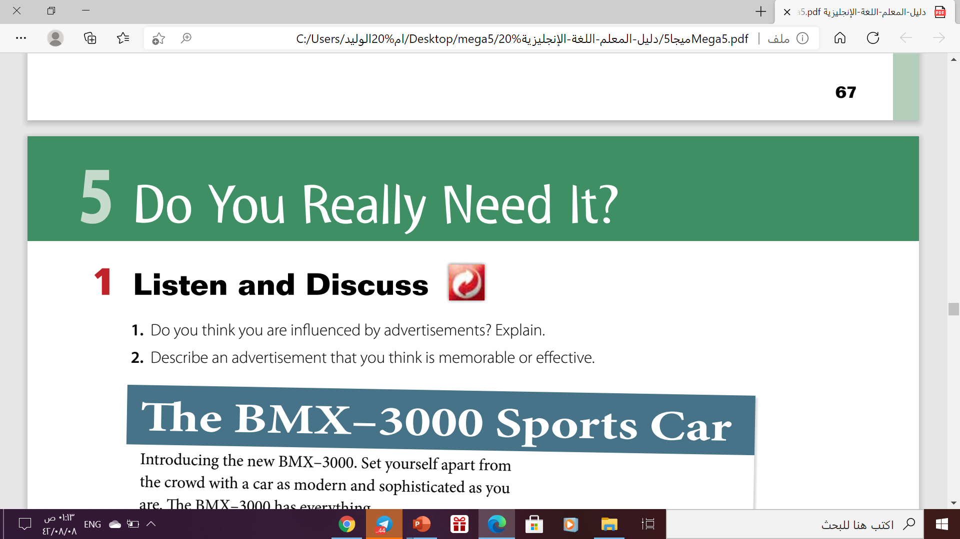

Slide 14
02
Listen and Disuss

Slide 15

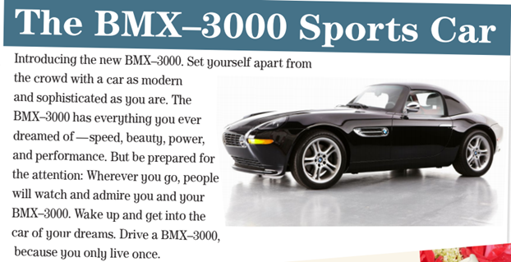
What kind of car is this?
A fast , beautiful sports car
Everyone will watch and admire you
What will happen if you drive this car?

Slide 16

What will happen if you use this shampoo?
Your hair will be shiny and strong
It makes your hair twice as strong, protects your hair against wind and sun
What have the studies shown?

Slide 17
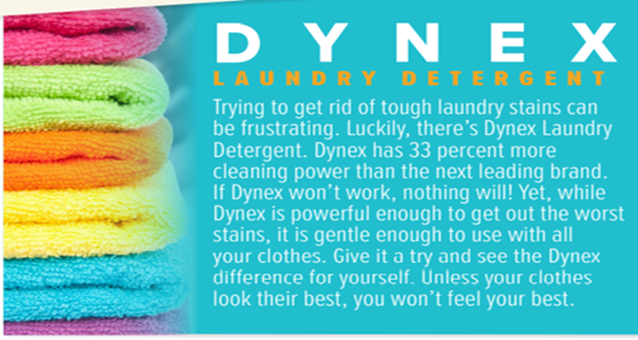
Why is this detergent better than others?
Because it contains more cleaning power.
What can this detergent do?
They get out the worst stains)

Slide 18

Open
your student’s book
p. ( 69)

Slide 19
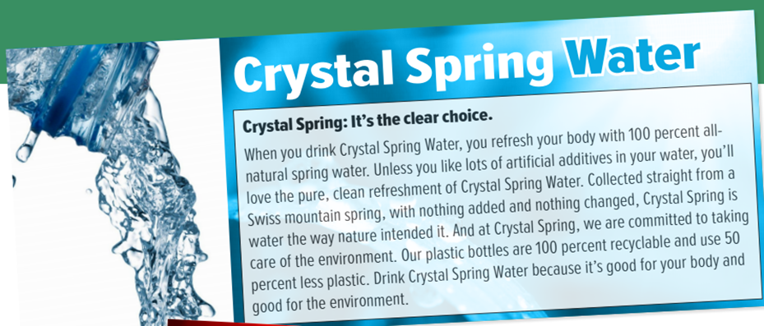
How is Crystal Spring Water different?
It is all-natural with no additives
Where does it come from?
They get out the worst stains.
What else is special about it?
It is good for the environment

Slide 20
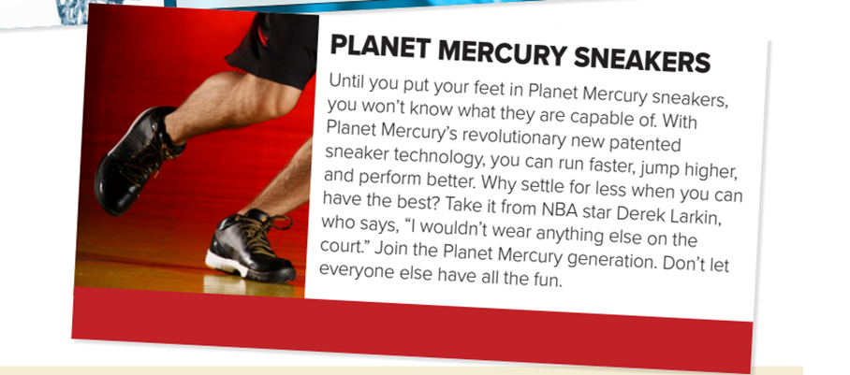
If you wear these sneakers, what will you be able to do?
run faster, jump higher, and perform better
Culture Note
NBA stands for National Basketball Association. It is a league made up of professional basketball teams from the United States and one from Canada.
Who wears these sneakers?
an NBA star

Slide 21
03
After Reading

Slide 22
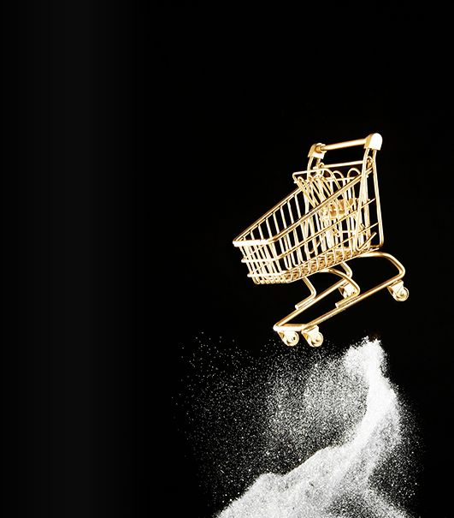
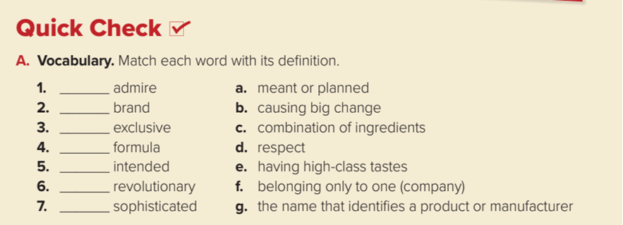
Quick Check
d
g
f
c
a
b
e

Slide 23
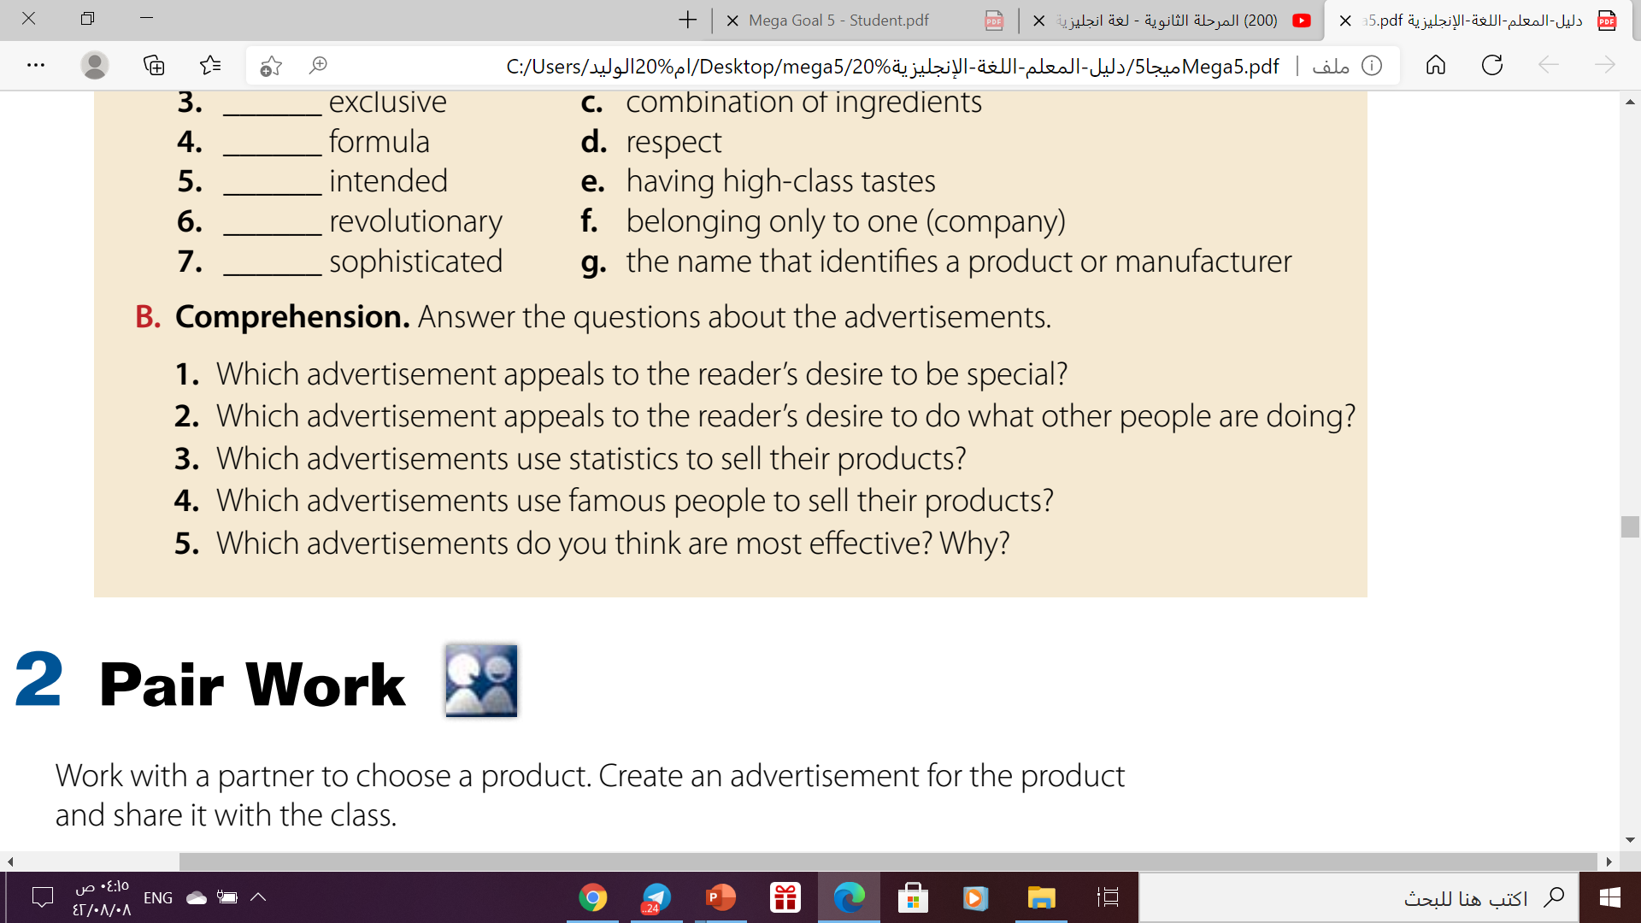
4
5
1
2
3
BMX–3000 Sports Car
Planet Mercury Sneakers
Dynex Laundry Detergent and Crystal Spring Water
Planet Mercury Sneakers
I think the ad for the BMX–3000 Sports Car is the best because it
makes me want to buy one.

Slide 24
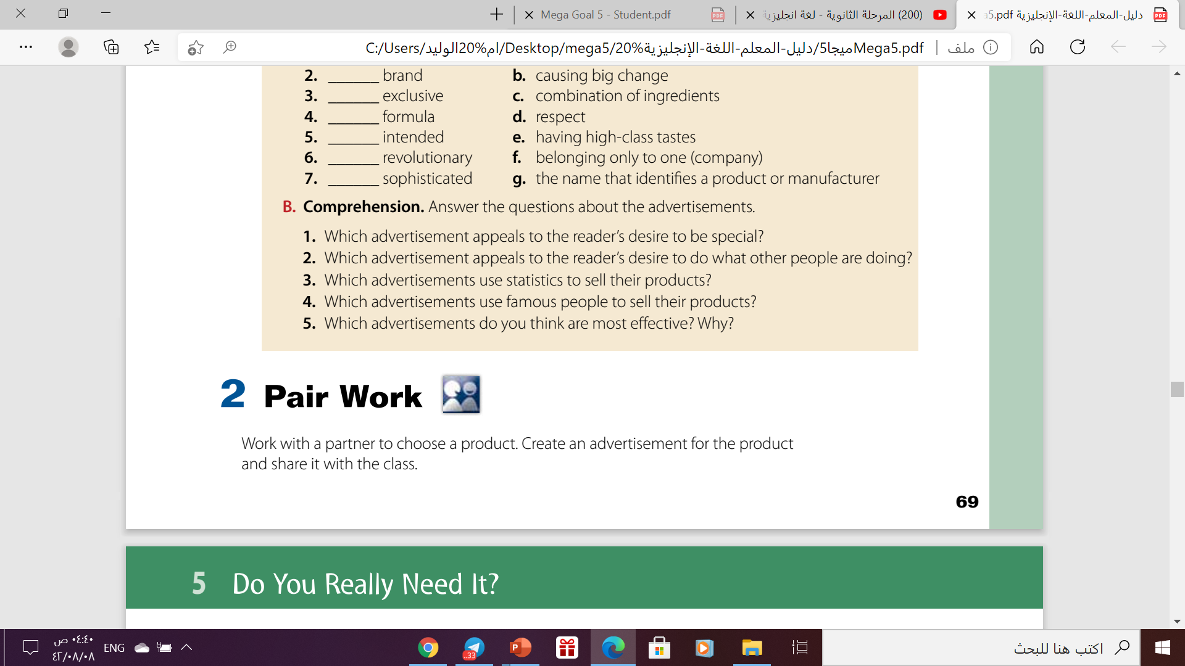

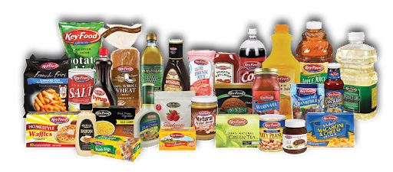

Slide 25

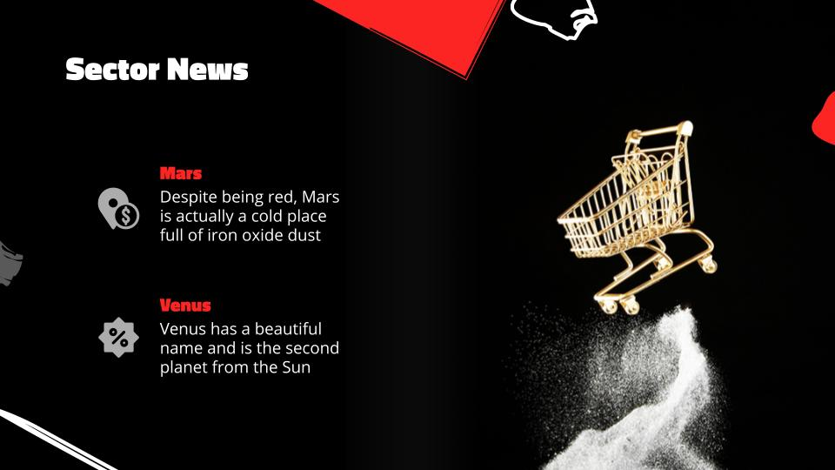

Let’s Practice
https://wordwall.net/play/12631/049/546

Slide 26
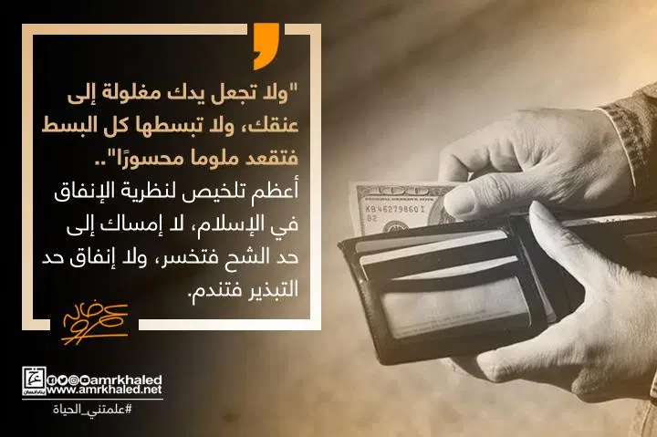

Slide 27
Homework
Work book
Exercise ( A) , P.47

Slide 28

Thanks!

