Slide 1
Do You Really Need It?
Mega Goal 5
Unit 5
Reading
Done by: Entisar AL-Obaidallah

Slide 2
Lesson Objectives
01.
02.
03.
04.
Name
Read
Answer
Talk
Places where they
see ads in everyday life
the text for specific information
Some comprehension question about the text
about techniques used in advertisement

Slide 3

Your studen’s book p.
74
Open

Slide 4
Reading
Before

Slide 5
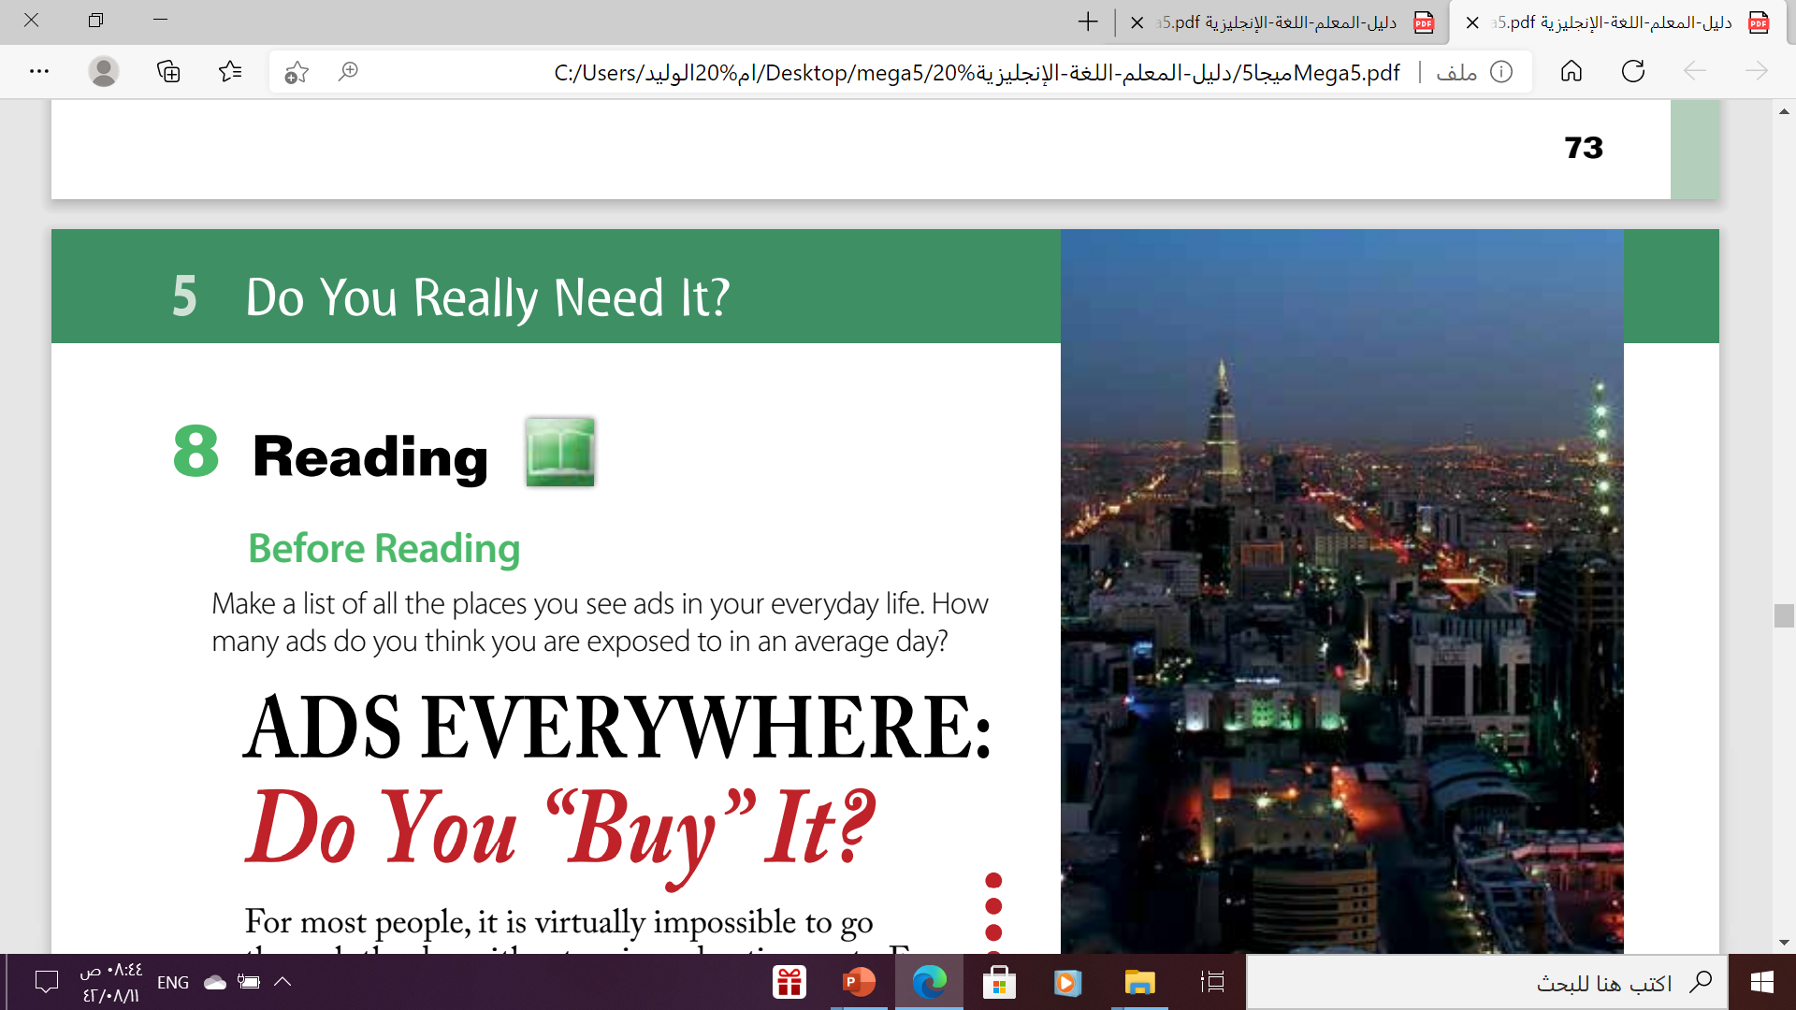
Before Reading

Slide 6

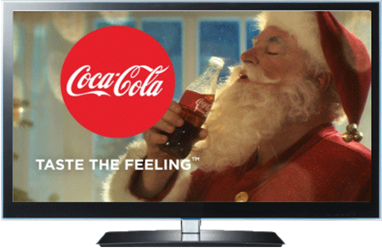
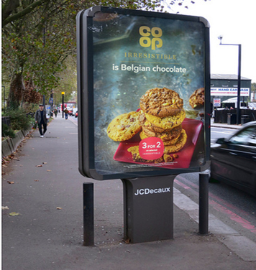
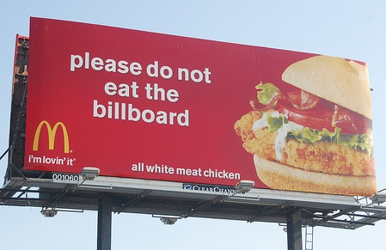
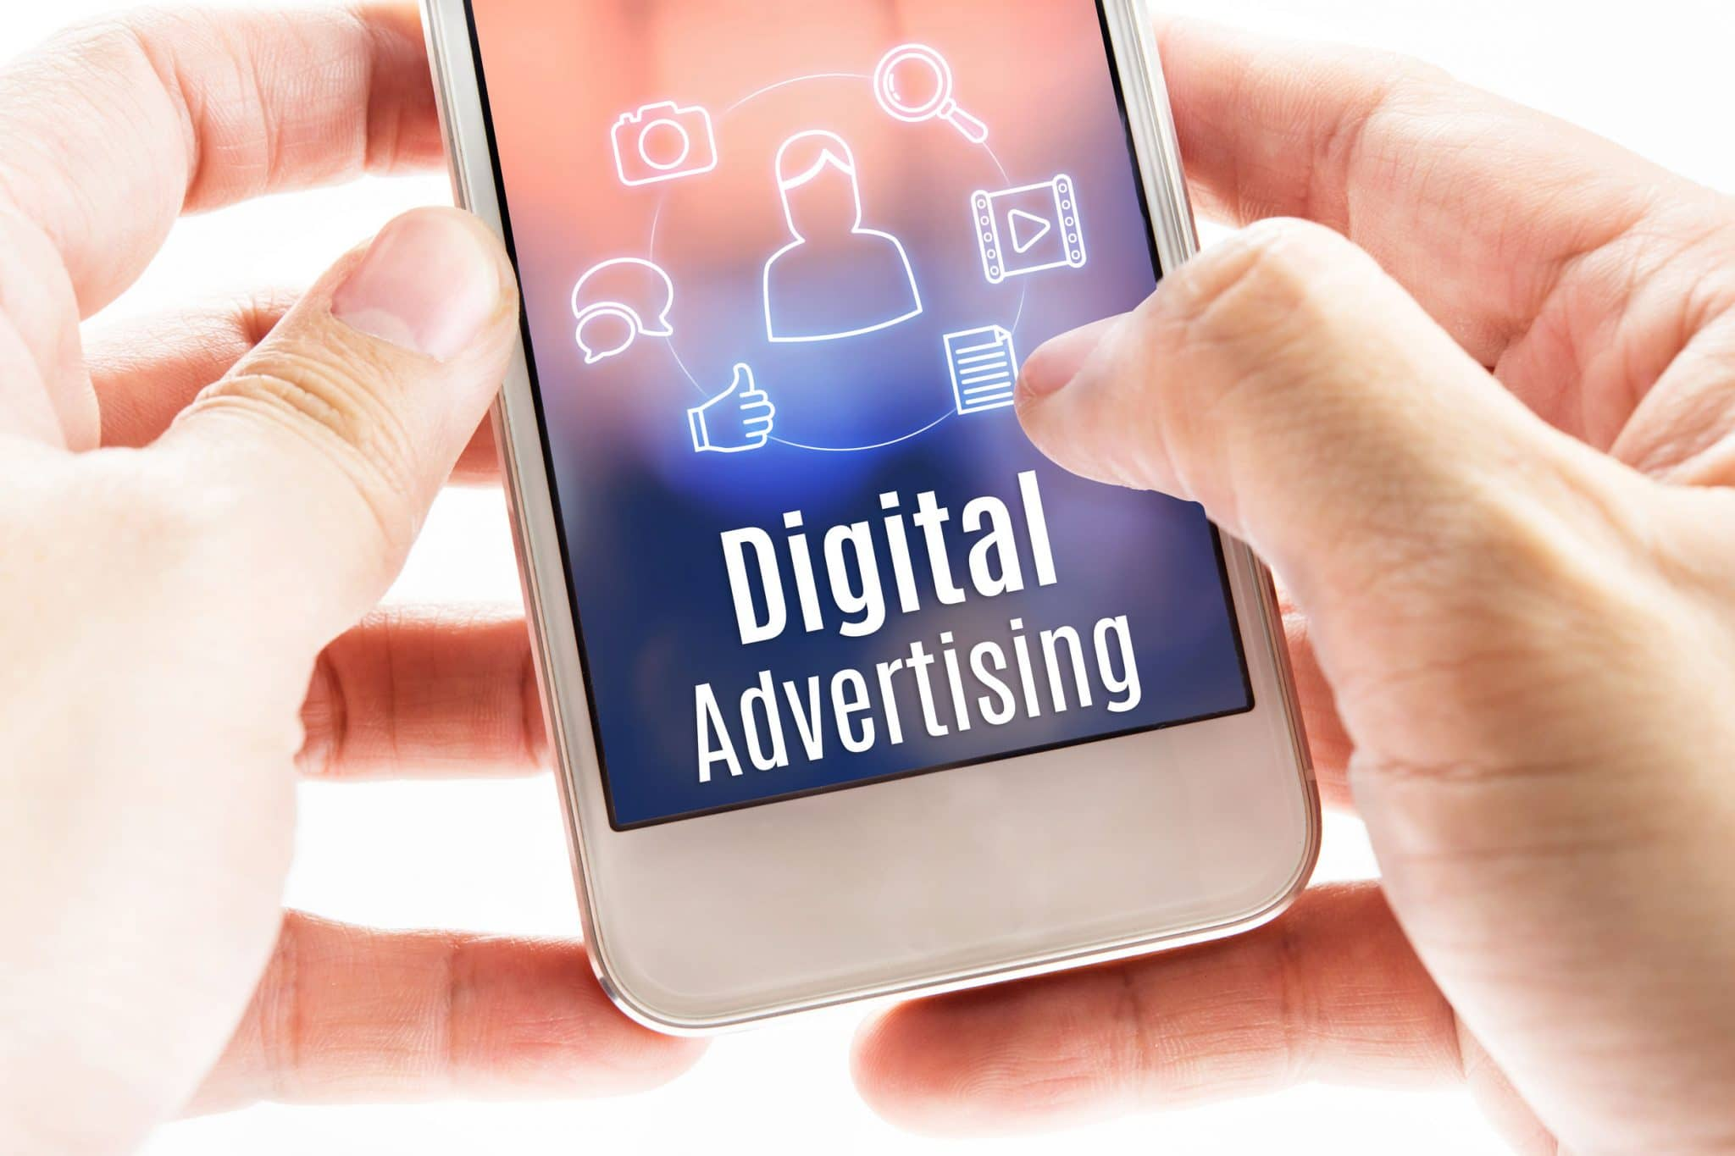

Slide 7
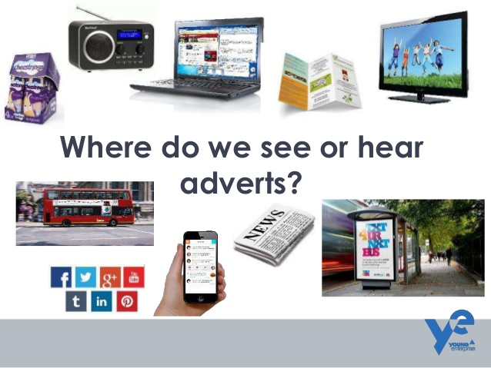

Slide 8
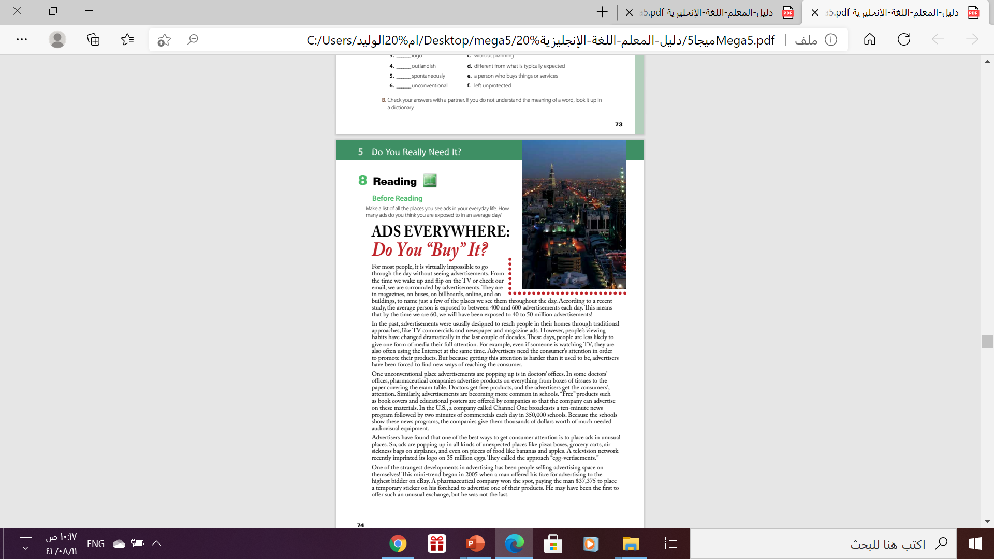
Why is “Buy in quotation marks?
“buy” has two meanings in this title.
more idiomatic meaning is to accept, believe, or support something
to purchase something.

Slide 9
What are the two
meanings of the title?
Do you buy products that you see advertisements for?
Do you accept the practice
of being exposed to advertisements everywhere?

Slide 10
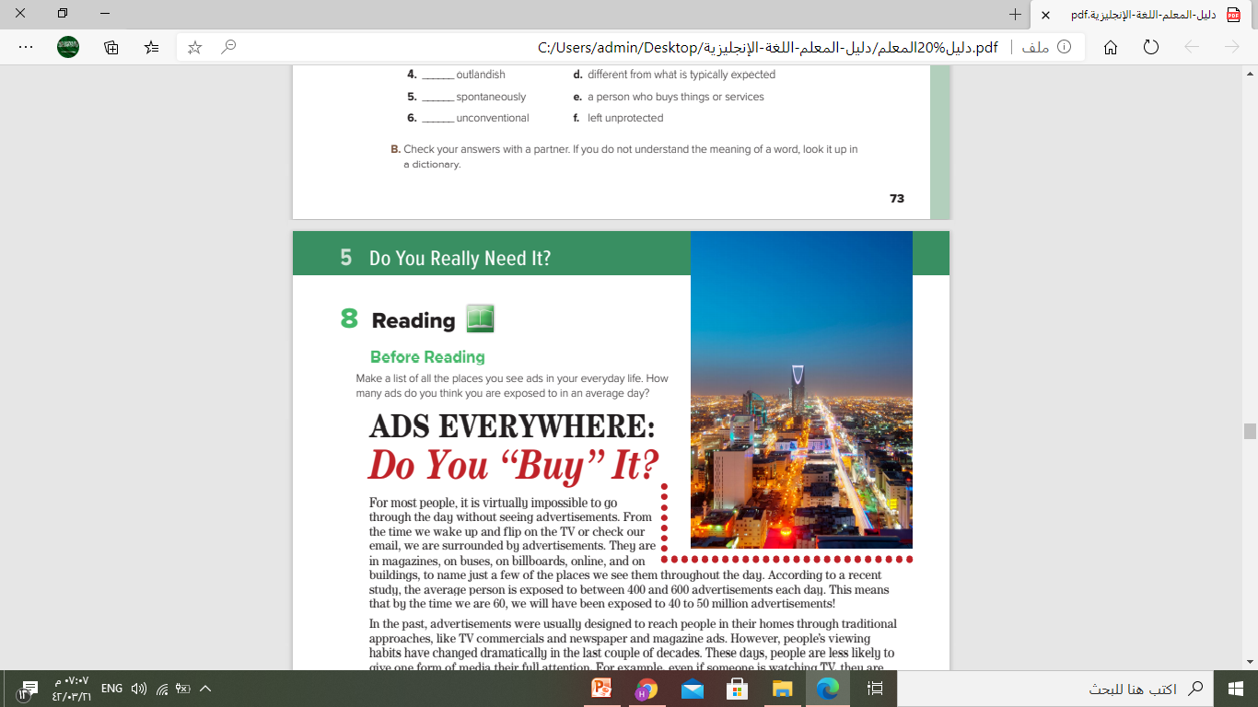
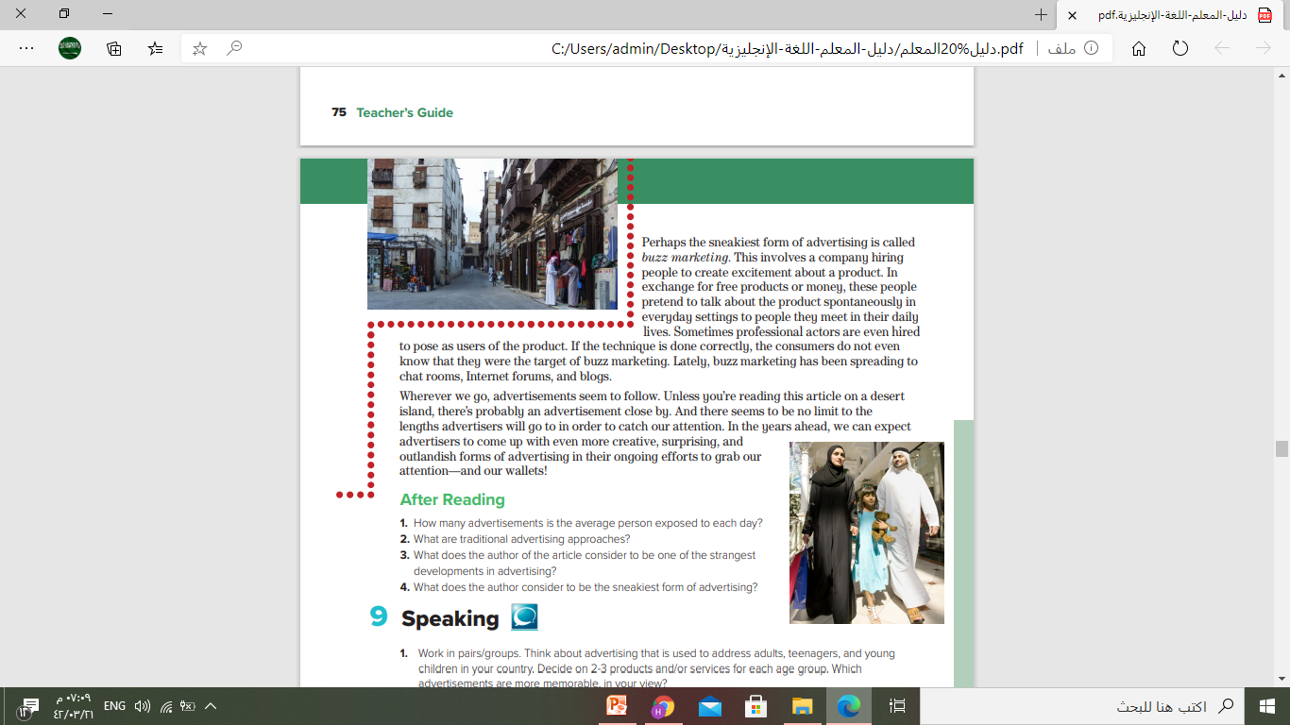
Do you recognize these cities?
Riyadh
Jeddah

Slide 11

What is the main idea of this paragraph?
It is about the amount of advertisements people see in a day.

Slide 12
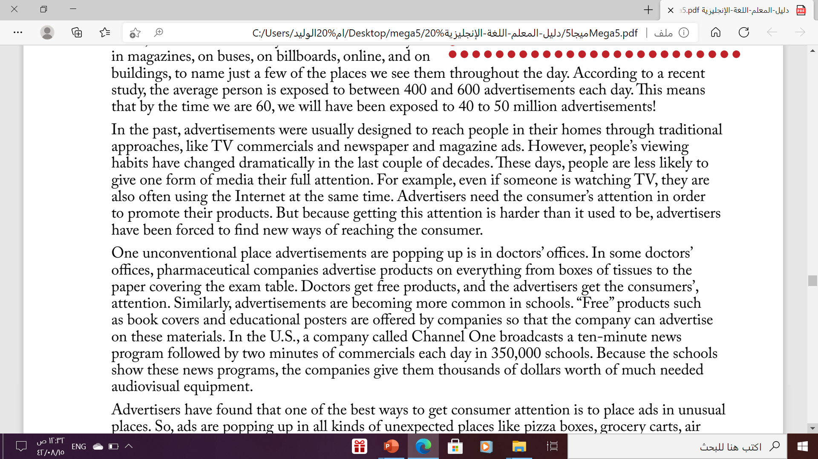
What do you think you will learn in this paragraph?
It is about how advertisements reach people today

Slide 13
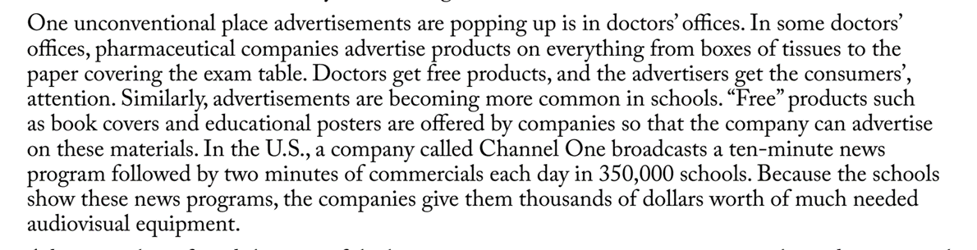
What do you think you will learn in this paragraph?
It’s about unconventional places of advertisement

Slide 14
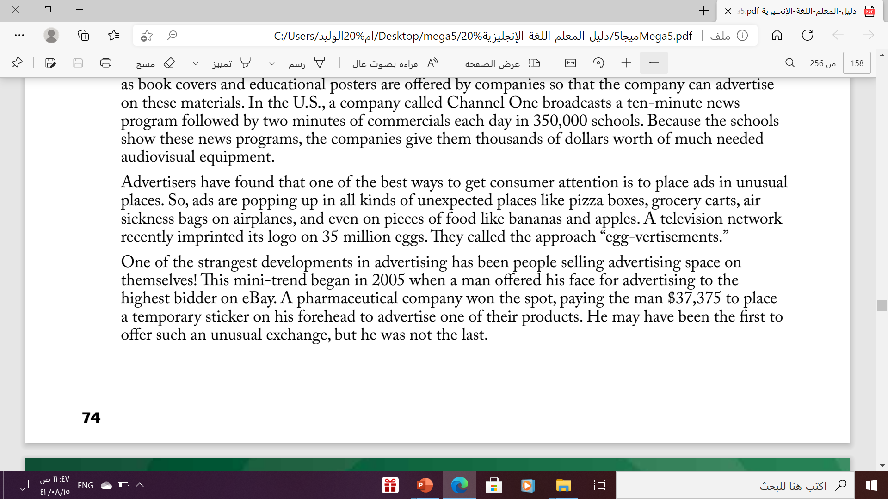
What do you think you will learn in this paragraph?
It’s about the best way to get consumer’s attention

Slide 15
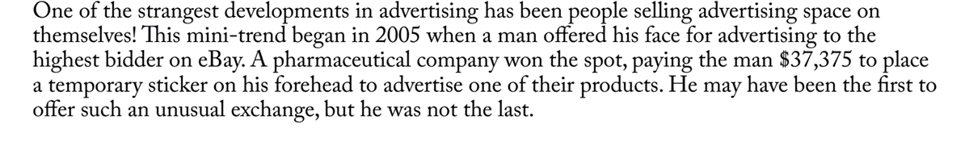
What do you think you will learn in this paragraph?
It’s about the strangest development in advertising

Slide 16
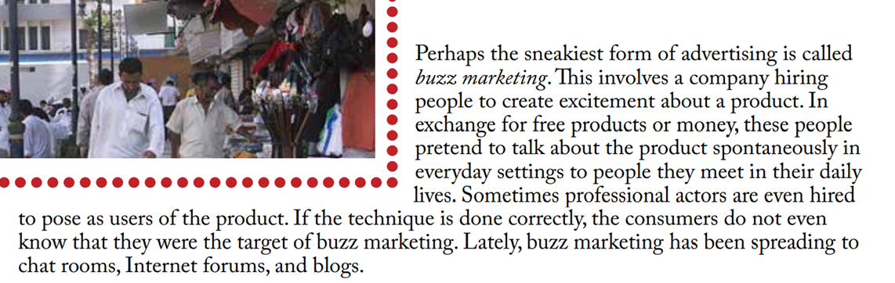
What is the main idea of this paragraph?
It’s about buzz marketing

Slide 17
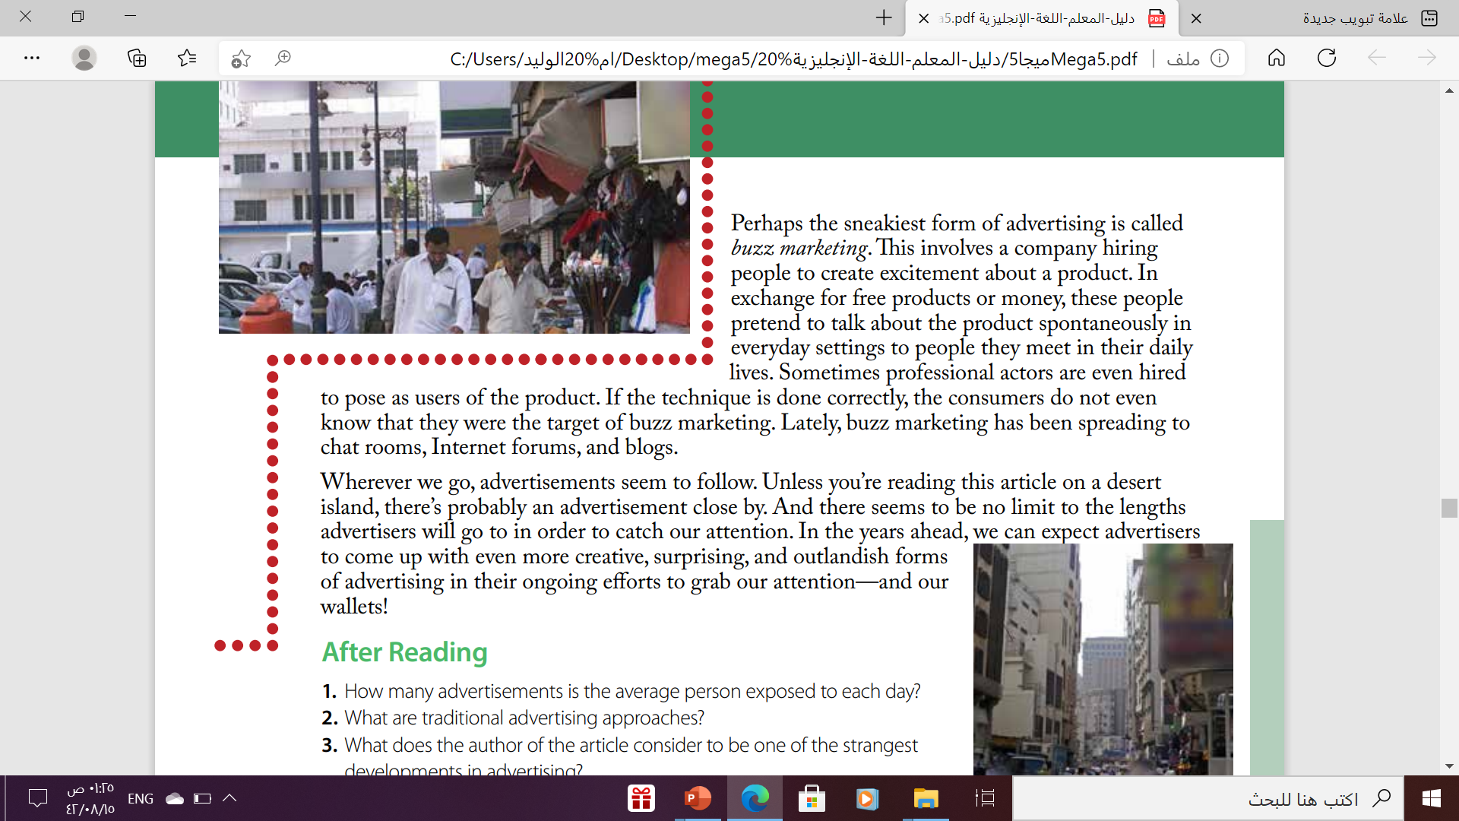
What is the main idea of this paragraph?
It’s about the advertisement everywhere

Slide 18
Your studen’s book p.
75
Open

Slide 19
Reading
After

Slide 20
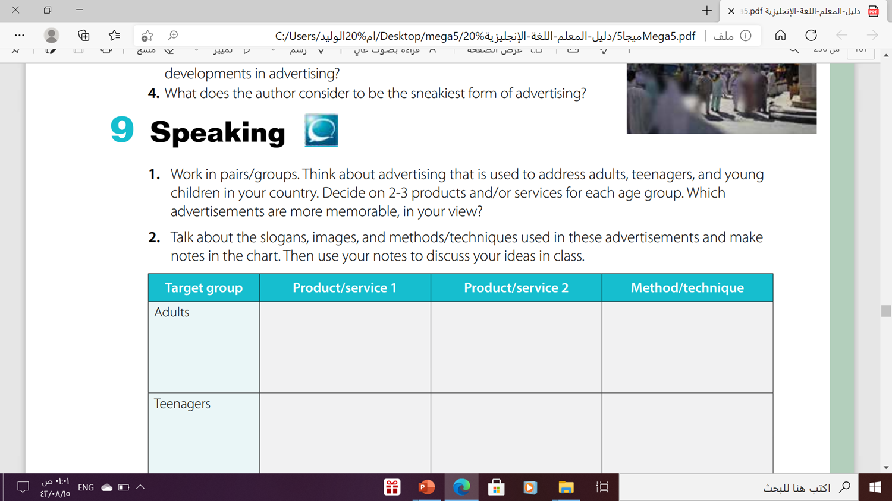

Slide 21
After Reading
1. The average person is exposed to between 400 and 600 advertisements each day
2- TV commercials, newspaper ads, and magazine ads are traditional advertising approaches.
3- Selling advertising space on one’s body is a strange development in advertising.
Buzz marketing is considered the sneakiest form of advertising.

Slide 22
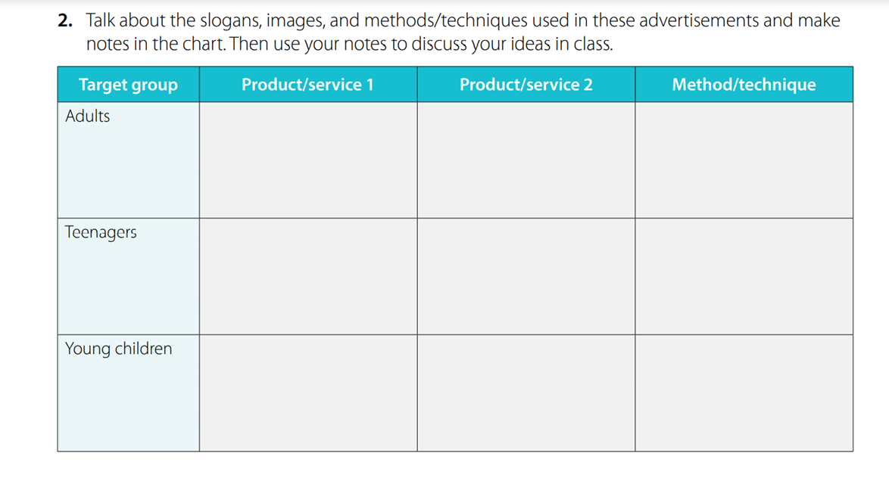
After Reading

Slide 23
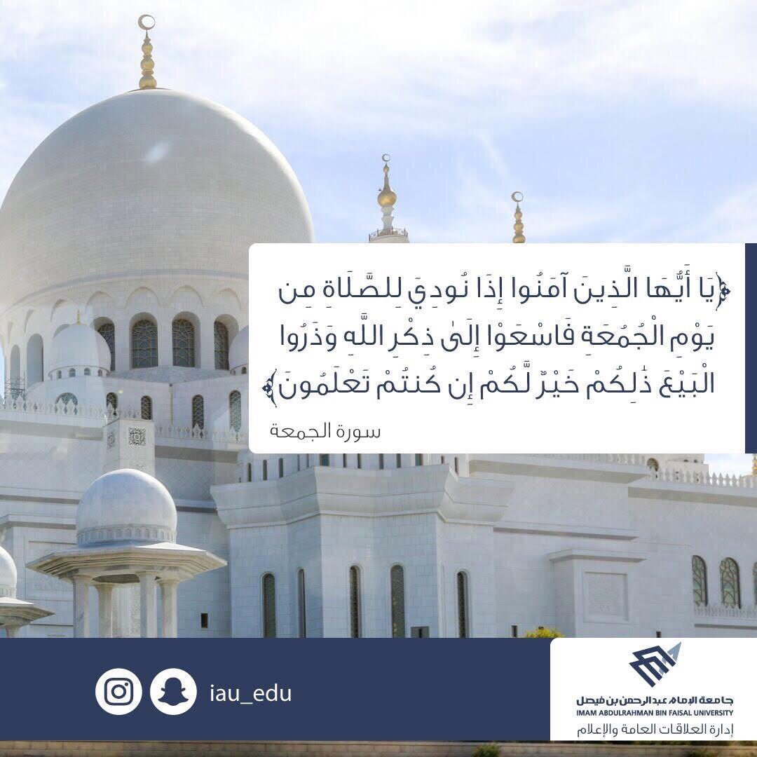
From The Holy Qura’an

Slide 24
Homework
Workbook p.(52) , exercise ( J)

Slide 25

Thanks !

