Slide 1

UNIT 6
The Gender Divide
Form , Meaning & Function
Done by: Entisar Al-Obaidallah

Slide 2
Lesson Objectives
01
02
03
Distinguish
Form
Form
04
05
06
Practice
Use
Apply
Between present perfect simple and present perfect progressive
Sentences using present perfect simple
Sentences using present perfect progressive
Words connected with hobbies and interests
Adjective +Preposition + Gerund correctly
the rules to do the exercises

Slide 3

Open
Your studen’s book p.(92)

Slide 4
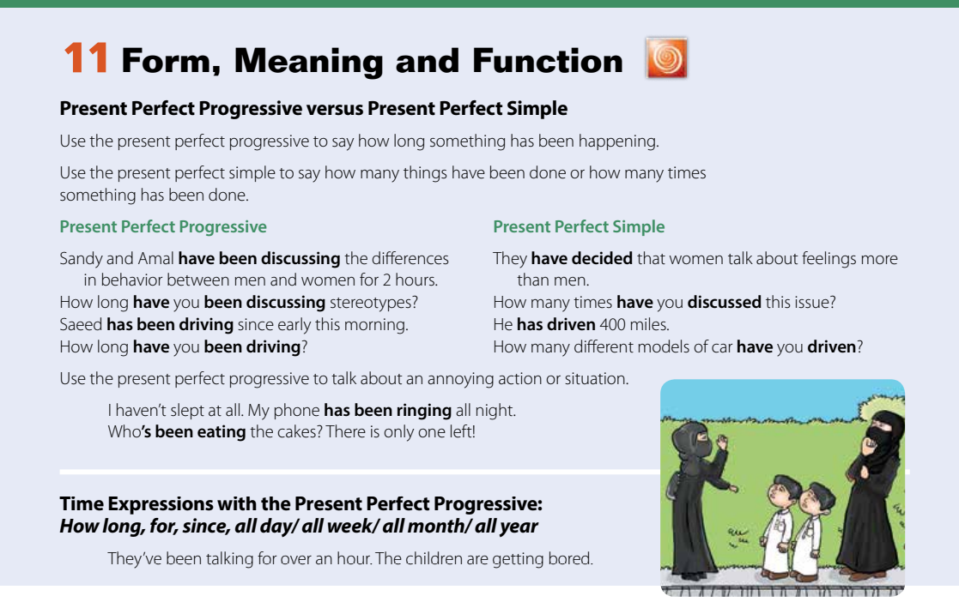
WHAT SETS US APART?

Slide 5
Present Perfect simple
➔Use the present perfect simple to say how many things have been done or how many times something has been done.
Form
subject
Has/have
V.Past Participle(3)
I
You
We
They
plural
She
He
It
Singular
has
have
Example
He has driven 400 miles.

Slide 6
Present perfect progressive
➔Use the present perfect progressive to say how long something has been happening
Form
subject
Has/have
been
V+ing
I
You
We
They
plural
She
He
It
Singular
has
have
Example
She has been teaching for 2 hours.

Slide 7
➔Use the present perfect progressive to talk about an annoying action or situation.
Example
I haven’t slept at all. My phone has been ringing all night.
➔Time Expressions with the Present Perfect Progressive:
How long, for, since, all day/ all week/ all month/ all year
Exaple
How long have you been studying?
I have been studying all day .

Slide 8
In brief
present perfect simple | present perfect simple
➔Used:
1- finished actions.
2-to say how many times something has been done.
3-To say how many things have been done.
➔Examples:
I’ve already written ten e-mails
I haven’t eaten lunch yet
How many cars have you driven?
➔Used:
1- unfinished actions
2- to emphasis the duration.
3- To express annoyance.
➔Examples:
I’ve been working here since 2010.
I have been writing e-mails all day.
I haven’t slept at all . My phone has been ringing all night .

Slide 9

Open
Your student’s book p. ( 93)

Slide 10
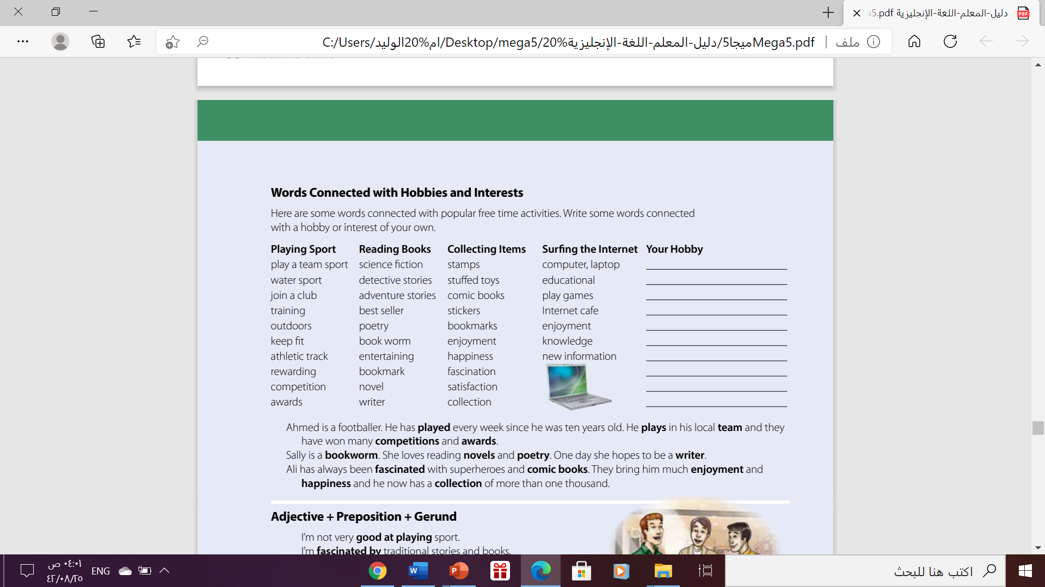
Hobbies & interests

Slide 11
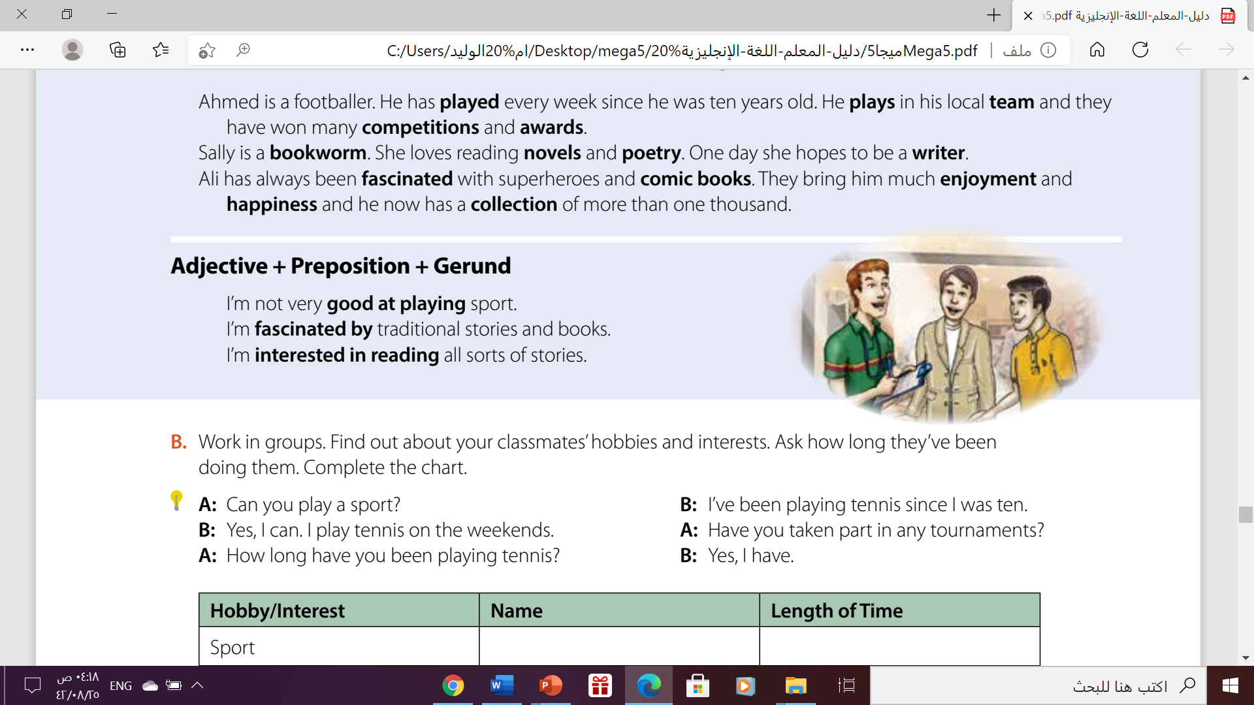
adjective + Preposition + Gerund
2005
2015
2019
Example
I’m good at using computers.
I’m not very good at speaking in public.
I’m interested in working outdoors.
I'm not interested in working in the computer industry.

Slide 12
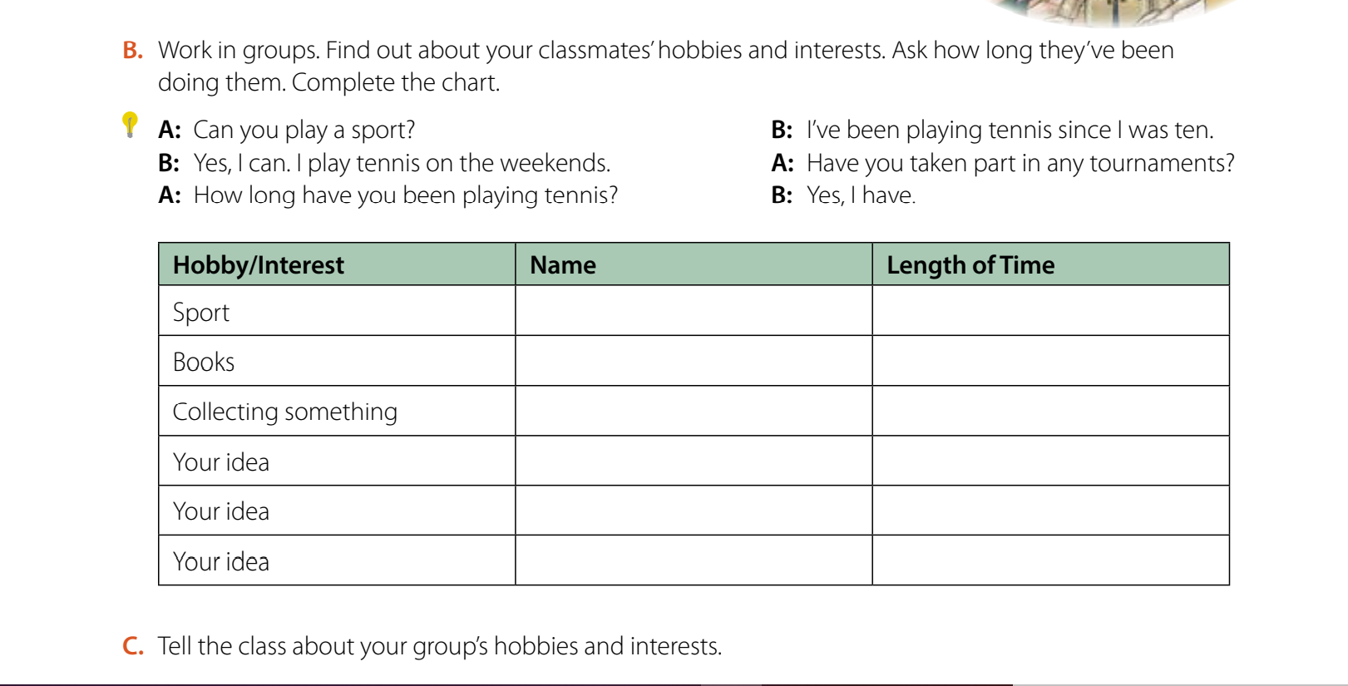

Slide 13
Home work
Work book p. (65) , exercise ( M)

Slide 14

THANKS!

