Slide 1
Unit6 The Gender Divide Writing
Done by: Entisar Al-Obaidallah

Slide 2
Lesson Objectives
01
04
02
05
03
06
Distinguish
Identify
Between verbal and nonverbal communication.
the characteristics of the comparative essay
State
Organize
the characteristics of nonverbal communication.
their own ideas to write a comparative essay
Read
Write
the text for specific information correctly
an essay about communication features of men or women from different cultures

Slide 3
Open
01
02
03
04
Your student’s book , p( 90)
05
Let's Get Started
06

Slide 4
Let’s Discuss

Slide 5
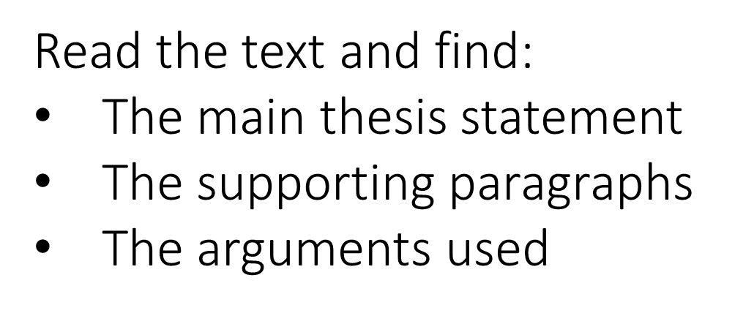
01
02
1
03
What is the title of the text ?
4
04
2
6
Verbal and non-verbal communication
05
How many paragraphs ?
5
06
There are 6 paragraphs
3

Slide 6
Read the text and find:
The main thesis statement
01
02
03
Thesis Statement
04
05
Read the text and find:
The supporting paragraphs
06
Supporting paragraphs: paragraphs 2 to 6.

Slide 7
Read the text and find:
The arguments used
01
02
03
04
Argument Statement
05
06
Arguments: describing as opposed to looking at a photograph of the center of town .

Slide 8
01
Argument Statement
02
03
Read the text and find:
The arguments used
04
05
06
Arguments: Showing or telling a friend about a new gadget.

Slide 9
01
Argument Statement
02
03
Read the text and find:
The arguments used
04
05
06
Arguments: Situations where verbal language is required, for example when running into someone you haven’t seen for a long time

Slide 10
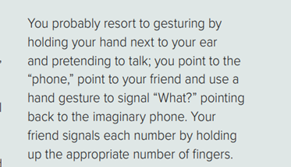
01
Argument Statement
02
03
Read the text and find:
The arguments used
04
05
06
Arguments: Having to communicate with someone at a distance/at the airport to get his phone number

Slide 11
01
Read the text and find:
The arguments used
02
03
04
Argument Statement
05
06
Arguments: According t studies 60% of communication is carried out
through non-verbal means.

Slide 12
01
02
03
04
05
06

Slide 13
Follow these steps to write a comparative / contrastive essay:
01
02
03
04
05
06

Slide 14
Open
01
02
03
04
Your student’s book ,
p.( 91)
05
06

Slide 15
Thanks!
01
02
03
04
05
06

