Slide 1

Form , meaning and function
Mega goal 1.3
Unit : 3
(if it hadn’t happened)
Tr: Kholoud Al Ghamdi

Slide 2
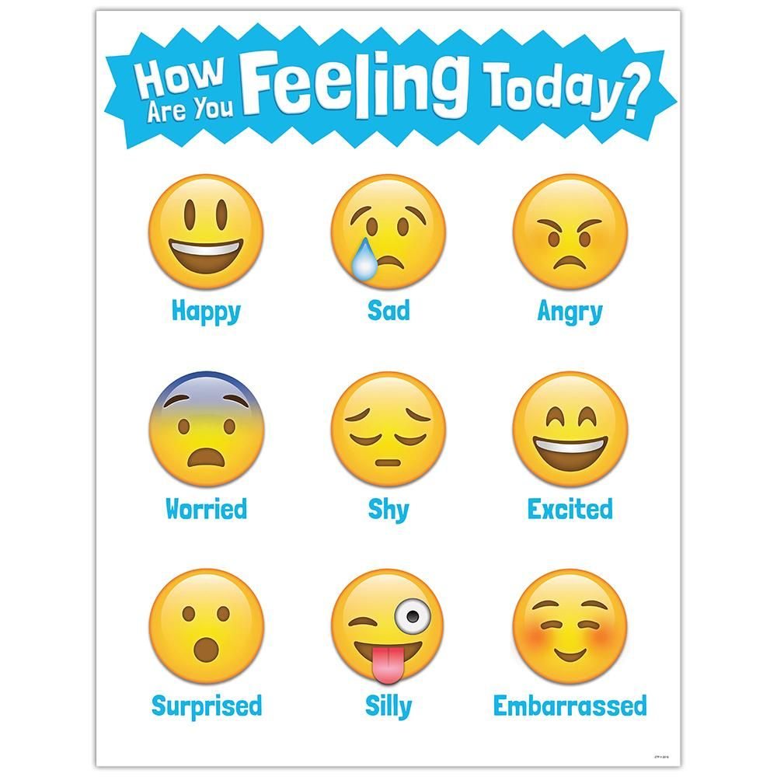

Slide 3
Revision :
Regret :
S+ should have + v3
- I should have ( listen –listened –listening ) to my mom.
-She shouldn’t have (eat –ate-eaten) a lot of candy .

Slide 4
Revision :
Conditional sentences : (hypothetical situation )
If + had +v3 , would + v
If+ had +v3 , would have + v3
If + had +v3 , would have be + v-ing
If + had +v3 , could /might + v
-if I had (studied –study) , I would have ( pass –passed ) the exam
-If you hadn’t (learning-learned) ,you wouldn’t (understand- understood)
-If we had (win –won), we would have be ( celebrating –celebrated)

Slide 5

Lesson Objectives
01
03
Form
Practice
02
04
Practice
Use
Sentences using present perfect and simple past correctly
Expressing : Ability, Permission and Request correctly
Using time expressions : Ago , For & Since
If with past perfect and Would Be Able / Would Have Been Able

Slide 6

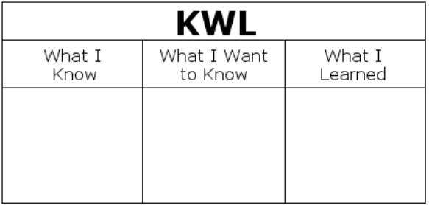
What do you know about present perfect ?
Past simple ?
Present perfect : have/has +v3
-The using of them
-the difference of them
-their time expression
(key words )
Past simple : S + v -ed

Slide 7

Present perfect simple:
Time is not known or not important
Using :
1- to say how many things have been done or how many times something has been done…
2 – to talk about recently completed action..
3- to talk about something happened in the past and continue to the present ,, or past actions with an important present result..
Key words:
Never, ever, already, just ,yet ,since ,and for

Slide 8

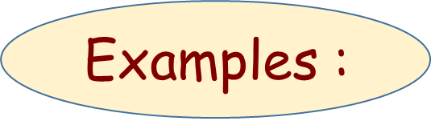
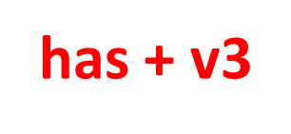




Structure :
She
He
It
Singular
I
You
We
They
plural
Is the time accurate ? important ?
She has already studied English
You have just eaten Kabsah

Slide 9

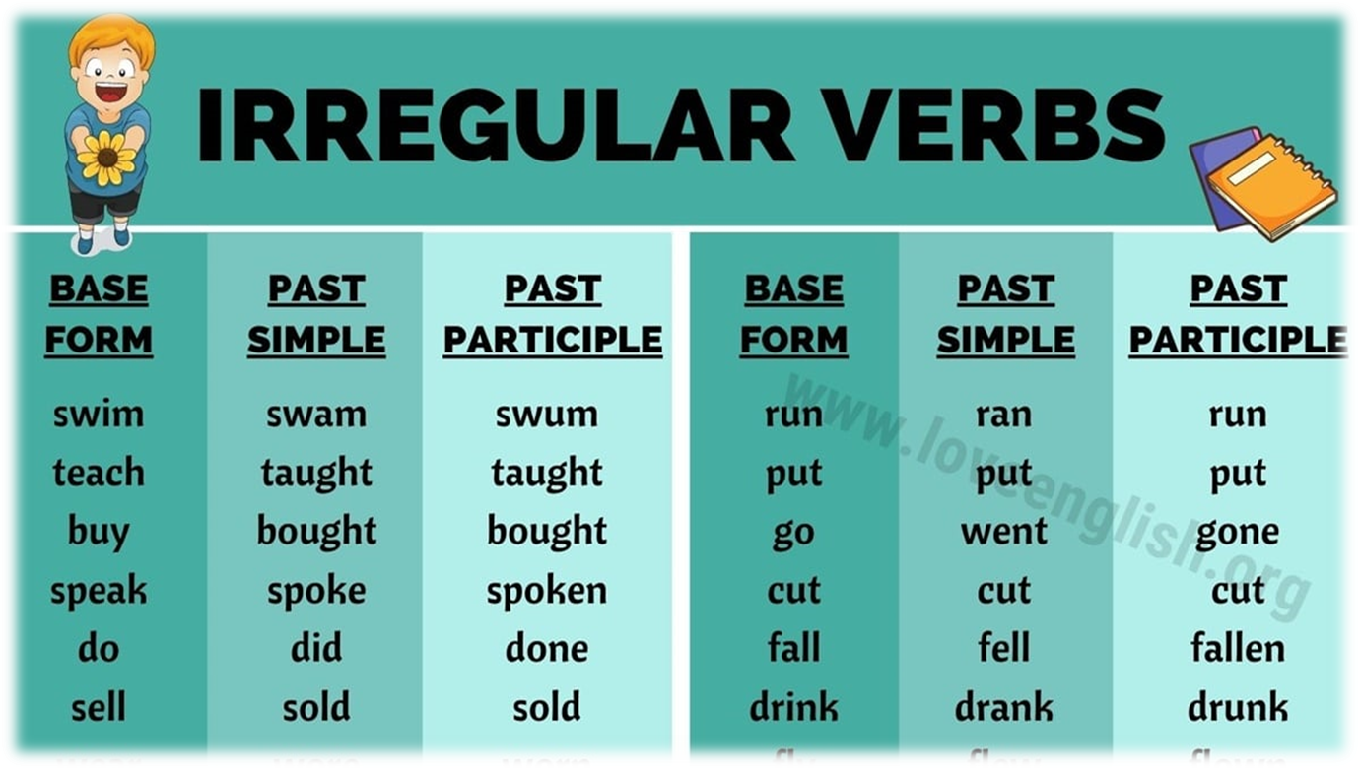

Let’s revise :
Write down sentences in present perfect simple !!
Pair work
Time : 3 minutes
Clean – cook – help – work – play – wash –invent – travel –live – dance-paint
Regular verbs examples

Slide 10
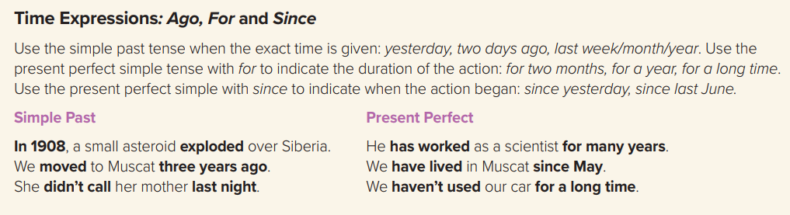

Slide 11
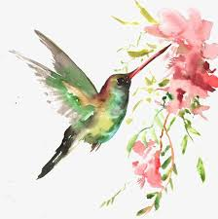

The expression with for and since:
for
To indicate the duration of the action ..
For two months , for a year , for a long time….
I have lived in Jeddah for 34 years
To indicate when the action began ..
Since yesterday , since last June , since the morning
I have lived in Jeddah since 1987
since

Slide 12
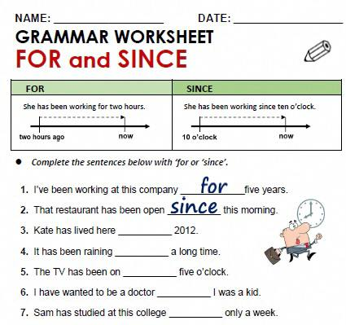
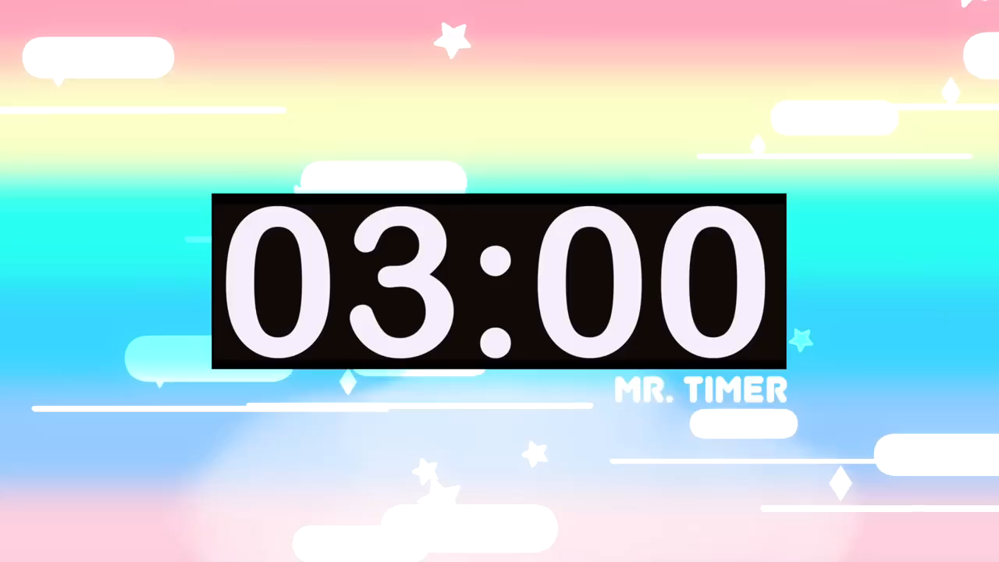
Pair work
Time : 3 minutes

Slide 13
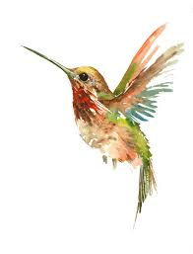
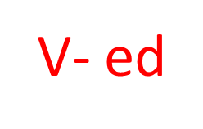
Past simple tense
Time is accurate and important
Using :
(to describe things that started and finished in the past ) completed actions..
Structure :
She/he/it
You/I/ we
They/plural(boys)
Singular (Sara)
Example :
*She cleaned her room last week..
*I slept early yesterday..
Key words : yesterday , last , ago , old date

Slide 14
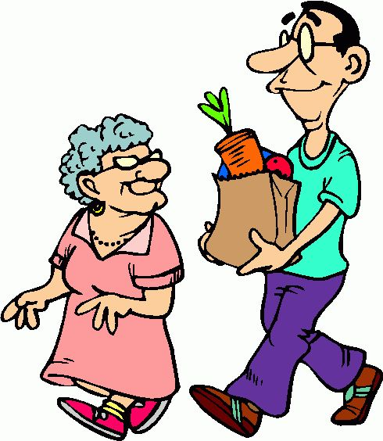
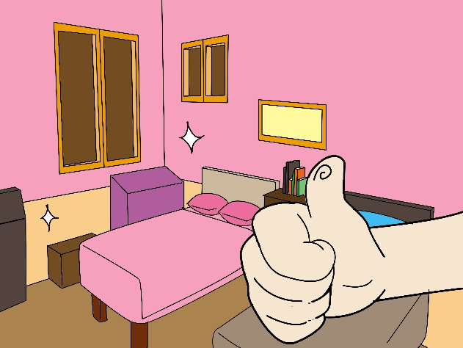

Write sentences in simple past :
Go /supermarket
Clean / bedroom
Watch / movie

Slide 16




Past simple present perfect simple
Past simple
Present perfect simple
the exact time isn’t known, or isn’t important
The exact time is given
Time is specific
I watched TV two hours ago.
I visited Sarah last Monday.
Time isn’t specific
I have already eaten ..
I have just eaten ..
I have never met Ali.

Slide 17

Present perfect : have/has +v3
-The using of them
-the difference of them
-their time expression
(key words )
Making sentences using present perfect and past simple
Past simple : S + v -ed
Using For and since with present perfect
Time expression of past simple

Slide 18
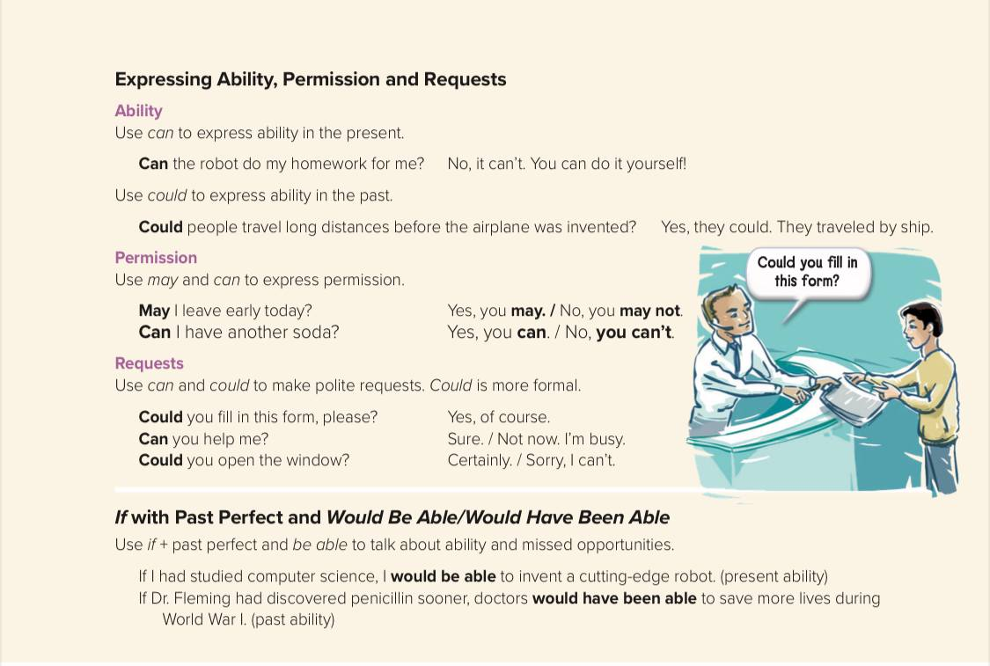

Slide 19

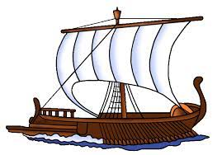
Ability
Can + V present
Can she travel abroad ? Yes, she can
Could + V past
Could they travel long distances before airplane was invented ?
Yes , they could by ship.

Slide 20
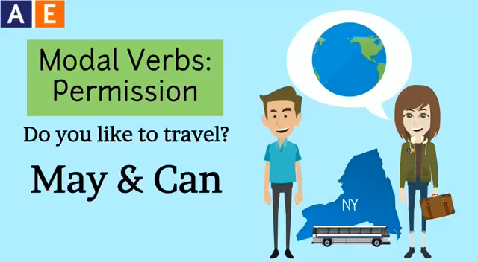

Slide 21


permission
May + V
Can + V
May I leave early ?
Can I go to bathroom ?

Slide 22
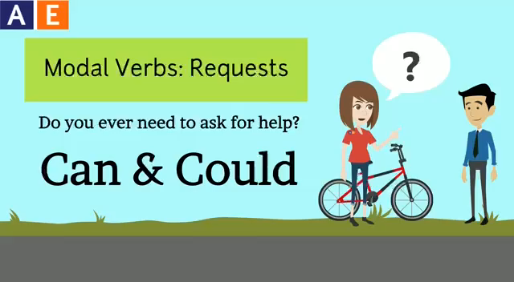

Slide 23
Request
Could you help me please ?
Yes, of course
Can you close the door ?
Certainly
Could is more formal

Slide 24

Write a request ?
A permission ?

Slide 25
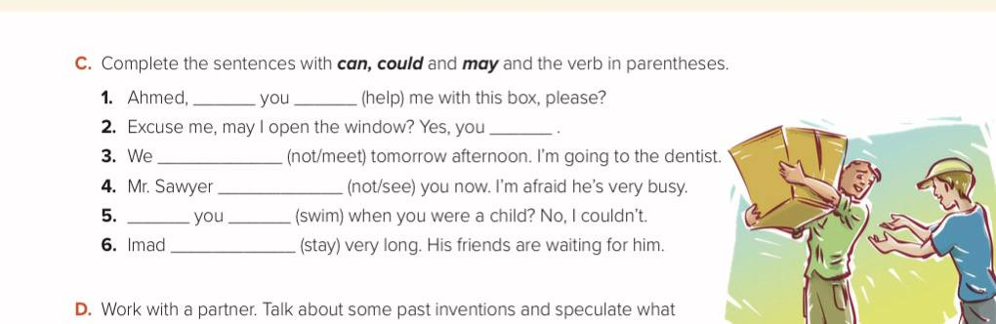
Let’s practice :
Think , pair and share

Slide 26

Tr: Kholoud AlGhamdi

