Slide 1
Unit 4
What They Said
Language in Context+ Conversation
Mega Goal 1.3
Done by:Entisar Al-Obaidallah

Slide 2
Lesson Objectives
01
02
03
04
Listen for specific information
Report sentences about global warming .
Distinguish between stressed and unstressed "that” .
Answer Comprehension questions about the convesation

Slide 3

Open
Your student’s book
p.(52)

Slide 4
01
Language in Context

Slide 5
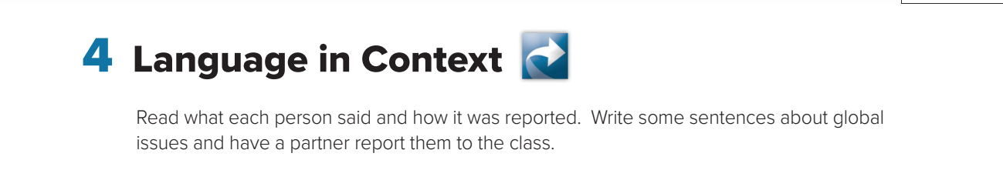
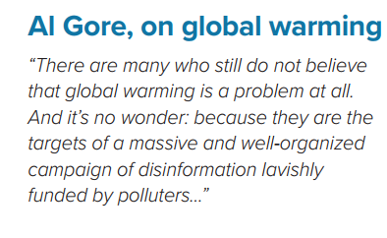
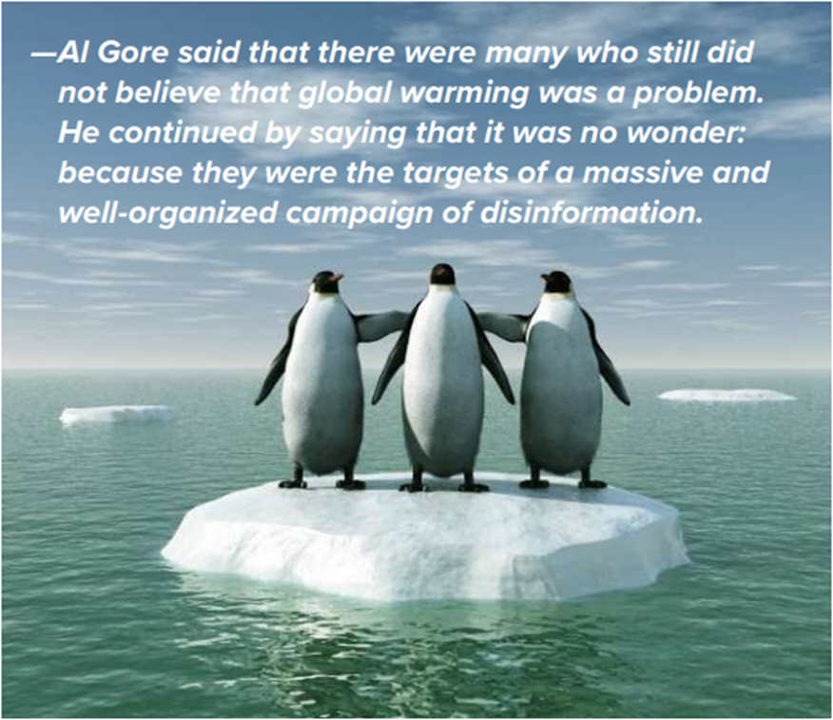
Reported Speech
Direct Speech

Slide 6
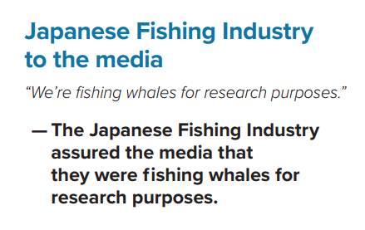
Direct Speech
Reported Speech

Slide 7

Write some sentences about
“ Global issues” and report them

Slide 8
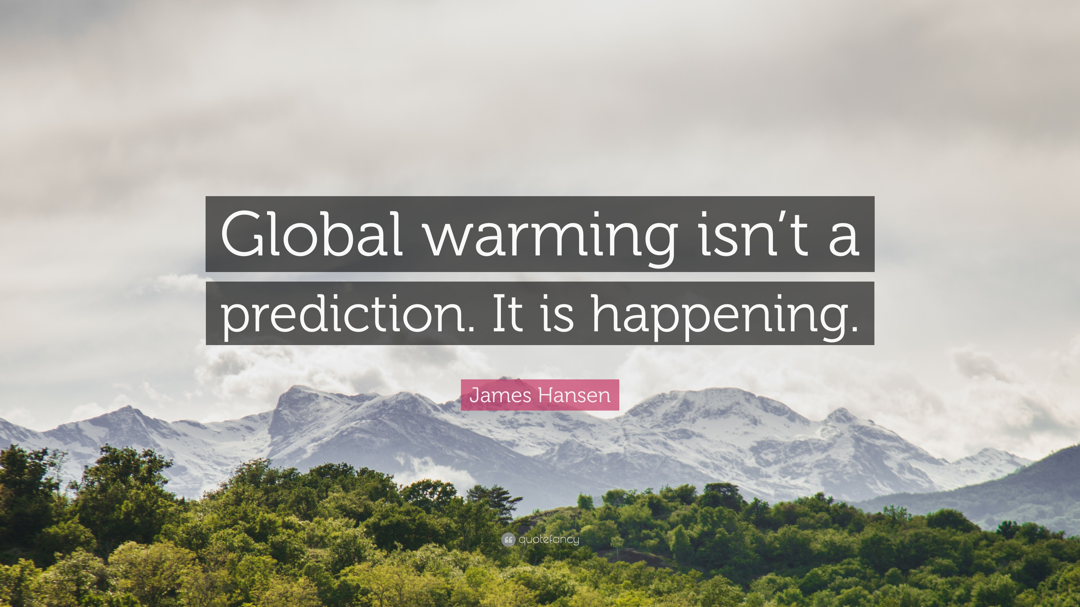
James Hasten said that Global Warming wasn’t a prediction and believed it was happening .

Slide 9
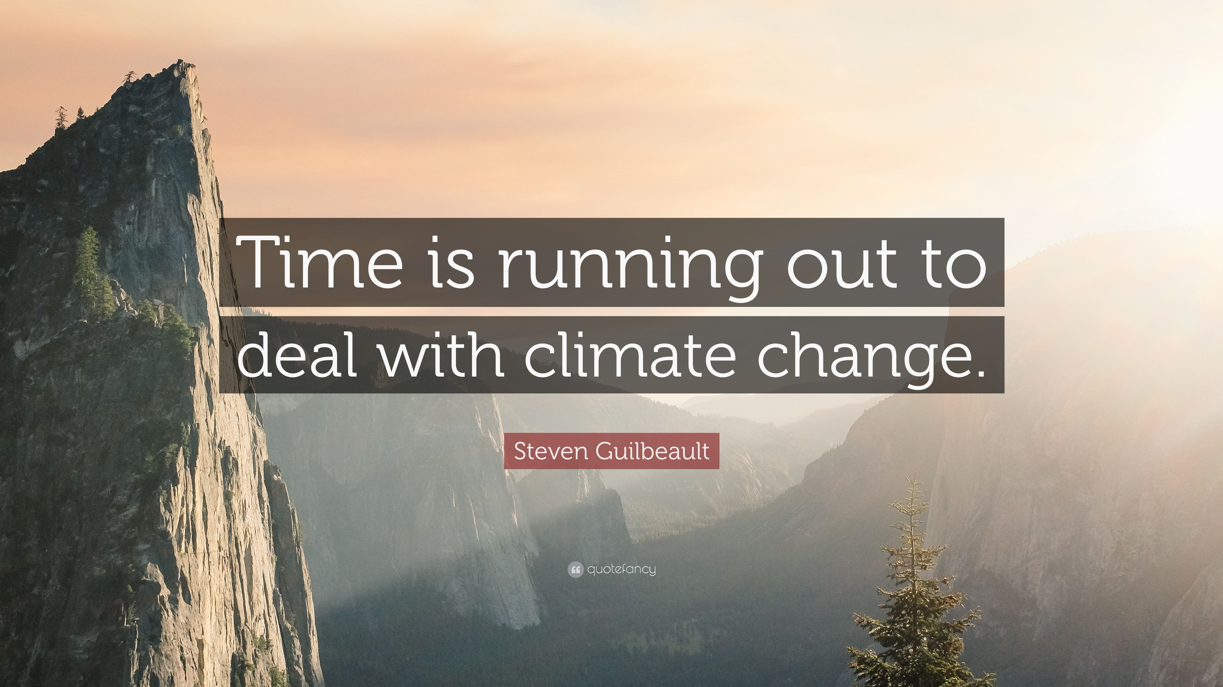
Steven Guilbeault said that time was running out to deal with climate change .

Slide 10
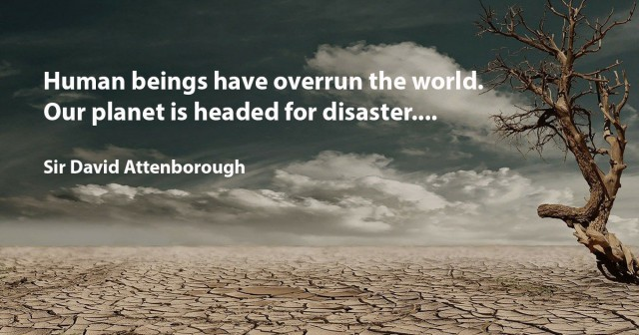
Sir David Attenborough said that human beings had overrun the world and our planet was headed for disaster.

Slide 11
02
Listening

Slide 12
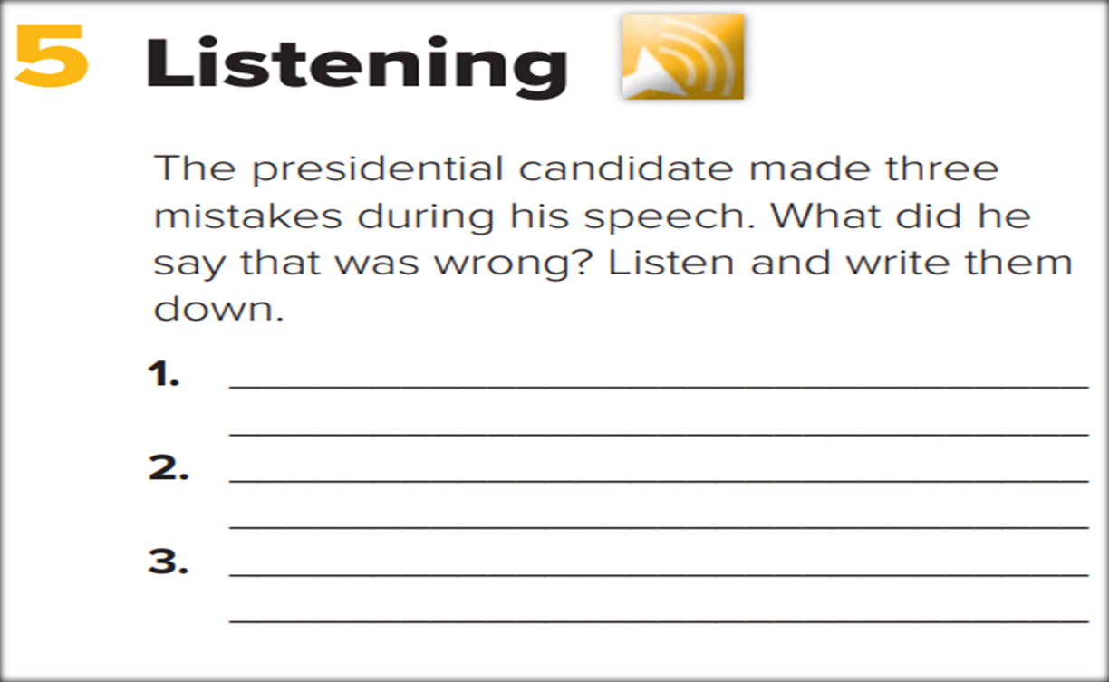

. He said that he would raise unemployment.
He said that he would ask his staff to wake him up at any time, even during meetings.
He said that people who couldn’t read and write shouldn’t be in school.

Slide 13
Pronounciation
03

Slide 14
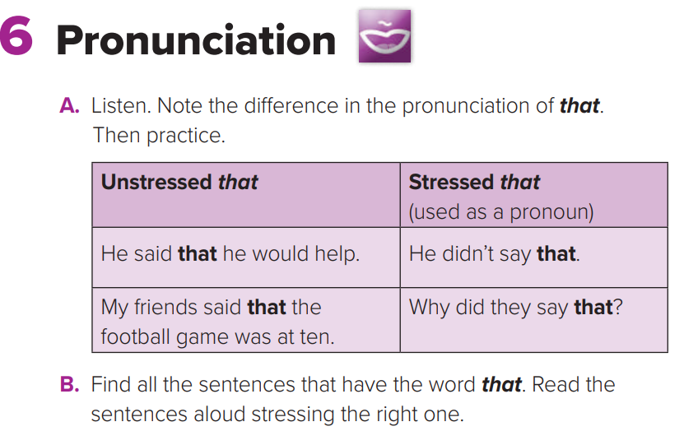
The word ( that ) is unstressed when it connects parts of the sentence .
The word ( that ) is stressed when it functions as a pronoun .

Slide 15
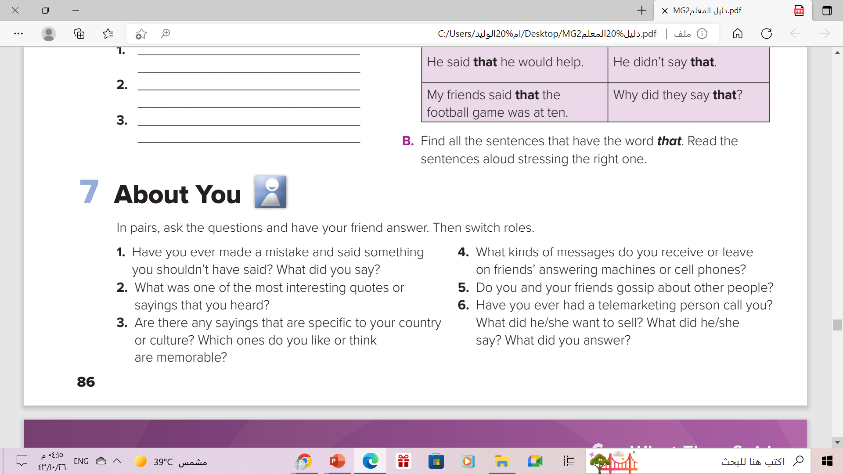


Now , your Turn

Slide 16
Open
Your student’s book
p.(53)

Slide 17
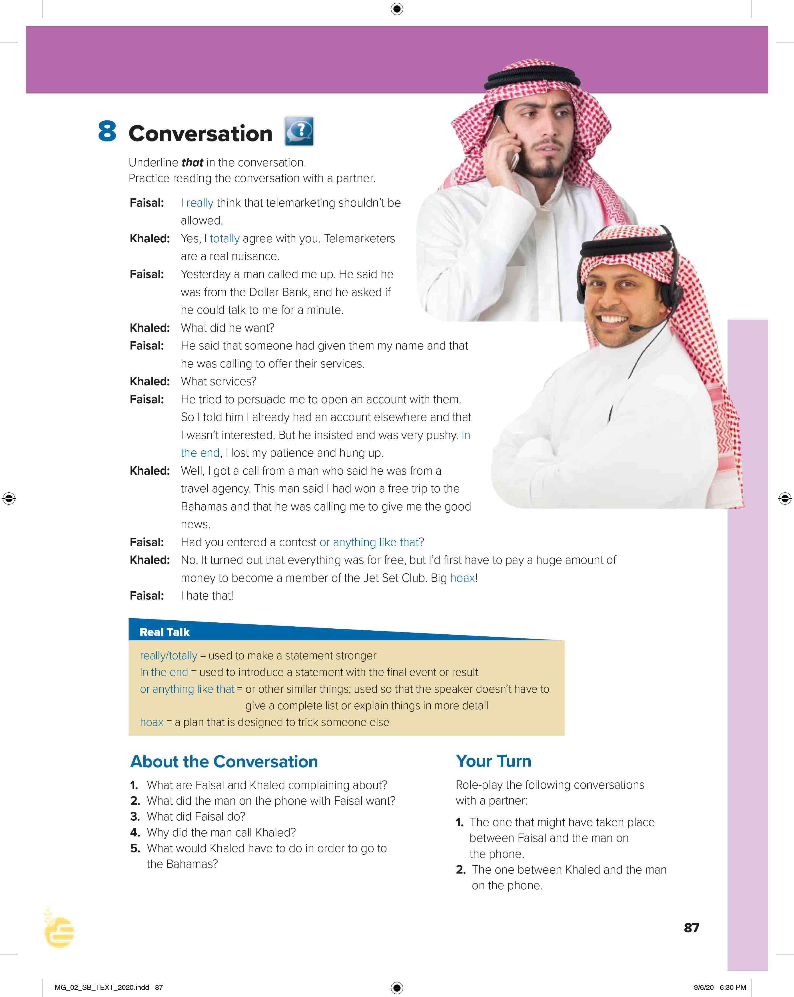
Underline that in the conversation
What is this conversation about ?
Telemarketing calls
What was Faisal’s call about ?
Opening account in a bank .
What was Khalid’s call about ?
Travel agency to offer him free ticket .

Slide 18


Slide 19


Find a word that means…..
the activity of selling a product or service by phone
telemarketing

Slide 20
Find a word that means…..
something that is very annoying
nuisance

Slide 21
Find a word that means…..
to try to get someone to do something
persuade

Slide 22
Find a word that means…..
somewhere else, some other place
elsewhere

Slide 23
Find a word that means…..
so determined to succeed that the person is rude
pushy

Slide 24
Words and Meanings
telemarketing = the activity of selling a product or service by phone
nuisance = something that is very annoying
persuade = to try to get someone to do something
elsewhere = somewhere else, some other place
pushy = so determined to succeed that the person
is rude

Slide 25



Slide 26
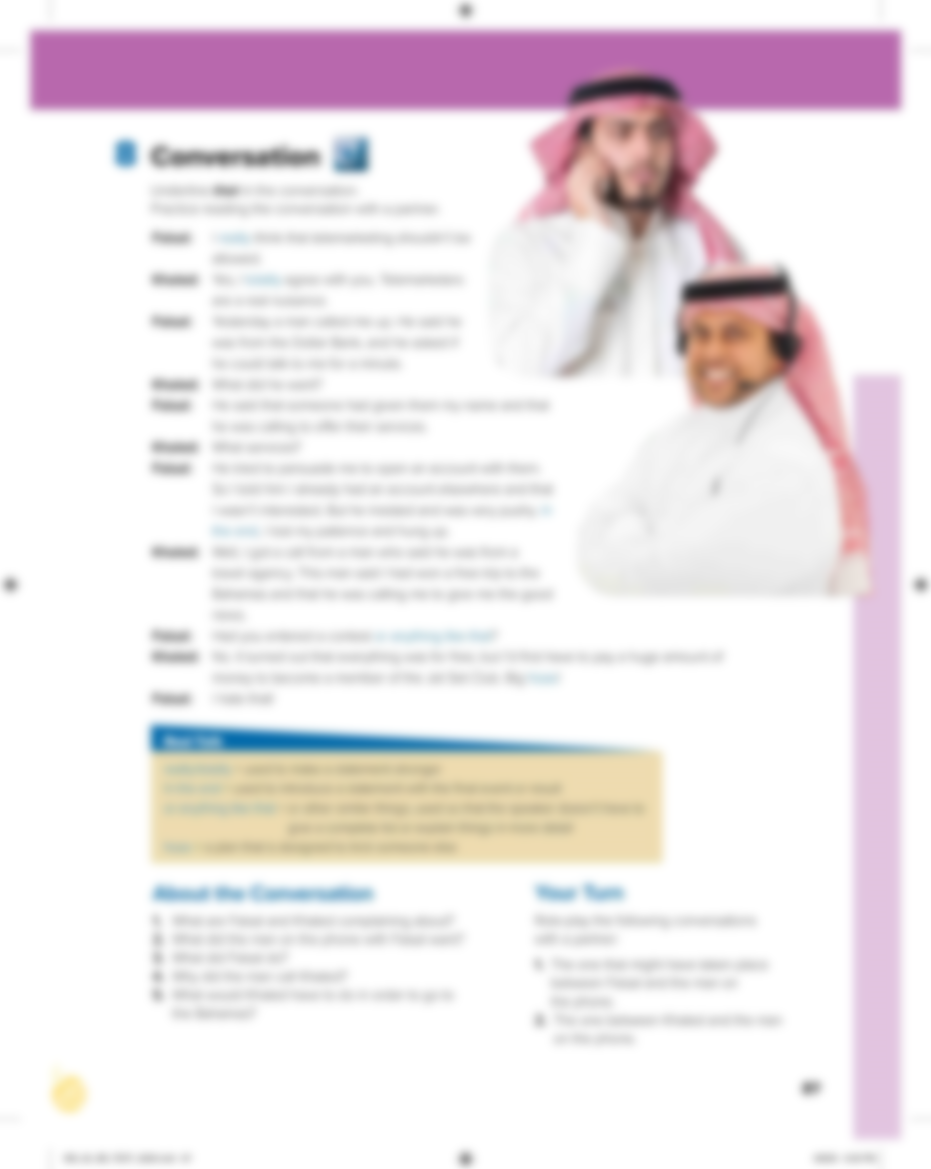

Who says ………
really
Faisal

Slide 27
Who says ………
totally
Khaled

Slide 28
Who says ………
In the end
Faisal

Slide 29
Who says ………
or anything like that
Faisal

Slide 30
Who says ………
hoax
Khaled

Slide 31
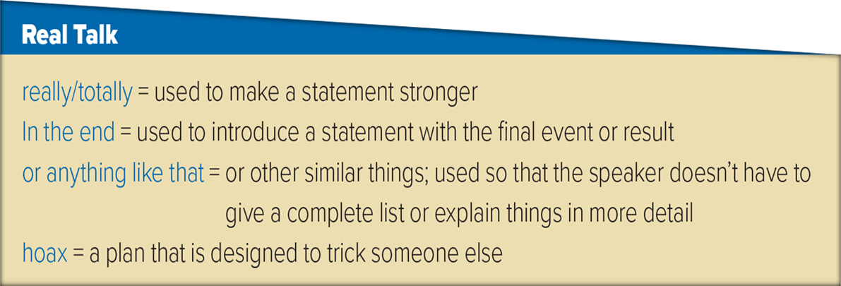
Read the words and their meaning:
In addition to totally and really, completely or absolutely can be used.
It can be a harmless joke that is played on someone

Slide 32
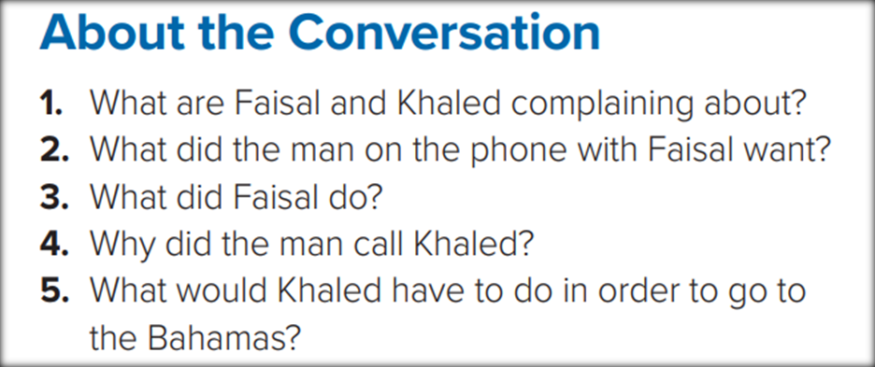
1- Faisal and Khaled are complaining about telemarketers .
2- The man on the phone with Faisal tried to persuade him to open an account at a bank .
3- Faisal lost his patience and hung up .
4- The man told Khaled that he had won a free trip to the Bahamas .
5- Khaled would have to pay a huge amount of money to join a club to go on the trip .

Slide 33


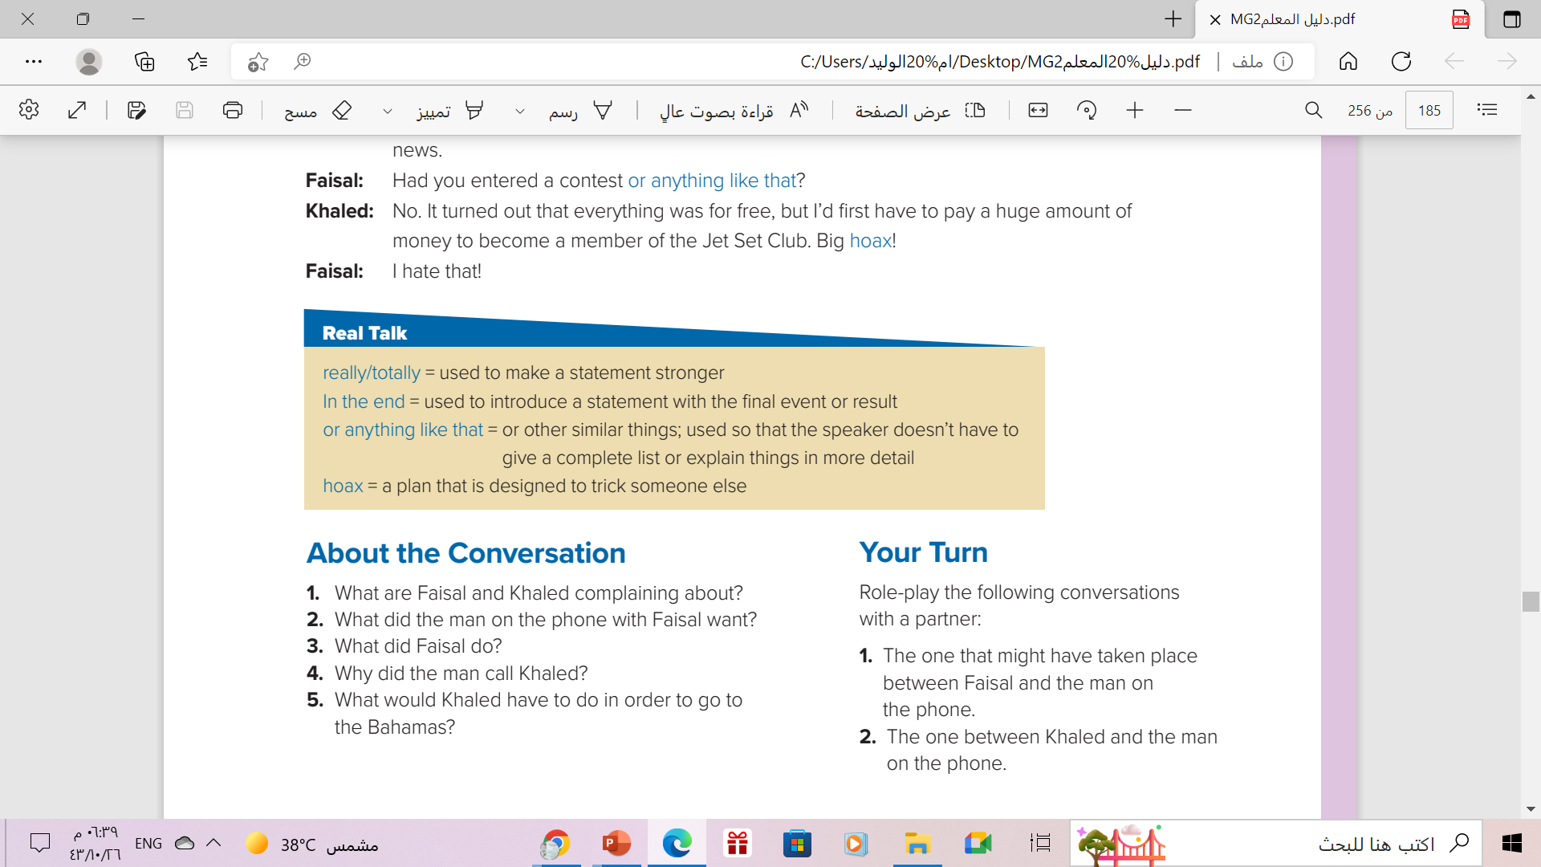
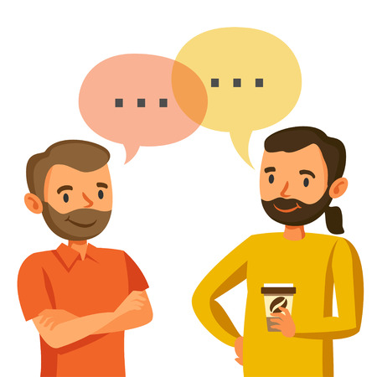
Your Turn

Slide 34

From The Holy Qura’an

Slide 35
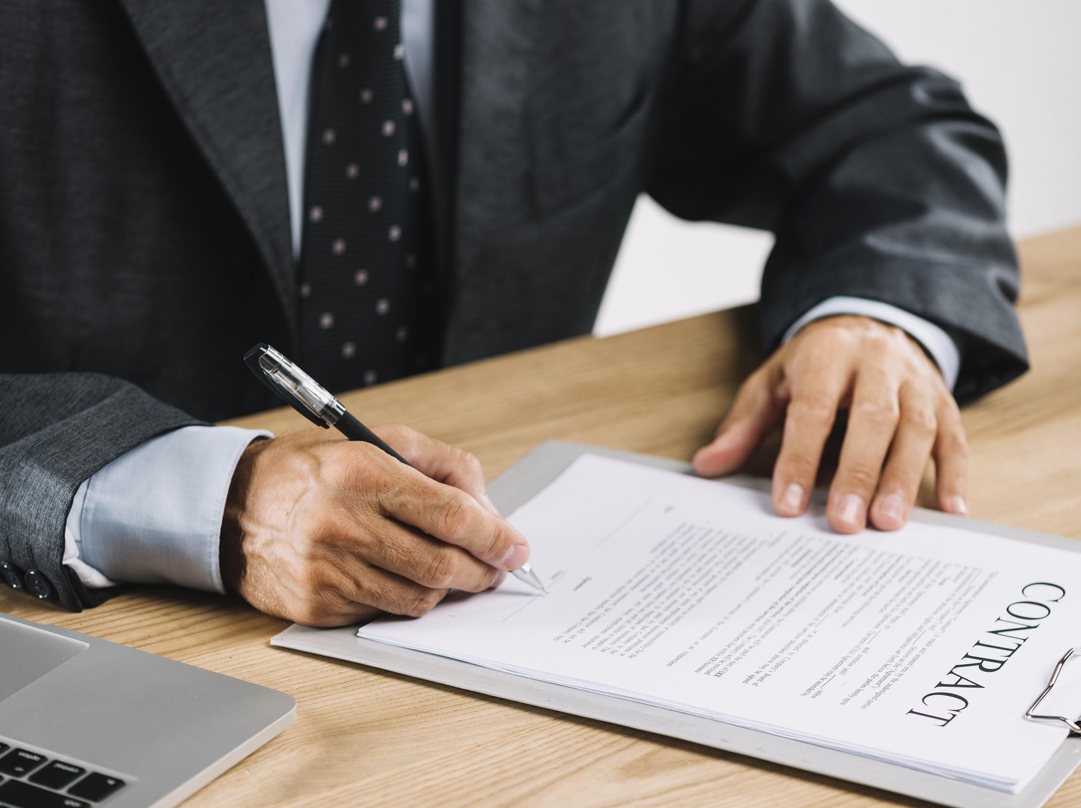
Homework
Workbook p.( 110) , exercise (B)

Slide 36

THANKS

