Slide 1
Unit 4
WhatThey Said
Form,Meaning & Function
Mega Goal 1.3
Done by: Entisar Al-Obaidallah

Slide 2
Lesson Objectives
01
02
03
04
Practice
Ask
Use
Express
Words connected with the environment and natural disaster
Negative questions correctly
The relative adverb: Where correctly
Agreement and disagreement correctly

Slide 3
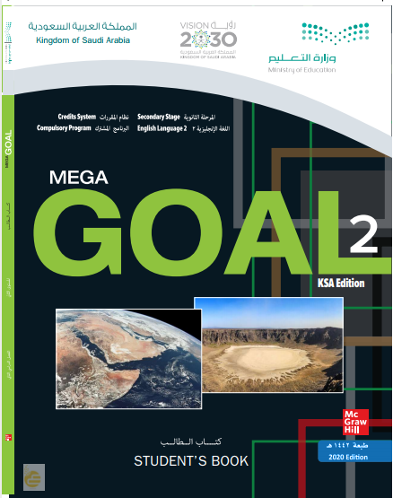
Open
Your student’s book p.
( 58)

Slide 4
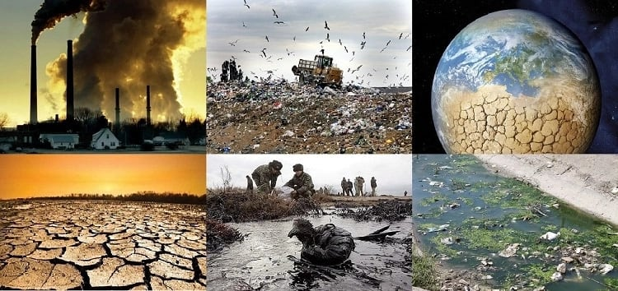

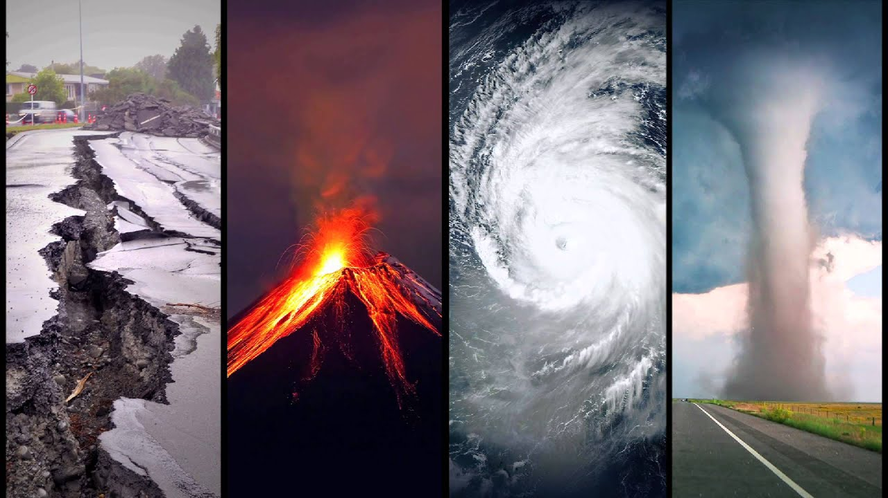
What is the difference between the Environmental Issues & Natural Disaster?

Slide 5
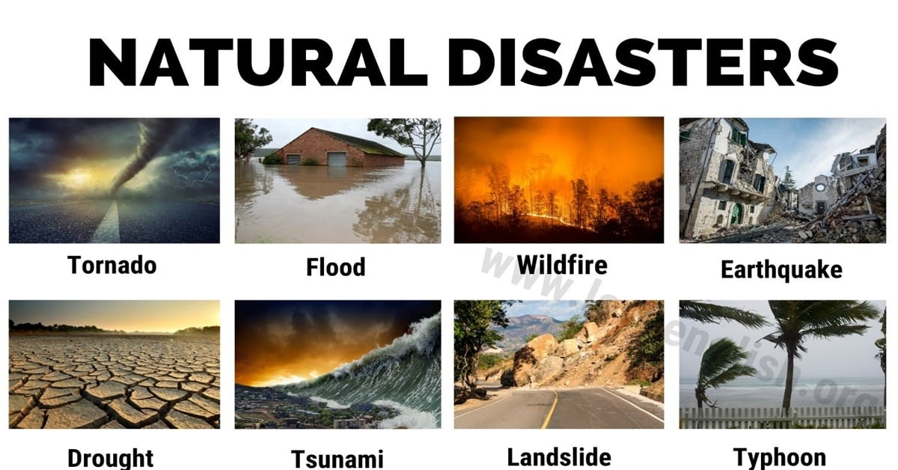
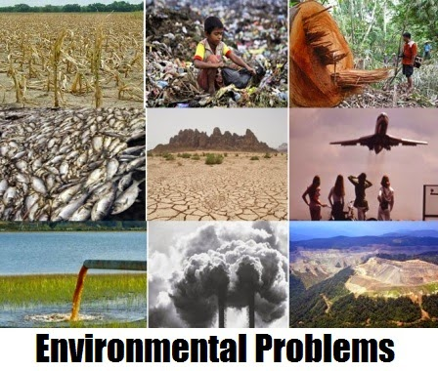
Natural Disaster: a sudden and terrible event in nature (such as a hurricane, tornado, or flood) that usually results in serious damage and many deaths
overfishing
rubbish
hunting
Environmental issues are harmful effects of human activity on the biophysical environment.
Drought
Water pollution
air pollution
Global warming

Slide 6
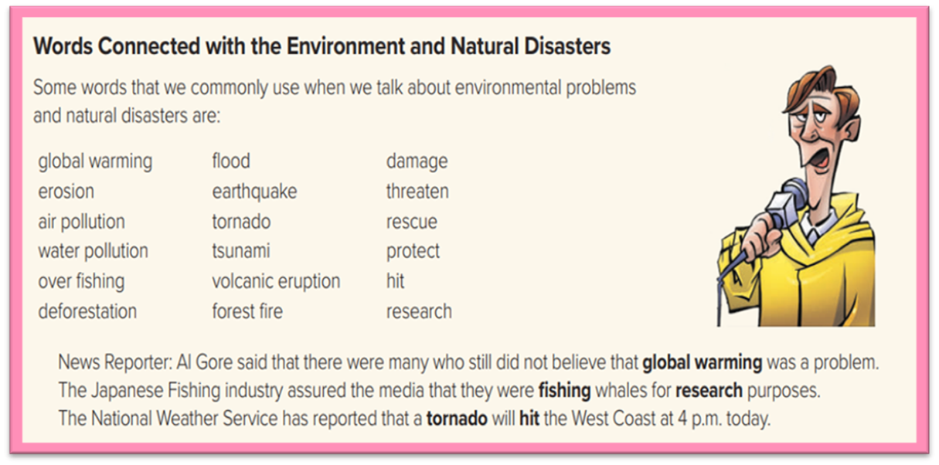

Slide 7
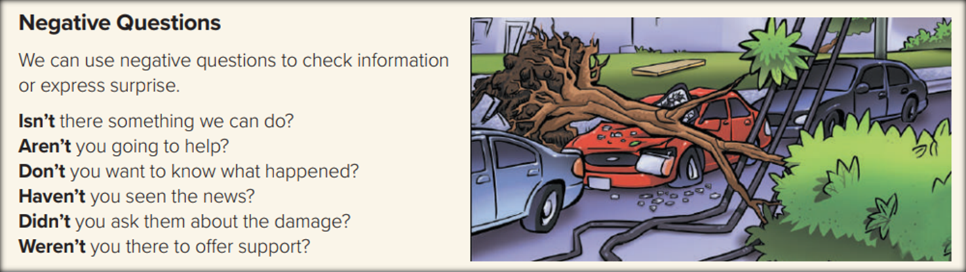
Negative Questions
Form
Auxiliary verb
not
subject

Slide 8
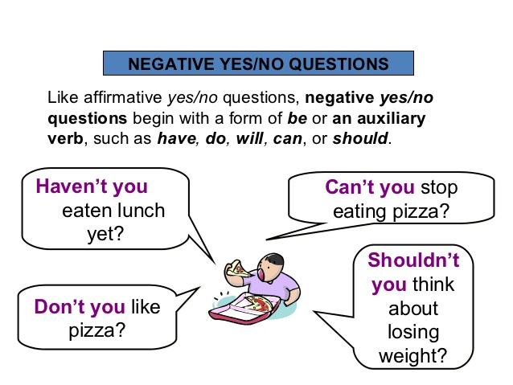
Negative Questions

Slide 9
Example of Negative Questions
Wasn’t Ali at the meeting last night? (Getting information)
Didn’t he study for the test? (Expressing surprise)
Don’t you want to see a doctor? (Urging someone to take action)

Slide 10
Open
Your student’s book p.
( 59)

Slide 11
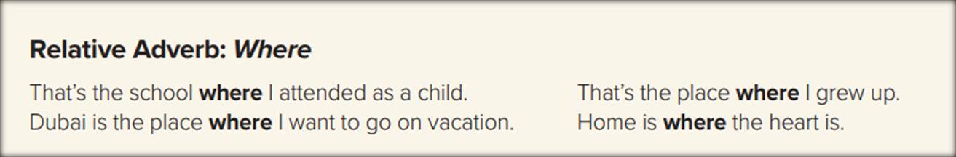
The man who lives next door is a doctor.
This is the car which my sister wants to buy.
That’s the restaurant where we ate last Friday.
Who
Person
Which
thing
Where
place

Slide 12
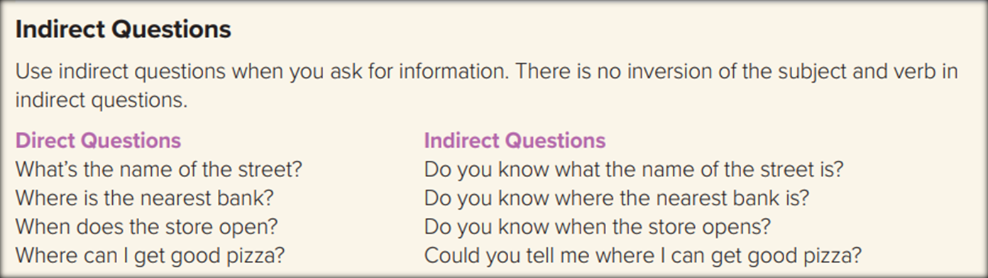
  We start the indirect questions with an introductory phrase such as:
(Do you know / Could you tell me)
In indirect questions, do not use the auxiliary (do, does, or did).

Slide 13
Direct Question
Who is she ?
Question Word
Auxiliary verb
subject
Who
is
she
Indirect Question
subject
Auxiliary verb
Introductory phrase
Question Word
Do you know
Who
she
is

Slide 14
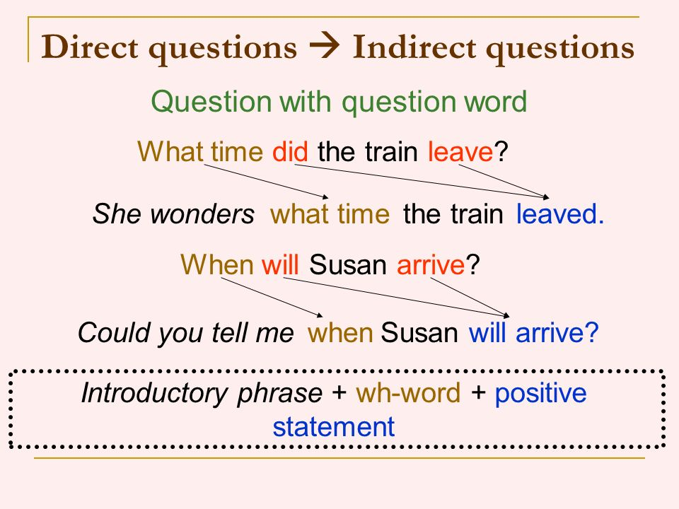

Slide 15
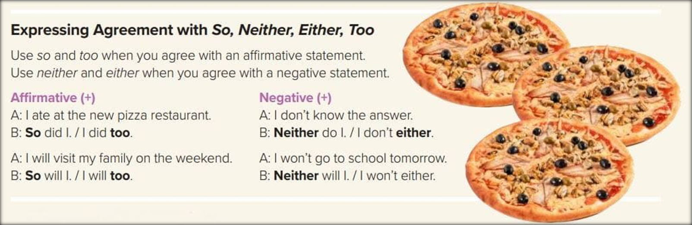

Slide 16
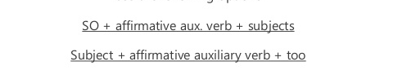
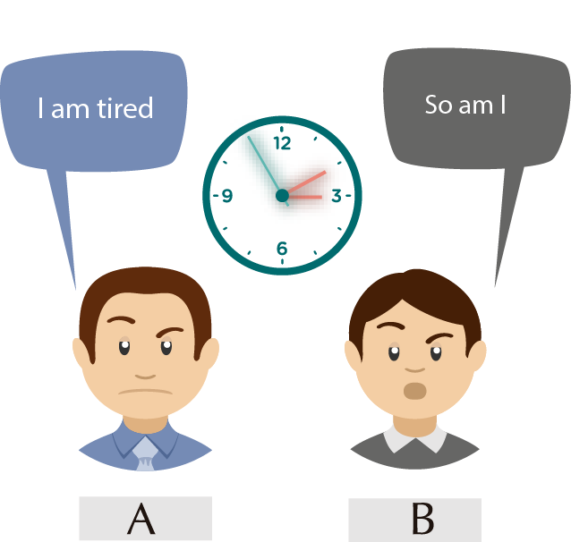
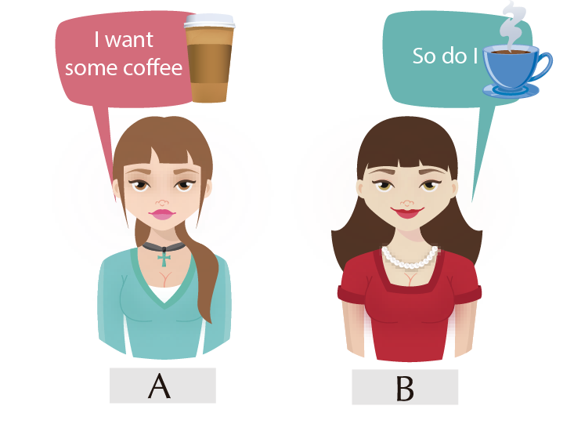
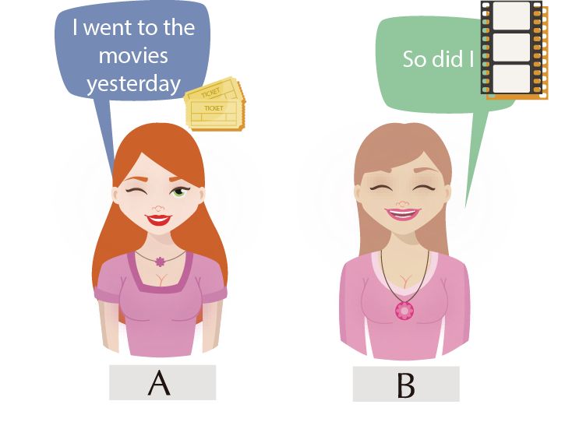
Form

Slide 17
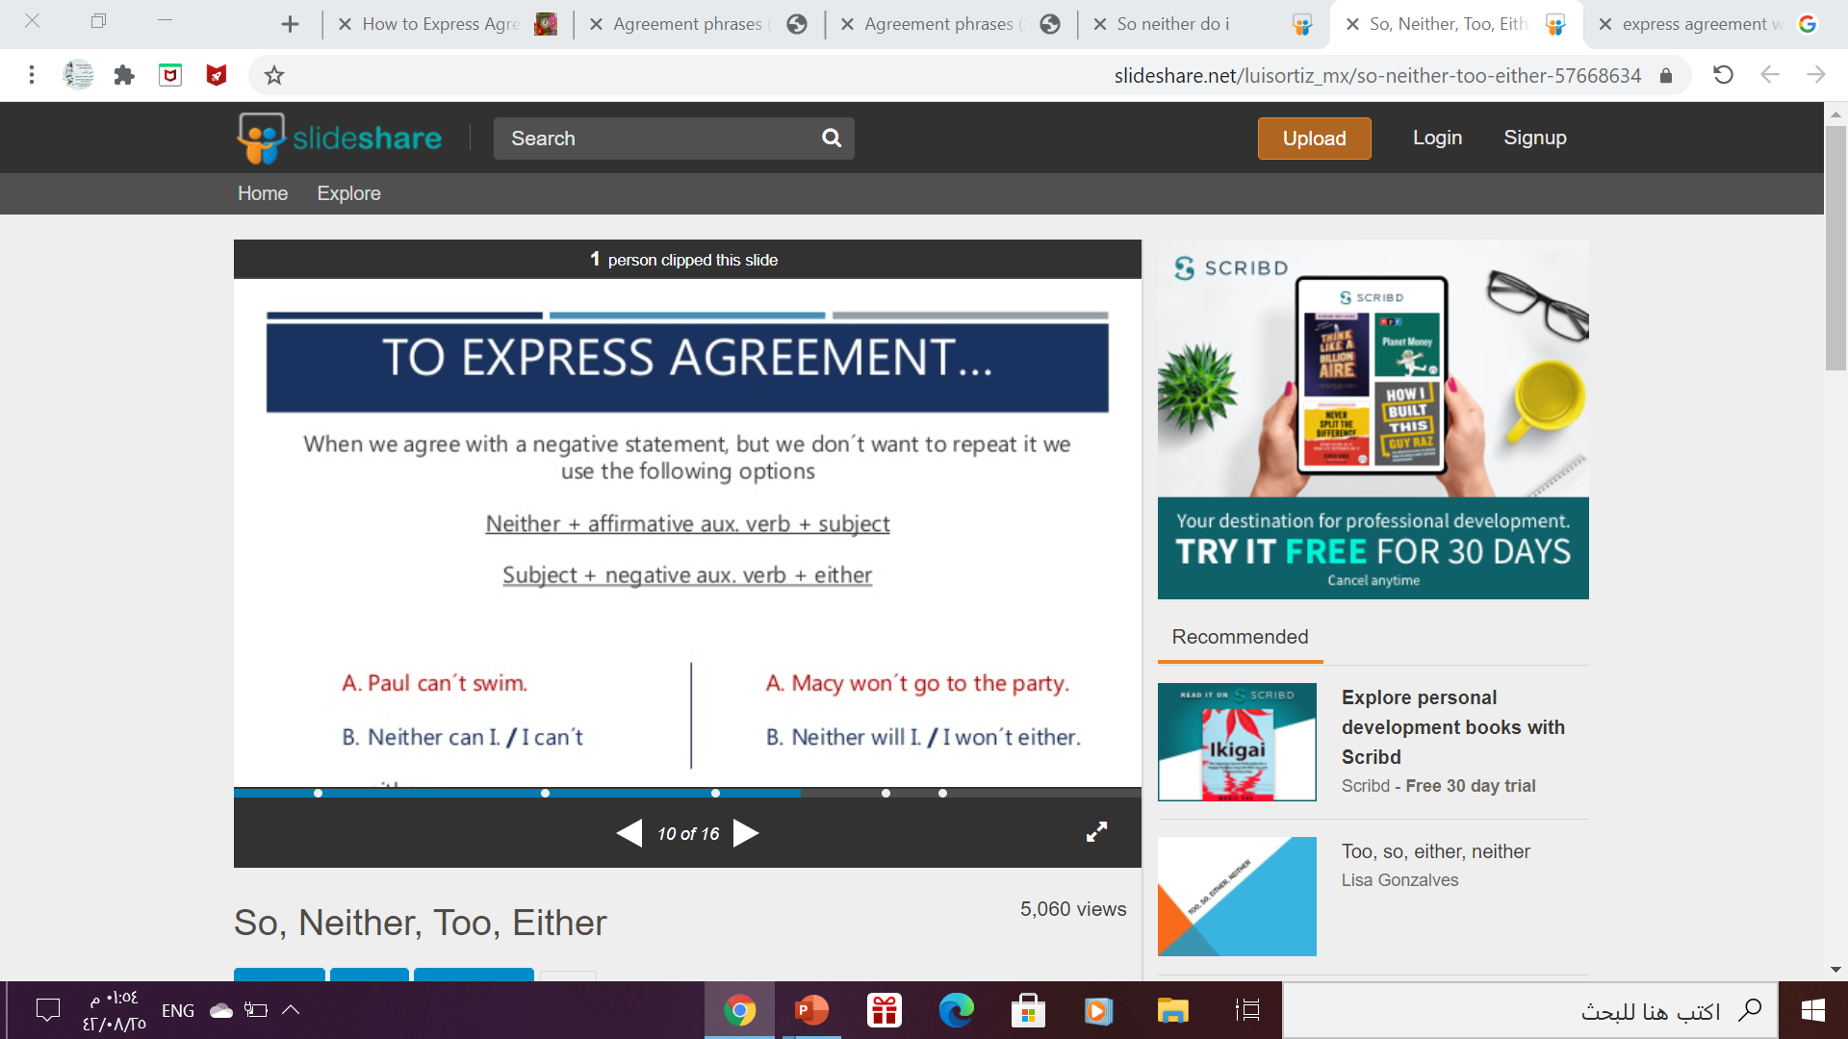
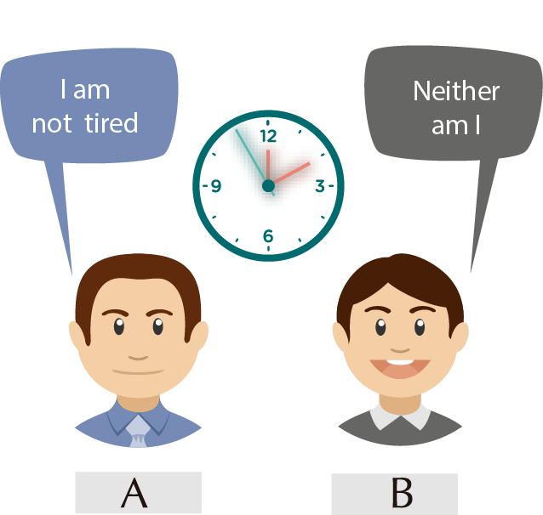
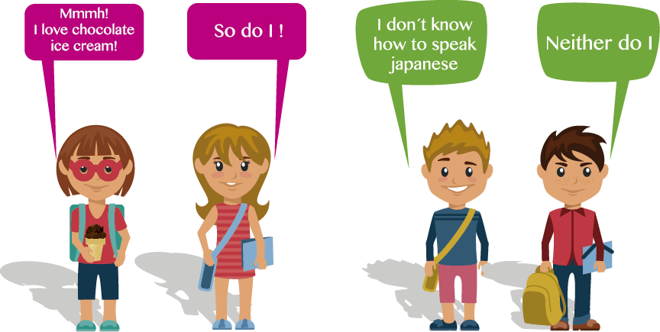

Slide 18
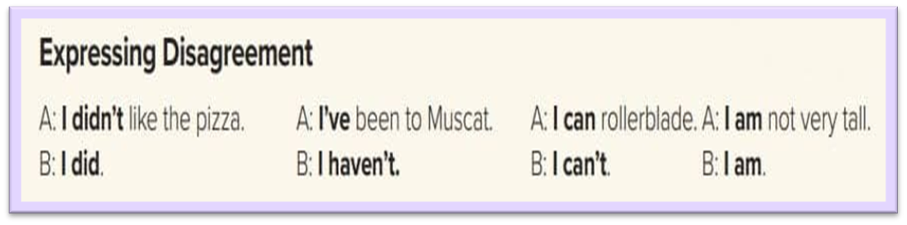

Slide 19
Homework
Workbook ,exercise ( K)
p.(117)

Slide 20

Thanks

