Slide 1



Slide 2

Good Morning

Slide 3

Unit-4-
What They Said

Slide 4
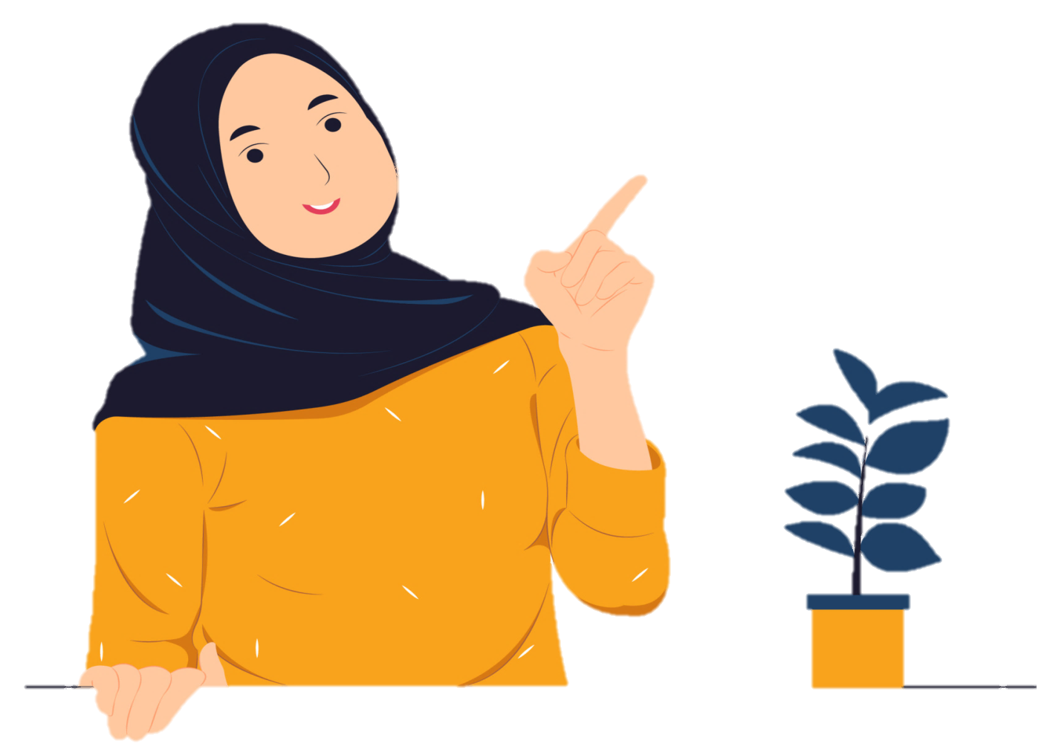
3-Grammar

Slide 5

Reported Speech
Reported Questions
Word Changes in Reported Speech
Reporting Verbs

Slide 6

Objectives
T
The students will be able to :
1–report a speech in the correct tense .
2–use the correct tense to report a question .
3–change pronouns/ adverbs of time correctly in reported speech
4–replace the word "say" with suitable words .

Slide 7


What did he say?
Reported Speech
Warm Up

Slide 8
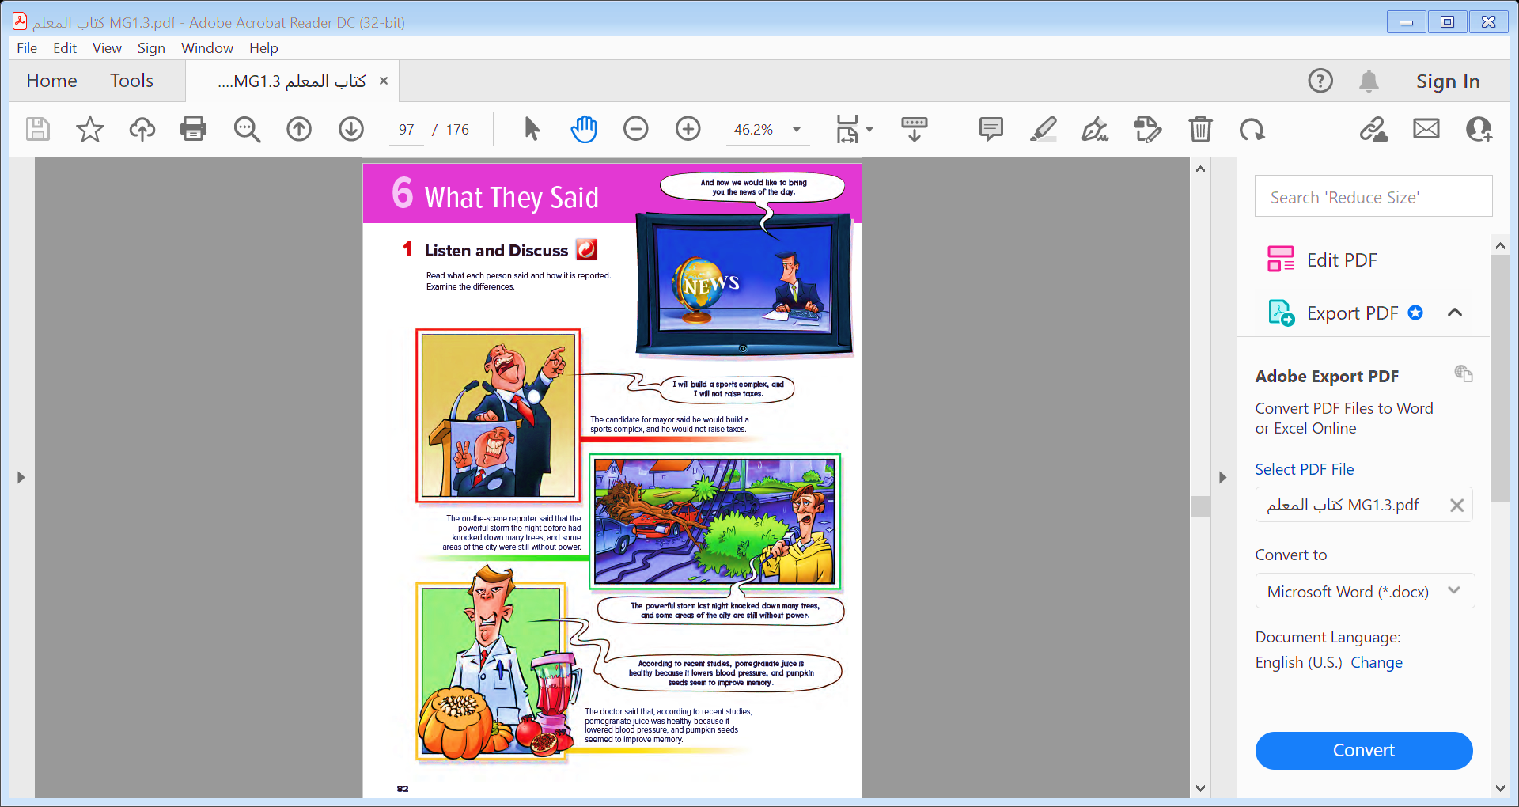
Warm Up
What did he say?

Slide 9



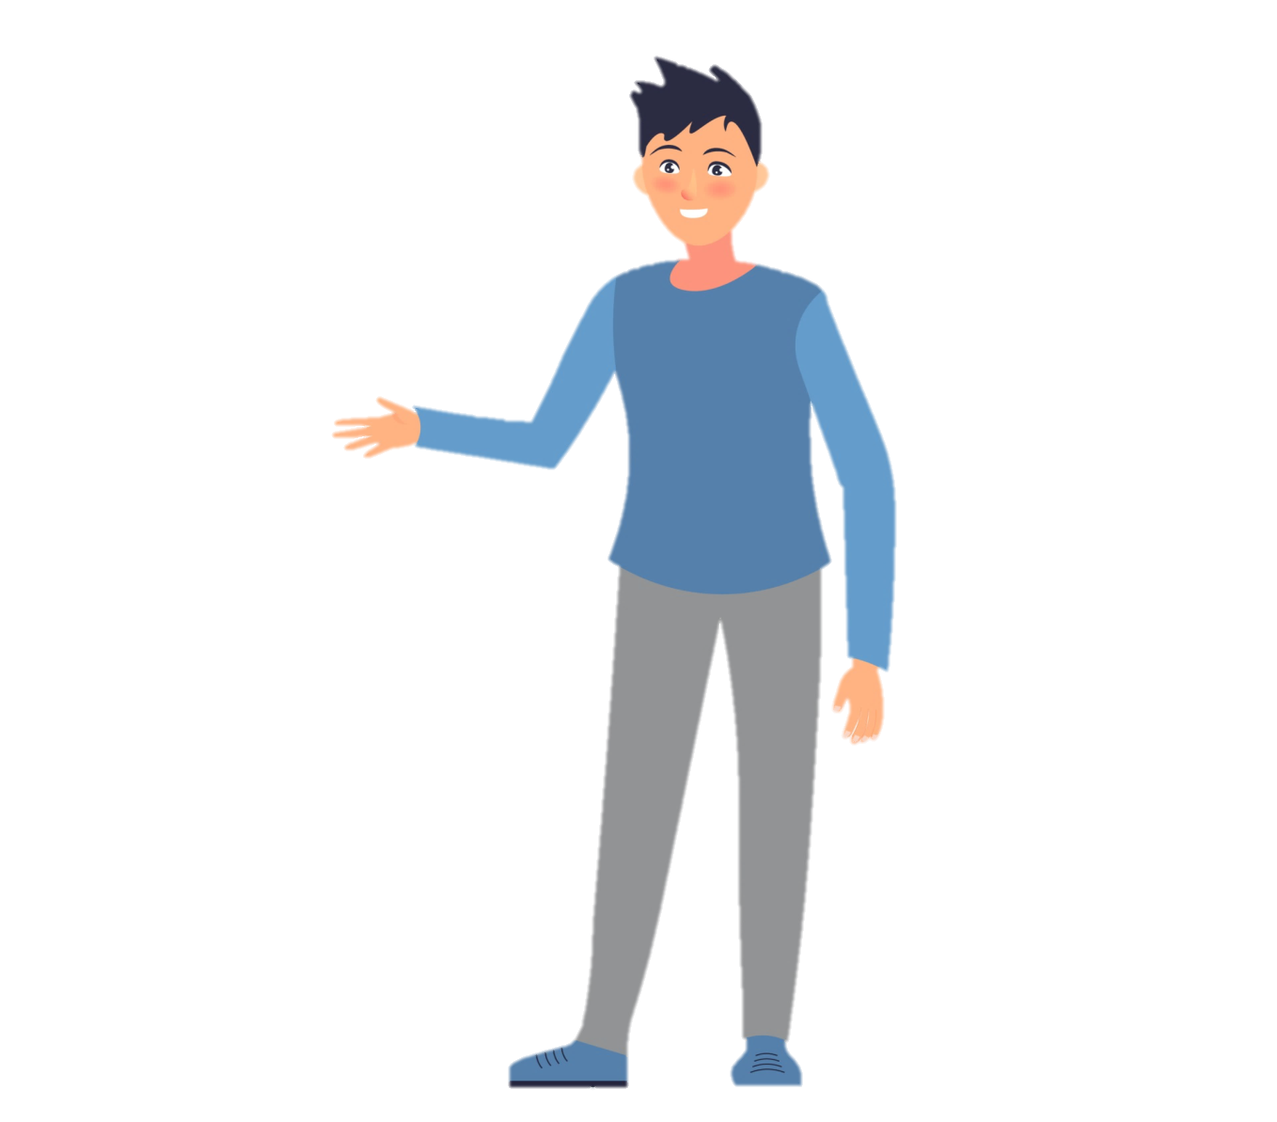
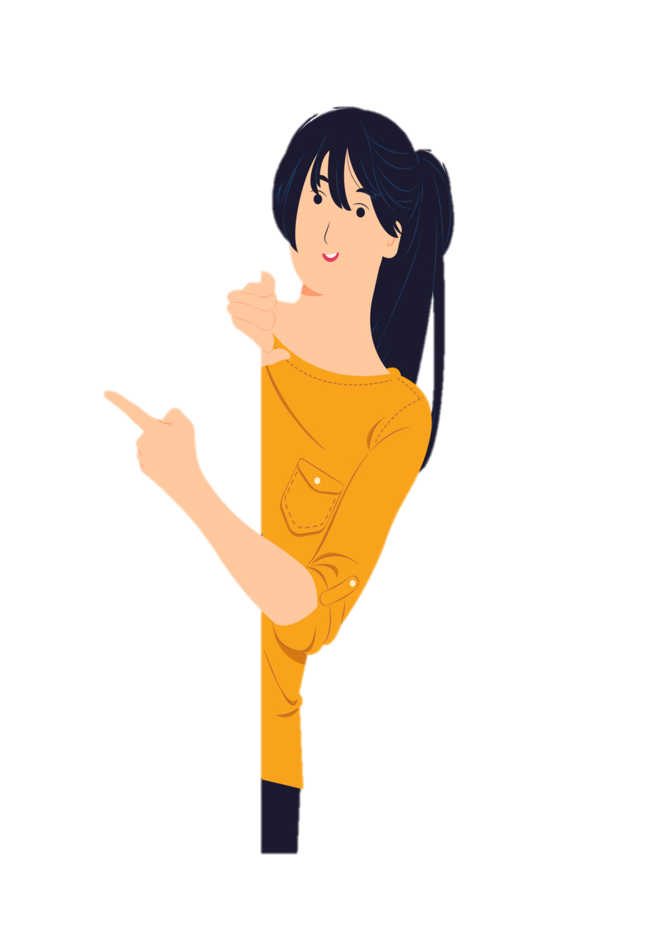
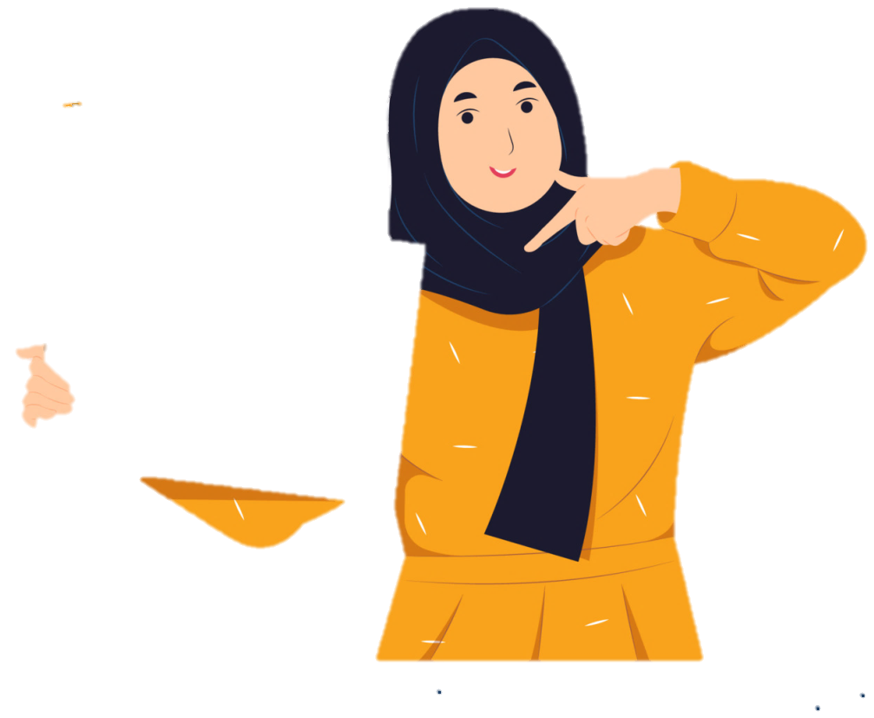
Simple Present
Simple Past
He said (that) he had a brother and a sister.
She said (that) she didn’t like mangoes
“I have a brother and a sister.”
“I don’t like mangoes.”
What did he say?

Slide 10
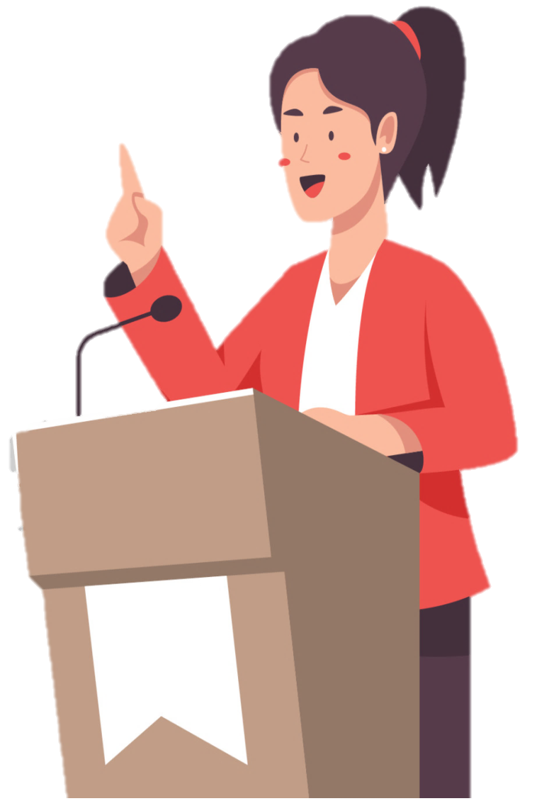
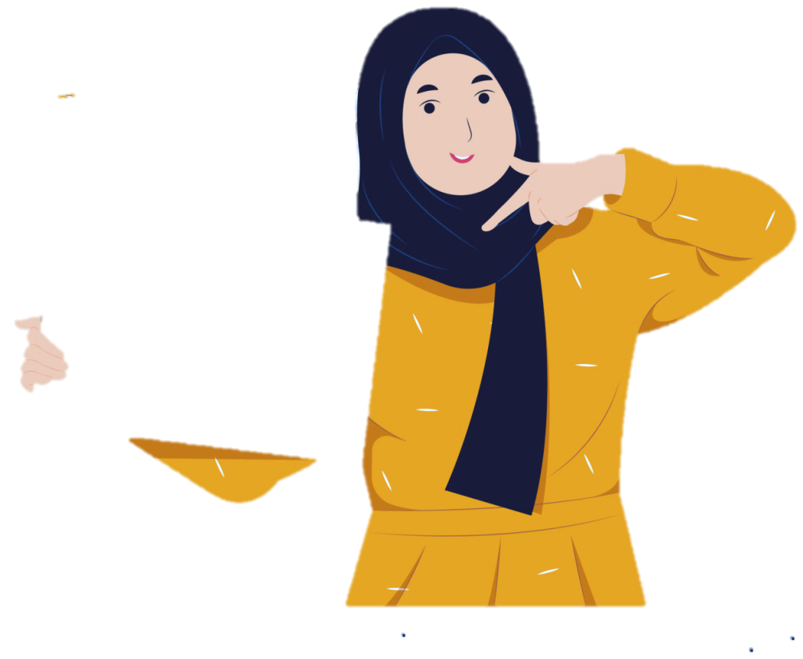
Present Progressive
Past Progressive
““I’m talking to Mary.”
She said she was talking to Mary.
What did she say?

Slide 11
Simple Past
Past Perfect
“I learned English in Canada.”
He said he had learned English in Canada
What did he say?

Slide 12

Modals
Present Perfect
Past Perfect
“I haven’t seen the film yet
She said she hadn’t seen the film yet.
What did he say?

Slide 13

Modals
“I’ll see you later.”
“I can’t come to the meeting.”.
“I have to/must go to the doctor.”
“We may be late.”
She said she would see them later.
He said he couldn’t come to the meeting.
She said she had to go to the doctor.
I said that we might be late.
Note: The word that may be omitted after said

Slide 14
Reported Questions

Slide 15

How old are you?
He asked how old I was
Where were you last night?
She wanted to know where we had been the night before.
What did he ask?

Slide 16
Are you a student?
He asked if Tom was a student.
Did you enjoy the dinner party?
She asked if they had enjoyed the dinner party.
What did he ask?

Slide 17


Note: If there is no question word (how, where, when, etc.), if is used.
In reported –Wh questions, we use the wh- word + the subject + the verb
We don’t use the interrogative form of the verb-do , does or did .
As it is an indirect question no question marks are used .
Are you a student?
He asked if Tom was a student.
Did you enjoy the dinner party?
She asked if they had enjoyed the dinner party.

Slide 18



Slide 19
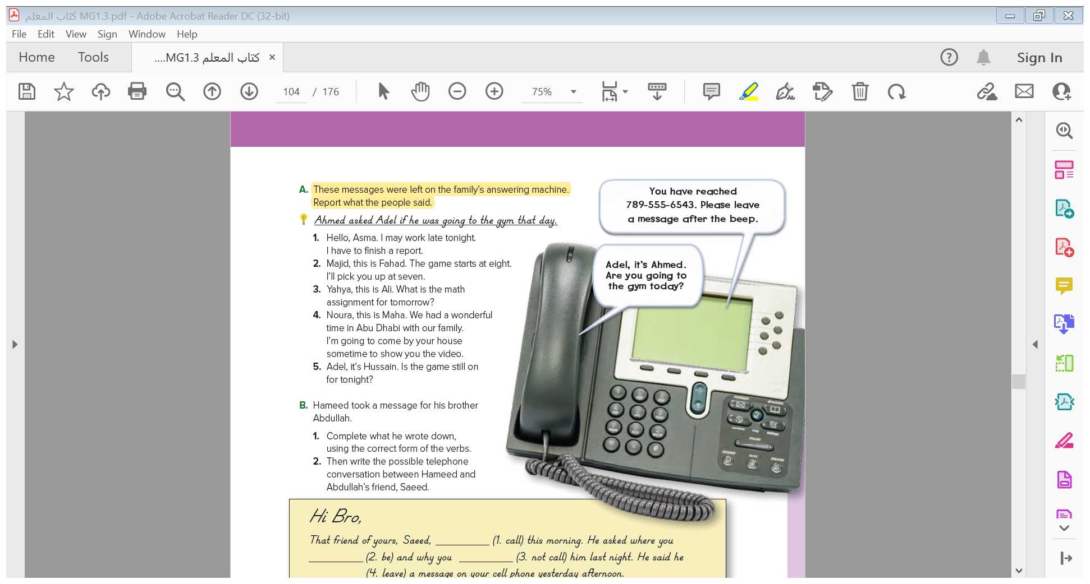


Slide 20
1- He said that he might work late that night and that he had to finish a report .
2- Fahad told Majid that the game started at eight and that he would pick him up at seven .
3- Ali asked Yahya what the math assignment for the next day was .
4- Maha told Noura that she had had a wonderful time in Abu Dhabi. She said that she was going to come by Noura’s house to show her the video .
5- Hussain asked Adel if the game was still on for that night .

Slide 21
Word Changes in Reported Speech

Slide 22
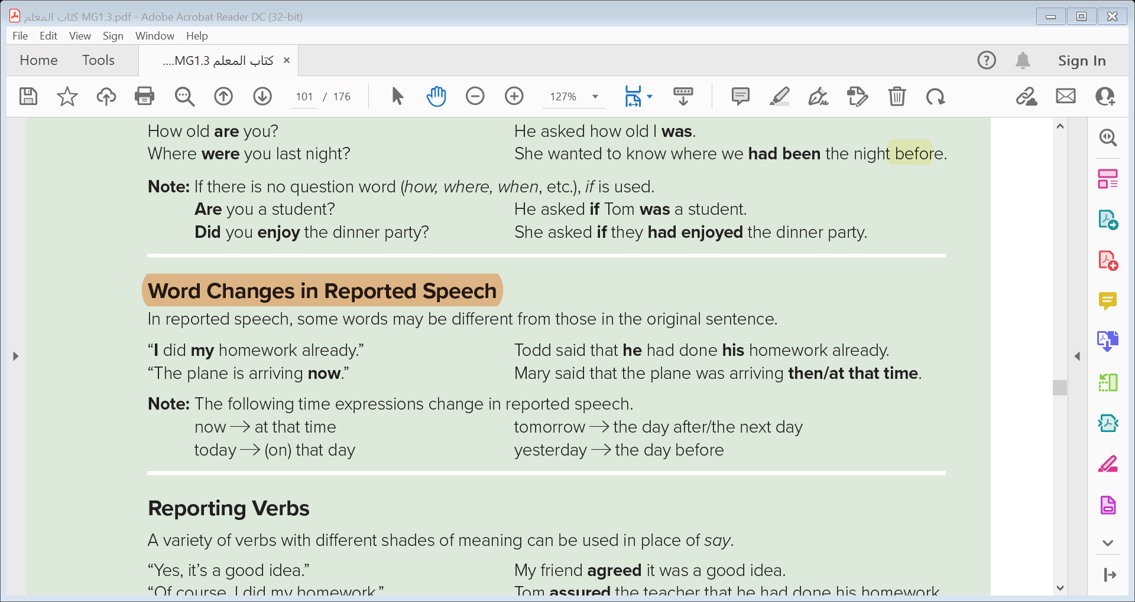

Slide 23

Place changes
here
there
this
that
Time changes
now
at that time
today
(on) that day
tomorrow
the day after / The next day
yesterday
the day before

Slide 24
Personal pronouns changes
I
He , She
You
I , he , she , we , they
we
they
me
him , her
you
him , her , us , them ,
us
them

Slide 25
Possessive pronouns changes
my
his , her
your
my , his , her , our , their
our
their
mine
his , hers
yours
mine , his , hers , ours , theirs
ours
theirs

Slide 26
Reporting Verbs

Slide 27
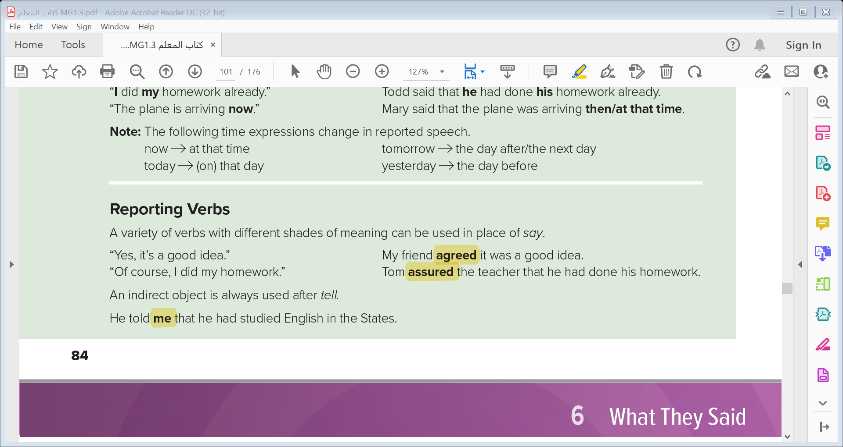

Slide 29
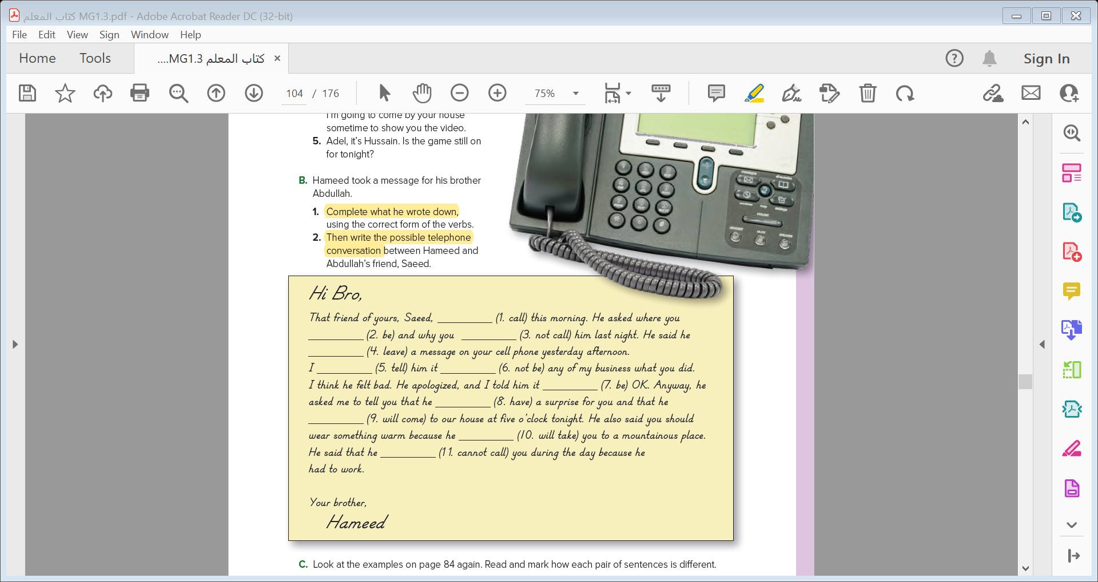

Slide 30


Quick Check

Slide 31


