Slide 1
Mega Goal 1.3
Unit 2 GAME
I Wonder What Happened

Slide 2




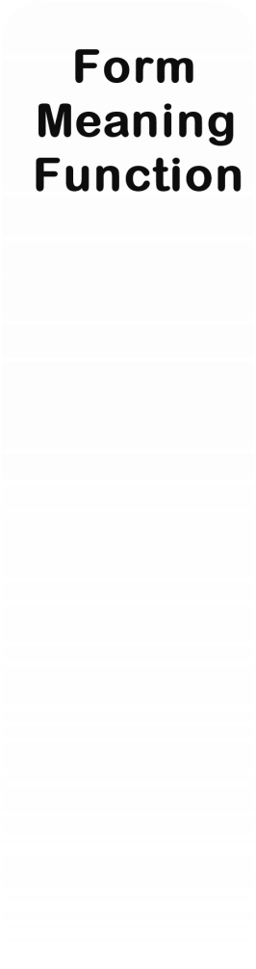
U2
I Wonder
What Happened
1
1
1
1
1
2
2
2
2
2
3
3
3
3
3
4
4
4
4
4
5
5
5
5
5

Slide 3

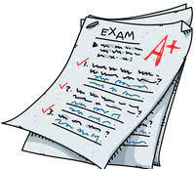

It (beats me) how she got a full mark.
I have no idea
anything is possible
I know

Slide 4
She has a (weird) character.
very good
very strange
very nice

Slide 5
“An exclamation that is used to express surprise” is
Excuse me
You never know
Gee

Slide 6
The spaceship was hidden in the _______ of an extinct volcano on a remote island.
fireball
locomotive
crater

Slide 7
“the remains of something broken down”
is
asset
debris
remote

Slide 8

I_______ have an extra pen. I am not sure.
might
couldn’t
must

Slide 9
Identify the correct NEGATIVE form
1- She not could see the result of her test.
2- She could not saw the result of her test. 3- she could not see the result of her test.
1
2
3

Slide 10
The ship ________ sailed
before we arrived to the port.
had
has
have

Slide 11
He has just left. He ________ be too far.
must
couldn’t
can’t

Slide 12
Look at all that snow. It _____ be cold outside.
must
could
might

Slide 13

Identify the odd word
hurricane
tornado
bull
volcano

Slide 14
__________ of the broken vase were everywhere.
debris
fragments
meteorite

Slide 15
You got an extra mark

Slide 16
Identify the odd word
investment
urban
economy
trade

Slide 17


can – might - must
Present
Oops!!
WRONG
Past
Can – could - must
might – could - must

Slide 18

It is time for final exam. _____ one student didn’t show up.
Yet
So
Or

Slide 19
She was sick, _____ she couldn't attend the meeting.
and
but
so

Slide 20
I didn’t need to _______. She was there on time.
waited
waits
wait

Slide 21
He seemed a ________ and energetic leader.
sustainable
dynamic
locomotive

Slide 22
We left the city for a _________ home.
culture
streamlined
rural

Slide 23

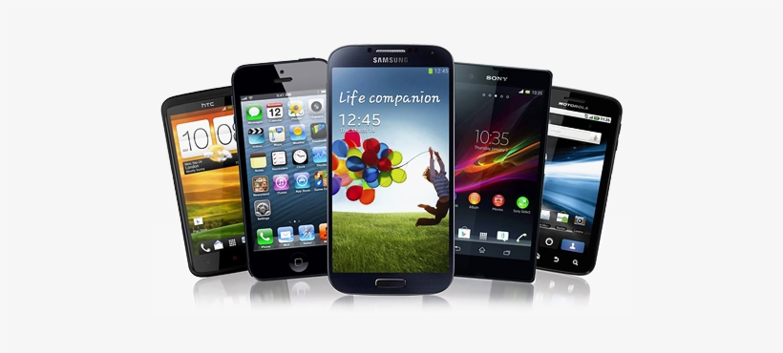
I have two phones. Hawaii _______ iPhone.
or
but
and

Slide 24
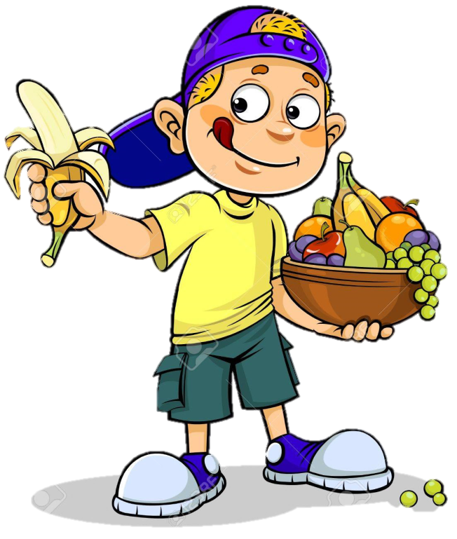
He is on a diet ______ he only eats healthy food.
yet
so
but

Slide 25
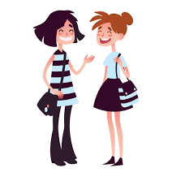
The movie was _______ interesting.
It was _____ amazing.
very // absolutely
absolutely // very
absolutely // absolutely

Slide 26

If you freeze water, it _______ into ice.
turn
turns
turned

Slide 27
If you don’t hurry up, we ________ be late.
were
are
will

