Slide 1
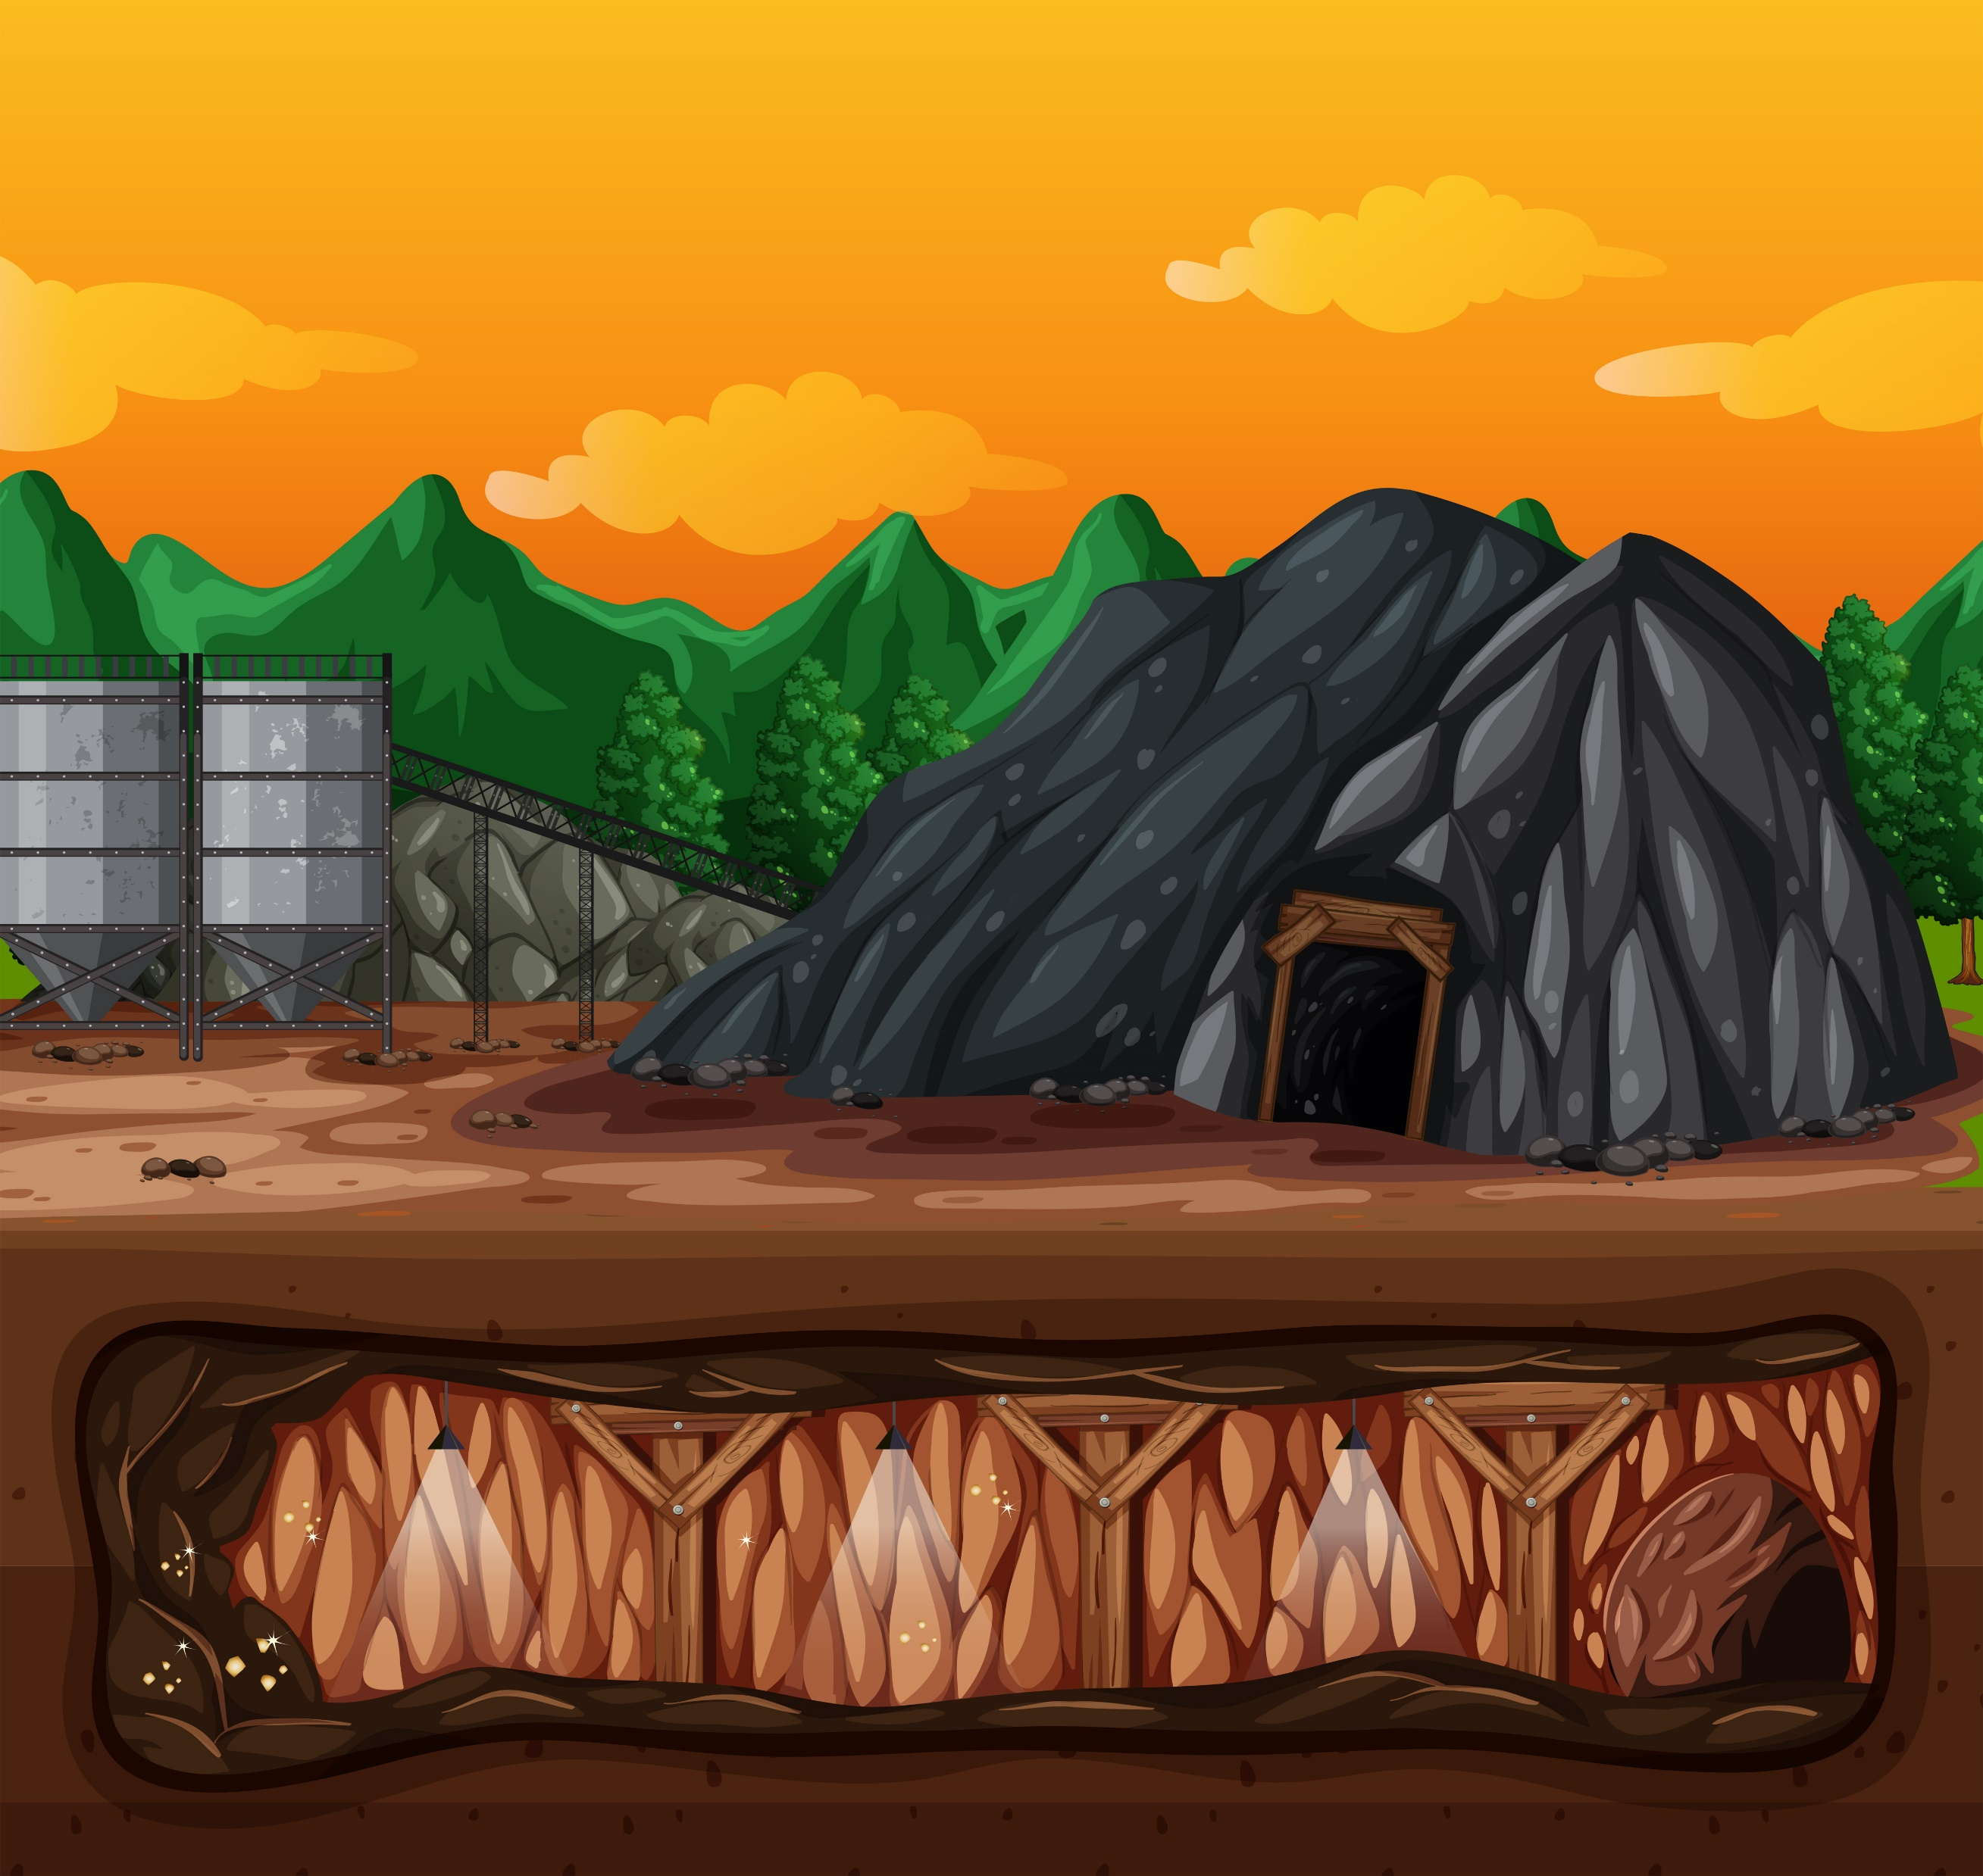
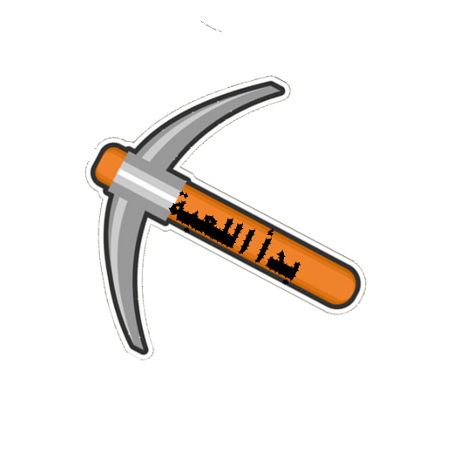
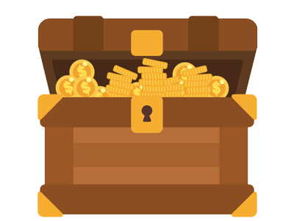
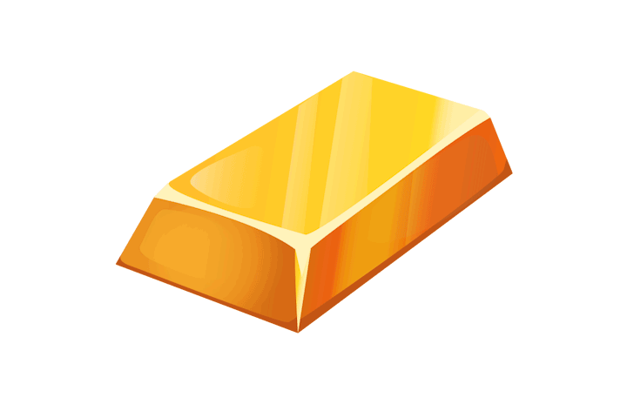
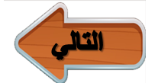
Entisar Al-Obaidallah
Revision U3
لعبة المنجم
Let’s dig for the jewelry that has the correct answer :

Slide 2
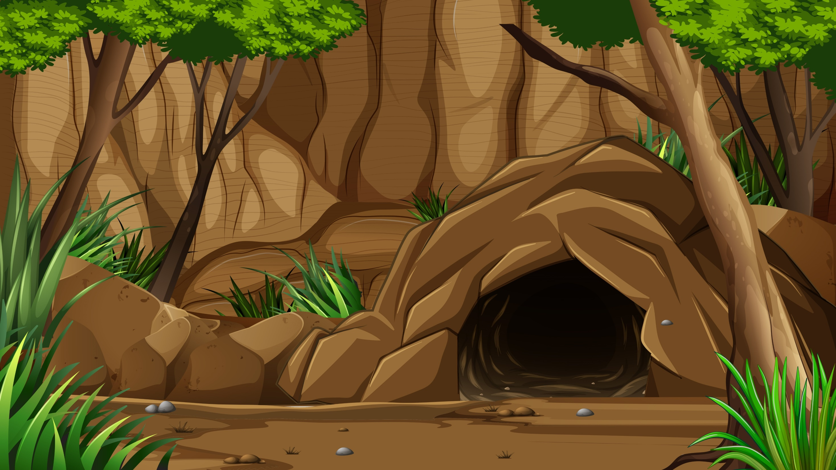
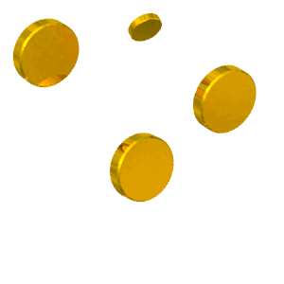
I should have ………………..you earlier.
calling
calls
called

Slide 3
If we had ______ to that new restaurant, we wouldn’t
be hungry now
go
went
gone

Slide 4
If you had graduated, we would be_____
celebrate
celebrating
celebrated

Slide 5
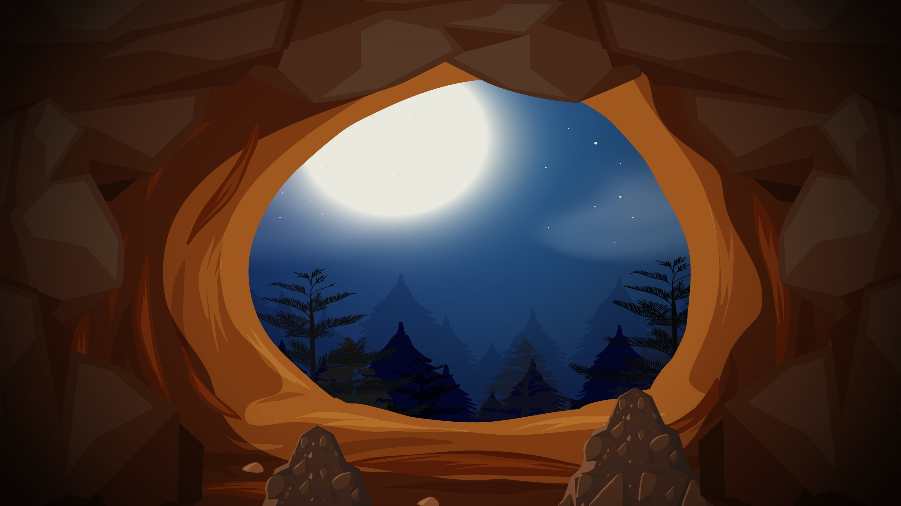
_______you met your neighbors yet?
Has
Have
Are

Slide 6
He has lived in Dammam _____ 1999.
since
for
ago

Slide 7
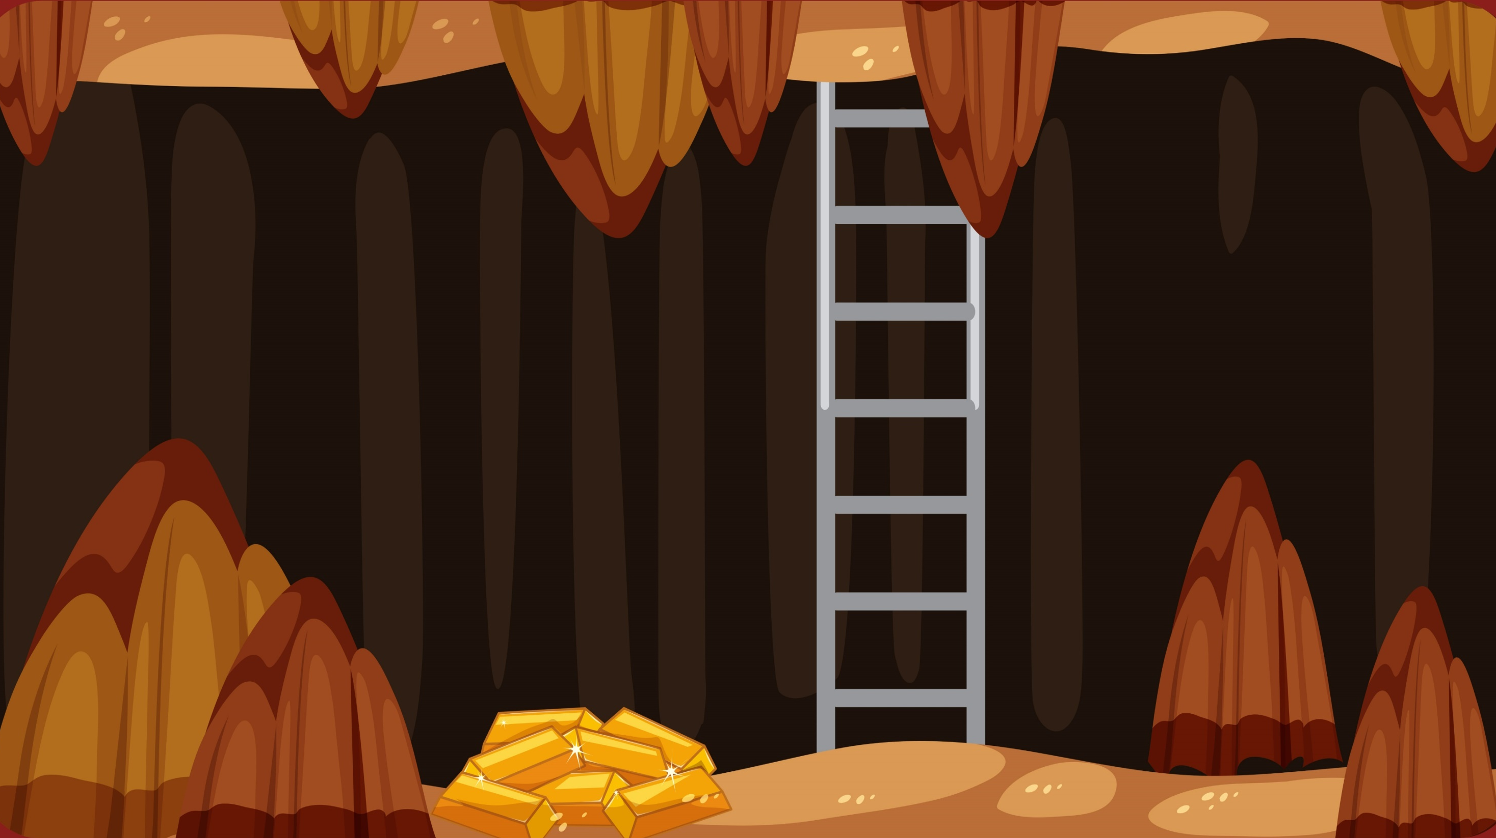
He moved to Jeddah three years ____________.
ago
yet
since

Slide 8
_______I go outside, please?
Would
May
Should

Slide 9
I _____ run 10 miles when I was young along the road .
can
might
could

Slide 10
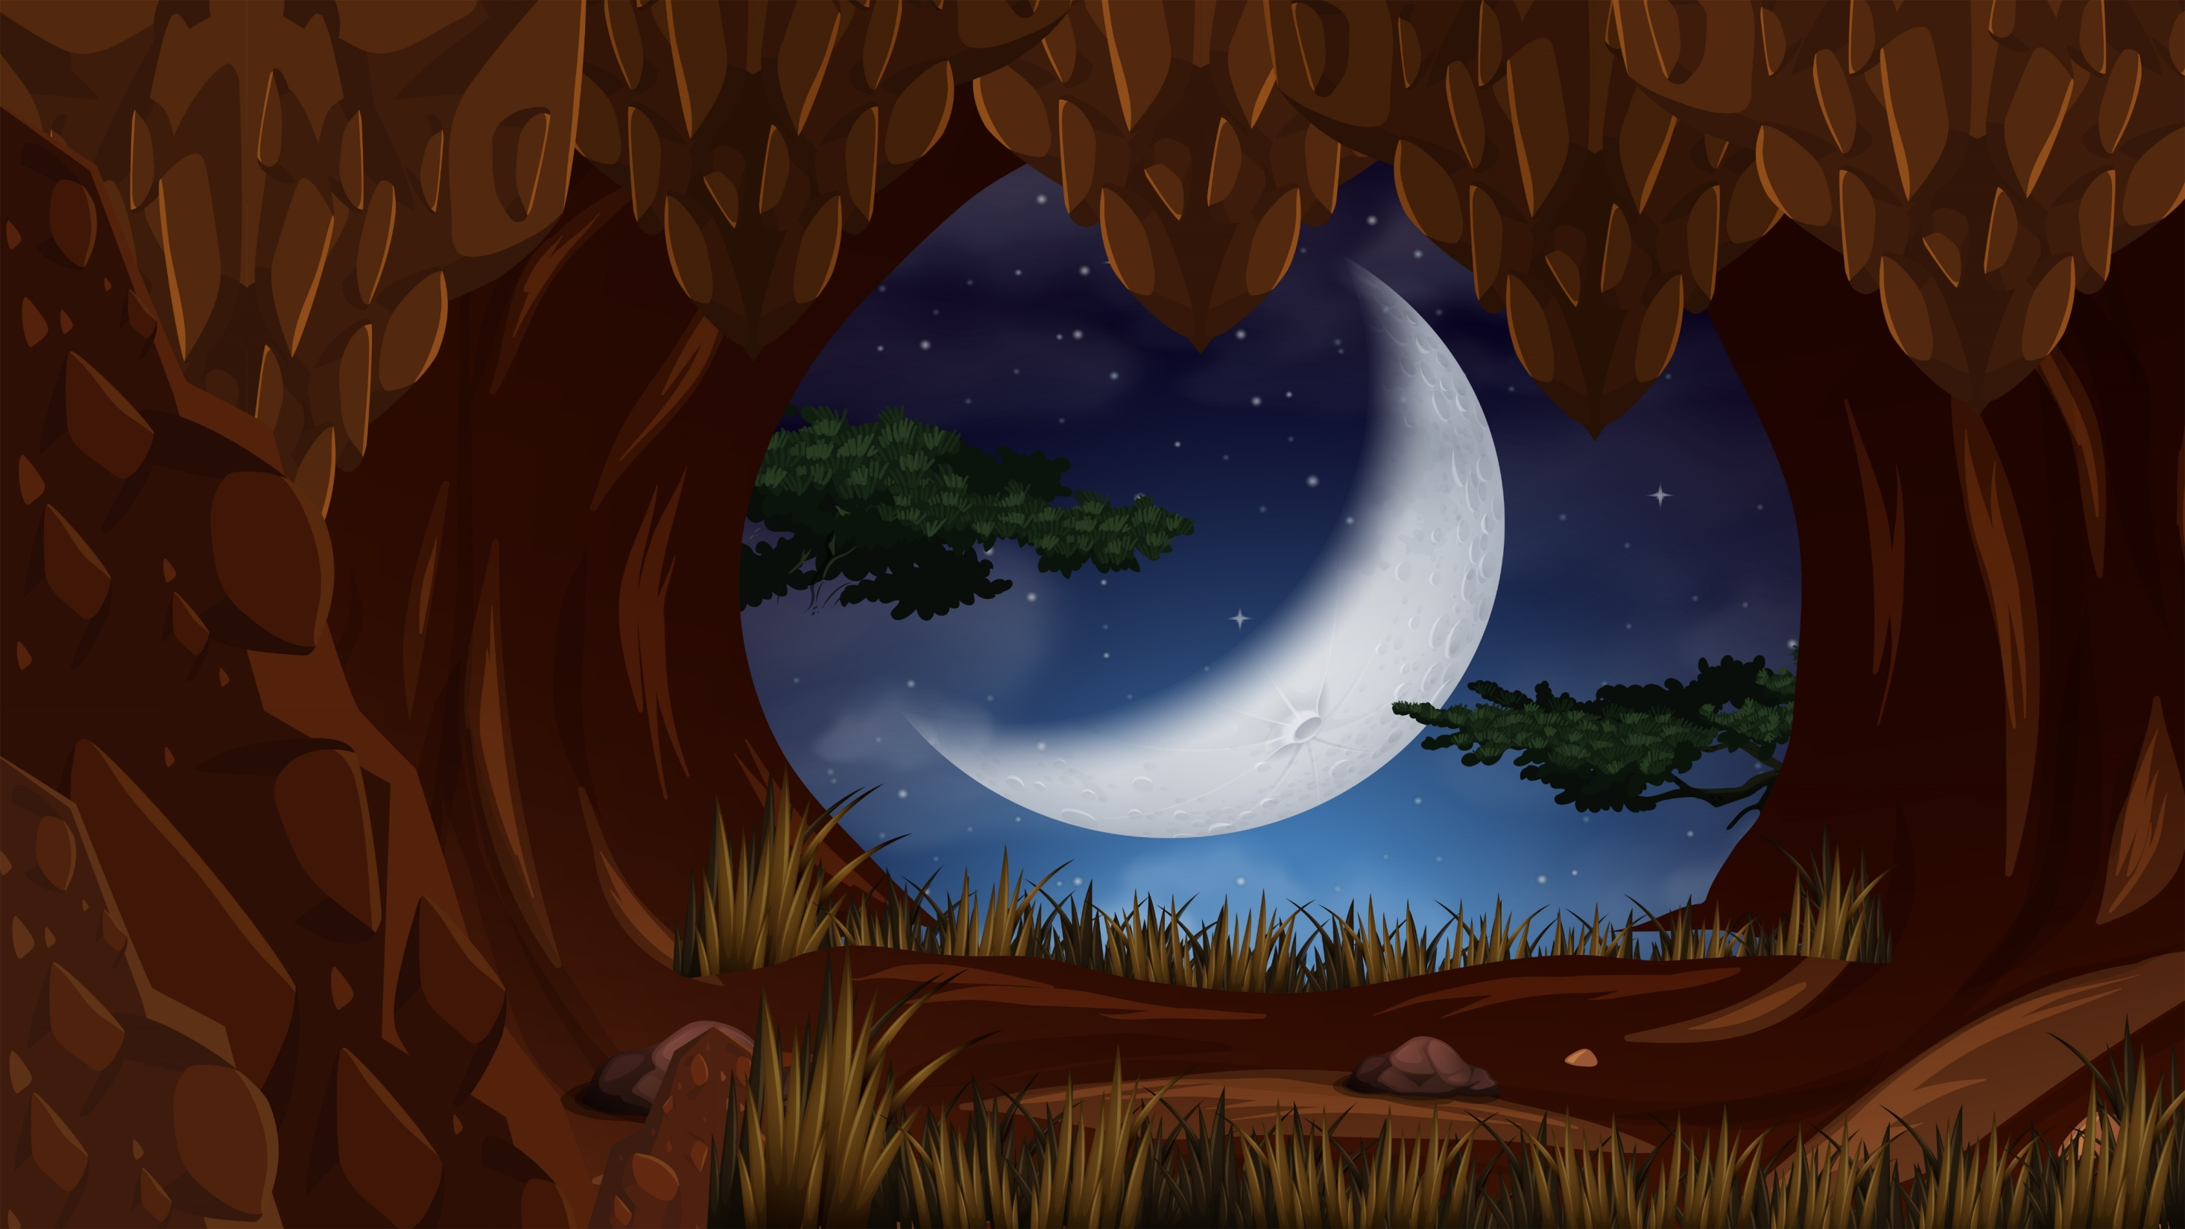
The Sumerians_____ the wheel in 5000 B.C.E.
invented
discovered
electric

Slide 11
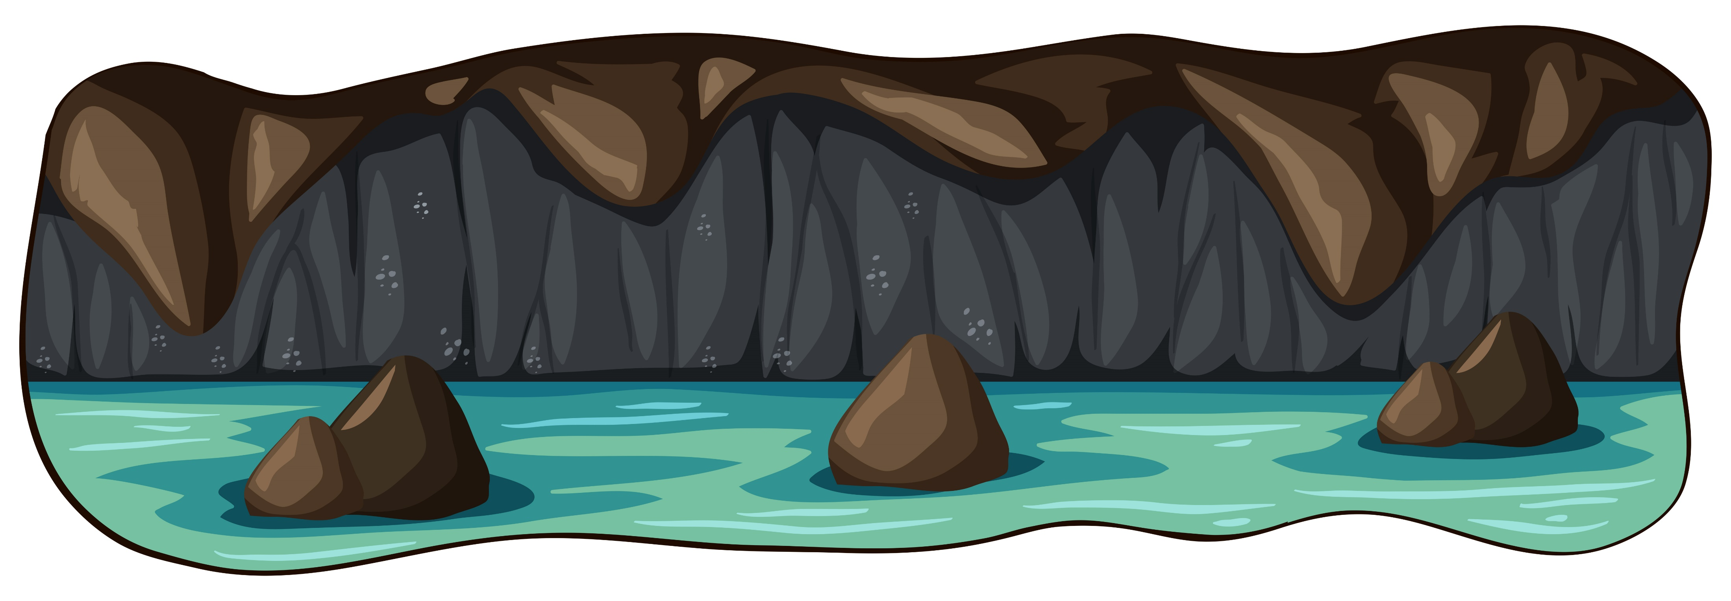
Thomas Edison developed the first _____ light bulb.
airplane
wheel
electric

Slide 12
The correct meaning of “ hoax” ____
thankful
jock
lawyer

Slide 13
Which of the following words is NOT related to the category of “ inventions”?
oil
radio
computer

Slide 14
The word “grateful” means _____
thankful
lawyer
jock

Slide 15
Which of the following words is NOT related to the category of “Discoveries ”?
America
oil
wheel

Slide 16
The opposite of the word “honest” is ______
untruthful
loyal
humble

Slide 17
The opposite of the word “heavy” _____
shiny
dark
light

Slide 18
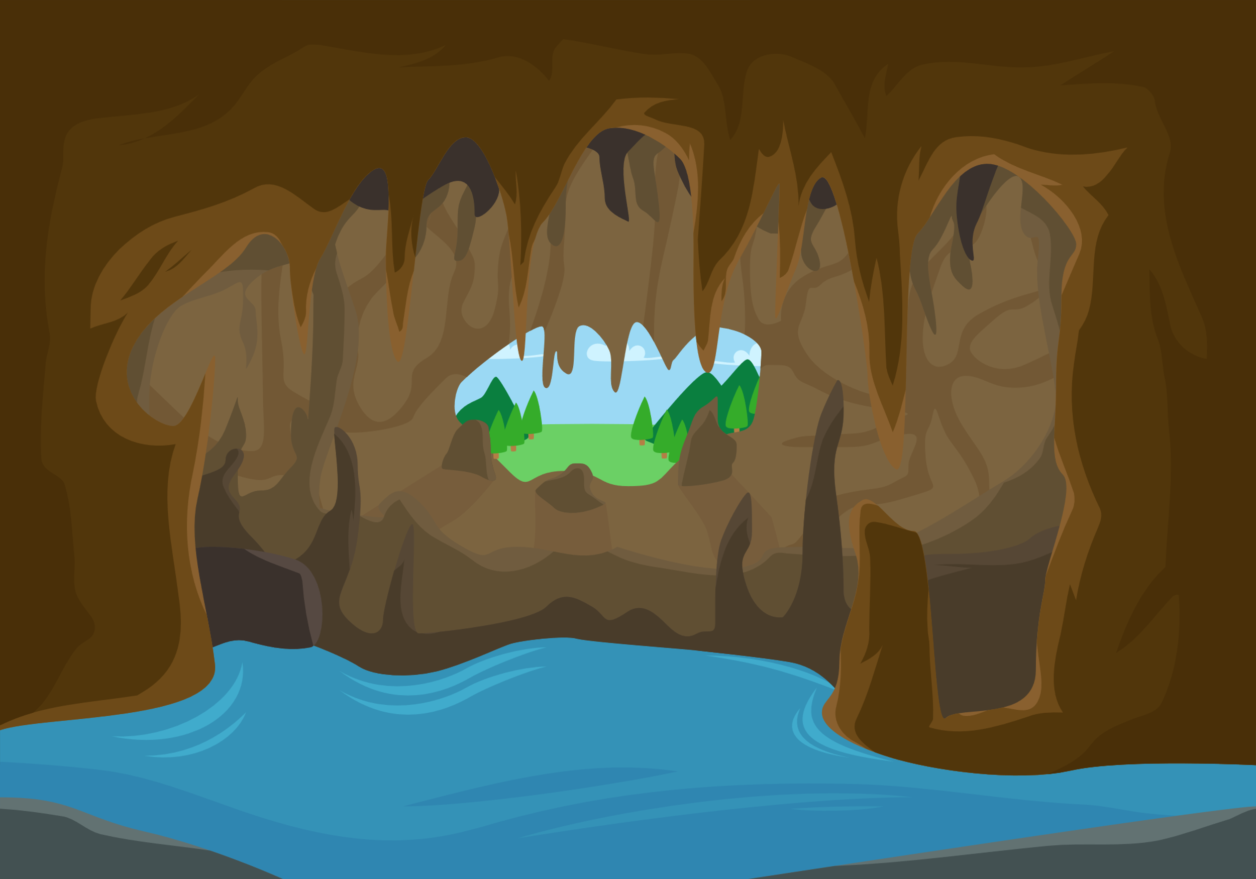
This picture shows _____
worried
angry
embarrassed

Slide 19
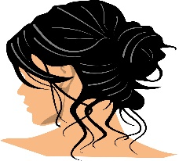
This picture shows _____
hair dryer
hairpin
hairstyle

Slide 20
Congratulation .. You are the winner

