Slide 1
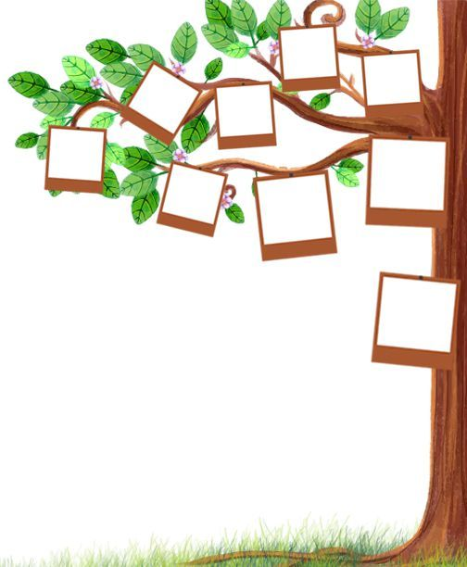
Unit:
Lesson:1
Date:
We can
English
My school
is cool
Day:
6th grade
Finding Out
Time

Slide 2
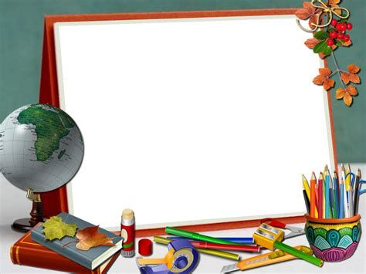

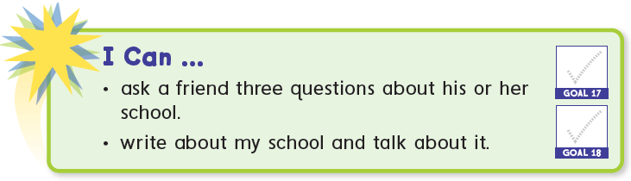

Slide 3
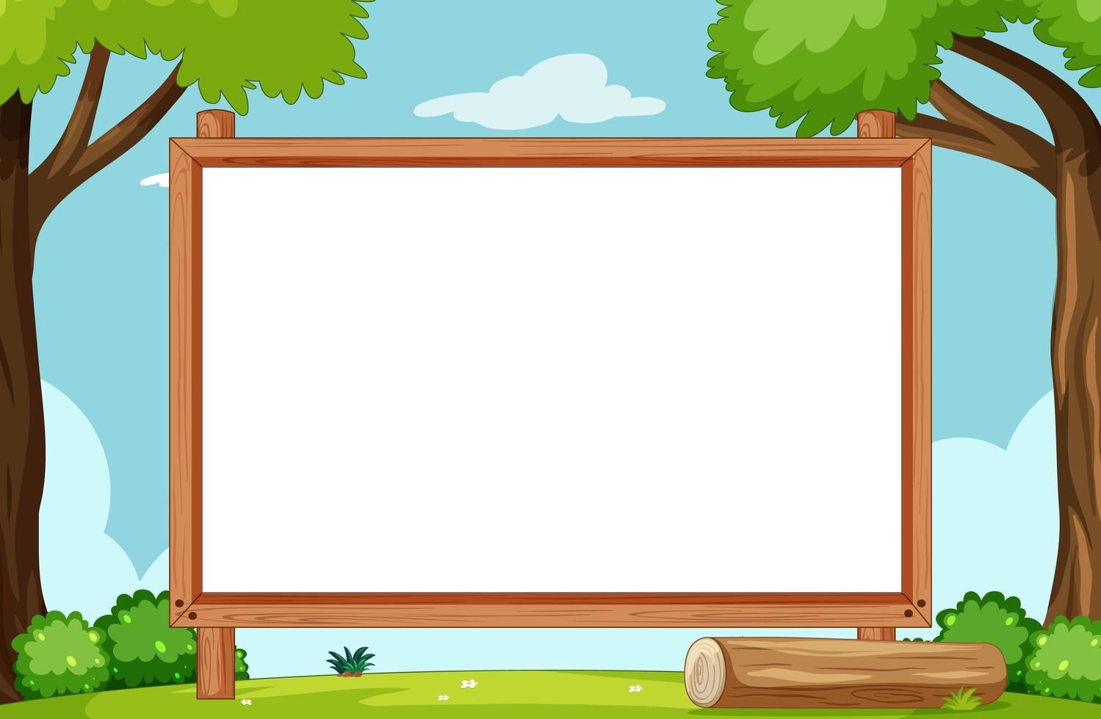


Slide 4
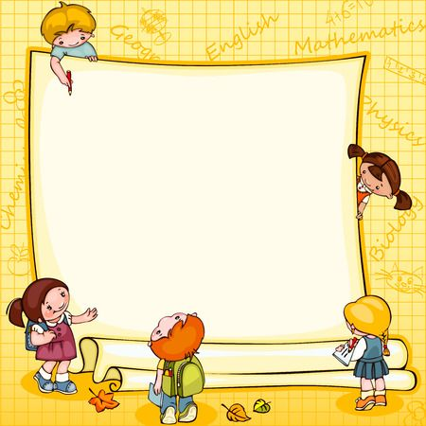


Slide 5
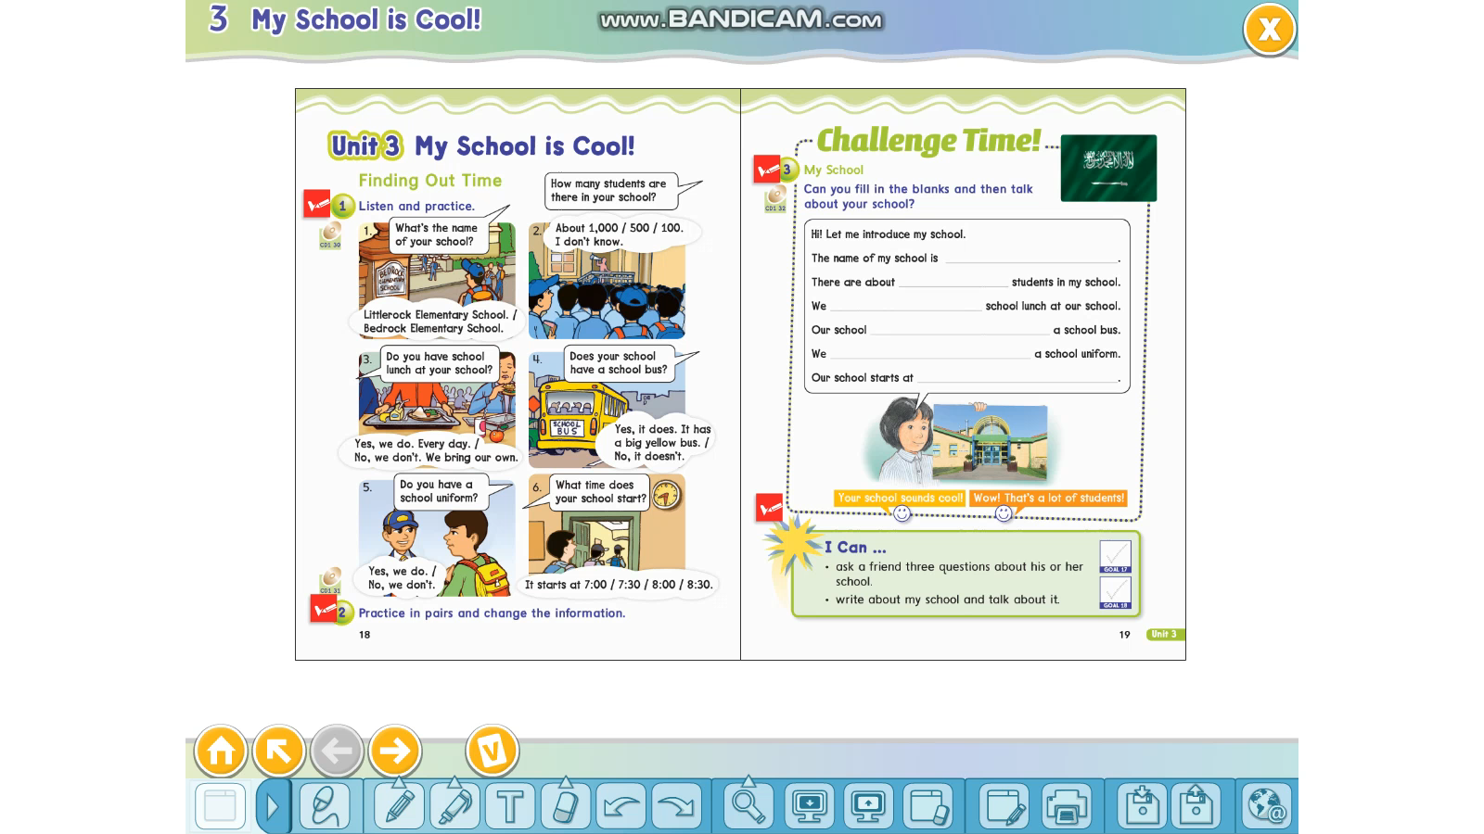

Slide 6
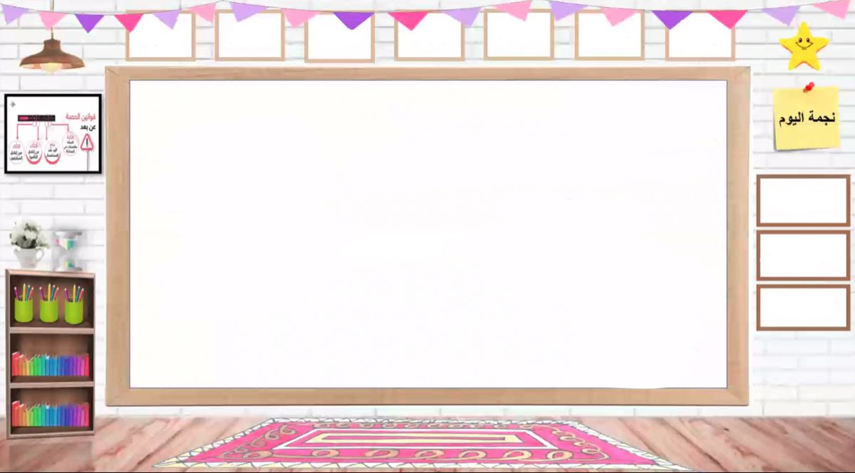
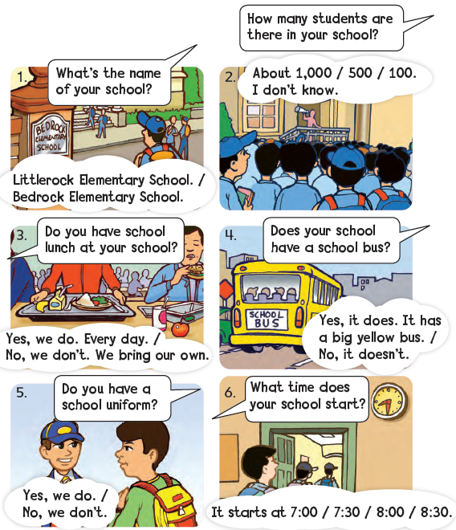



Slide 7

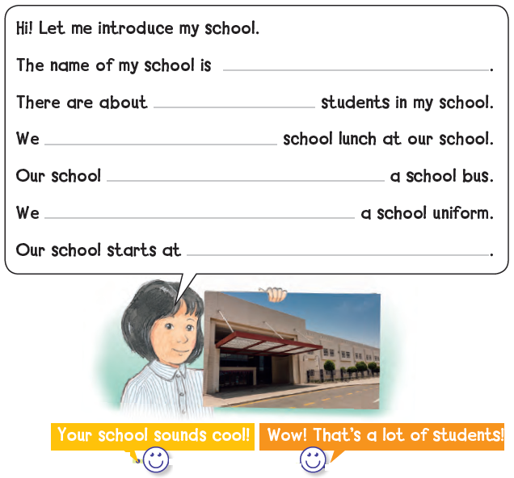
13th elementary school
600
don’t have
doesn’t have
have
8:00 a.m.

Slide 8

What‘s the name of your school?

Slide 9
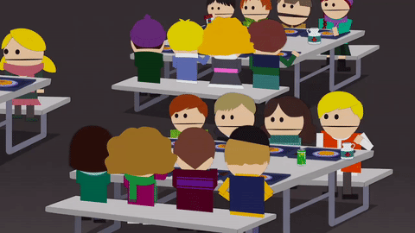
Do you have school lunch at your school?

Slide 10
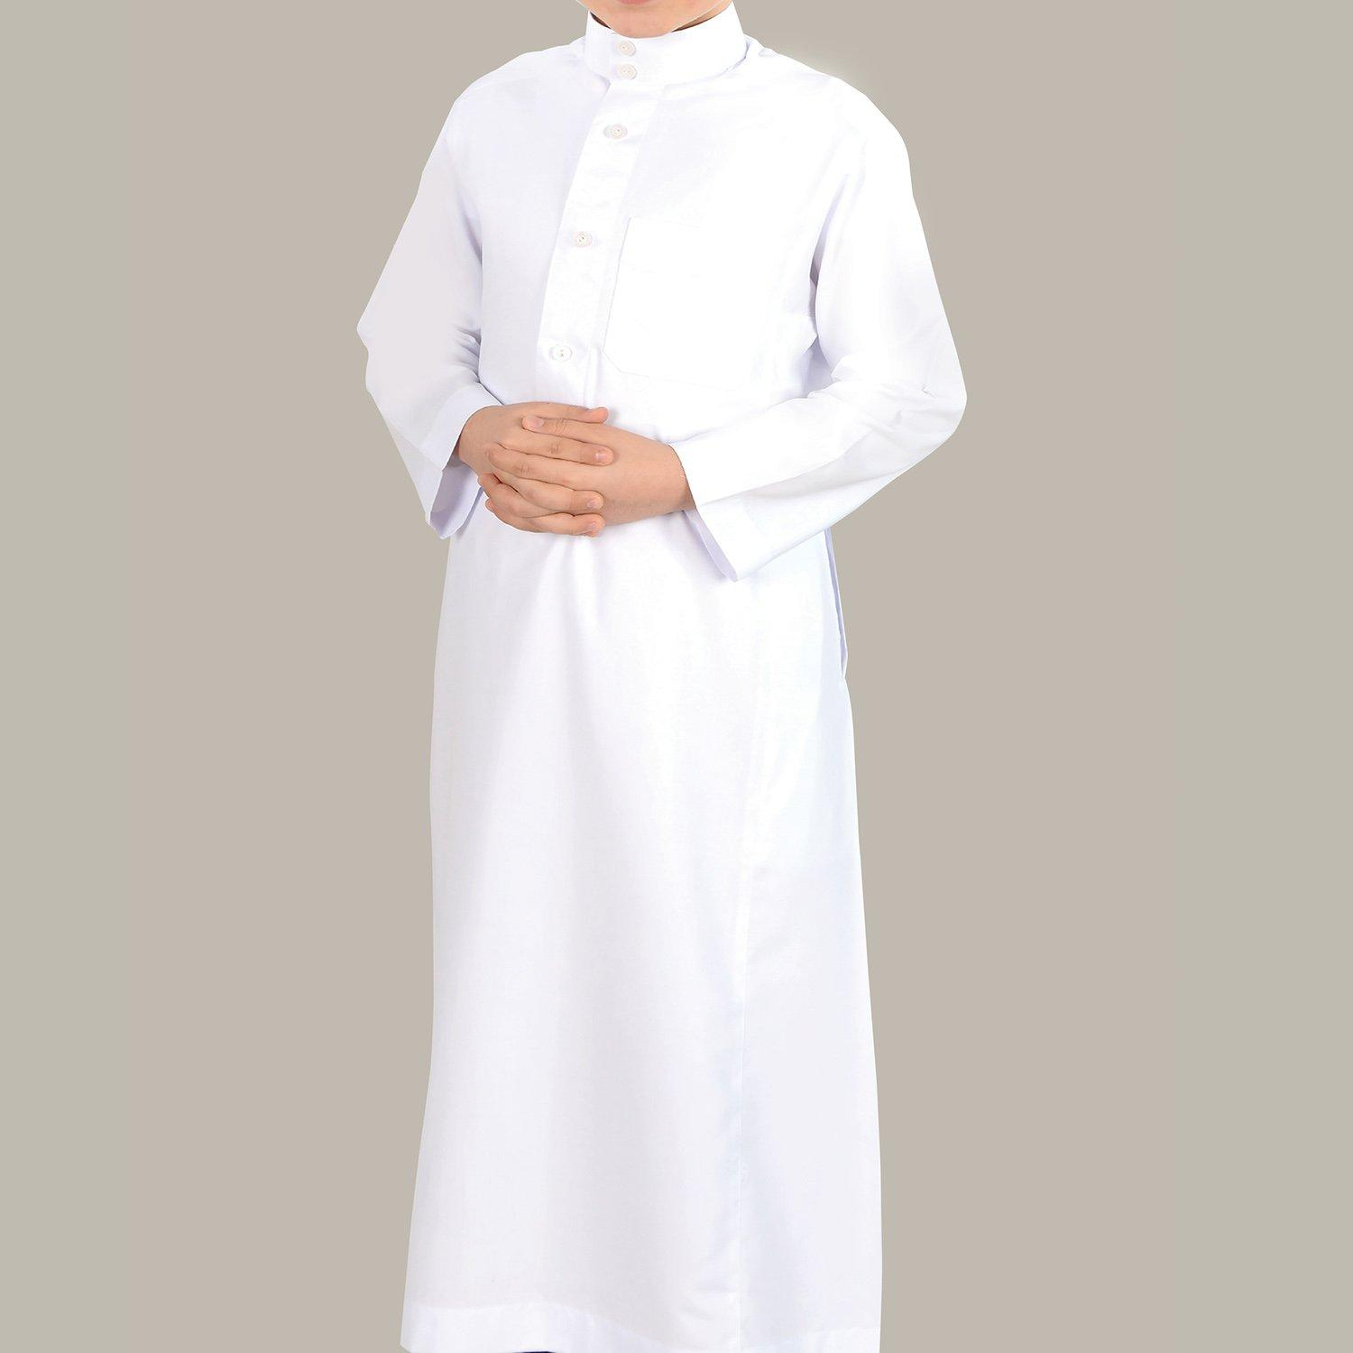
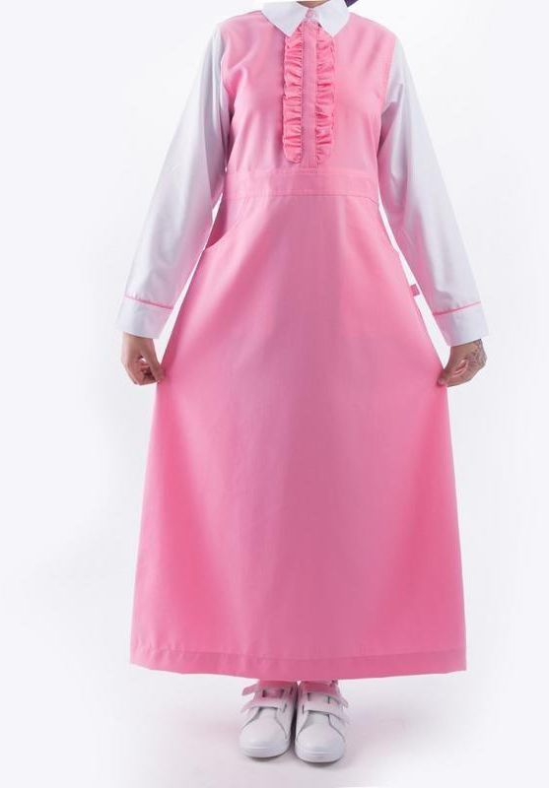
Do you have a school uniform?

Slide 11
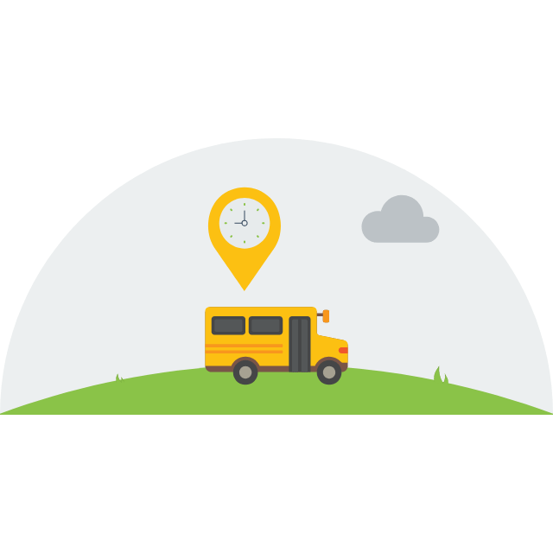
Does your school have school buses?

Slide 12
Homework:
87+88

