Slide 1


Good Morning

Slide 2

Unit -2-
I Wonder What Happened

Slide 3
4-Language in context
5-Listening
6-Pronunciation
7-About you

Slide 4


Warm Up
Lesson Objectives
The students will be able to :
point out events according to a picture.
summarize events according to an audio.
illustrate words with (er)sound.
perform an interview using “ have/ever ‘.

Slide 5


Warm Up

Slide 6
4-Language in context

Slide 7

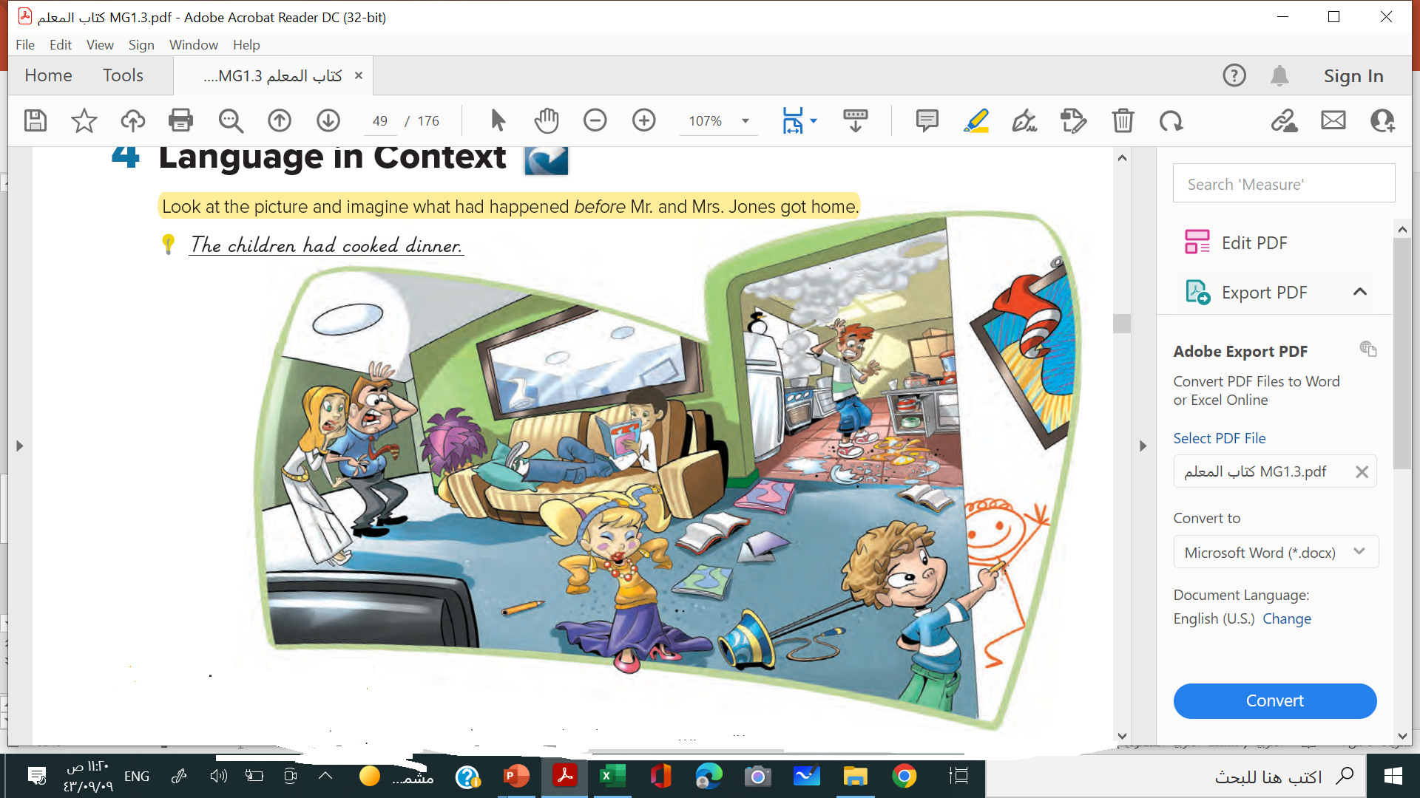

Slide 8
They had thrown some books on the floor .
They had broken some plates .
The little boy had drawn on the wall .
The girl had put moms make up.
They had read some books .
They had cooked food.

Slide 9
5-Listening

Slide 10
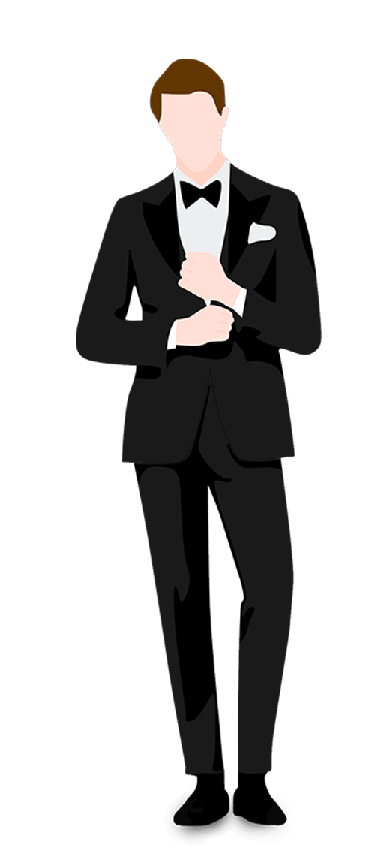


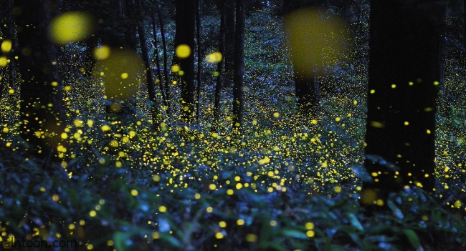

Slide 11



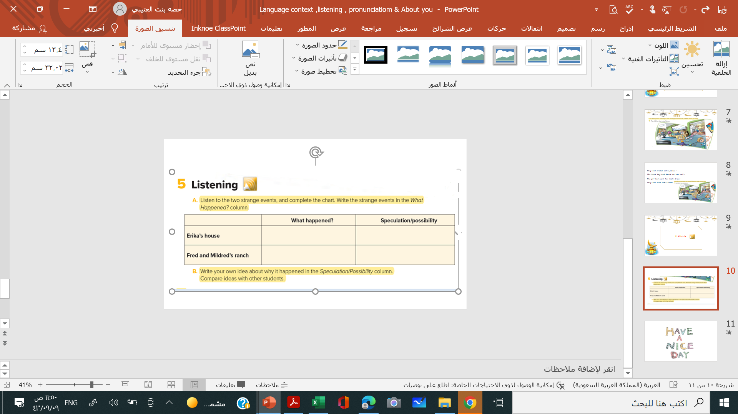


People saw a man in dark pants, white shirt, and a black tie in Erika’s house. Erika and her husband also heard noises in the night
The man might have been a ghost .
Fred and Mildred saw a bright glow from some bushes. As they got closer, they saw thousands of tiny lights on the bushes
They must have been fireflies .

Slide 12
6-Pronunciation

Slide 13
Listen. Note the er ending in the following words.
Then practice.
water
recover
crater
driver
discover

Slide 14
7-About you

Slide 15
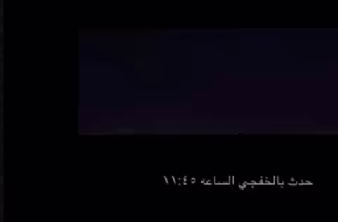

Slide 16

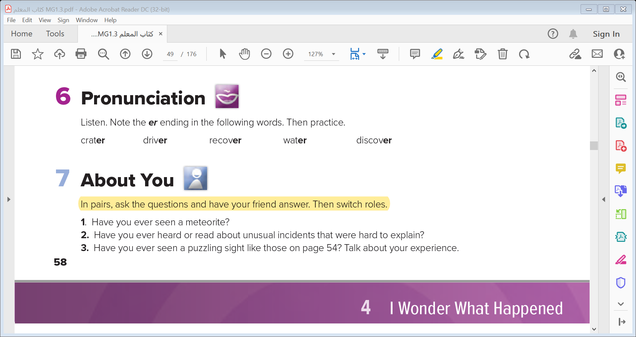

Slide 17
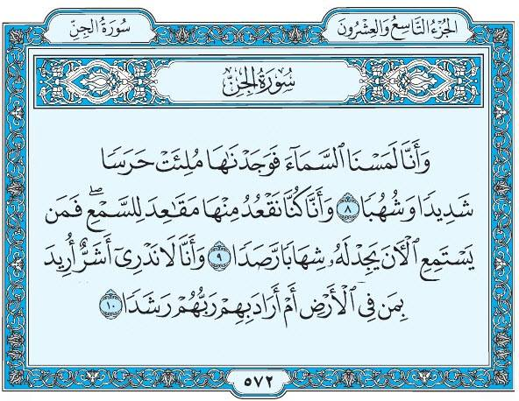

Slide 18


