Slide 1
Mega goal 2

Slide 2
Unit 1

Slide 3
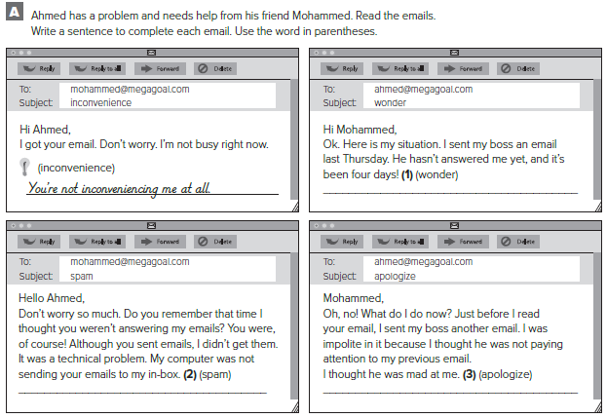
I wonder if he is mad at me.
It thought they were spam!
I need to call him and apologize for my last email.

Slide 4
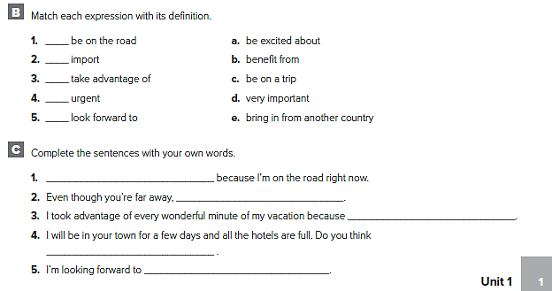
c
e
b
d
a
I don’t have access to my email
I think about you all the time
I really needed to relax
you could put me up?
my vacation in New York City

Slide 5
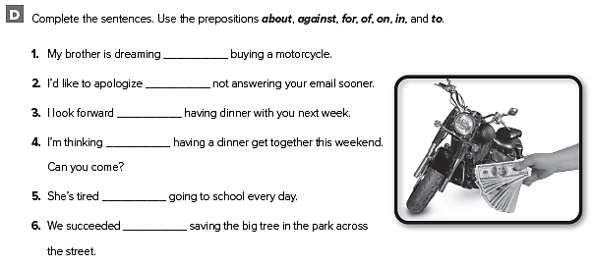
of
for
to
of
of
in

Slide 6
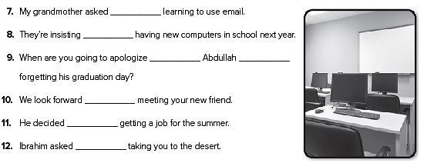
about
on
to
for
to
against
about

Slide 7
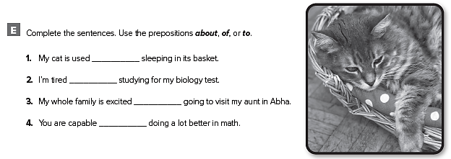
to
of
about
of

Slide 8
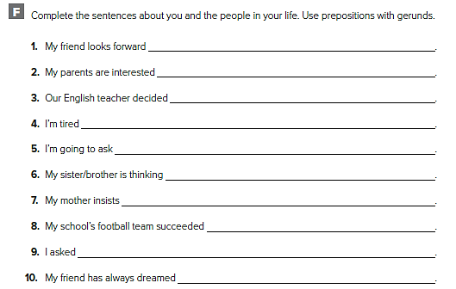
to sleeping late on the weekend
in starting our vacation early
against giving a test tomorrow
of going to the gym every day
about going to the dinner on Saturday
of getting a new computer
on cooking dinner for us
in winning the championship this year
about driving my brother’s car to school
of riding his bike across the country

Slide 9
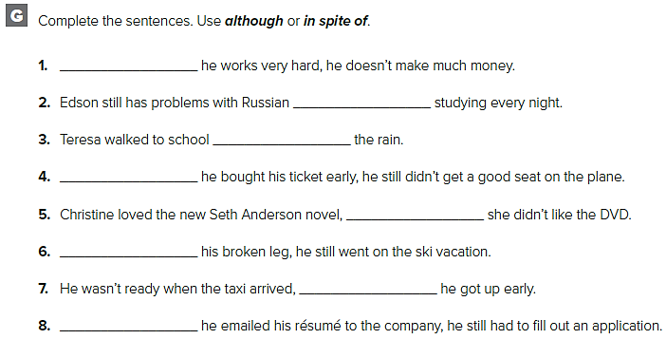
Although
in spite of
in spite of
Although
although
in spite of
although
Although

Slide 10
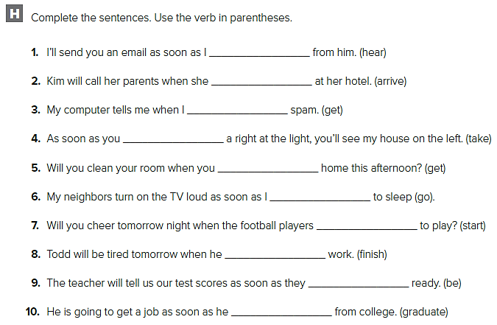
hear
arrives
get
take
get
go
start
finishes
are
graduates

Slide 11
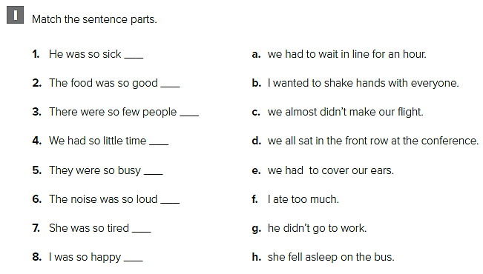
g
f
d
c
a
e
h
b

Slide 12
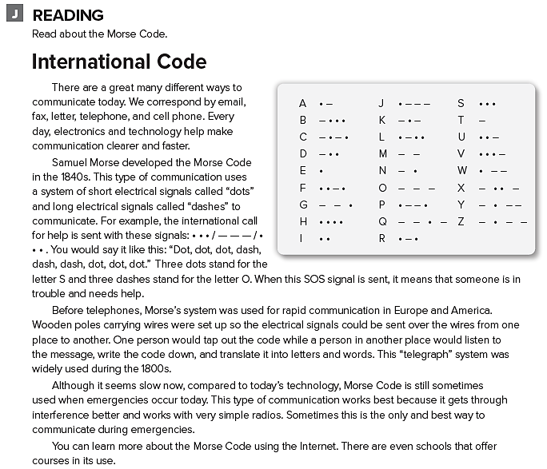

Slide 13
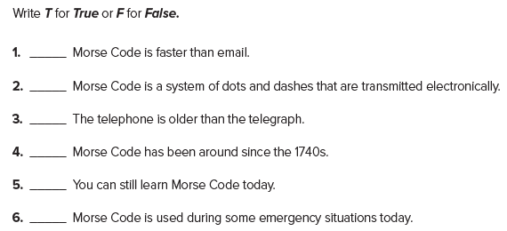
F
T
F
F
T
T

Slide 14
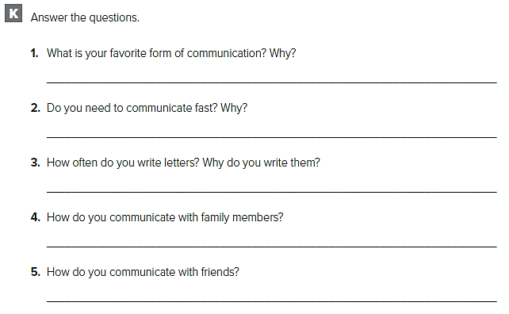
قد تختلف الإجابات
My favorite form of communication is emailing because it is reliable and fast.
Yes, I do. I have to communicate fast for professional reasons.
I write letters once or twice a month to people who don’t have email.
I usually call family members or arrange to see them.
I call, text message, email or communicate Face-to-face

Slide 15
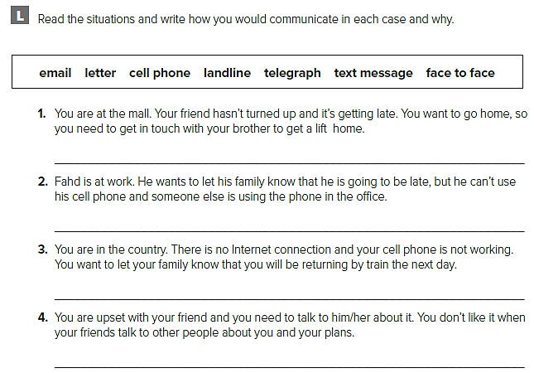
قد تختلف الإجابات
I would call and if he didn’t answer I would text him.
He could text message or email.
I would send a telegram
I would prefer to talk to him Face-to-face

Slide 16
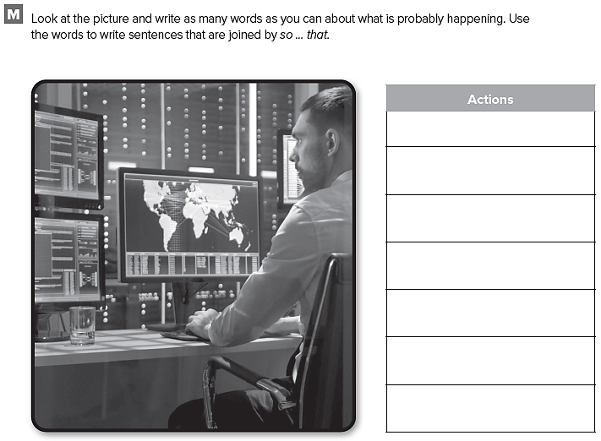
قد تختلف الإجابات
monitor
Watch
Call
Notify
Warn
Alert
Protect

Slide 17
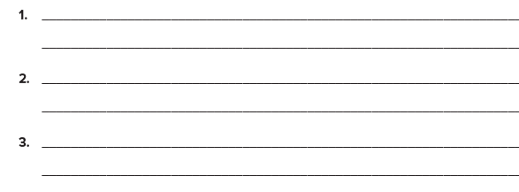
Weather changes are monitored closely so that damage by storms can be prevented
The controller watches the screen very carefully so that accidents can be avoided
Large screens are used so that conditions can be shown clearly over a broad area

Slide 18
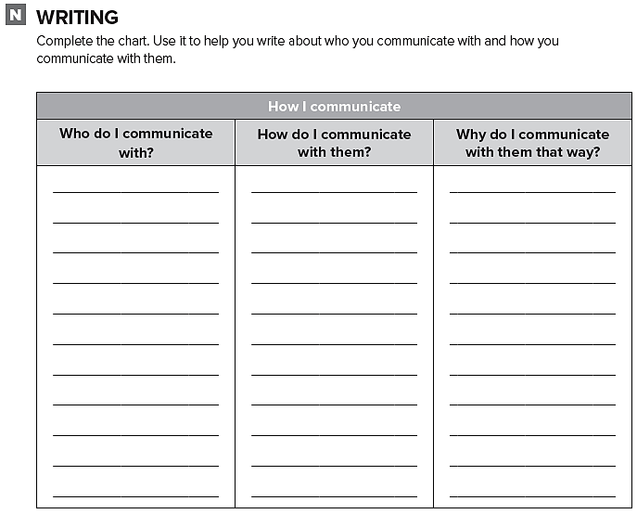
أكمل الجدول حول الأشخاص الذين تتواصل معهم

Slide 19
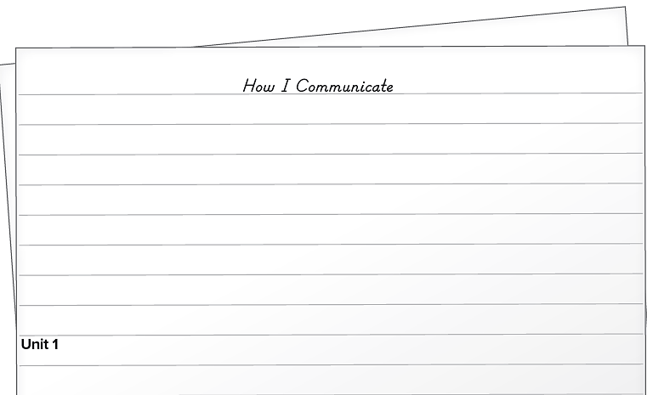

Slide 20
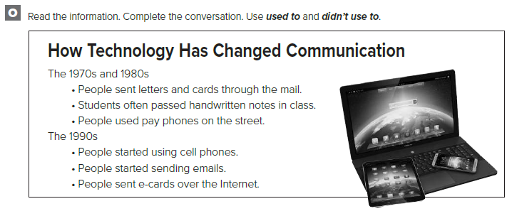

Slide 21
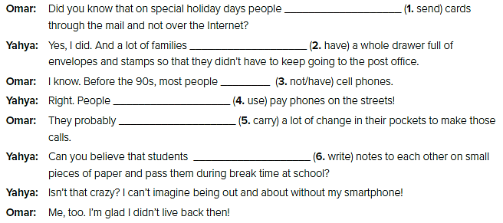
used to send
used to have
didn’t use to have
used to use
used to carry
used to write

Slide 22
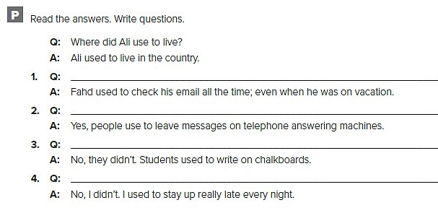
Did Fahd use to check his email all the time?
Did people use to leave messages on telephone answering machines?
Did students use to write on paper/in books/on tablets?
Did you use to go to bed early?

Slide 23
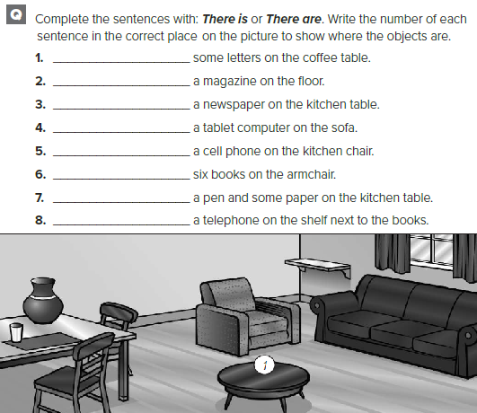
There are
There is
There is
There is
There is
There are
There is
There is

Slide 24
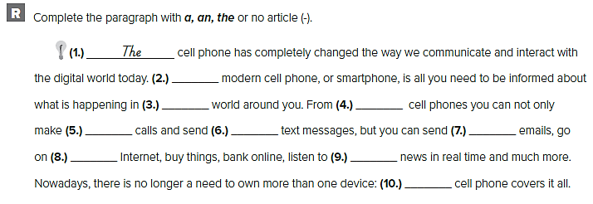
The
_
the
_
_
_
the
the
a

Slide 25
Unit 2

Slide 26
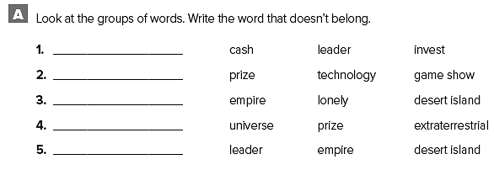
leader
technology
empire
prize
desert island

Slide 27
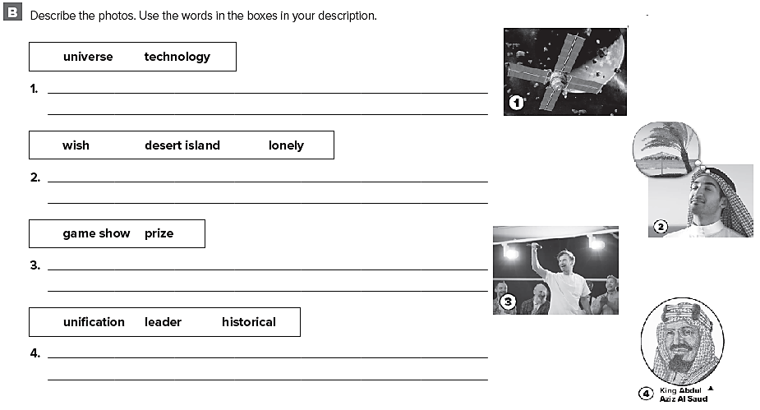
قد تختلف الإجابات
Scientists use technology like satellites to study the universe
He wishes that he was on a desert island. He wouldn’t be lonely there
The man participated in a game show on television, and he won a very large prize
King Abdul Aziz Al Saud was a historical leader. He was responsible for the unification of Saudi Arabia

Slide 28
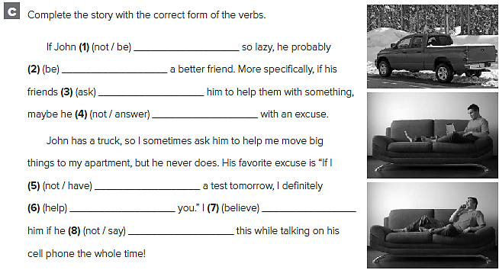
weren’t
would be
asked
wouldn’t answer
didn’t have
would help
would believe
didn’t say

Slide 29
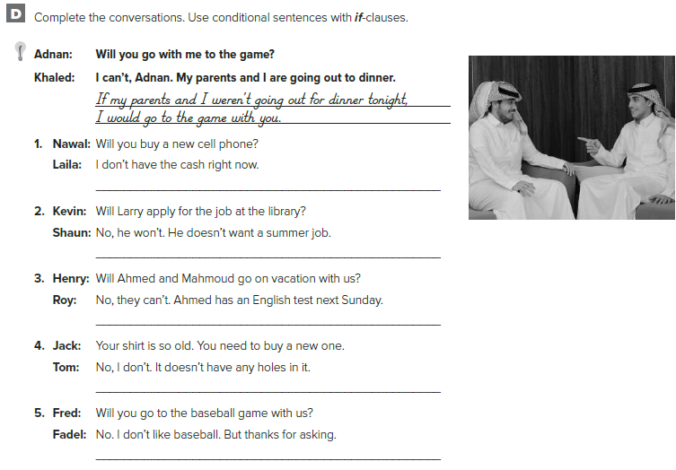
If I had the cash right now, I would buy a cell phone.
If Larry wanted a summer job, he would apply for the job at the library.
If Ahmed didn’t have an English test next Sunday, they’d go on vacation with us.
If my shirt had holes in it, I’d buy a new one.
If I liked baseball, I’d go to the game with you.

Slide 30
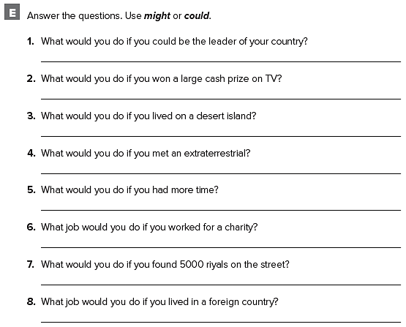
If I could be the leader of my country, I’d work to improve the environment.
If I won a large cash prize on TV, I could travel to every country in the world.
If I lived on a desert island, I could surf and swim all the time.
If I met an extraterrestrial, I might ask about life on other planets.
If I had more time, I could watch more TV.
If I worked for a charity, I might build houses for homeless people.
If I found 5,000 riyals on the street, I might try to find who lost it.
If I lived in a foreign country, I could teach English.

Slide 31
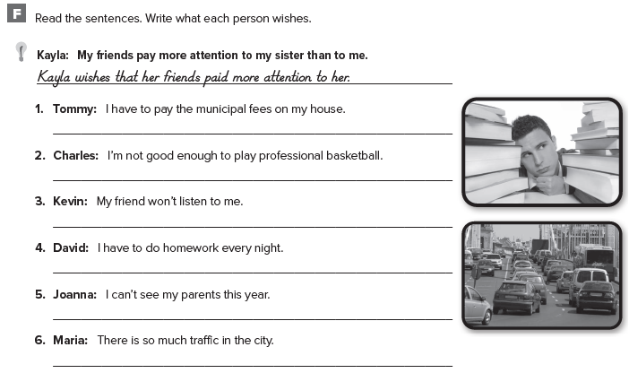
Tommy wishes that he didn’t have to pay the municipal fees on his house.
Charles wishes that he was good enough to play professional basketball.
Kevin wishes that his friend would listen to him.
David wishes that he didn’t have to do homework every night.
Joanna wishes that she could see her parents this year.
Maria wishes that there wasn’t so much traffic in the city.

Slide 32
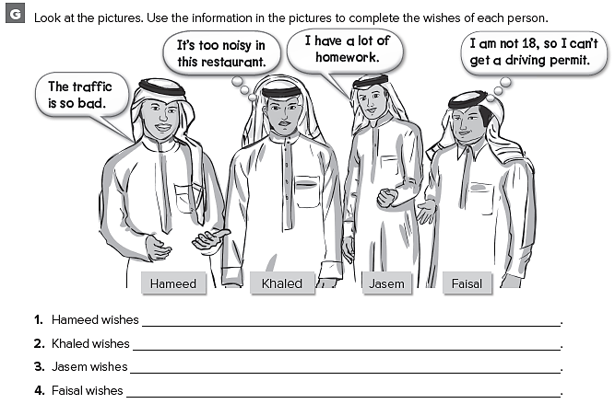
قد تختلف الإجابات
the traffic wasn’t so bad
it wasn’t so noisy at the restaurant
he didn’t have a lot of homework
he was 18

Slide 33
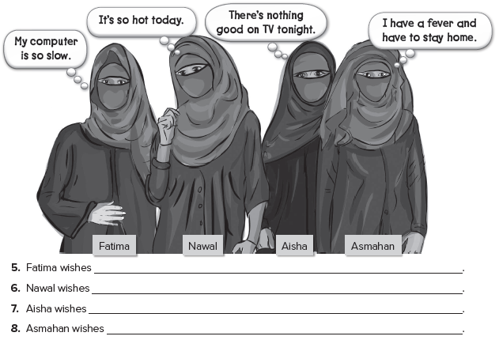
قد تختلف الإجابات
her computer wasn’t so slow
it wasn’t so hot today
there was something good on TV tonight
she didn’t have a fever

Slide 34
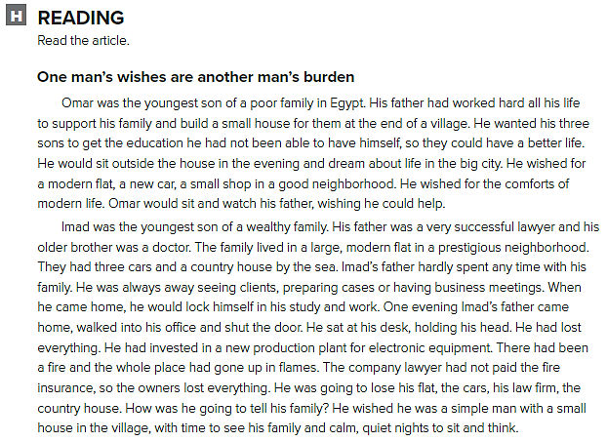

Slide 35
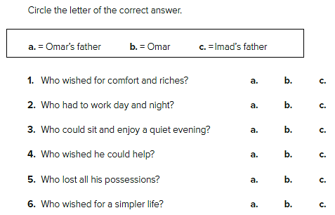

Slide 36
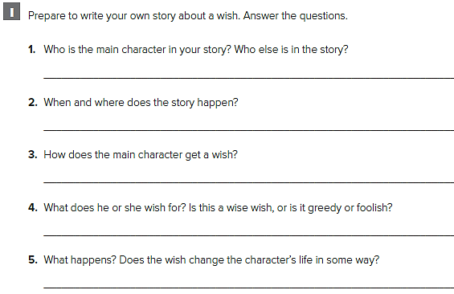
كل طالب يجيب عن قصته

Slide 37
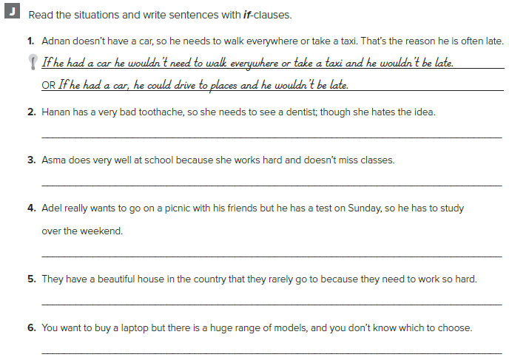
If she didn’t have a toothache she wouldn’t need to see the dentist.
Asma wouldn’t do so well at school if she missed classes.
Adel would go to a picnic with his friends if he hadn’t to study over the weekend for his test.
They would go to their house in the country more often if they didn’t need to work so hard.
If there wasn’t such a huge range of models I would know which laptop to choose.

Slide 38
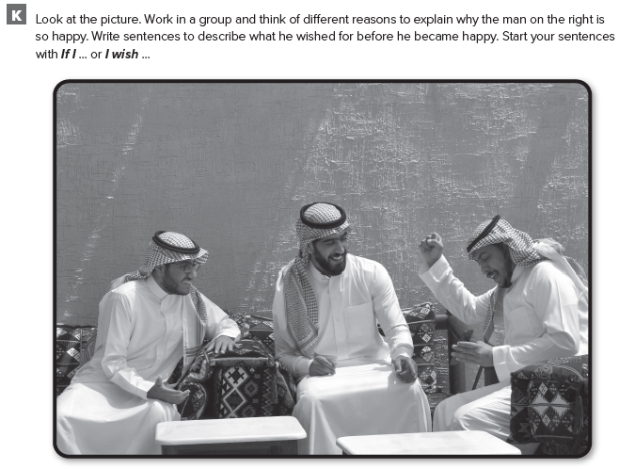

Slide 39
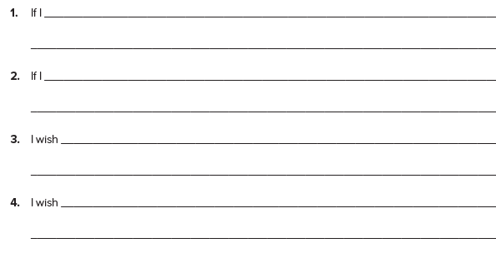
قد تختلف الإجابات
had some time off I’d go on a trip.
had enough money I’d invite my friend to come along.
I had the time and the money to do it.
my friend could accompany me

Slide 40
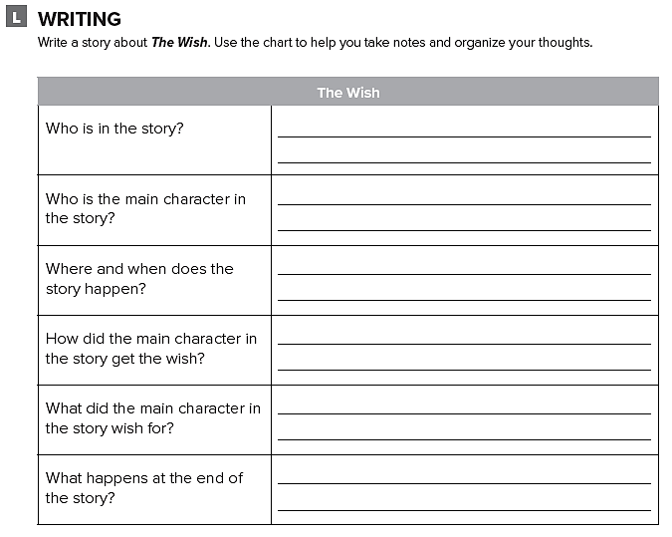
اكتب قصة عن أمنية تحققت لصاحبها

Slide 41
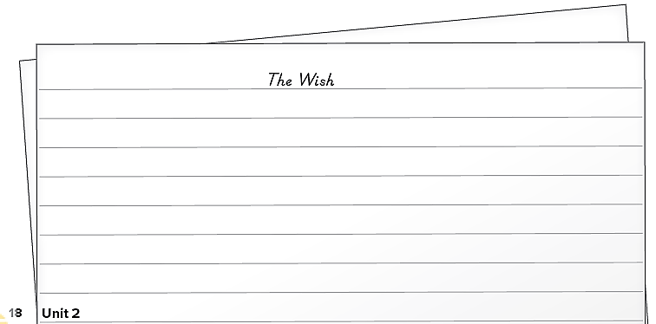

Slide 42
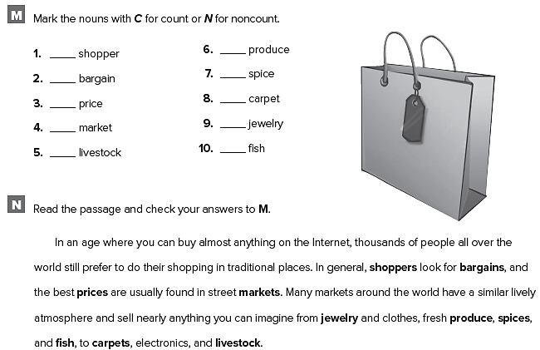
C
C
C
C
N
N
C
C
N
N

Slide 43
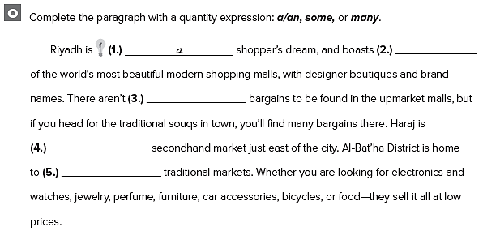
some
any
a
many

Slide 44
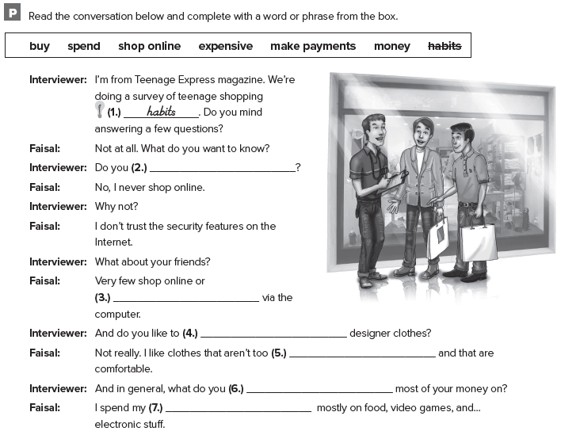
shop online
make payments
buy
expensive
spend
money

Slide 45
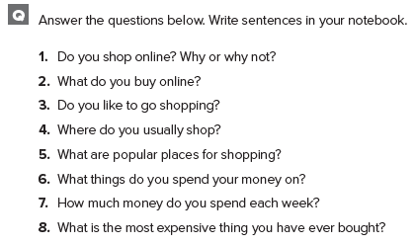
كل طالب يجيب عن نفسه

Slide 46
Unit 3

Slide 47
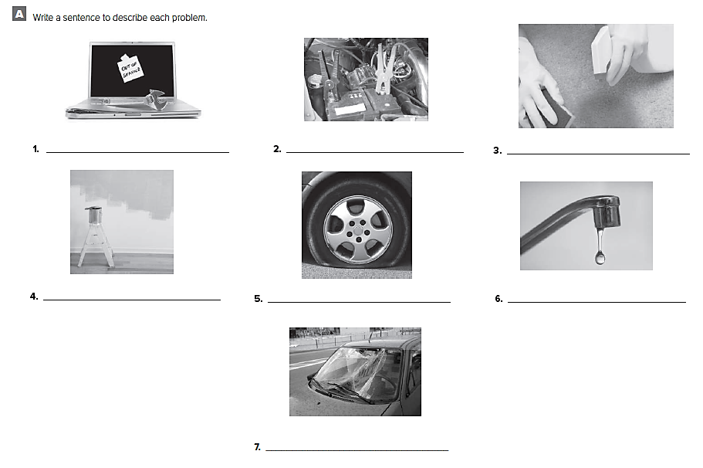
The computer crashed The battery is dead The carpet is stained
The wall needs to be The car has a flat tire The faucet is dripping
painted
The windshield is cracked

Slide 48
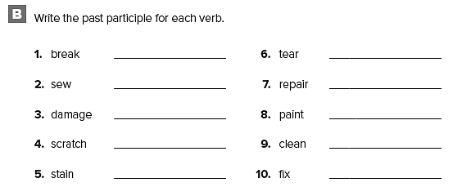
broken
sewn
damaged
scratched
stained
torn
repaired
painted
cleaned
fixed

Slide 49
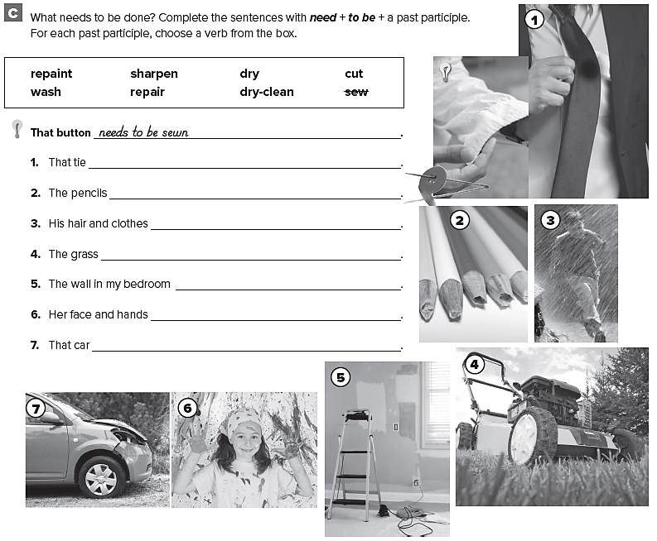
needs to be dry-cleaned
need to be sharpened
need to be dried
needs to be cut
needs to be repainted
need to be washed
needs to be repaired

Slide 50
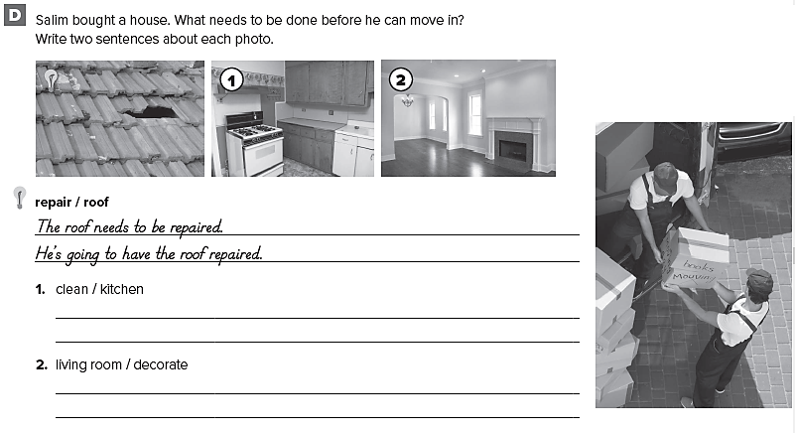
The kitchen needs to be cleaned.
She’s going to have the kitchen cleaned
The living room needs to be decorated.
She’s going to have the living room decorated

Slide 51
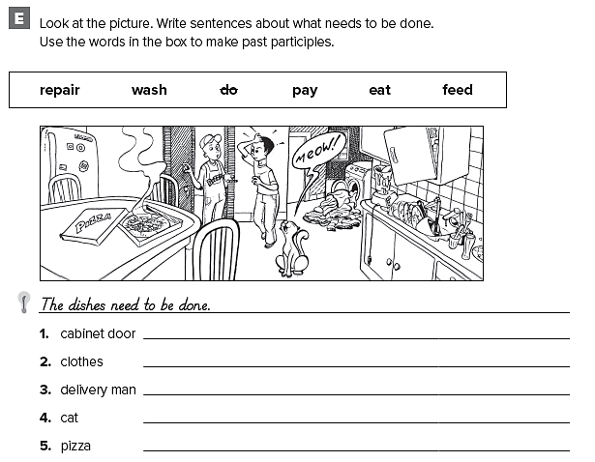
The cabinet door needs to be repaired.
The clothes need to be washed.
The delivery man needs to be paid.
The cat needs to be fed.
The pizza needs to be eaten.

Slide 52
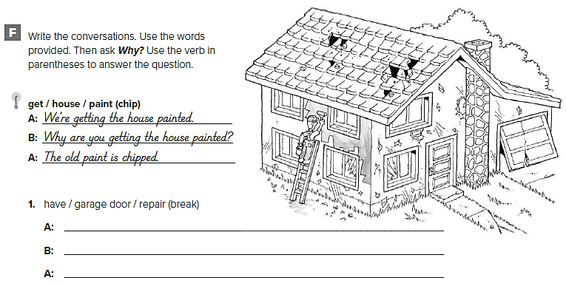
We’re having the garage door repaired.
Why are you having the garage door repaired?
The garage door is broken

Slide 53
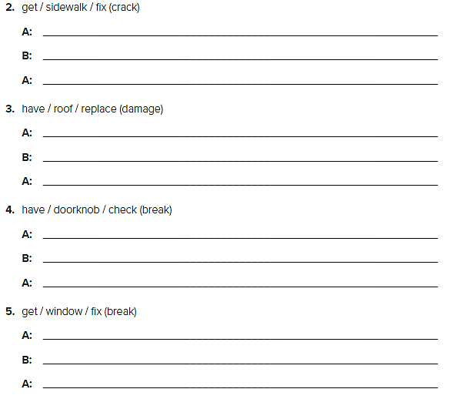
We’re getting the sidewalk fixed.
Why are you getting the sidewalk fixed?
The sidewalk is cracked.
We’re having the roof replaced.
Why are you having the roof replaced?
The roof is damaged.
We’re having the doorknob checked.
Why are you having the doorknob checked?
The doorknob is broken.
We’re getting the window fixed.
Why are you getting the window fixed?
The window is broken.

Slide 54
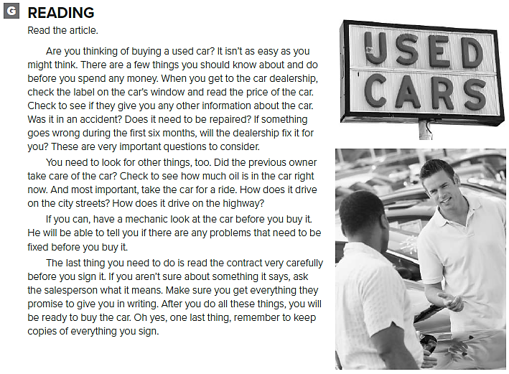

Slide 55

You need to know a few things.
You need to check the price of the car and how much oil is in the car right now
The most important thing is to take the car for a ride
You need to test drive the car on city streets and on the highway
You should have a mechanic look at the car before you buy it.
You need to keep copies of everything you sign.

Slide 56

قد تختلف الإجابات
The pants are too long.
The memory stick doesn’t work
The TV is faulty.
There are two buttons missing from the shirt.
The sunglasses are too small.
The jacket is torn at the back.
The hair dryer has a loose cable
There are 15 pages missing from the end of the novel

Slide 57

Hi,
I’m sorry to hear your laptop has crashed. You need to have it checked by a technician or better still you need to have it replaced. I’ll be over in ten minutes to help.

Slide 58

Hi,
No, I’m afraid there are no open stores at this time but you can have it fixed very quickly. I’ll give you a ring as soon as I get the address and tell you where to go.

Slide 59


Slide 60

قد تختلف الإجابات
This is the fifth time you have been two hours late this month
I am sorry but I come by bus and it is not very reliable.
You’ve said that before and I told you to take a Taxi
Please give me one more chance to prove that I can be reliable
You have not been reliable about anything in the last two months
I am sorry I’ll get a bike, that way I won’t be late.

Slide 61

قم بكتابة رسالة اعتذار

Slide 62


Slide 63

yet
already
just
yet
already

Slide 64

كل طالب يجيب عن نفسه

Slide 65

them
them
them
us
me
you

Slide 66

I need to call my friends.
Ali often complains about the cost of running his car.
What snacks do you need to buy?
He doesn’t like to share his laptop.
We don’t need to send an invitation.
Faris asked him to hold the
elevator door open.

Slide 67
Expansion 1- 3

Slide 68

in spite of
In spite of
Although
as soon as
although
although
as soon as
in spite of

Slide 69

Ali wishes he had time to play tennis every day.
Ahmed wishes he didn’t have to go to work this afternoon
Abdullah wishes he spoke English.
I wish my brother would lend me his new computer.
They wish they knew how to ski.

Slide 70

قد تختلف الاجابات
I’d buy a new computer
I would be on time
he might let me drive it
he would live in Thailand
I might do better on my tests
I’d talk with Abert Einstein
we might play soccer better
I’d definitely go to the new Indian restaurant

Slide 71

The car needs to be repainted after the crash.
The flat tire on my car needs to be repaired.
The hole in Thomas’s jeans needs to be sewn.
The old kitchen needs to be redecorated.
The new knives don’t need to be sharpened.

Slide 72

damaged
repaired
scratched
repainted
broken
decorated
cracked
torn

Slide 73

’m having the house painted
I’m getting the carpet cleaned
I’m going to have the old TV fixed
‘s getting the living room redecorated
’re going to have the damaged roof repaired

Slide 74


Slide 75

قد تختلف الاجابات
The windows were broken.
The roof was damaged
The windows need to be replaced.
The roof needs to be repaired
He’s going to have the windows replaced.
He’s going to have the roof repaired

Slide 76

كل طالب يجيب بأفكاره

Slide 77


Slide 78

قد تختلف الاجابات
Happy excited ecstatic exhilarated enthusiastic satisfied rewarded confident
Yeah! We’re the best!
I can’t believe it! We’ve won.
I knew we’d do it..
What a great moment

Slide 79

تصور بأنك مدرب لفريق ما
قم بالكتابة عن فريقك

Slide 80


Slide 81
Unit 4

Slide 82

meteorite crater
volcano
tornado
debris
bulls

Slide 83


Slide 84

Carl and John looked in the living room for the keys, but their little brother had taken them into the bedroom.
When the football game came on TV, they hadn’t cleaned up yet from the party.
It started to rain, but Karen had left her umbrella at home
They didn’t take any photos on their vacation because they had forgotten their camera
He fell asleep while studying because he had stayed up late every night this week

Slide 85

went
had never been
saw
was
had never seen
Was
did know
Was

Slide 86

had hung
had placed
had put
saw
was
didn’t like

Slide 87

can’t
must
might
must
can’t
might

Slide 88

He must have gone buying a car.
He might have received a parking ticket.
He could have had the car repaired.
He must have called a friend.
He might have been late for a meeting.
He could have forgotten an address.
He must have studied too much.
He might have been bored.
He could have not slept well last night.

Slide 89


Slide 90

They had lived a very quiet life on their farm.
They had never talked to so many people before.
They had never seen a meteor before.
She still carries a piece of the meteorite

Slide 91

كل طالب يجيب عن نفسه

Slide 92

قد تختلف الإجابات
You must have dropped it in the car.
Someone might have stolen it.
I might have left it at my mother’s house
It must still be on the little table.
I must have forgotten that I’d taken it out of my bag.
I must have forgotten I put it there.

Slide 93


Slide 94

smoke flames put out the fire
explosion building check for live ash
The fire must have started in one of the 5th floor flats.
The building had been evacuated when the fire fighters arrived.
The building will probably be torn down.

Slide 95

تحدث عن واقعة غريبة حصلت لك

Slide 96


Slide 97

The man ate the pizza and drank the soda so he wasn’t hungry or thirsty
We can study hurricanes or the planetary system.
I read the science book and I saw the scientific documentary, too.

Slide 98

I like hot air balloons but , yet I am scared of heights.
It could be a helicopter or a plane.
I don’t like guessing so I will wait for the facts.
It might be a weather balloon or a UFO.
I wanted to get home quickly so I took a shortcut through the park
I don’t think the human race can live on another planet but , yet scientists are investigating the possibility.
The remote control can turn off the TV and switch channels but it can’t switch on my computer.

Slide 99

قد تختلف الاجابات
1- The city may have won an award.
2- The sculpture could have been donated by a local businessman.
3- The city council must have decided the park needed to attract more tourists.

Slide 100


Slide 101

قد تختلف الاجابات
more people might visit the park.
the city will be greener. People will visit the park and appreciate the beauty of nature.
make the place messy.
have to have to clean it all the time.

Slide 102
Unit 5

Slide 103

penicillin
unemployed
regretted
source

Slide 104

advantages
drilled
heavy
oil well

Slide 105

should have been
should have told
should have stopped her
shouldn’t have panicked

Slide 106

should have controlled
shouldn’t have let
should have realized
should have won

Slide 107

قد تختلف الاجابات
I shouldn’t have gone to the mall with Tim.
I should have studied for the history test.
I should have apologized to Camilla.
I shouldn’t have walked to school in the rain.

Slide 108

قد تختلف الاجابات
I should have asked for directions.
I should have gone to the football game.

Slide 109

We shouldn’t have brought all these things.
إجابات من قبل الطلاب

Slide 110

If I had driven, I would have asked for directions.
If my friends had asked me, I would have gone to the library
If I had packed for the trip, I would have taken shorts and T-shirts.

Slide 111

قد تختلف الاجابات
1. If I had grown up in Canada, I could have spoken English and French in school.
2. If I had grown up in the United States, I might have liked to watch football.
3. If I had listened to my father, I would have bought a new car instead of a used car.
4. If Mei had called me earlier, I could have bought her a pizza, too.
5. If I had studied more, I might have passed the biology test.

Slide 112

What is dreaming?
What causes dreaming?

Slide 113

Do we dream in color?
What does sleep research involve?

Slide 114


Slide 115

doing something dangerous / broke my leg
If I hadn’t done something dangerous, I wouldn’t have broken my leg.
being mean to a friend / made me very unpopular
If I hadn’t been mean to a friend I wouldn’t have become so unpopular
telling someone something I shouldn’t have / hurt his/her Feelings
If I hadn’t told her anything, her feelings wouldn’t have been hurt and she wouldn’t have been upset

Slide 116


Slide 117

pay, career opportunities, security, housing, education, family, higher standards of living,
wouldn’t have developed the way it has.
automobiles wouldn’t have developed the way they have.
a number of countries wouldn’t have developed into rich nations

Slide 118

تحدثت عن شيء قمت بفعله ثم ندمت عليه

Slide 119


Slide 120

appeared appeared
be been
became became
built built
cooled cooled
discovered discovered
do done
import imported
invent invented
kept kept
make made
preserved preserved
put put
used used

Slide 121

have tried
invented
kept
imported
put
built
appeared
preserved
became
have cooled

Slide 122

كل طالب يجيب بعباراته

Slide 123


Slide 124

had been
weren’t able to
have been able to
are able

Slide 125
Unit 6

Slide 126

power
had bothered

Slide 127

had knocked down
had raised

Slide 128

had to pick it up
wanted to talk to you about publishing an article
wanted to talk to you about publishing an article
he had not been free last week
wanted to meet you for dinner

Slide 129

Jason’s mom told him that he would do all of the homework for Mr. Wilson’s class.
Jason said that Mr. Wilson could give less homework to the class
Jason’s mom explained that he wouldn’t play football.
Jason assured his mom that he would finish all the homework
Jason’s mom agreed that Mr. Wilson just might be right from time to time!

Slide 130


Slide 131

who had made the plans for the park
why they hadn’t asked for his ideas
if they had planned an area for bicycles
if there was a path where people can jog
if there would be lots of benches

Slide 132

where the football field would be
how many tennis courts there would be
when the park would open
if the plans included some basketball courts
why they didn’t include a place for family picnics
how they could do all these things

Slide 133


Slide 134



Slide 135


Slide 136

T
F
T
F
F

Slide 137

قم بكتابة محادثة بين شخصين حول موضوع ما

Slide 138

The teacher greeted us/said good morning. Then she said that she hoped we had everything we needed, pens, pencils, extra paper
She asked us to keep our test booklets closed and just write our name on the front page.
Then she said the time was ten minutes past eight and told us/informed us that we had to complete the test by ten minutes past ten. She added that we had 2 hours.
She told us to open/she suggested that we open our test booklets and start writing. She asked us to keep our eyes on our paper and not speak to each other. She told us to raise our hand if we needed anything.

Slide 139


Slide 140

Sports Celebration Environment Education
Sports
Our National Team are on their way back with the trophy!
Celebration
The National Day is celebrated all over KSA.
Environment
Our government promote a new program for protecting wild life
Education
A new, state of the art, elementary school has just been
opened in Jeddah.

Slide 141

قم بنقل محادثة حصلت بينك وبين صديقك

Slide 142


Slide 143

countryside
city
harm
news
hit

Slide 144

Haven’t you brought your computer?
Haven’t you left yet?
Don’t you like what I’ve ordered?
Haven’t you watched the news?

Slide 145


Slide 146

They live in forests in southwestern China .
How many wild pandas are there?
About 1,600.
Who is working to protect the pandas ?
The Chinese government and conservation organizations
How much does a panda eat?
panda eats up to 95 pounds (45 kg) of bamboo a day.
How long does a panda eat for each day?
For about 16 hours.

Slide 147
Expansion 4 – 6

Slide 148

had watched
had left
had decided
had failed
had received
had taken

Slide 149

Greg couldn’t have been at home.
Adel may be in a cast for six weeks.
Stephanie may pass her test tomorrow.
They must be excited about their vacation.
The car might have been on sale.
Daniel must be sick.
It might have been Michael.

Slide 150

I shouldn’t have eaten so much food.
I should have been more careful.
Hanan should have studied with Karen.
Fahad should have warmed up more.
I shouldn’t have had that much coffee at dinner.
I should have brought a sweater.
I shouldn’t have bought the book.
I should have paid more attention.

Slide 151

If Mark had gone to bed early, he wouldn’t have been tired.
If Ibrahim hadn’t lived in Paris for three years, he wouldn’t have learned to speak French.
If I hadn’t bought a new computer, I would have gone on vacation with my friends.
If it hadn’t rained all day, I wouldn’t have taken a nap.
If Sarah hadn’t been sick, she would have been at school today.
If my brother had learned how to swim, he would have learned how to water-ski.

Slide 152


Slide 153

he had seen that little red sports car
he hadn’t seen it
Qassim would get a car like that
was probably his father’s car
was usually so quiet and shy
maybe he had changed
that he was going to call Qassim
he was going to do that

Slide 154

said that he had tried to stop
said that the other driver was talking on his cell phone
said that he saw the driver on his cell phone
said that was not true at all

Slide 155

تحدث عن حوادث السيارات
ما الذي يحدث قبل وبعد الحادث

Slide 156


Slide 157

mosque
monument
tower
design
build
construct
beautiful
elegant
expensive
The Mosque of the Prophet in Madinah is one of the most beautiful mosques in the world.
The construction took years to complete.
Thousands of workers, artisans and craftsmen were employed to do the work.

Slide 158

قم بالكتابة عن حادث شاهدته أو سمعت عنه

Slide 159


Slide 160
Prepared by
Teacher :
Badr Sayid Al-Shehri

