Slide 1
Unit 2
I Wonder What Happened Grammar
Mega Goal 1.3
Done by: Entisar Al-Obaidallah

Slide 2
Lesson Objectives
1
2
3
4
Practice
Use
Defferentiate
Apply
using past perfect tense
correctly
The rules to do the exercises
Can’t , could , couldn’t , must , may , might to make supposition correctly .
Between the modals of suppositions in the past & present

Slide 3
Open your studen’s book p . 22

Slide 4
1
Past Perfect Tense

Slide 6
Past Perfect Tense
Example
What is the past perfect??
An action (A) happened before another action (B) in the past.
What do we use the past perfect tense??
Use it to talk about things that happened before an event in the past.
B
A
When I woke up, my mother had already prepared breakfast for me.

Slide 7
Past Perfect Tense
What are the two verbs in this sentence?
When I woke up, my mother had already prepared breakfast for me.
V ( Past simple)
V ( past participle)
Look at the time word!
Example time word: when, before, after, because, by the time

Slide 8
Do you still remember the structure?
Form:
Affirmative(+)
Subject
had
V( past participle) 3
He had washed the car.

Slide 9
Do you still remember the structure?
Form:
Negative (-)
had
not
V( p.p3)
Subject
He had not washed the car.

Slide 10
Do you still remember the structure?
Form:
Question (?)
Had
Subject
V( p.p3)
?
Had he washed the car?

Slide 11
Let’s Practice
https://wordwall.net/resource/12118423

Slide 12
2
Can’t, could, couldn’t , must , may or migh

Slide 13
USING OF “ MUST”
USING OF “ can’t”, couldn’t
USING OF “ MAY ,MIGHT”

Slide 14
PRESENT
can’t
couldn’t have been
might
might have been
past
must
must have been

Slide 15
The Structure in the Present
Form:
Affirmative(+)
Subject
Modal verb
V( base form)
He might go to the work.

Slide 16
The Structure in the Present
Form:
Negative (-)
Subject
not
V( base form)
Modal verb
He might not go to the work.

Slide 17
The Structure in the Past
Form:
Affirmative(+)
have
V( p.p3)
Subject
Modal verb
He might have gone to the work.

Slide 18
The Structure in the Past
Form:
Negative (-)
Subject
Modal verb
not
have
V( p.p.3)
He might not have gone to the work.

Slide 19
Let’s Practice
Open
workbook p. 92

Slide 20
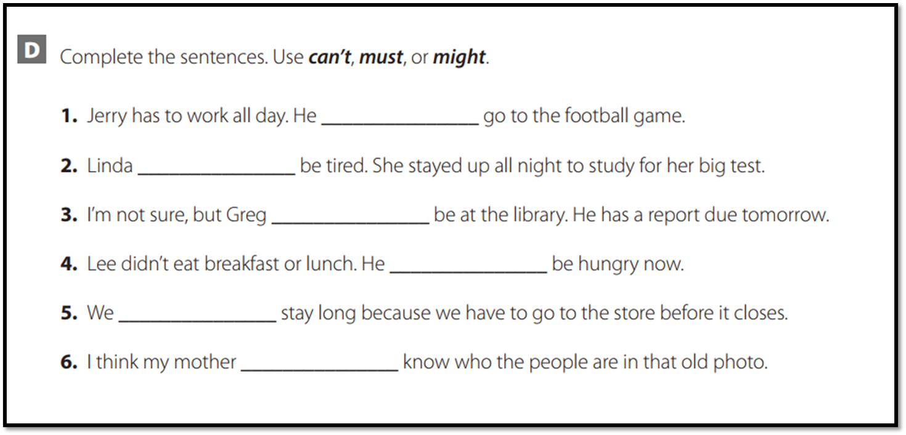
ACTIVITIES
can’t
must
might
must
can’t
might

Slide 21
Homework
Workbook , p.(91), Exercise (C)

Slide 22
THANKS!

