Slide 1
Unit 2
I Wonder What Happened
Writing
Mega Goal1.3
Done by: Entisar Al-Obaidallah

Slide 2
Lesson Objectives
1- Identify the different stages that remote controls went through
2- Read the article for specific information
3- Find the topic of each paragraph
4- Decide if the conclusion of the article is wonderful or scary
5- Write a short description of your vessel, voyage expedition

Slide 3

Open
Your student’s book
p. (28)

Slide 4

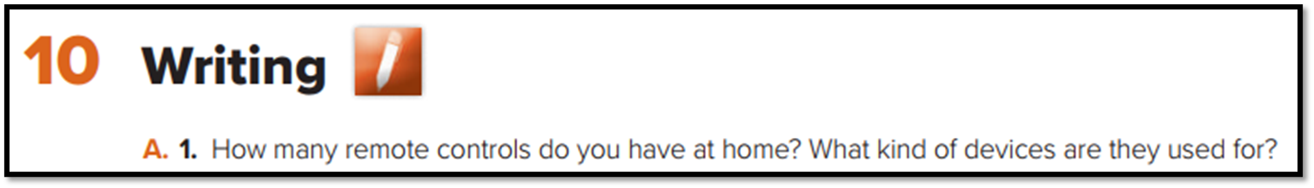

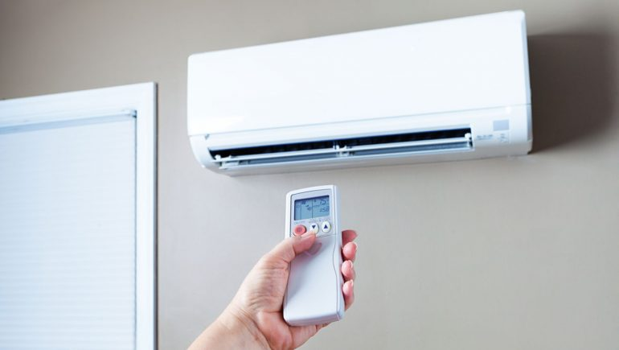






Slide 5
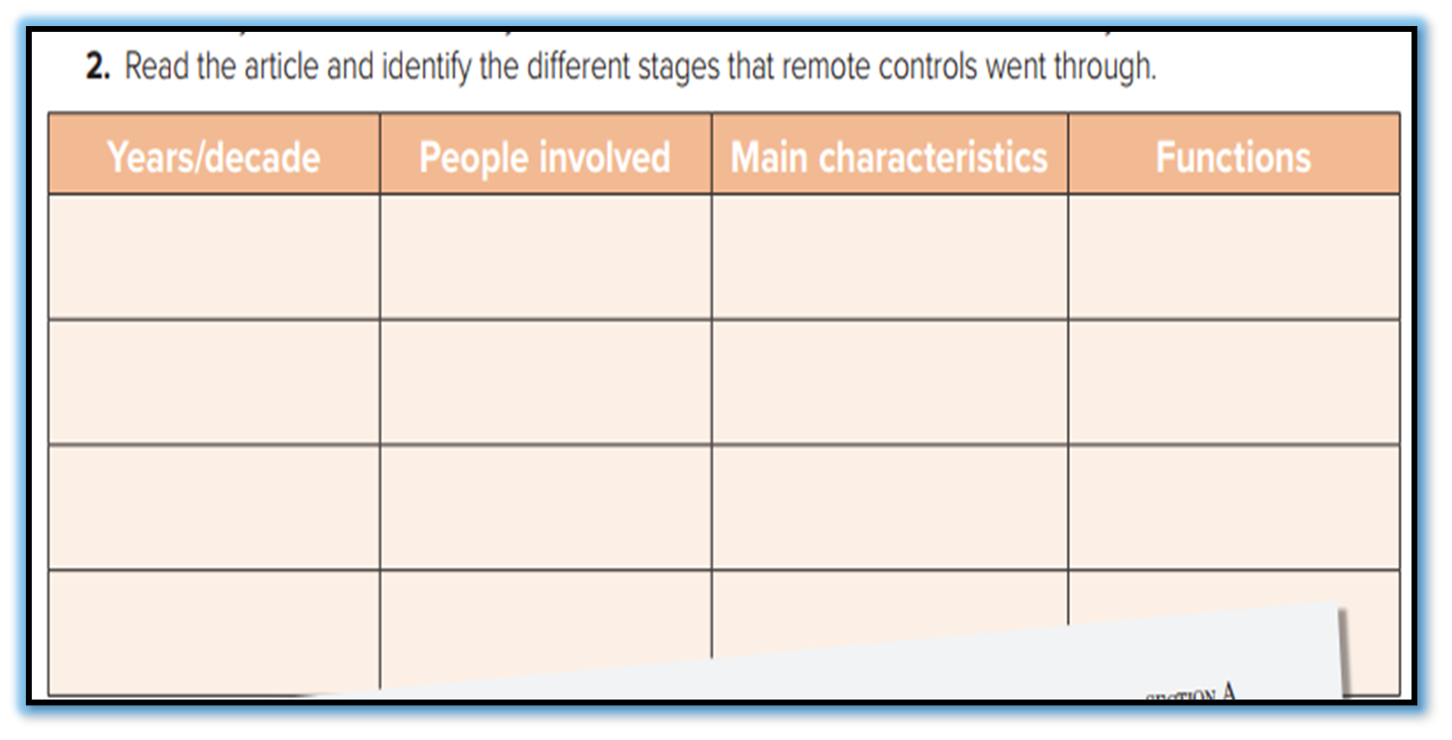
Listen and follow in your book to fill in the chart

Slide 6

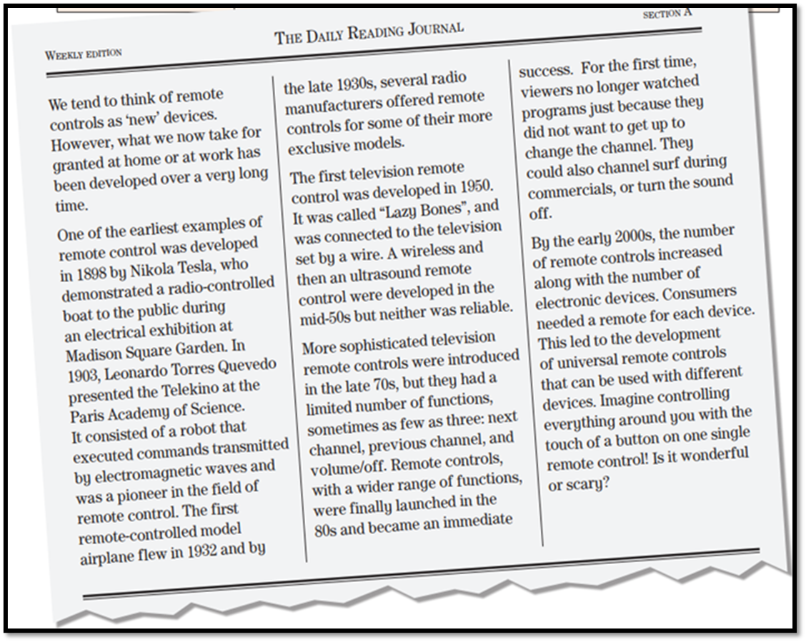
1
3
What’s the article about?
2
5
It is about Remote Control
4
How many paragraphs are there?
There are 5 paragraphs

Slide 7
The History of Remote Control

Slide 8
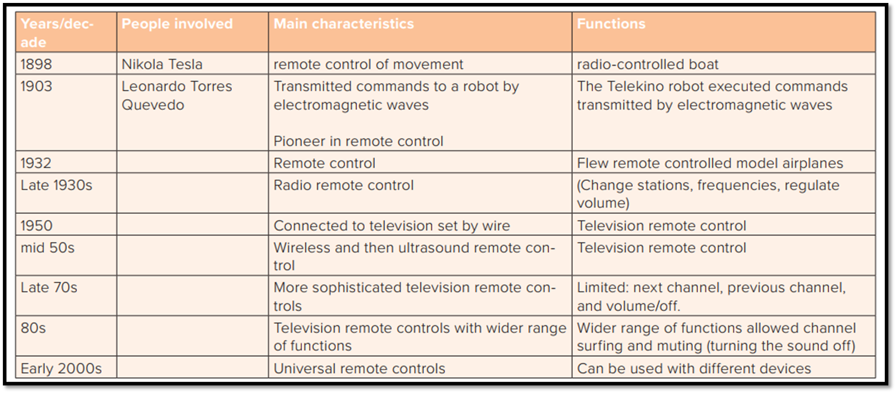
The History of Remote Control

Slide 9
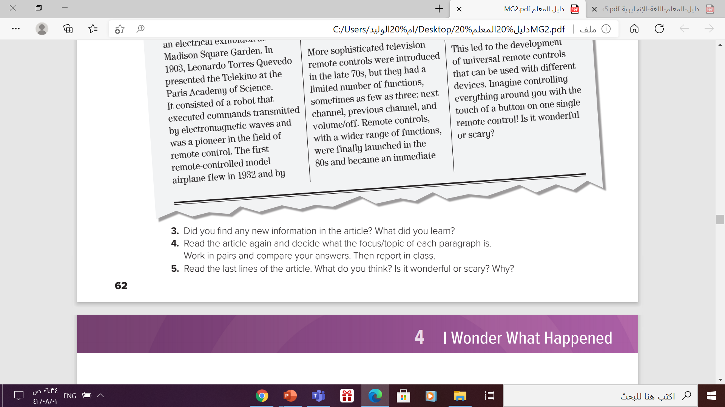
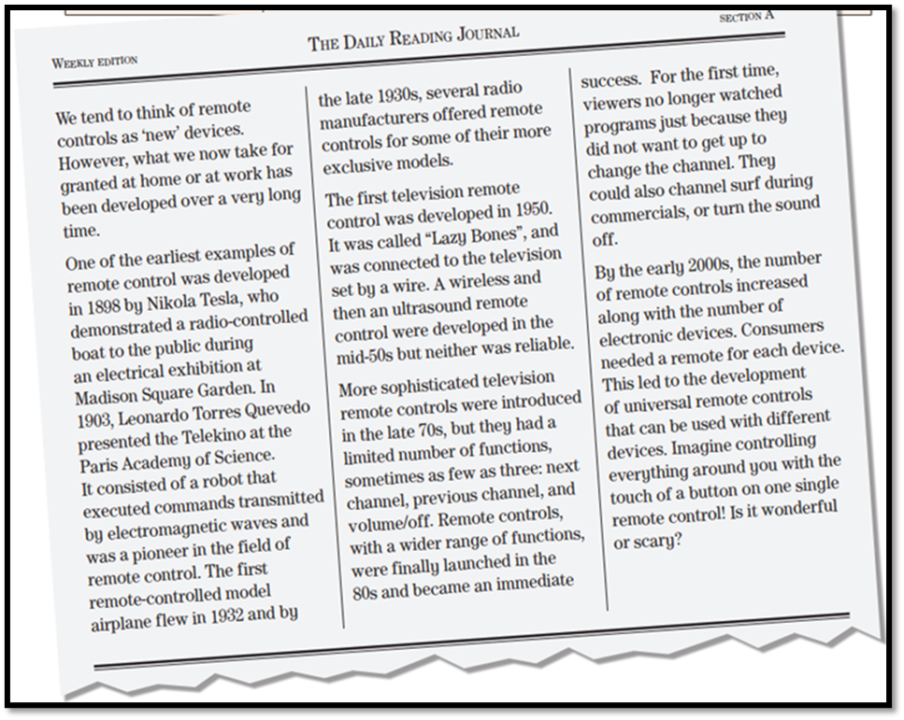
Paragraph 1: introduce article
theme/remote control
Paragraph 2: early examples
of remote control
Paragraph 3: early television
remote controls / the first
television remote control
Paragraph 4: more sophisticated
remote controls, 70s onwards
Paragraph 5: developments in
the 2000s, universal remote controls

Slide 10
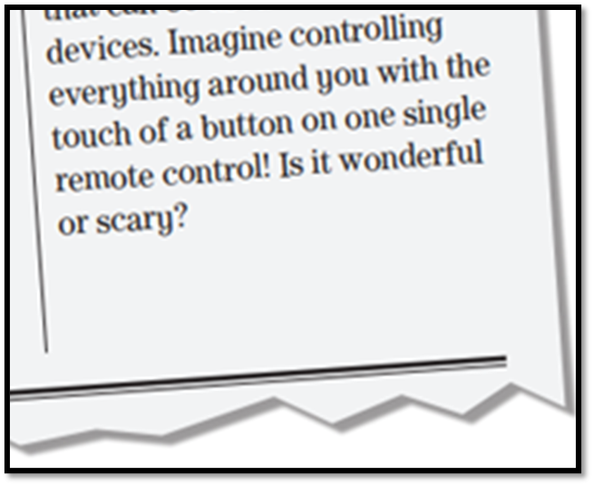


Slide 11
Open
Your student’s book
p. (29)

Slide 12
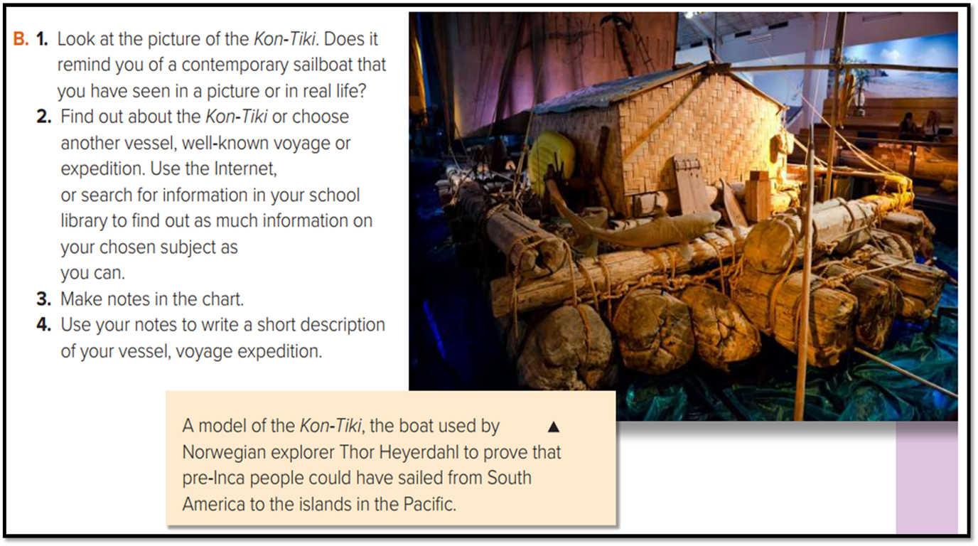
Writing Task

Slide 13
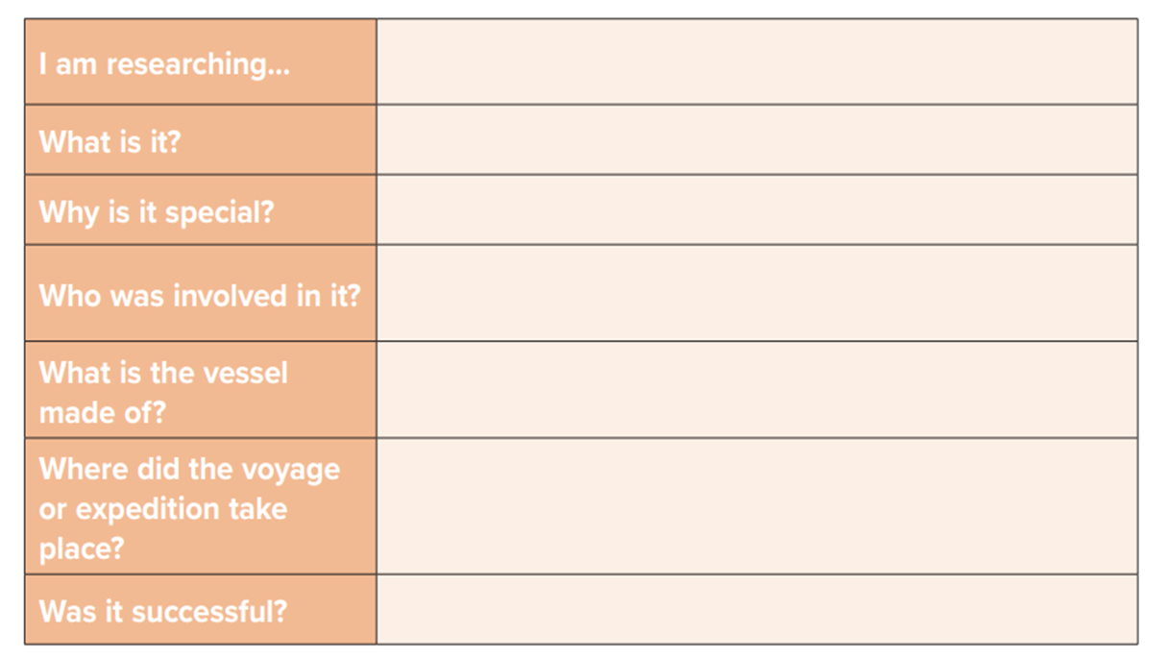
Example
James Cook’s Voyage
First sea voyage
The first scientific expedition to the pacific
The British Navy
wood
The Pacific
Yes , it was

Slide 14
What is a descriptive essay?
→It is an essay that describes something – an object or person, an event or place, an experience or emotion, or an idea. The goal of this kind of essay is to provide readers with enough detailed descriptions for them to be able to picture or imagine the chosen topic.

Slide 15
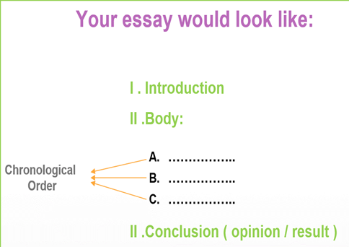
How to write a descriptive essay?
1- The introduction in which you give name, time, place, and reasons for the expedition or the experience
2- The body (3 paragraphs at leas) in which you describe the actual events in separate paragraphs. Use the past tenses to illustrate those you attended some time ago.
3- The conclusion which includes people’s feelings , opinions , comments or final results of the events .

Slide 16
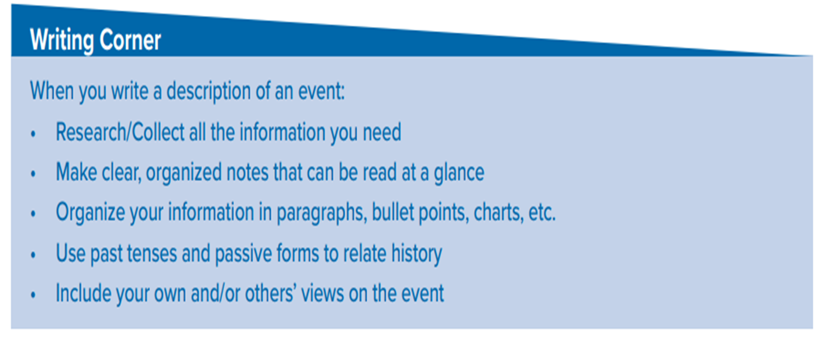
Follow these steps to write a descriptive essay

Slide 17
Homework
Your student’s book
p. (29)

Slide 18

Thanks!

