Slide 1
Unit 2
I Wonder What Happened
Form, Meaning & Function
Mega Goal 1.3
Done by: Entisar Al-Obaidallah

Slide 2
Lesson Objectives
01
02
03
04
Use
Practice
Distinguish
Write
Independent clauses with and , but , or , so and yet
Using the past with Dependent Time Clause
Between Gradable and Non-Gradable adjectives
Conditional sentences with present and future forms

Slide 3
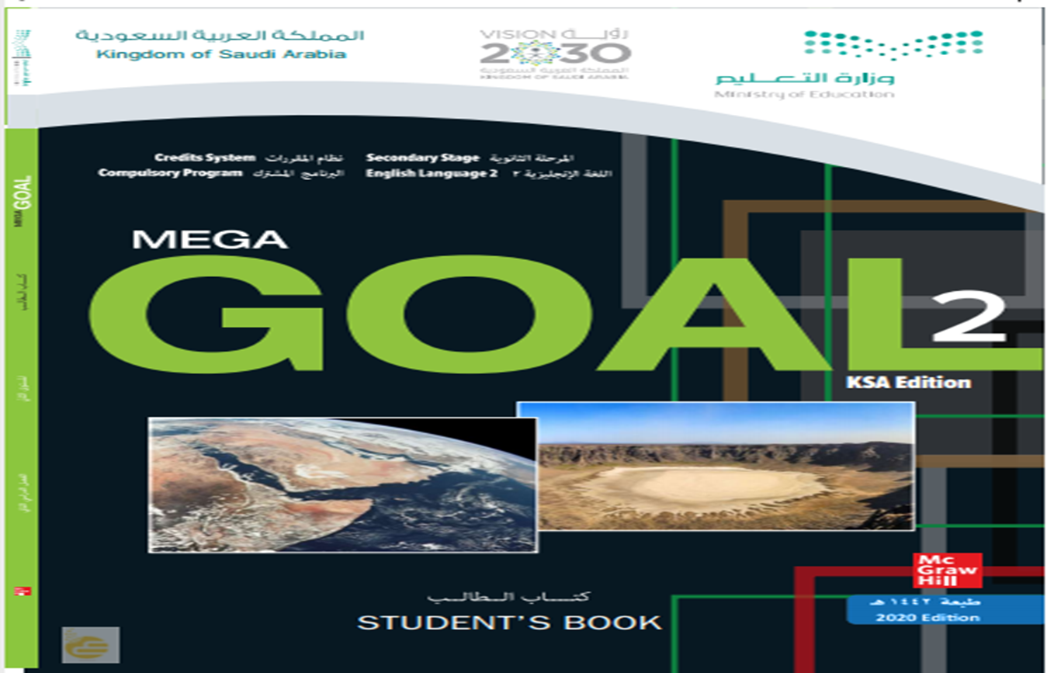
Open
Your student’s book p. (30)

Slide 4
01
Independent Clauses with
And, But, Or , So , Yet

Slide 5
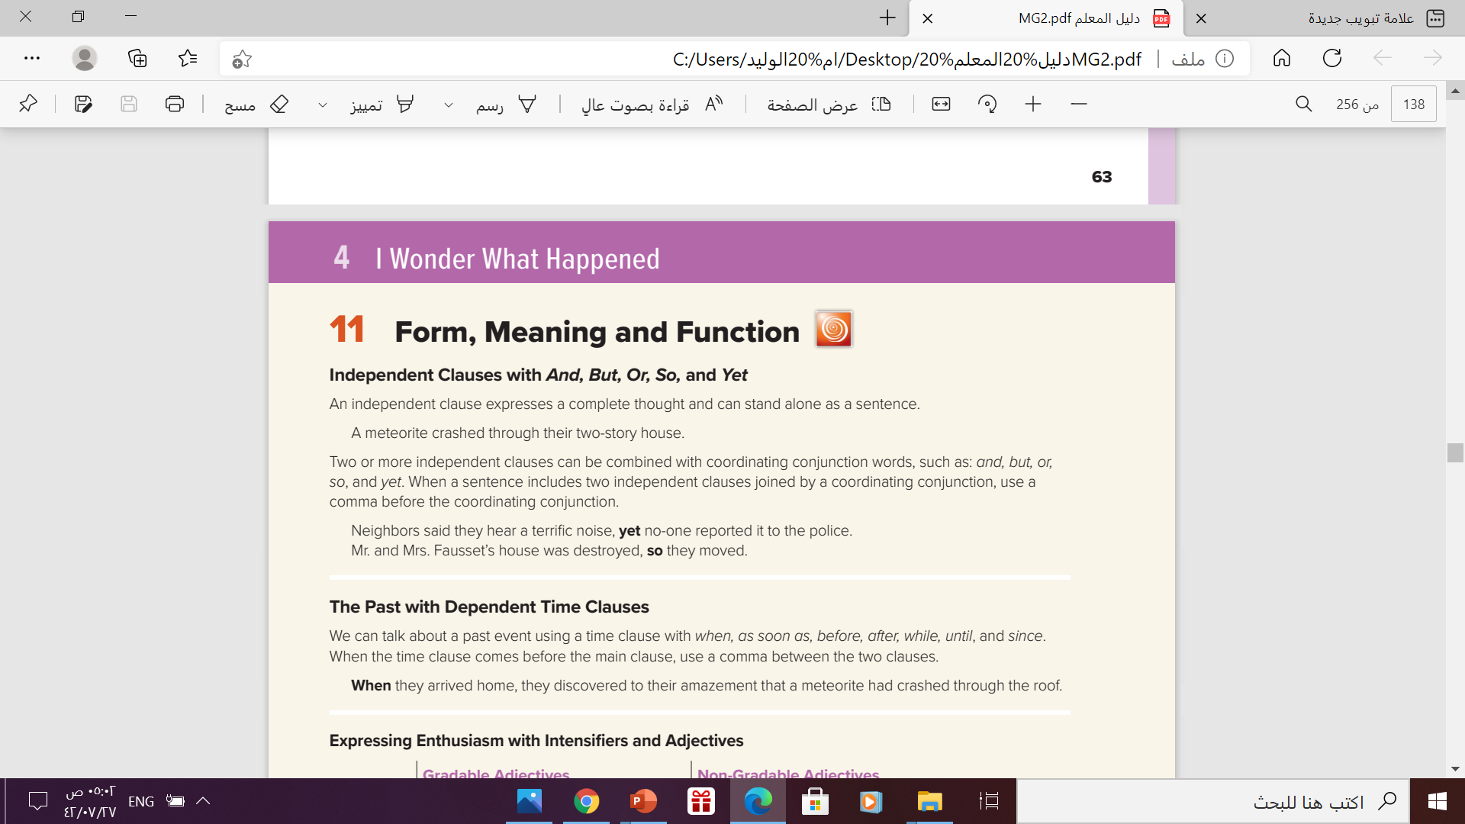
All these examples are independent clause
Complete each sentence with the correct conjunction(s)
and
1- It is raining hard, ______ there is a lot of lightning.
so
2- He didn’t want to walk in the rain, ___ he took a taxi.
3-He doesn’t live far away, ___ he always drives.
but
or
4- We could go to a restaurant, ___ we could stay home and watch TV.

Slide 6
What is a clause?
A clause is a group of words that includes a subject and a verb. (A clause functions as an adjective, an adverb, or a noun.)
Examples:
I graduated last year. (One clause sentence)
When I came here, I saw him. (Two clause sentence)
When I came here, I saw him, and he greeted me. (Three clause sentence)
Types of Clause:
→Clauses are mainly of two types:
Independent Clause
Dependent clause

Slide 7
What is the differences ?
indepedent
dependent
Independent Clause
Dependent Clause
An independent clause functions on its own to make a meaningful sentence and looks much like a regular sentence.
In a sentence two independent clauses can be connected by the coordinators: and, but, so, or, yet*.
A dependent clause cannot function on its own because it leaves an idea or thought unfinished. It is also called subordinate clause. Dependent clauses help the independent clauses complete the sentence. A dependent clause alone cannot form a complete sentence.
I want to buy a phone, but I don’t have enough money. (Two independent clauses)
He bought a car which was too expensive.

Slide 8
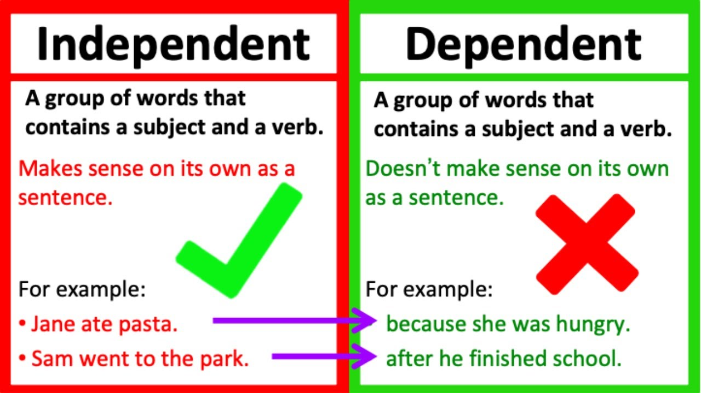

Slide 9
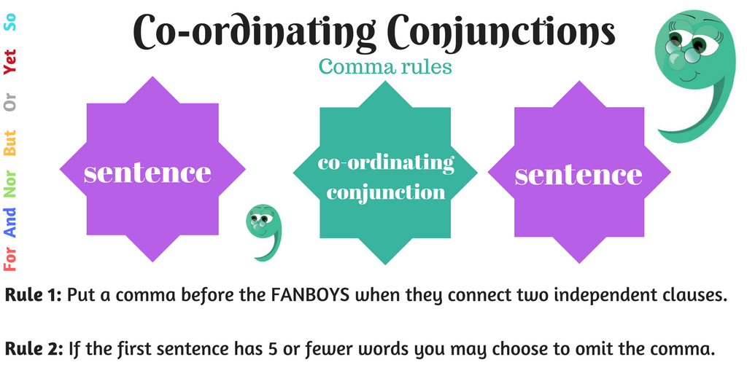
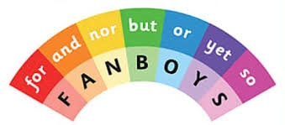
What Is a Coordinating Conjunction?
coordinating conjunction is a word that joins two verbs, two nouns, two adjectives, two phrases, or two independent clauses. The seven coordinating conjunctions are for, and, nor, but, or, yet, and so.
Meet the Key Players: FANBOYS
The best way to remember the seven coordinating conjunctions is by using the acronym FANBOYS:

Slide 10
02
The Past with Dependent Time Clause

Slide 11
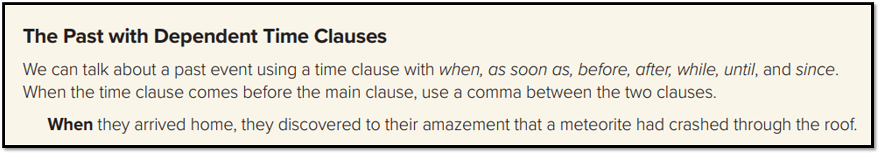
when
As soon as
while
since
Subordinating Conjunctions
until
before
after
Before we watched the movie , we had dinner
Time Clause ( dependent )
comma
Main clause ( independent )

Slide 12
03
Expressing Enthusiasm with intensifieres and adjectives

Slide 13
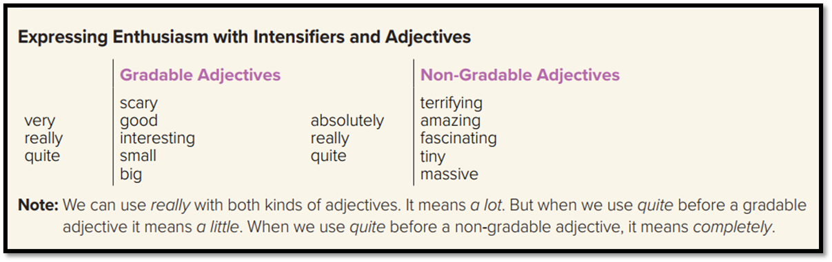
➔Adjectives describe a quality that something has, such as the temperature, appearance or size, and they fall into two categories:
1-gradable adjectives and 2- non-gradable adjectives.
But what does this mean?
To describe variations in temperature, for example, we can use hot or cold, which are gradable adjectives, but to describe the limits or extremes of temperature we use boiling (= very hot) or freezing (= very cold); these are non-gradable adjectives.

Slide 14
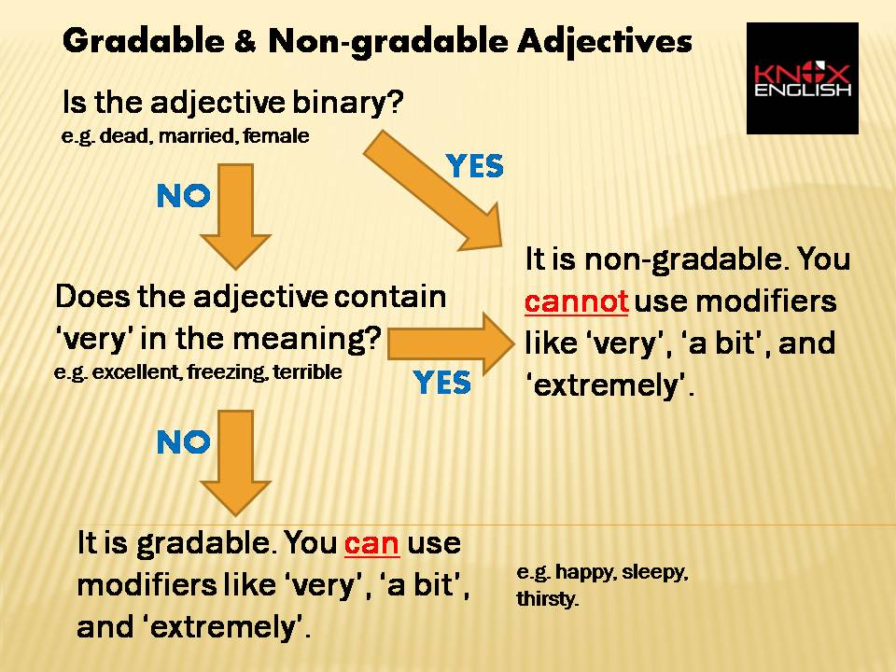
This guide will help you remember:

Slide 15
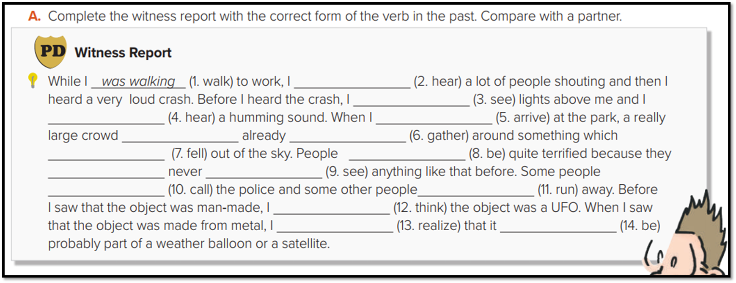
heard
had seen
had heard
arrived
had
gathered
had fallen
were
had
seen
heard
ran
had thought
realized
was

Slide 16
Open
Your student’s book p. (65)

Slide 17
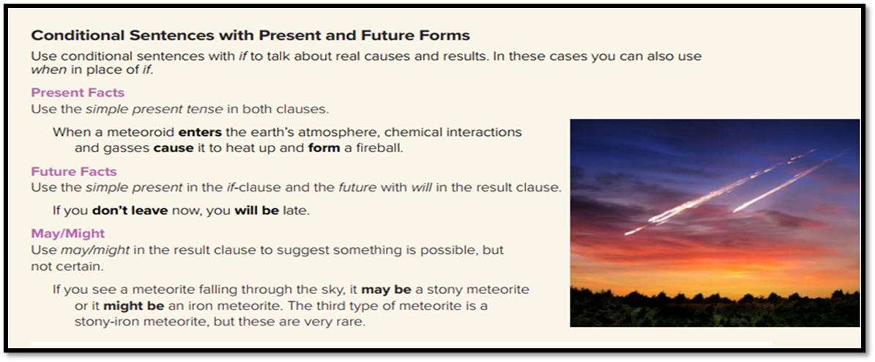
If you heat water, it boils .
Present facts
When you heat water, it boils .
If you wake up late , you will miss the bus
Future Facts
If it rains , we will stay at home

Slide 18
If conditional with present facts
,
If
Present Simple
Present Simple
If conditional with future facts
,
will
infinitive
Present Simple
If
If conditional with possibility
,
If
Present Simple
May - might
infinitive

Slide 19
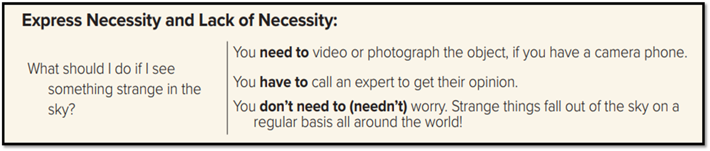
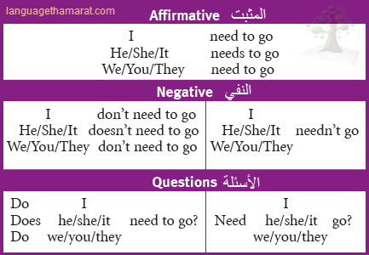

Slide 20
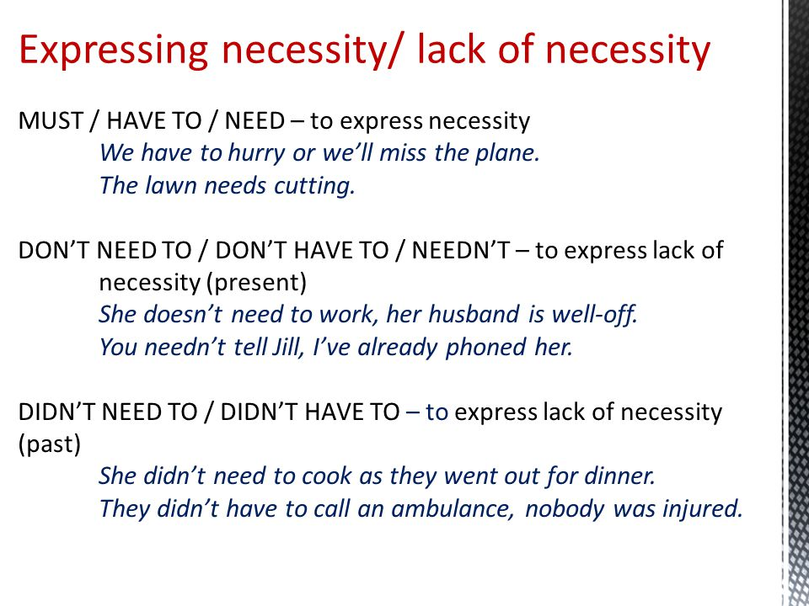

Slide 21
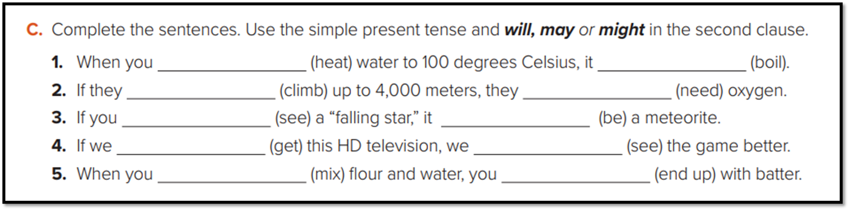
heat
boils
climb
will need
see
Might heat
get
will see
mix
end up-will end up

Slide 22

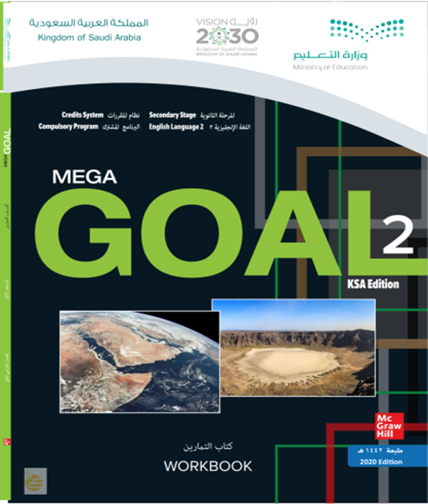
Homework workbook p. 97, exercise (K)

Slide 23

Thanks!

