Slide 1


Welcome to class
T.

Slide 2

1
Unit 1

Slide 3





workbook
Pages 41 , 42

Slide 4
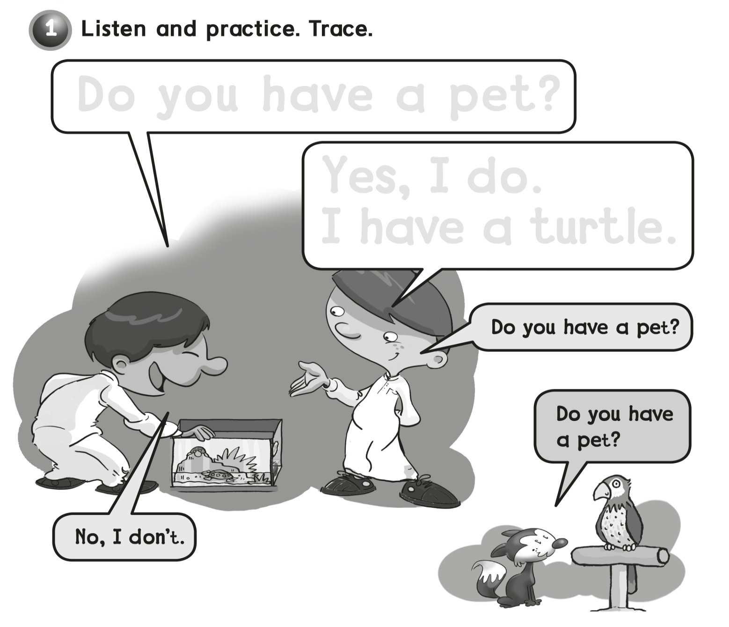
Do you have a pet ?
Yes , I do
I have a turtle .

Slide 5
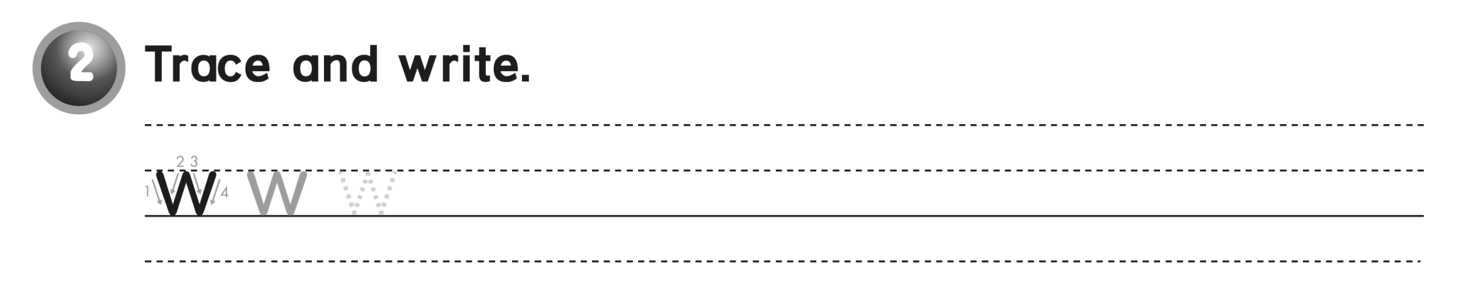
w w w w

Slide 6
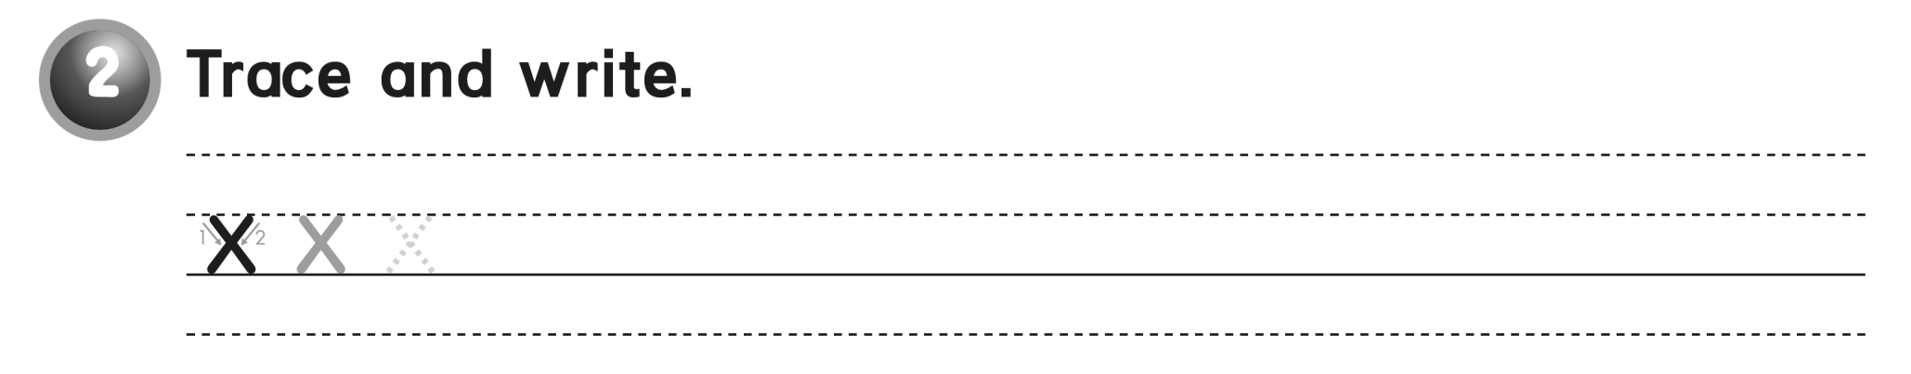
x x x x

Slide 7
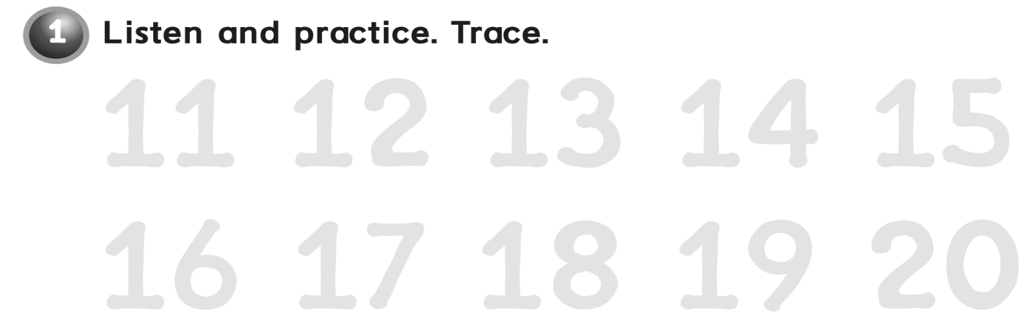
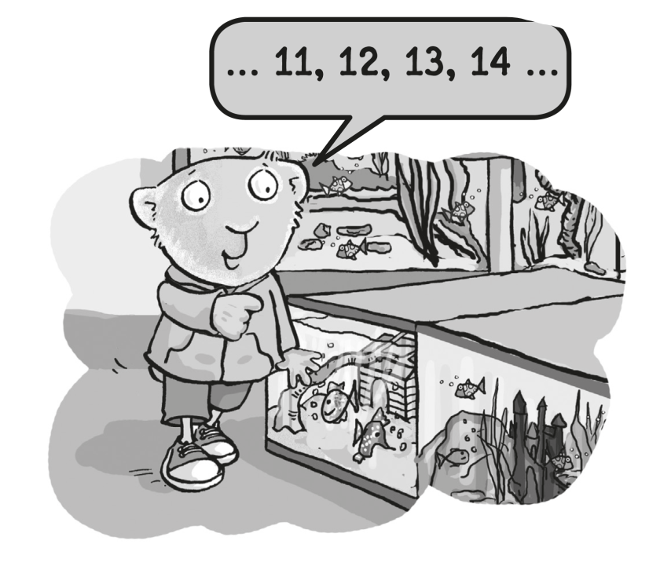
11 12 13 14 15
16 17 18 19 20

Slide 8
workbook
Pages 43 , 44

Slide 9
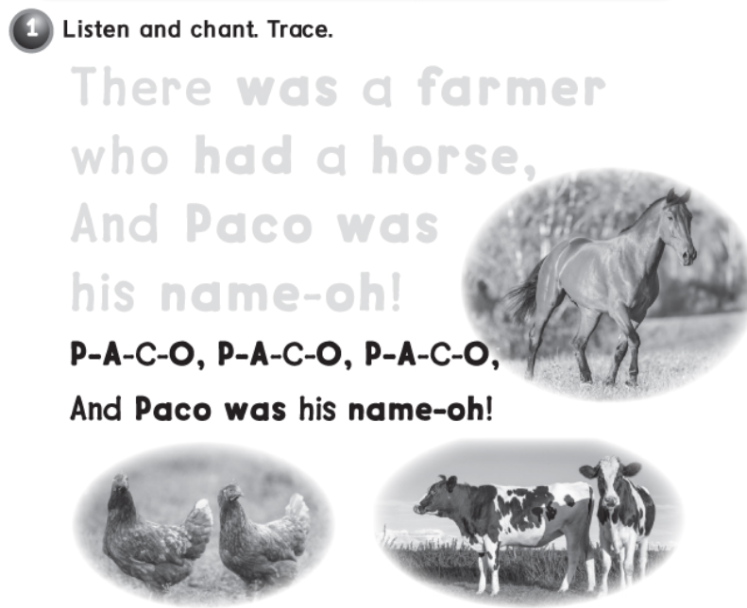
There was a farmer
who had a horse ,
and Paco was
his name-oh !

Slide 10
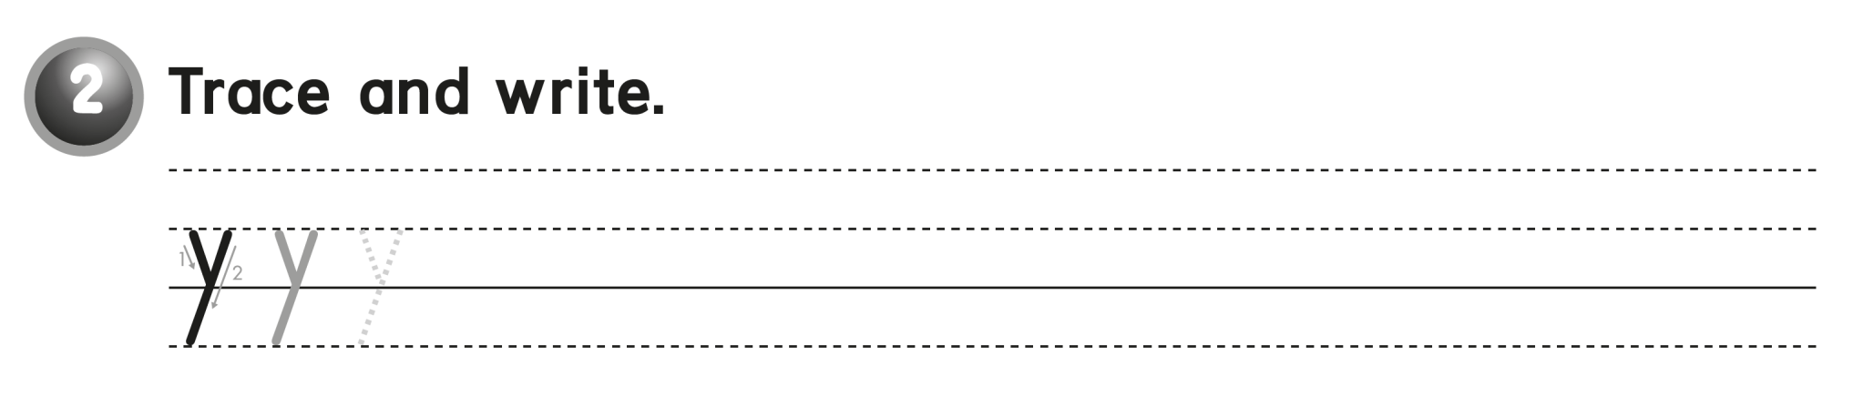
y y y y

Slide 11
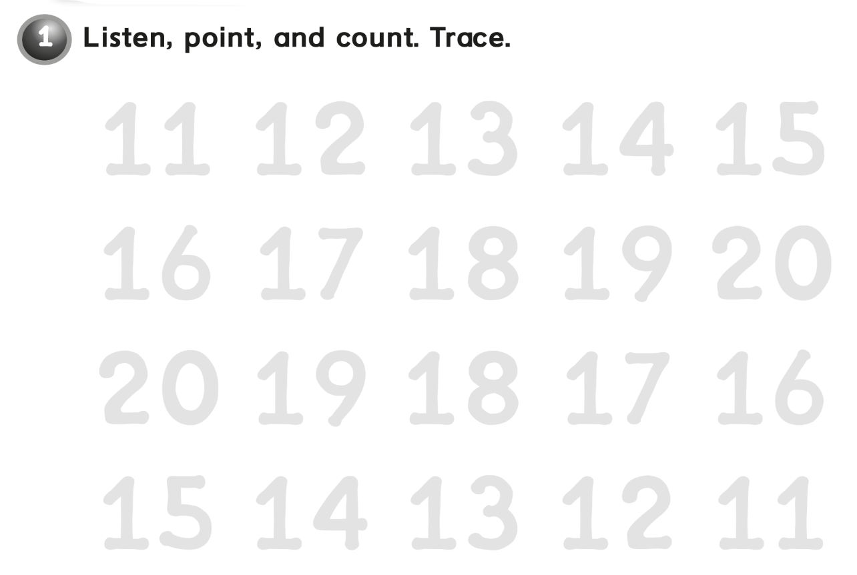
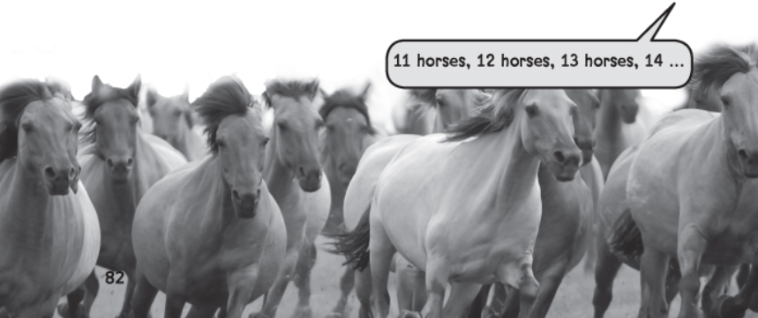
11 12 13 14 15
16 17 18 19 20
20 19 18 17 16
15 14 13 12 11

Slide 12
workbook
Pages 45 , 46

Slide 13
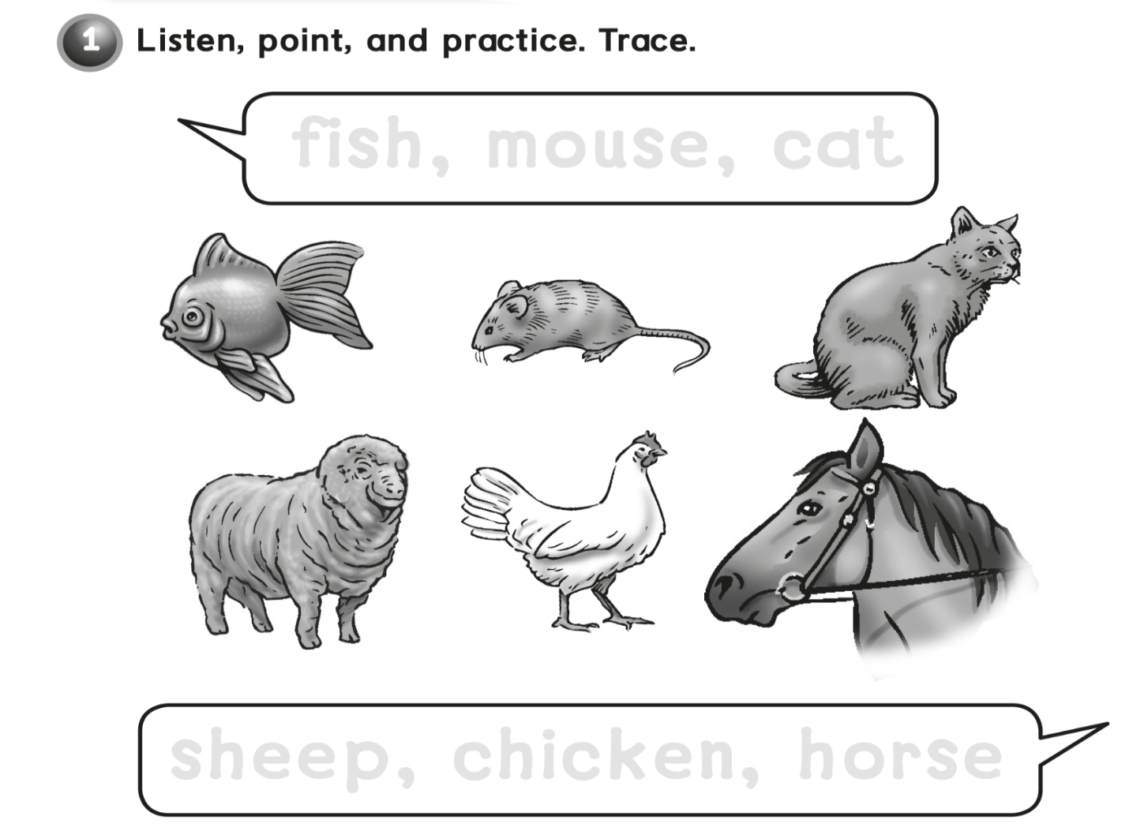
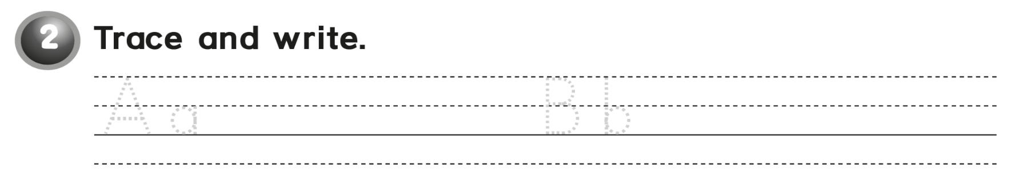
Fish, mouse, cat
Sheep, chicken, horse
Aa Aa Aa Bb Bb Bb

Slide 14
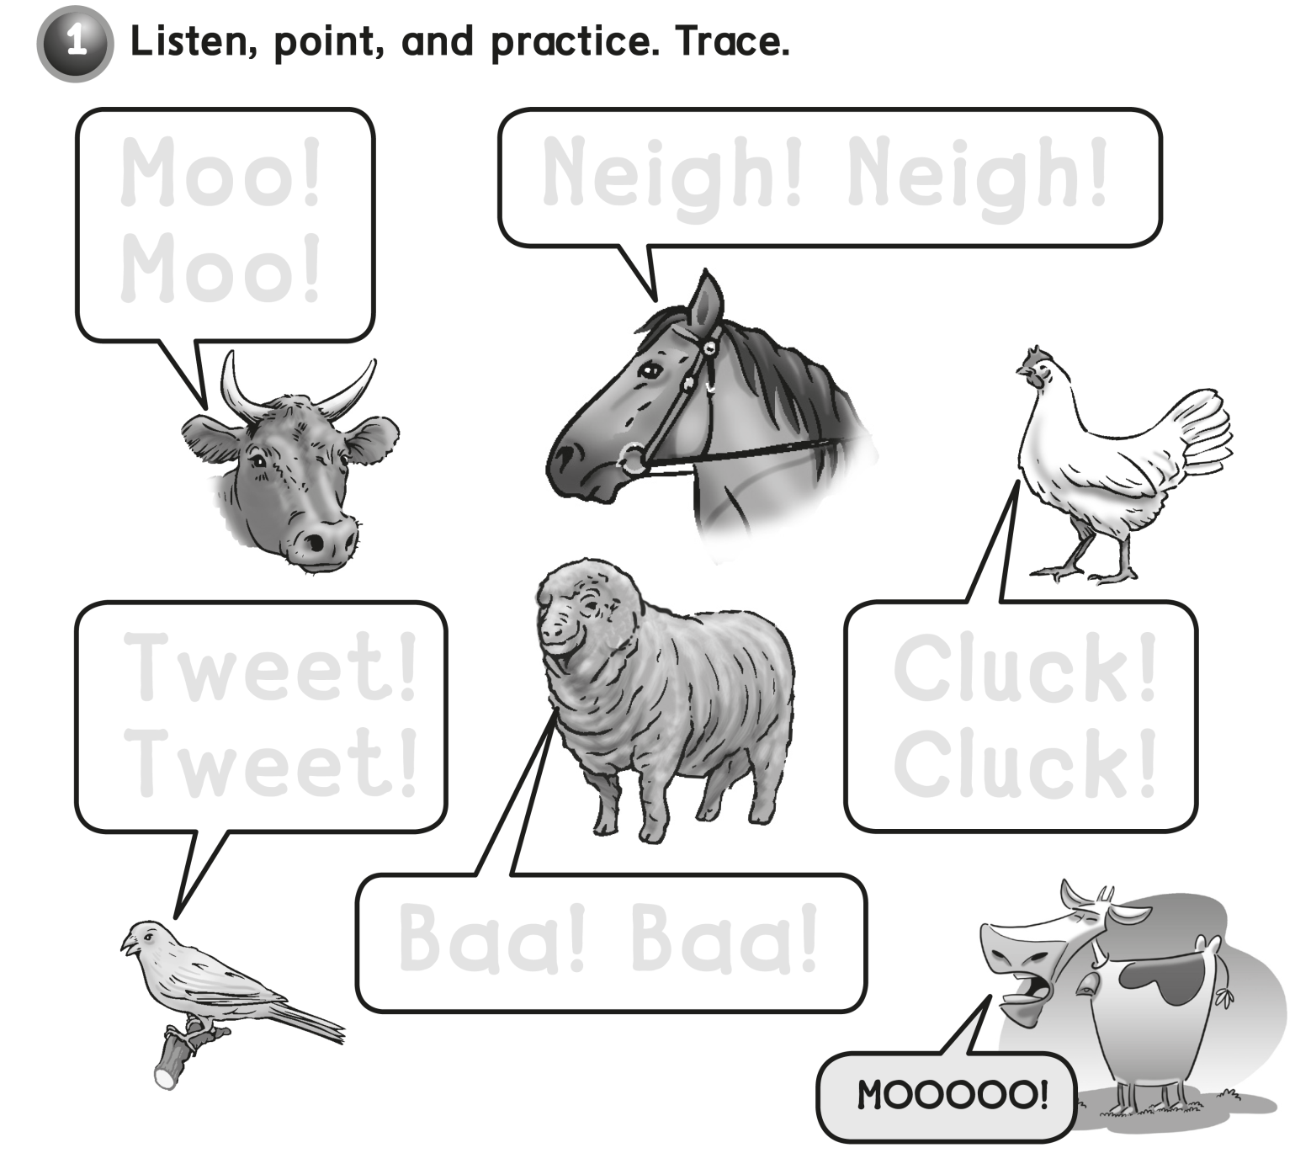
Moo!
Moo!
Neigh! Neigh!
Tweet !
Tweet !
Cluck !
Cluck !
Baa ! Baa !

Slide 15

Cc Cc Cc Dd Dd Dd

Slide 16
workbook
Pages 47 , 48

Slide 17
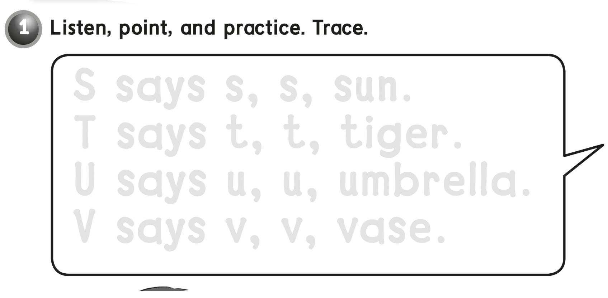
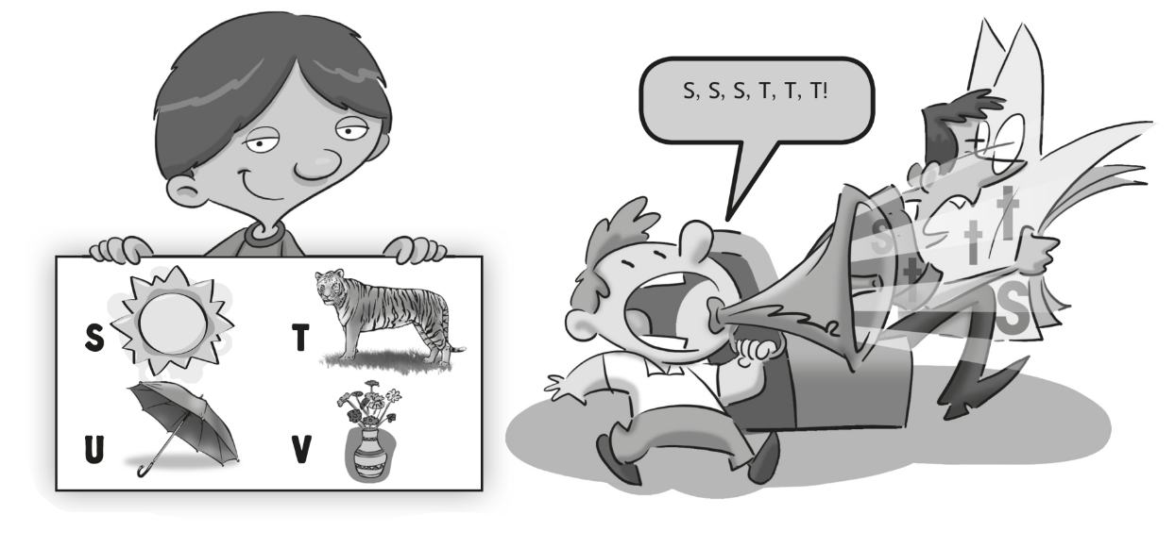
S says s, s, sun.
T says t, t, tiger .
U says u, u, umbrella .
V says v, v, vase .

Slide 18
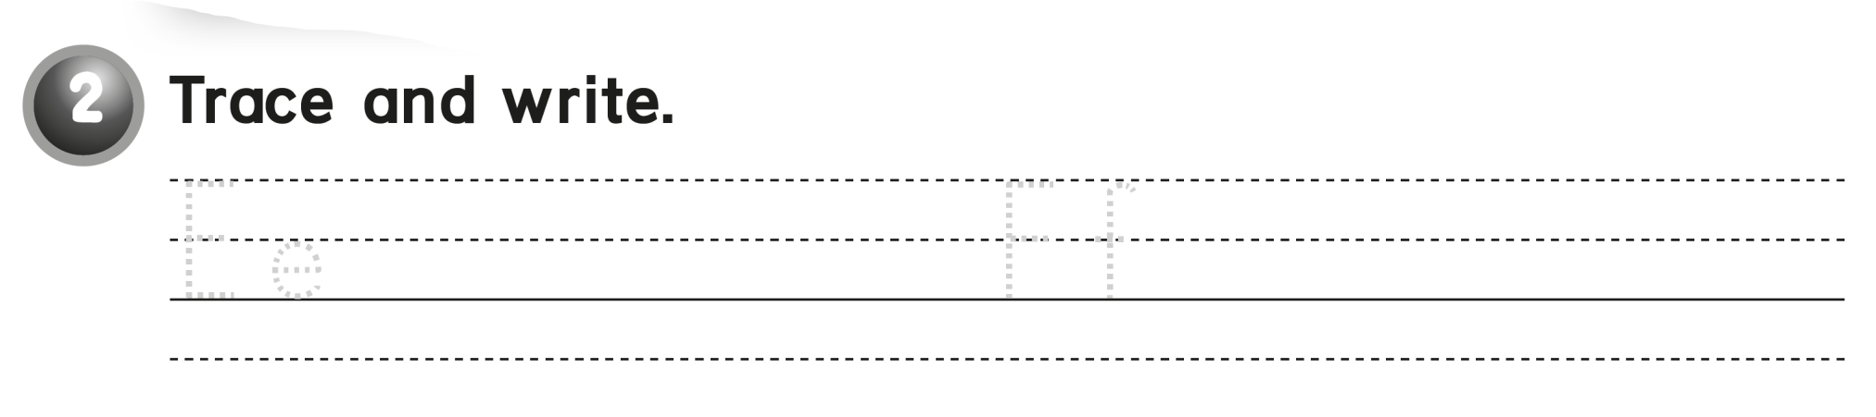
Ee Ee Ee Ff Ff Ff

Slide 19
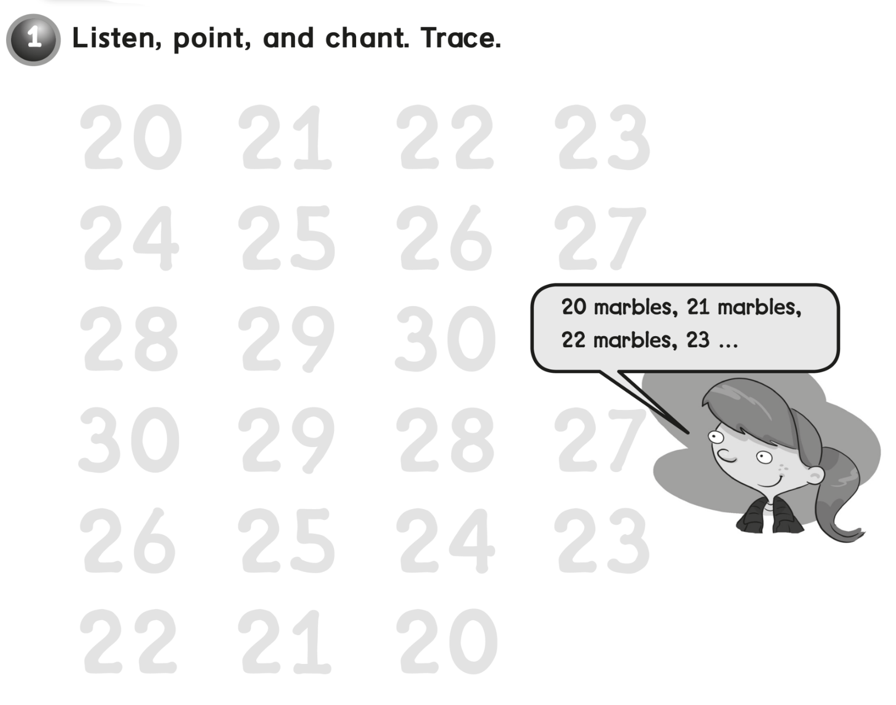
20 21 22 23
25 26 27
28 29 30
30 29 28 27
26 25 24 23
22 21 20

Slide 20
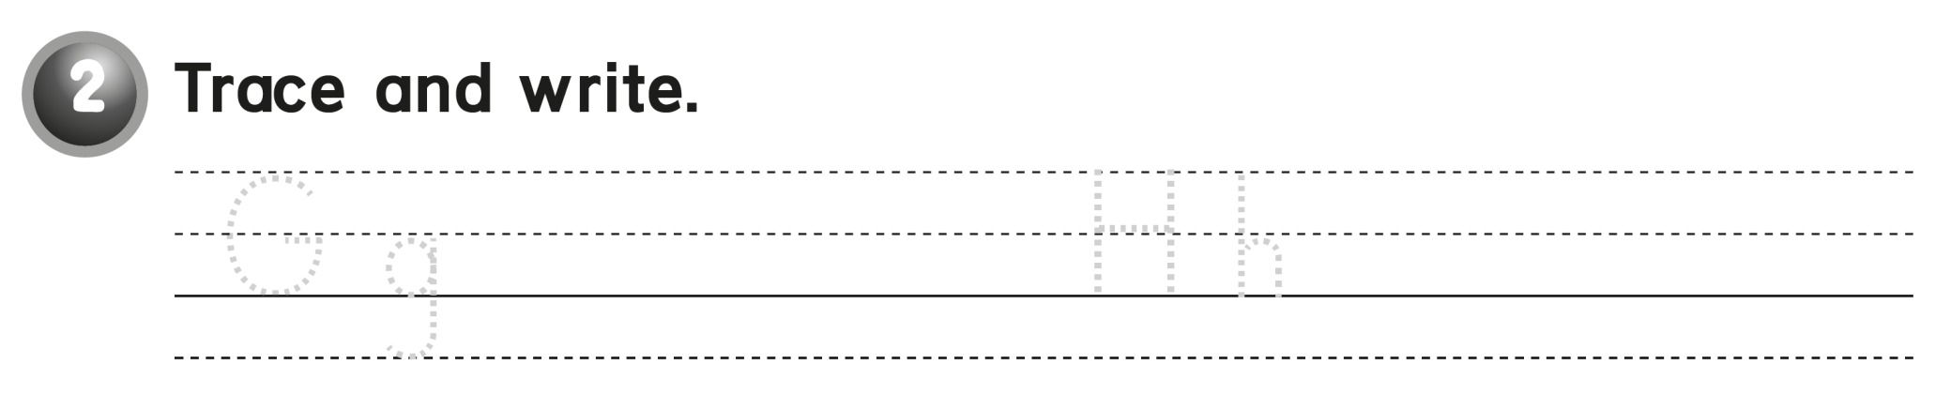
G g Gg Gg Hh Hh Hh

Slide 21


