Slide 1
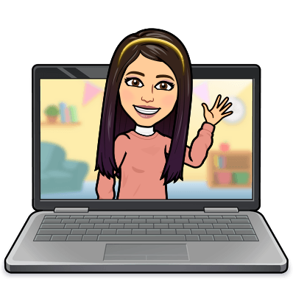

Hello My lovely students
I’m your teacher
Hanan AlShobaily

Slide 2

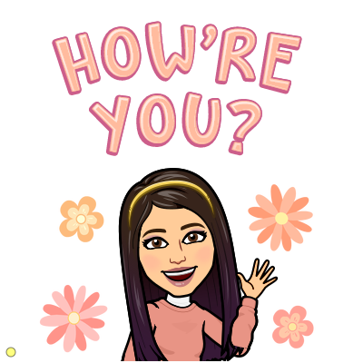
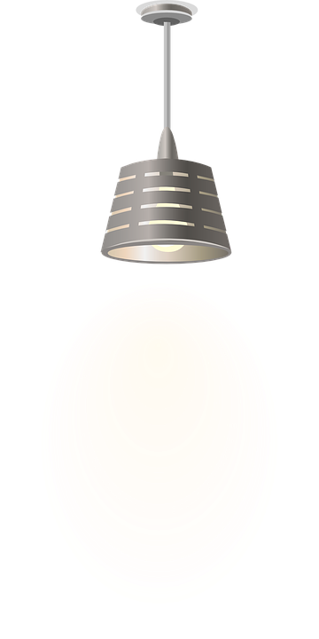
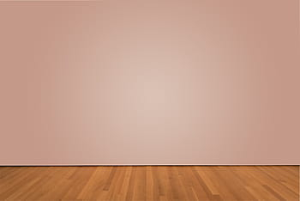
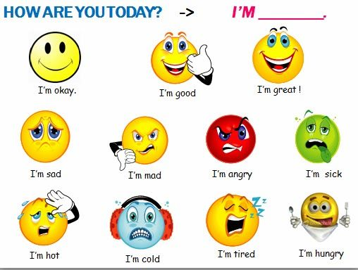
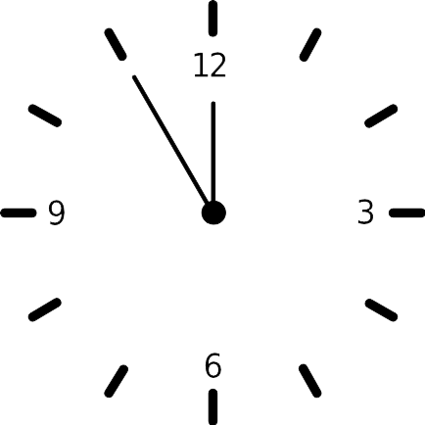



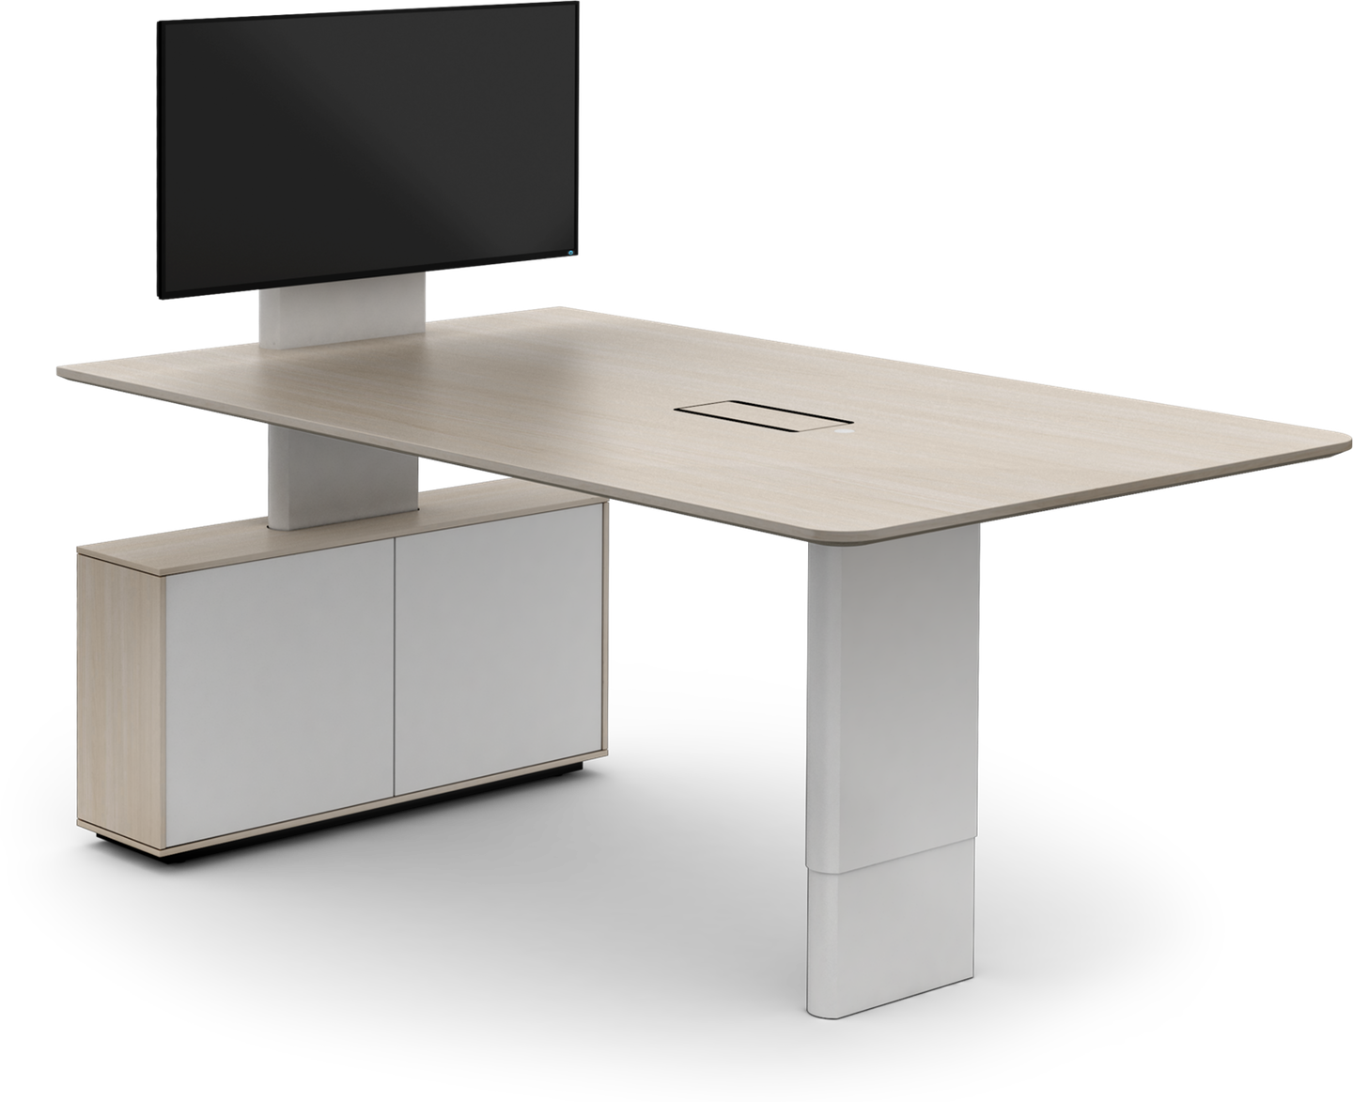
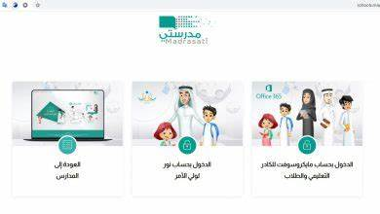
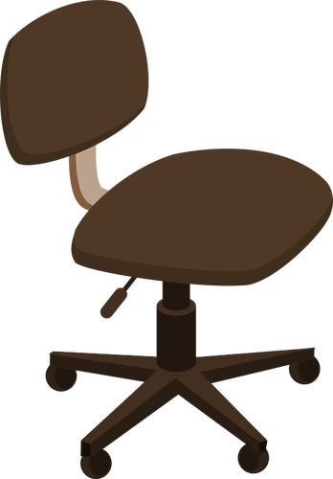


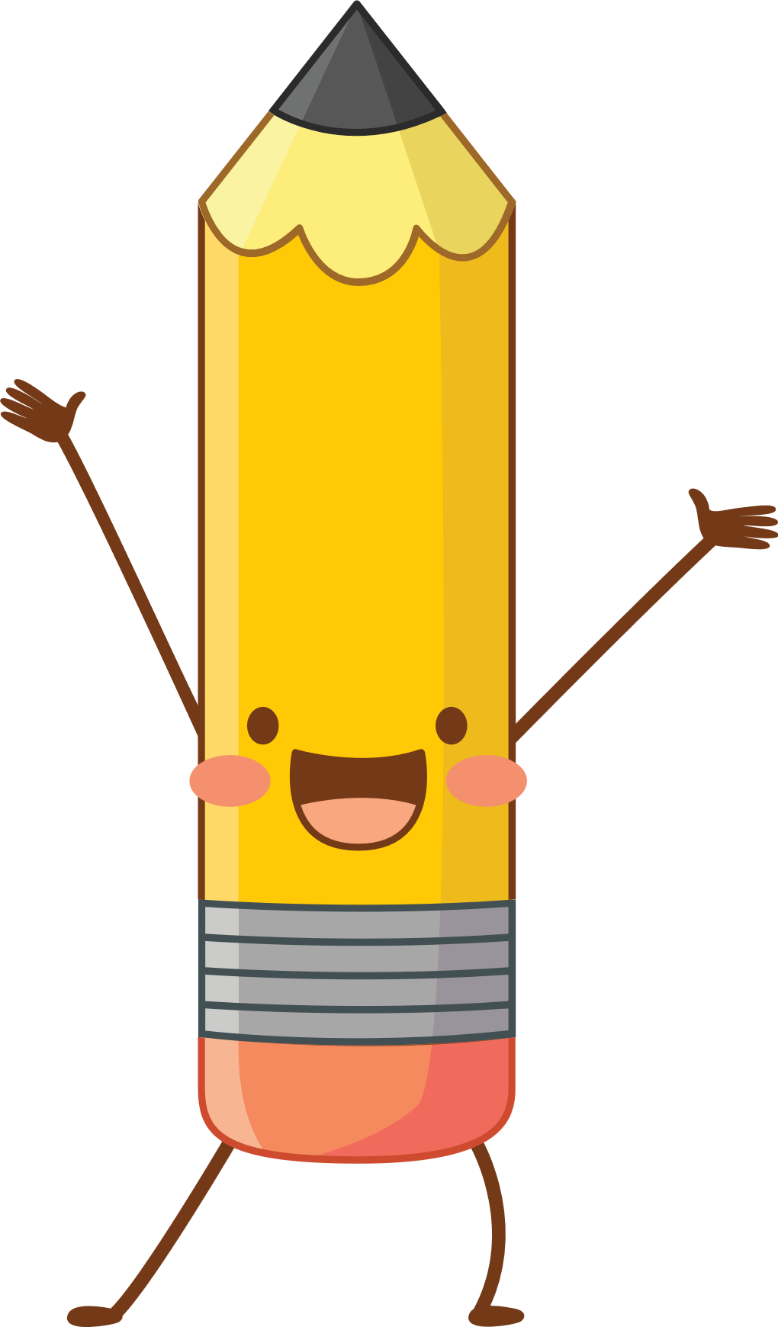
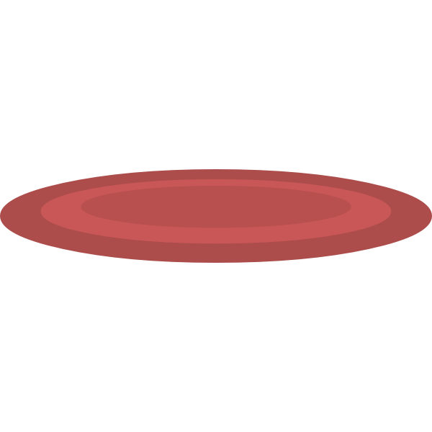


I love English

Slide 3
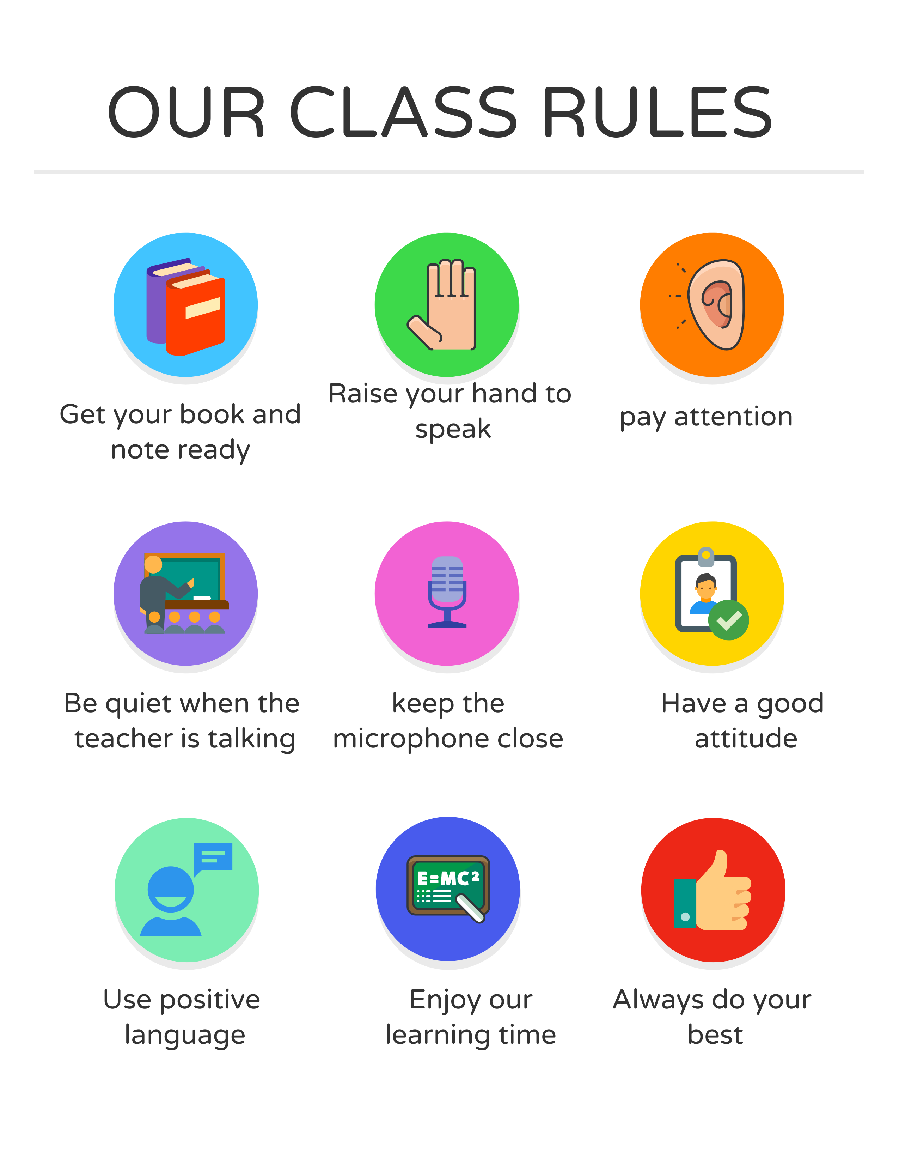
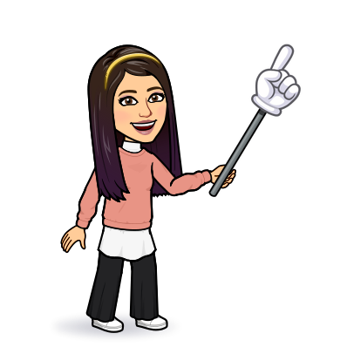
I love English

Slide 4
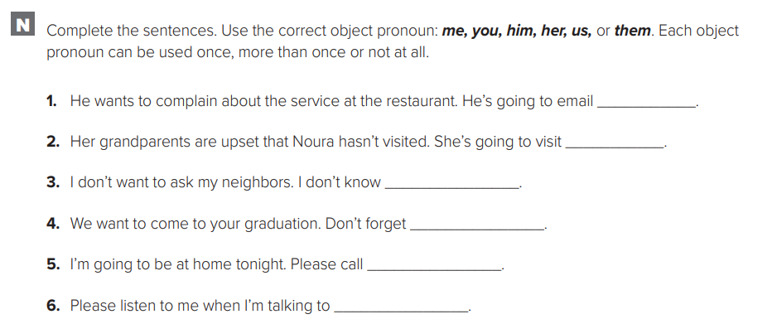
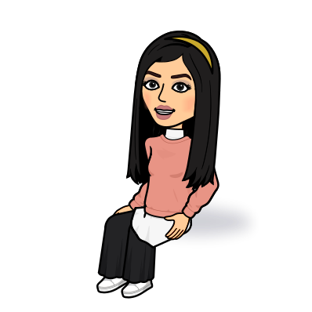
I love English
them
them
Let’s do the homework before starting the lesson.
Mega Goal 2 .. WB (30)
them
us
me
you

Slide 5
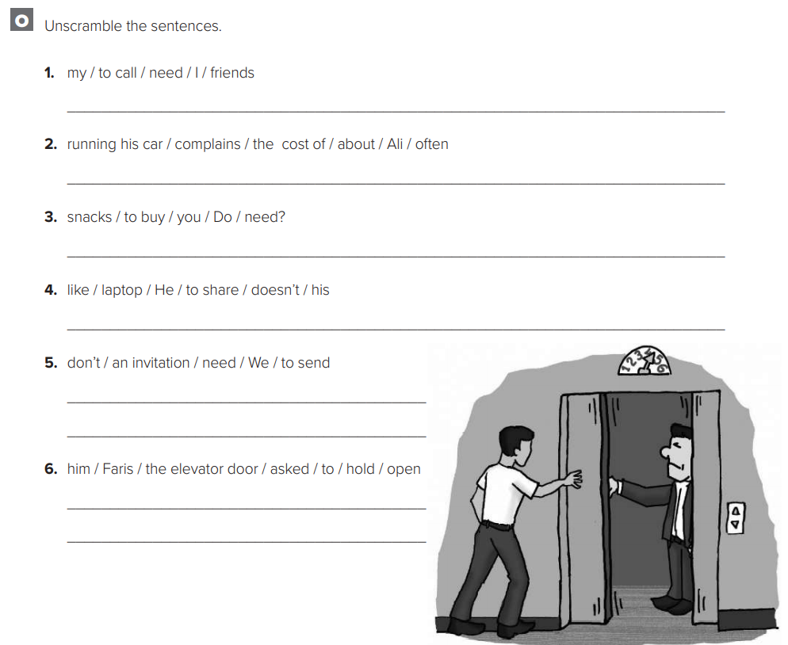
I love English
I need to call my friends.
Ali often complains about the cost of running his car
Do you need to buy snacks?
Let’s do the homework before starting the lesson.
Mega Goal 2 .. WB (30)
He doesn’t like to share his laptop.
We don’t need to send an invitation.
Faris asked him to hold the elevator door open.

Slide 6
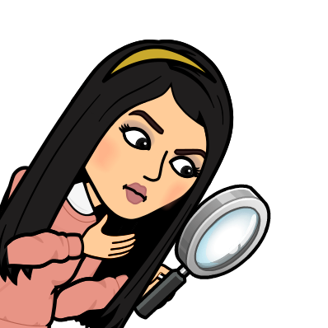

I love English
Revising the previous lesson
https://www.liveworksheets.com/1-sv1779028le

Slide 7
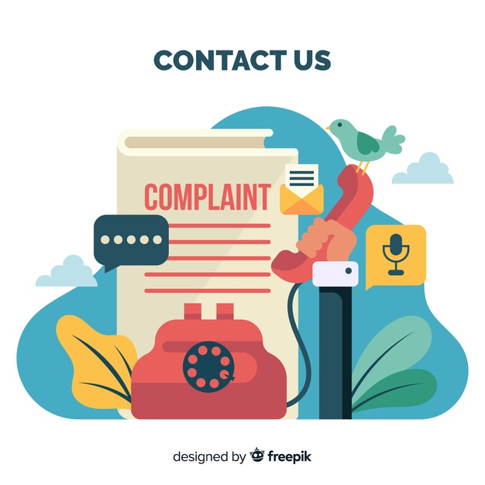
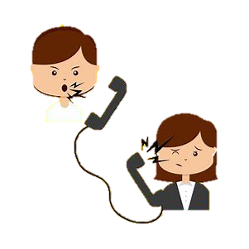

I love English
Mega Goal 2
Unit 3
(Complaints, Complaints)
Project
Tuesday
18/7/1442

Slide 8

I love English
Lesson Goals
Students will be able to:
Do a family survey on complaints about products and design a poster or presentation with their advice.
Form sentences to describe the faulty item.

Slide 9
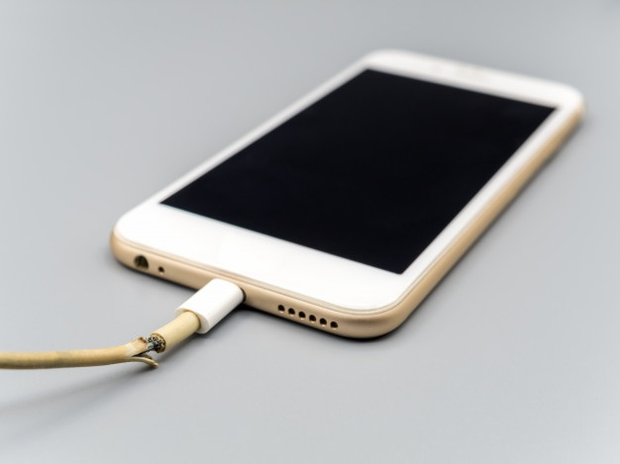
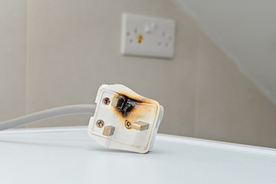
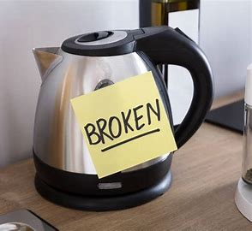
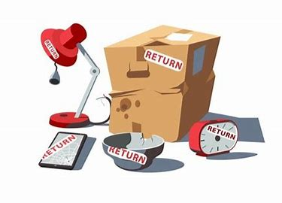

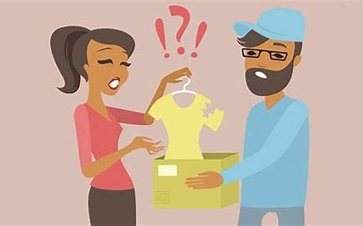

I love English
Look at the pictures then tell me what do you think about them?

Slide 10
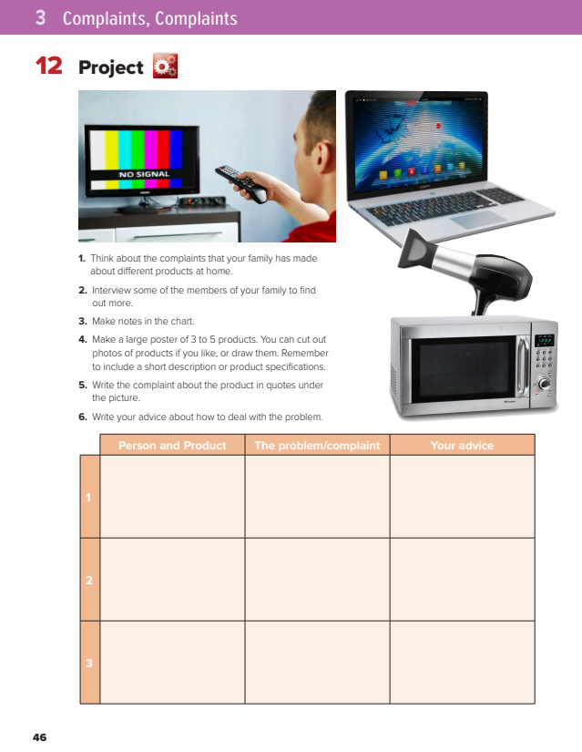
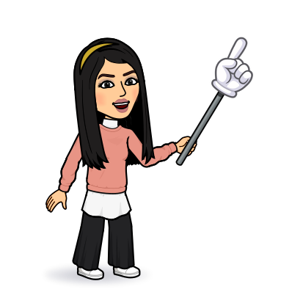
I love English
Open your Student’s book page: 46

Slide 11
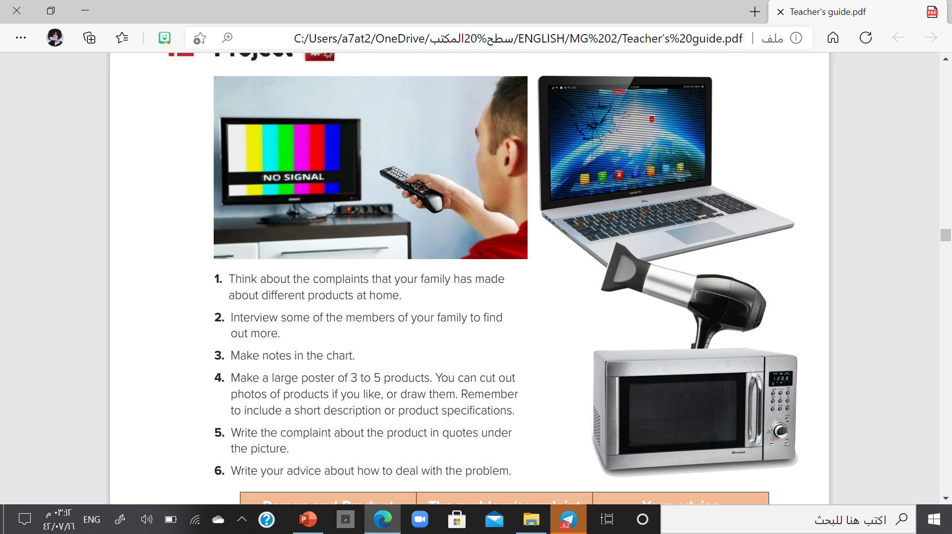

Slide 12
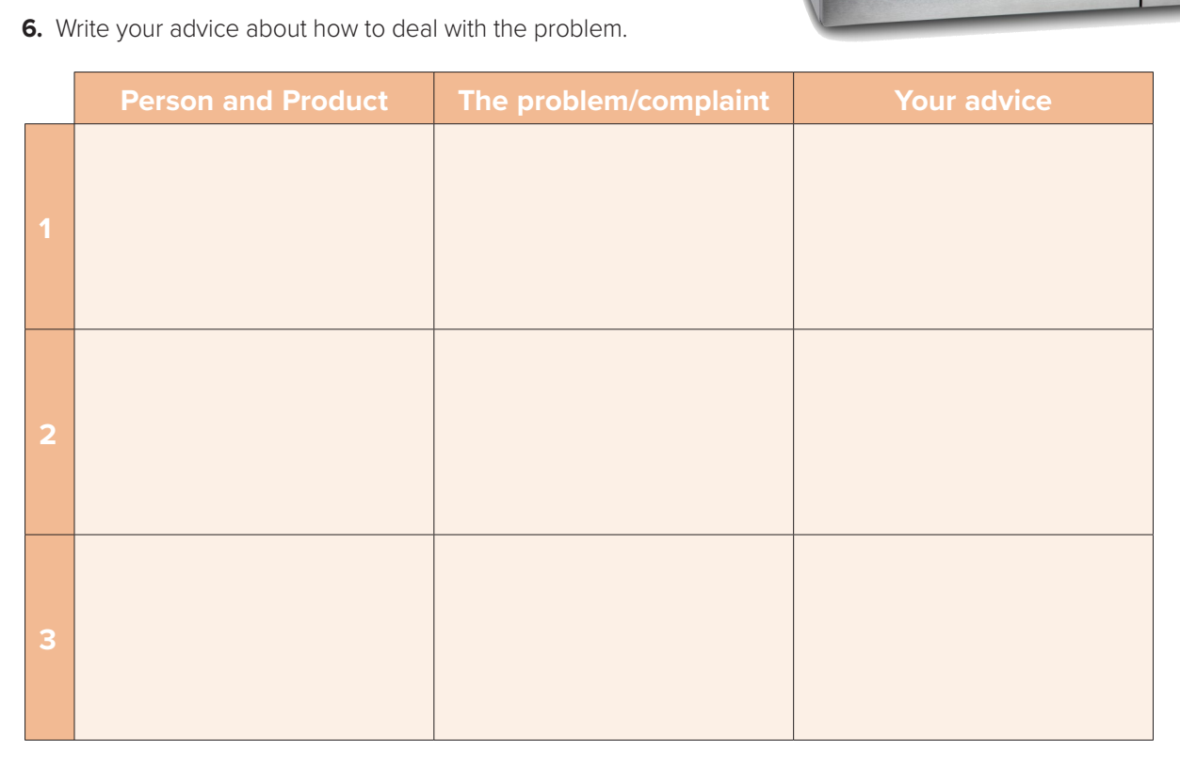
Ask your family and fill the chart
Sister: glasses
broken
Aske for change
Dad: laptop
damaged
Ask for refund
Mom: skirt
torn
Ask for change

Slide 13

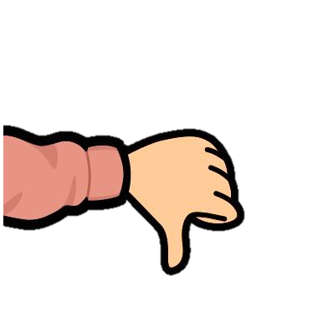
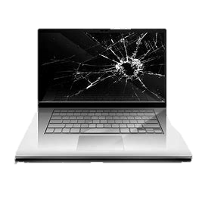
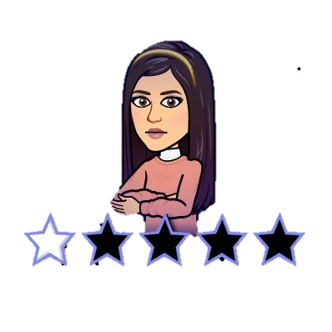
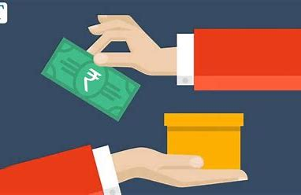
Let’s design an attractive poster
1
Design a poster, Make attractive decorations.
Damaged laptop
2
Add your pictures.
3
Form sentences to describe the faulty item and the problem.
4
Write the solution that you suggested.
REFUND

Slide 14
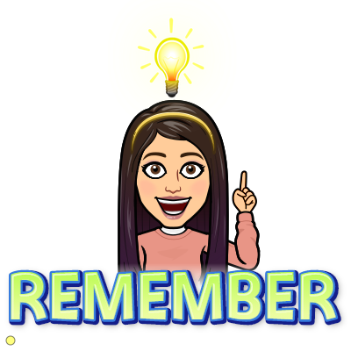
"إِنّ اللَّهَ تَعَالى يُحِبّ إِذَا عَمِلَ أَحَدُكُمْ عَمَلاً أَنْ يُتْقِنَهُ"

Slide 15
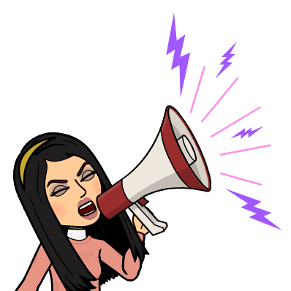
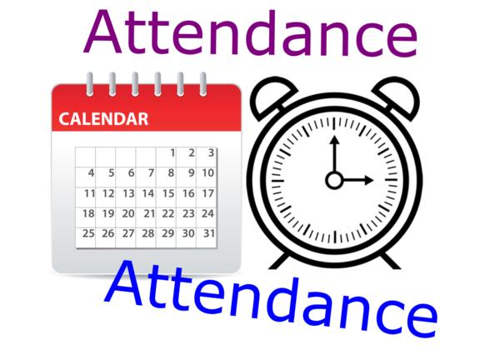
I love English

Slide 16
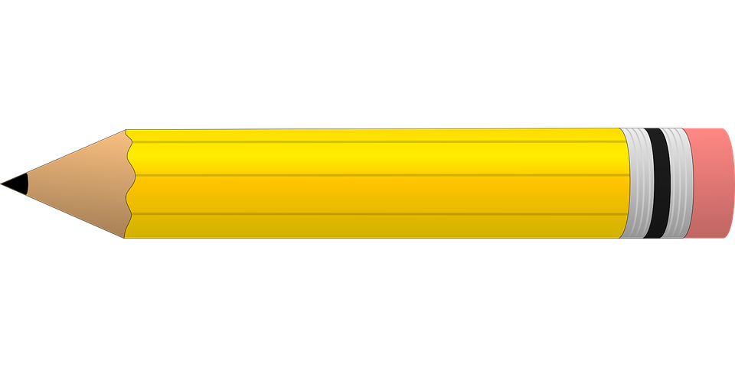
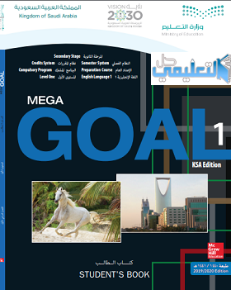
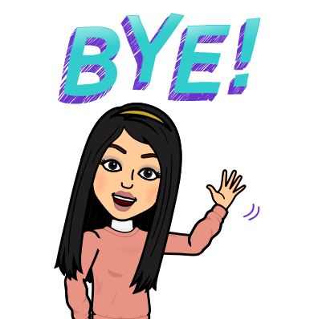

Homework
I love English

Slide 17
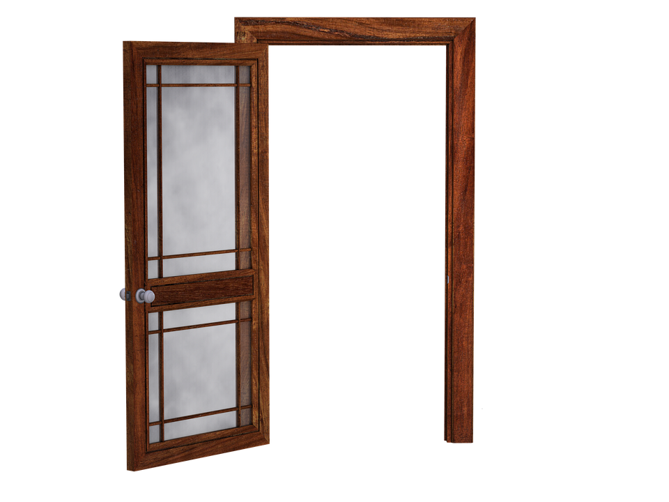
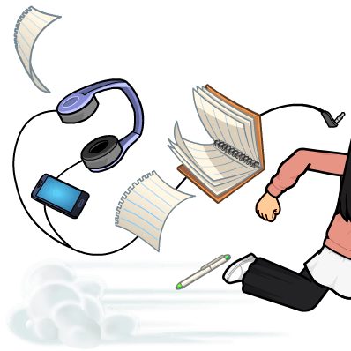
Homework

Slide 18
Homework

Slide 19
Homework

Slide 20
Homework

Slide 21
Homework

Slide 22

Homework

