Slide 1
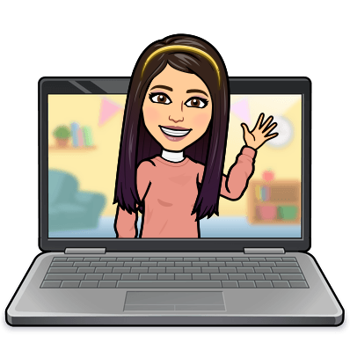

Hello My lovely students
I’m your teacher
Hanan AlShobaily

Slide 2




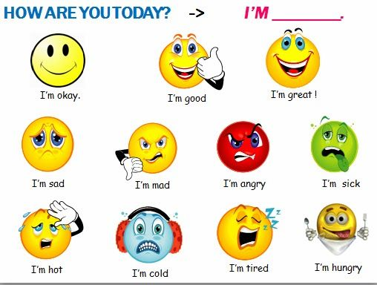
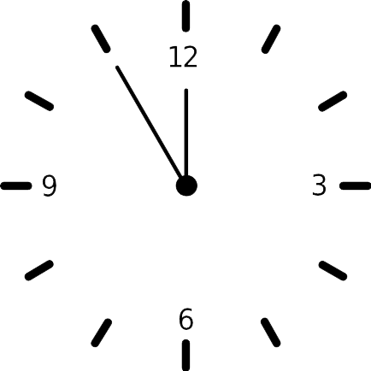



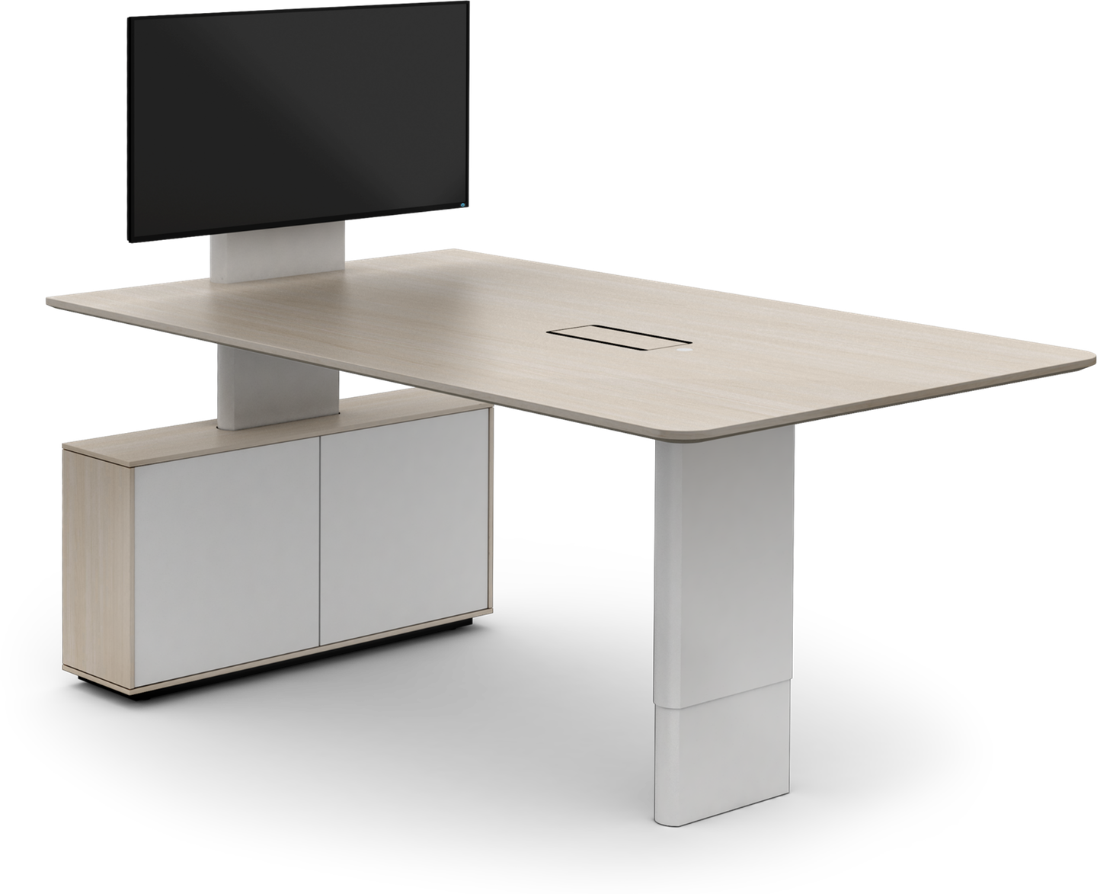
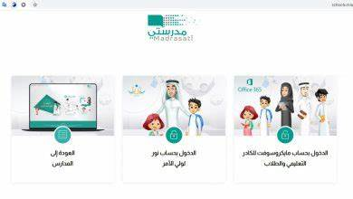



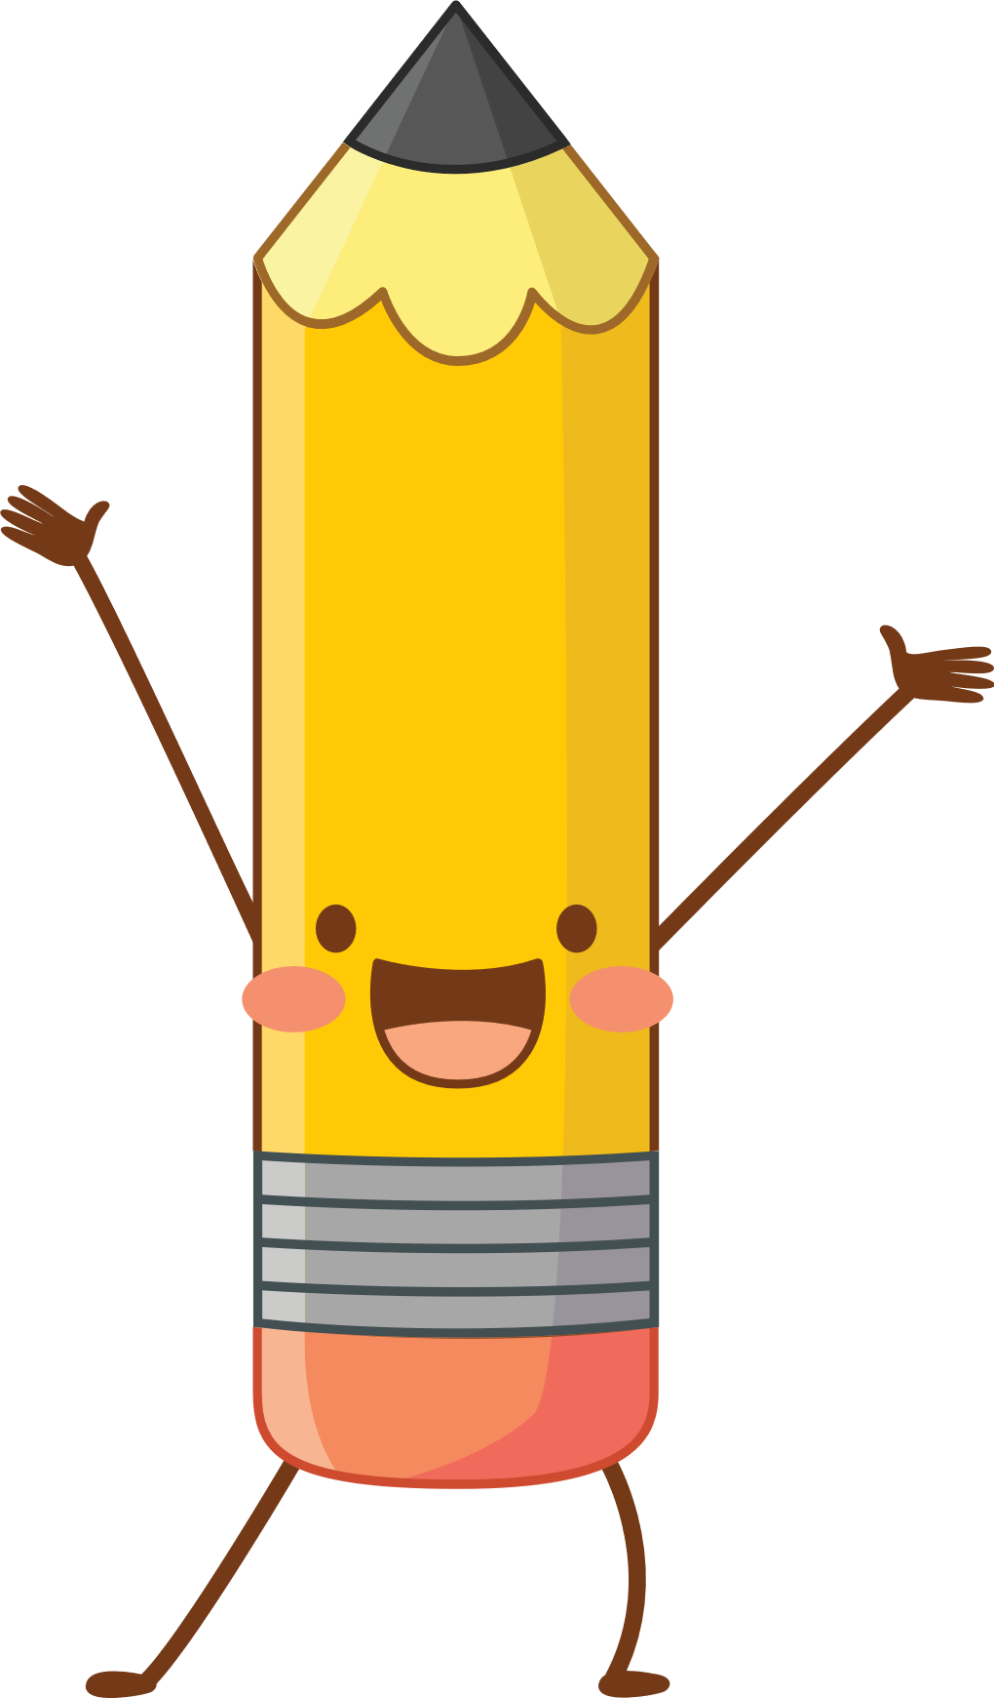



I love English

Slide 3
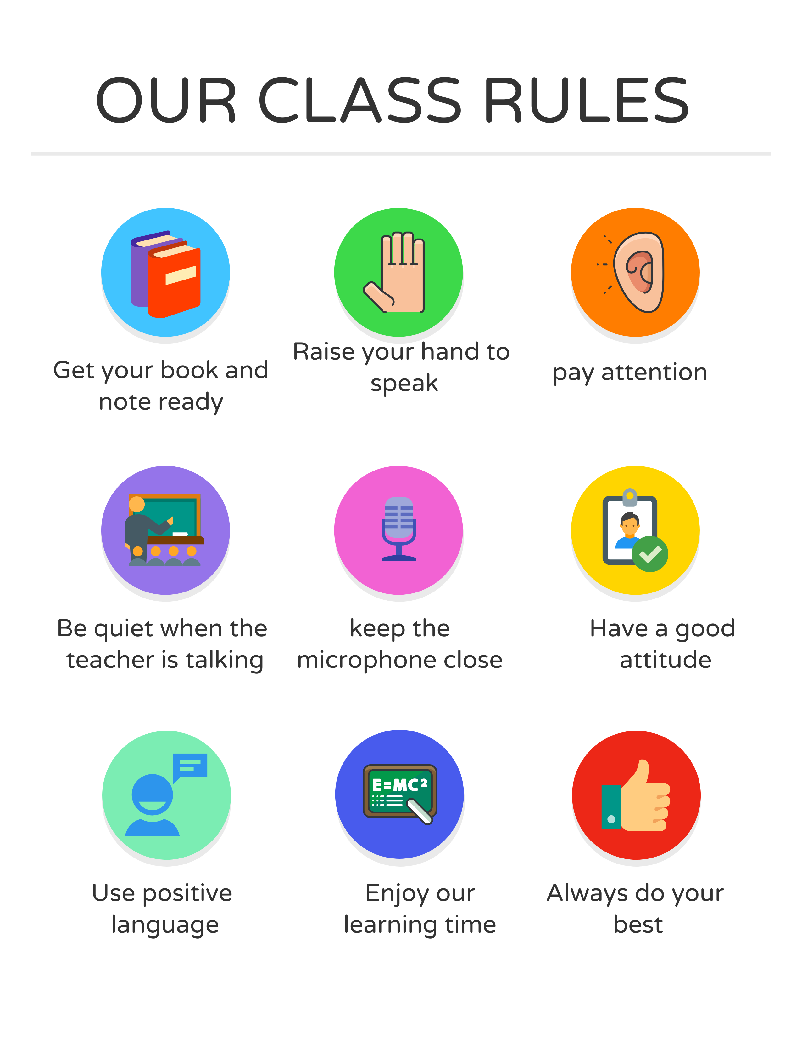
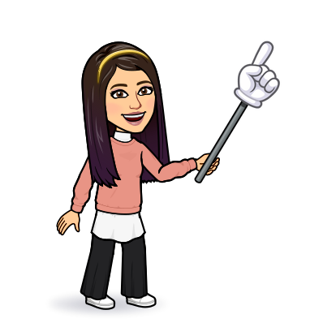
I love English

Slide 4
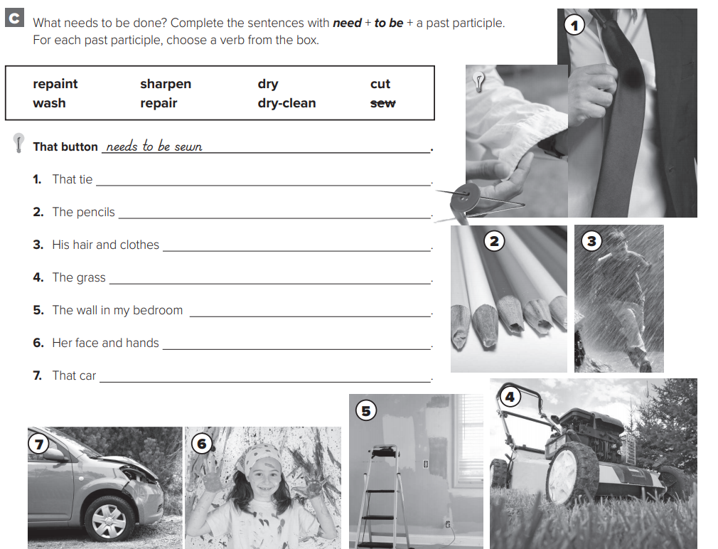
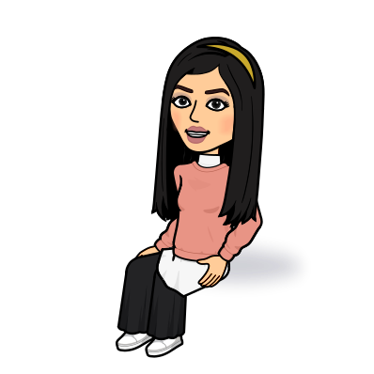
I love English
needs to be dry-cleaned
need to be sharpened
Let’s do the homework before starting the lesson.
need to be dried
Mega Goal 2 .. WB (22)
needs to be cut
needs to be repainted
need to be washed
needs to be repaired

Slide 5

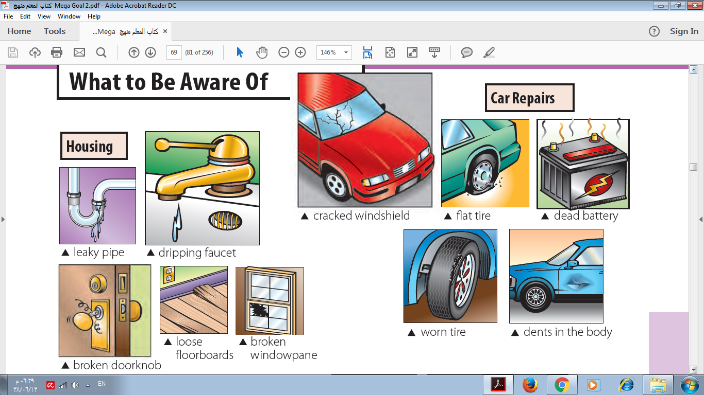

I love English
Revising the previous lesson
Write what’s the wrong and what needs to be done
Windowpane / break / fix
computer / crash / repair
The windowpane is broken.
It needs to be fixed.
The computer is crashed.
It needs to be repaired.

Slide 6

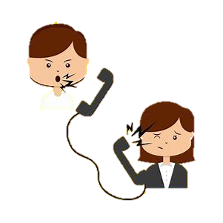

I love English
Mega Goal 2
Unit 3
(Complaints, Complaints)
Language in Context
Listening
Pronunciation
About You
Monday
10/7/1442

Slide 7

I love English
Lesson Goals
Students will be able to:
Aske for advice.
Form sentences to give advice using different ways.
Write problems according to a listening audio.
Practice the stress in a compound noun.
Ask and answer questions about a defective product.

Slide 8
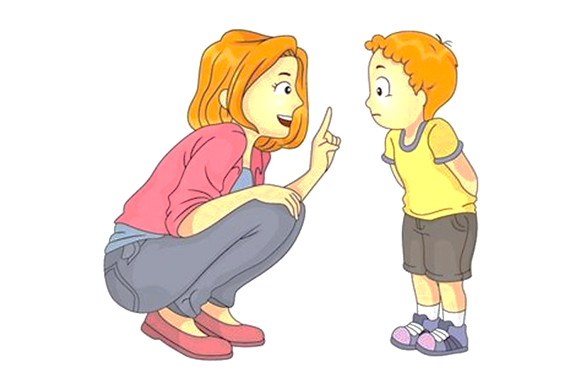
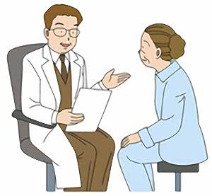
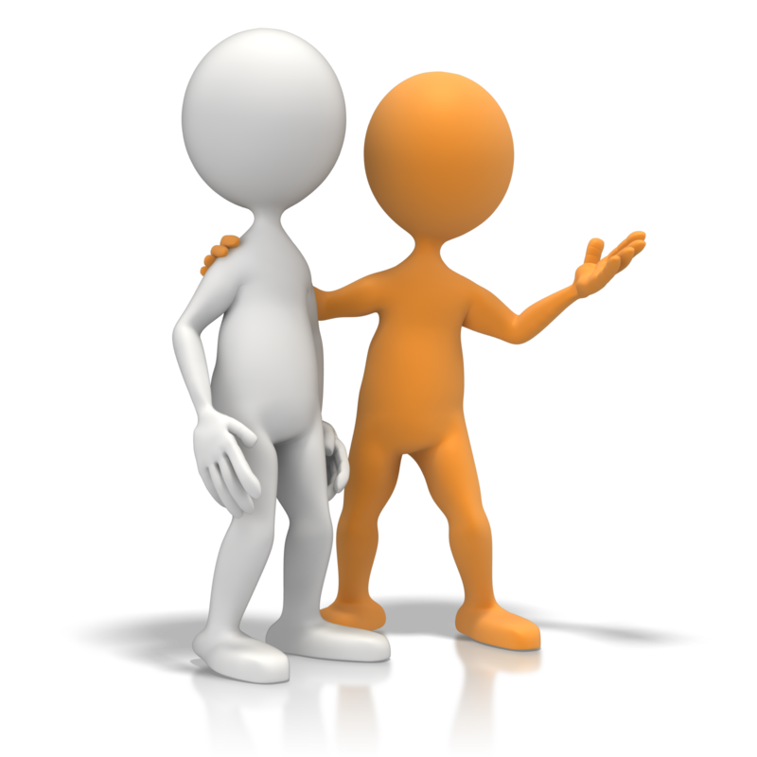

I love English
What do the people in the pictures need?
What is advice?
An opinion you give someone about what they should do.
Look at the pictures then discuss

Slide 9
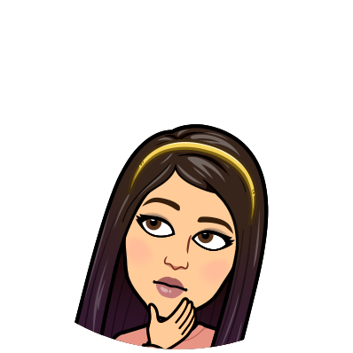
I love English
How to ask for advice?
How to give advice?
Should
Must
Ought to
Had better
Shouldn’t
Mustn’t
Ought not to
Had better not
I have a headache, what should I do?
You should take a painkiller.

Slide 10
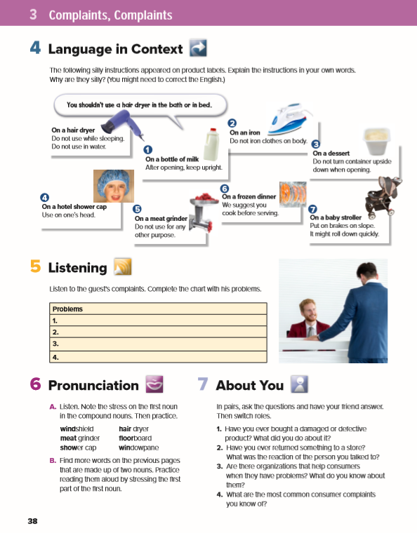
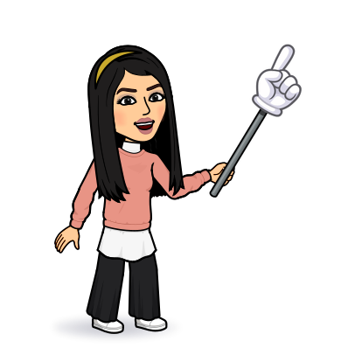
I love English
Open your Student’s book page: 38

Slide 11
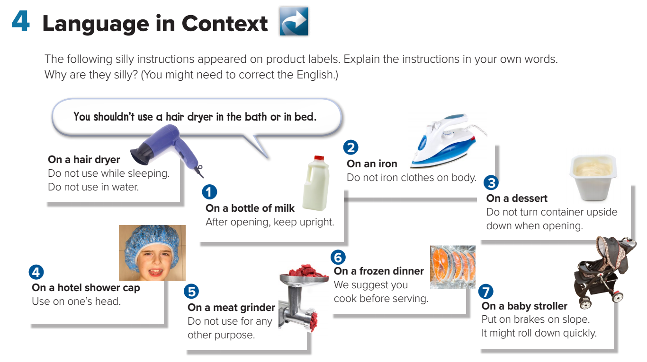

Slide 12
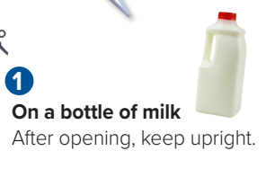
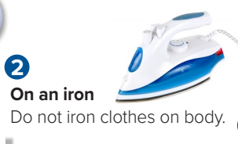
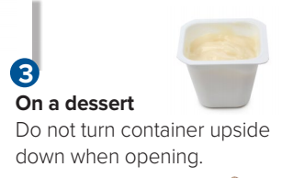
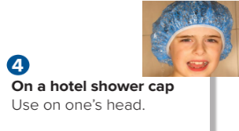
You should keep the bottle upright after opening.
You had better not iron clothes on body.
You shouldn’t turn container upside down when opening.
You must use on your head only.

Slide 13
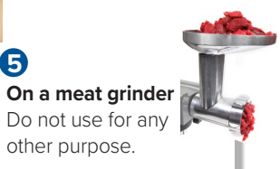
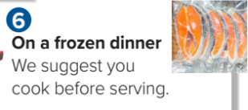
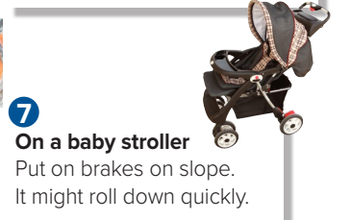
You should use only with meat.
You ought to cook before serving.
You had better put on brakes on slope.

Slide 14
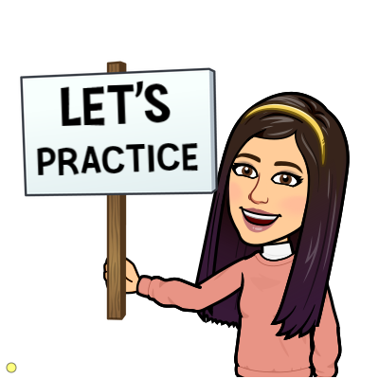
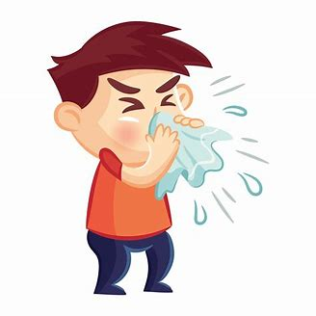
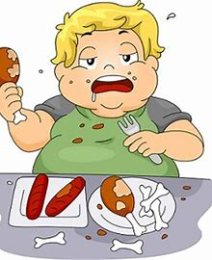
Give advice for the following situations:
You should see a doctor.
You had better stop eating junk food.

Slide 15

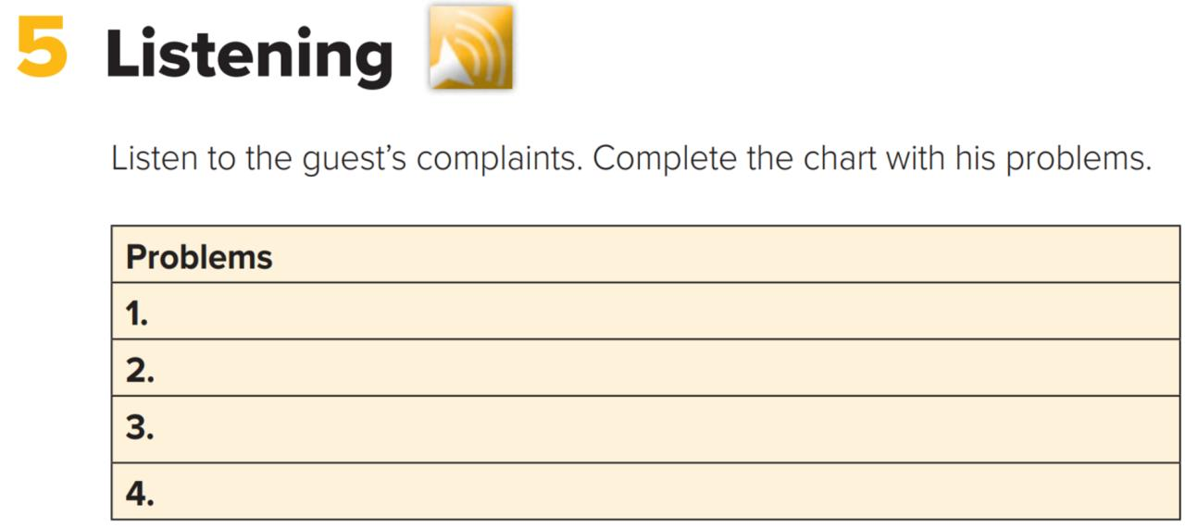

The shower isn’t working. / There is no hot water.
The bathtub leaks.
The neighbor snores so loudly that the walls shake and the guest can’t sleep.
The towels and sheets aren’t changed every day.

Slide 16
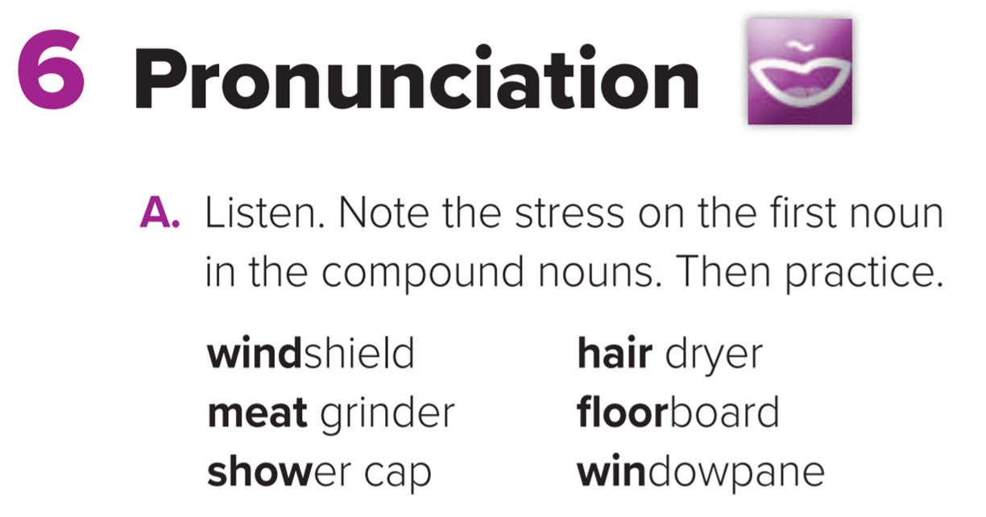
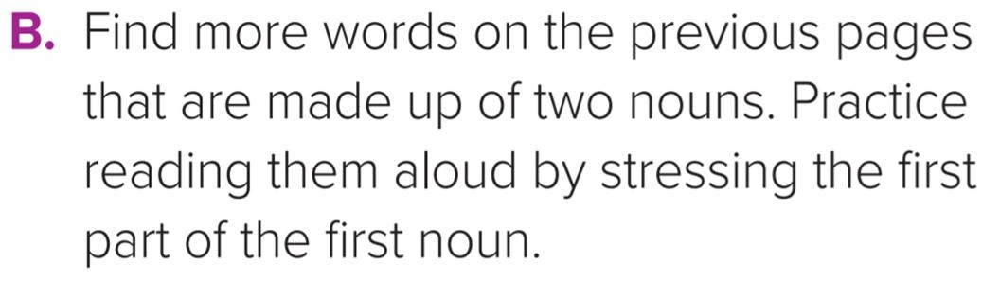
When compound nouns are spoken aloud, the first word usually receives more stress than the second word.

Slide 17
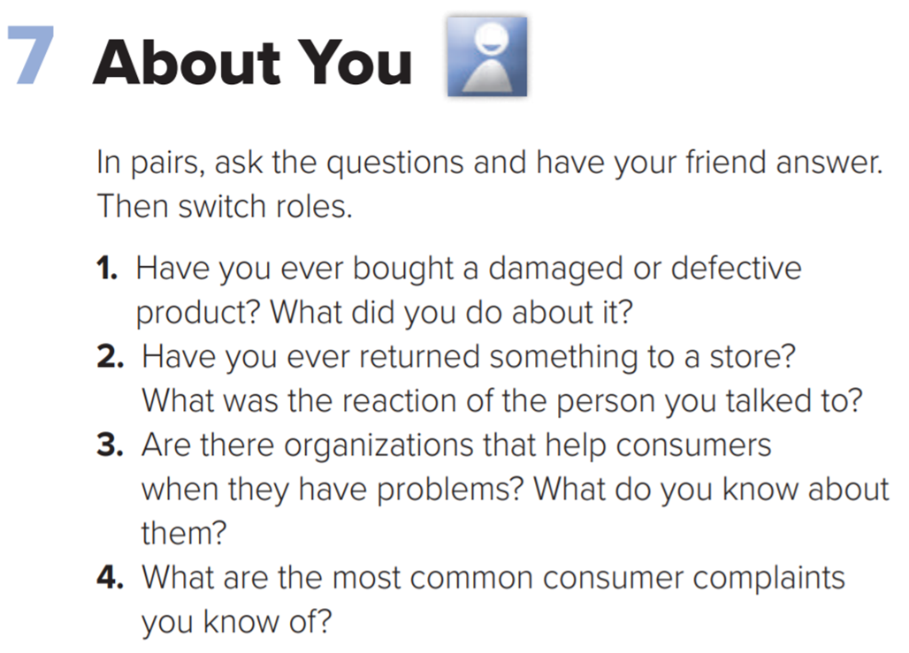
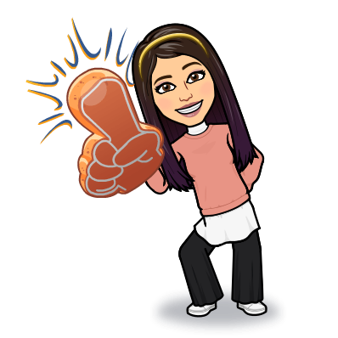

Slide 18

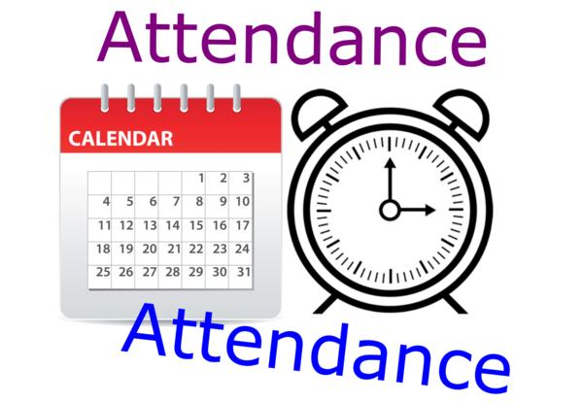
I love English

Slide 19



Homework
I love English

Slide 20
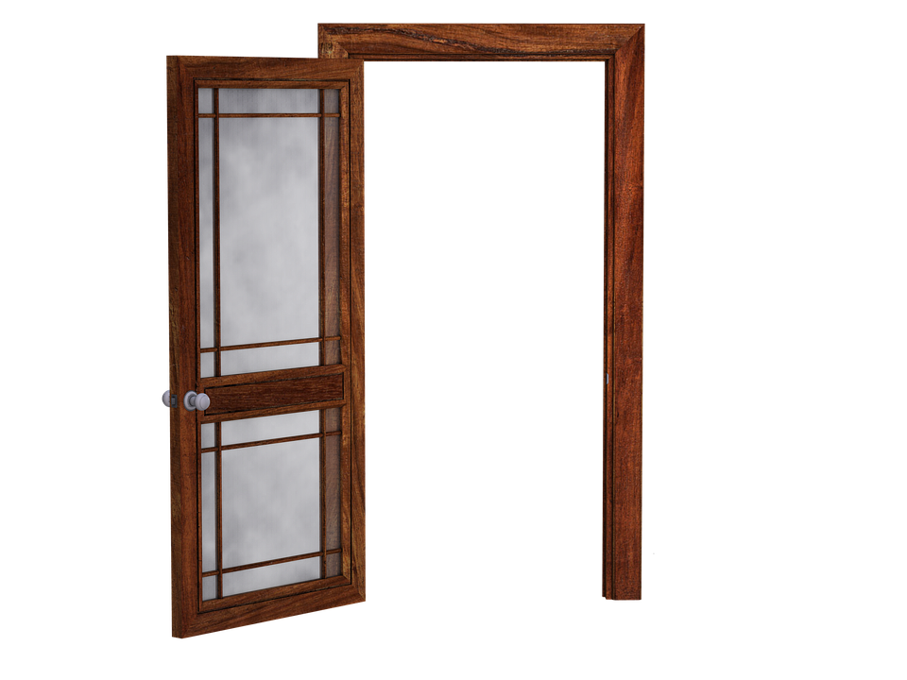
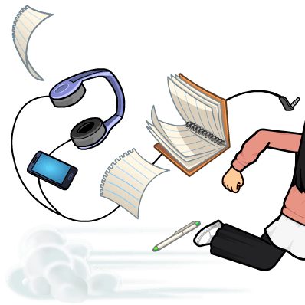
Homework

Slide 21
Homework

Slide 22
Homework

Slide 23
Homework

Slide 24
Homework

Slide 25

Homework

