Slide 1
Hello My lovely students
I’m your teacher
Hanan AlShobaily

Slide 2
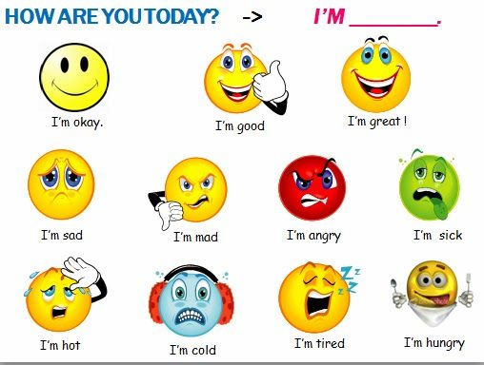
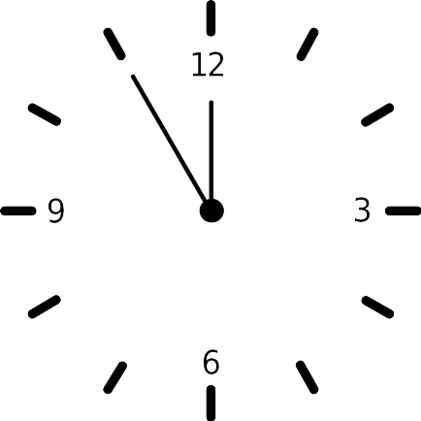
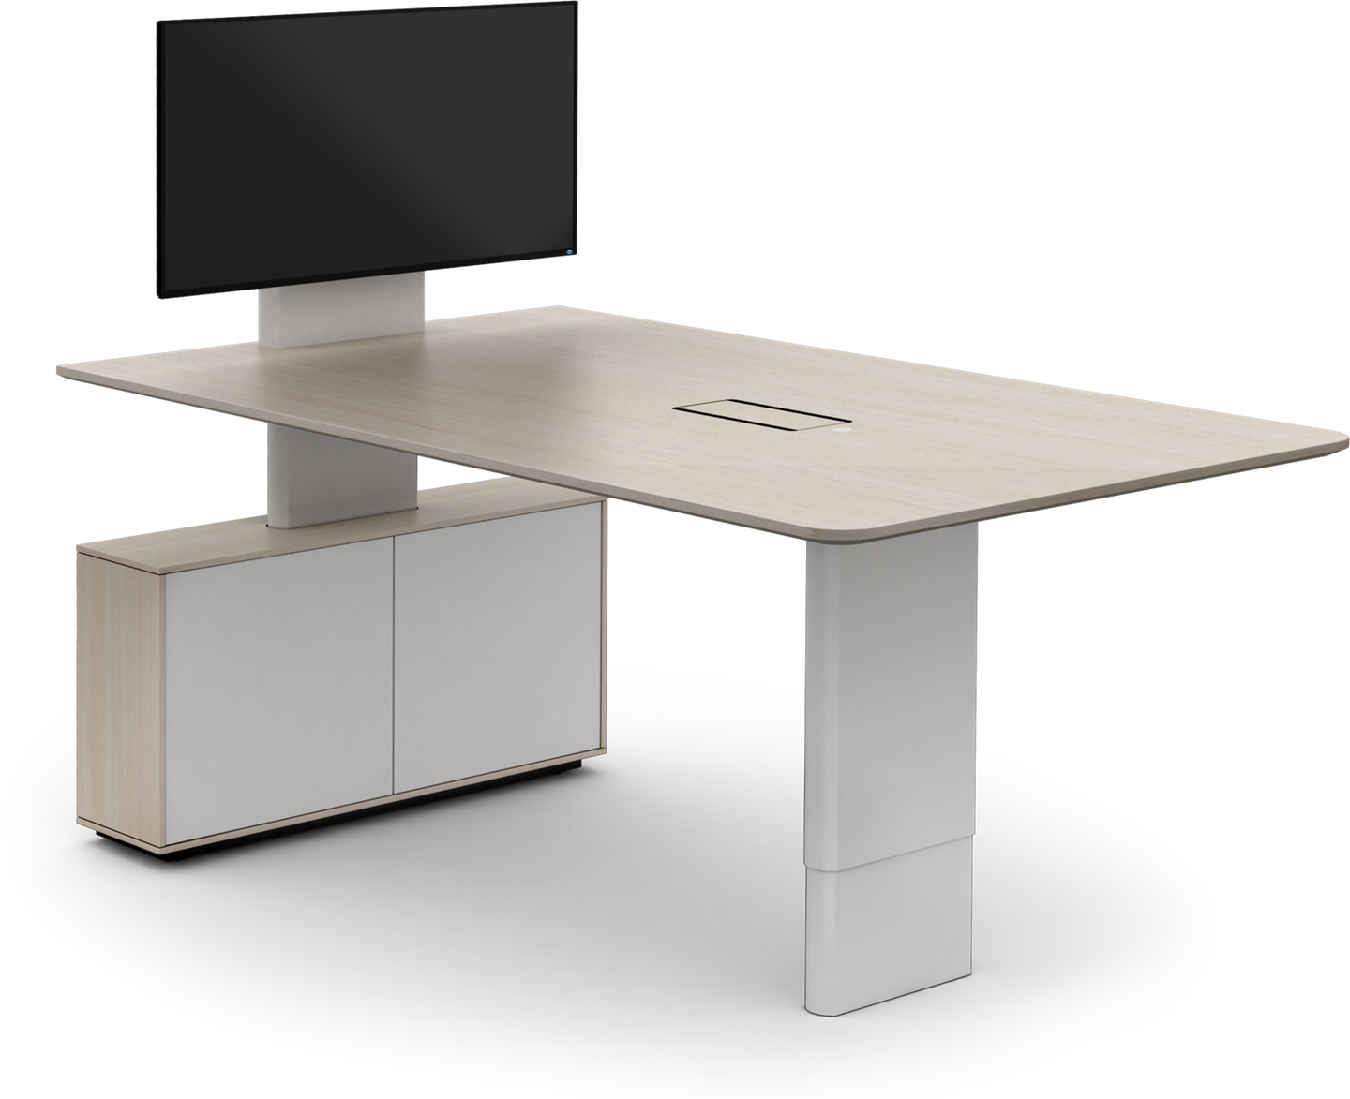
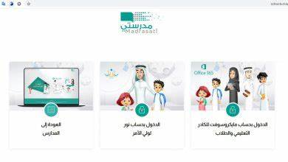
I love English

Slide 3
I love English

Slide 4
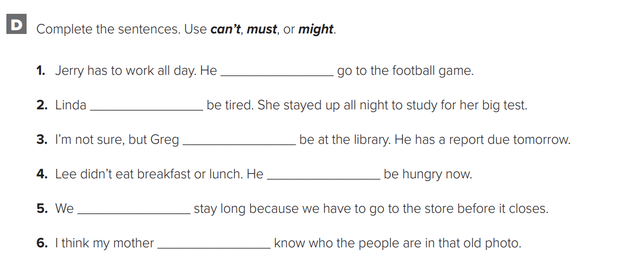
I love English
can’t
must
Let’s do the homework before starting the lesson.
might
Mega Goal 2 .. WB (40)
must
can’t
might

Slide 5
I love English
Revising the previous lesson
https://www.liveworksheets.com/1-ao1794782ox

Slide 6
Mega Goal 2
Unit 4
(I Wonder What Happened)
Language in Context
Listening
Pronunciation
About You
Tuesday
25/7/1442
I love English

Slide 7
I love English
Lesson Goals
Students will be able to:
Form sentences using the past perfect.
Use the past perfect tense to describe what had happened promoted by picture.
Summarize events according to an audio.
Illustrate words with (er)sound.
Perform an interview using “have/ever”.

Slide 8
Past Perfect
S + had + V3 (Past Participle)
Use it to indicate an action that happened before another action in the past
I had eaten my breakfast before I went to school.

Slide 9
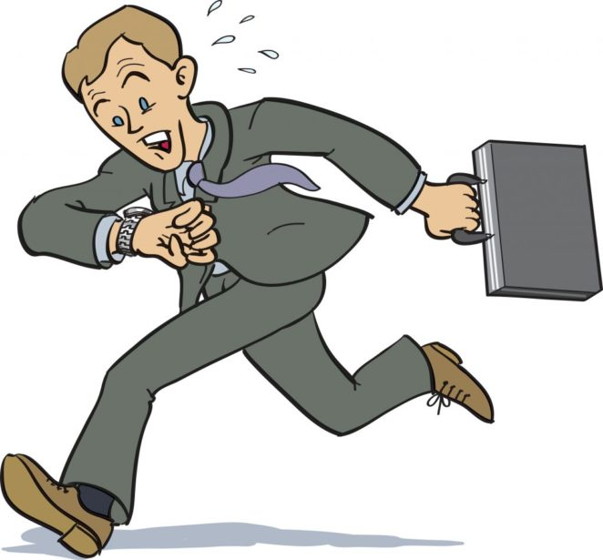
Look at the picture and imagine what had happened before the man arrived late to work.
The man had woken up late.

Slide 10
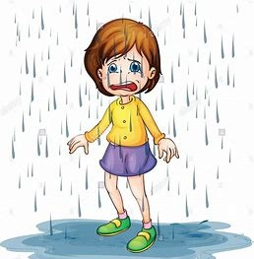
Look at the picture and imagine what had happened before the girl got wet.
The girl had forgotten her umbrella.

Slide 11
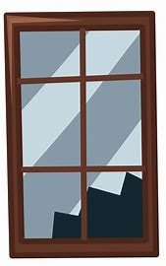
Look at the picture and imagine what had happened before the father saw the broken window.
Someone had broken the window.

Slide 12
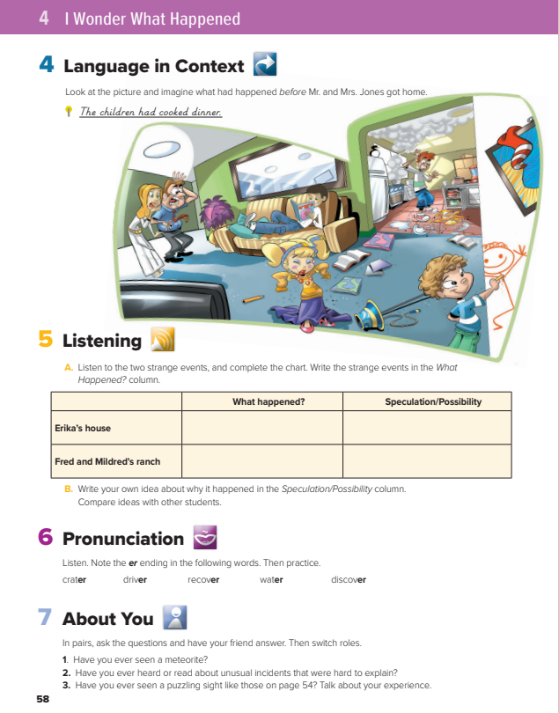
I love English
Open your Student’s book page: 58

Slide 13
Use had + past participle
They had broken some plates.
The little boy had drawn on the wall.
The girl had worn her mom dress.
They had read some books.
What had happened?

Slide 14
People saw a man in dark pants, white shirt, and a black tie in Erika’s house. Erika and her husband also heard noises in the night.
The man might have been a ghost.
Fred and Mildred saw a bright glow from some bushes. As they got close, they saw thousands of tiny lights on the bushes
They must have been fireflies.

Slide 17
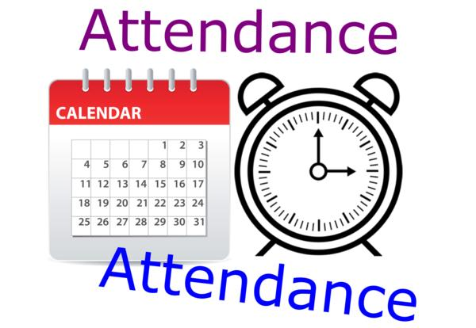
I love English

Slide 18
Homework
I love English

Slide 19
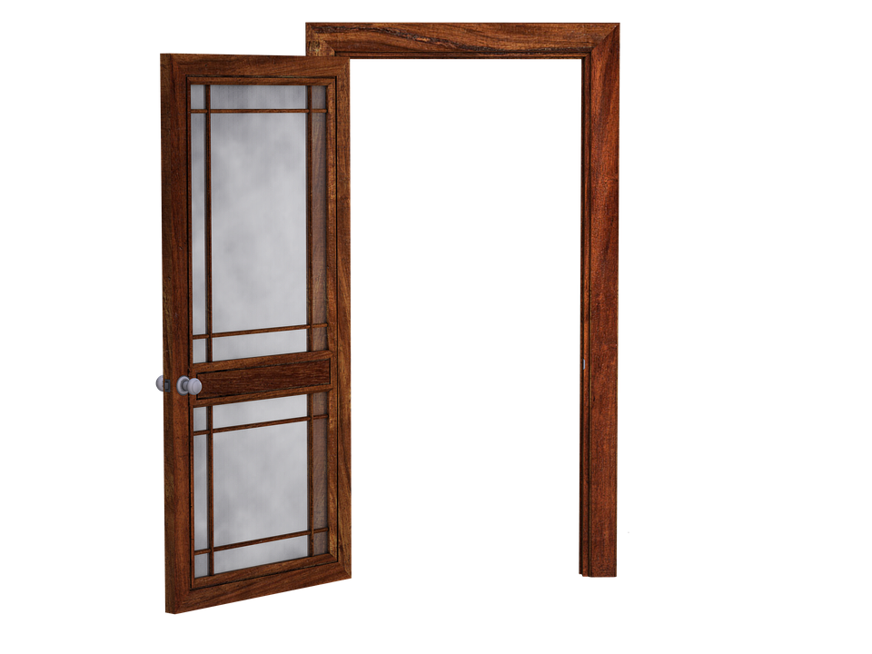
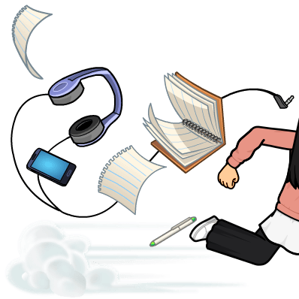
Homework

Slide 20
Homework

Slide 21
Homework

Slide 22
Homework

Slide 23
Homework

Slide 24
Homework

