Slide 1
Hello My lovely students
I’m your teacher
Hanan AlShobaily

Slide 2
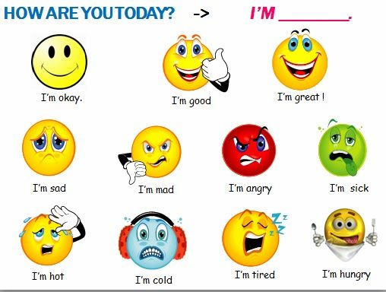
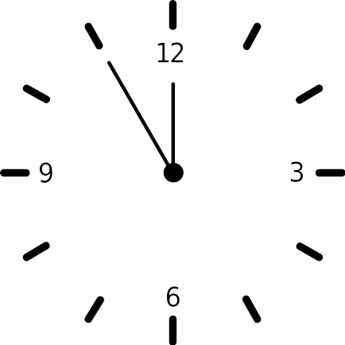
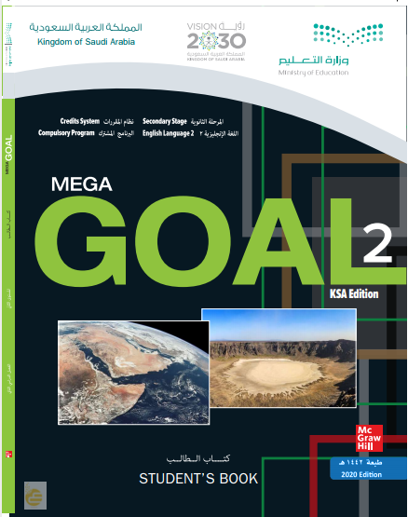
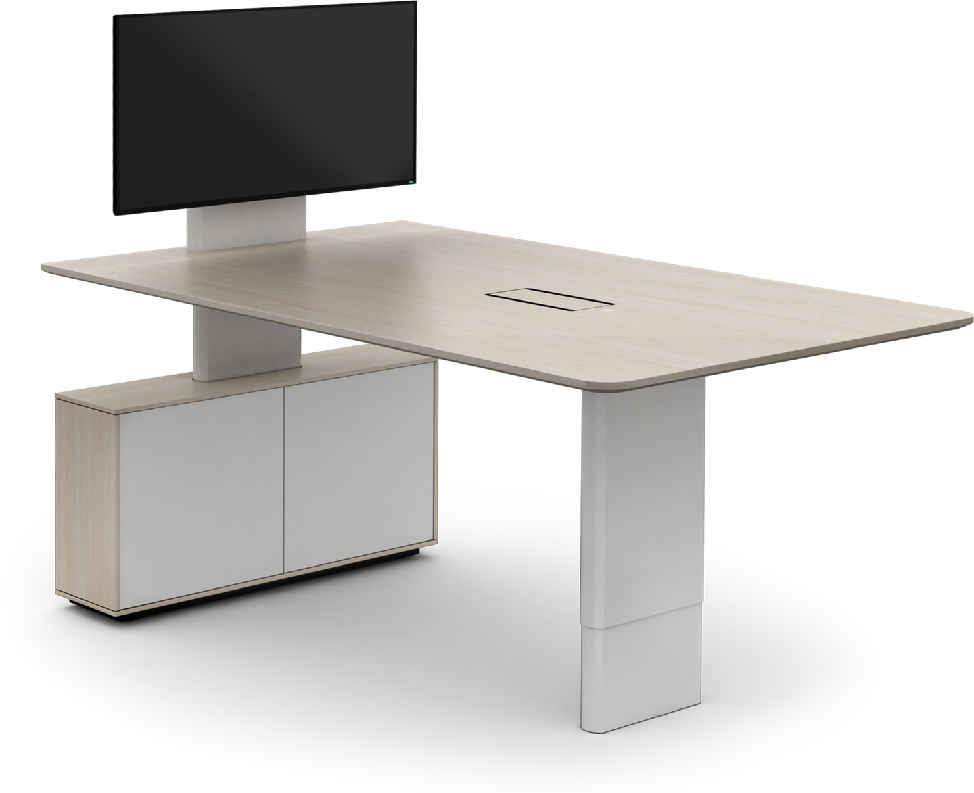
I love English

Slide 3
I love English

Slide 4
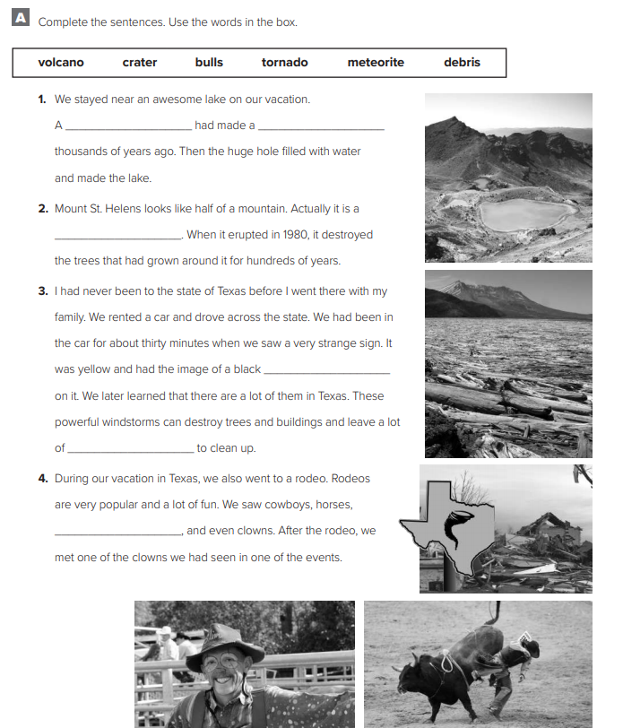
I love English
meteorite
crater
volcano
Let’s do the homework before starting the lesson.
Mega Goal 2 .. WB (37)
tornado
debris
bulls

Slide 5
I love English
Revising the previous lesson
Sorry incorrect answer ☹
Try again.
Next
Tornado
Locomotive
Crater
Bull
Volcano

Slide 6
I love English
Mega Goal 2
Unit 4
(I Wonder What Happened)
Grammar
Monday
24/7/1442

Slide 7
I love English
Lesson Goals
Students will be able to:
Use the past perfect to indicate an action.
Use “ must" to assure an information.
Use “can’t / couldn’t" to negate a statement.
Use “may / might / could" correctly.

Slide 8
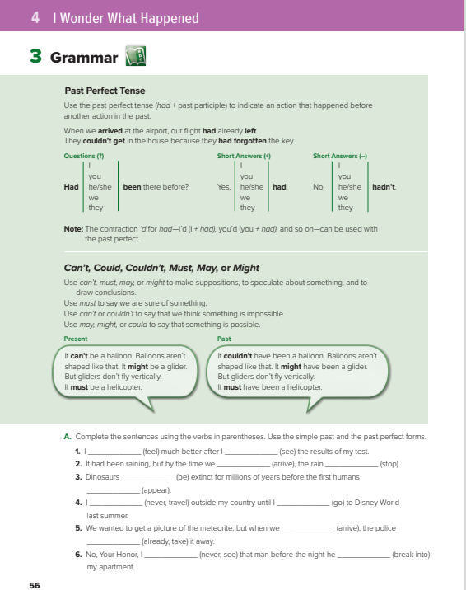
I love English
Open your Student’s book page: 56

Slide 10
Past Perfect
Form
S
+
had
+
V3 (past participle)
e.g.
I had eaten my breakfast before I went to school.
I had eaten my breakfast
I went to school
perfect
past
Now
Future

Slide 11
Negative
Form
S
+
had
+
not
+
V3 (past participle)
He
had
studied hard.
e.g.
not

Slide 12
Yes/No Questions
Had
Form
+
S
+
V3 (past participle) ?
Had
had
he
studied hard
He
.
e.g.
?
Yes, he had.
No, he hadn’t.

Slide 13
Time Expressions with the Past Perfect
already
never
before
just
when
after
till/until
as soon as
by the time

Slide 14
https://wordwall.net/resource/12118423

Slide 16
must
must
He must live near here because he always walks to work.
To say we are sure of something
Can’t
Couldn’t
Can’t
Couldn’t
To say that we think something is impossible
It can’t be far now . We’ve been driving for hours.
May
Might
Could
May
Might
Could
To say that something is possible
She’s not here yet. She might have been stuck in traffic.

Slide 18
Present
Form
S
+
Modal Verb
+
Main Verb
e.g.
Your team has won. You must be very happy.
He might go to the party.
negative
S
+
Modal Verb
+
not
+
Main Verb
e.g.
He might not go to the party.

Slide 19
Past
Form
S
+
Modal Verb
+
have
+
V3 (Past Participle)
e.g.
He must have been sick.
She might have been at home.
negative
S
+
Modal Verb
+
not
+
have
+
V3 (Past Participle)
e.g.
She might not have been at home.

Slide 20
https://www.liveworksheets.com/1-ao1794782ox

Slide 21
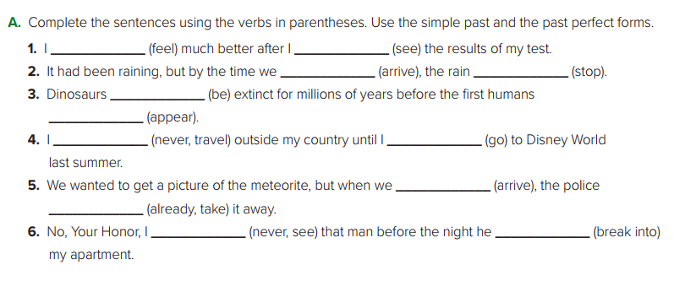
felt
had seen
arrived
had stopped
had been
appeared
had never traveled
went
arrived
had already taken
had never seen
broke into

Slide 22
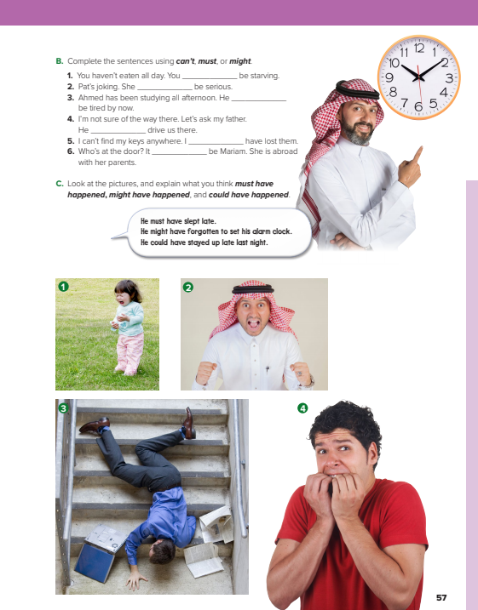
I love English
Open your Student’s book page: 57

Slide 23
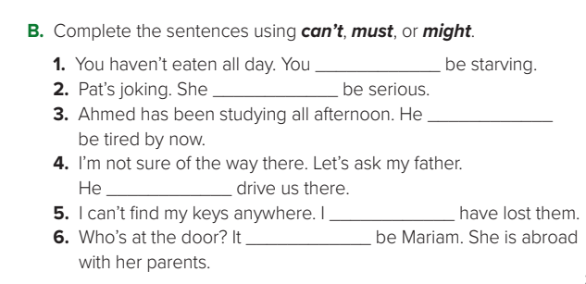
must
can’t
must
might
must
can’t

Slide 24
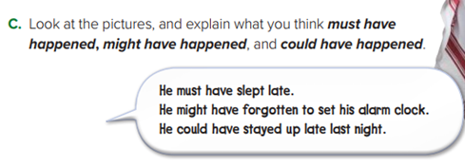
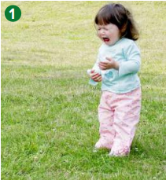
1- ▪ Something must have scared the girl.
▪ The girl might have hurt herself.
▪ The girl could be hurt.

Slide 25
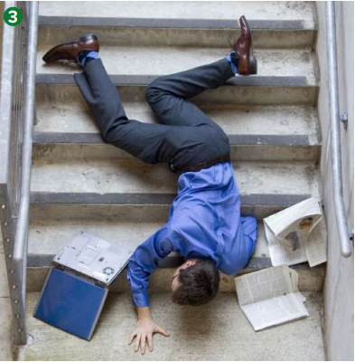
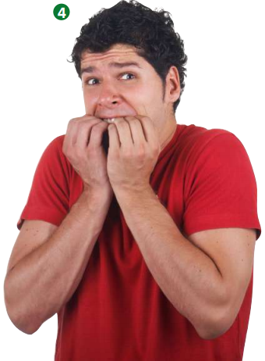
2- ▪ The man must have heard some good news.
▪ The man might have heard a funny joke.
▪ The man could have gotten an A on his test.
3- ▪ The man must have tripped on something and fallen.
▪ The man might have fallen while he was running.
▪ The man could have slipped on some water.
4- ▪ The boy must have seen a ghost.
▪ There could be an earthquake.
▪ The boy might have seen a horror film.

Slide 27
I love English

Slide 28
Homework
I love English
Work Book: Page 40

Slide 29
Homework
Work Book: Page 40

Slide 30
Homework
Work Book: Page 40

Slide 31
Homework
Work Book: Page 40

Slide 32
Homework
Work Book: Page 40

Slide 33
Homework
Work Book: Page 40

Slide 34
Homework
Work Book: Page 40

