Slide 1
Hello My lovely students
I’m your teacher
Hanan AlShobaily

Slide 2
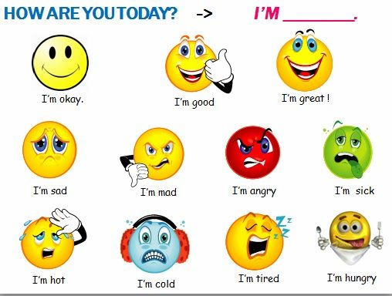
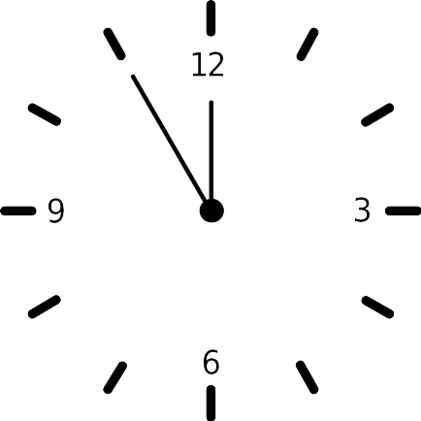
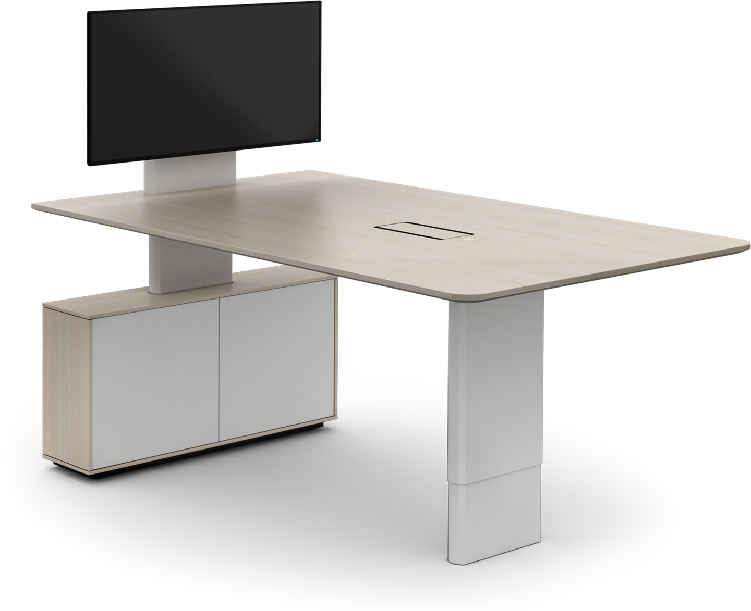
I love English

Slide 3
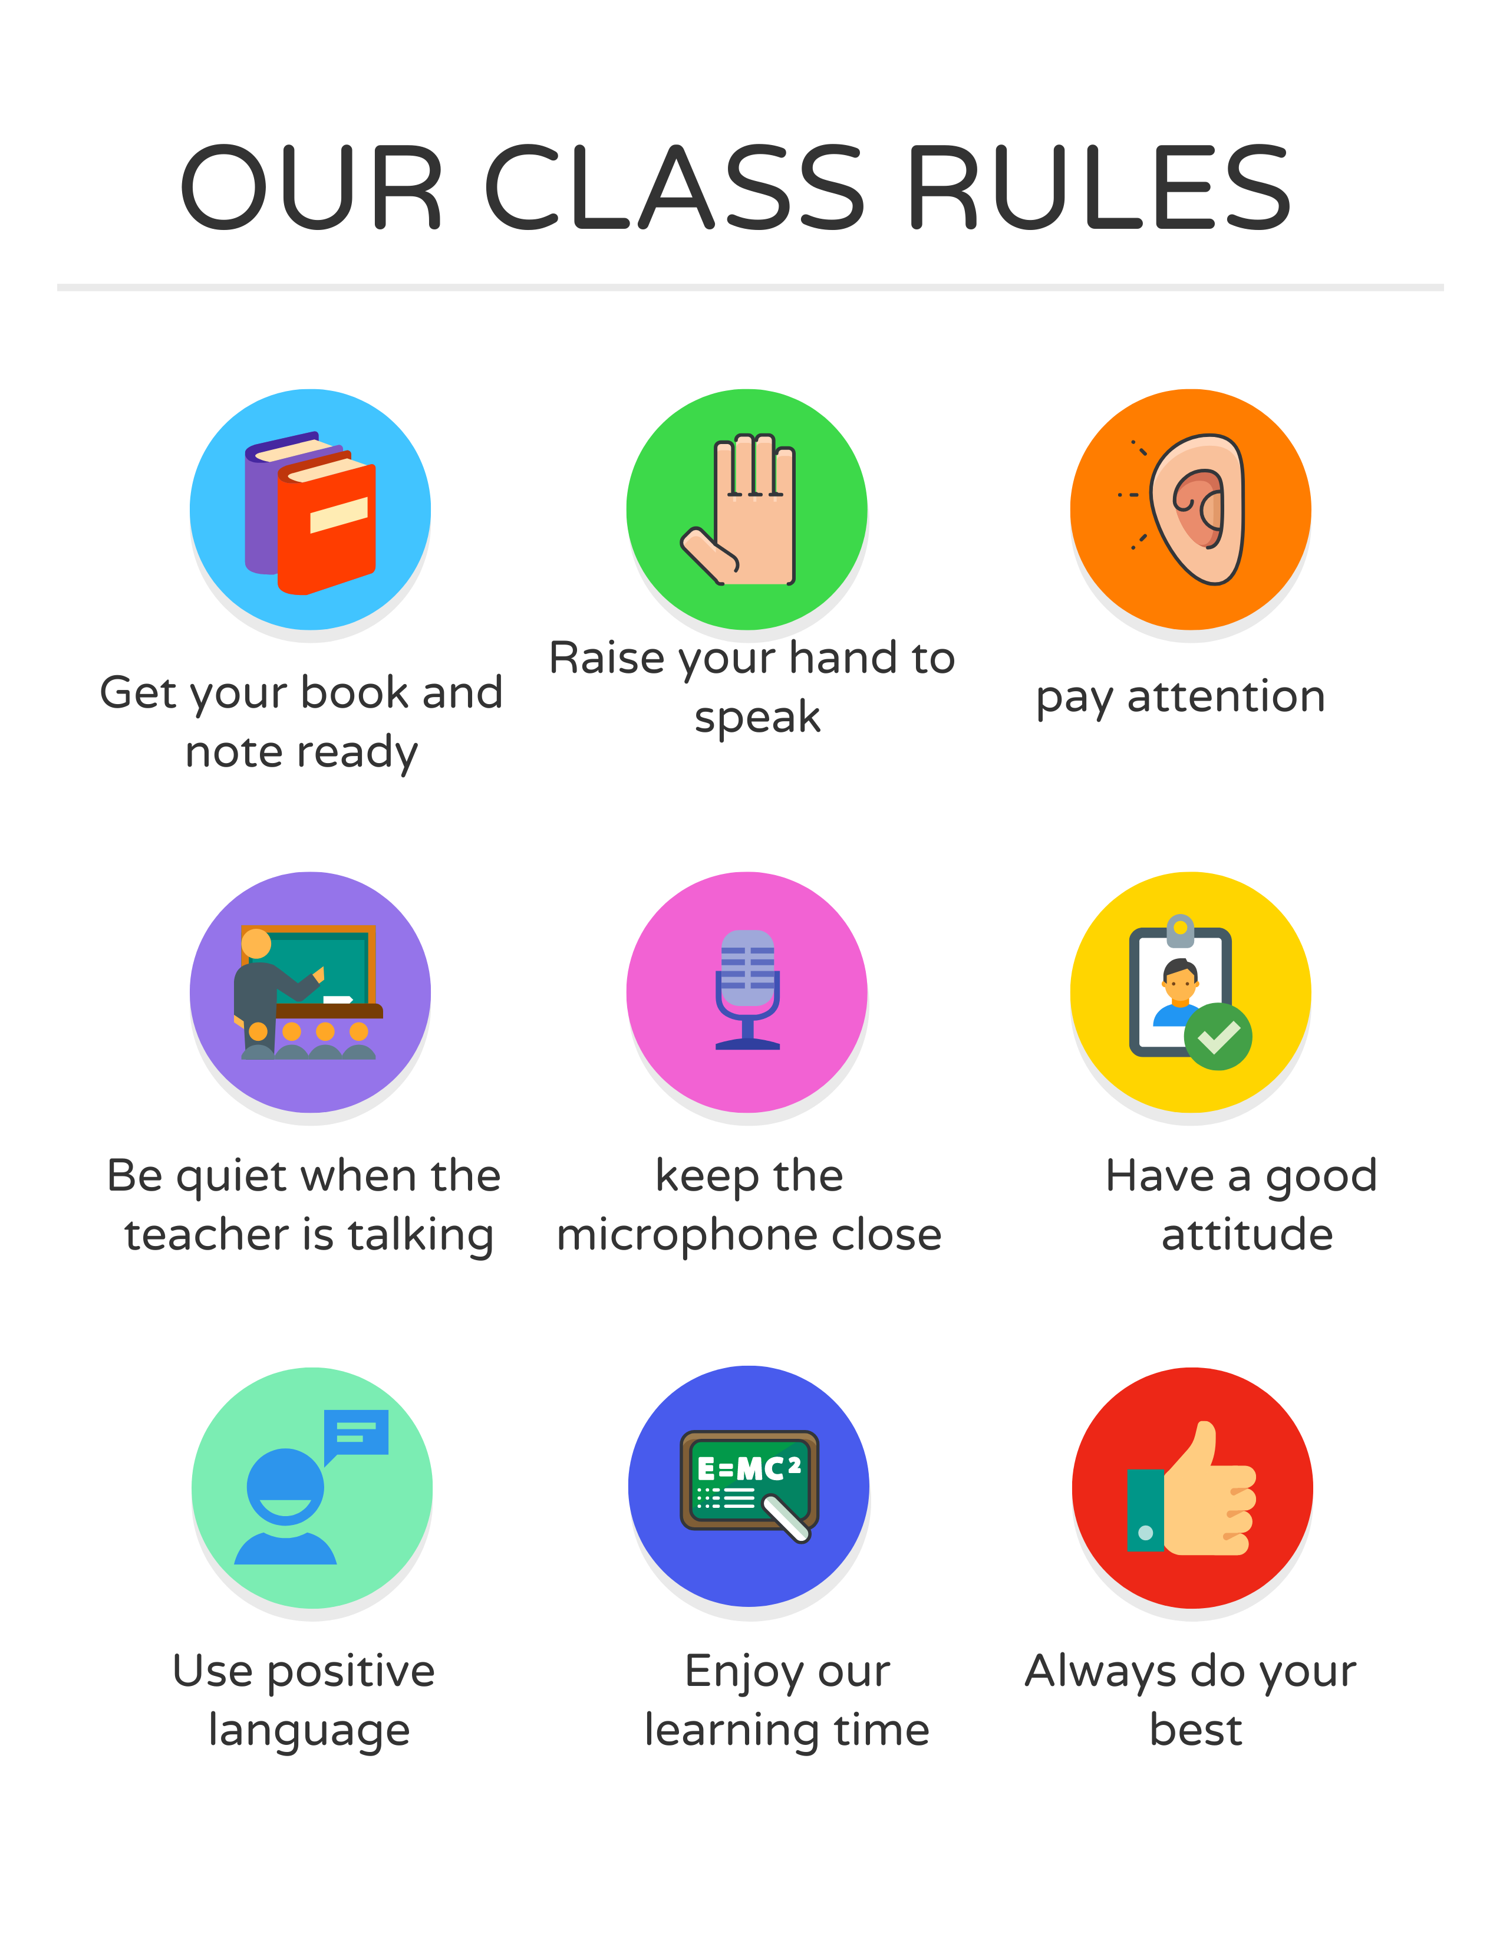
I love English

Slide 4
I love English
Mega Goal 2
Unit 4
(I Wonder What Happened)
Form, Meaning and Function
Monday
2/8/1442

Slide 5
I love English
Lesson Goals
Students will be able to:
Use independent clauses with (And, But, Or, So, and Yet).
Write past sentences with dependent time clauses.
Express enthusiasm with intensifiers.
Express enthusiasm with adjectives.
Use conditional sentences to talk about causes and results.
Express necessity and lack necessity.

Slide 6
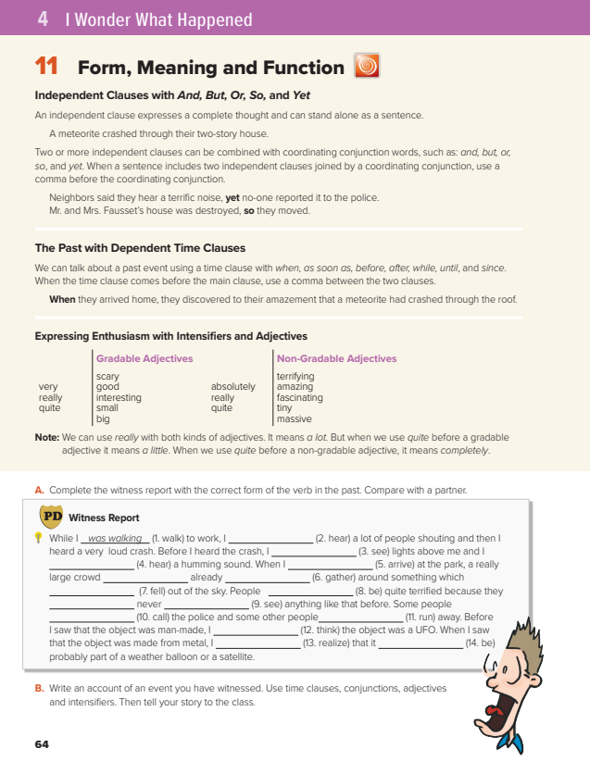
I love English
Open your Student’s book page: 64

Slide 8
Independent clauses
An independent clause
expresses a complete thought and can stand alone as a sentence.
Form
Subject
+
Verb
What’s an independent clause?
e.g.
❍ I studied hard for my test.
Independent clause
Does that sound complete and make sense by itself?
Yes, it does.
❍ Because I studied hard for my test.
Dependent clause
Does that sound complete and make sense by itself?
No, it doesn’t. It needs more information to make sense.
❍ Because I studied hard for my test, I got the full mark.
Now, does that sound complete and make sense by itself?
Yes, it does.

Slide 9
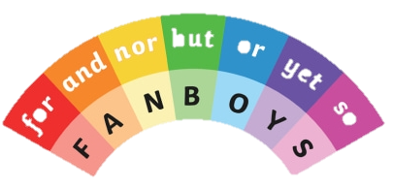
Independent clauses with And, But, Or, So, and Yet
Two or more independent clauses can be combined with coordinating conjunction words, such as: and, but, or, so, and yet.
Coordinating conjunction
For
And
Nor
But
Or
Yet
So
Independent clause
,
Coordinating conjunction
Independent clause
Form
+
+
+
e.g.
It was raining
,
and
there was a lot of lightening.
When a sentence includes two independent clauses joined by a coordinating conjunction, use a comma before the coordinating conjunction.

Slide 10
Coordinating Conjunctions
I work in a police office, and I also work in a library.
and
joins two ideas, in addition to
We could go out, or we could stay at home.
or
shows choice, an alternative
We wanted to go out, but it was very cold outside.
but
shows contrast
I like hot air balloons, yet I’m scared of heights.
yet
shows a contrast in spite of something = (but)
I didn’t want to walk in the rain, so I took taxi.
so
shows the consequence or result of something

Slide 12
The Past with Dependent Time Clauses
A dependent clause cannot stand alone and must be used with a main clause.
Past time clauses are dependent clauses. They begin with words such as before, when, while, and after.
Subordinating conjunction
When
As soon as
Before
After
While
Until
Since
,
Time clause
(Dependent)
Main clause (Independent)
Form
+
+
Join dependent clauses to independent ones
After
I cooked dinner
e.g.
,
I cleaned the kitchen.
The past time clause can come after or before the main clause (independent)
Use comma only when the time clause comes at the beginning.
I cleaned the kitchen
after
I cooked dinner.

Slide 13
Subordinating Conjunctions
I was very happy when I got my test back.
when
As soon as I saw him, I knew there was something wrong.
as soon as
I brushed the snow off my car before I drove to work.
before
After they got married, they bought a house.
after
I got my job while I was in college.
while
I stayed in the office until I finished the report.
until
Since he was a boy, he’s lived there.
since

Slide 14
https://wordwall.net/resource/12561850

Slide 15
heard
had seen
had heard
arrived
had
gathered
had fallen
were
had
seen
called
ran
had thought
realized
was

Slide 16
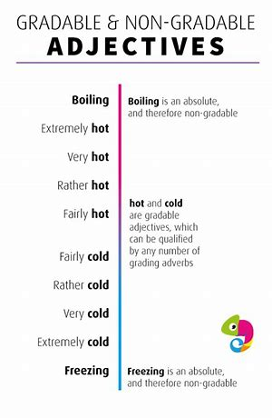
Gradable Adjectives
Non-Gradable Adjectives
Have comparative or superlative form
Can be qualified by words such as “very” and “quite”
Don’t have comparative or superlative form
Can’t be qualified by words such as “very” and “quite”
used with very, quite, rather, fairly, really, extremely
used with absolutely, completely or really
It’s very cold.
It’s absolutely freezing outside.
He’s quite hungry.
The food was really delicious.

Slide 17
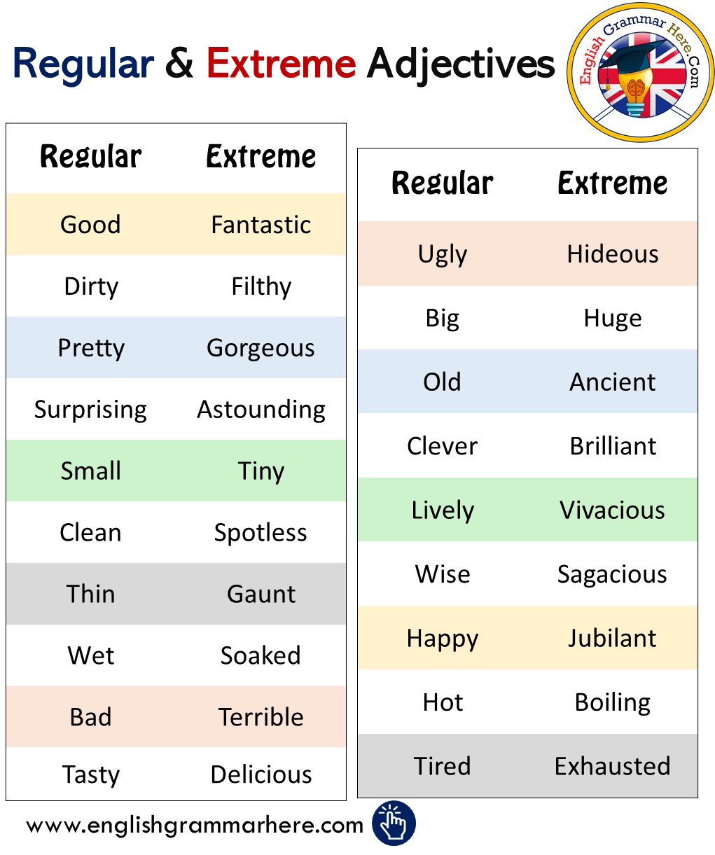
Gradable and Non-Gradable Adverbs

Slide 18
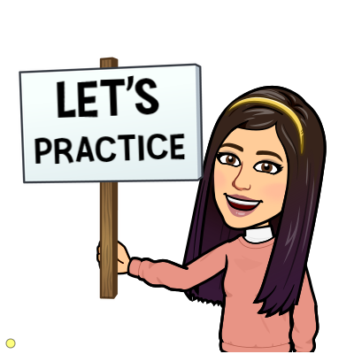
https://wordwall.net/resource/12621913

Slide 19
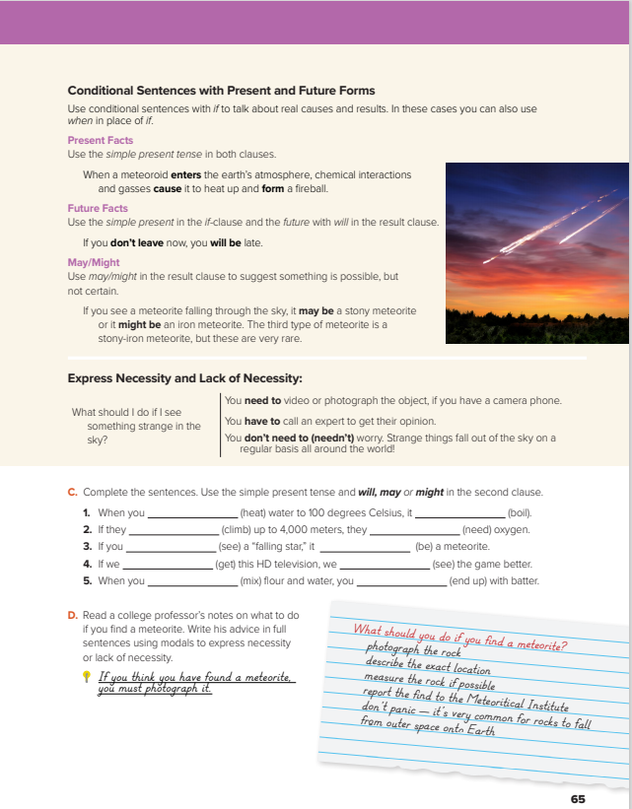
I love English
Open your Student’s book page: 65

Slide 21
Present Facts
We can substitute If with ( when ) because ( If ) in the present facts means whenever.
+
Present Simple
,
Form
If
+
+
Present Simple
e.g.
If you drop a stone, it falls down.
When you drop a stone, it falls down.
Future Facts
+
Present Simple
,
Form
If
+
+
will + infinitive
e.g.
If they study hard, they will pass the exam.
Possibility
+
Present Simple
,
Form
If
+
+
may/might + infinitive
e.g.
If he plays the match, he may/might score a goal.

Slide 22
I have to take my passport to the airport .
She has a toothache. She has to go to the dentist .
They need to do this exercise . It is obligatory .
You don’t need to go to the store .
He needn’t complete the work right away. There’s plenty of time .

Slide 23
Have to
Have to
Expresses strong obligation or something that is necessary.
Need to
Need to
Something is necessary but less strong than have to.
Need to
Need to
Something is not necessary.
The verb after (have to) and (need to) must be in the base form.

Slide 24
https://wordwall.net/resource/12581836

Slide 25
heat
boils
climb
will need
see
might be
get
will see
mix
end up/will end up

Slide 27
I love English

Slide 28
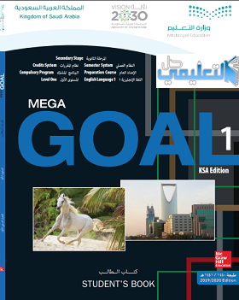
Homework
I love English
Work Book: Page 45

Slide 29
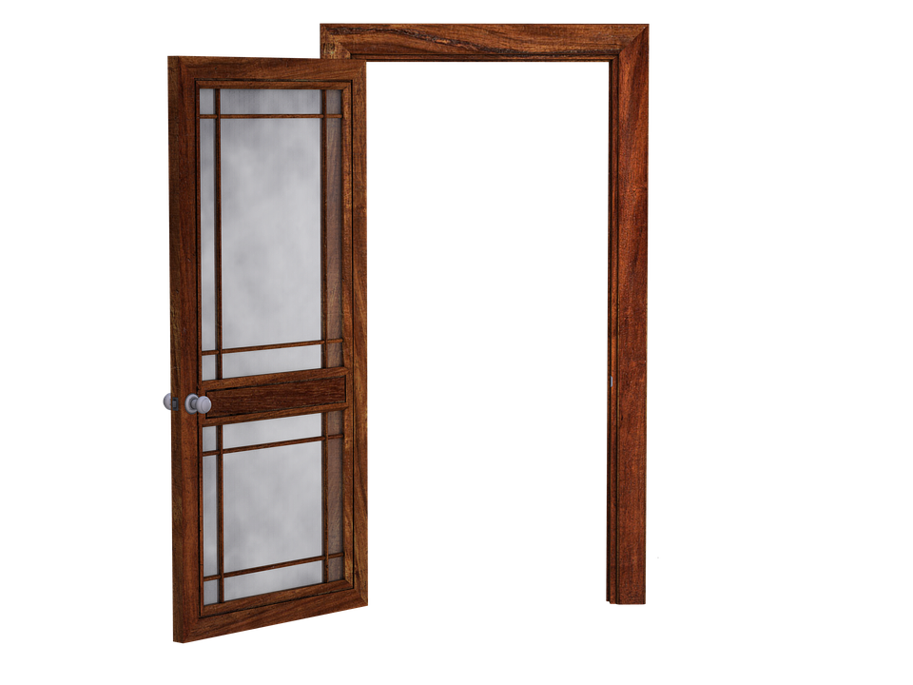
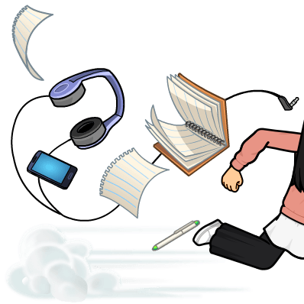
Homework
Work Book: Page 45

Slide 30
Homework
Work Book: Page 45

Slide 31
Homework
Work Book: Page 45

Slide 32
Homework
Work Book: Page 45

Slide 33
Homework
Work Book: Page 45

Slide 34
Homework
Work Book: Page 45

