Slide 1
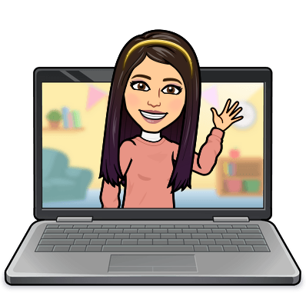

Hello My lovely students
I’m your teacher
Hanan AlShobaily

Slide 2

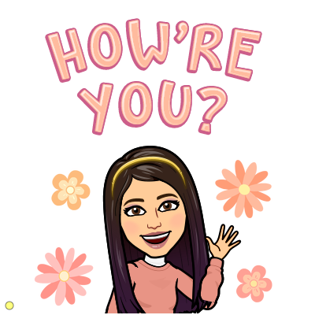


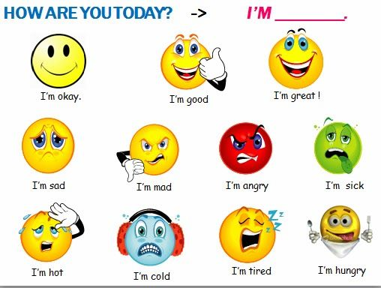
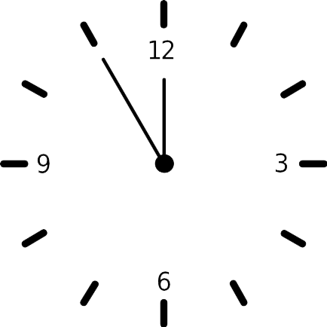
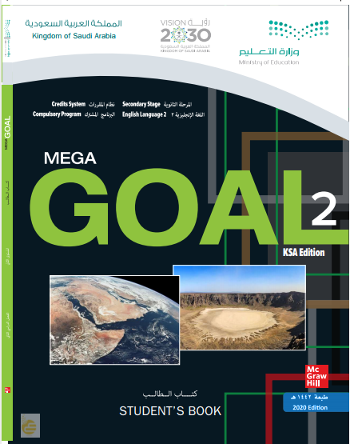


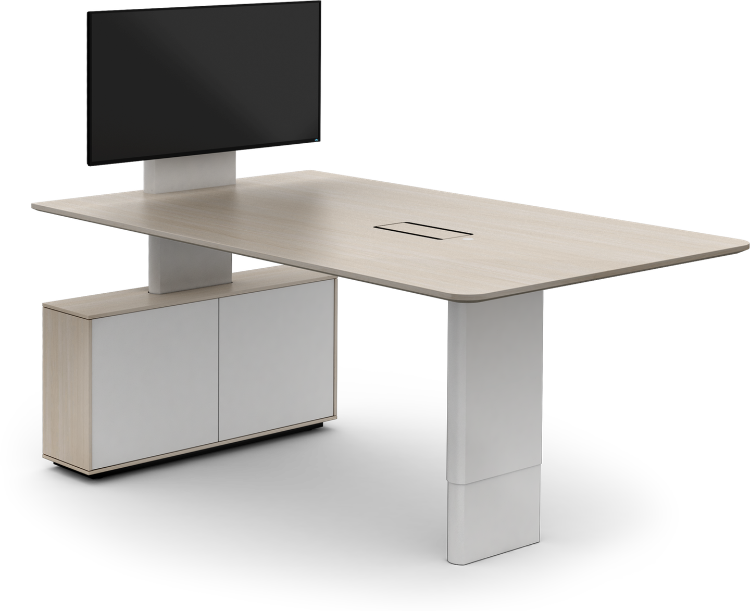
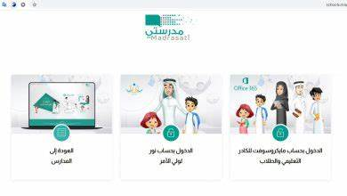



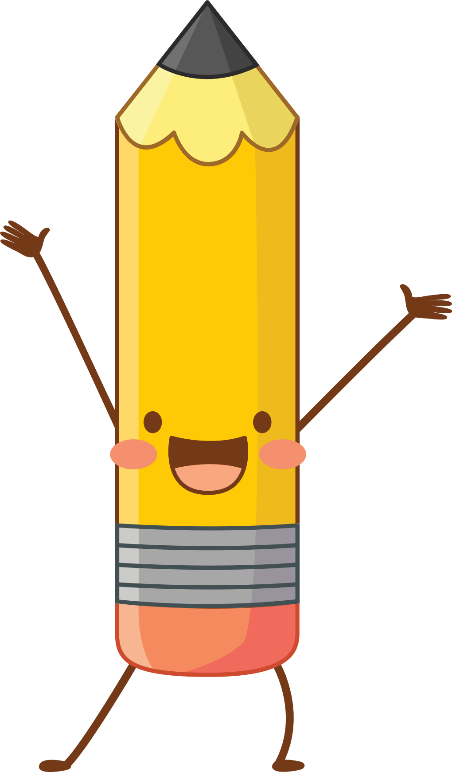


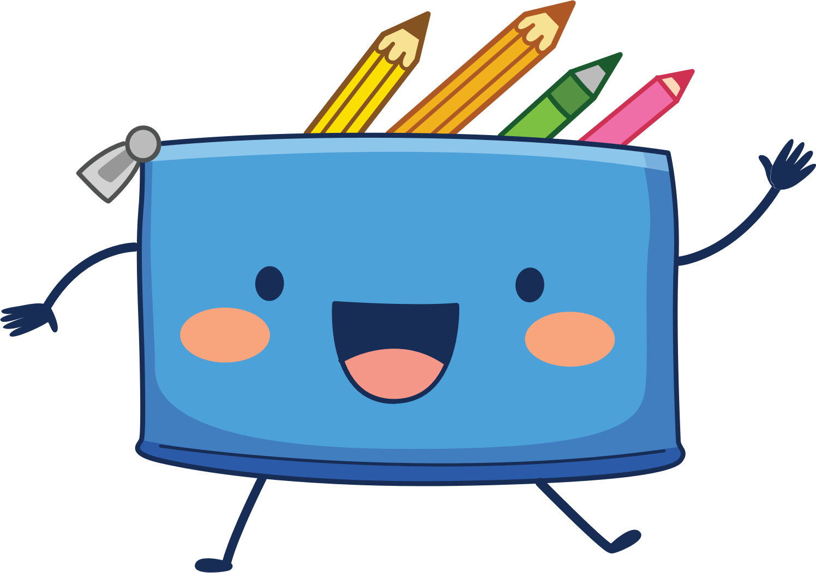
I love English

Slide 3
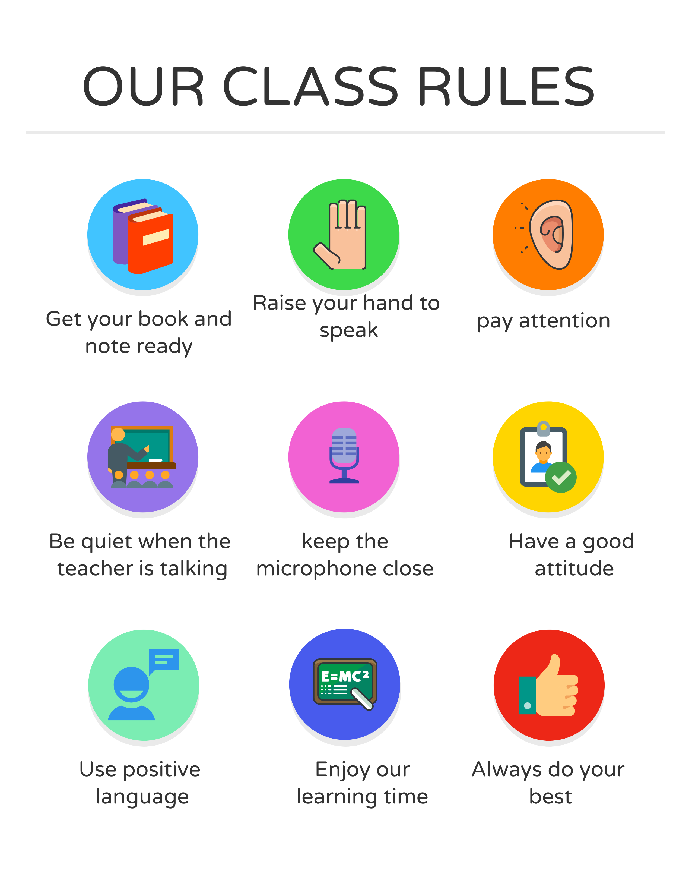
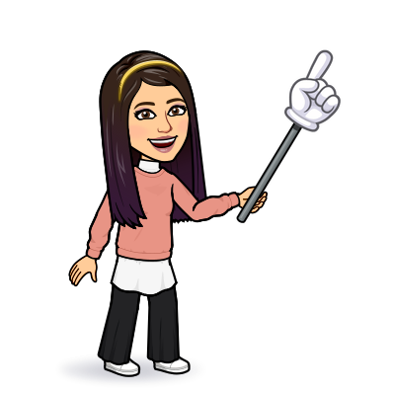
I love English

Slide 4



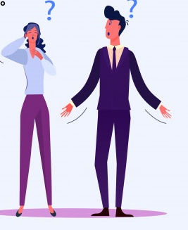


I love English
Mega Goal 2
Unit 4
(I Wonder What Happened)
Conversation
Wednesday
26/7/1442

Slide 5

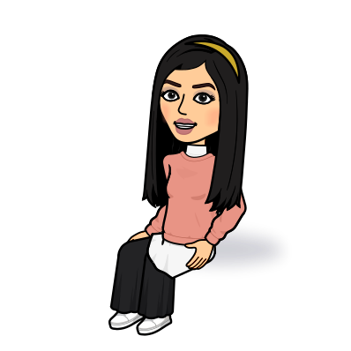
I love English
Lesson Goals
Students will be able to:
Practice reading the conversation in pairs.
Employ "real talk" phrases in new sentences.
Answer comprehension questions about the conversation.

Slide 6
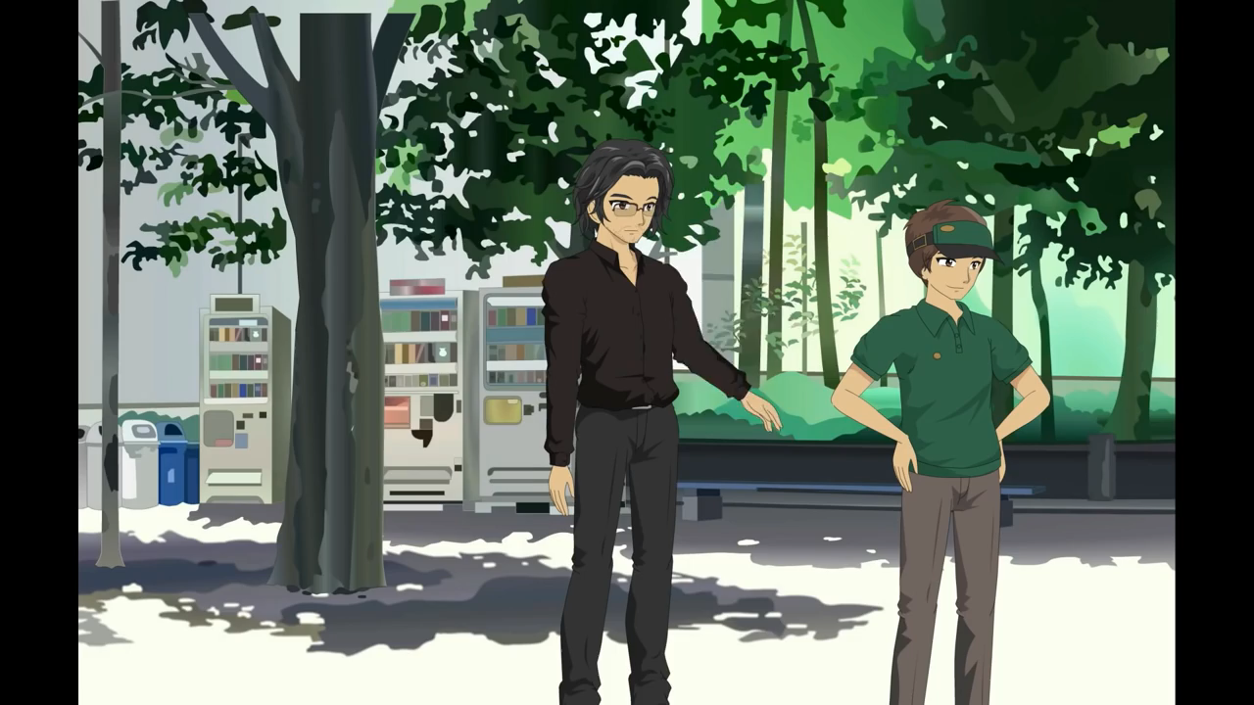
I love English
Watch the video then guess what had happened?

Slide 7
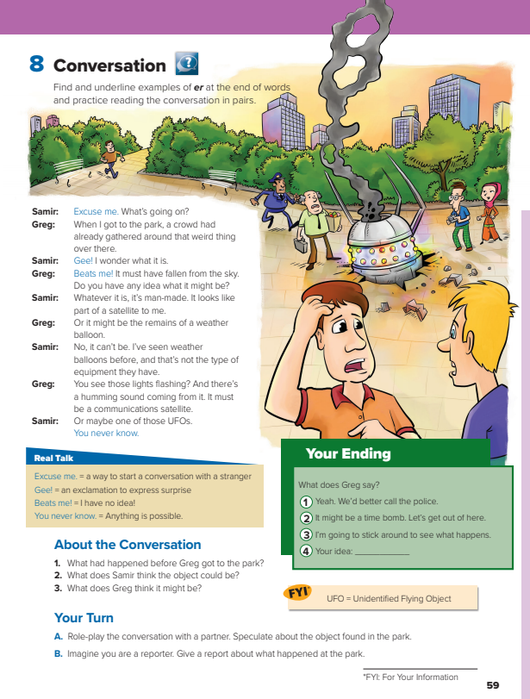
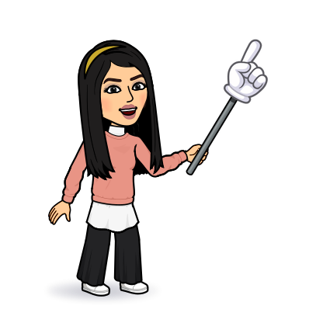
I love English
Open your Student’s book page: 59

Slide 8
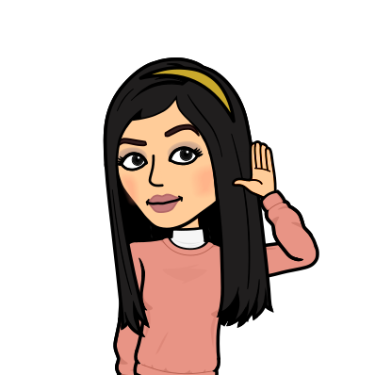
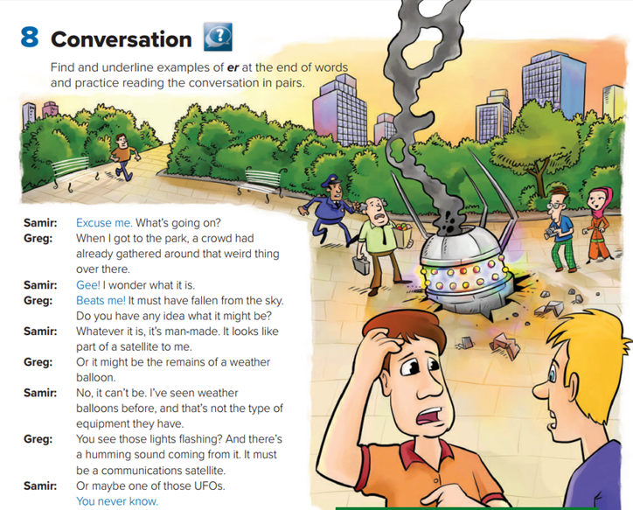
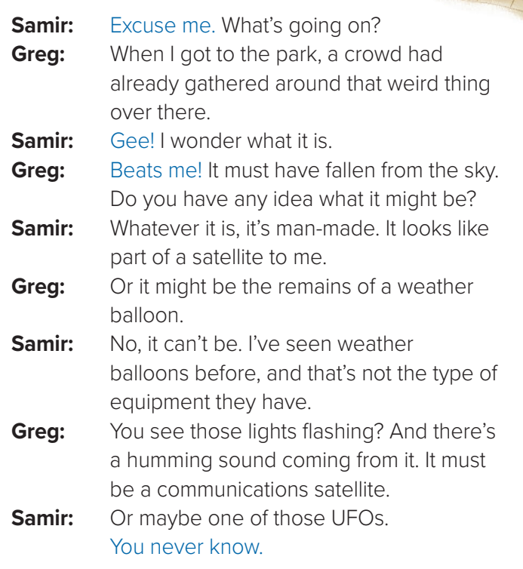

A way to start a conversation with a strange
Between whom did the conversation take place?
An exclamation to express surprise
Where are they?
In the park.
I have no idea
Does Samir know Greg before?
No, he doesn’t.
What had happened in the park?
Scan for speculate.
It’s a balloon that you send to the sky for giving information about the weather
Unidentified Flying Object
Anything is possible

Slide 9
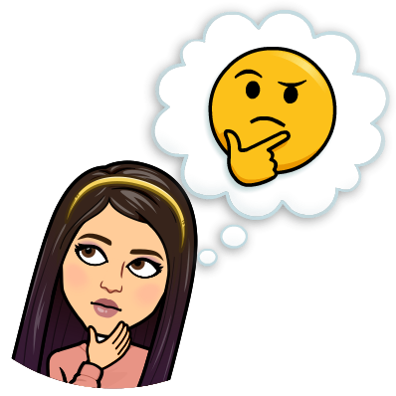
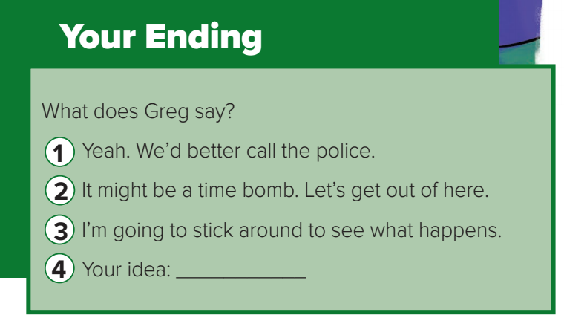

Slide 10
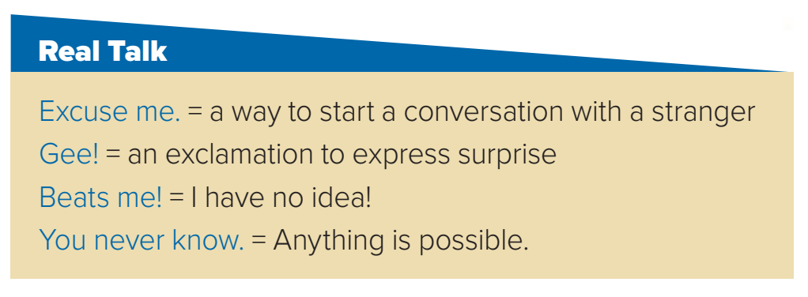
- Excuse me. May I say something?
- Gee! That looks like fun.
- Beats me! It must be a call for you.
- You never know, he might change his mind.

Slide 11
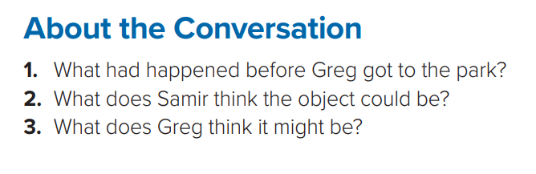
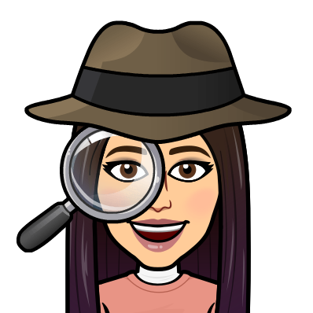
1- A crowd had gathered around a weird object.
2- Samir thought the object could be a satellite.
3- At first Greg thought it might be a weather balloon. But then he changed his mind and thought it must be a communications satellite.

Slide 12
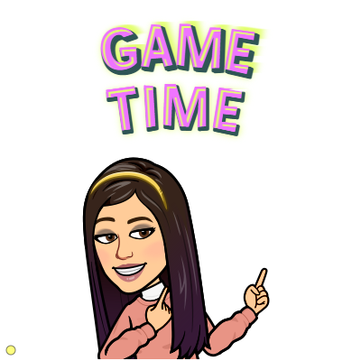

https://wordwall.net/resource/12193168

Slide 13
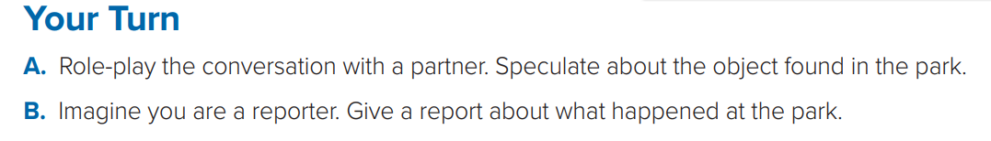
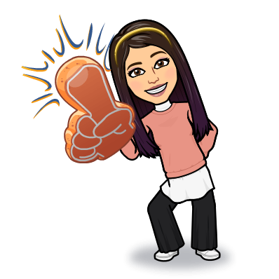

Slide 14
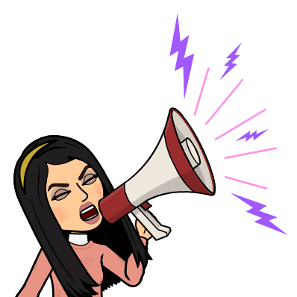
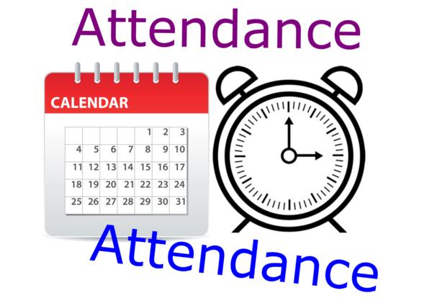
I love English

Slide 15
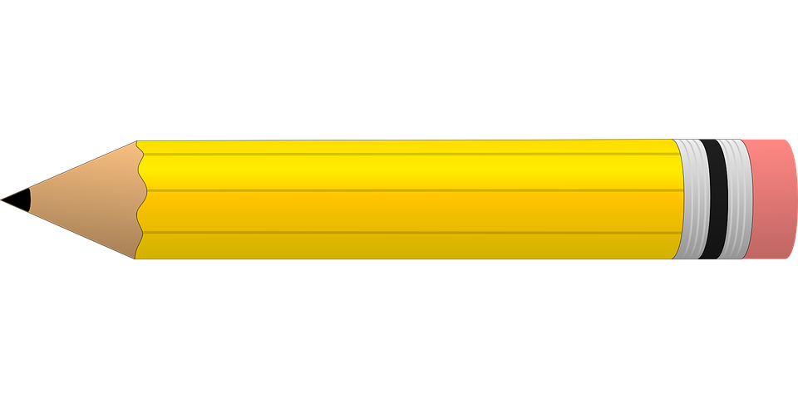
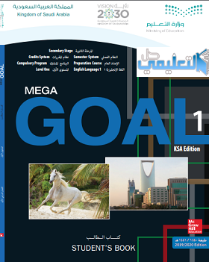


Homework
I love English

Slide 16
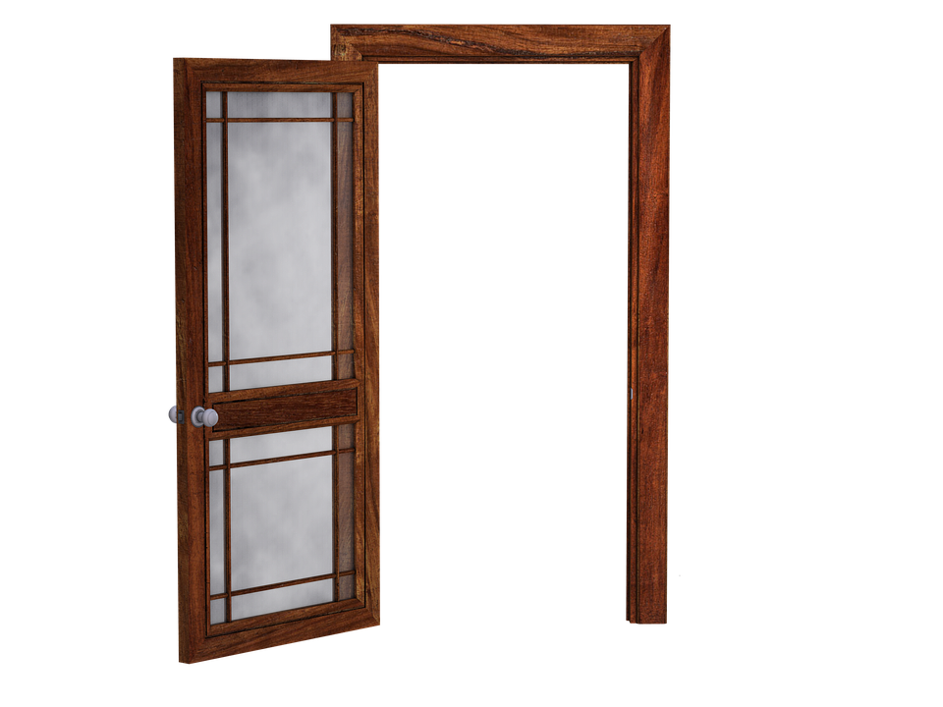
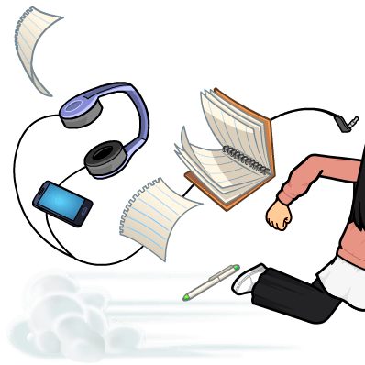
Homework

Slide 17
Homework

Slide 18
Homework

Slide 19
Homework

Slide 20
Homework

Slide 21
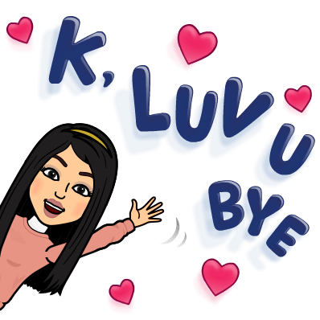
Homework

