Slide 1
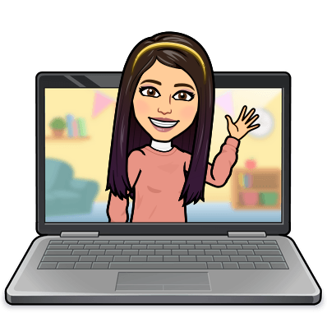

Hello My lovely students
I’m your teacher
Hanan AlShobaily

Slide 2

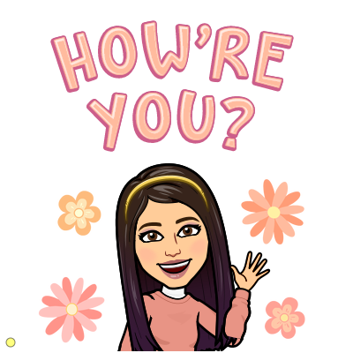


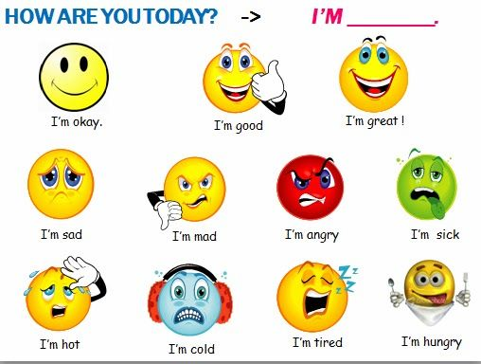
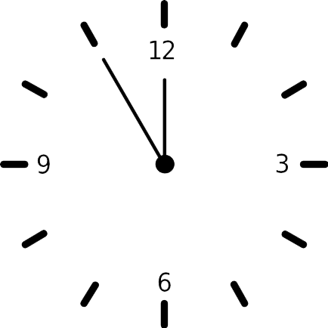
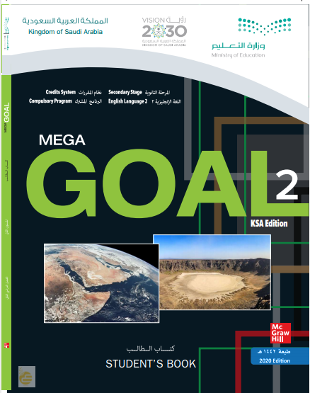


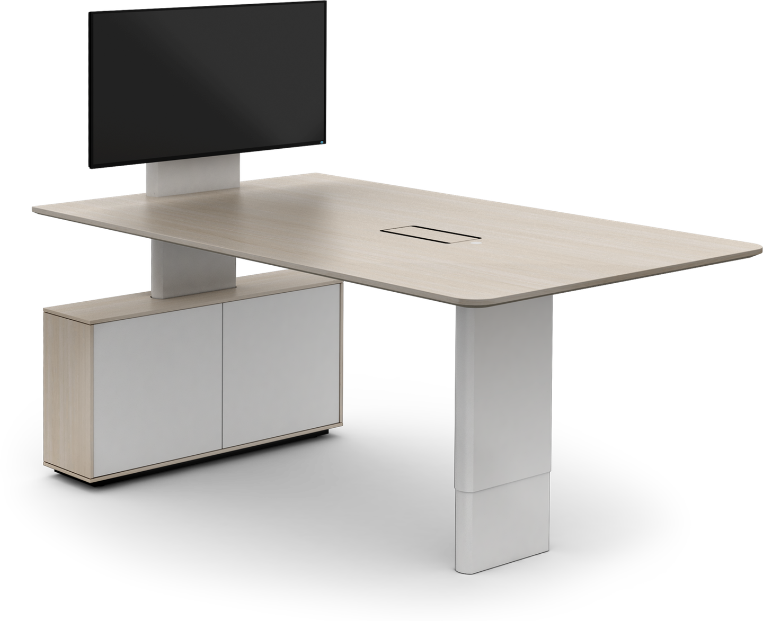
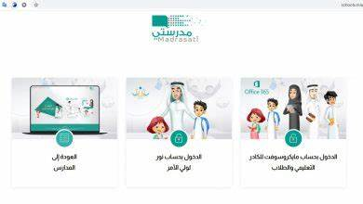







I love English

Slide 3
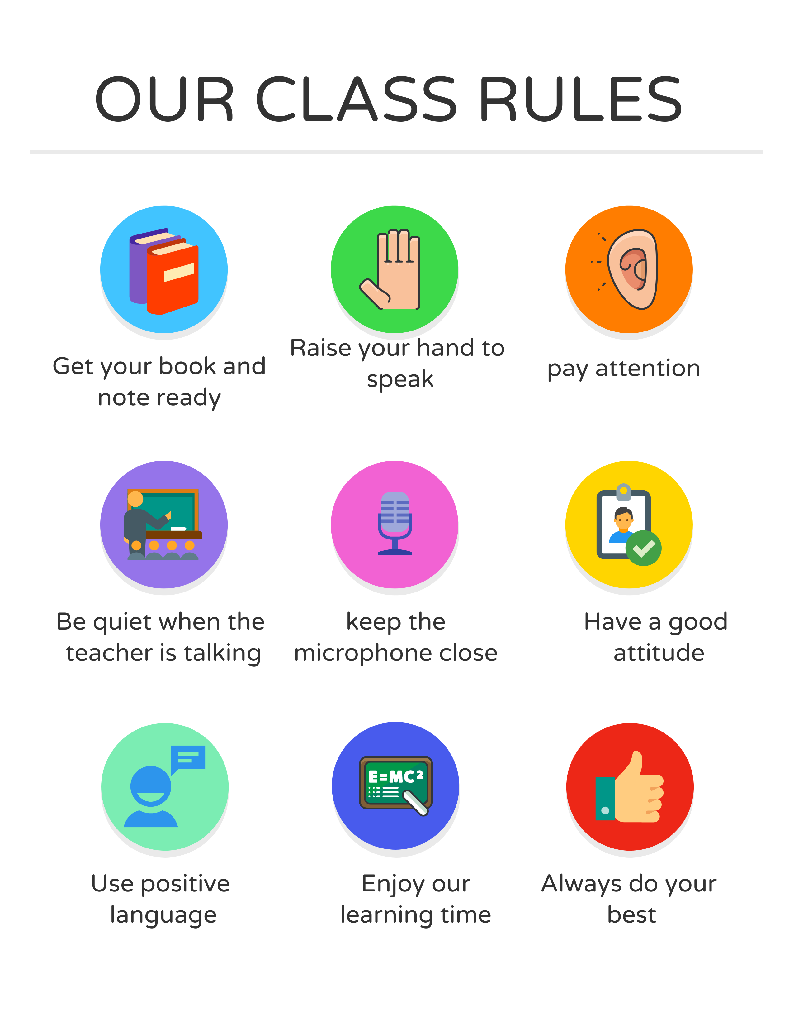
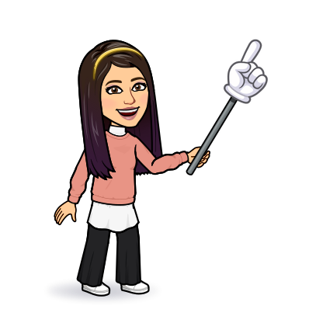
I love English

Slide 4
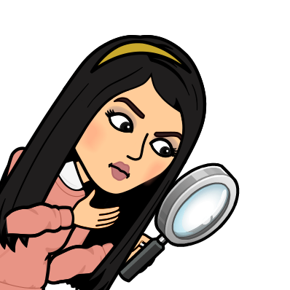
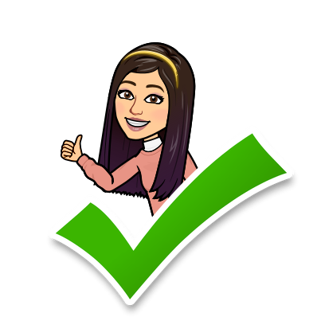
I love English
Revising the previous lesson
Choose the correct answer:
1- an expression used to confirm what someone else has said.
a. you mean
b. as for me
c. go out into the world
2- be firmly decided.
a. go out into the world
b. breathing down someone’s neck
c. have one’s mind set on something

Slide 5

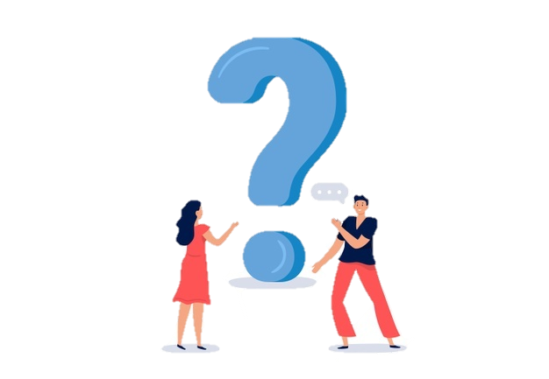
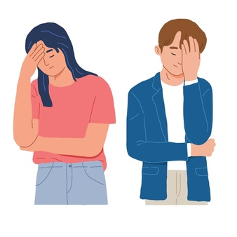
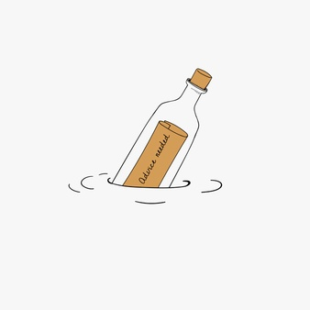

I love English
Mega Goal 2
Unit 5
(If It Hadn’t Happened)
Reading
Thursday
12/8/1442

Slide 6

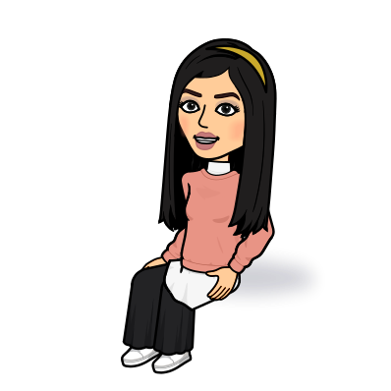
I love English
Lesson Objectives
Students will be able to:
Identify the type of advice an article offers.
Recommend suitable advice for each problem.
Compare the two stories
Answer specific questions based on a reading text.
Identify the meaning of new words in the text.

Slide 7
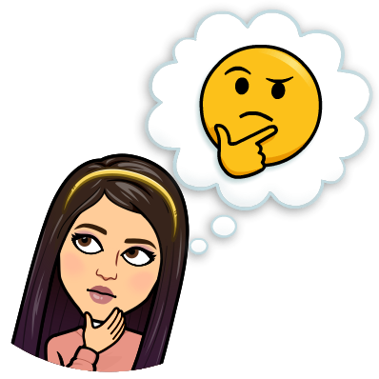


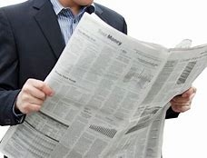
Warm Up
Do you like reading newspaper and magazine?
Online
Paper

Slide 8
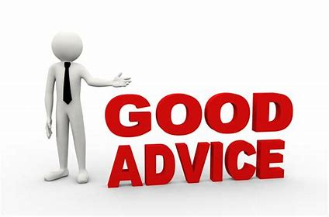

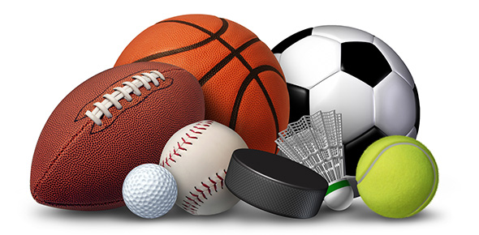
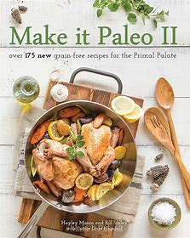
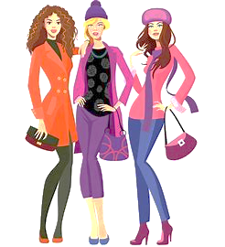
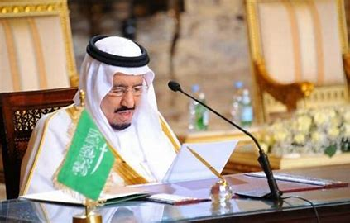
Warm Up
What is the first column you read in a newspaper?
Medical Column
Advice Column
Sport Column
Food Column
Fashion Column
Political Column

Slide 9
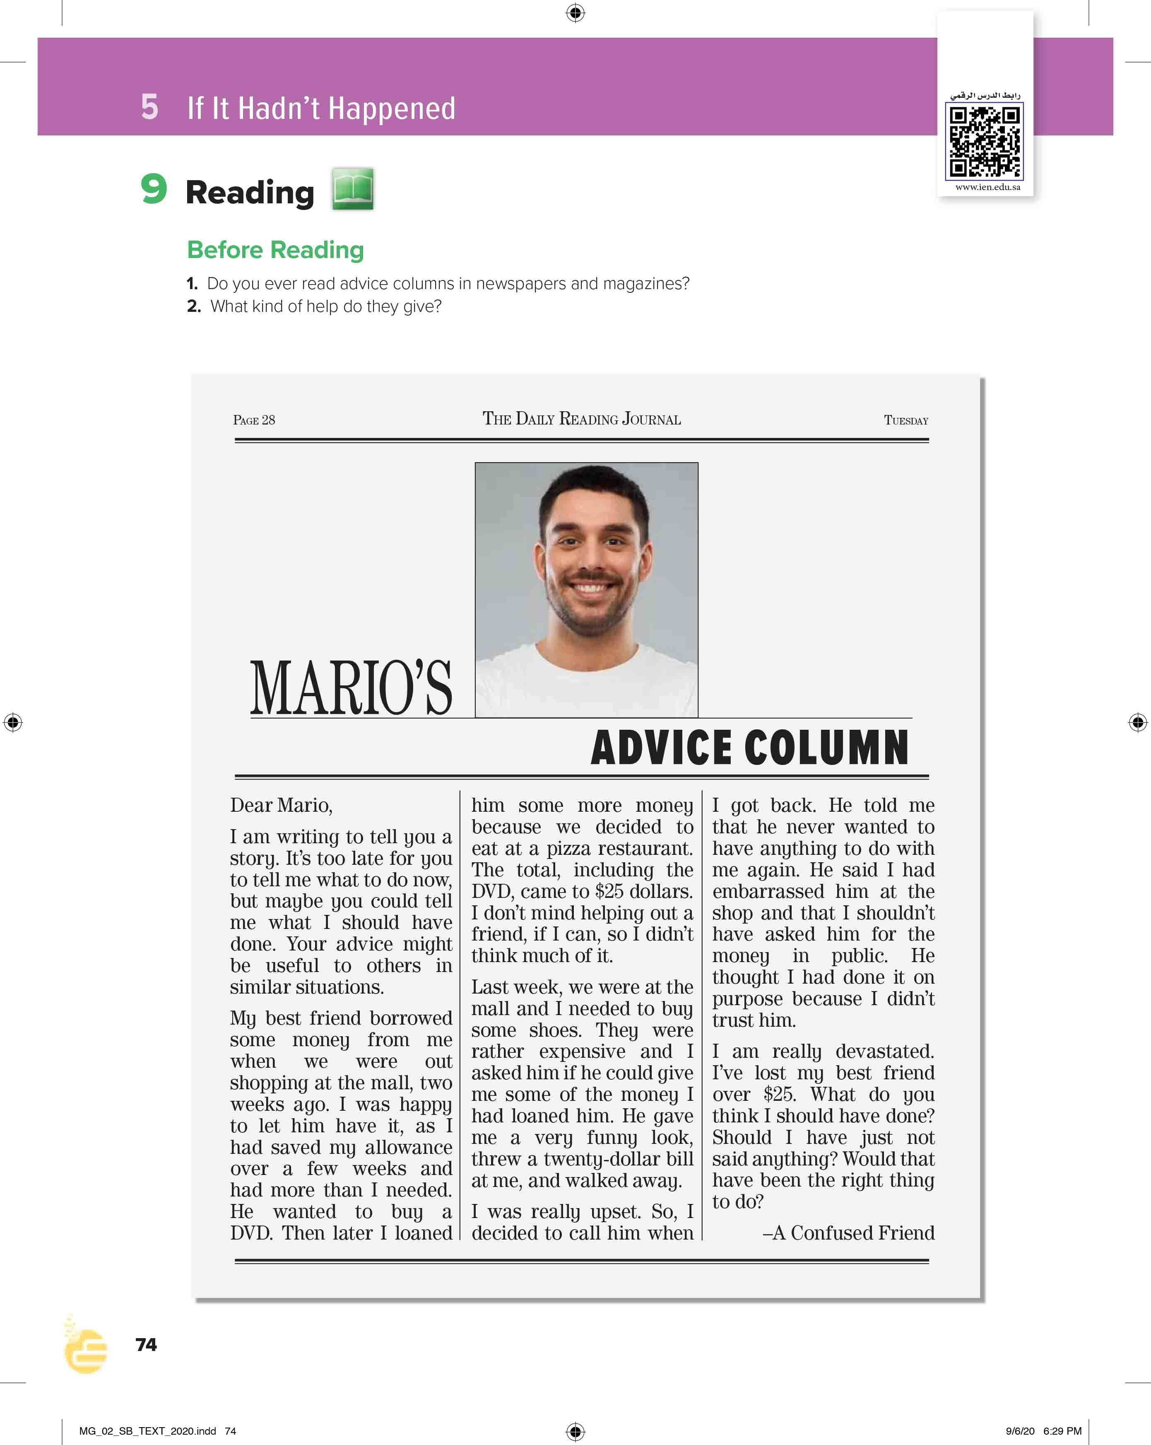
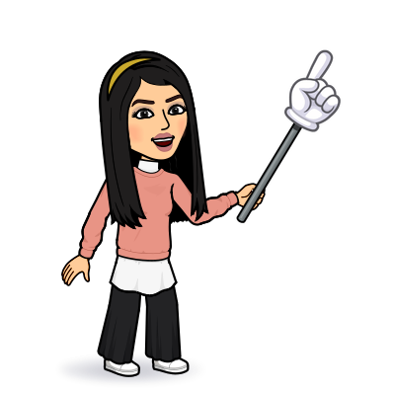
I love English
Open your Student’s book page: 74

Slide 10

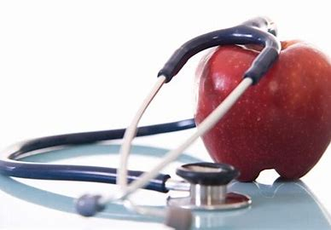
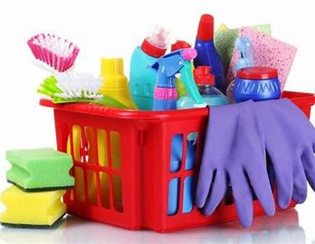
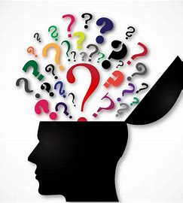
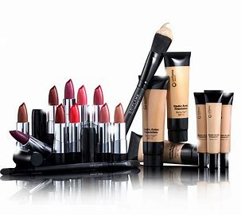
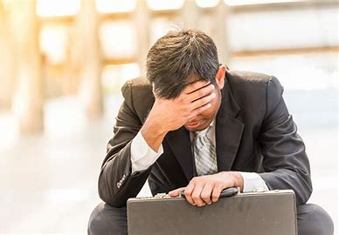
Health
Job
Household
Psychology
Makeup

Slide 11
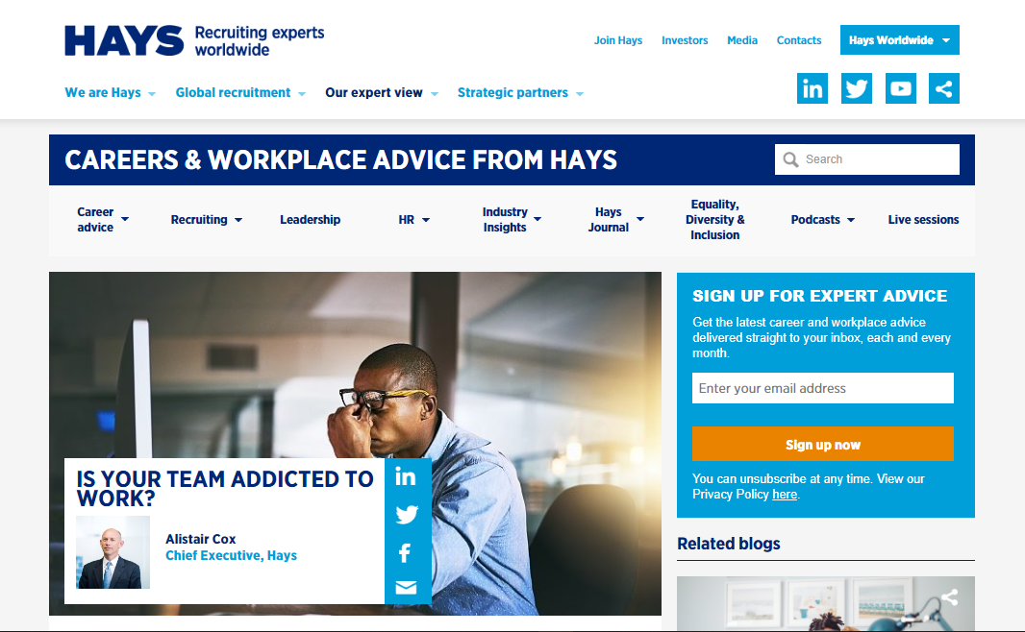
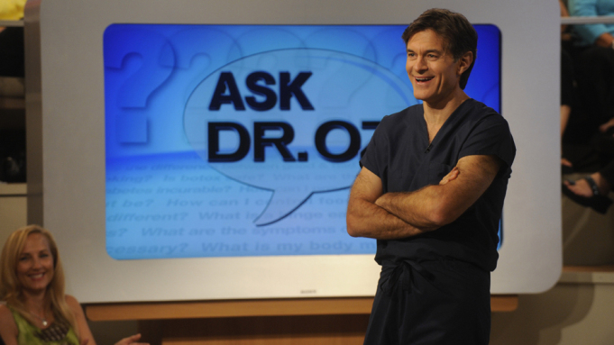
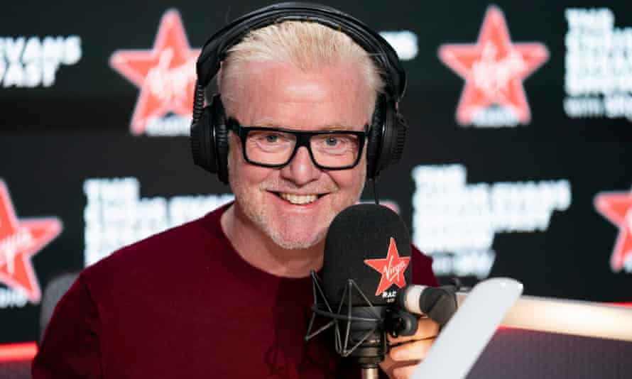
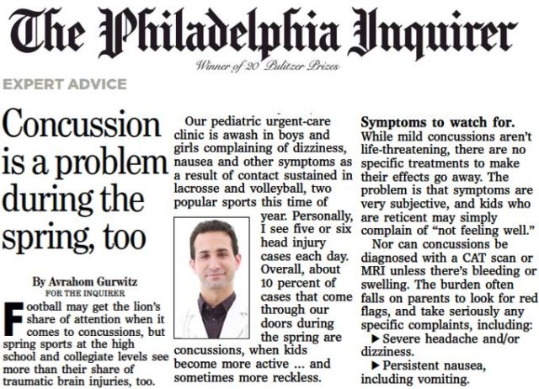
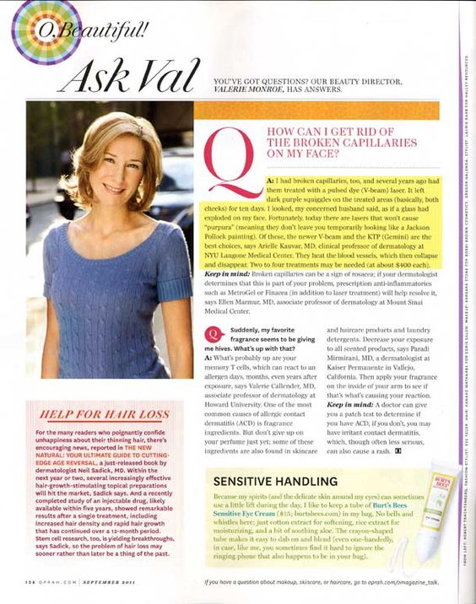
Where can you get advice?
Online
TV Show
Radio Show
Newspaper
Magazine

Slide 12
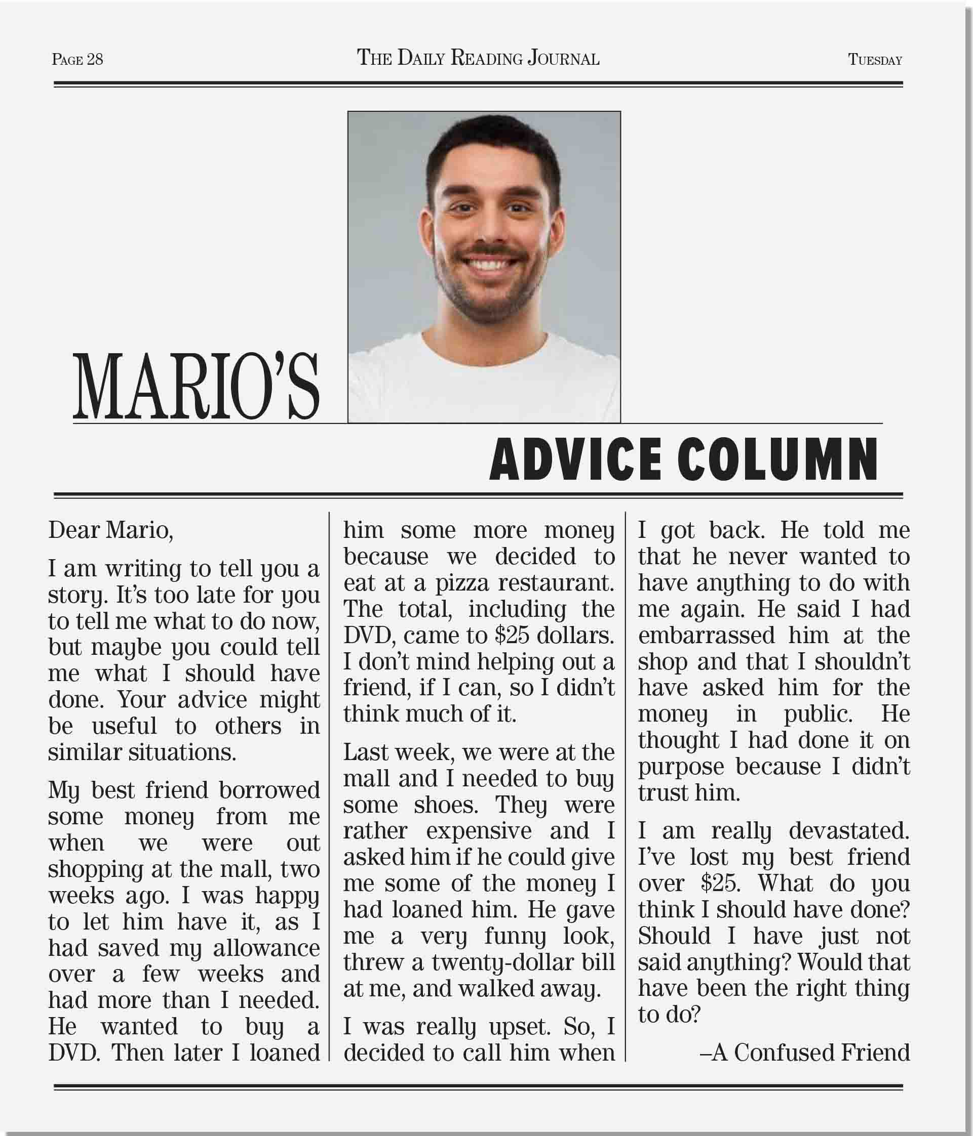
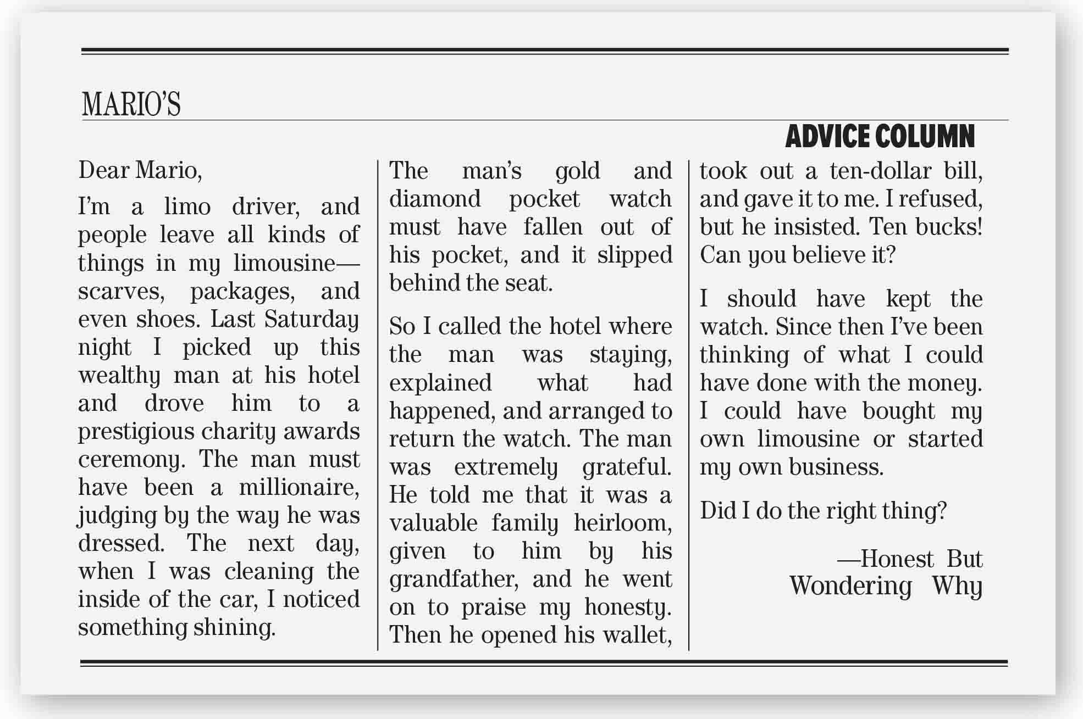
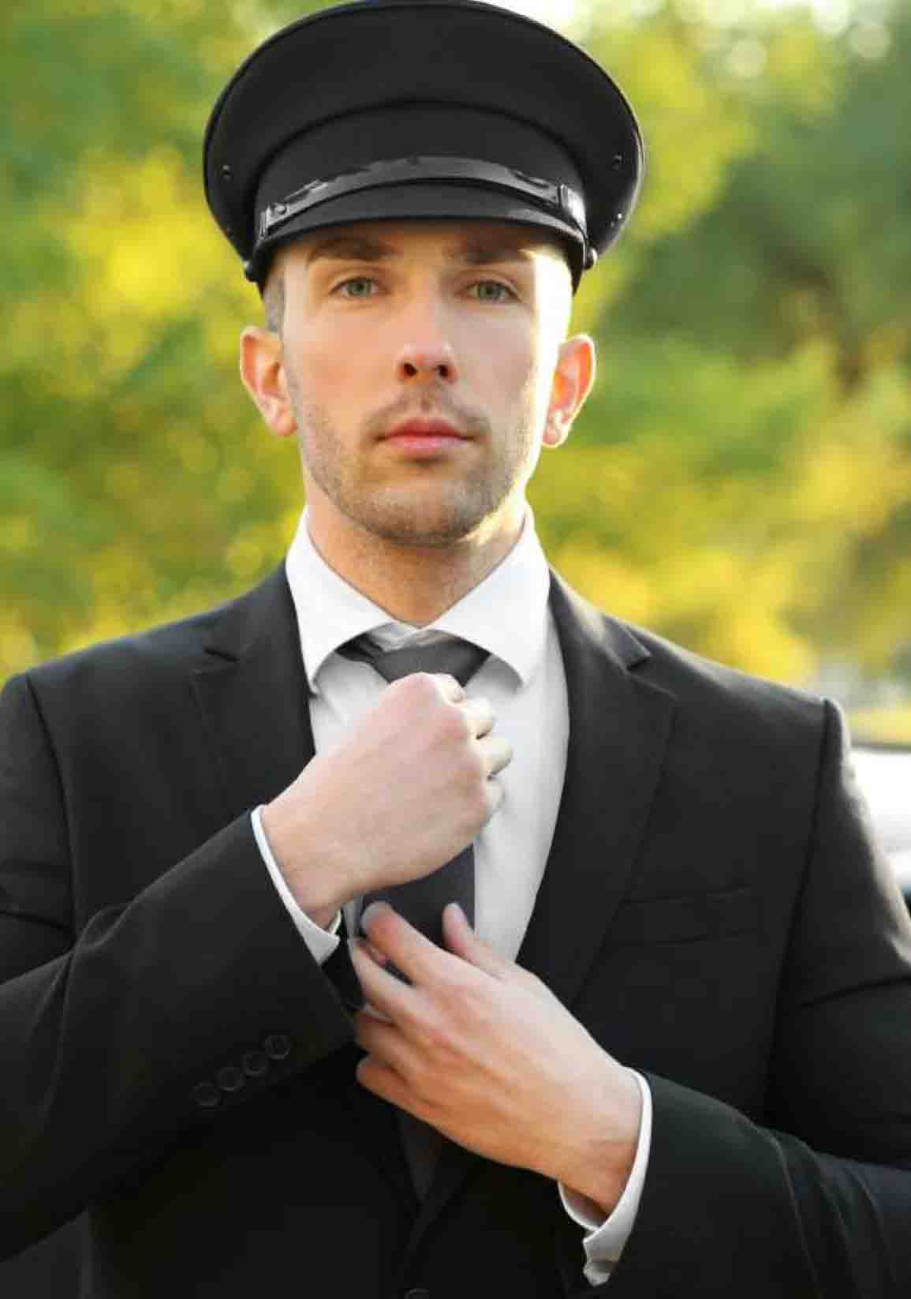
What’s the title?
Mario’s Advice Column
How many letters are there?
Two letters
How many pictures?
What do the pictures show?

Slide 13

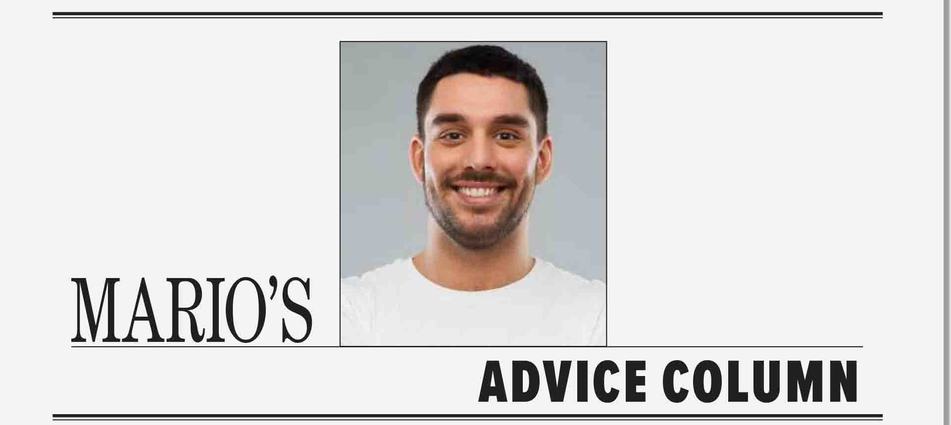

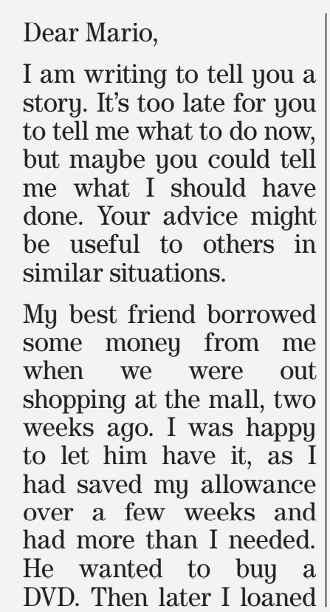
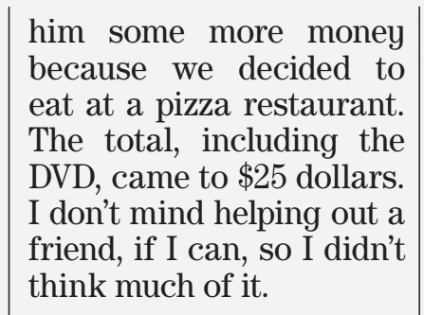
What’s the main idea of this letter?
A problem with a friend
Why did he write the letter?
He needs advice
What happened at the mall two weeks ago?
He lent his friend some money
What did his friend want to buy?
A sum of money paid regularly to a person

Slide 14
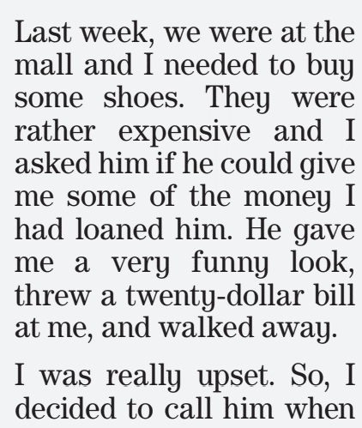
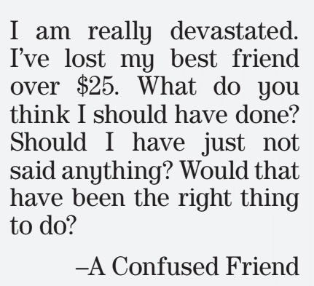
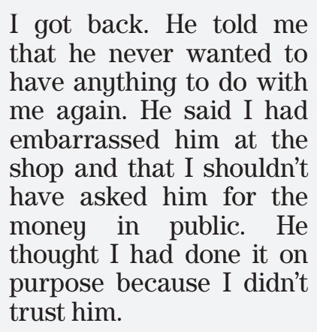
What happened at the mall last week?
What was his friend reaction?
Why was his friend angry?
He was embarrassed because he asked him in public
What does he wish hadn’t done?
What did his friend think?
showed displeasure
Not to have any social contact
Emotionally shattered

Slide 15
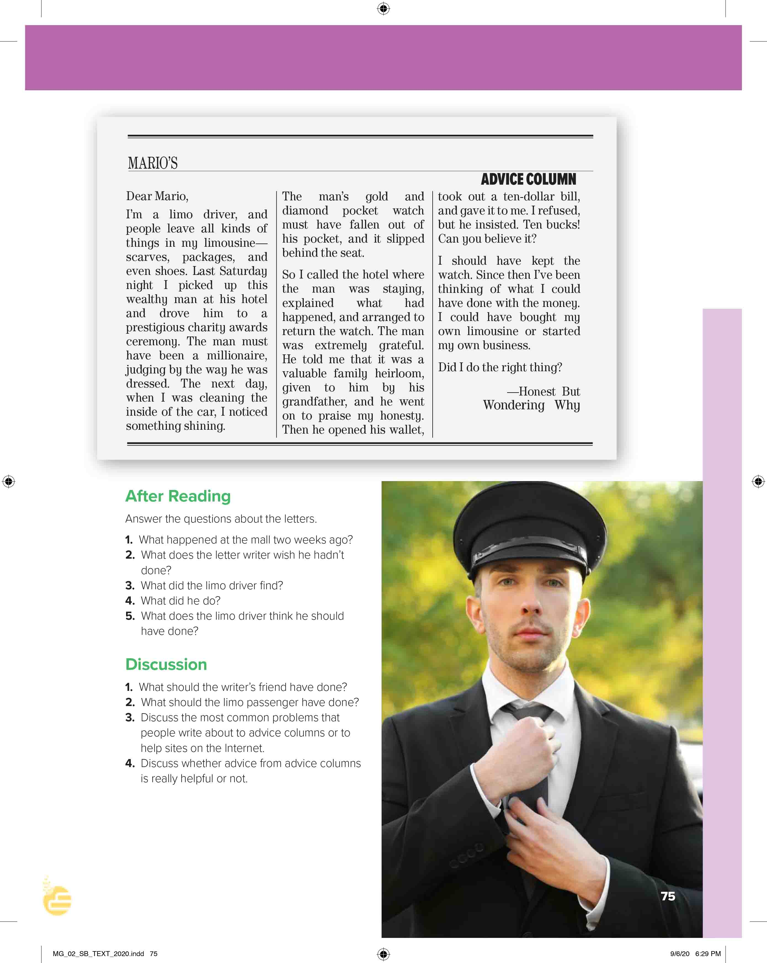
I love English
Open your Student’s book page: 75

Slide 16
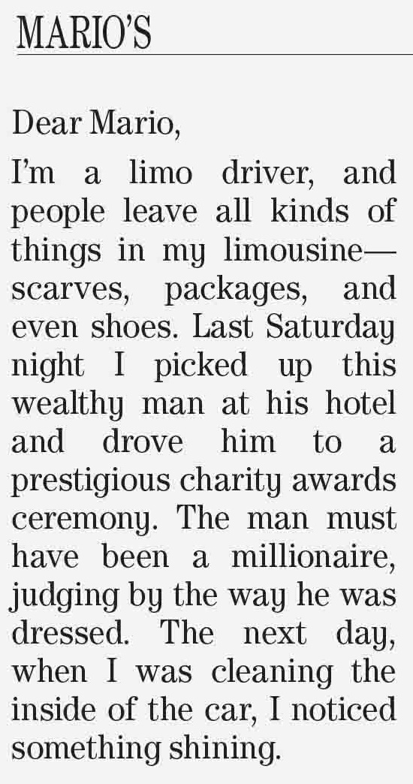
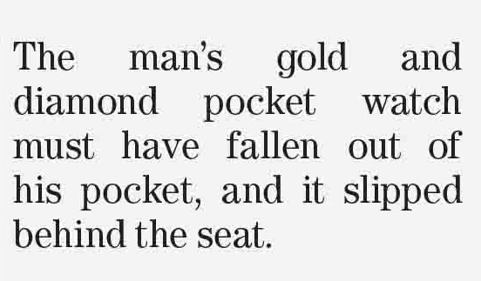
What’s the main idea of this latter?
A missing watch
Who wrote this letter?
What kind of things do people leave in his limousine?
What happened last Saturday night?
What did he find?

Slide 17
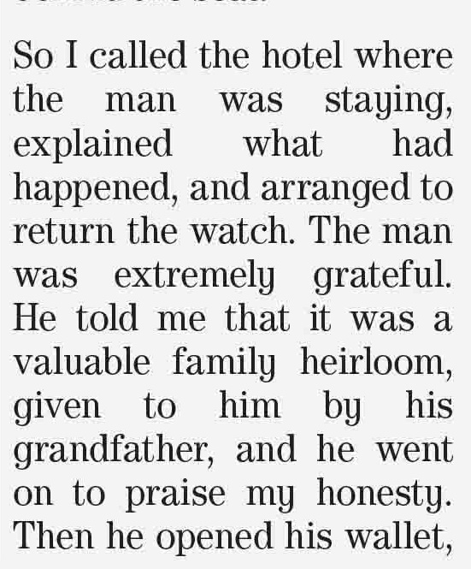
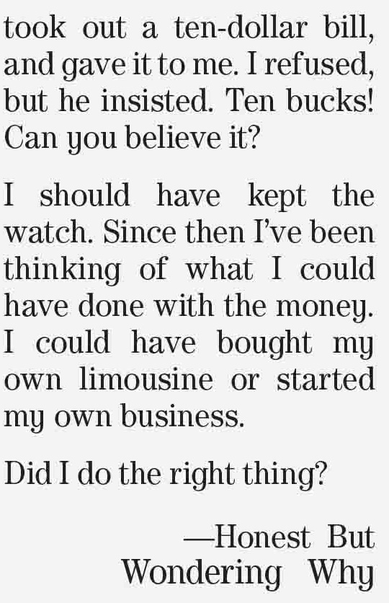
What did the limo driver do?
He returned the watch to the passenger
What did the man give him?
Why was he disappointed when the man gave him ten bucks?
He expected to get lots of money.
What does he think he should have done?
Grateful = Thankful
Praise = to say you admire

Slide 18
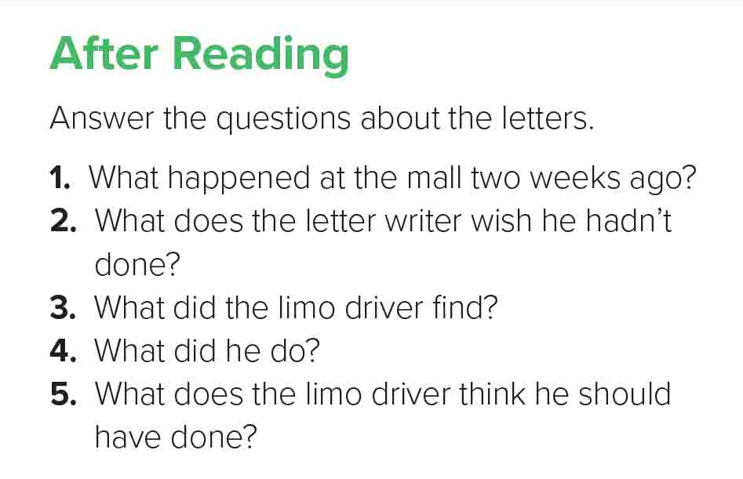

1- The letter writer lent some money to his friend.
2- The letter writer wishes that he hadn’t asked for the money in public.
3- The driver found a passenger’s diamond pocket watch.
4- The driver returned the watch to the passenger.
5- The driver thinks that he should have sold the watch and bought his own limo or started his own business.

Slide 19
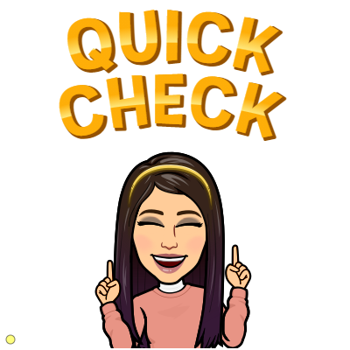

https://wordwall.net/resource/13346116

Slide 20


Slide 21


Must have
should have
must have
is used to make a conclusion.
should have and could have are used to express regret about possibilities in the past.

Slide 22

Good advice is often annoying, bad advice never is.

Slide 23


I love English

Slide 24



Homework
I love English

Slide 25


Homework

Slide 26
Homework

Slide 27
Homework

Slide 28
Homework

Slide 29
Homework

Slide 30

Homework

