Slide 1


Hello My lovely students
I’m your teacher
Hanan AlShobaily

Slide 2




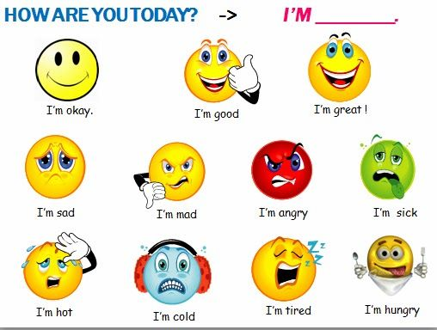
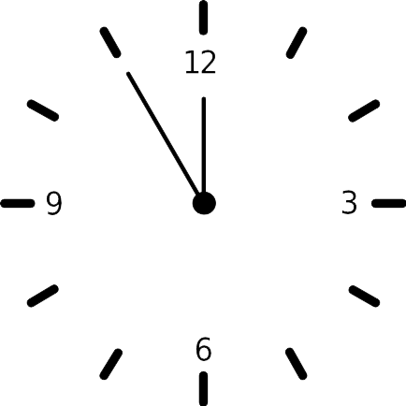



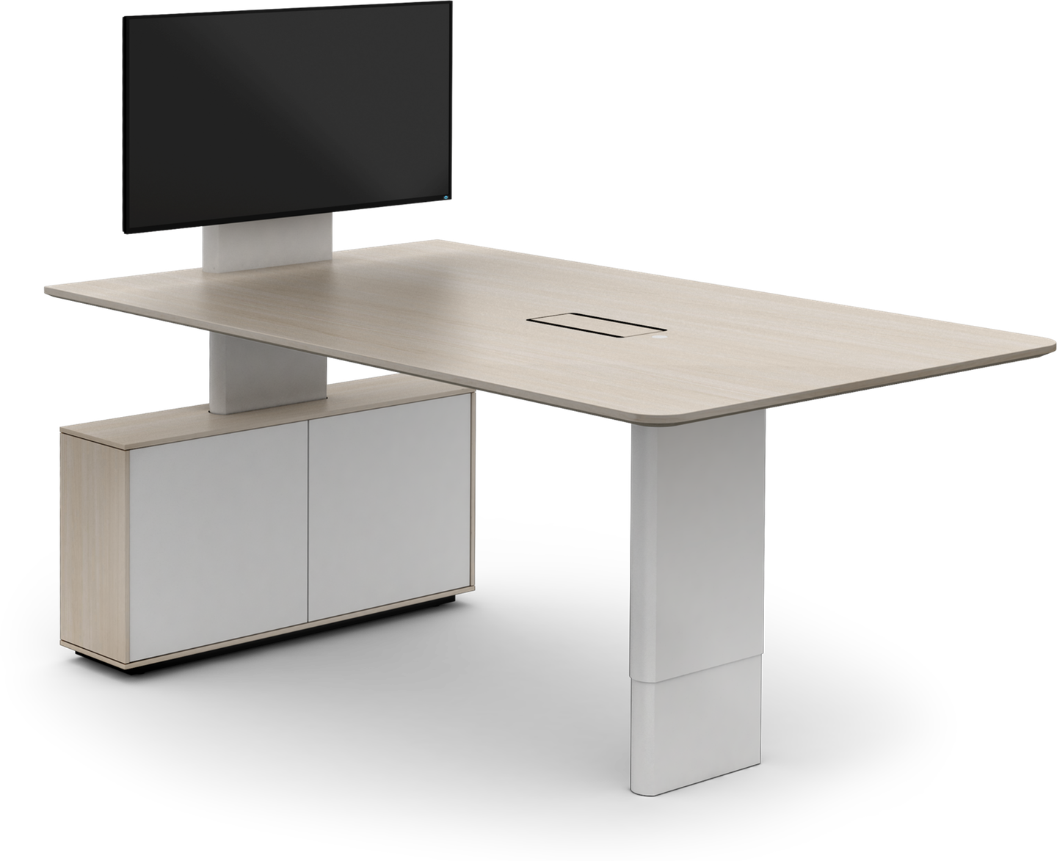
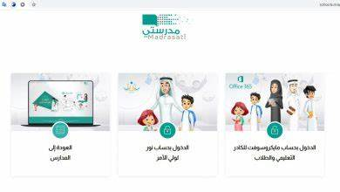







I love English

Slide 3
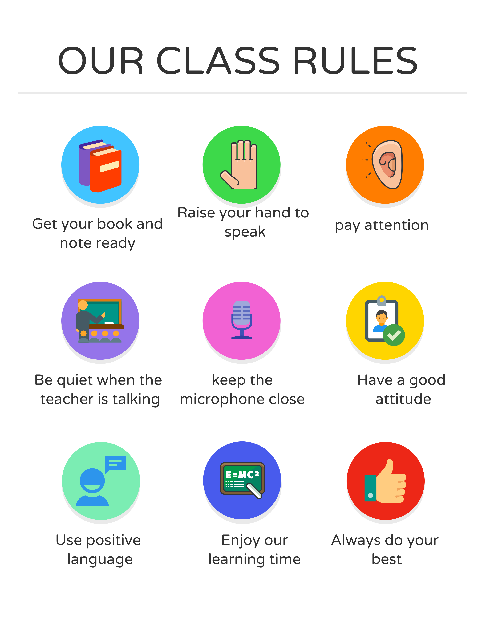

I love English

Slide 4
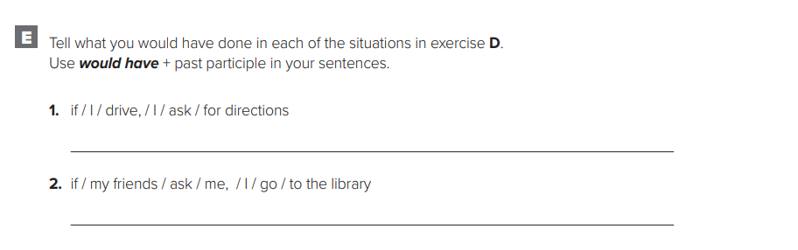

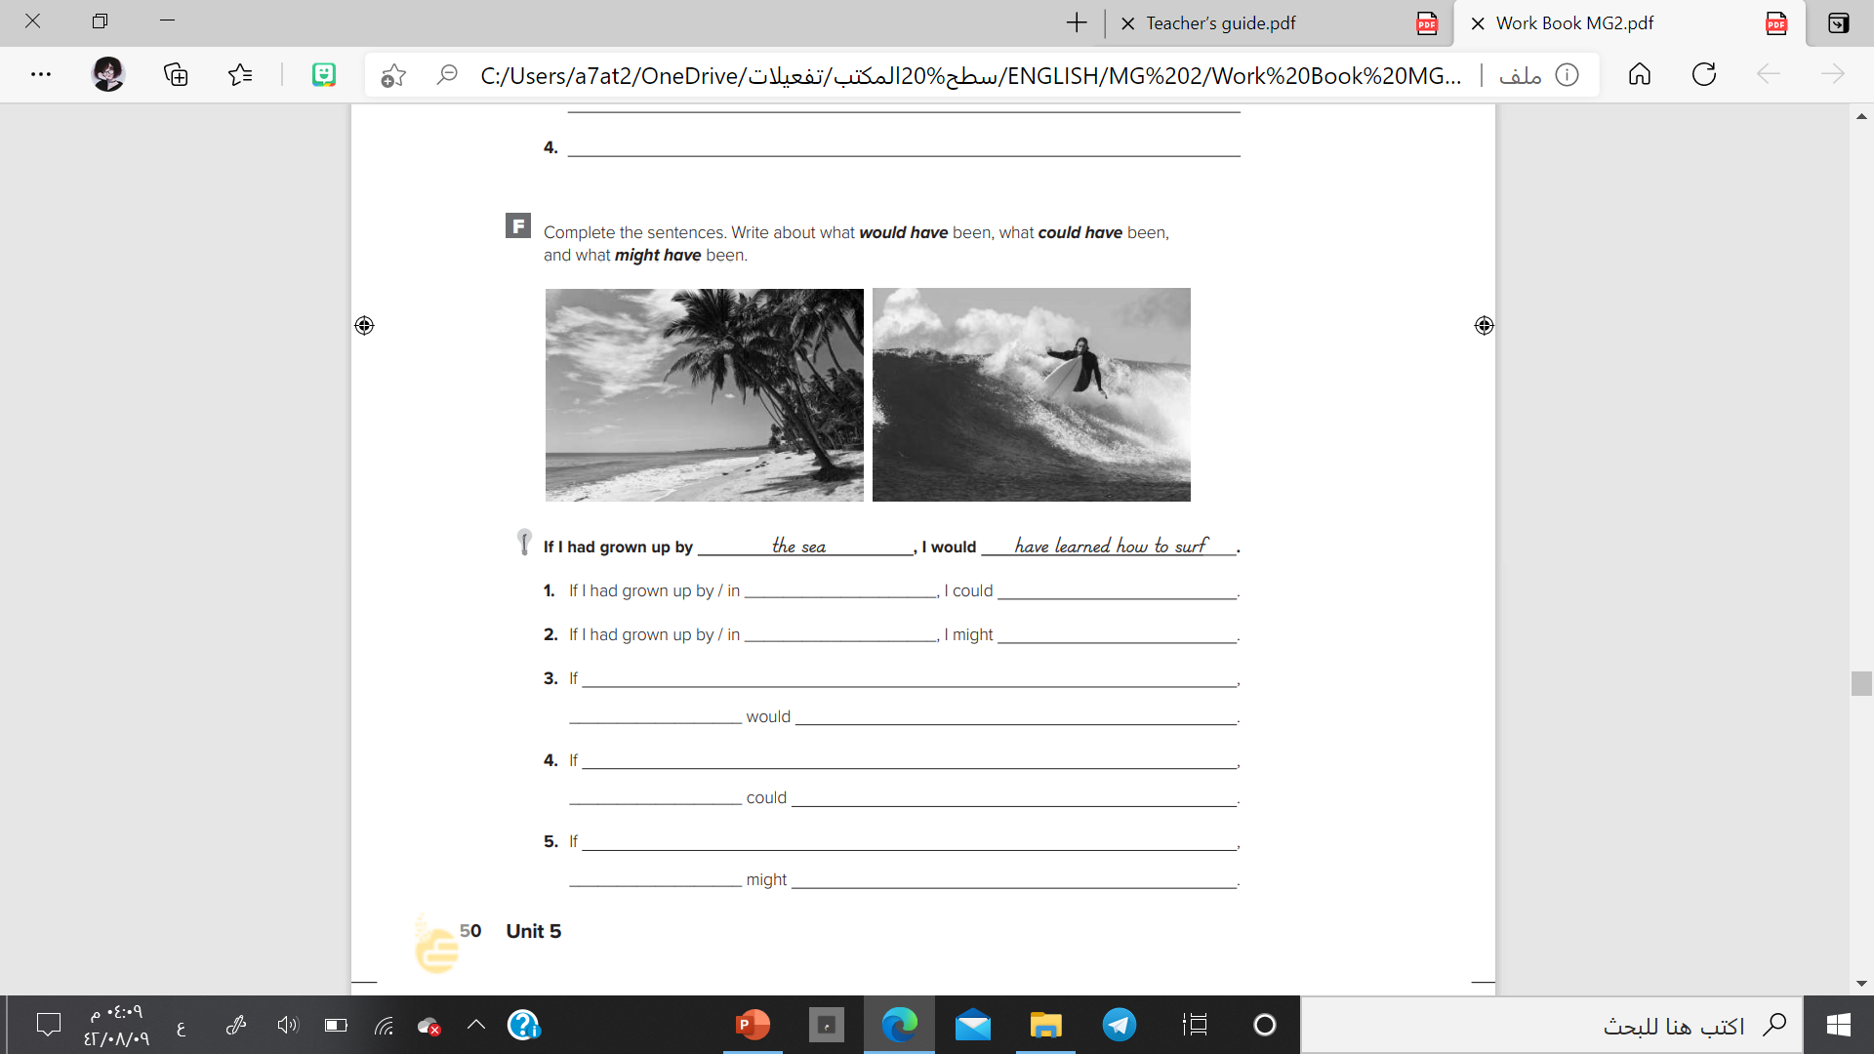
I love English
If I had driven, I would have asked for directions.
If my friends had asked me, I would have gone to the library.
Let’s do the homework before starting the lesson.
Mega Goal 2 .. WB (50)
Canada
have spoken English and French in school.
the United States
have liked to watch football.
I had listened to my father
I
have bought a new car instead of a used car.

Slide 5




Let’s revise the previous lesson
https://wordwall.net/resource/12871800

Slide 6




Mega Goal 2
Unit 5
(If It Hadn’t Happened)
Language in Context
Listening
Pronunciation
About You
Conversation
Tuesday
10/8/1442
I love English

Slide 7

I love English
Lesson Objectives
Students will be able to:
Dramatize a hypothetical situation.
Summarize a person's regret accordion to audio.
Practice reduction of “could have, should have and would have”.
Practice reading the conversation in pairs.
Answer specific questions based on conversation.
Use the “real talk” phrases in new sentences.

Slide 8
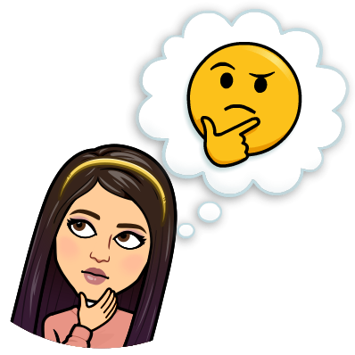
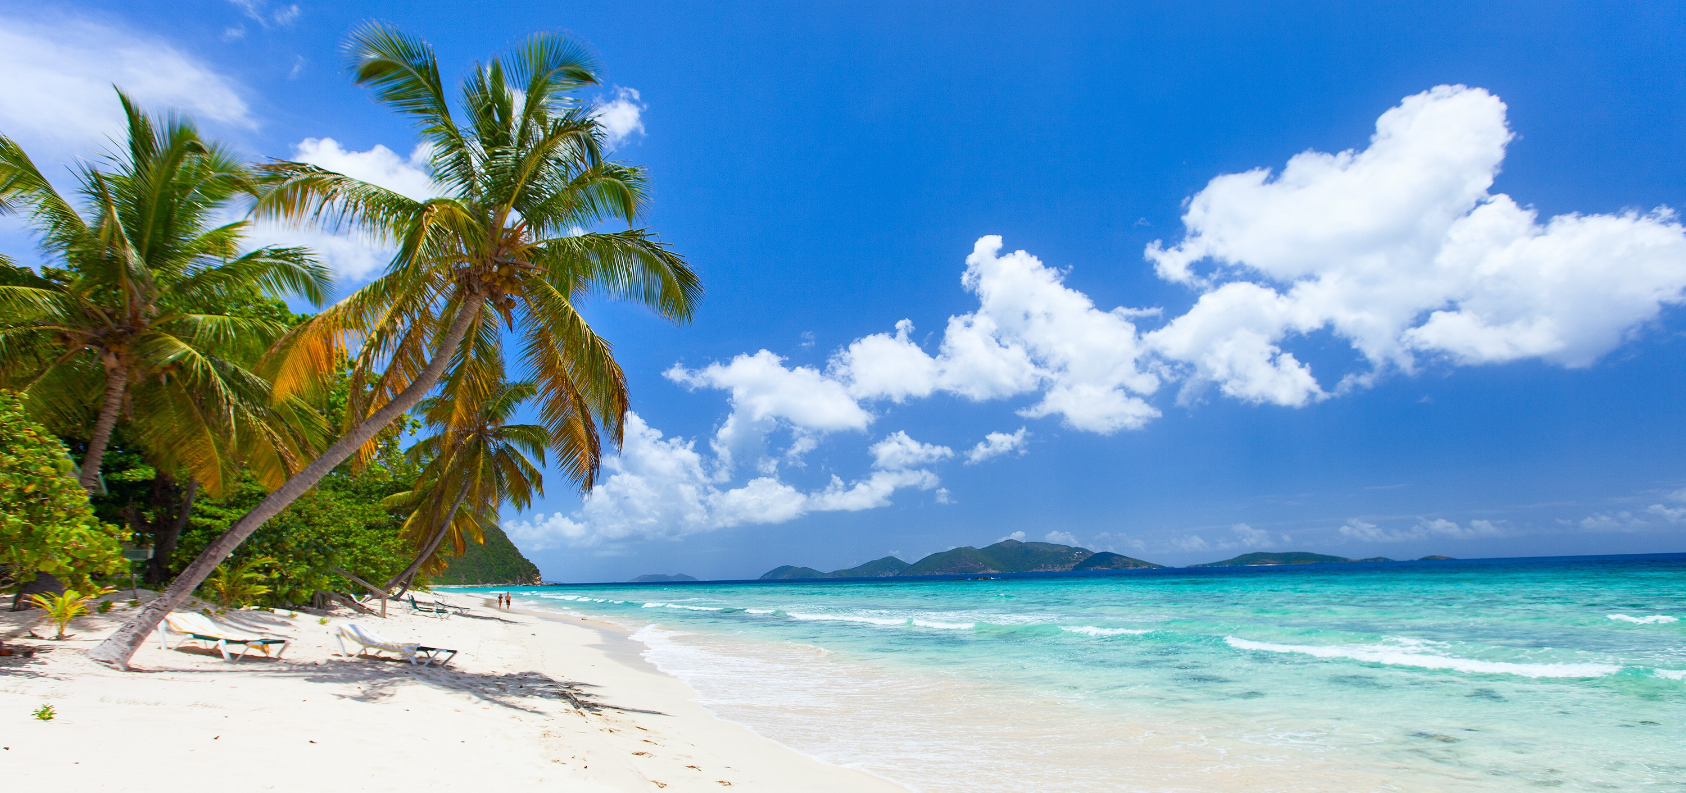

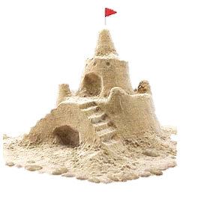
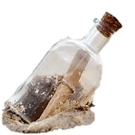

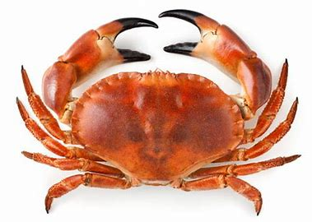
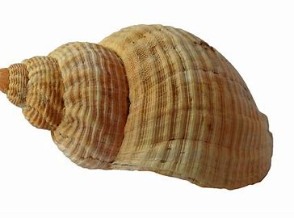
Warm Up
What do you see in the picture?
What are things you can find at the beach?
Have you ever found something strange on the beach?
Sand castle
Crab
Starfish
Shell

Slide 9
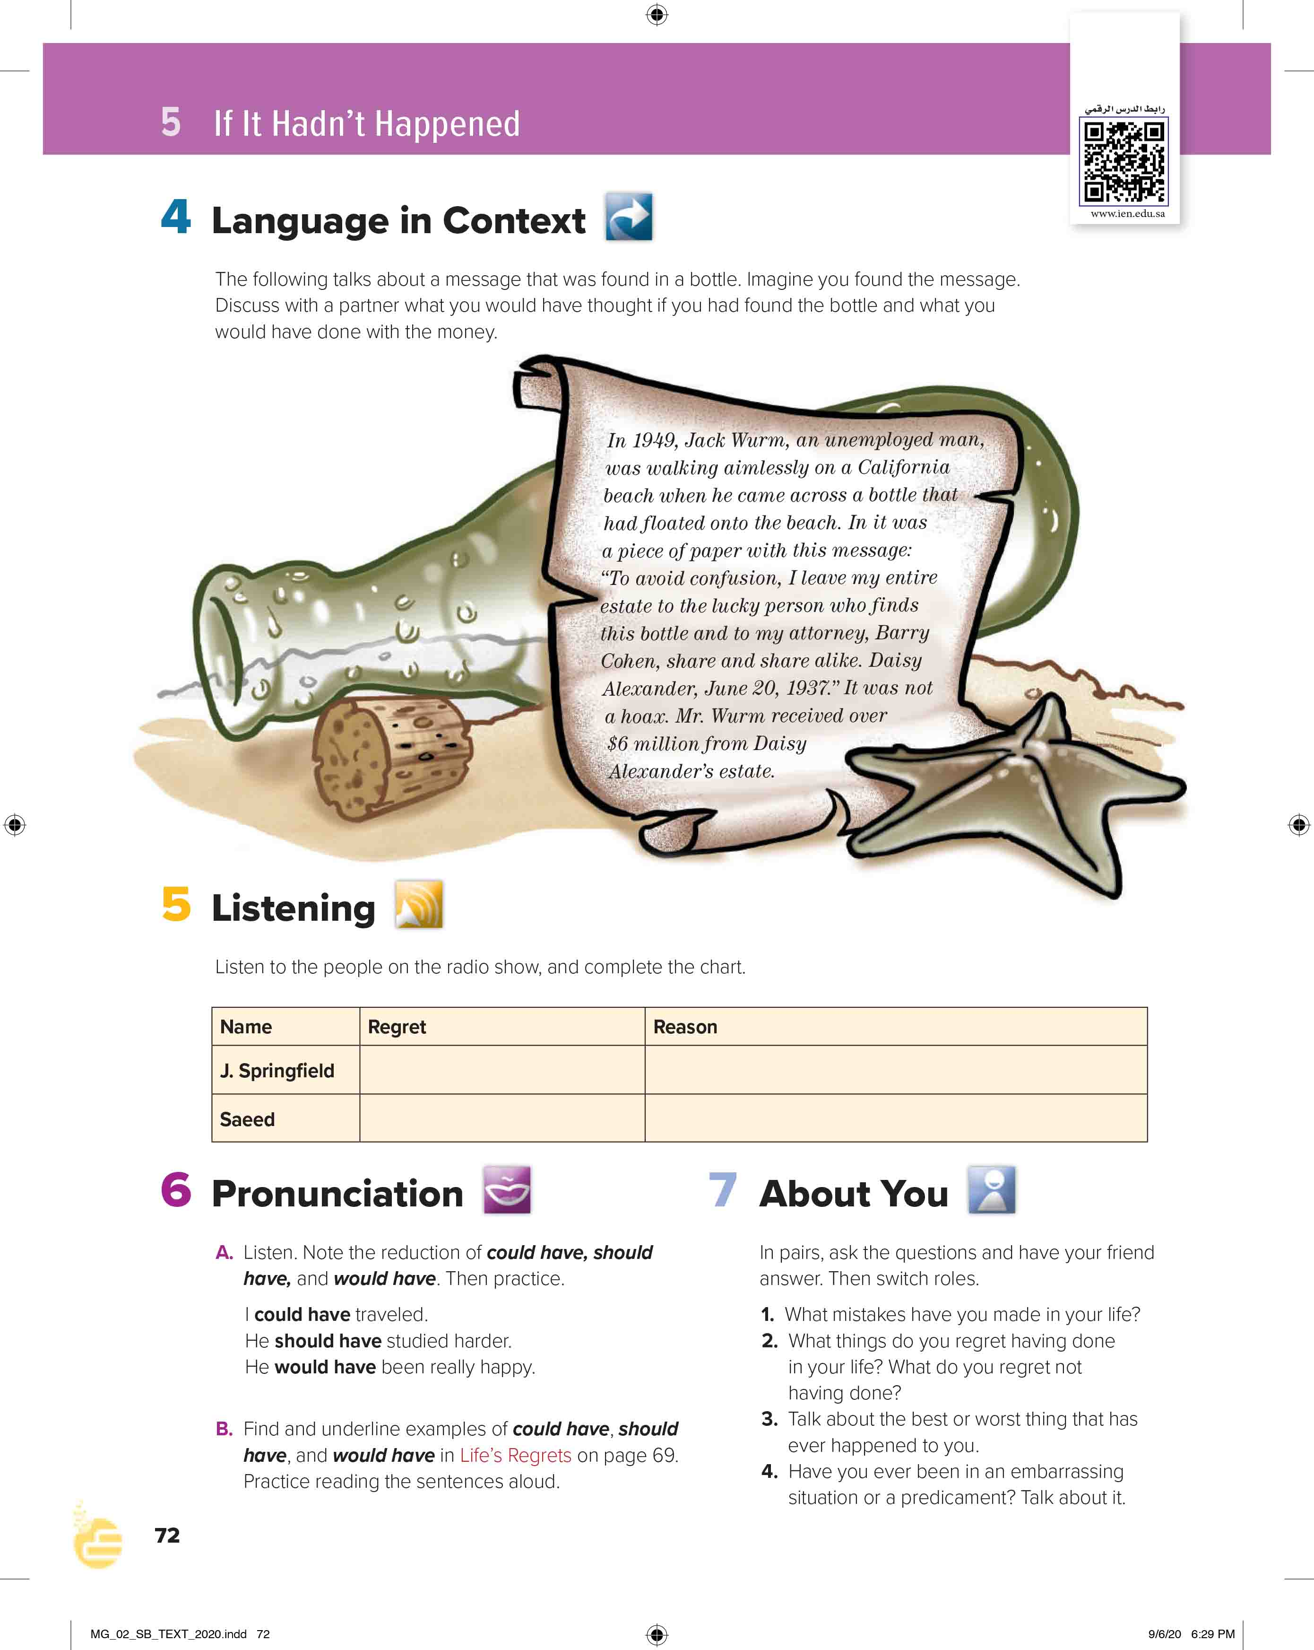

I love English
Open your Student’s book page: 72

Slide 10
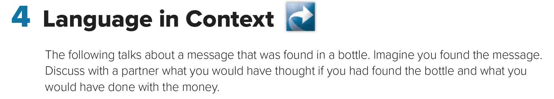

Slide 11
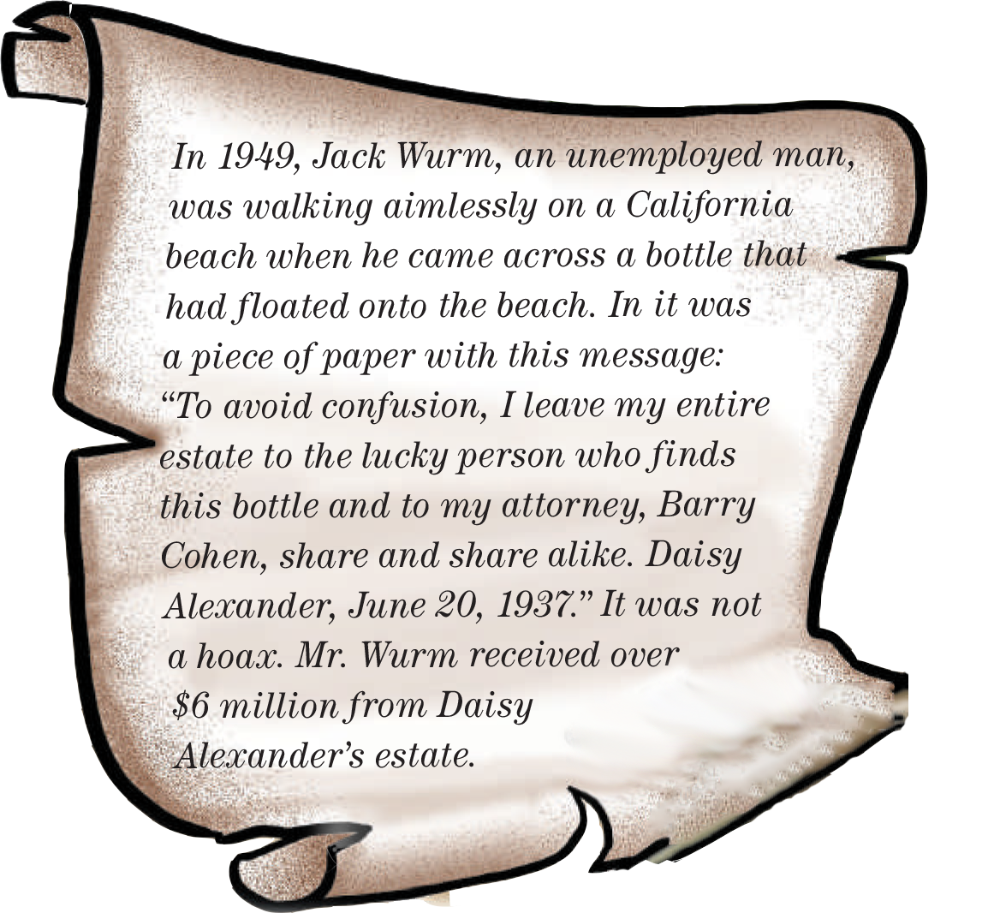
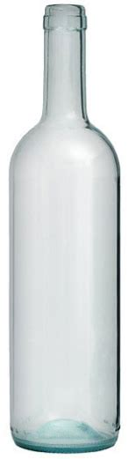
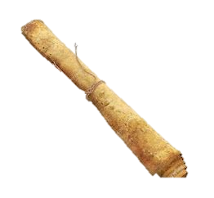
Who was walking on the beach?
When?
Where?
What was he doing?
What did he find?
What was inside the bottle?
What does the message say?
When Daisy write it?
How much money did Jack receive?

Slide 12
New Words and their Meaning
Without purpose
Being unclear
All the money and property
A lawyer
A joke

Slide 13

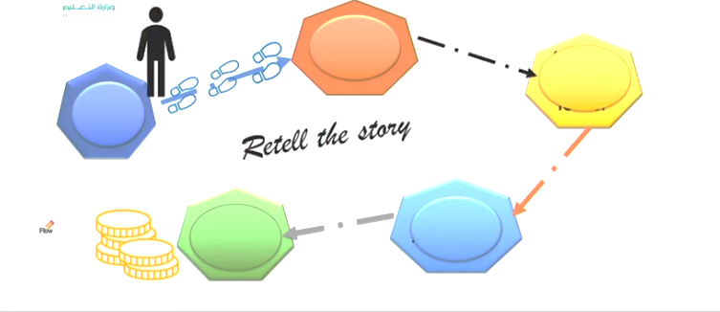

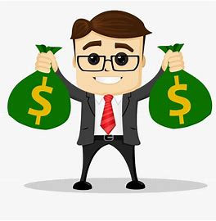
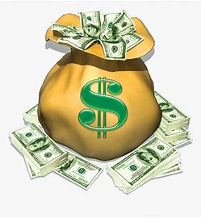
Retell the story
California beach
A bottle with a letter
Jack Wurm
Daisy Alexander
$6 Million

Slide 14




Now it’s your turn
Imagine you had found the bottle?
If you had found the bottle, what would you have done with the money?
If I had found the bottle, I would have bought a new house.
If I had found the bottle, I would have………………………..

Slide 15

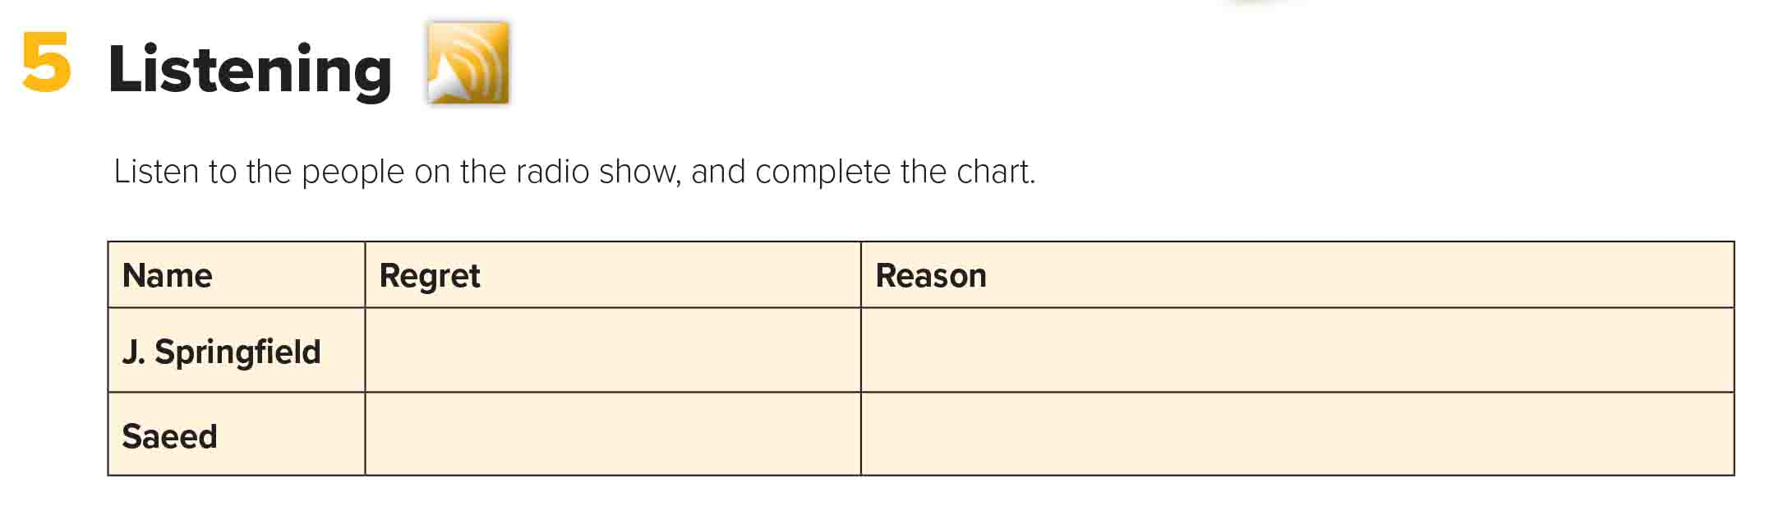
His boss was very demanding, so he resigned. Now he thinks he shouldn’t have.
He doesn’t know if he’ll be able to find another job.
He loves his job, but he got fired.
He got fired because he is irritable and abrupt when he is under pressure.

Slide 16
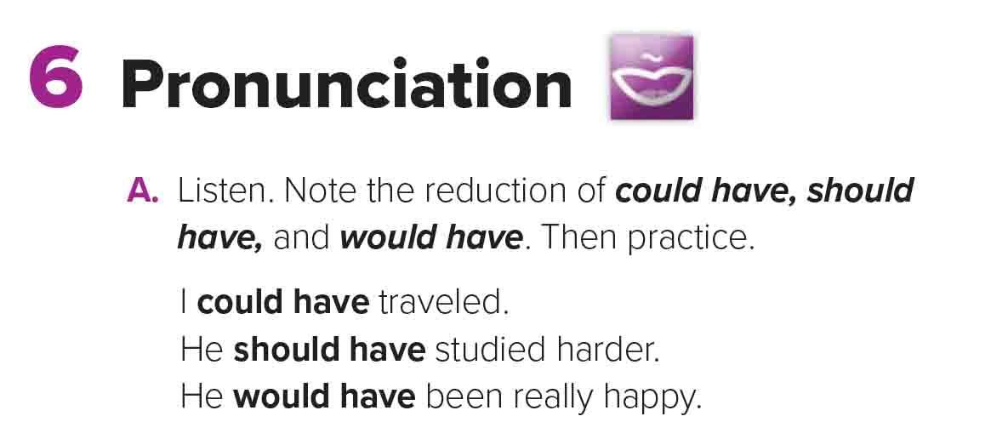
Could
have
Could’ve
Would
have
Would’ve
Should
have
Should’ve

Slide 17
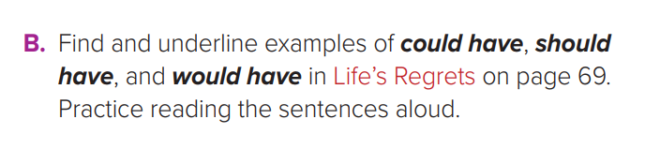
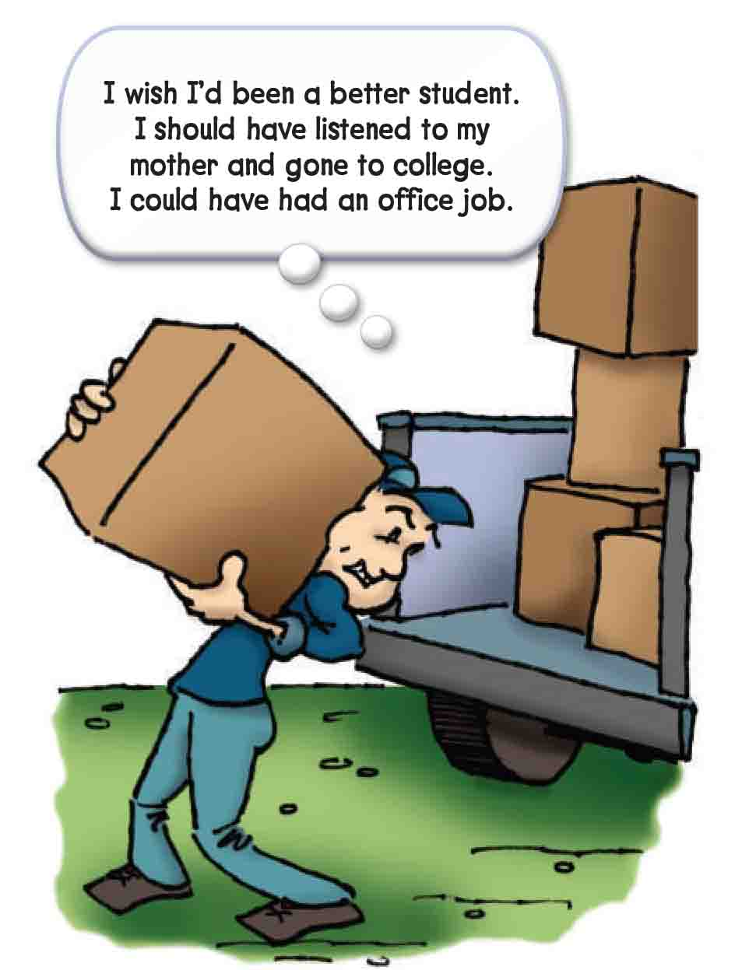
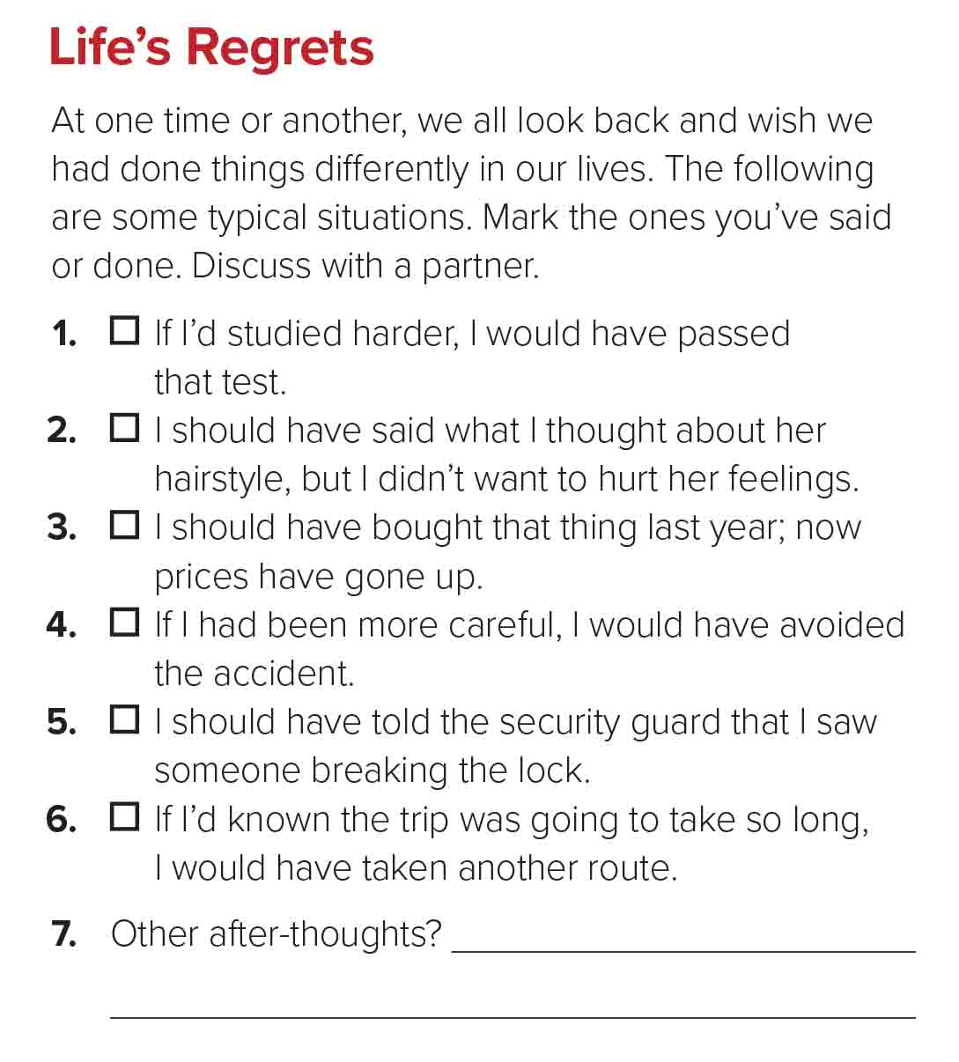

Slide 18
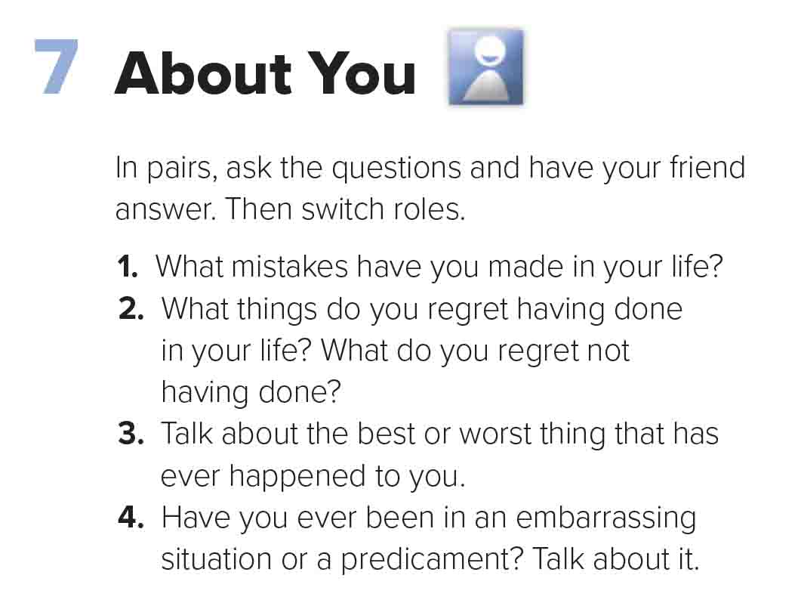


Slide 19

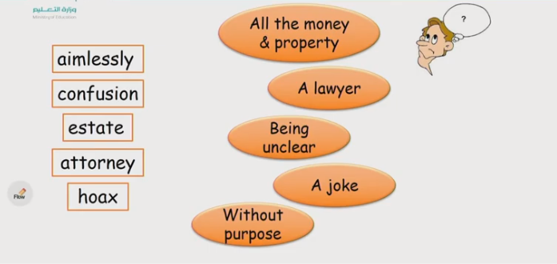
Revising the previous lesson
WEEK 1 - OCTOBER 2020
SUN 27
MON 28
TUE 29
WED 30
THU 01
FRI 02
SAT 03
Study
Study
Study
Study
Study
Exam
Review
Test
Exam
Exam
Test
Review

Slide 20
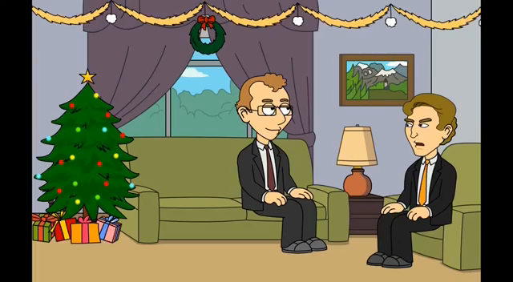
I love English
Watch the video then guess what are they talking about?

Slide 21
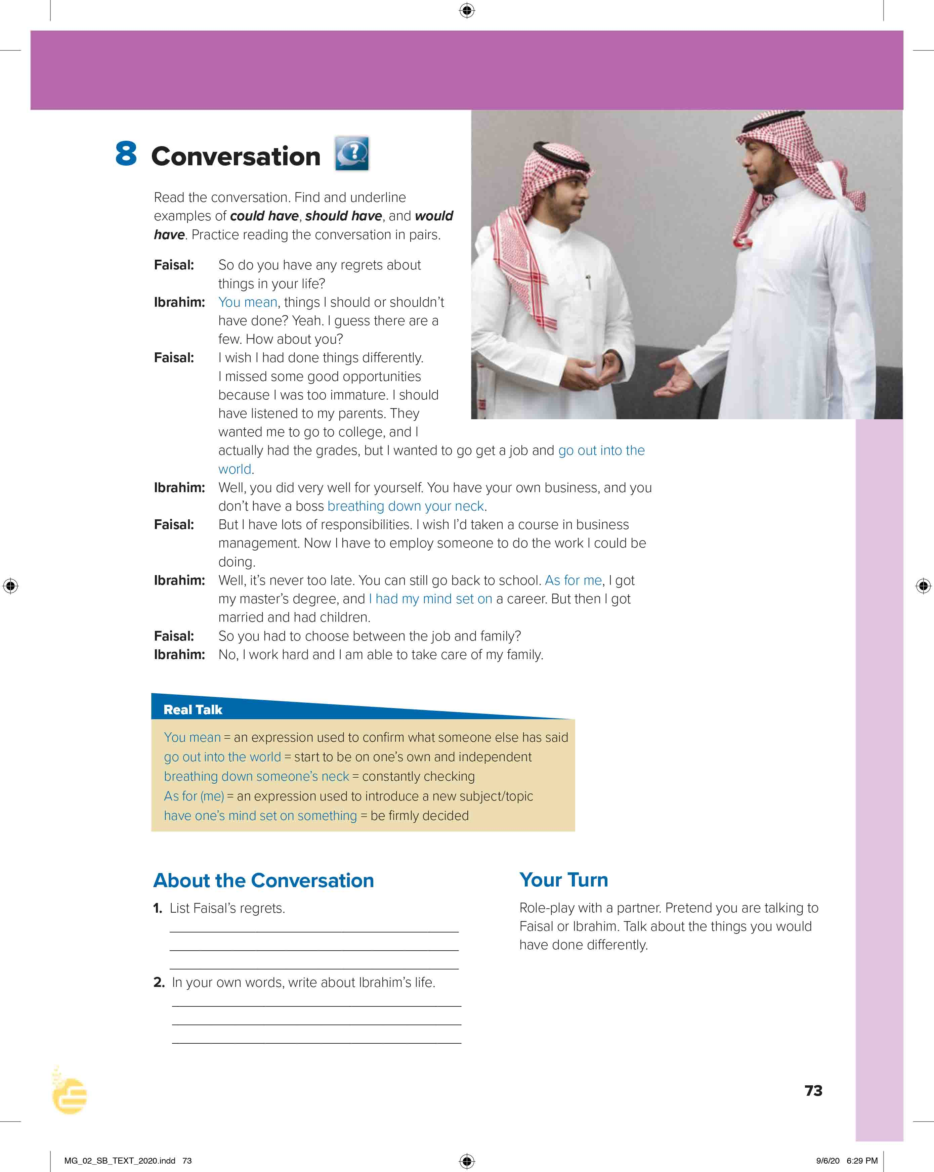
I love English
Open your Student’s book page: 73

Slide 22
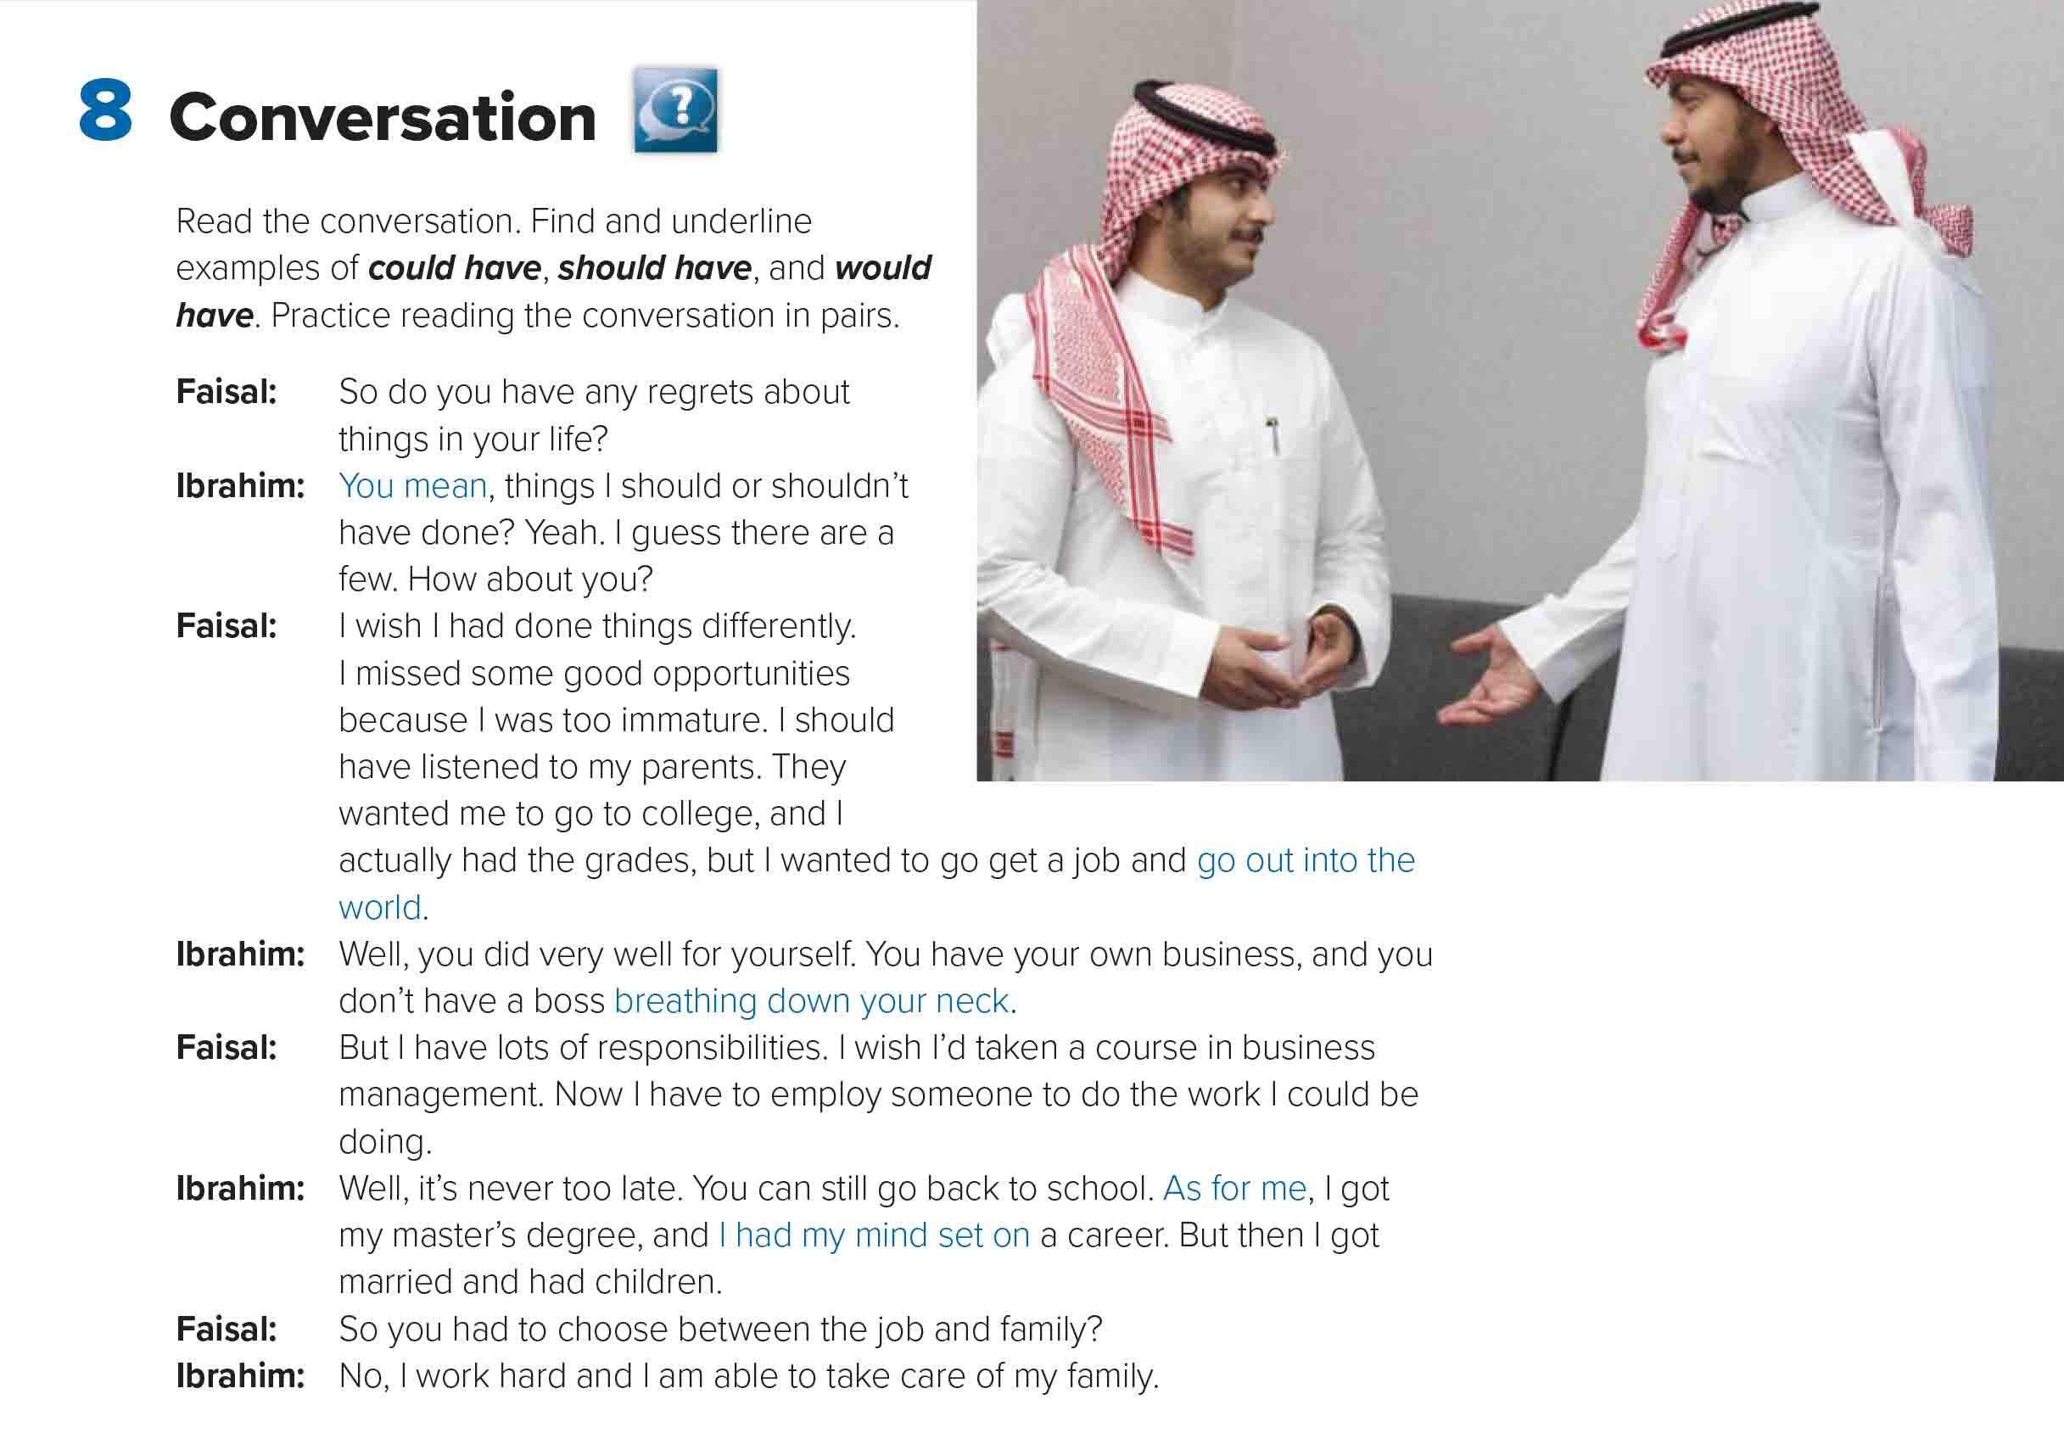
Between whom did the conversation take place?
Where are they?
What are they doing?
What kind of jobs do you think they have? Why?

Slide 23
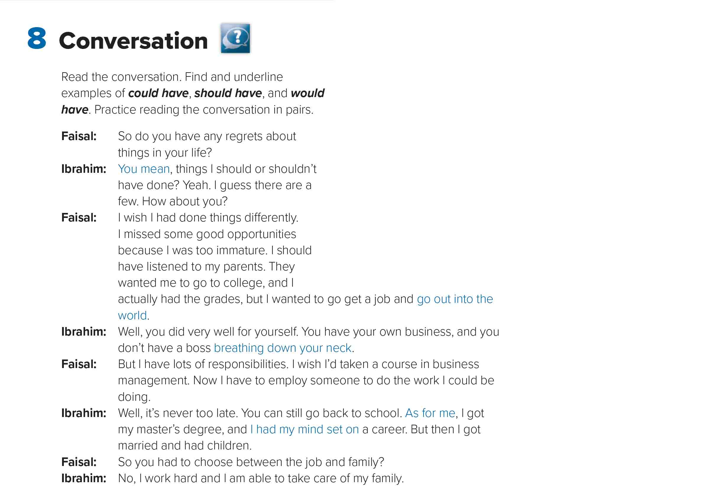
An expression used to confirm what someone else had said
What are they talking about?
Why did Faisal miss some good opportunities?
not behaving in a way appropriate for one’s age
Start to be on one’s own and independent
What did his parents want him to do and what did he do?
Who gave advice to the other?
Constantly checking
What did Faisal wish?
What kind of degree did Ibrahim get?
An expression used to introduce a new topic
Be firmly decided

Slide 24
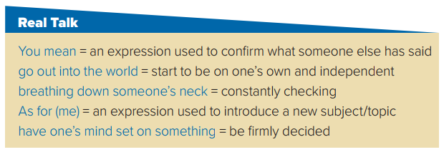
- What if I had said no? “ About the apartment, you mean?
- I want to finish my study in the university and go out into the world.
- How can I concentrate with you breathing down my neck all the time?
- As for (me), I studied technology in the future.
- I had my mind set on a career because I got a bachelor degree.

Slide 25

https://wordwall.net/resource/13099977

Slide 26
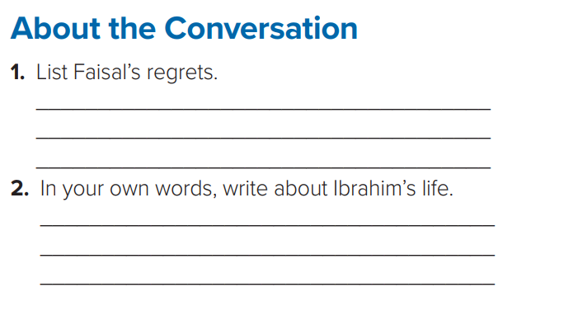

Faisal thinks that he should have listened to his parents
and gone to college. He thinks that he should have
taken courses in business management.
Ibrahim went to college and got a master’s degree.
Then he got married and had children.
Now he works hard and he is able to take care of his family.

Slide 27
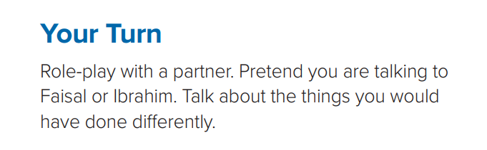

Slide 28
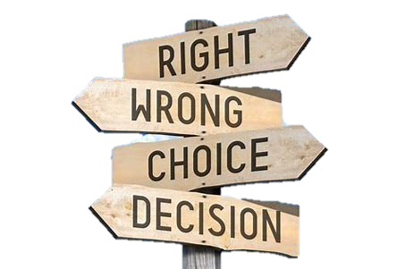



Life is a matter of choices, and every choice you make makes you.
But unsuccessful people make decisions based on their current situations, and successful people make decisions based on where they want to be.
Which one are you

Slide 29


I love English

Slide 30



Homework
I love English

Slide 31


Homework

Slide 32
Homework

Slide 33
Homework

Slide 34
Homework

Slide 35
Homework

Slide 36

Homework

