Slide 1
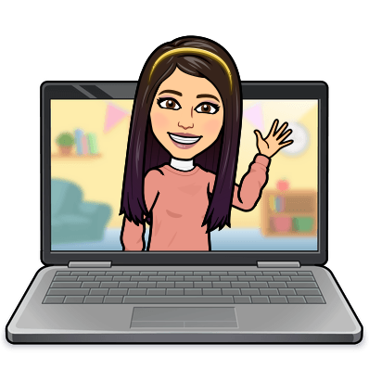

Hello My lovely students
I’m your teacher
Hanan AlShobaily

Slide 2

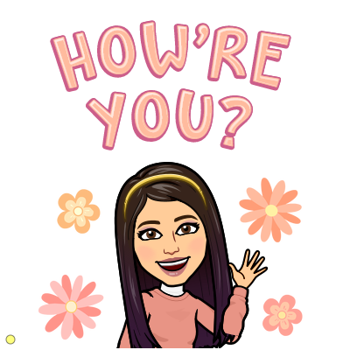


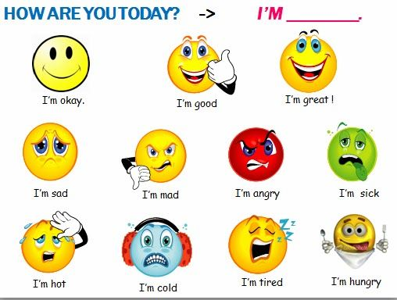
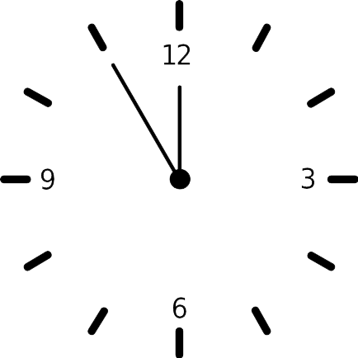


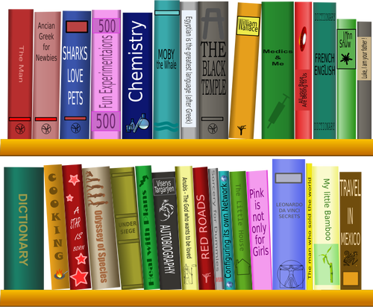
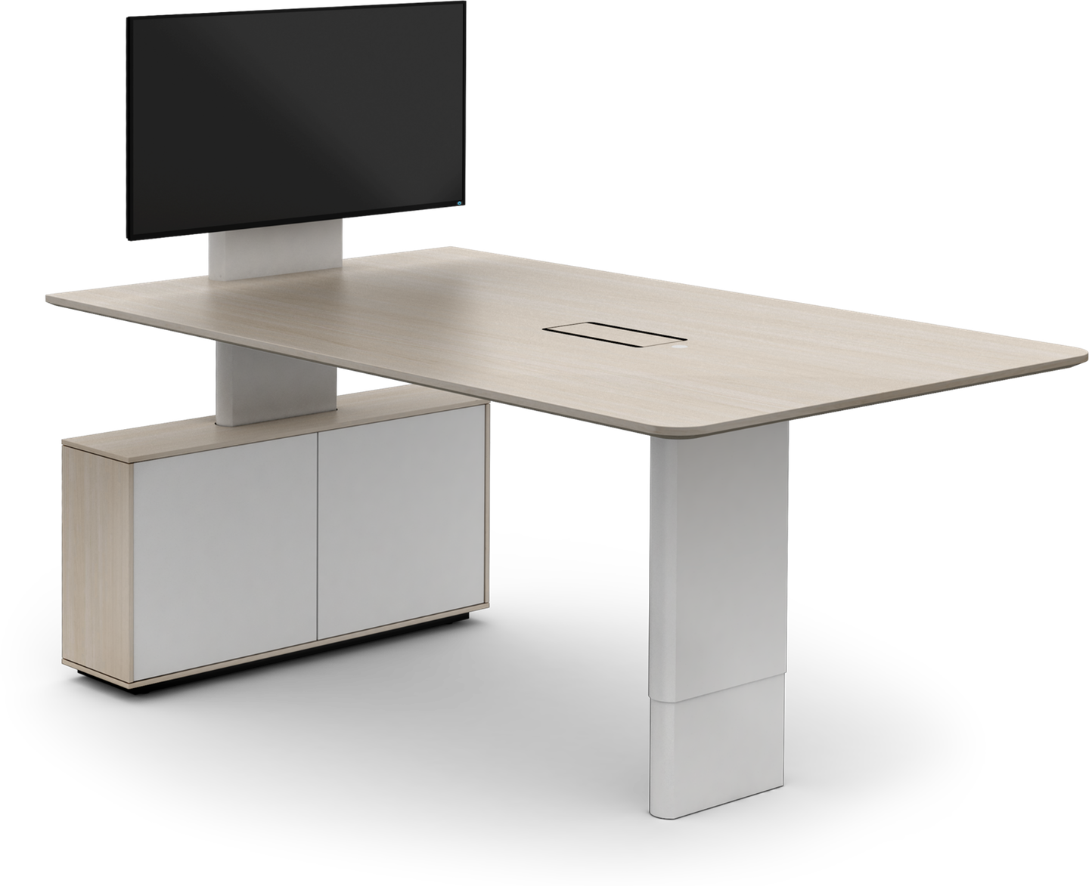
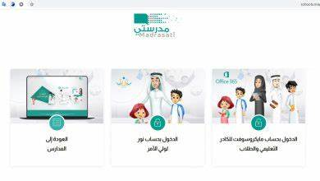







I love English

Slide 3
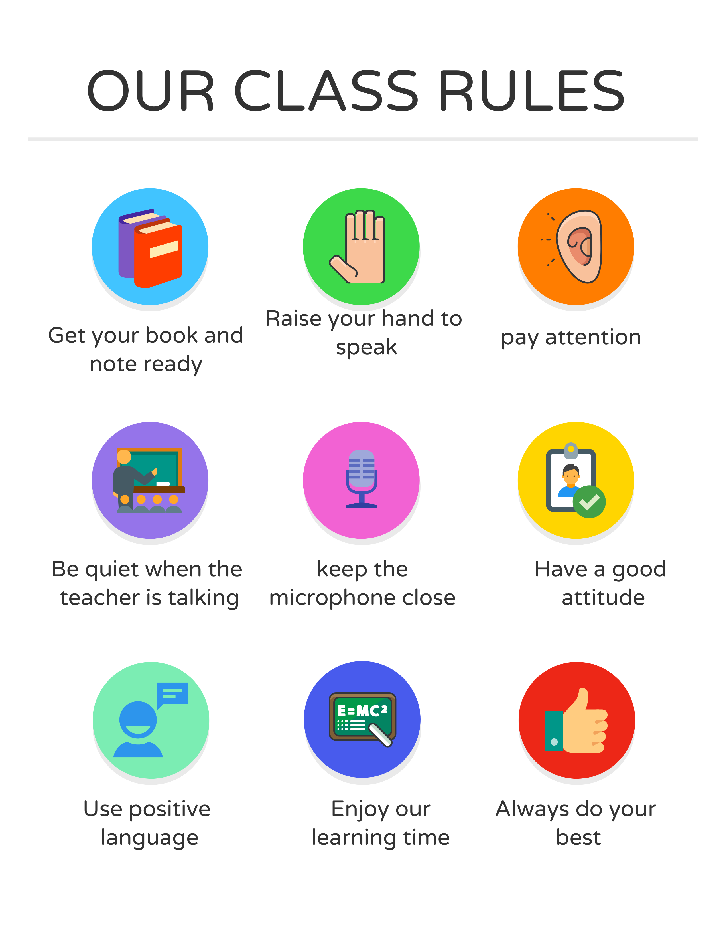
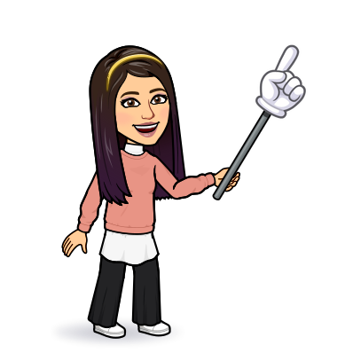
I love English

Slide 4
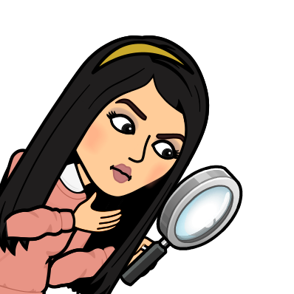

I love English
Revising the previous lesson
https://wordwall.net/resource/13774203

Slide 5

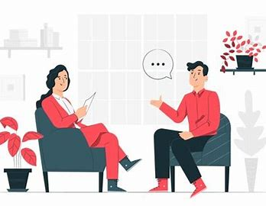
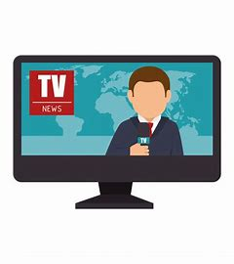

I love English
Mega Goal 2
Unit 6
(What They Said)
Reading
Tuesday
24/8/1442

Slide 6

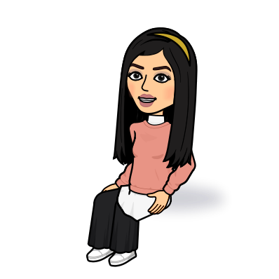
I love English
Lesson Objectives
Students will be able to:
Identify humor and irony in the quotes.
Find the meaning of new words.
Identify words that sound plural, but actually are singular.
Report quotes correctly.

Slide 7
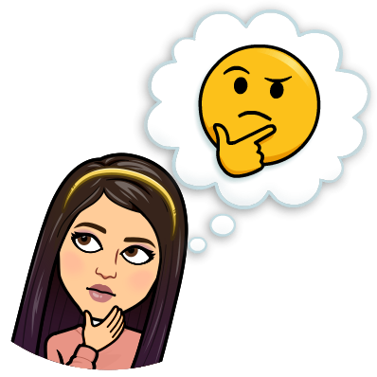
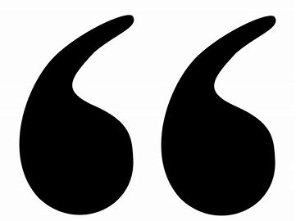

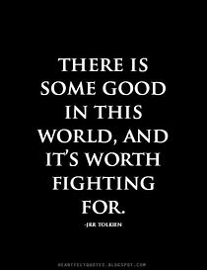
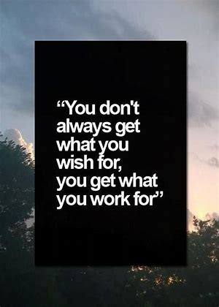
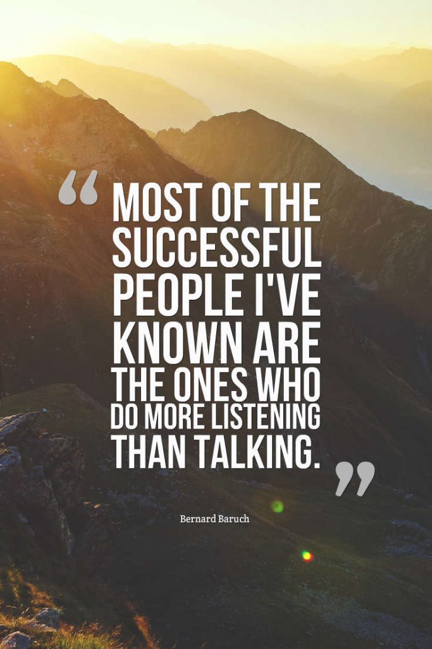
Warm Up
What’s this?
Quotes
What does “quote” mean?
The quote, words full of wisdom that someone important said and can make the reader get inspired

Slide 8
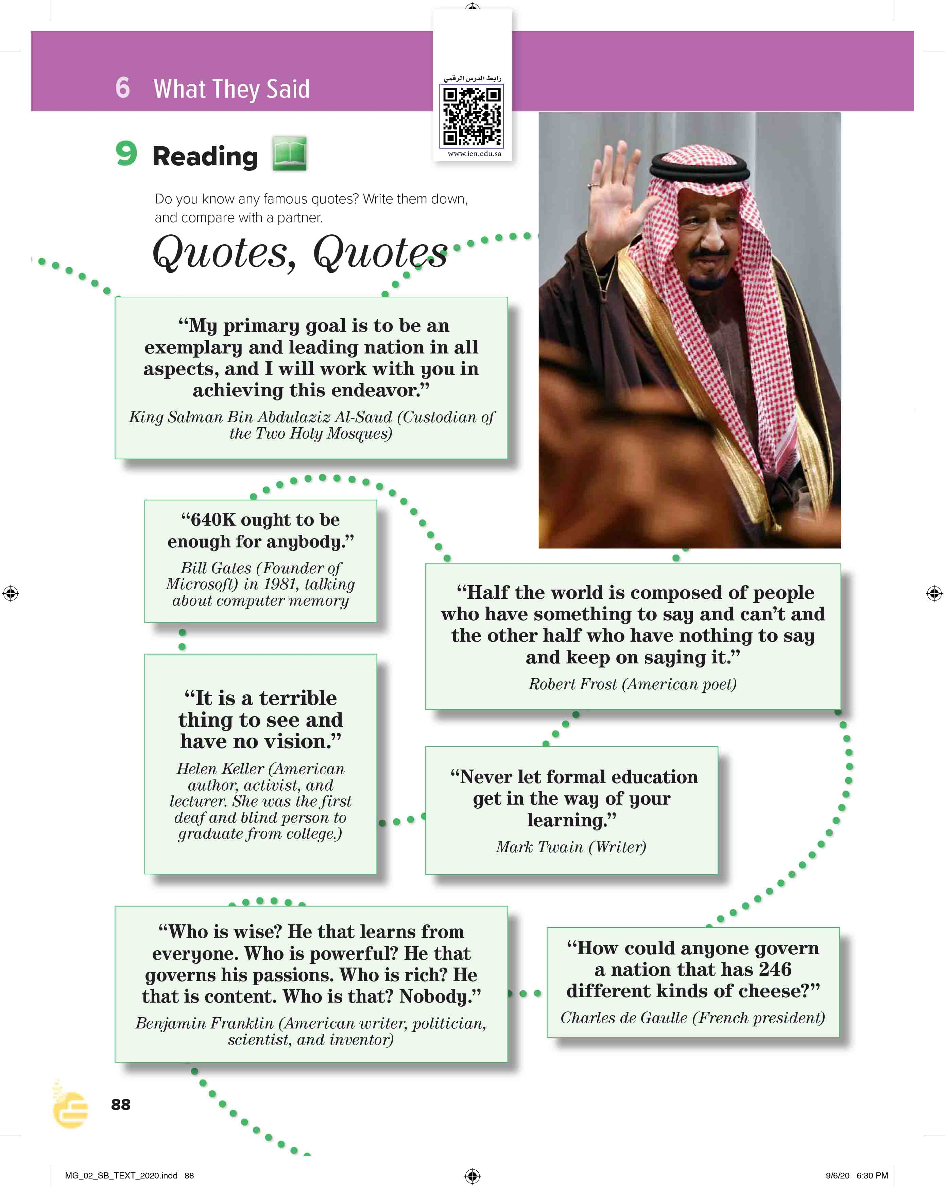
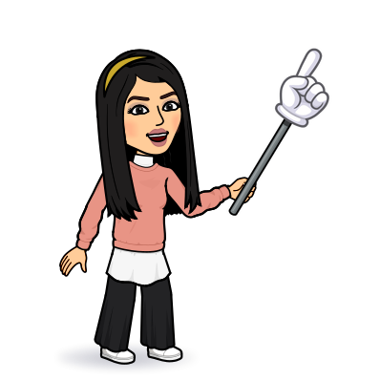
I love English
Open your Student’s book page: 88

Slide 9



Slide 10
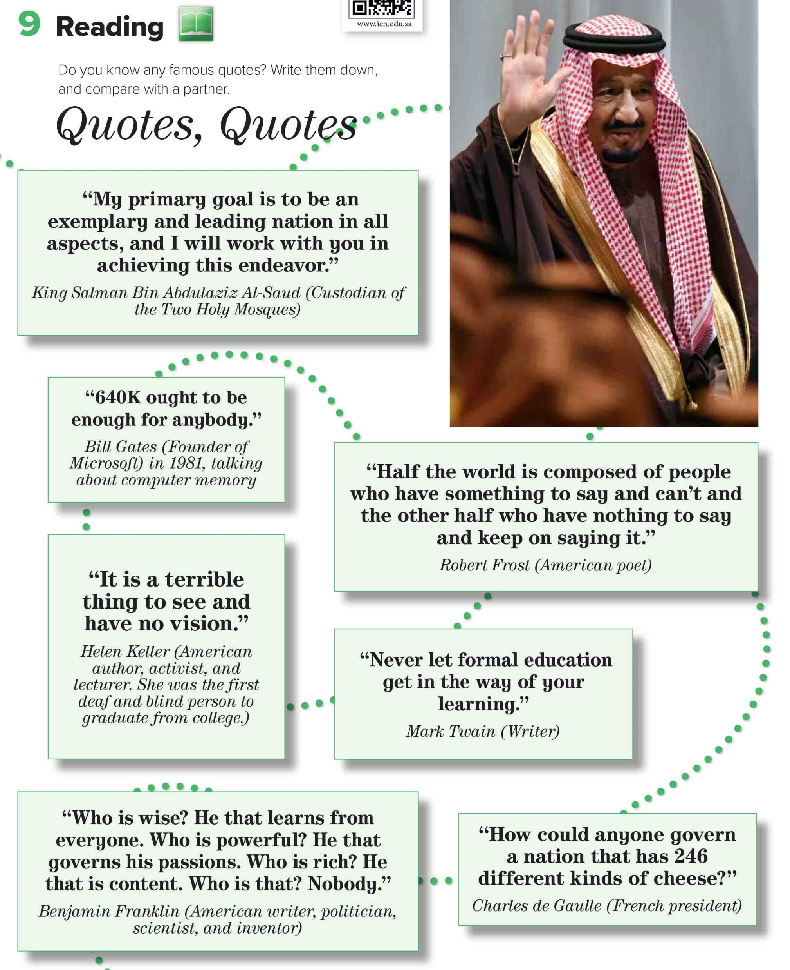
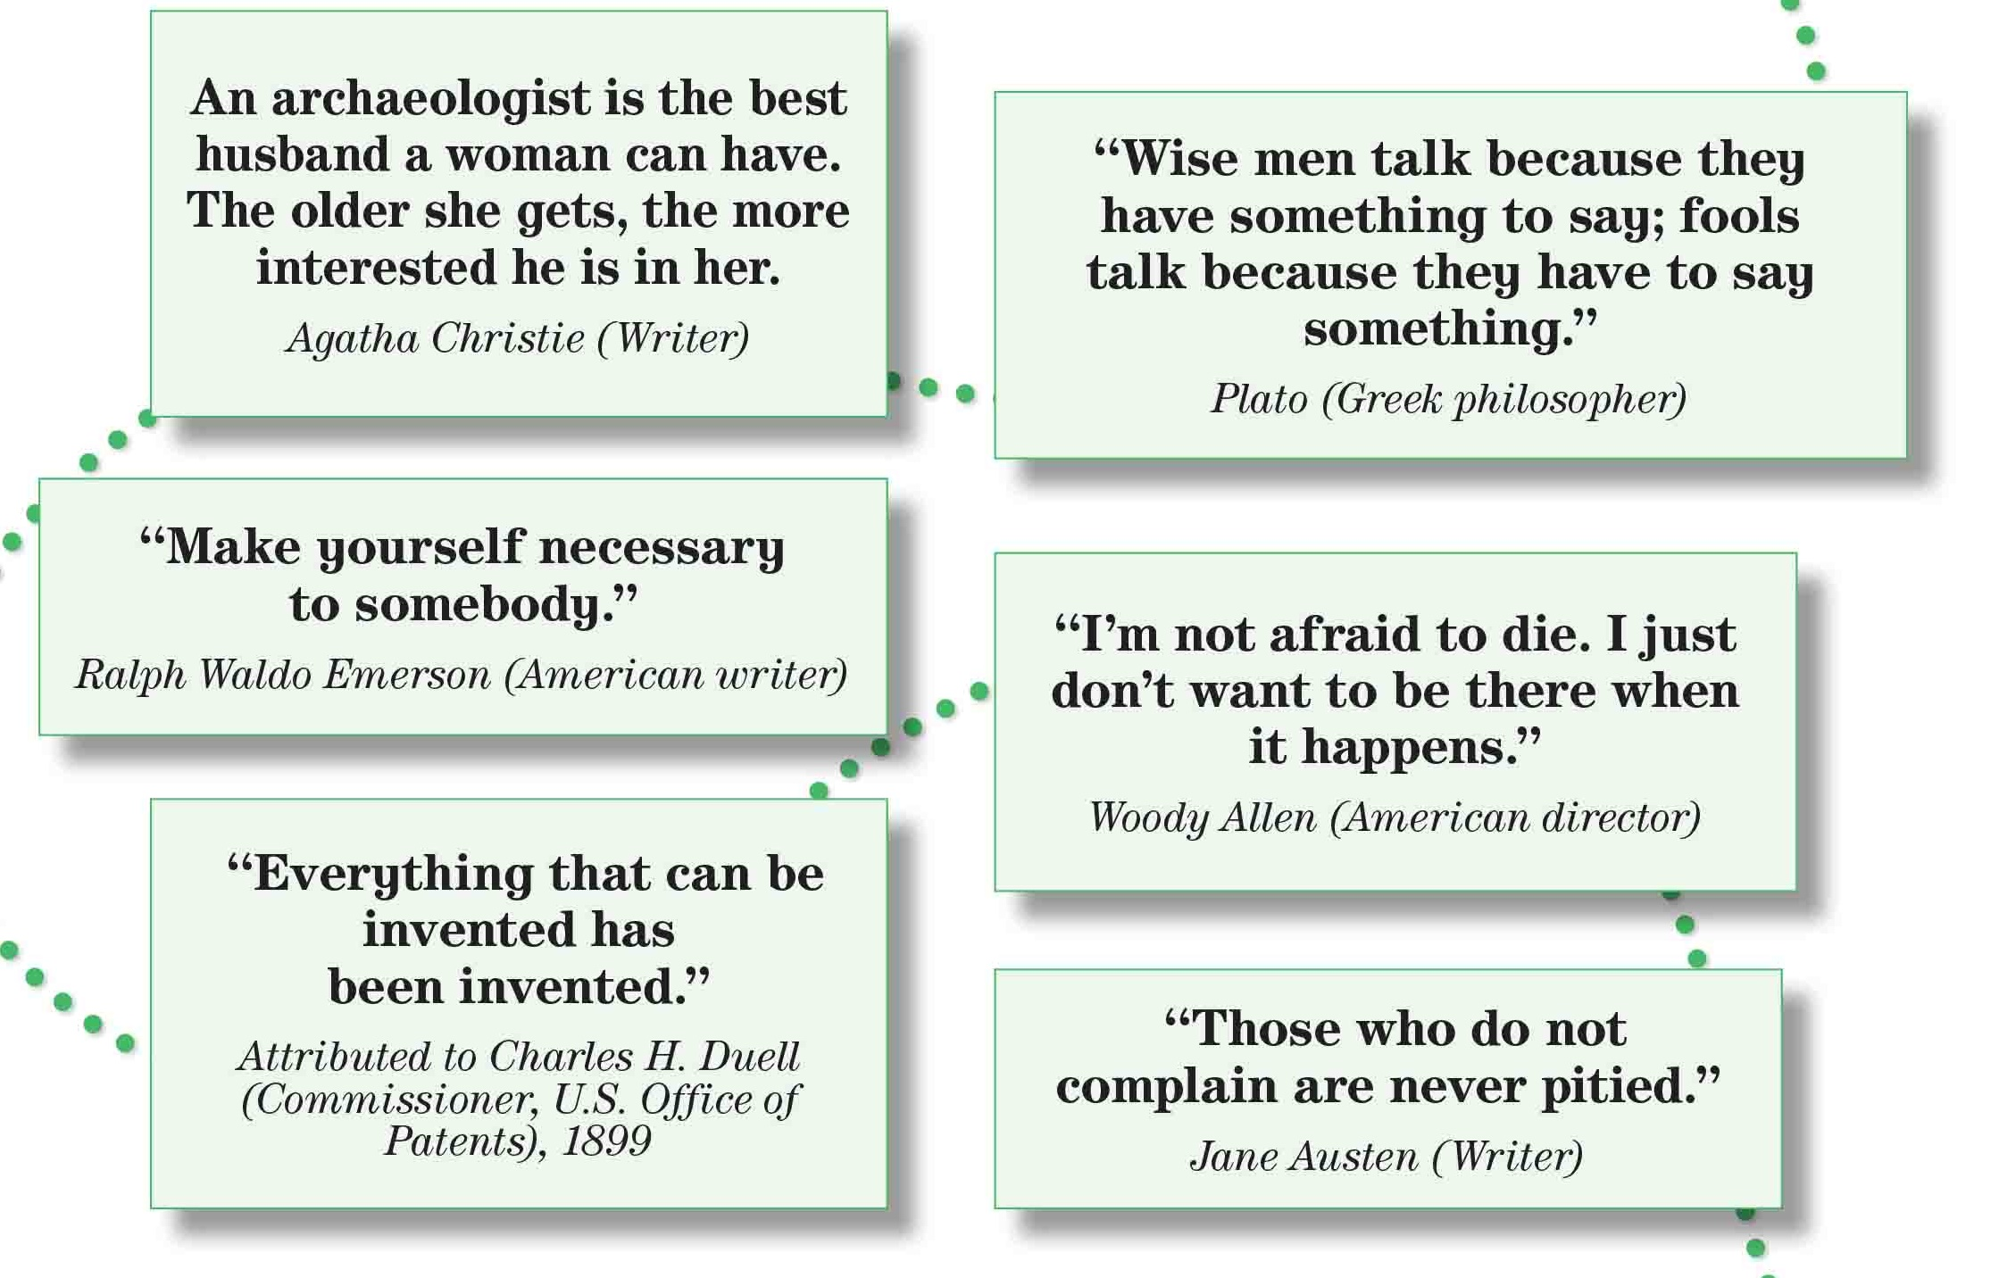


8
9
1
10
11
Skimming
12
13
2
King Salman
3
4
What’s the title?
5
How many quotes are there?
How many pictures are there?
6
7
What does the picture show?

Slide 11

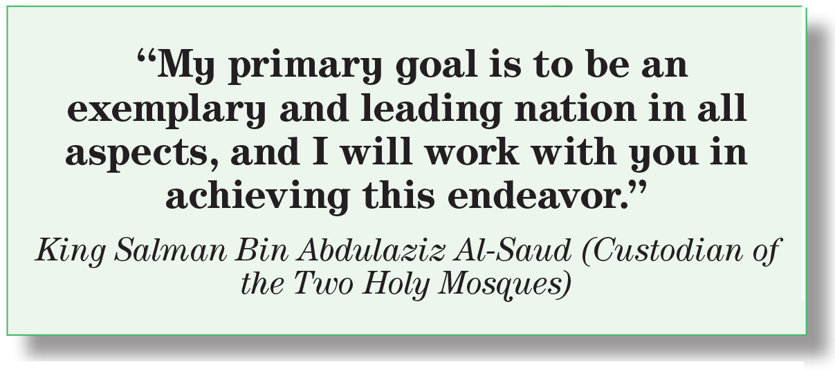


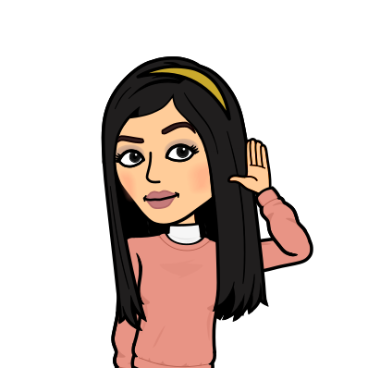

Who said this quote?
What’s his primary goal?
What does this quote mean?
Leading Saudi Arabia to be the best nation.

Slide 12
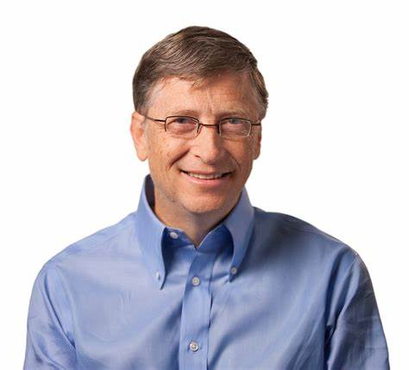
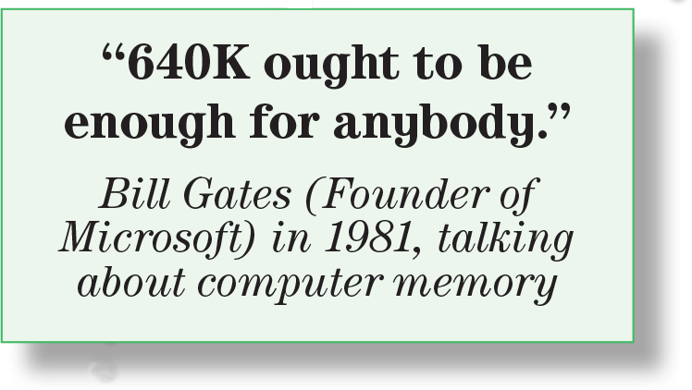
Who said this quote?
What was the quote about?
Computer
Is it enough now?
No, it isn’t enough. It changes a lot.

Slide 13
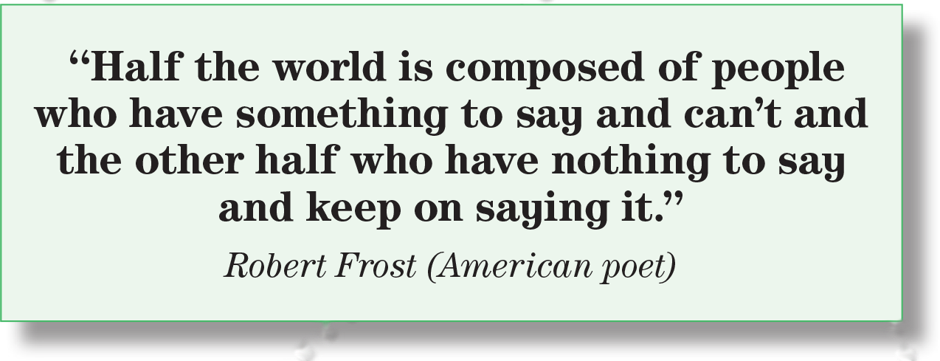
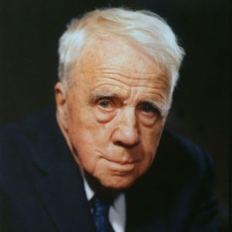
Who said this quote?
What does this quote mean?
Half of the world who have experienced things that are worthwhile for the world to hear cannot express what they want to say, and half of the world talk a lot but nothing comes out (rubbish).

Slide 14
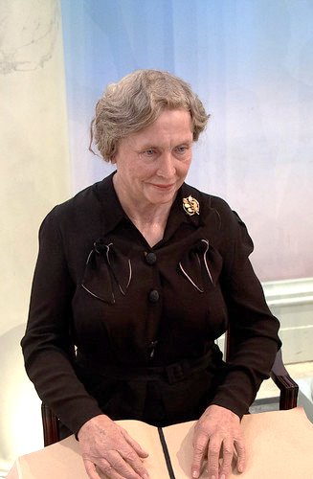

Who said this quote?
What does she mean by vision here?
It means having a goal , a plan or a life mission.
Creativity, insight or understanding.

Slide 15
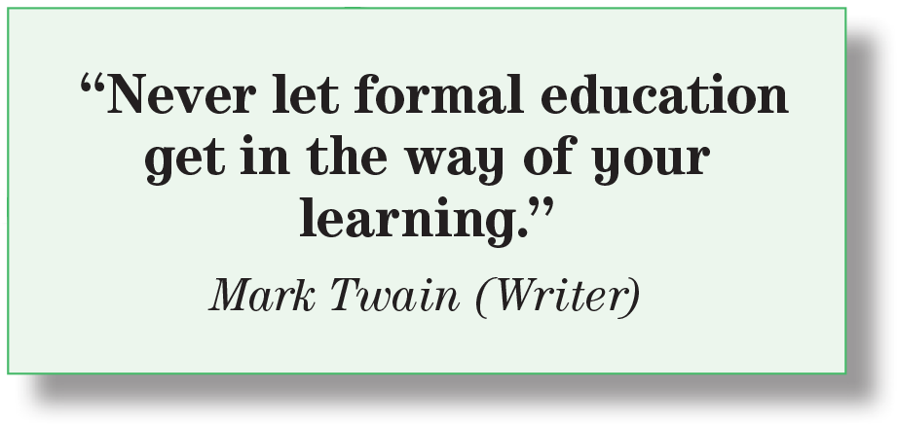
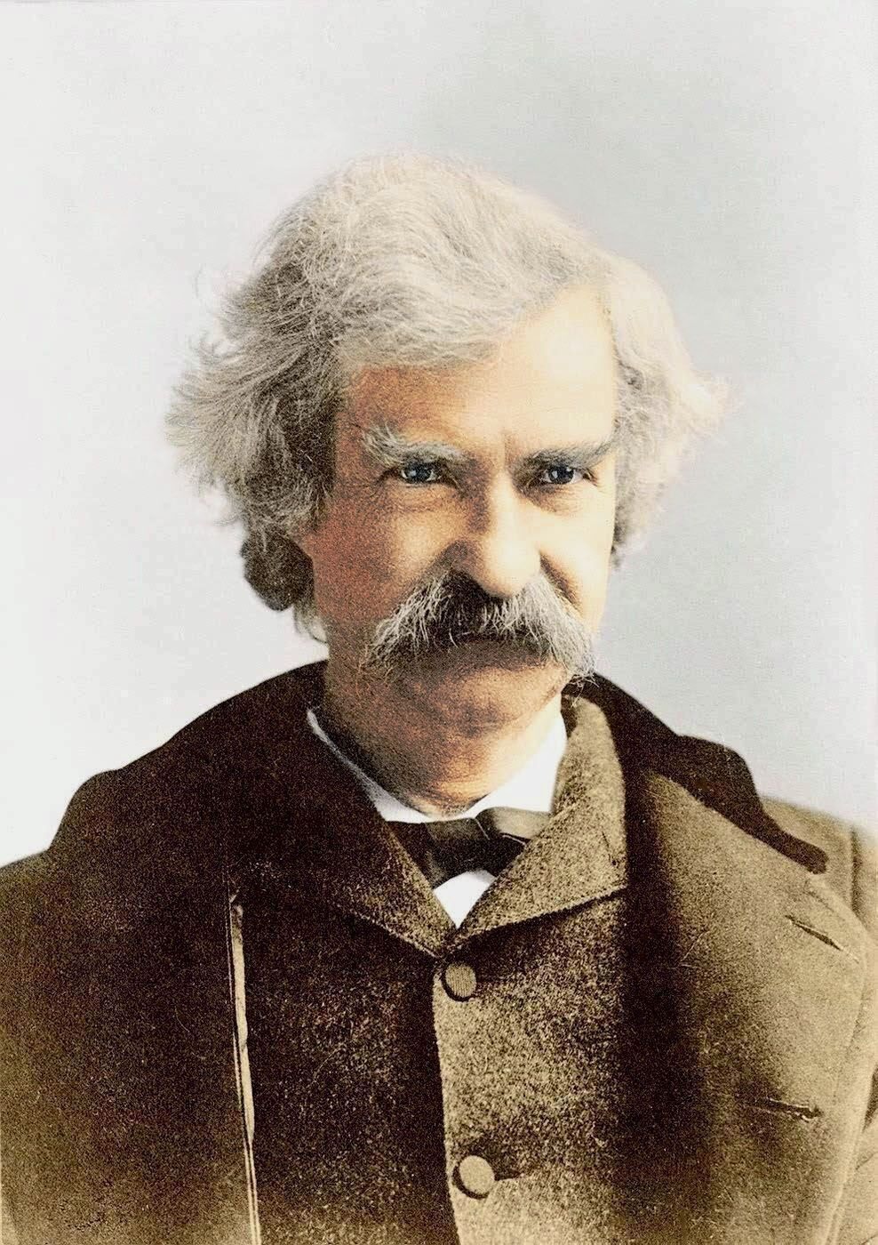
Who said this quote?
What does this quote mean?
Don’t stop at the formal education. Try to expand your knowledge by reading, experimenting and benefiting from other people experiences.

Slide 16
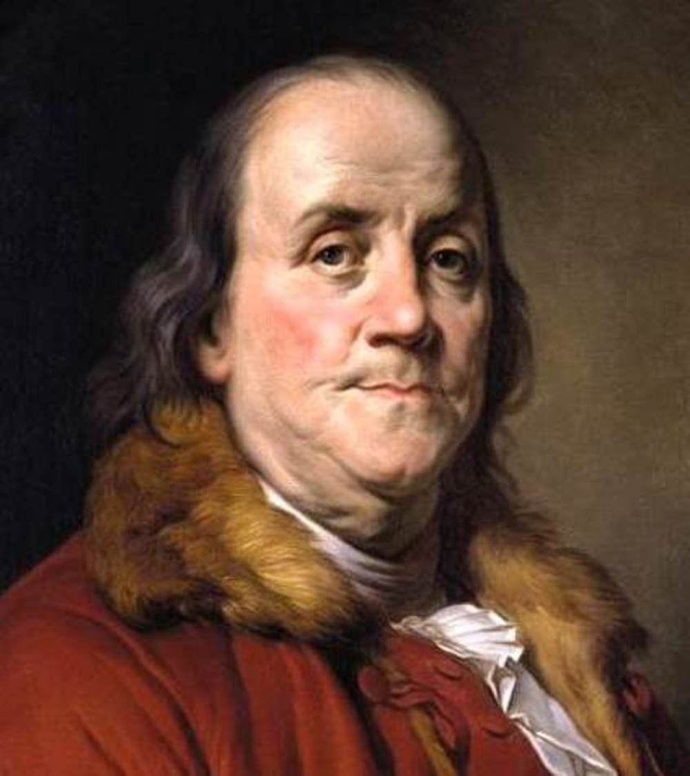
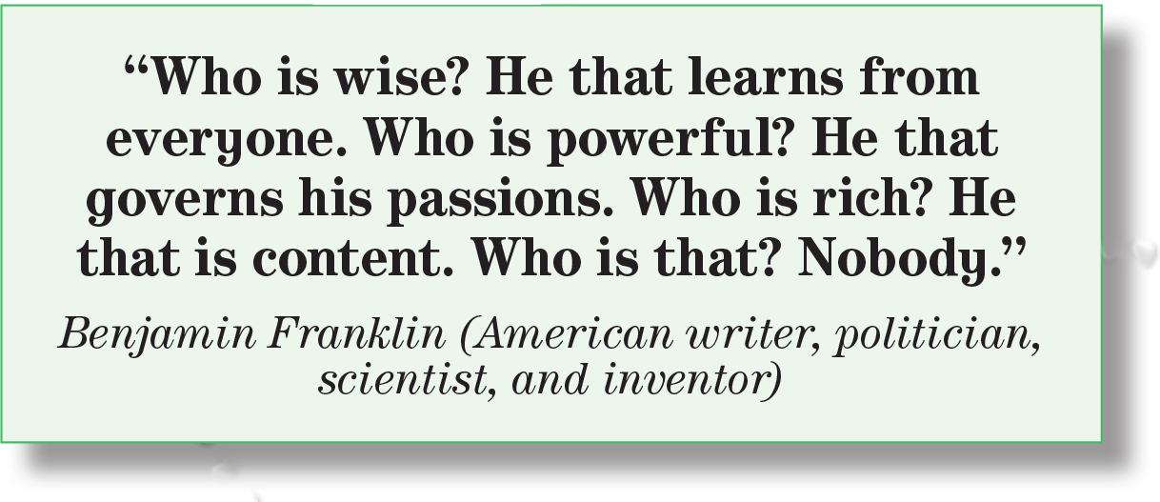
Who said this quote?
Who is wise according to Benjamin Franklin?
From Benjamin’s point of view, who is powerful?
Who is rich?
Content = to be satisfied & pleased with your situation

Slide 17
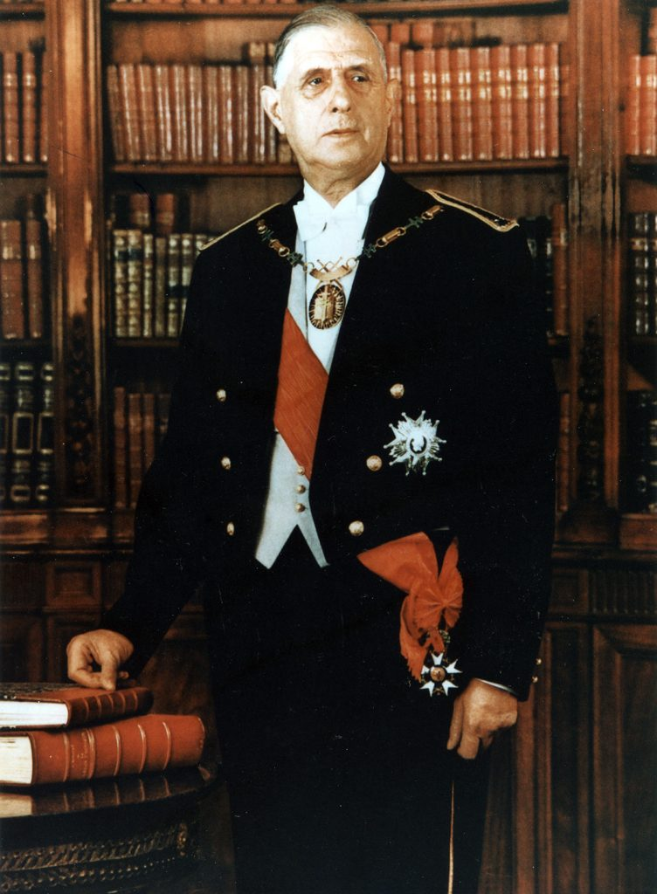
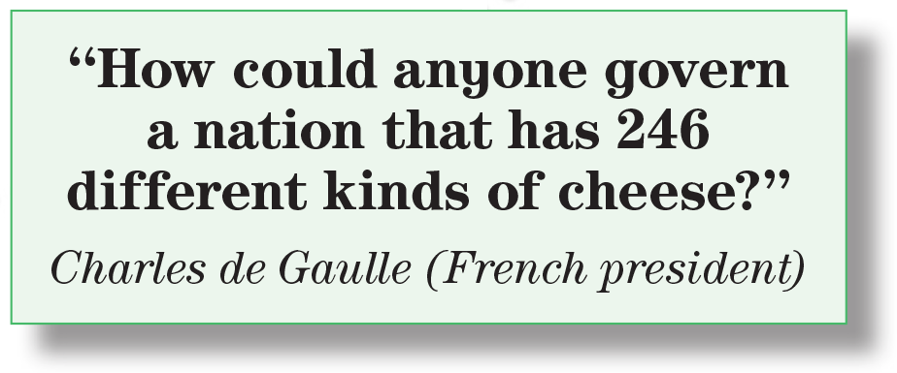
Who said this quote?
Who’s he?
What does he say about the French?
The French like cheese and have different kind of cheese . So, people who have a good taste and can taste different kind of cheese is not easy to govern them.

Slide 18

https://wordwall.net/resource/13854713

Slide 19
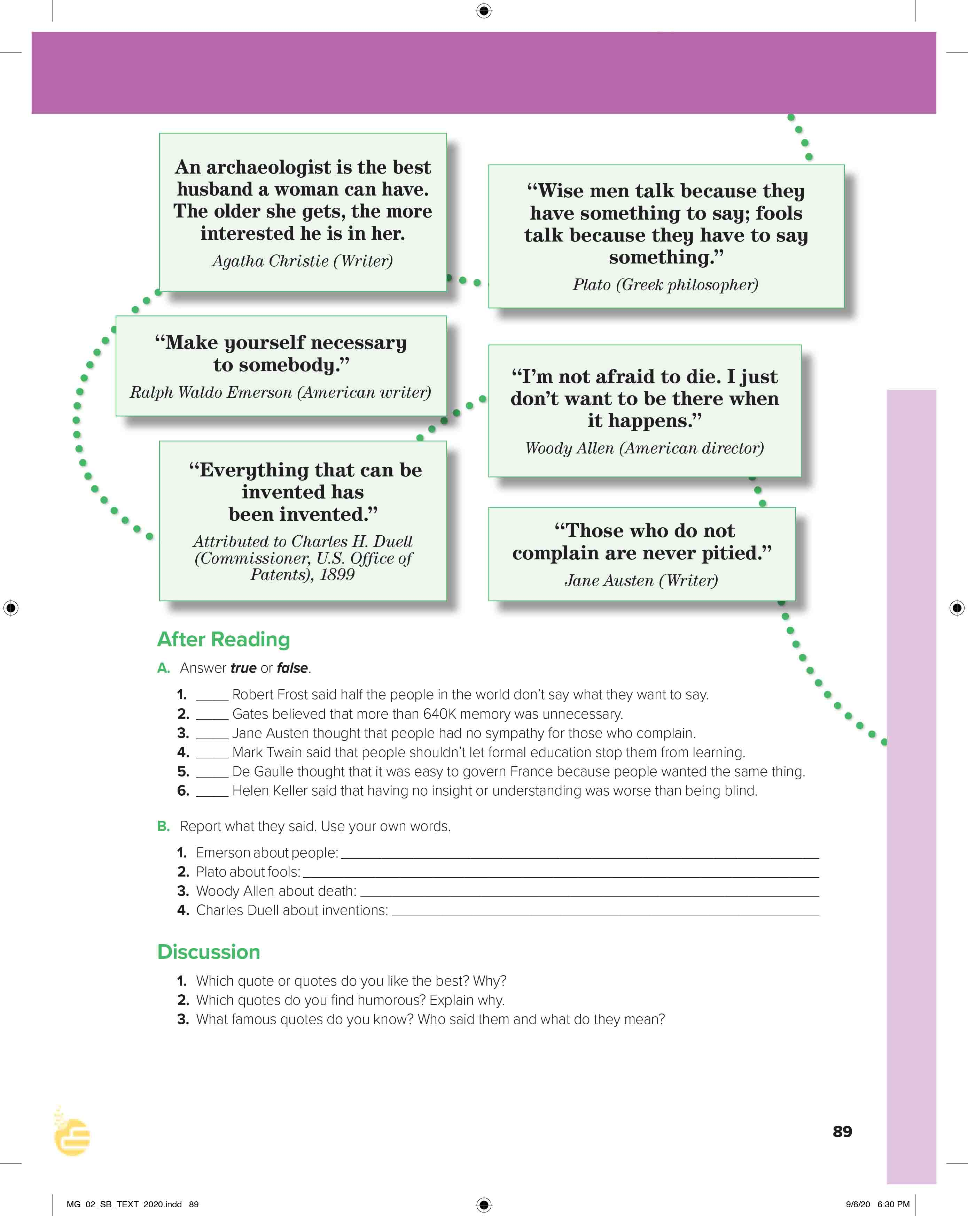
I love English
Open your Student’s book page: 89

Slide 20
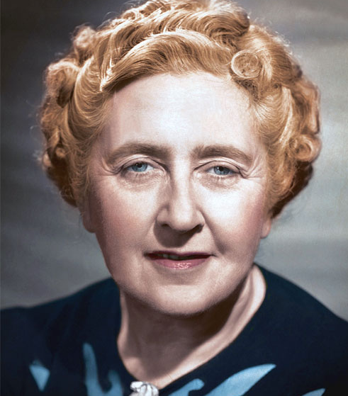
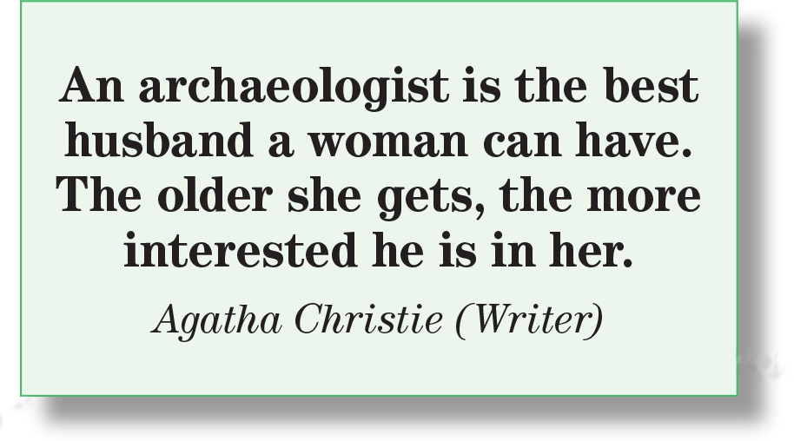
Who said this quote?
What’s the meaning of (an archaeologist)?
A person who studies ancient societies by studying the remains of old buildings, graves.

Slide 21
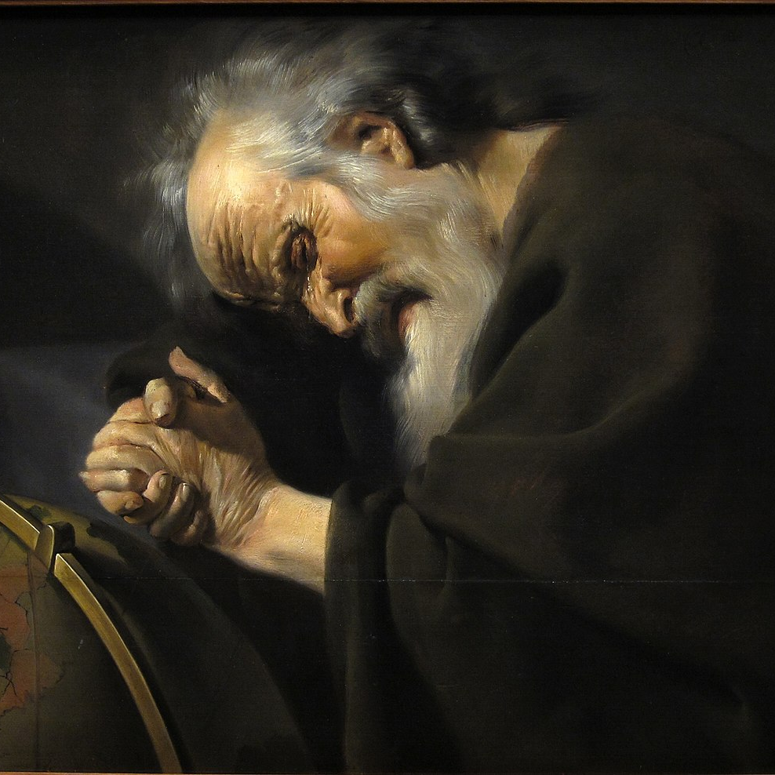
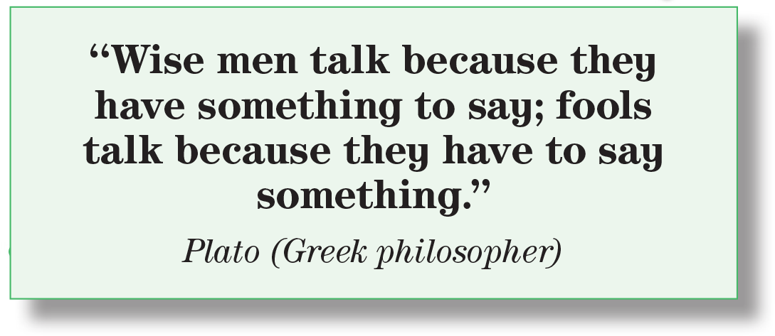
Who said this quote?
What’s the meaning of (wisemen)?
A man of unusual learning, judgment, or insight.
What’s the difference between wise men and fools?

Slide 22
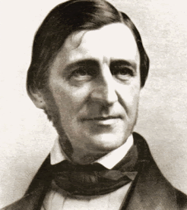
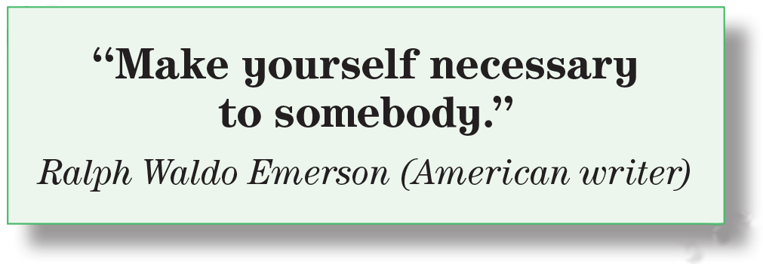
Who said this quote?
What’s the meaning of (necessary)?
Helpful, important person.

Slide 23
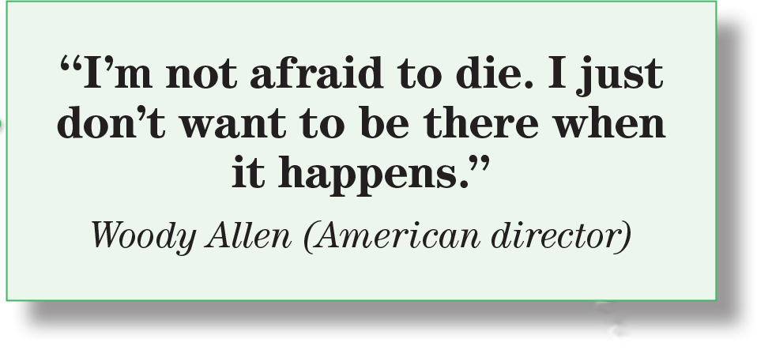
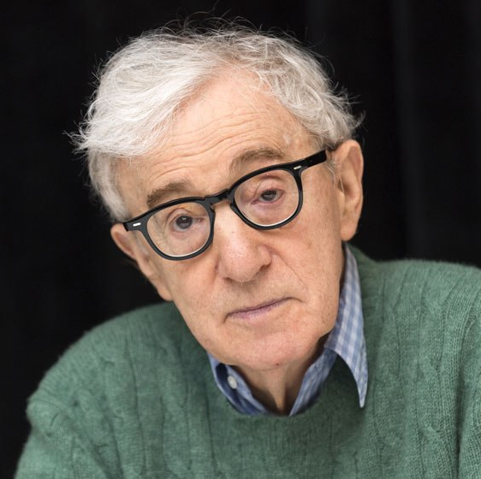
Who said this quote?
An example of humor. The humor is that a person must be present when he or she is dying.

Slide 24
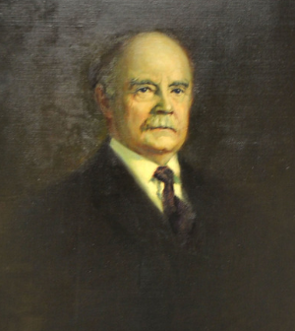
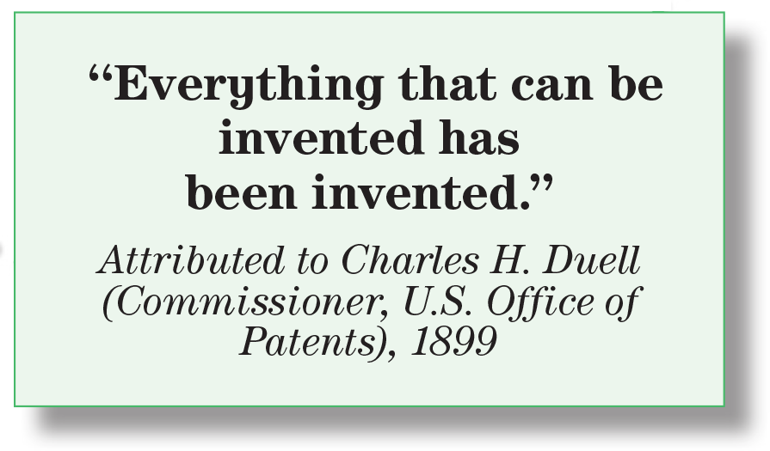
Who said this quote?
Hers is an irony because invention is still going on. It doesn’t stop.

Slide 25
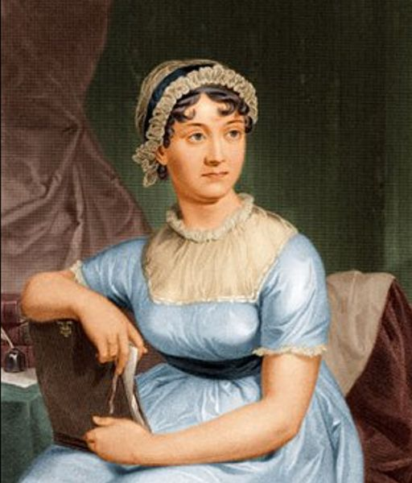
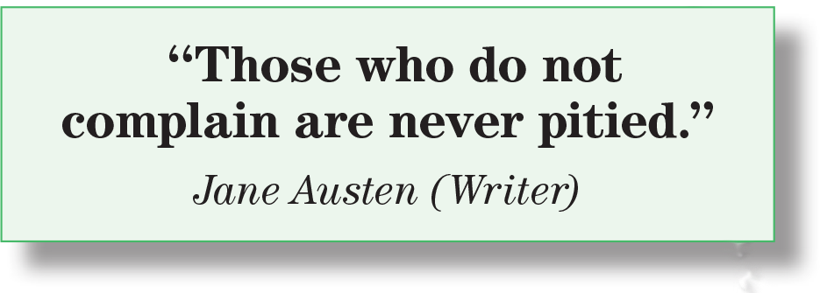
Who said this quote?
What’s the meaning of (to be pitied)?
When someone feels sympathy for you because of a bad situation.
What does this quote mean?
If you don’t complain, nobody is going to feel sorry for you.

Slide 26

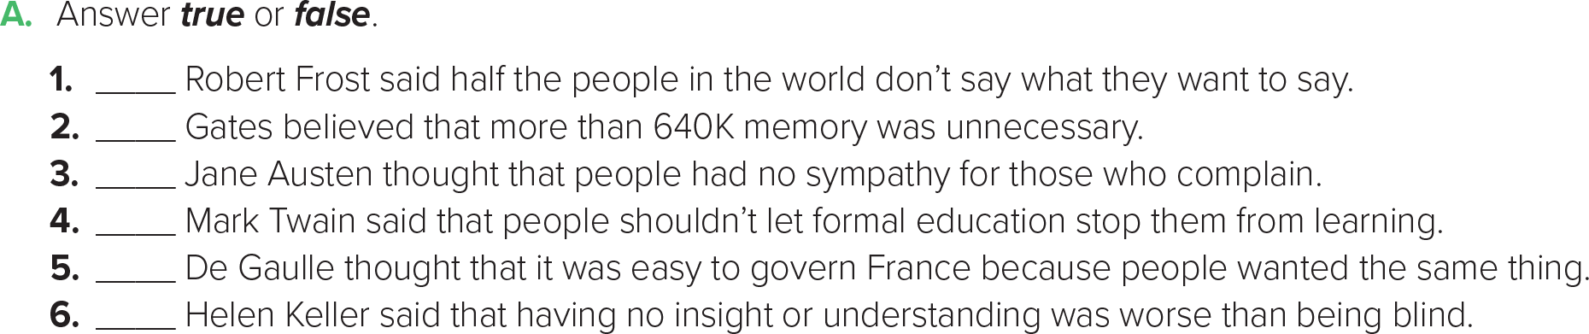
F
T
F
T
F
T

Slide 27
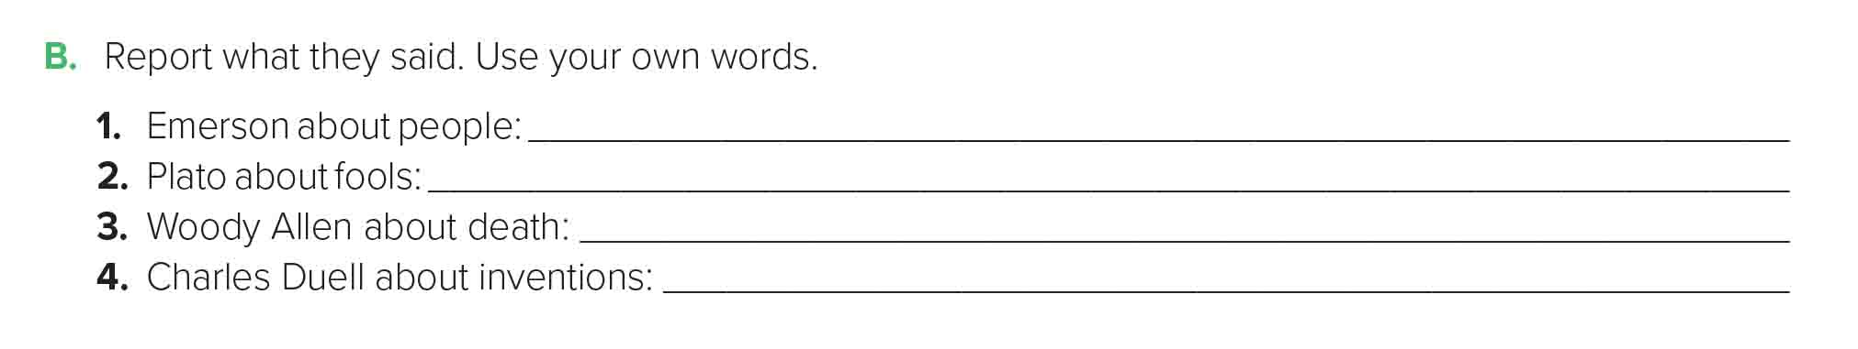
Emerson said to make yourself necessary to somebody.
Plato said that fools talked because they had to say something even if it was worthless.
Woody Allen said he was not afraid of death but that he didn’t want to be there when he died.
Charles Duell said in 1899 that everything that could be invented had been invented.

Slide 28

https://wordwall.net/resource/13854898

Slide 29


Slide 30


I love English

Slide 31



Homework
I love English

Slide 32


Homework

Slide 33
Homework

Slide 34
Homework

Slide 35
Homework

Slide 36
Homework

Slide 37

Homework

