Slide 1


Hello My lovely students
I’m your teacher
Hanan AlShobaily

Slide 2




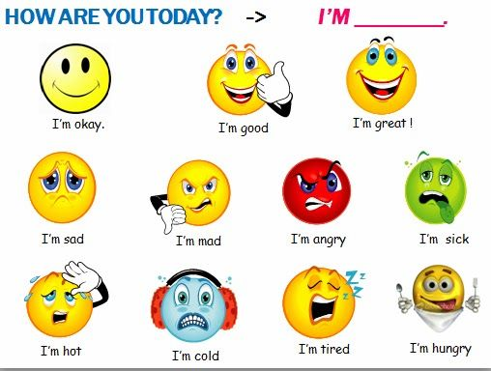
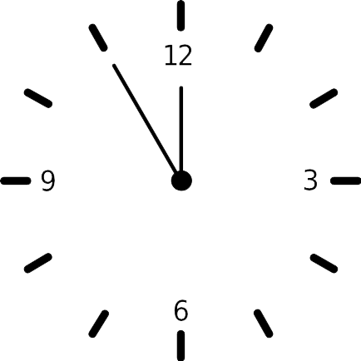



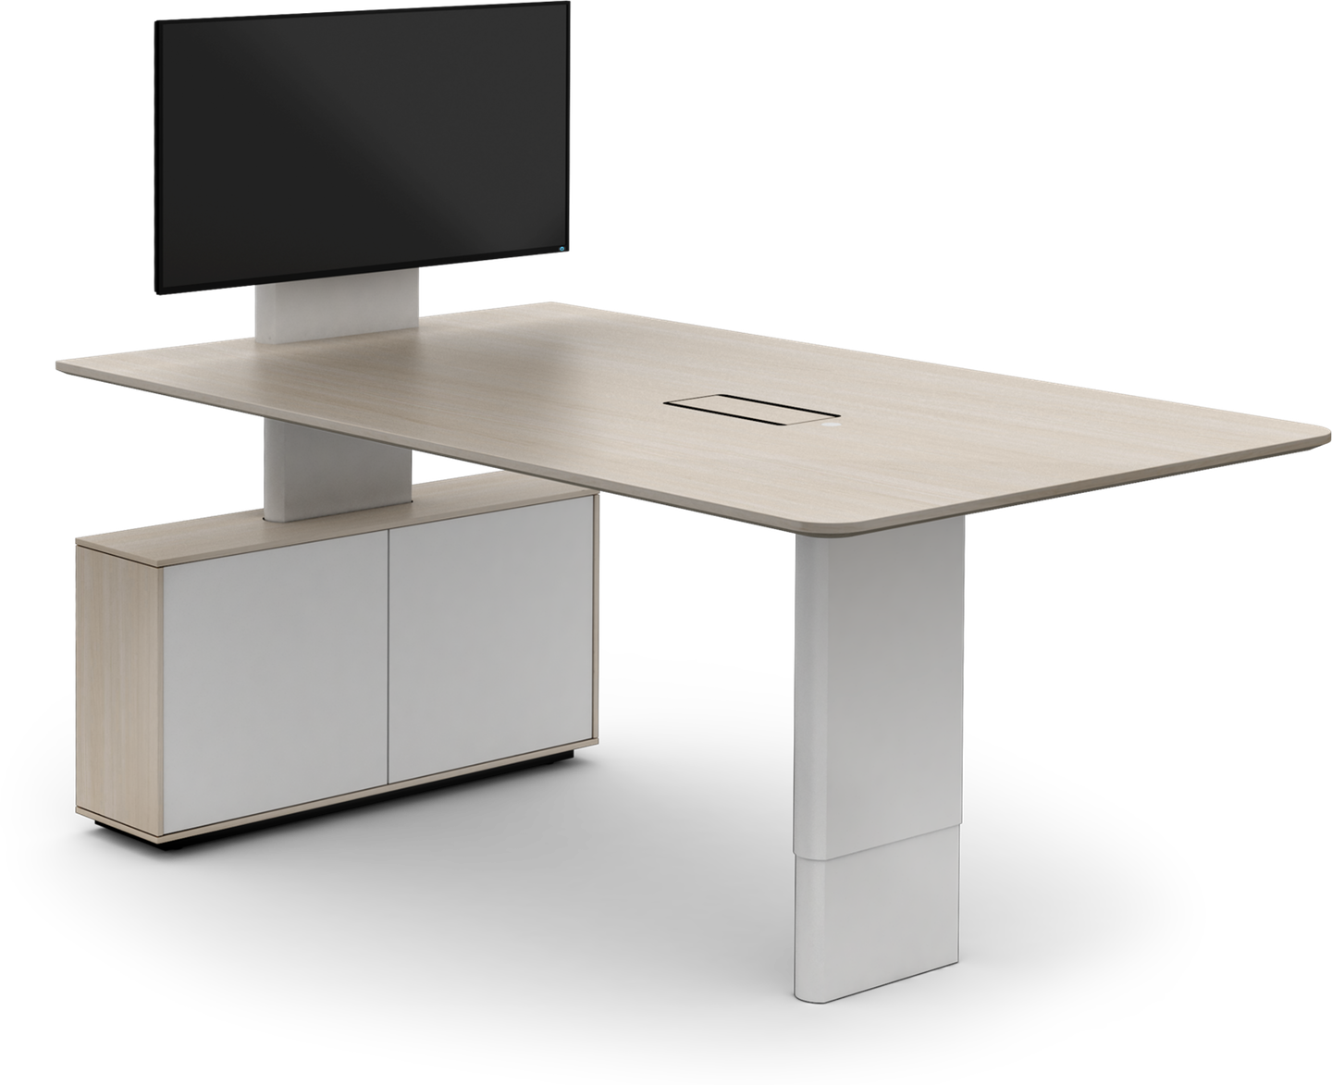
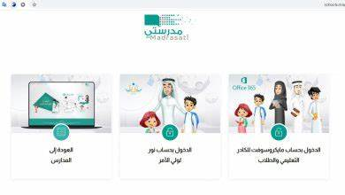







I love English

Slide 3


I love English

Slide 4




Let’s revise the previous lesson
https://wordwall.net/resource/13911818

Slide 5



I love English
Mega Goal 2
Unit 6
(What They Said)
Project
Sunday
29/8/1442

Slide 6



Warm Up
Why is reading important?
To get knowledge
Develop the imagination
Improve your language
Learn from other people experiences

Slide 7


I love English
Lesson Objectives
Students will be able to:
Find interesting quotations by famous people.
Design a poster presenting famous quotes.
Revise Unit 6.

Slide 8


What are famous quotes about?
history
literature
law
politics
science
education
life

Slide 9
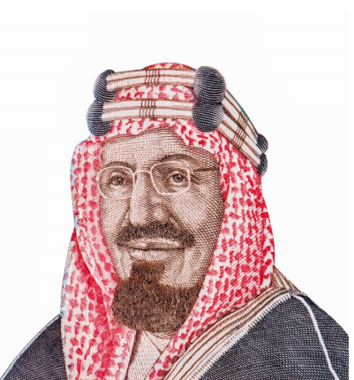
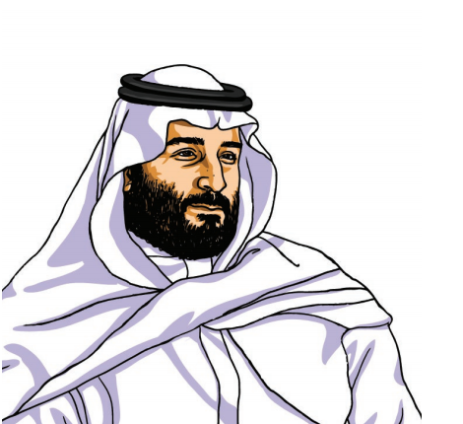
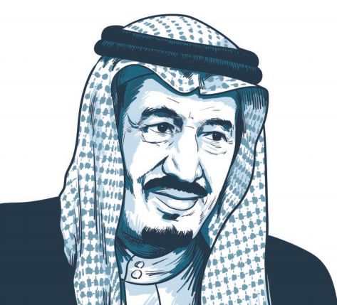
Who’s behind these famous quotes?
Famous people

Slide 10
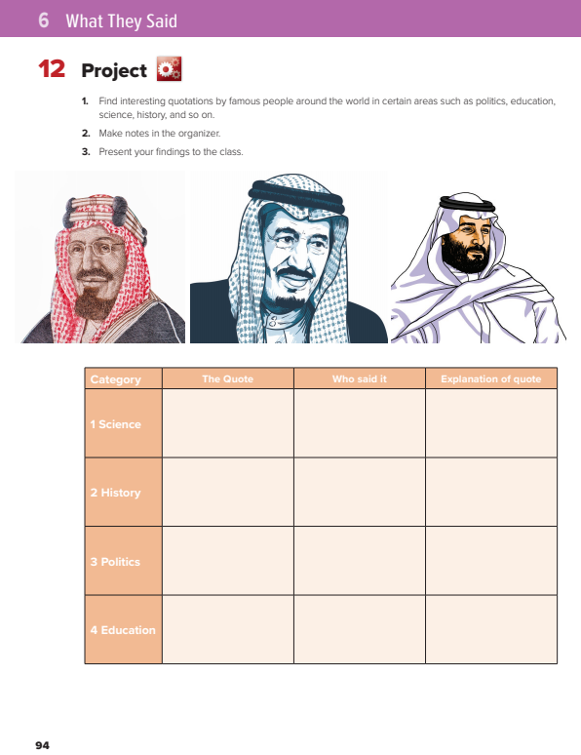

I love English
Open your Student’s book page: 94

Slide 11
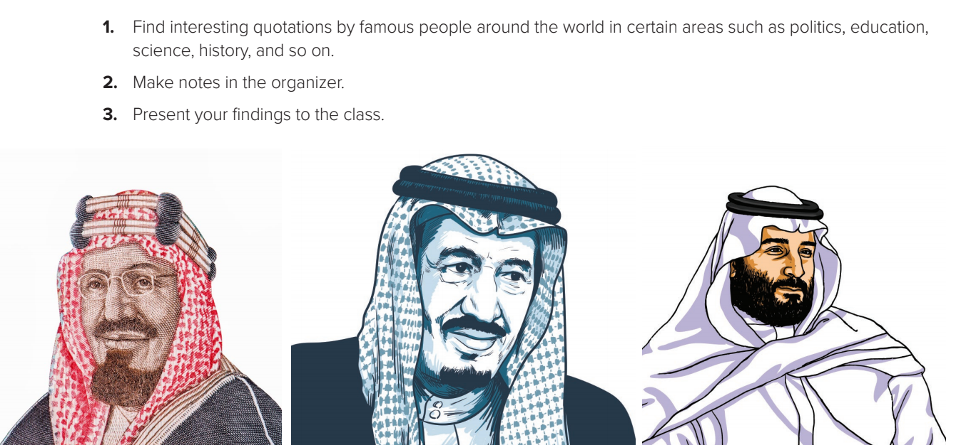

Slide 12
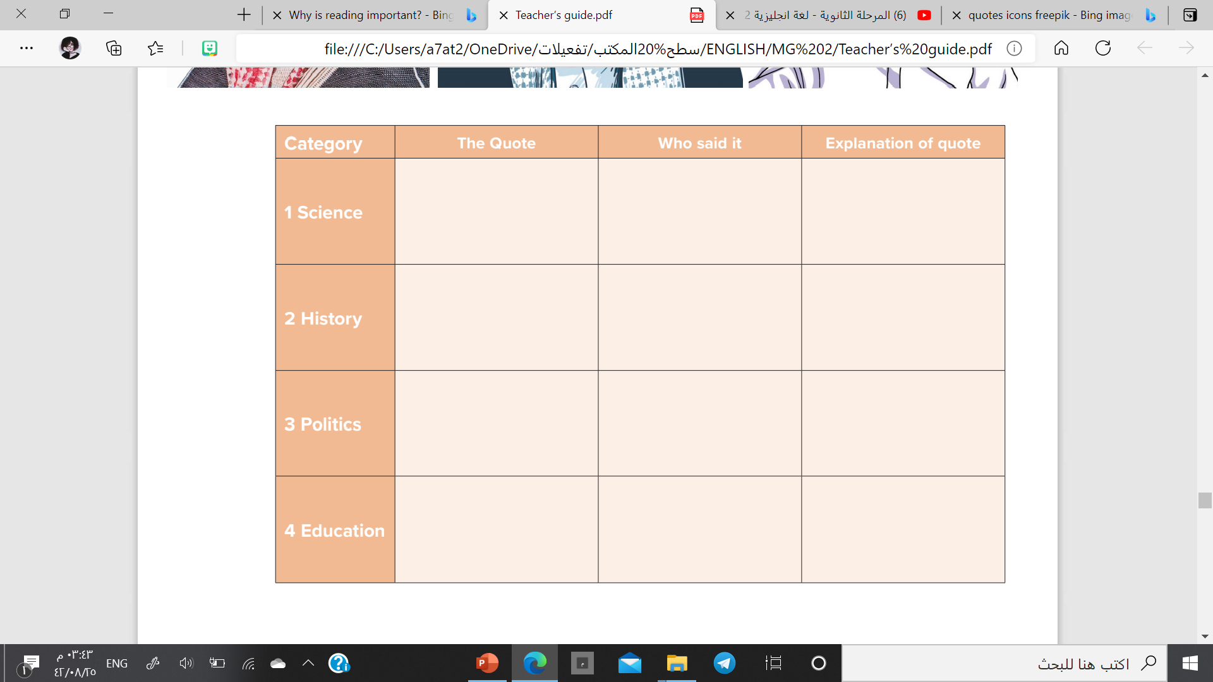
“Investing in science education and curiosity-driven research is investing in the future”
Ahmed Zewail
The real investment for the future in science and research.
“The more you know about the past the better prepared you are for the future”
We have to learn from the history
Theodore Roosevelt
“We will continue, God willing, to hold the straight course that this country has followed since its establishment by the late King Abdul-Aziz,"
On the country’s progressions and stability
King Salman bin Abdul-Aziz
“Education is what remains after one has forgotten what one has learned in school”
Education is not only in schools, but what you learn all your life.
Albert Einstein

Slide 13

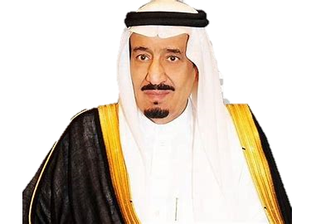
Let’s design an attractive poster
1
Design a poster, Make attractive decorations.
“We will continue, God willing, to hold the straight course that this country has followed since its establishment by the late King Abdul-Aziz“
King Salman bin Abdu Aziz
2
Add your pictures.
3
Add the quote.
4
Present it to your class.

Slide 14


Now design your own poster
and share it with your family.

Slide 15


REVISION
UNIT 6

Slide 16


I love English

Slide 17



Homework
I love English

Slide 18
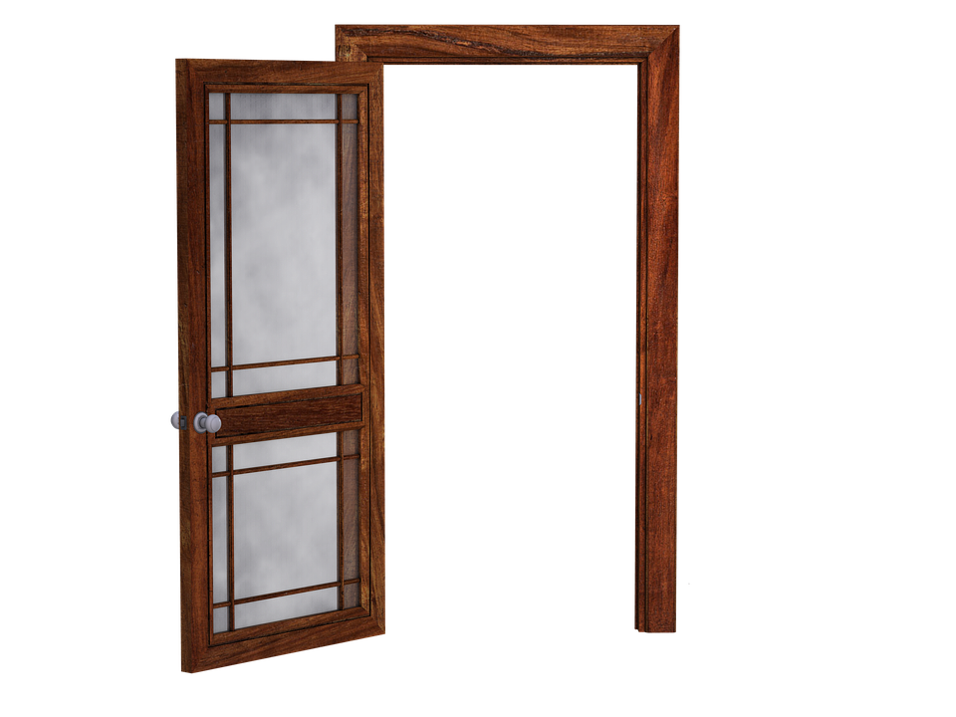

Homework

Slide 19
Homework

Slide 20
Homework

Slide 21
Homework

Slide 22
Homework

Slide 23

Homework

