Slide 1


Hello My lovely students
I’m your teacher
Hanan AlShobaily

Slide 2




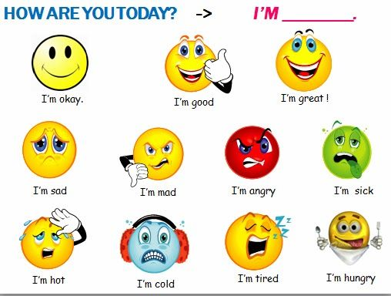
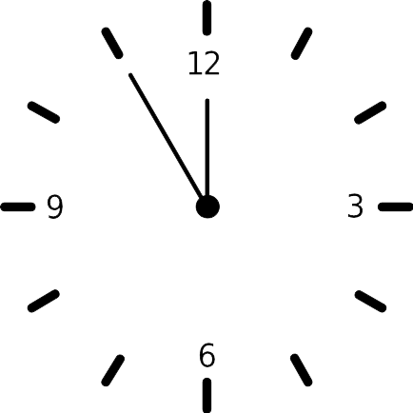



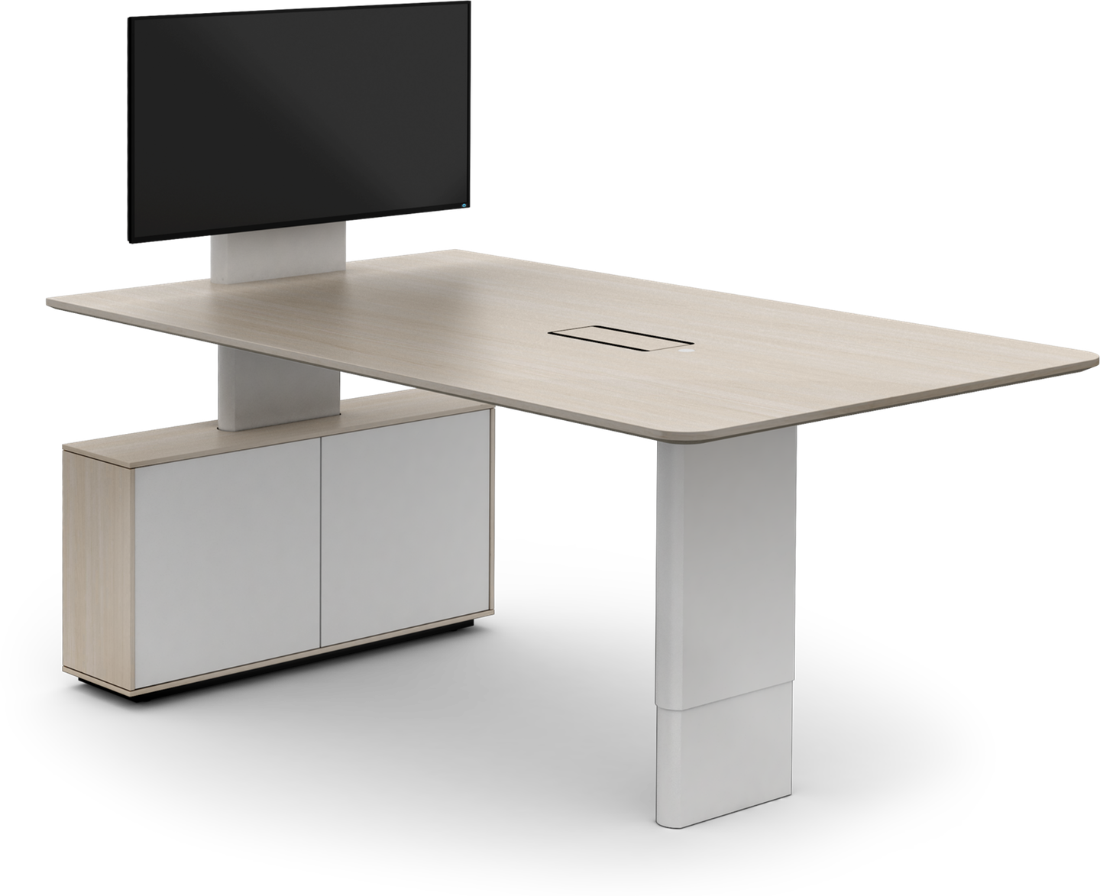
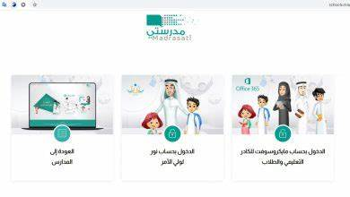







I love English

Slide 3
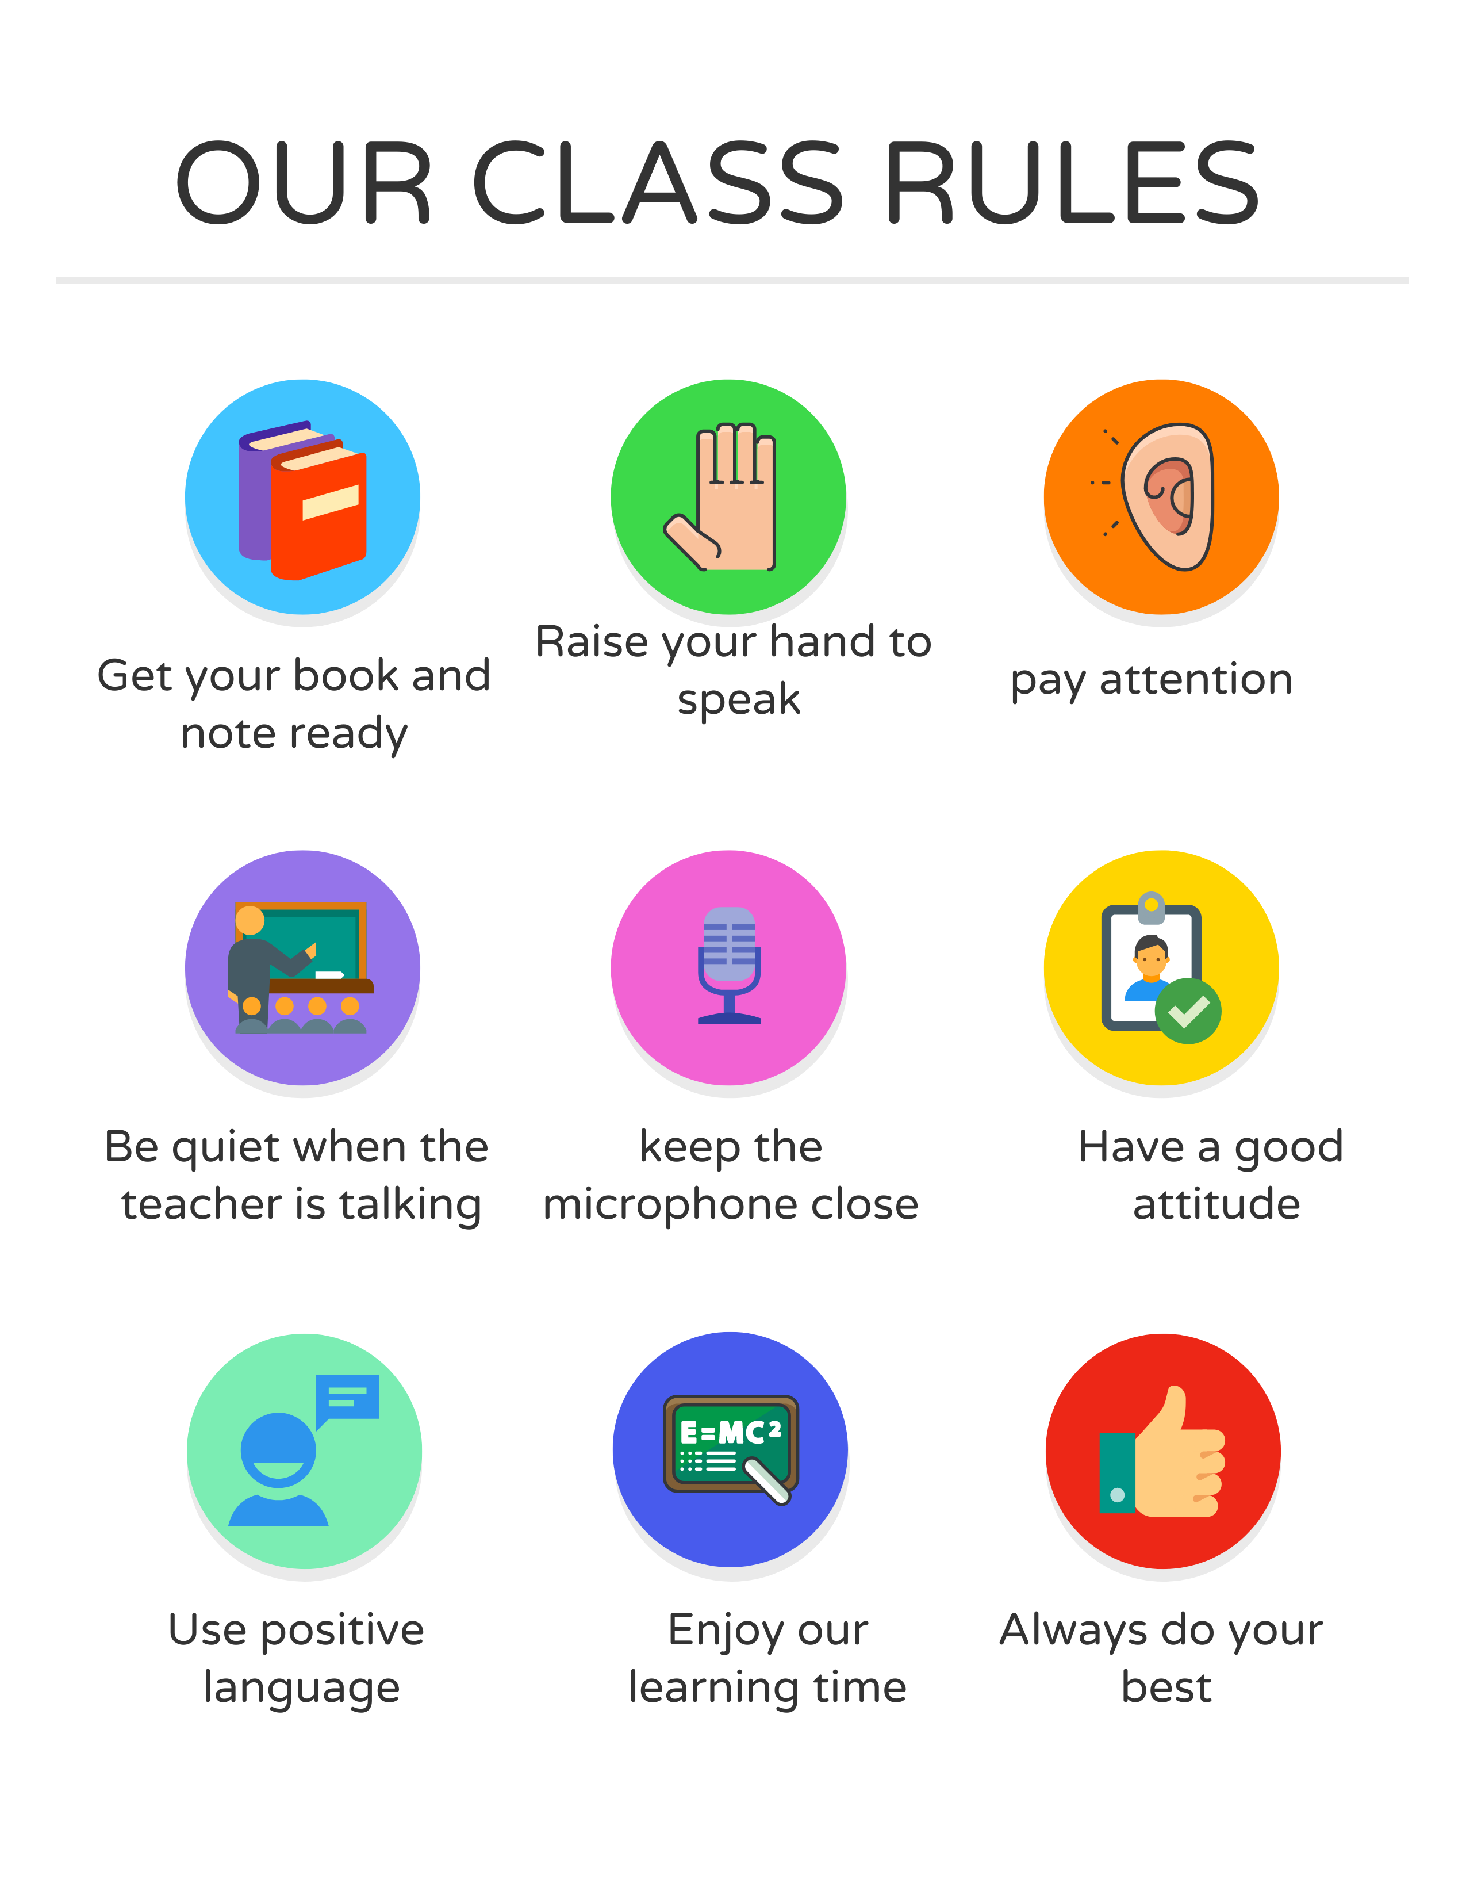

I love English

Slide 4

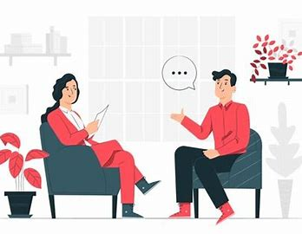


I love English
Mega Goal 2
Unit 6
(What They Said)
Form, Meaning and Function
Thursday
26/8/1442

Slide 5

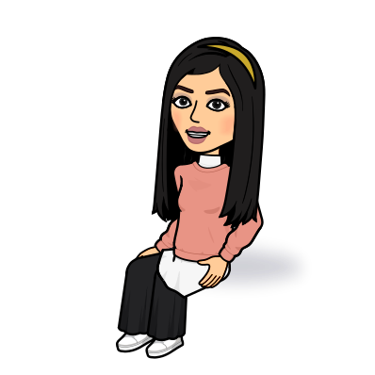
I love English
Lesson Objectives
Students will be able to:
Identify the words that are connected with the environment and natural disasters.
Express surprise through negative questions.
Use relative adverb “where” to refer to places.
Ask for information using indirect question.
Express agreement with So, Neither, Either, Too.
Express disagreement.

Slide 6
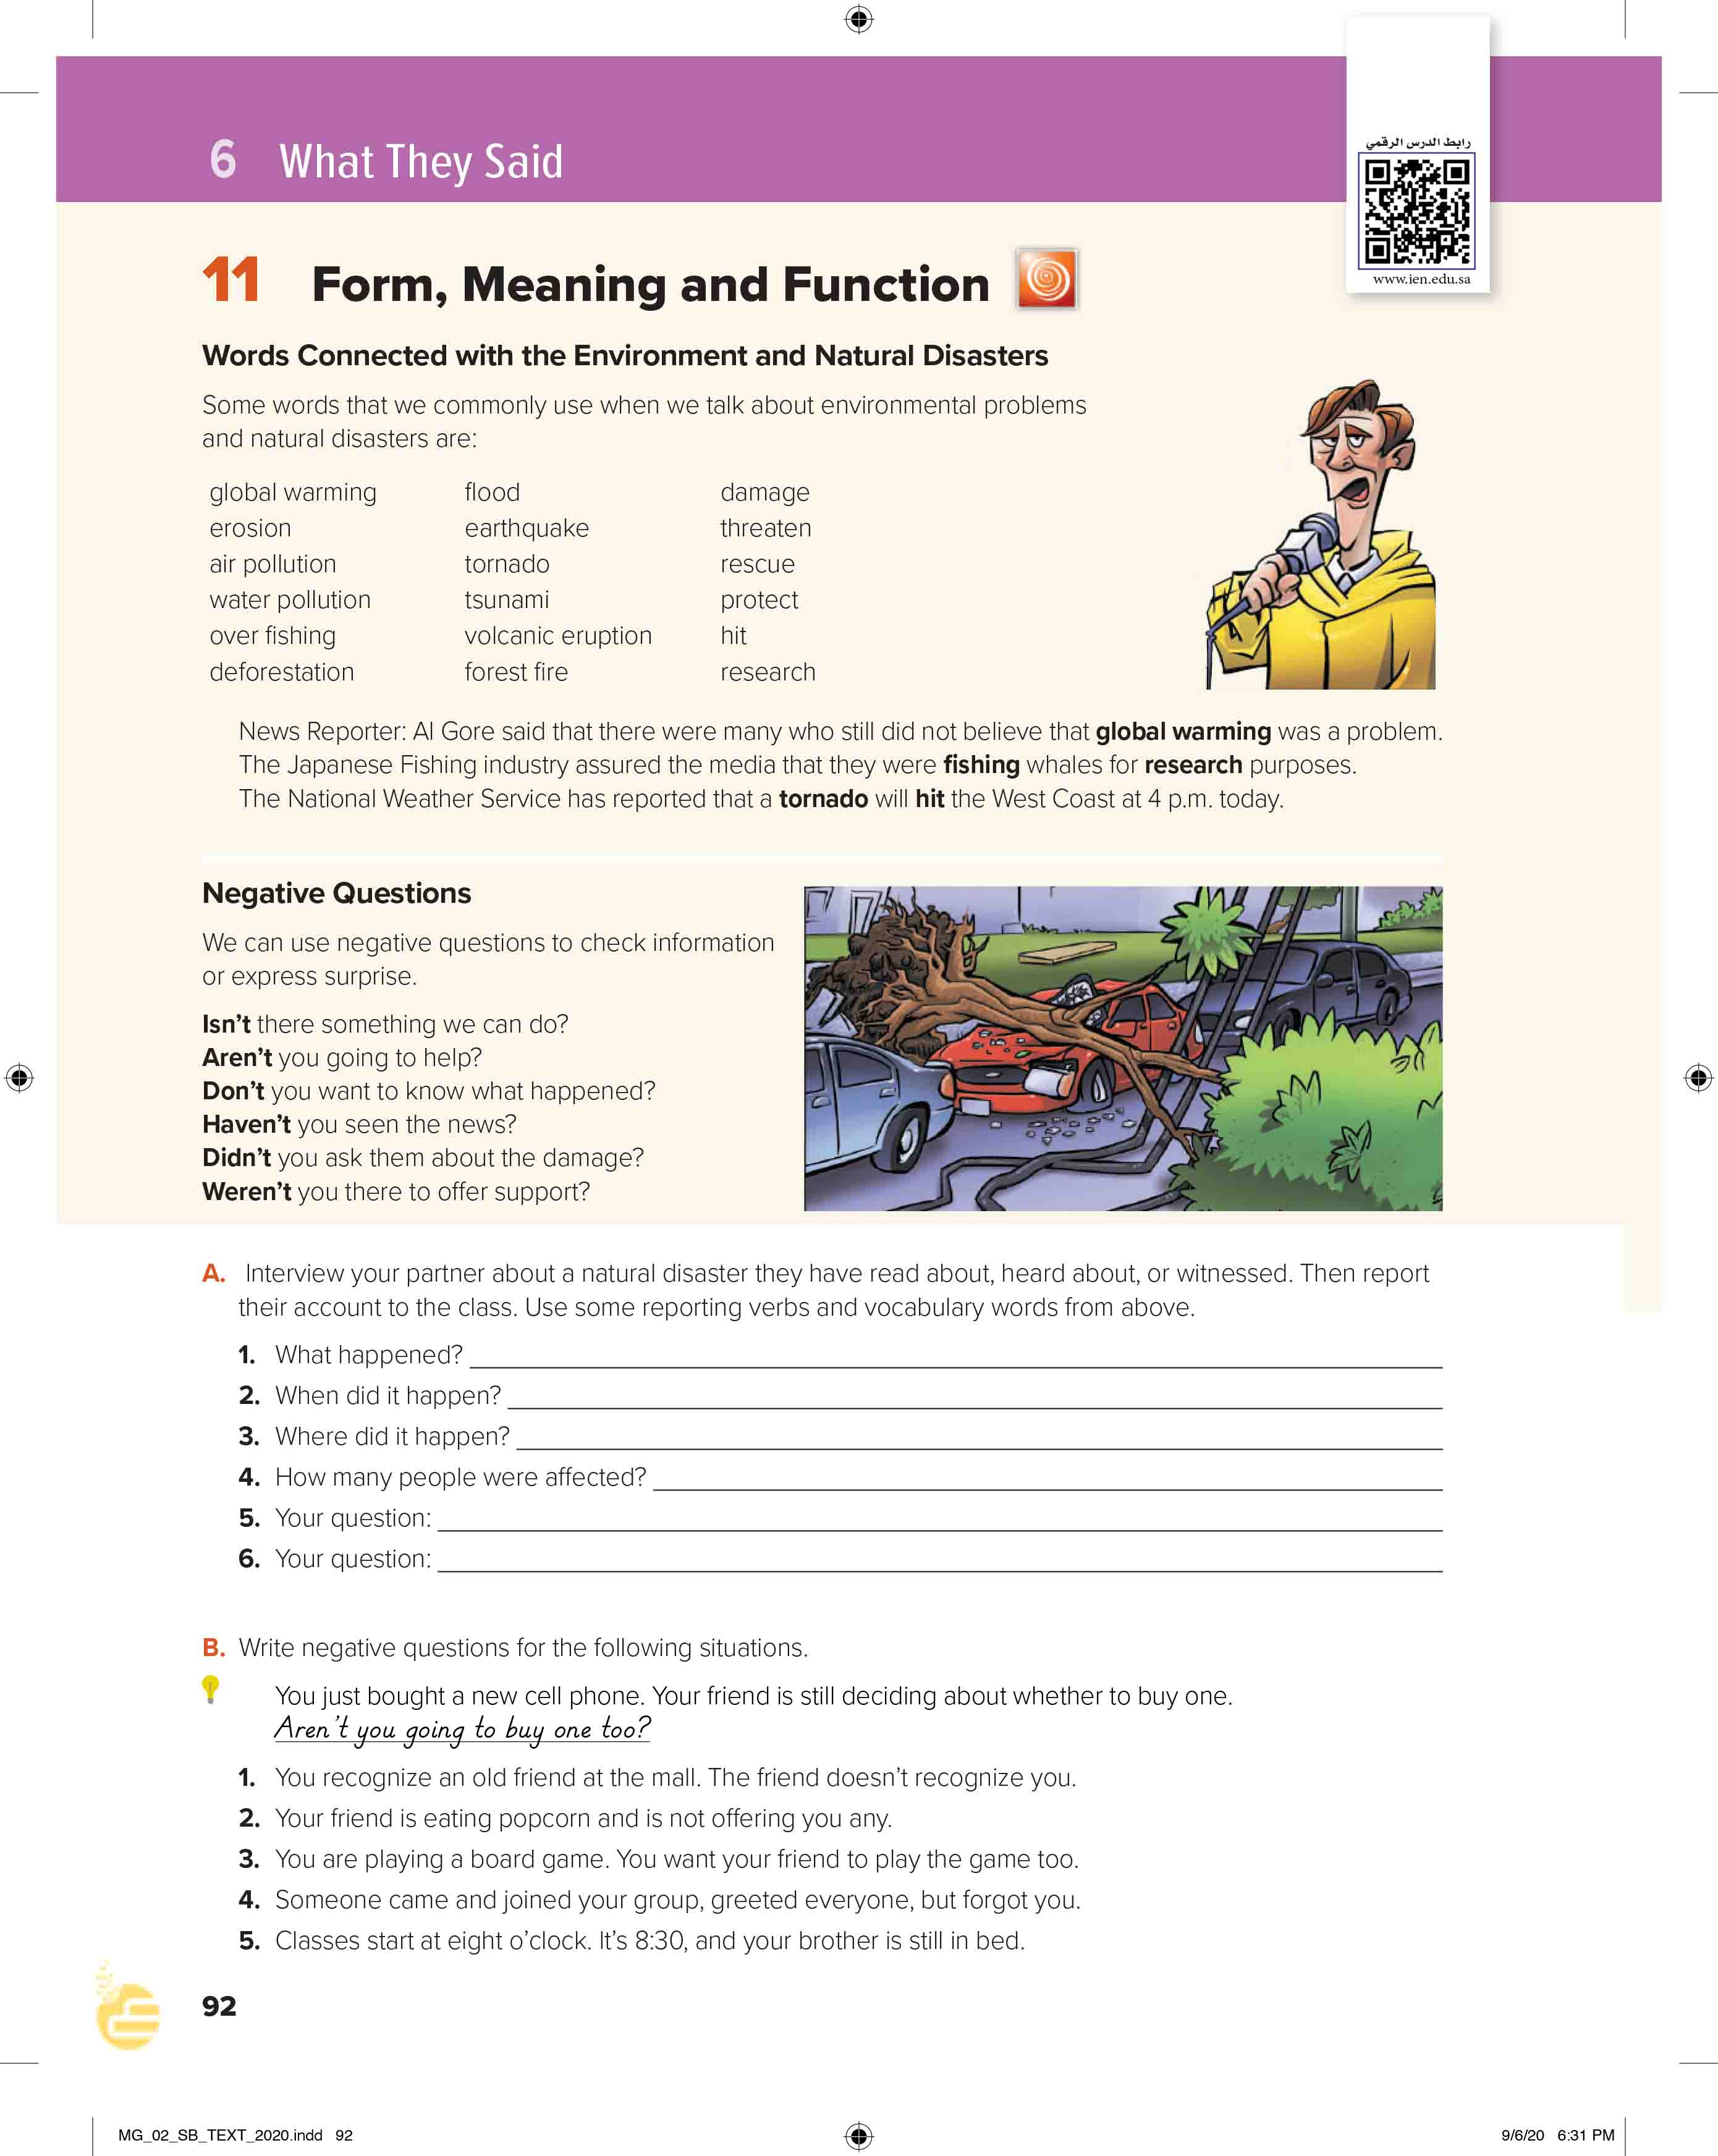

I love English
Open your Student’s book page: 92

Slide 7
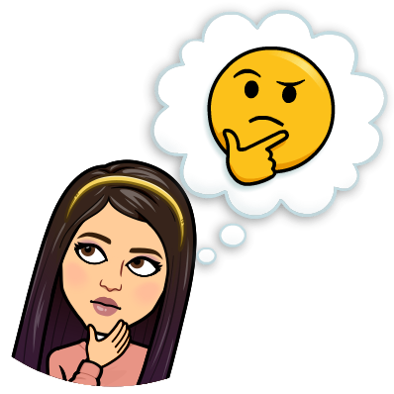
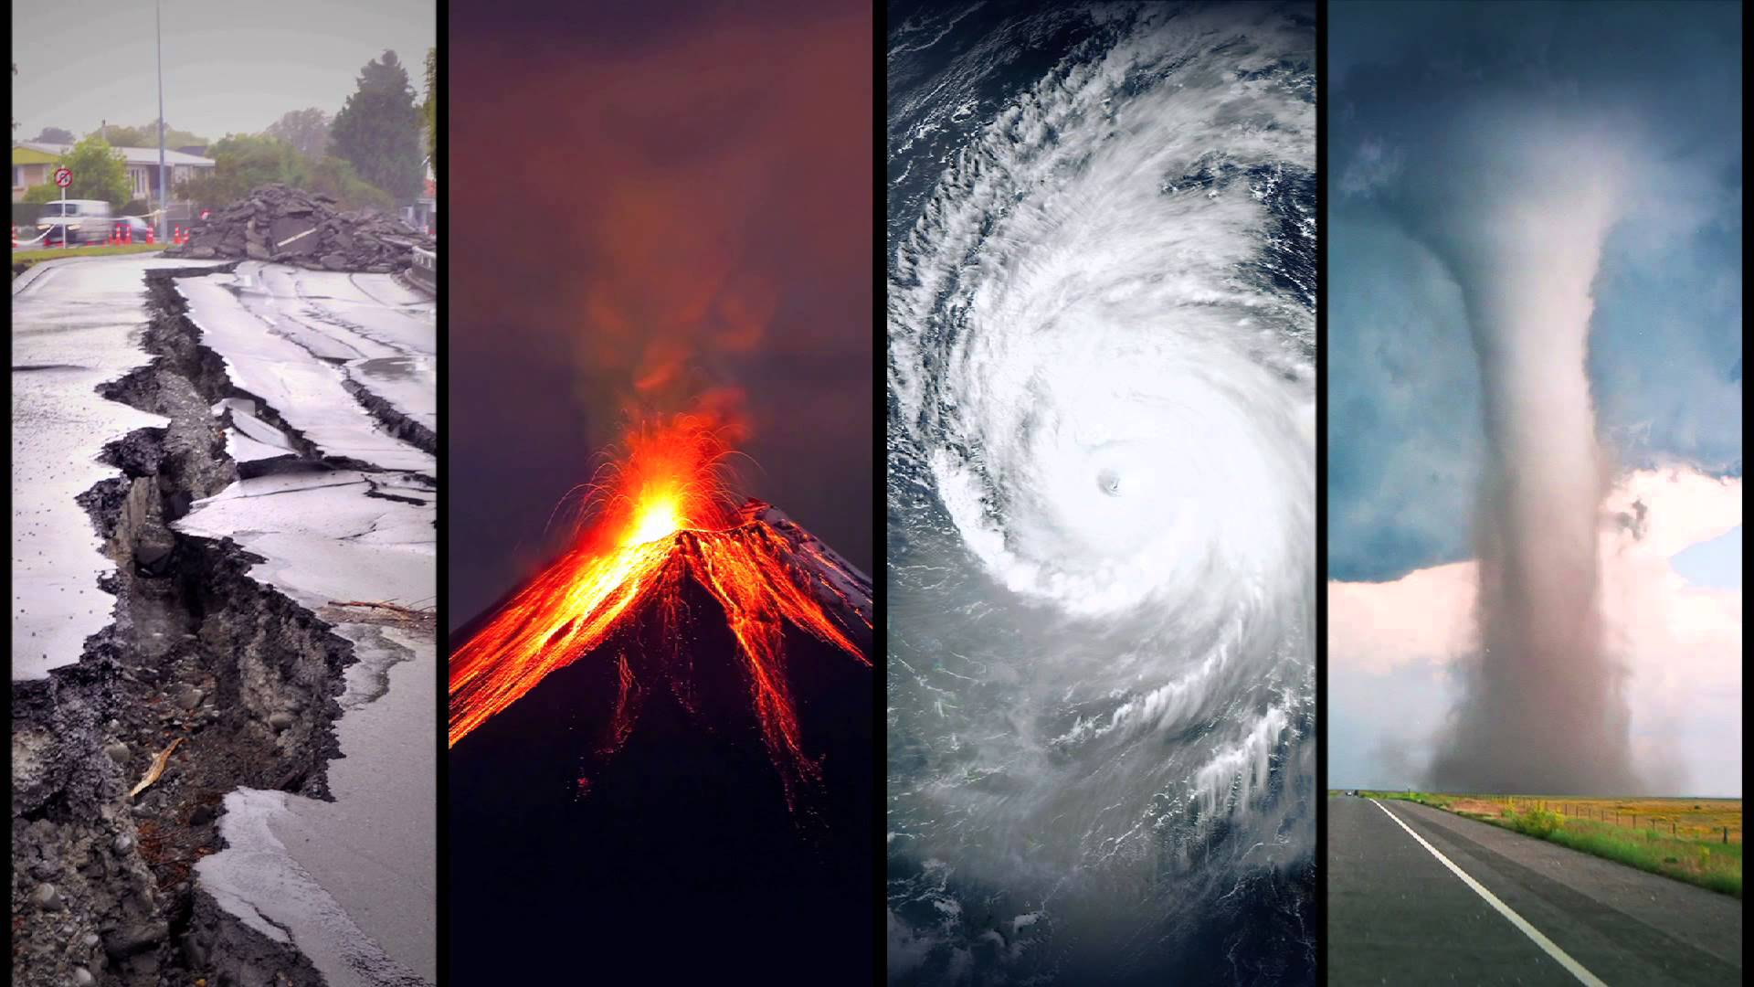
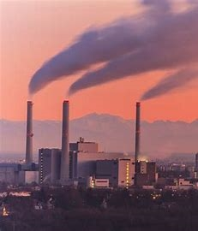
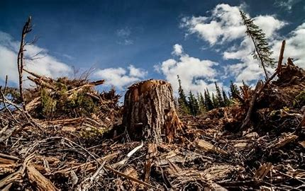
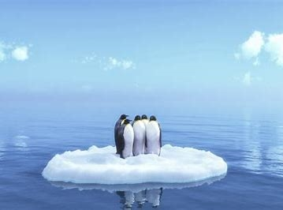
Warm Up
What’s the difference between them?
What do the pictures show?
A major adverse event resulting from natural processes of the Earth.
Any negative or adverse affect on a natural resource caused by human impacts.
Natural Disasters
Environment Issues
Earthquake
Volcano
hurricane
Tornado
Pollution
Deforestation
Global warming

Slide 8
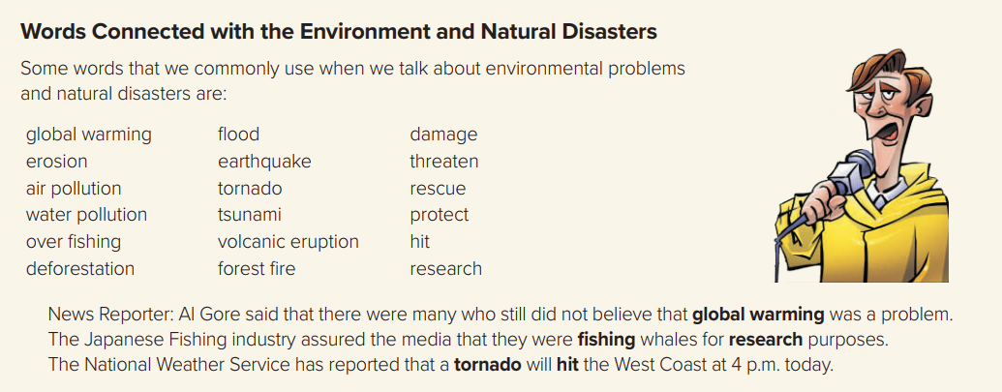

Slide 9

Fill in the space with the correct word:
tornado
global
protect
pollution
1 – My friend still don’t believe that warming was a problem.
2 – The National Weather Service has reported that a will hit the West Coast at 4 p.m. today.
3 – There’s so much in the air now that if it weren’t for our lungs there’d be no place to put it.
4 – We have to work together to our planet.

Slide 10

Negative Questions
We use negative questions to check information or express surprise.
Form
Auxiliary verb
+
not
+
subject
Wasn’t Ali at the meeting last night? (Getting confirmation)
Didn’t he study for the test? (Expressing surprise)
Don’t you want to see a doctor? (Urging someone to take action)
e.g.

Slide 11
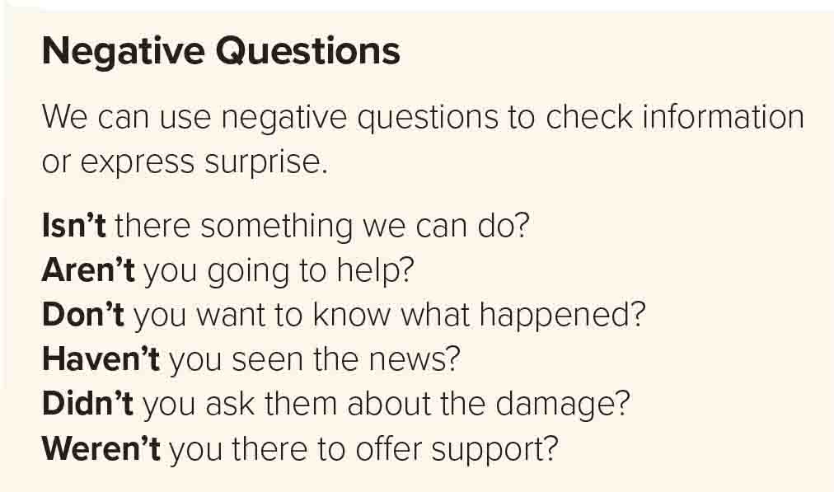

Slide 12
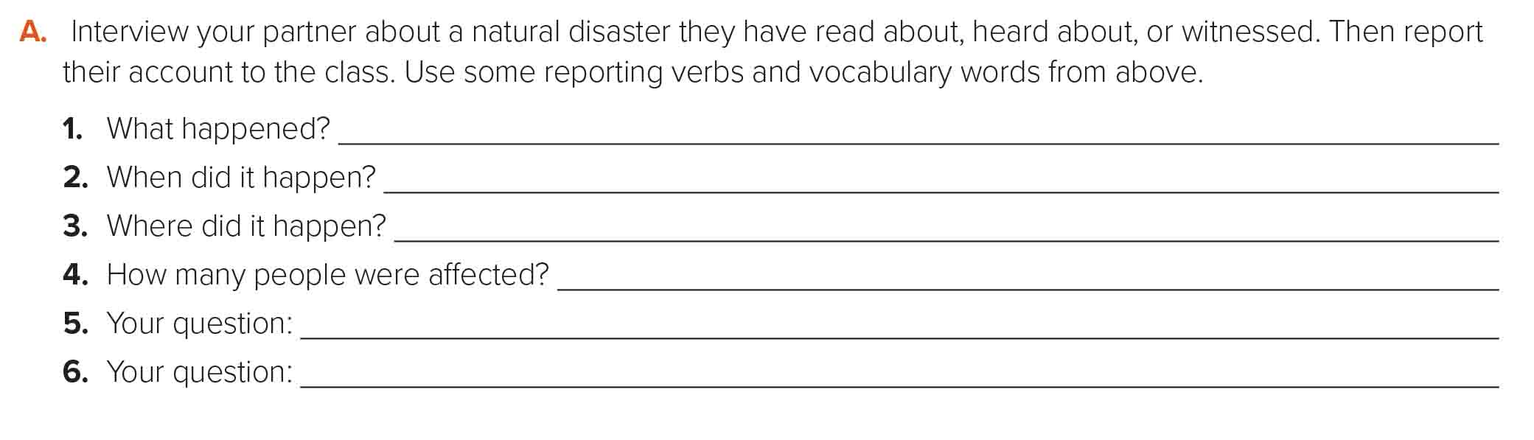
Indian Ocean tsunami
In 2004
In the Indian Ocean near the west of Sumatra.
The tsunami resulted in at least 227,898 fatalities.
What is a tsunami?
How many countries were affected?

Slide 13
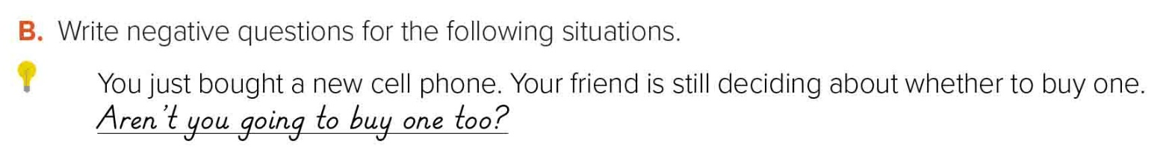
Don’t you recognize me?
Aren’t you going to offer me any?
Don’t you want you play?
Aren’t you going to say ‘hello’ to me, too?
Aren’t you going to get up today?

Slide 14
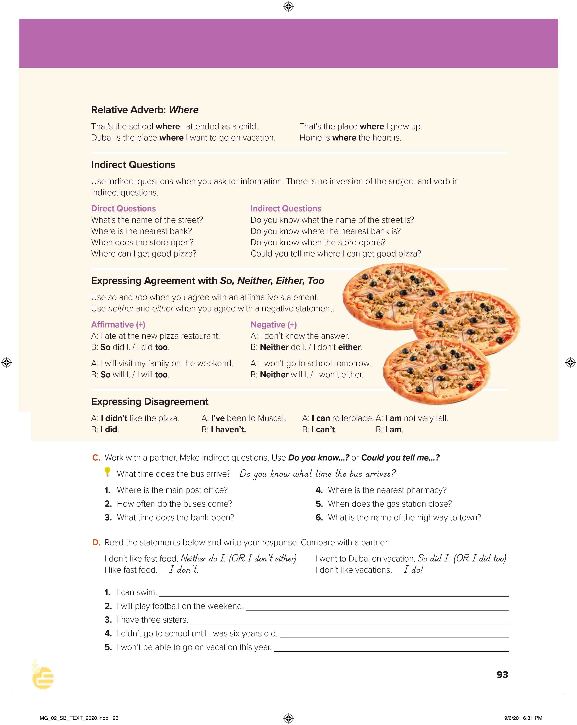
I love English
Open your Student’s book page: 93

Slide 15


Relative Pronouns
Look at the sentences, what do we use here?
The man who lives next door is a doctor.
This the car which my sister wants to buy.
That’s the place where the accident occurred.
What does each one refer to?
Who
Person
Which
Thing
Where
Place

Slide 16

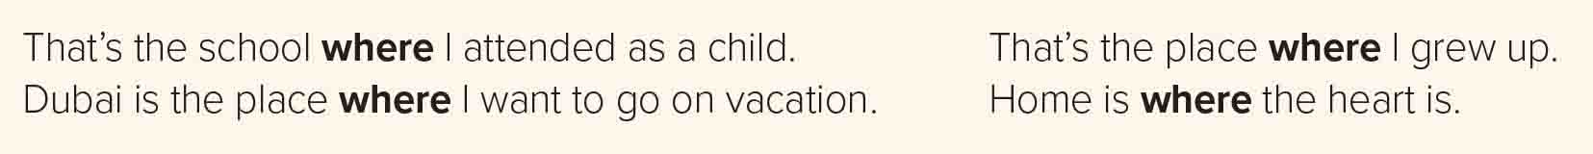
It’s used after nouns that refer to places.
What does where refer to?
The house where he was born is now a museum.
The building where my father works is too old.
That’s the shop where I bought my new sport shoes.
e.g.

Slide 17
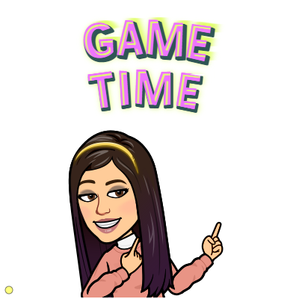

https://wordwall.net/resource/13910163

Slide 18

Direct and Indirect Questions
Direct Questions
Indirect Questions
The “normal” questions that we can ask friends, family members, and people who we know well.
More formal and polite. We use them when talking to a person we don’t know very well, or in professional situations.
Question word
Introductory phrase
Question word
Form
+
+
Form
verb
subject
+
+
subject
+
verb
e.g.
Where is the hospital?
e.g.
Could you tell me where the hospital is?
  We start the indirect questions with an introductory phrase such as:
(Do you know / Could you tell me)
In indirect questions, do not use the auxiliary (do, does, or did).
NOTES
Where does he live?
Do you know where he lives?

Slide 19
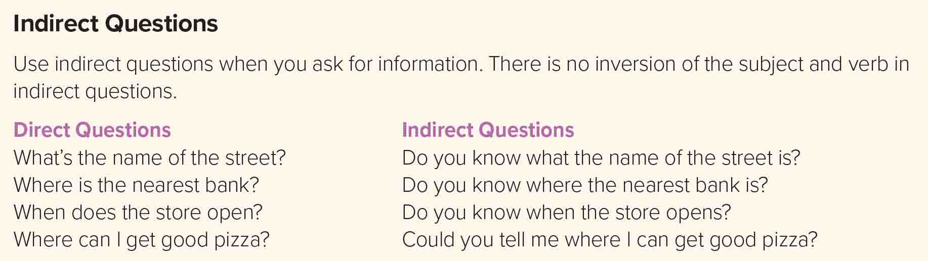

Slide 20
Express Agreement
Affirmative
Negative
Use “So” and “Too” to agree a positive statement.
Use “Neither” and “Either” to agree a negative statement.
So
auxiliary
pronoun
Neither
auxiliary
pronoun
+
+
+
+
Form
Form
Pronoun
auxiliary
too
Pronoun
either
+
+
+
auxiliary + not
+
B: So am I.
B: Neither am I.
e.g.
A: I am happy.
e.g.
A: I am not hungry.
C: I am too.
C: I am not either.
B: So do I.
B: Neither can I.
A: I like coffee.
A: I can’t stand fast food.
C: I do too.
C: I can’t either.

Slide 21
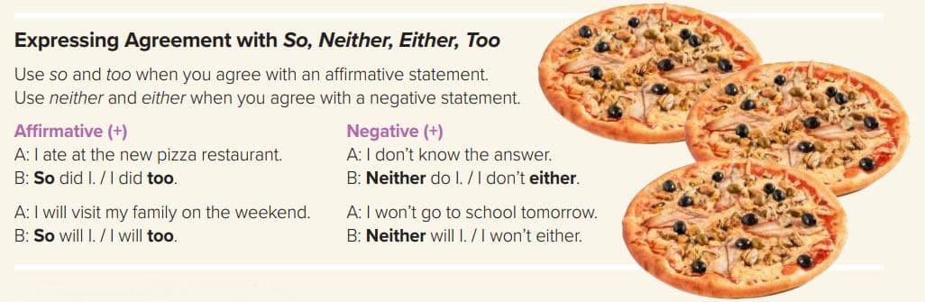

Slide 22
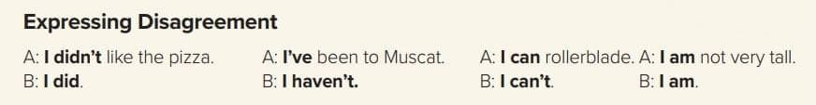
Express Disagreement
Affirmative
Negative
Positive to negative.
Negative to positive.
Form
Pronoun
auxiliary + not
+
Form
Pronoun
auxiliary
+
e.g.
A: I like chocolate.
e.g.
A: I can’t swim.
B: I don’t.
B: I can.
A: I will go to the party.
A: I didn’t study English.
B: I won’t.
B: I did.

Slide 23
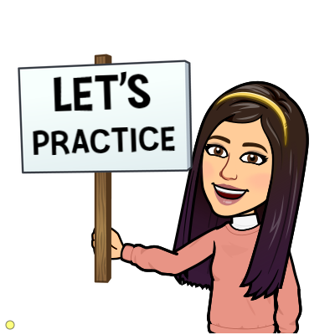
https://wordwall.net/resource/13911818

Slide 24
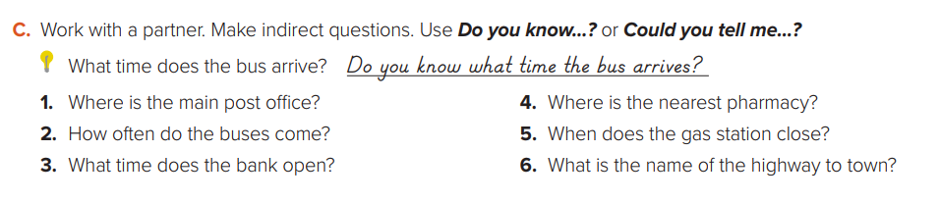
1- Do you know where the main post office is?
2- Do you know how often the buses come?
3- Do you know what time the bank opens?
4- Could you tell me where the nearest pharmacy is?
5- Do you know when the gas station closes?
6- Could you tell me the name of the highway to town?

Slide 25
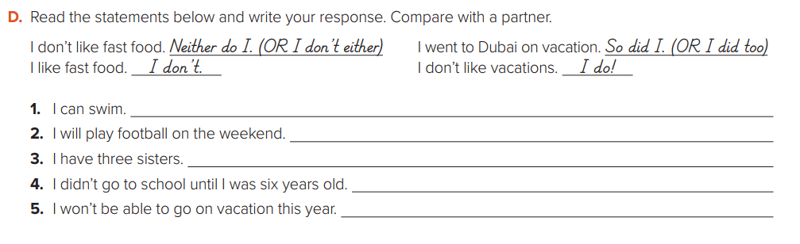
So can I / I can too
So will I / I will too
So have I / I have too
Neither did I / I didn’t either
Neither will I / I won’t either

Slide 26

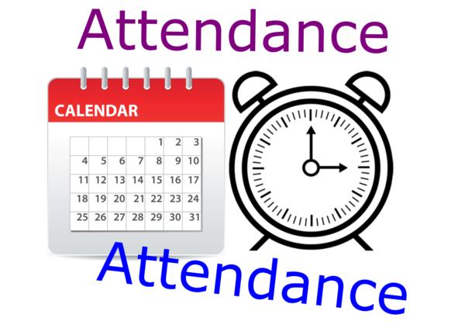
I love English

Slide 27




Homework
I love English
Work Book: Page 65

Slide 28
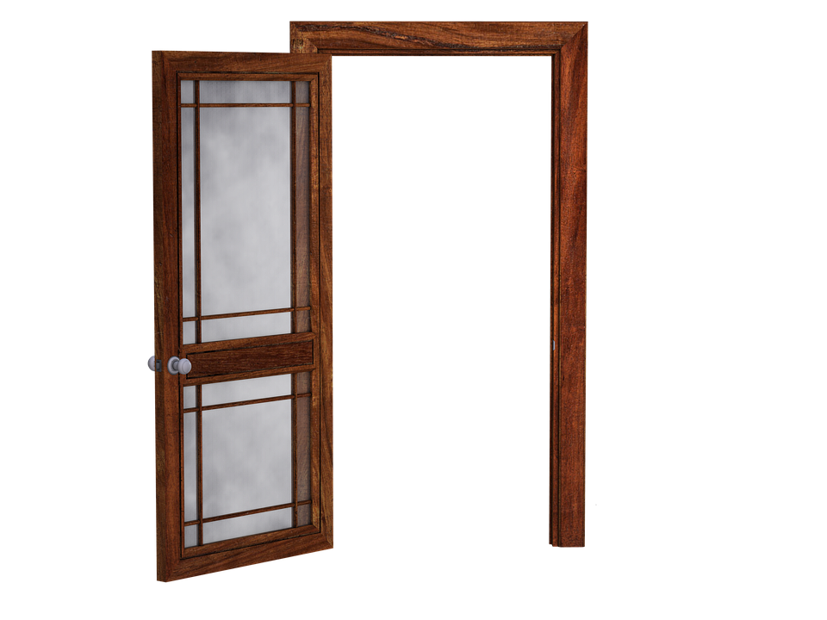
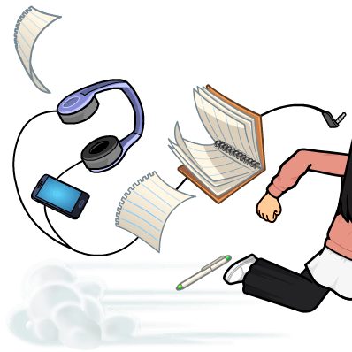
Homework
Work Book: Page 65

Slide 29
Homework
Work Book: Page 65

Slide 30
Homework
Work Book: Page 65

Slide 31
Homework
Work Book: Page 65

Slide 32
Homework
Work Book: Page 65

Slide 33

Homework
Work Book: Page 65

