Slide 1


Slide 2

Unit -3-
If It Hadn’t Happened
Good Morning

Slide 3
Unit -3-
If It Hadn’t Happened

Slide 4
9-Reading

Slide 5

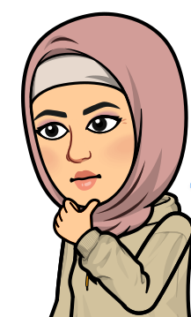
Objectives
The students will be able to :
identify the type of advice an article offers .
predict the writer's story .
find the reason that upset the friend .
inspect the action that made the driver angry .
recommend suitable advice for each problem .
compare the two stories .

Slide 6

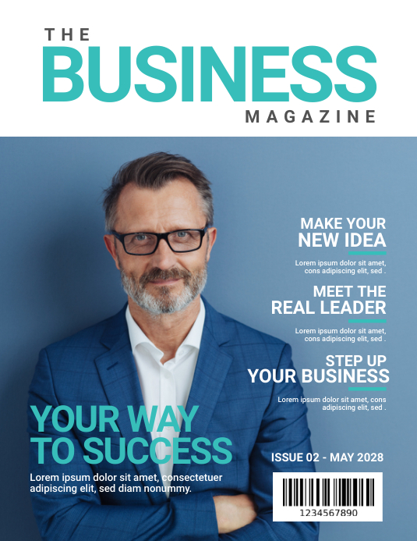
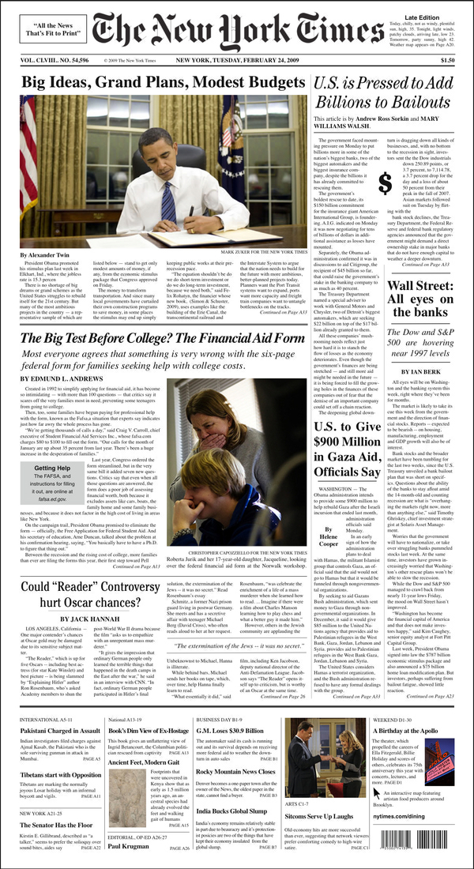
Warm Up
Do you prefer reading newspaper and magazine ?
What are types of newspaper and magazine ?

Slide 7
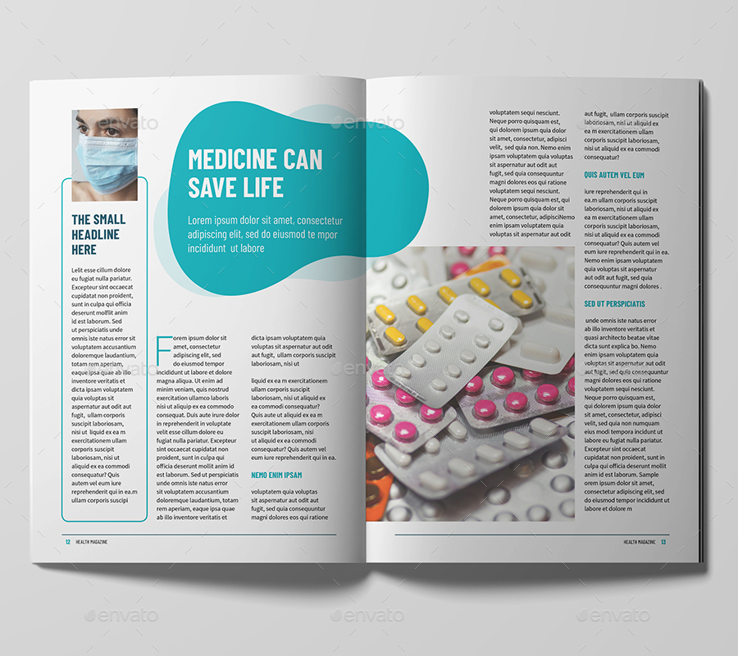
Students Book P. 40-41
Which column do you prefer to read if you have a problem?
An advice column

Slide 8

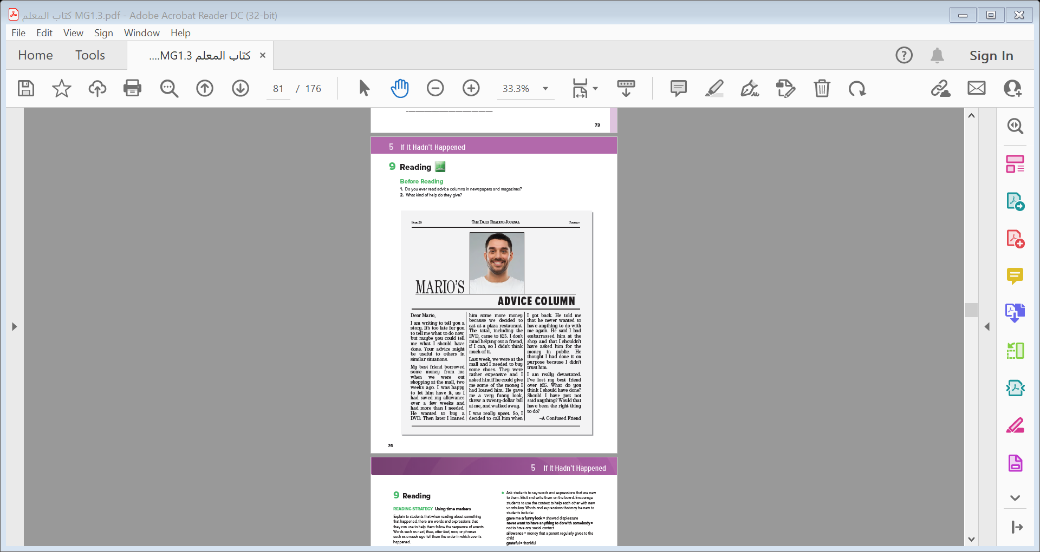
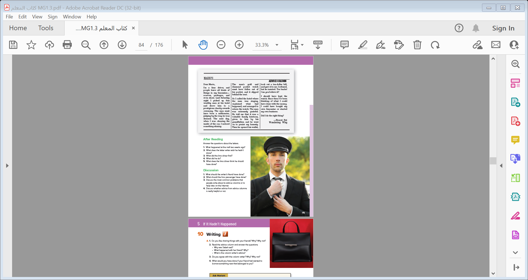
What is the title ?
How many letters are there ?
Students Book P. 40-41
What do the pictures show ?

Slide 9

Listen & Read
What is the title ?
Mario’s Advice Column
How many letters are there ?
Two
What do the pictures show ?
Mario / a limo driver

Slide 10


READING STRATEGY Using time markers
Listen & Read

Slide 11
READING STRATEGY Using time markers
Notes:
Explain to students that when reading about something
that happened, there are words and expressions that
they can use to help them follow the sequence of events.
Words such as next, then, after that, now, or phrases
such as a week ago tell them the order in which events
happened.

Slide 12
What did the writer lend his friend ?
What did the writer’s friend want to buy ?
How much money did he lend his friend ?
What did the writer need to buy ?
What happened when the writer asked his friend some of the money ?
What was the writer’s reaction after his friend walked away?
Did the writer’s friend misjudge him ?
Yes, he did .
What is the main idea of this letter ?
A problem with a friend

Slide 13
Scan..
His job is….
What did people leave in his limousine ?
What was the driver’s speculation about the man?
How did the driver judge that the man must have been a millionaire ?
What did the driver find in his car ?
What did the driver do ?
How was the man’s feeling ?
How much money did the driver get ?
Did the writer regret to get it back ?
Yes, he did .
What is the main idea of this letter ?
A missing watch

Slide 14
Unfamiliar words
Scan..
money that a parent regularly gives to the
child
showed displeasure
thankful
not to have any social contact
to say you admire

Slide 15
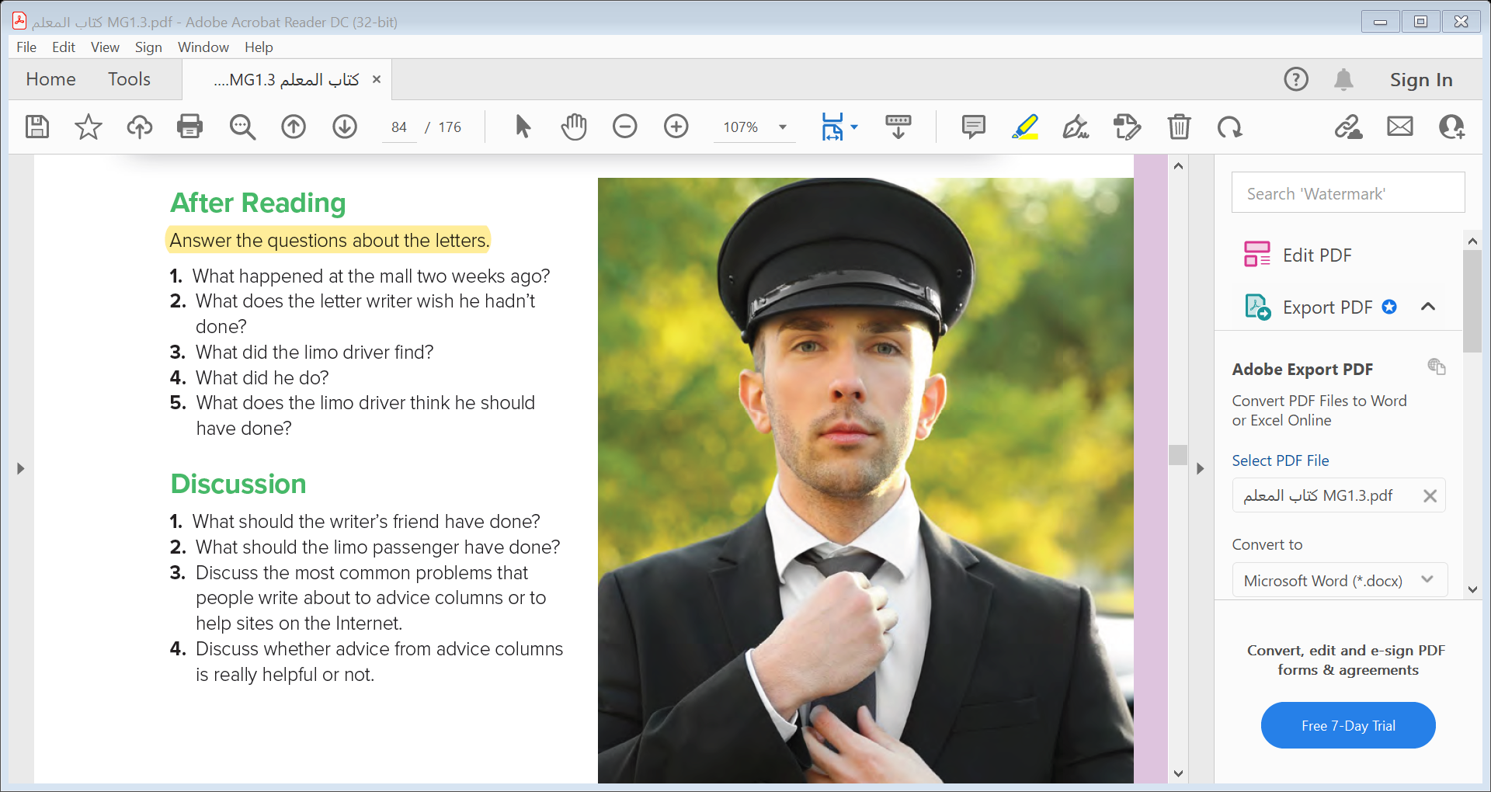
1- The letter writer lent some money to his friend.
2- The letter writer wishes that he hadn’t asked for the money in public .
3- The driver found a passenger’s diamond pocket watch .
4- The driver returned the watch to the passenger .
5- The driver thinks that he should have sold the watch and bought his own limo or started his own business.

Slide 16


Slide 17


Quick Check

Slide 18
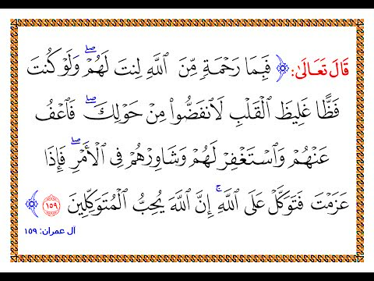

Slide 19


