Slide 1



Slide 2

Good Morning

Slide 3
Unit-4-
What They Said

Slide 4
1-Listen and Discuss
2-Pair Work

Slide 5

Objectives
The students will be able to :
compare the different reporting styles
match words with their meanings .
practice using reported speech .
correct some information about the reports .

Slide 6

Warm Up
1-Listen and Discuss
Listen & Read

Slide 7

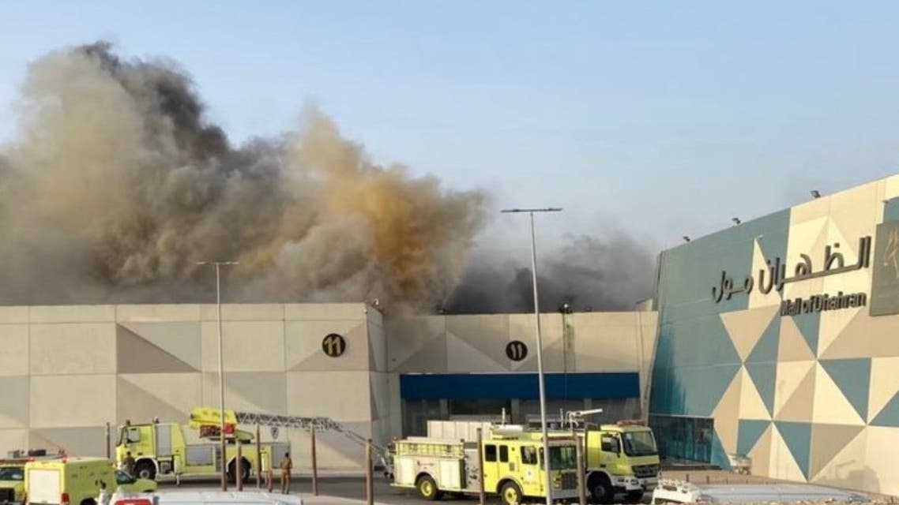
Warm Up
There was a fire in Dahran Mall Downtown. Nobody was hurt, but the Mall was destroyed.
Where are they ?
How many pictures are there?
What are they doing?
Skimming
Listen & Read

Slide 8

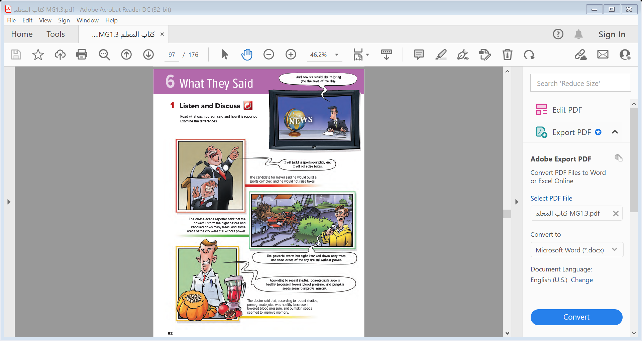
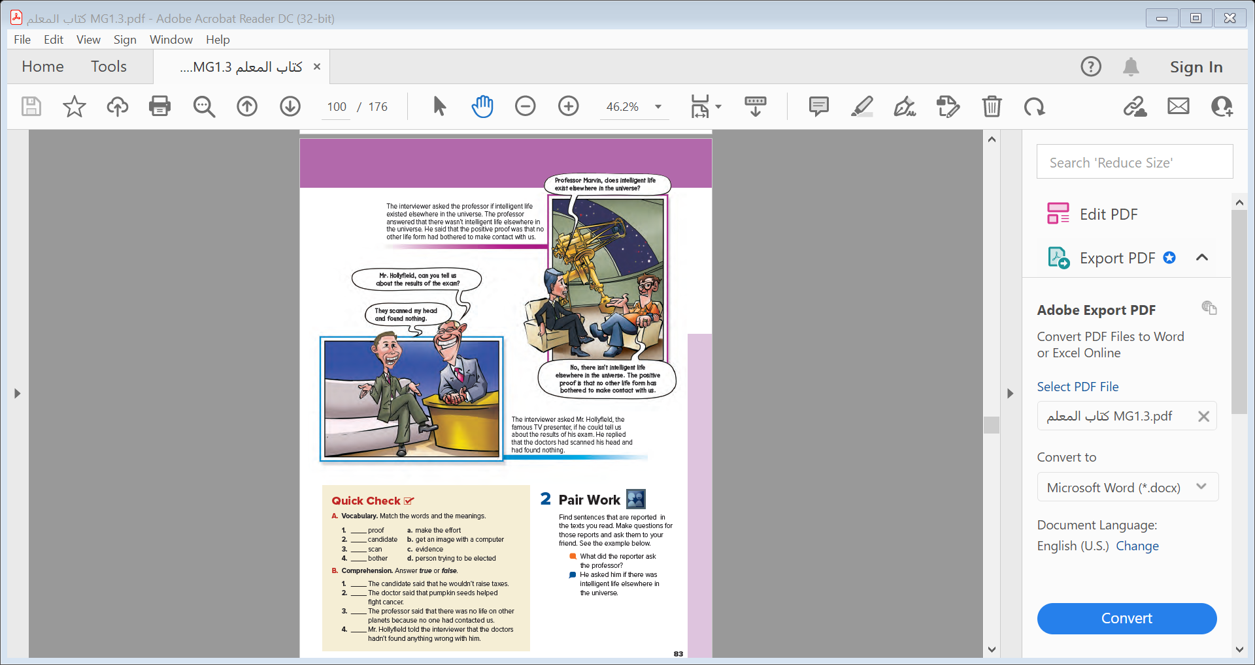
Listen & Read
Skimming
How many pictures are there?
What are they doing?
Where are they ?

Slide 9

Who is he?
Listen & Read

Slide 10
Who is he?
announcer

Slide 11
What did the candidate for mayor promise?
(to build a sports complex and not raise taxes)
Why do you think he promised this?
to gain votes

Slide 12
How much damage did the storm cause?
a lot of damage)

Slide 13
What did the doctor recommend to lower
blood pressure?
(pomegranate juice)
What did the doctor say pumpkin seeds were
good for?
improving memory

Slide 14
Notes:
is irrational to assume that there
is no intelligent life elsewhere just because no one has
been successful contacting Earth. We would contact life
elsewhere in the universe if we could

Slide 15

What is funny in the conversation with Mr. Hollyfield ?
He intended to say that the doctor found no problems
With his head (or brain), but instead he said that they saw nothing in his head .
Can his reply have a different meaning that makes it funny ? What is it ?
That he has no brain
Notes:
Ask students what is funny in the conversation with Mr.
Hollyfield. Point out that he intended to say that the
doctor found no problems with his head (or brain), but
instead he said that they saw nothing in his head. This
obviously has a very different meaning—that he has no
brain

Slide 16
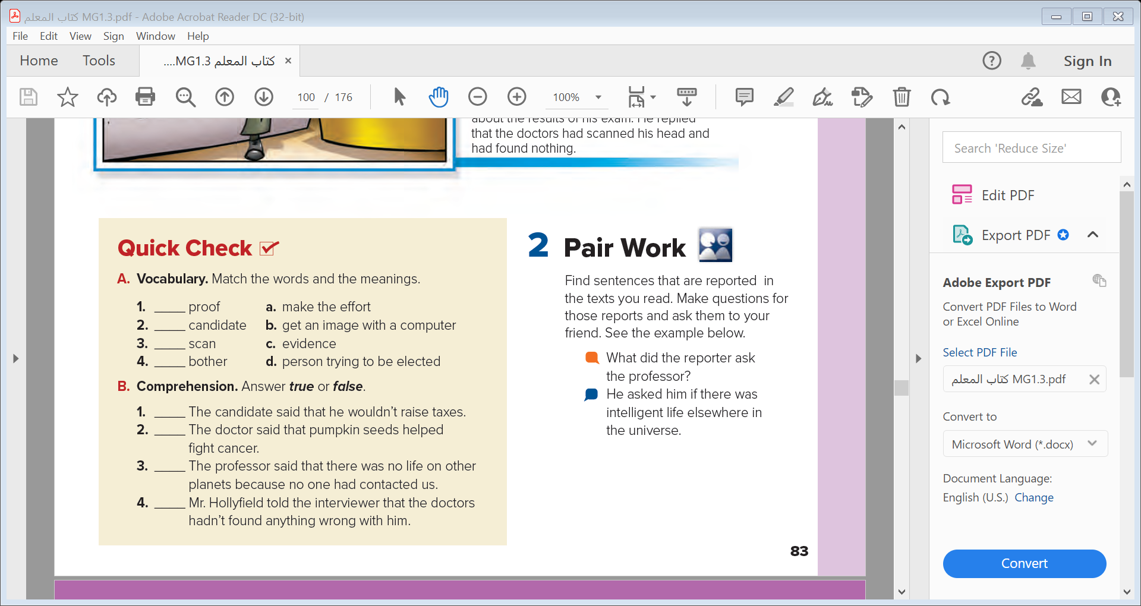
c
d
b
a
true
false
true
true

Slide 17
2-Pair Work

Slide 18
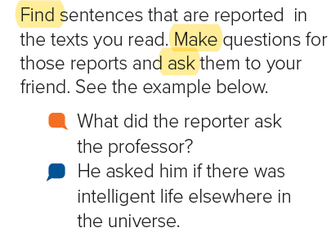


Slide 19


