Slide 1
Unit 4
What They Said?
Grammar
Mega Goal 1.3
Done by : Entisar Al-Obaidallah

Slide 2

Lesson Objectives
01.
02.
03.
04.
Report
Use
Direct speech using the correct tense
The correct tense to Report questions
Change
Replace
Pronouns /adverbs of time correctly in reported speech
the verb “ say “ with variety of verbs with different shades of meaning

Slide 3

Your book , p.(50)
Open

Slide 4
01.
Reported Speech

Slide 5
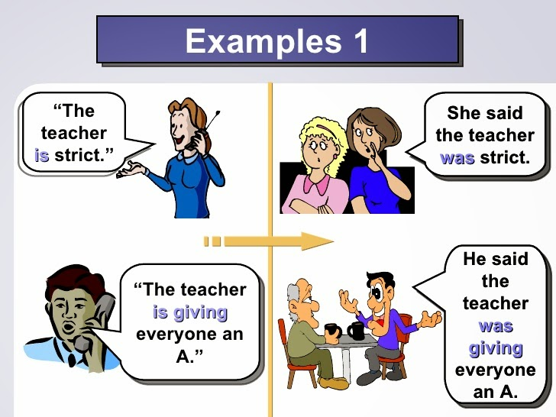
Look at these two examples:
Note: When we convert direct to reported speech , we use different tenses and modals

Slide 6



Reported Speech
Use:
➔ to report what someone has said without using their exact words .
I like ice cream.
Example:
What did he say??
He said ( that ) he liked ice cream.
Change the pronoun
Change the tense of the verb

Slide 7
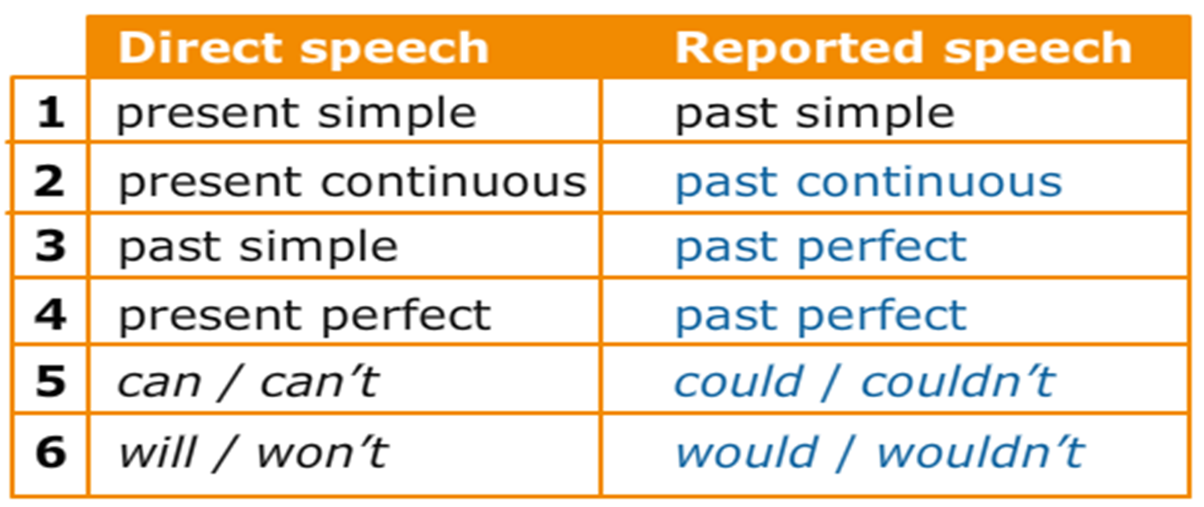
The Tense of Reported Speech
➔When we change DIRECT SPEECH to REPORTED SPEECH, we usually change the verb form to go ONE TENSE BACK

Slide 8
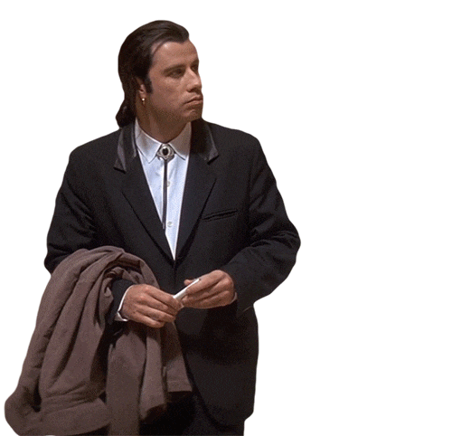
Changing pronouns, personal and possessive.
Pronouns change (or not) depending on the view of the reporter
I | ME | MY
He/She | him/her | his/her
WE | US | OURS
they | them | their
Example
Direct Speech: John said, “ I am waiting”
Reported Speech: John said (that) he was waiting
Change the pronoun
Change the tense of H.V

Slide 9
Time and Place Changes
It is often necessary to make time and place changes in relation to tense changes.
DIRECT SPEECH | REPORTED SPEECH
Now | Then
Today | That day
Tonight | That night
Yesteday | The day before
Tomorrow | The following day/The next day
Next day/Week/Month/Year | The following day/Week/Month/Year

Slide 10


Slide 11
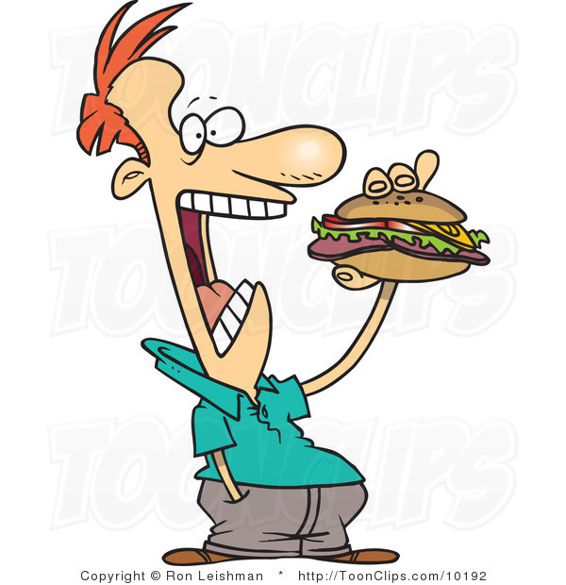
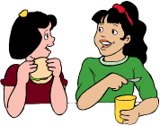
Simple Present
Simple Past
“I eat a lot of sandwiches”
What did he say?
He said (that) he ate a lot of sandwiches ..

Slide 12

➔Be careful with pronouns:
My sister is coming to visit me.
What did she say?
She said (that) her sister was coming to visit her ..

Slide 13
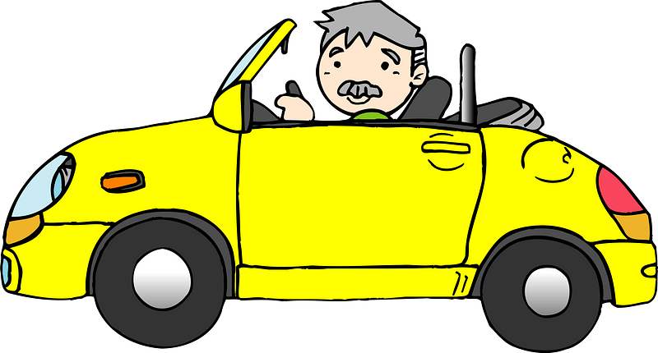
Present progressive
Past Progressive
“I am driving a car at the moment”
What did he say?
He said (that) he was driving a car then..

Slide 14

Past Simple
Past Perfect
“I bought a new car last month”
What did she say?
She said (that) she had bought a new car the month before.

Slide 15
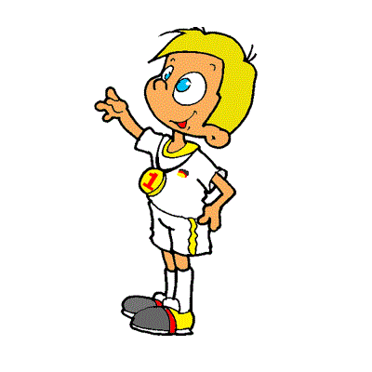
Present Perfect
Past Perfect
“I have won the competition”
What did he say?
He said (that) he had won the competition.

Slide 16
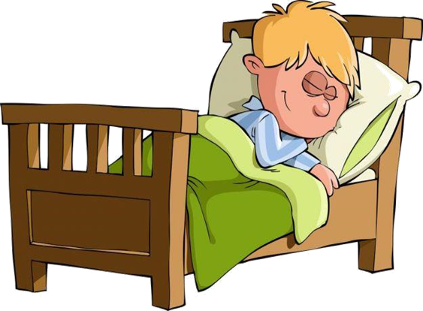
Modal ( will)
would
“I will go to bed early today”
What did he say?
he said (that) he would go to bed early that day.

Slide 17

Modal ( can)
could
"I can teach English online."
What did he say?
He said (that) he could teach English online

Slide 18
02.
Reported Questions

Slide 19
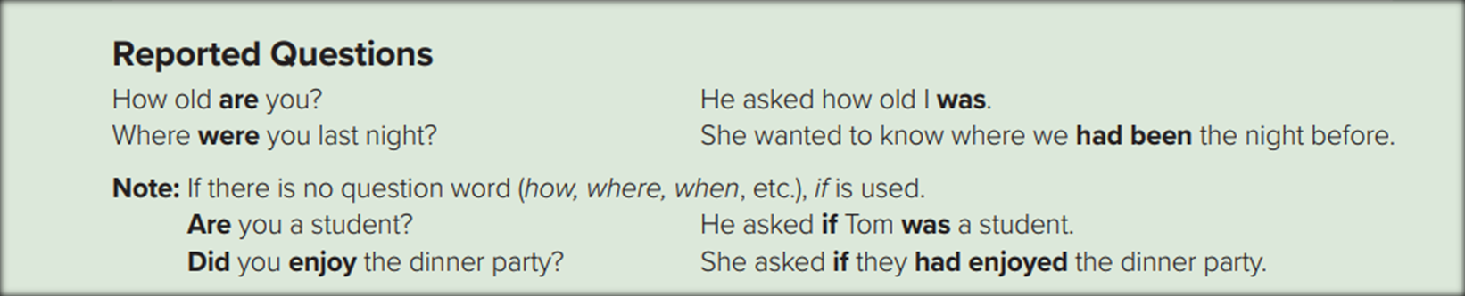
General:
We use reporting verbs: ask, want to know, wonder
Tense, pronoun and possessive adjective, and adverbs of time and place
change as in statement
The interrogative form ( ?) of the verb changes to the affirmative form (+).
The question mark (?) is omitted.

Slide 20


1- Yes-No Question
➔We introduce reported Yes/No questions with ask + if
➔The inversion in the direct question changes to statement word order.
Example :
“Are you ready?”
→ He asked (me) if I was ready.
Add if
Change the pronoun
Change the tense
He asked (me) if I was ready

Slide 21
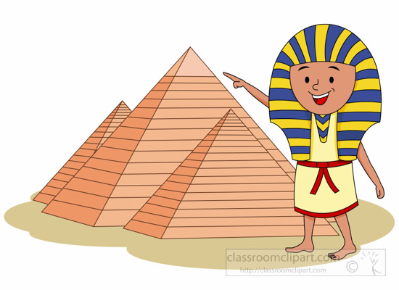
Yes –No Questions
Have you ever seen the pyramids?
What did he ask?
He asked me if I had ever seen the pyramids .

Slide 22

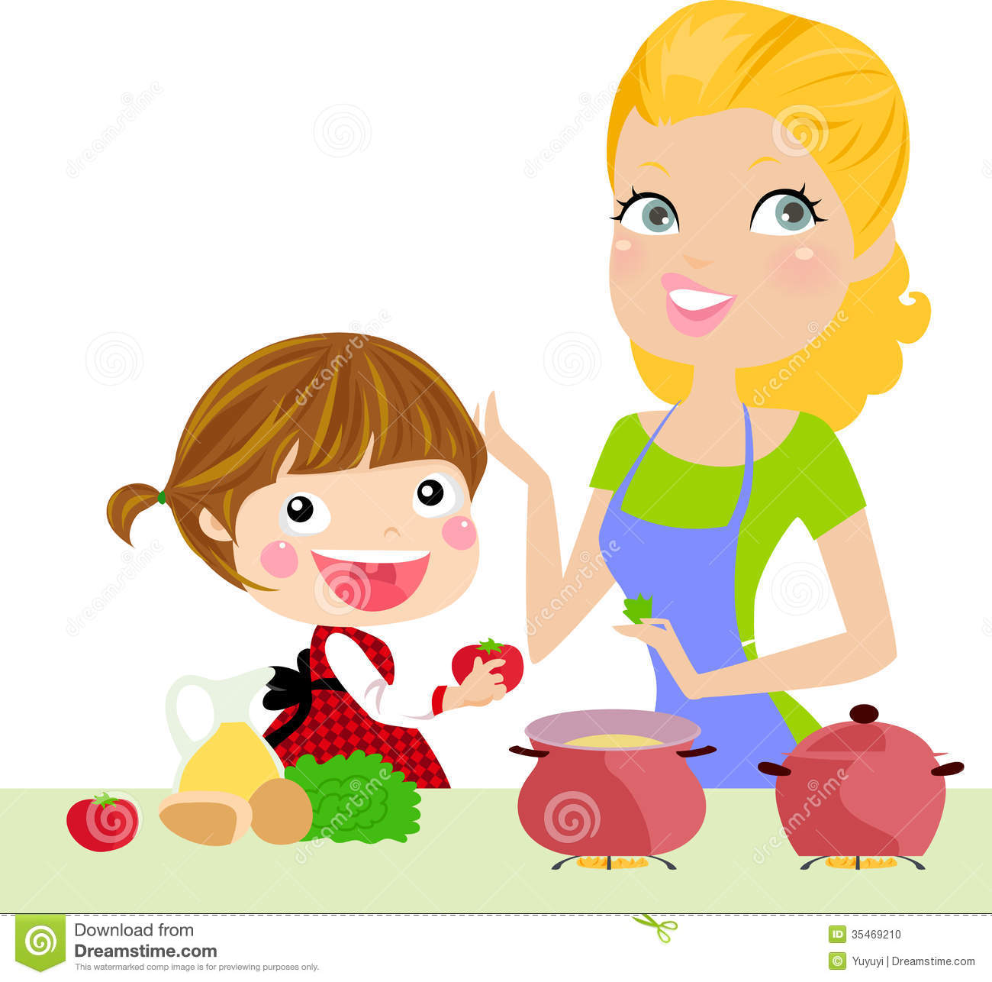
Yes –No Questions
The reported question has no auxiliary "do".
Do you cook the dinner?
She asked me if I cooked the dinner .
What did she say?

Slide 23
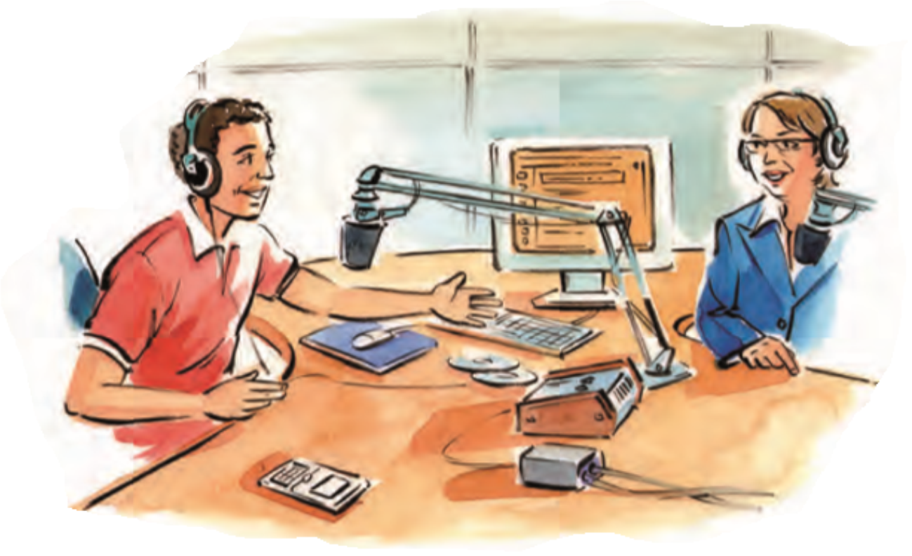
2-Wh Questions
➔We introduce reported Wh questions with ask + question word
He asked me where I studied .
Where do you study ?
What did he say?
21.8%
34.5%
32.7%
10.9%

Slide 24

2-Wh Questions
Change simple past Past Perfect ( Had + V.p.p(3)
He asked me why I had cooked fish
Why did you cook fish?
What did he say?
21.8%
34.5%
32.7%
10.9%

Slide 25

2-Wh Questions
Change Present Perfect Past Perfect ( Had + V.p.p(3)
How long have you lived in London ?
She asked me how long I had lived in London
What did she say?
21.8%
34.5%
32.7%
10.9%

Slide 26

2-Wh Questions
Change will would
Change can could
She asked me when I would visit her family .
What did she say?
21.8%
When will you visit my family ?
34.5%
32.7%
10.9%

Slide 27
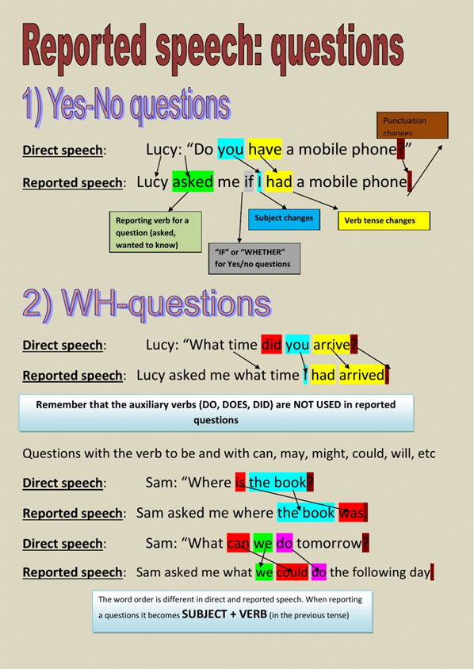


Slide 28
03.
Words Changes in Reported Speech

Slide 29
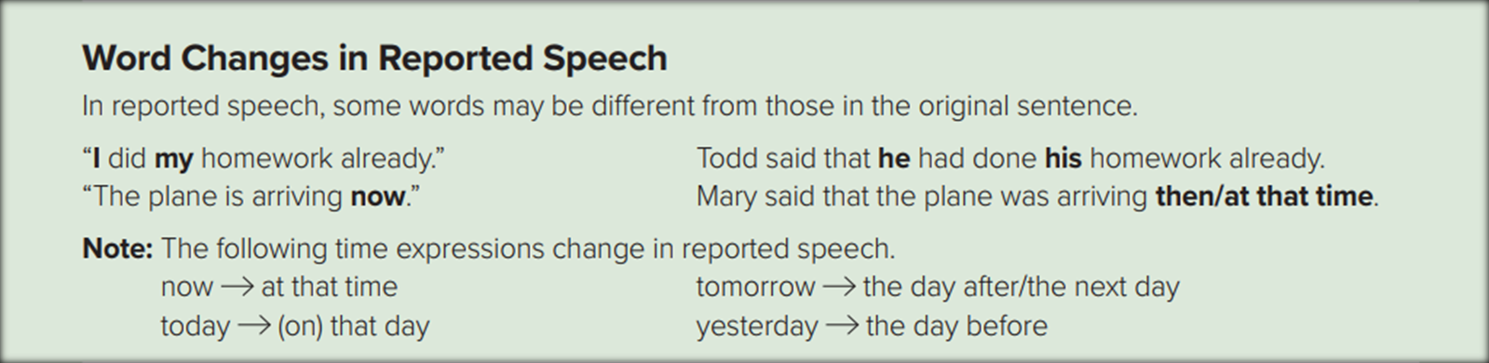

Slide 30
04.
Reporting Verbs

Slide 31
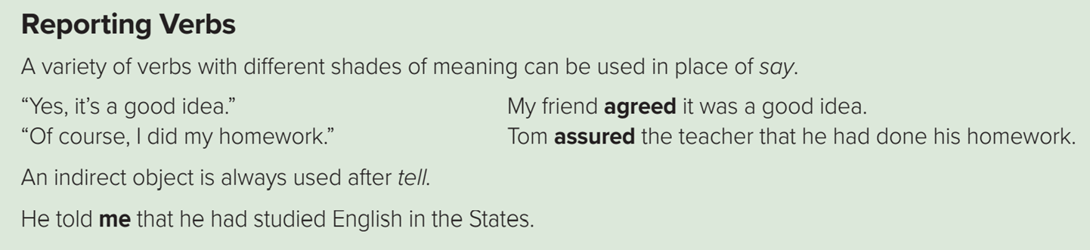
We use say and tell in both direct and indirect speech.
  We cannot use say or tell with reported questions.

Slide 32

From The Holy Qura’an

Slide 33

Homework workbook exercise (c). p. ( 110) ,

Slide 34

THANKS!

