Slide 1


Slide 2


Slide 3

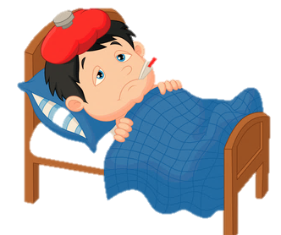
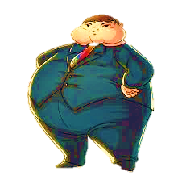
Revision
Unit -1-
Complaints ,Complaints
8-Conversation

Slide 4
Revision
Give them an advice
You should see a doctor .
You had better lose weight .

Slide 5

Where are they?
Skimming
Objectives
What do you see?
The students will be able to :
perform a conversation to complain about products .
use “ real talk " phrases in new conversations .
Answer comprehension questions about the conversation
Share positively in pair work.
What do you think
the problem is?

Slide 6

Listen & Read
Skimming
Salesperson: Can I help you, ma’am?
Customer: Yes, please, if you could. I’d like to return a
pair of jeans that my son bought—they’re
wide-cut with faded colors.
Salesperson: It sounds like one of Milo’s creations.
He designs loose-fitting clothing, and faded
clothes are in style this season. Your son
didn’t like them?
Customer: No, it’s not that. It’s the fabric. It’s really
flimsy, and…
Salesperson: Well, lightweight fabrics are the latest trend. Customer: You don’t seem to understand.
Salesperson: Of course, ma’am, I’ll try to help. Can you give me the jeans?
Customer: You see, they’re torn at the knees, and in several other places, and the material is falling apart. I noticed it when I was putting them in the washer.
Where are they?
What do you see?
What do you think
the problem is?

Slide 7

Scanning
Listen & Read
Salesperson: Can I help you, ma’am?
Customer: Yes, please, if you could. I’d like to return a
pair of jeans that my son bought—they’re
wide-cut with faded colors.
Salesperson: It sounds like one of Milo’s creations.
He designs loose-fitting clothing, and faded
clothes are in style this season. Your son
didn’t like them?
Customer: No, it’s not that. It’s the fabric. It’s really
flimsy, and…
Salesperson: Well, lightweight fabrics are the latest trend. Customer: You don’t seem to understand.
Salesperson: Of course, ma’am, I’ll try to help. Can you give me the jeans?
Customer: You see, they’re torn at the knees, and in several other places, and the material is falling apart. I noticed it when I was putting them in the washer.
Unfamiliar words ,,,

Slide 8
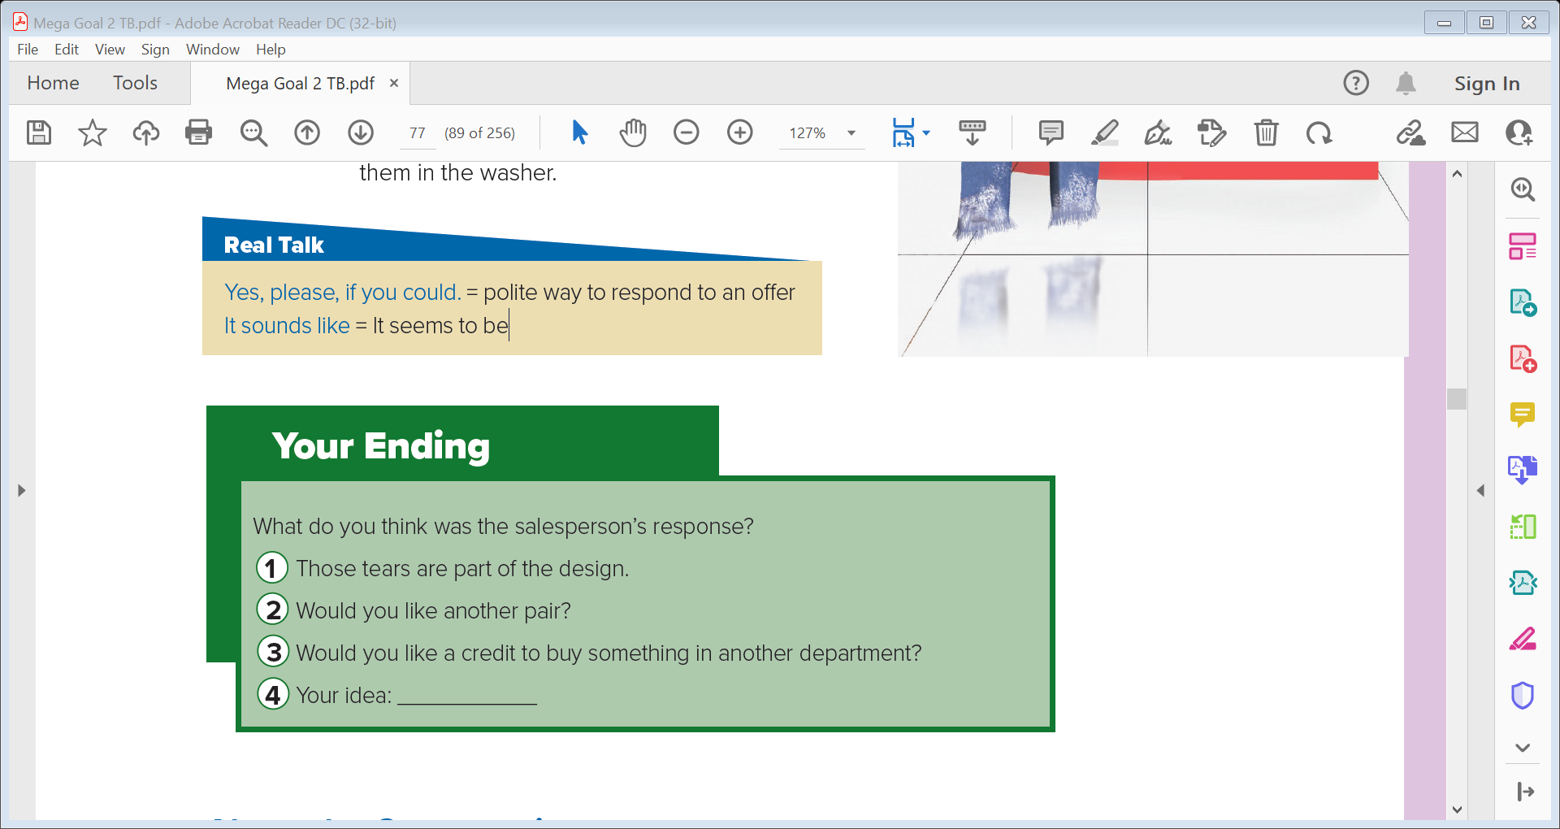
Scanning
Salesperson: Can I help you, ma’am?
Customer: Yes, please, if you could. I’d like to return a
pair of jeans that my son bought—they’re
wide-cut with faded colors.
Salesperson: It sounds like one of Milo’s creations.
He designs loose-fitting clothing, and faded
clothes are in style this season. Your son
didn’t like them?
Customer: No, it’s not that. It’s the fabric. It’s really
flimsy, and…
Salesperson: Well, lightweight fabrics are the latest trend. Customer: You don’t seem to understand.
Salesperson: Of course, ma’am, I’ll try to help. Can you give me the jeans?
Customer: You see, they’re torn at the knees, and in several other places, and the material is falling apart. I noticed it when I was putting them in the washer.
Salesperson: Can I help you, ma’am?
Customer: Yes, please, if you could. I’d like to return a
pair of jeans that my son bought—they’re
wide-cut with faded colors.
Salesperson: It sounds like one of Milo’s creations.
He designs loose-fitting clothing, and faded
clothes are in style this season. Your son
didn’t like them?
Customer: No, it’s not that. It’s the fabric. It’s really
flimsy, and…
Salesperson: Well, lightweight fabrics are the latest trend. Customer: You don’t seem to understand.
Salesperson: Of course, ma’am, I’ll try to help. Can you give me the jeans?
Customer: You see, they’re torn at the knees, and in several other places, and the material is falling apart. I noticed it when I was putting them in the washer.
Unfamiliar words ,,,
fade = to lose color or brightness flimsy = thin, light, not strong
trend = style

Slide 9


Real Talk

Slide 10
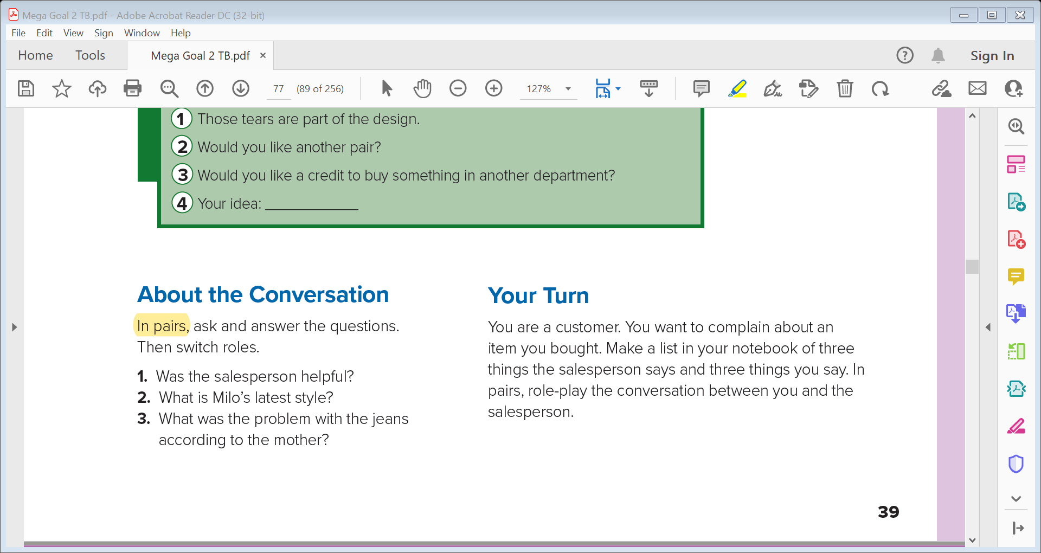

About the Conversation
Real Talk
Yes, please, if you could.
It sounds like
polite way to respond to an offer
= It seems to be
Can I help you ? Yes, please, if you could. I’d like to change this bag with a bigger one .
That kitten sounds like a human baby .

Slide 11
About the Conversation
1- The salesperson wanted to be helpful, but she didn’t understand the problem with the latest jeans. The jeans were in the latest style.
2- Milo designs loose-fitting clothes in faded colors .
3- The mother thinks that the jeans are torn and that the material is falling apart .

Slide 12
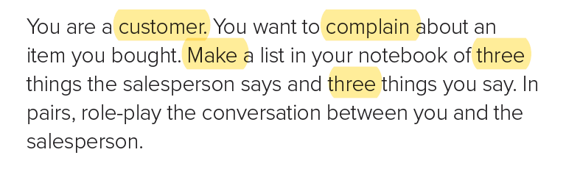
Your Turn

Slide 13



Your Turn

Slide 14
