Slide 1
Unit1 Complaints, Complaints Writing Done by: Entisar Al-Obaidallah
Mega Goal 1.3

Slide 2
Objective Lesson:
discuss an unfortunate event .
answer questions about a complaint card .
write a letter of complaint .

Slide 3
Open
Your student’s book p. 14

Slide 4
Examples
Return the product and get a refund
Return the product and replace it with a new one
Never go back to the store again
Never buy the brand again
Report the store and/or manufacturer to the
consumers’ association

Slide 5
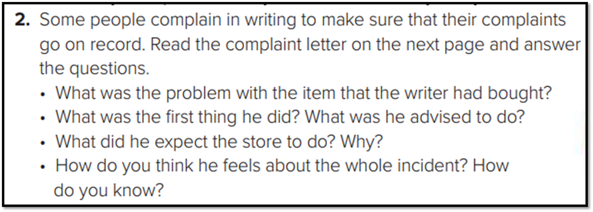
Writing:

Slide 6
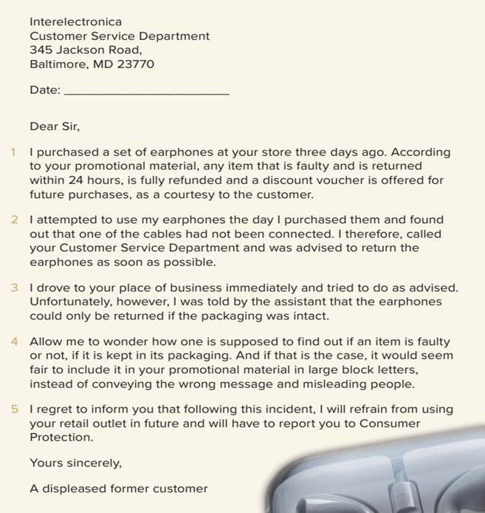
. The earphone cables are not connected.
. He called the Customer Service Department and was advised to return the item as soon as possible.
. He expected the item to be refunded and to be offered a discount voucher for future purchases according to the promotional material of the store.
. He is indignant/very angry. He expresses the way he feels in the content of the last two paragraphs.

Slide 7
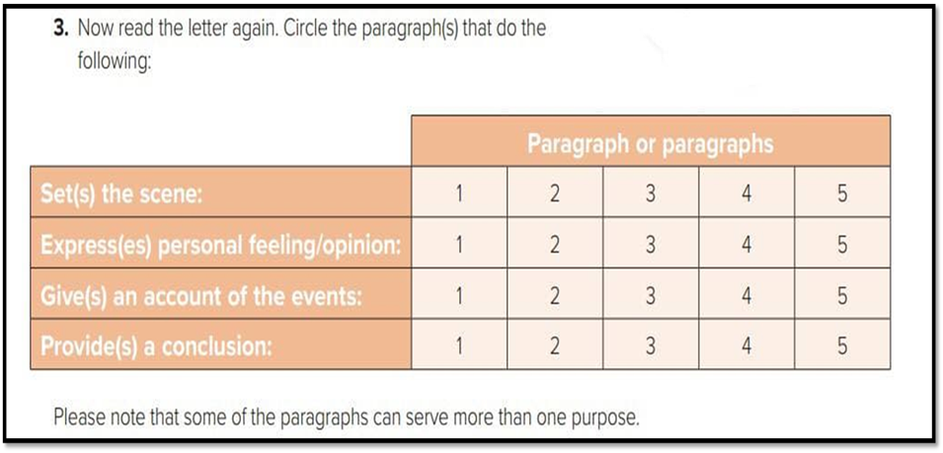

Slide 8
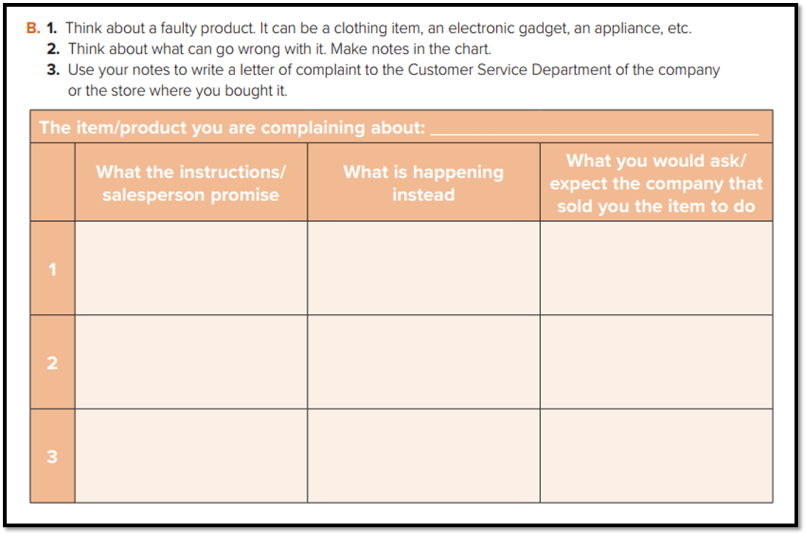
Leather jacket
Refund or change the item
Refund / on sale
Refund or change the item

Slide 9
Open
Your student’s book p. 43

Slide 10
Address of the company
How to write a letter of complaints
Greeting( formal)
Account of actual events
Express personal feeling clearly
closing
signature

Slide 11
Remember:

Slide 12
Homework
Your work book p.(86),
exercisi (K)

Slide 13
Thanks!

