Slide 1
Unit3
Complaints, Complaints
Form , Meaning & Function
Mega Goal 1.3
Done by: Entisar Al-Obaidallah

Slide 2
Lesson Objectives
01
02
Use
Ask
04
05
use
Practice
03
Ask
present perfect tense to talk about recently completed actions
About recently completed actions using the present perfect tense
About an event happened earlier using already, yet & just
06
Use
Objective pronouns correctly
Using Need- Want- Like + infinitive
Imperatives and Two – Word Verbs

Slide 3

Open
Your studen’s book p. 16

Slide 4
01
Present Perfect Simple Tense

Slide 5
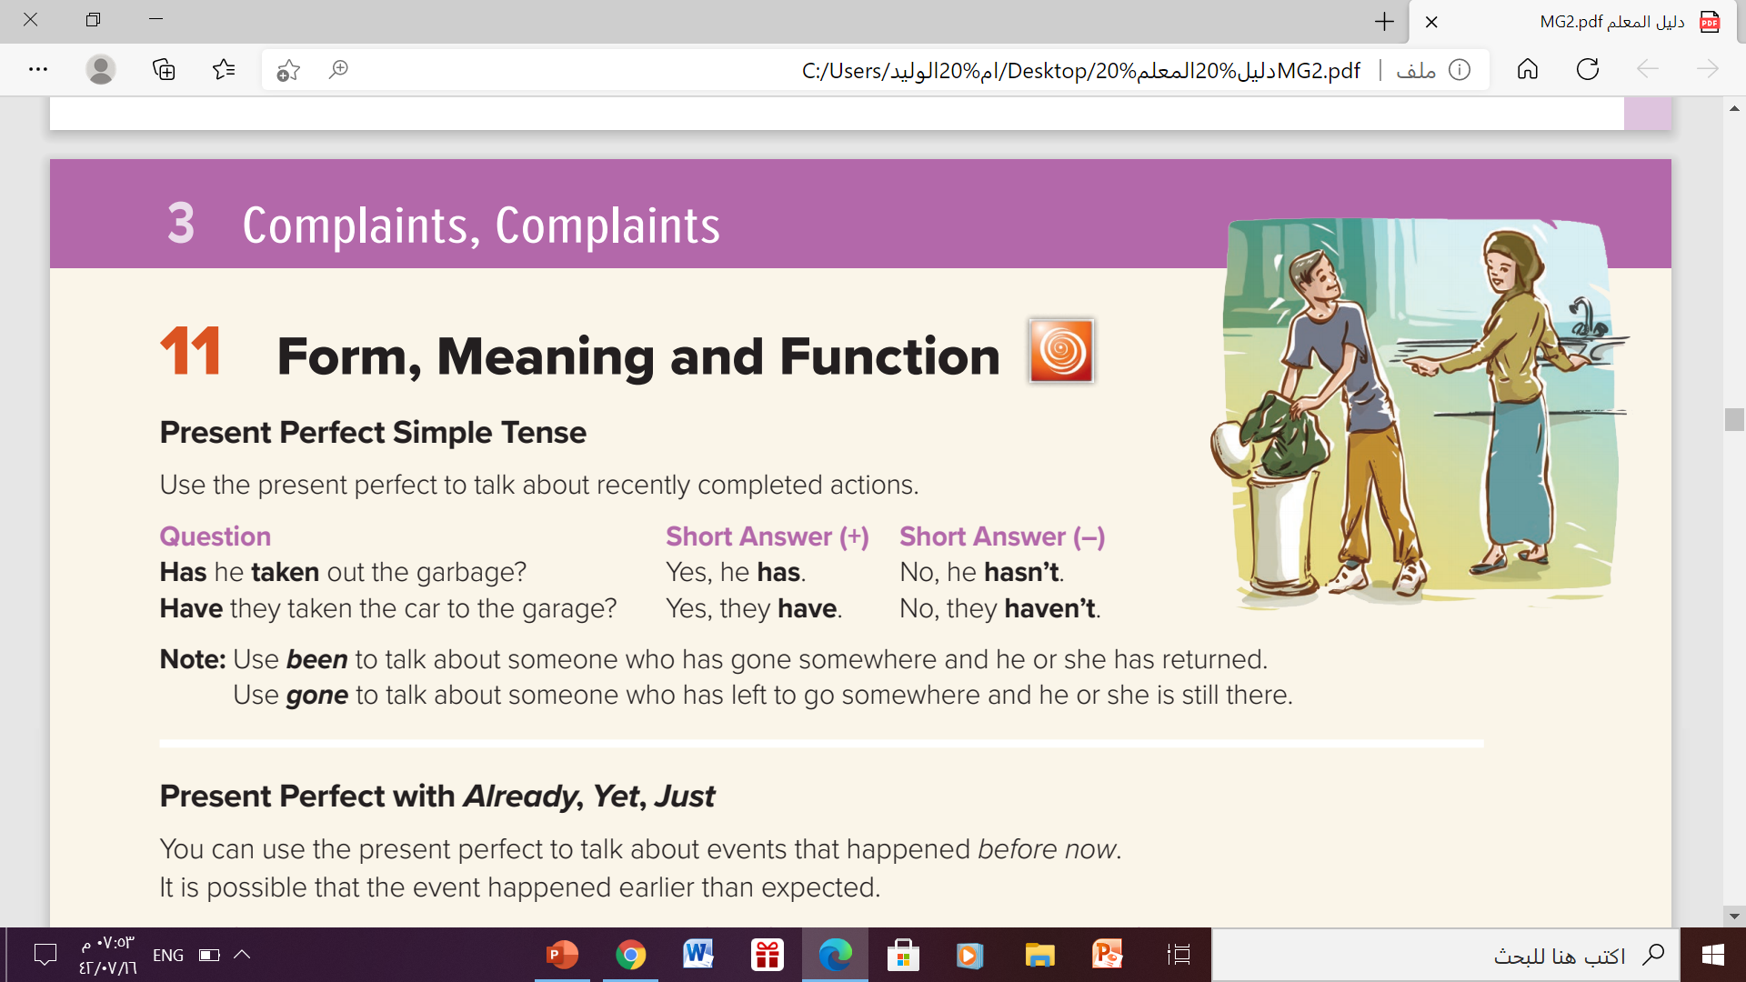
Present Perfect Tense:

Slide 6
Present Perfect Simple Tense
Use
To talk about recently completed actions
Example
She has cleaned the room .
They have played football.
Form
I
You
We
They
She
He
It
has
have

Slide 7
Form:
Affirmative(+)
Subject (She- He –It – singular)
has
V(p.p.3)
He has done his homework
V(p.p.3)
Subject (I -you - we - They - plural)
have
We have finished the lesson.

Slide 8
Form:
Negative (-)
hasn’t
V(p.p.3)
Subject (She- He-It -singular)
He hasn’t driven the car.
Subject (I -you - we - They - plural)
haven’t
V(p.p.3)
I haven’t studied English.

Slide 9
Form:
Question (?)
Has
Subject (She- He-It -singular)
V( p.p3)
Has he driven the car?
Have
Subject (I -you - we - They - plural)
V( p.p3)
Have you studied English?

Slide 10
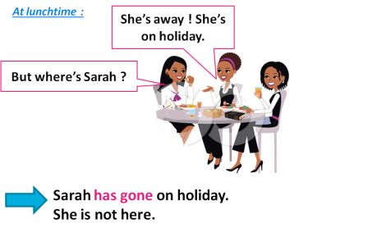
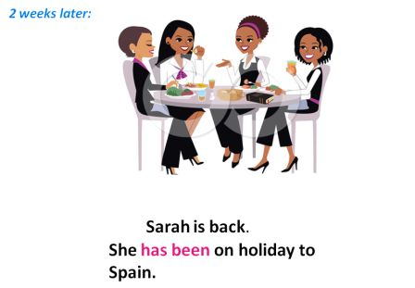
The difference between “ been” & “ gone”
HAVE GONE
We use 'have gone' when someone went to a place and is still there. The person hasn't come back yet.
HAVE BEEN
We use 'have been' when someone went to a place and came back ( returned). The person is no longer away.

Slide 11

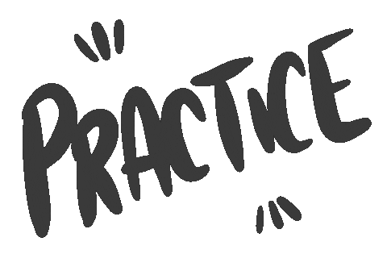

Slide 12
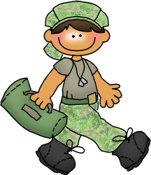

Choose the correct answer:
have joined
has joined
has joining
has joined
He __________ the army.

Slide 13

Choose the correct answer:
have cleaned
has cleaning
has cleaned
has cleaned
She __________ the room.

Slide 14


Choose the correct answer:
have walked
has walked
have walking
have walked
They ____________ to school.

Slide 15
02
Present Perfect with
Already ,Yet , Just

Slide 16
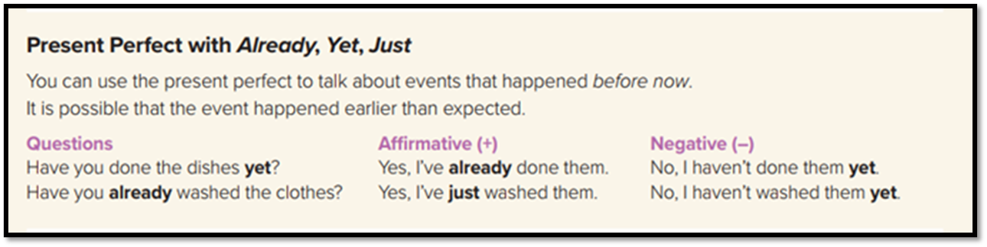
Present Perfect with Already, Yet, Just
I have already finished my homework.
I haven’t eaten at that restaurant yet.
She has just cooked the dinner.

Slide 17
Uses of Already, Yet, Just
A short time before
Before now
At any time up to now
just
already
yet
comes between the auxiliary verb (have/has) and the past participle.
can be used in affirmative and questions.
Already can come between the auxiliary and the main verb or at the end of the clause.
It is used in affirmative sentence and questions
( Yet ) is only used in negative sentences and questions.
Yet comes at the end of the sentence or question.

Slide 19
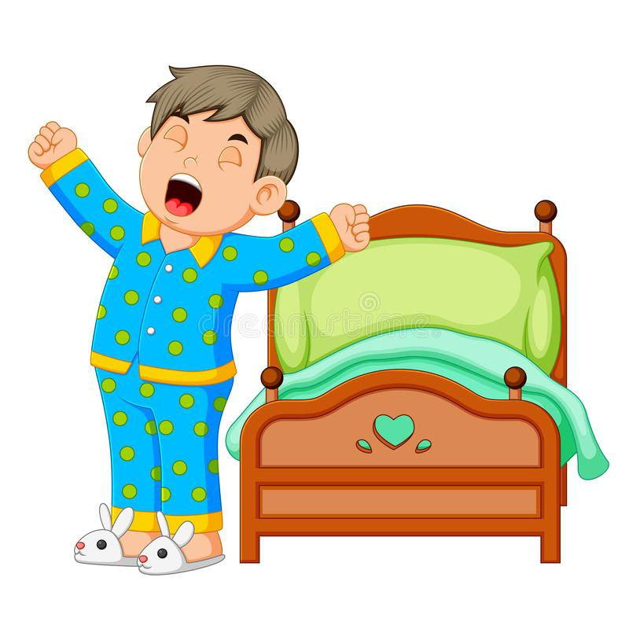
Correct the verb :
Wake up
Waken up
He has just____________

Slide 20
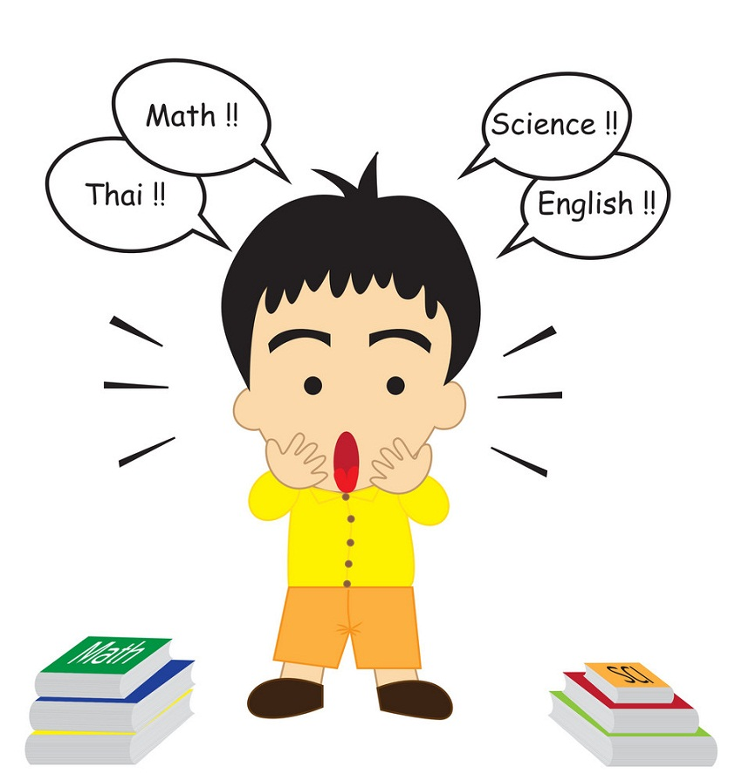
Correct the verb :
finish
finished
He hasn’t ___________ the homework yet

Slide 21
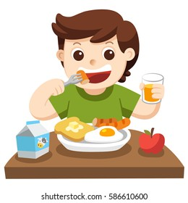
Correct the verb :
eat
eaten
I have already ___________ breakfast.

Slide 22
03
Verb+ Gerund

Slide 23
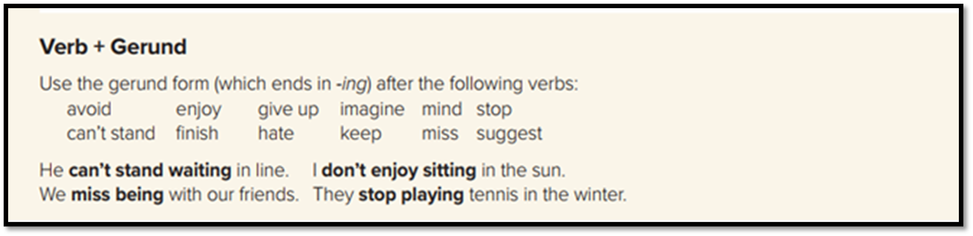
Verb+ Gerund
What does it mean?
what the four sentences have in common?
V-ing
They all have
gerunds or words that end in -ing after verbs.

Slide 25

Correct the verb using gerund form
She enjoys _______( go) shopping.
going

Slide 26
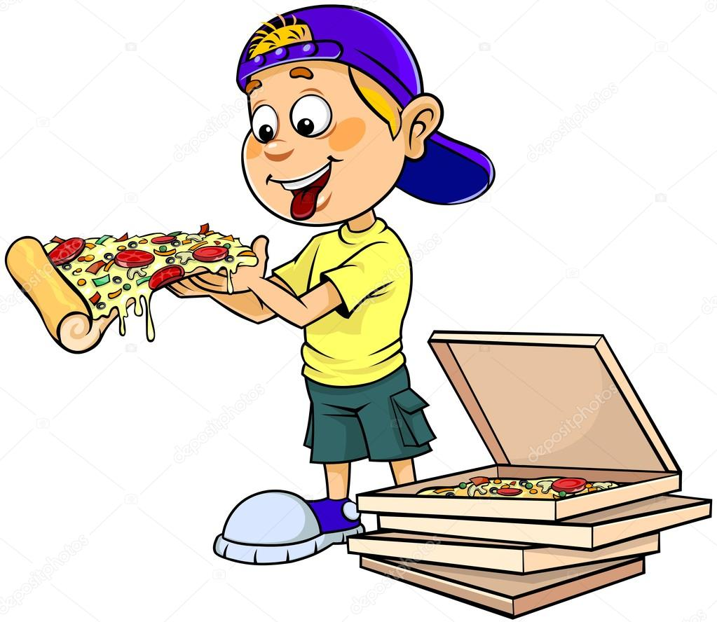
Correct the verb using gerund form
He likes _______( eat ) pizza.
eating

Slide 27
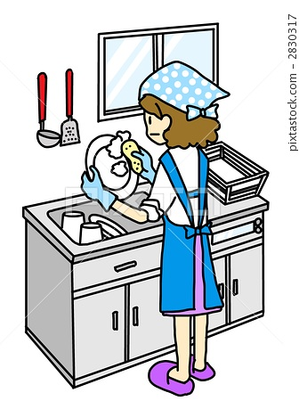
Correct the verb using gerund form
She hates _______( wash ) dishes
washing

Slide 28
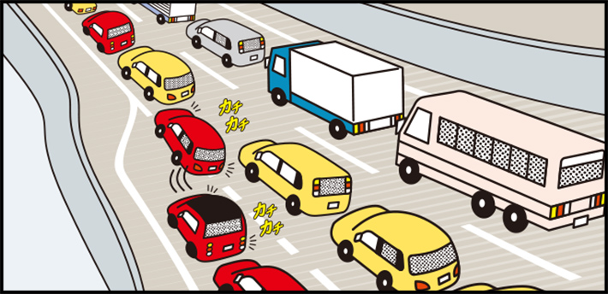
Correct the verb using gerund form
He avoid _______( drive ) in traffic
driving

Slide 29
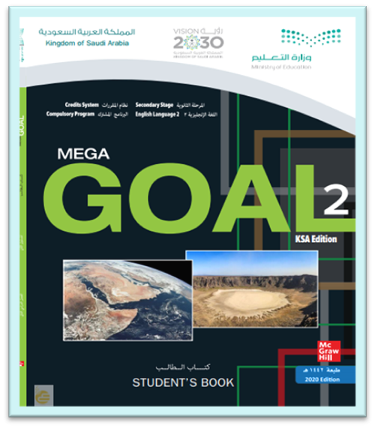
Open your student’s book p.17

Slide 30
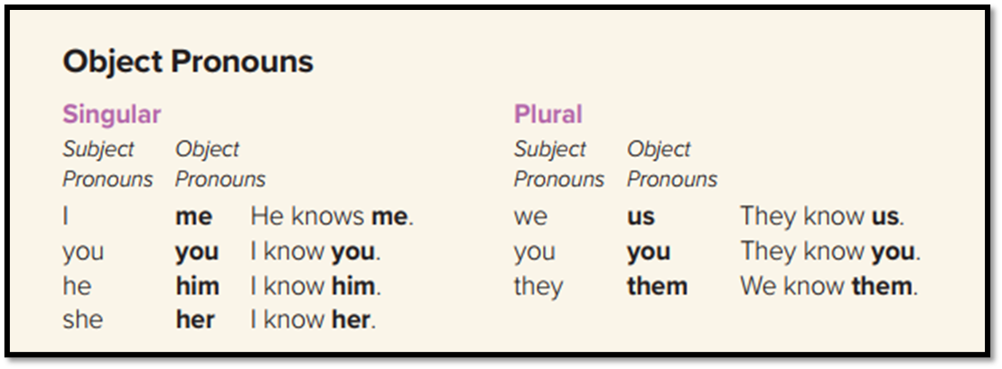
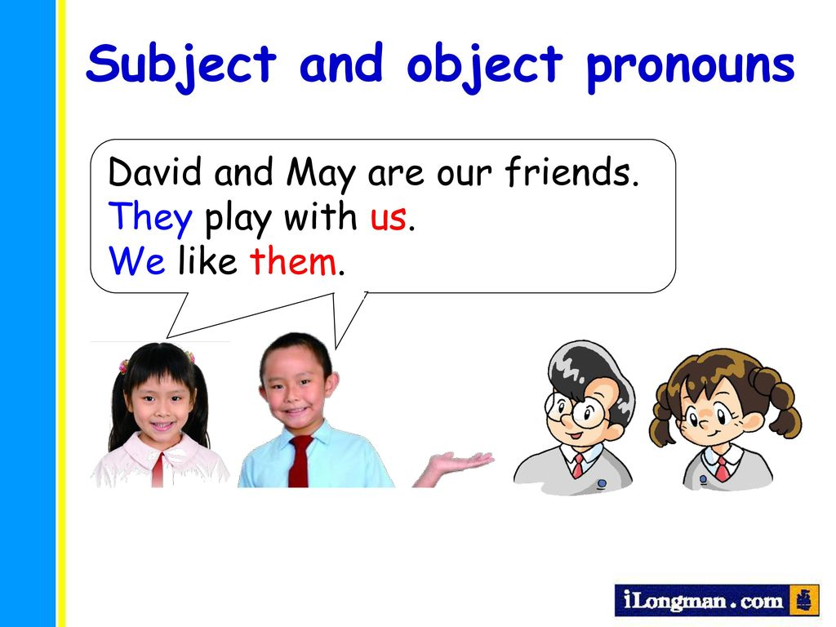
Object Pronouns:
Example

Slide 31
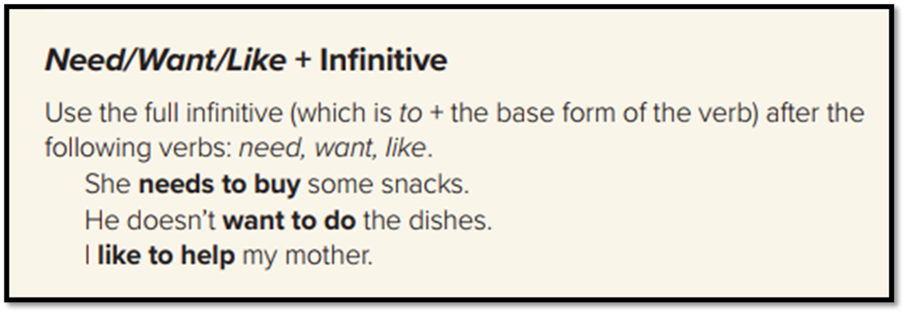
Need / Want / Like + infinitive
Need
Want + to + V ( base form)
Like
Examples

Slide 32
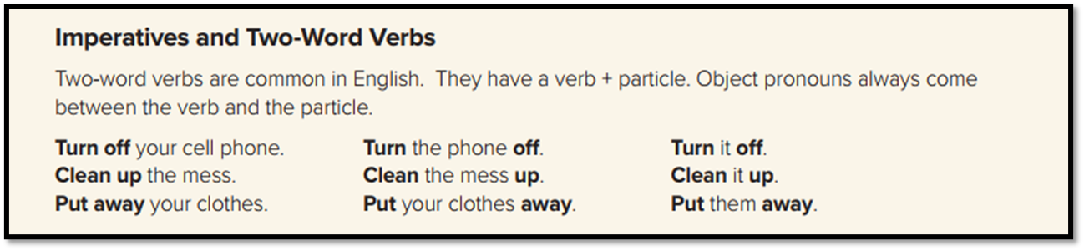
Imperatives and Two-Word Verbs
verb + particle.

Slide 34
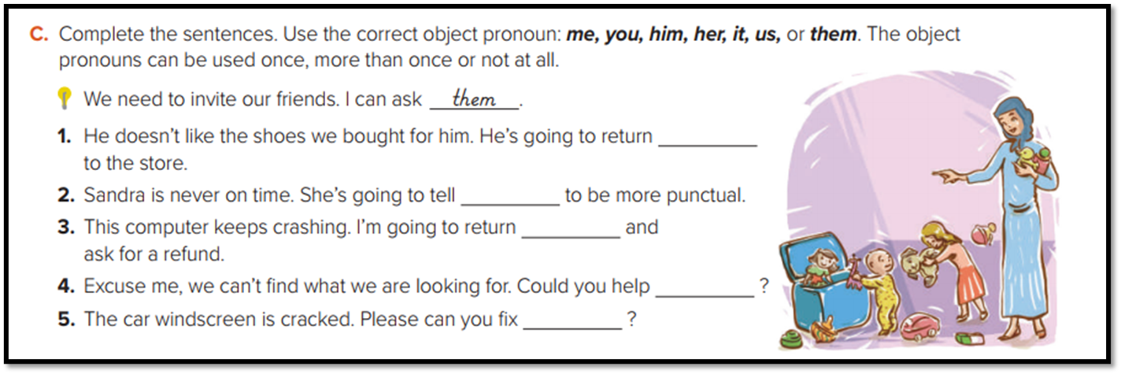
Complete the sentence with thr correct object pronoun:
them
her
it
me/us
it

Slide 35

Thanks!

